Slide 1
Springboot project
-Shrutika Mahajan

Slide 2
Objective: To build a robust and scalable Spring Boot application, automate its integration and deployment using Jenkins, and containerize it with Docker for consistent and portable deployment.
Key Components:
Spring Boot for backend development
Jenkins for continuous integration and delivery
Docker for containerization and deployment

Slide 3
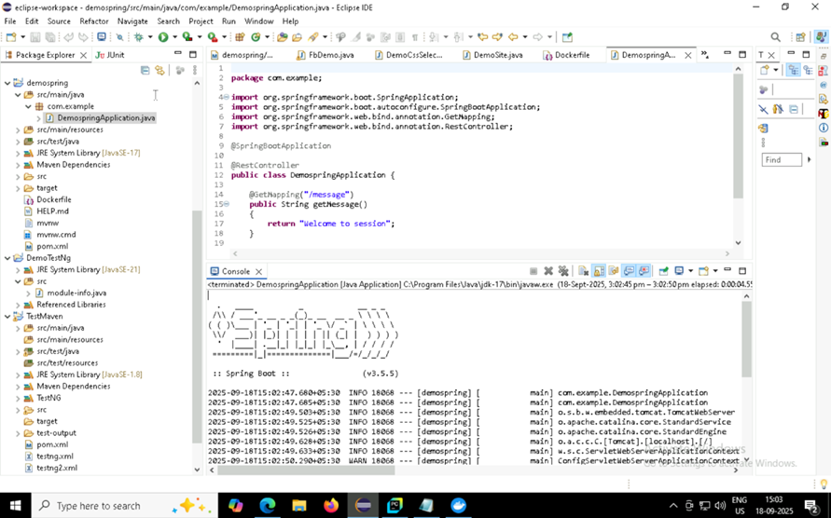

Slide 4
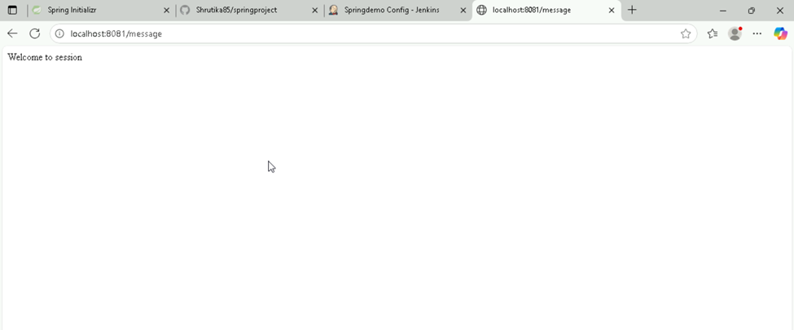

Slide 5
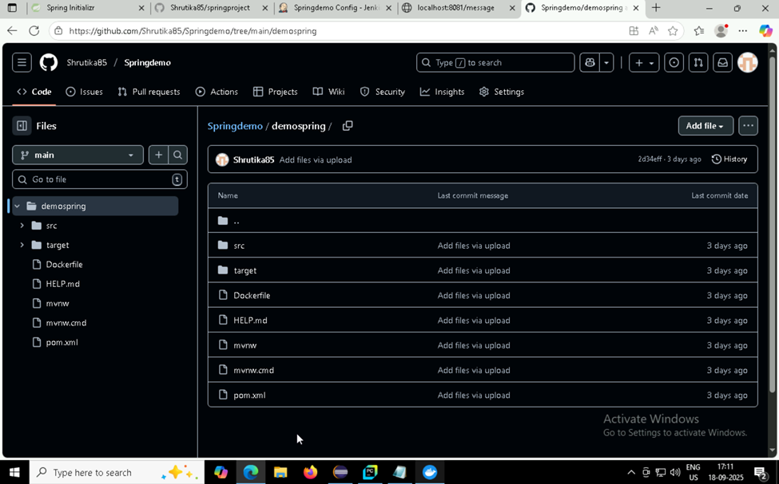

Slide 6
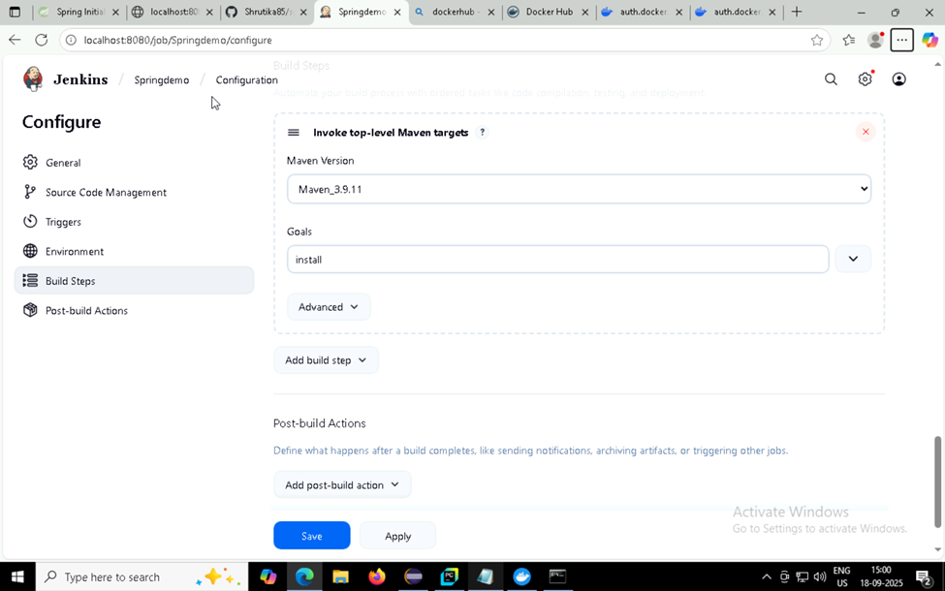

Slide 7
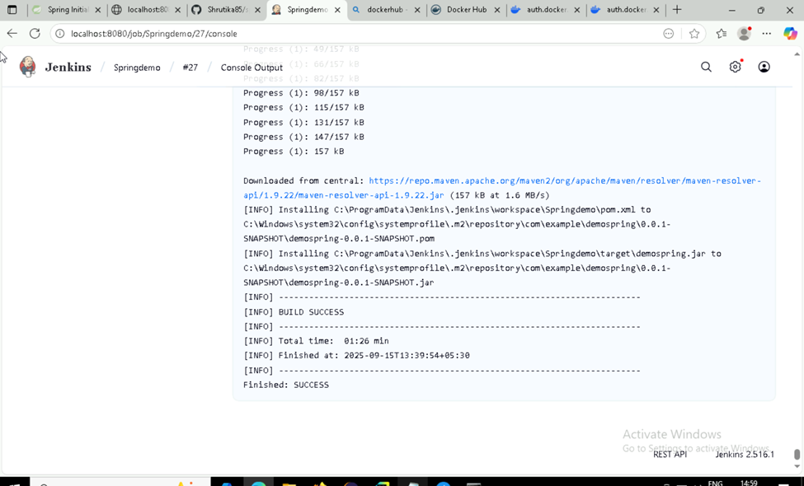

Slide 8
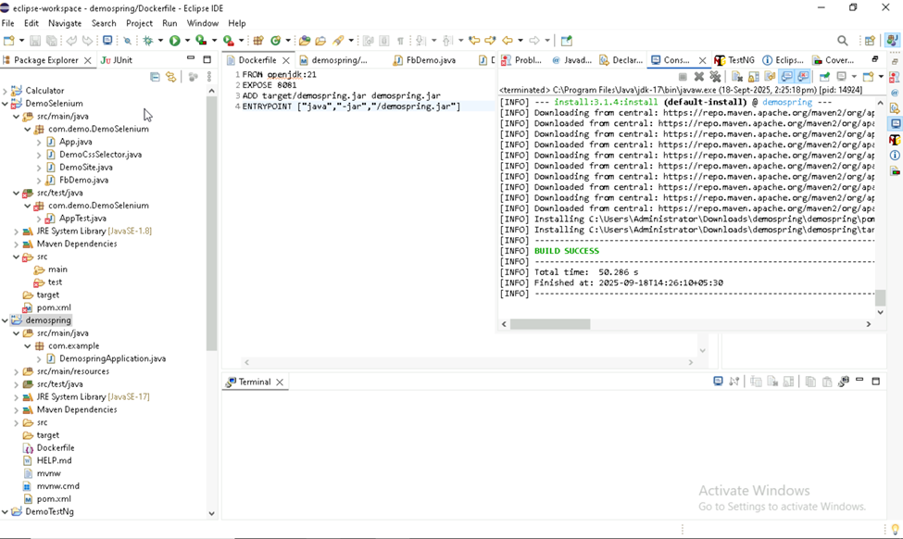

Slide 9
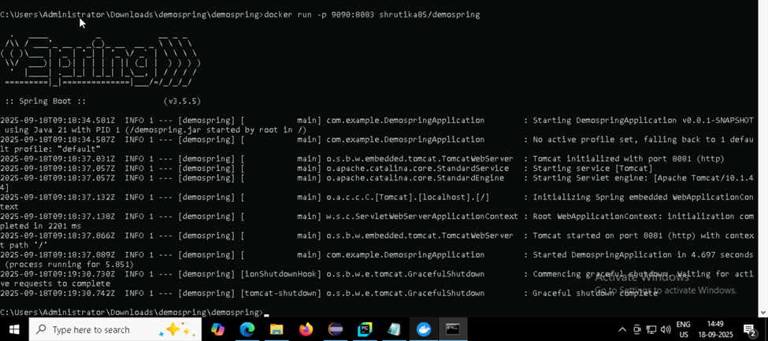

Slide 10
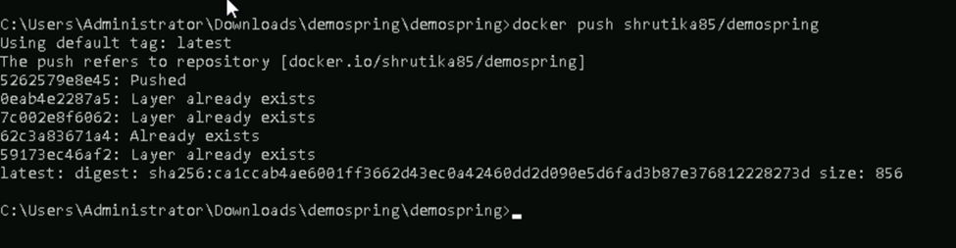

Slide 11
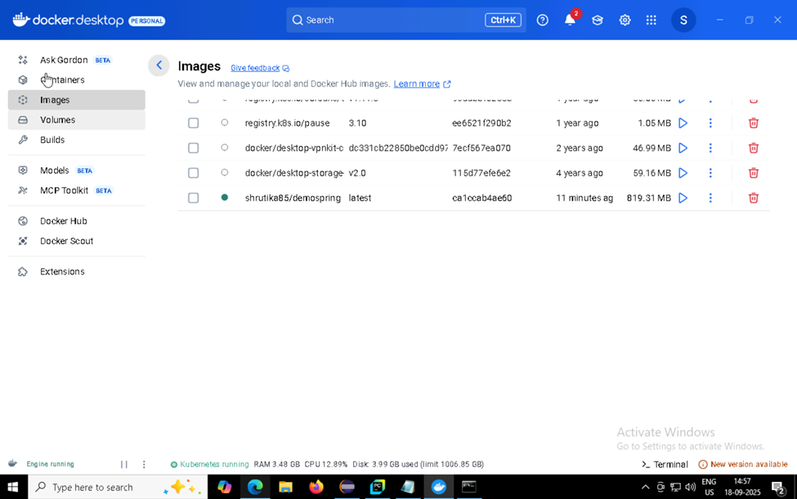

Slide 12
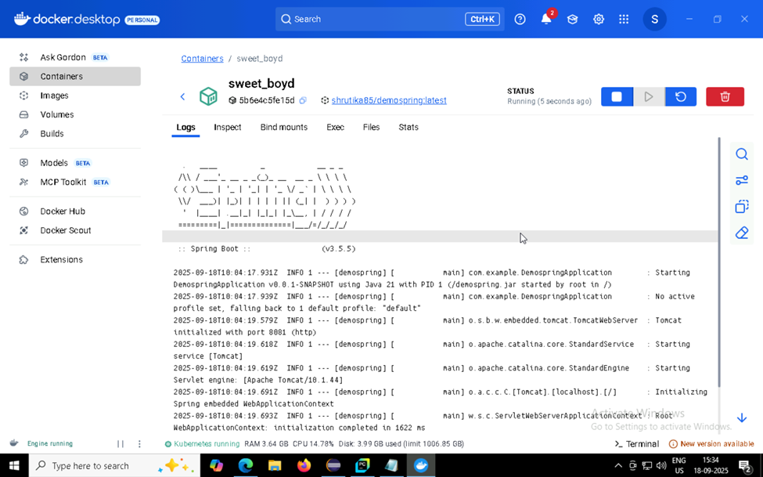

Slide 13
THANK YOU!

