Slide 1
GadgetBot
Group Members:
Lawrence Wanderi Mwangi (100836815)
Tejas Devani (100846988)
Smriti Raina (100830255)
Vaibhavi Thakkar (100833169)
Shrutika Raut (100844617)

Slide 2
Overview
Development Tools
Frontend
HTML/CSS
Backend
Database
Django/Python
SQLite
AI
Rasa ChatBot
Deployment
Django
Heroku
Rasa
Digital Ocean
Objective & Scope
Technology Stack
GadgetBot provides innovative and automated system that helps customer to buy gadgets at best deal.
A web-based software powered with AI that allows customer to browse the gadgets and bargain with the chatbot for the flexible price.

Slide 3
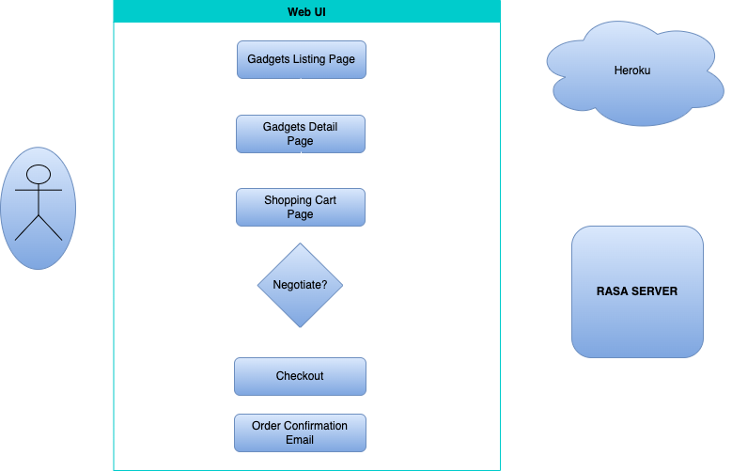
System Architecture

Slide 4
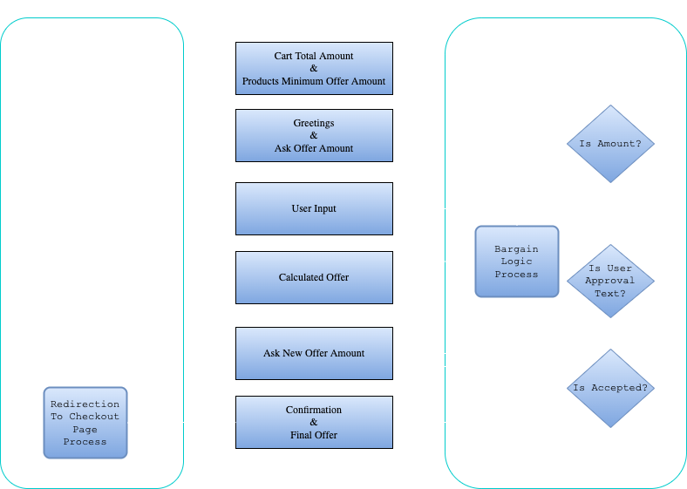
Chat-Bot System

