Slide 1
GadgetBot
Group Members:
Lawrence Wanderi Mwangi (100836815)
Tejas Devani (100846988)
Smriti Raina (100830255)
Vaibhavi Thakkar (100833169)
Shrutika Raut (100844617)

Slide 2
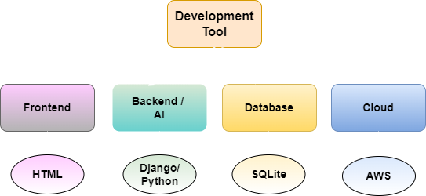
Overview
Objective & Scope
Technology Stack
GadgetBot provides innovative and automated system that helps customer to buy gadgets at best deal.
A web-based software powered with AI that allows customer to browse the gadgets and bargain with the chatbot for the flexible price.

Slide 3
Chatbot System
Frontend
RASA NLU (Natural Language Understanding)
Logic (Calculations)
RASA NLG (Natural Language Generation
User Input
Response to User

Slide 4
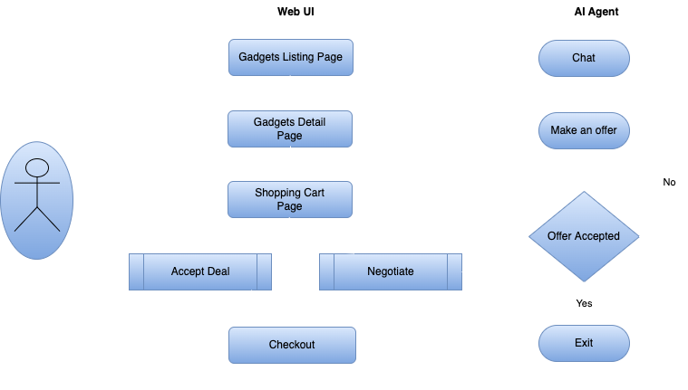
System Flow

