Slide 1

CRICKET DATA ANALYSER
SHRUTIKA JORI 112003134 (T5 RTCN)
TANIA MANDAL 112003145 (T5 RTCN)
SEJAL YEOLE 112003154 (T2 WST)

Slide 2
DATA SCRAPING
Process of extracting data from websites, onto a spreadsheet.
Website from which the data was taken to be scraped-
ESPNcricinfo Statsguru (https://stats.espncricinfo.com/ci/engine/stats/index.html)
Tools used for web scraping-
Octoparse
Web extension

Slide 3
GOAL
TO SELECT AND FORM A TEAM OF THE BEST 11 PLAYERS BASED ON AVAILABLE CRICKET STATS .
These players will be selected on the basis of certain parameters such as-
Wickets taken
Runs scored
Total innings batted
Total number of matches played
Average strike rate
Maidens Bowled

Slide 4
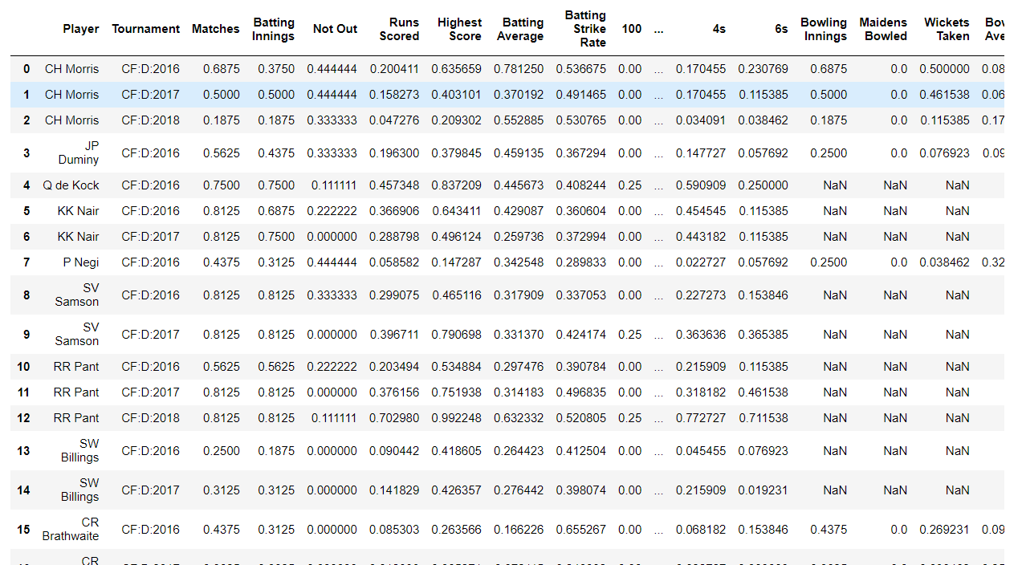
DATA preprocessing
Process of identifying and fixing incorrect data, as scraped data provides data in raw form.

Slide 5
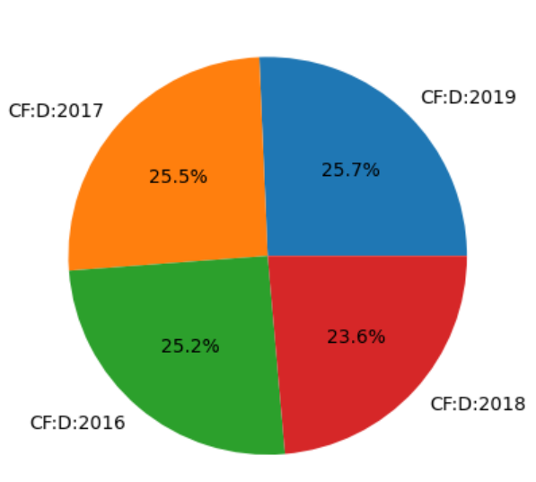
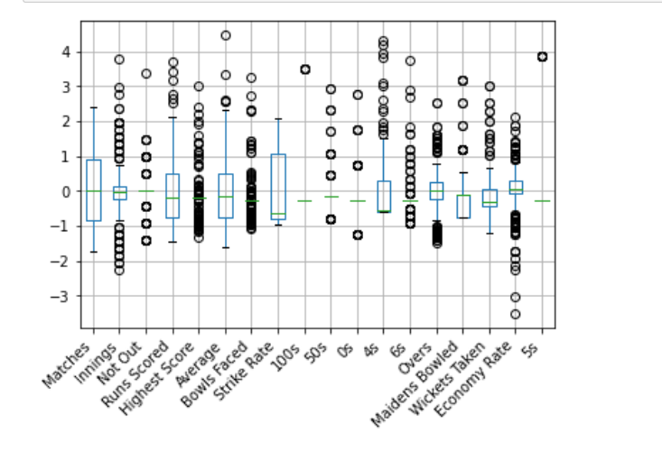
EXPLORATORY DATA ANALYSIS
Used to analyze and investigate data sets by employing data visualization methods.

Slide 6
OUTPUT MODEL
Output model is based on multiple regression.
Multiple regression is a statistical technique that can be used to analyze the relationship between a single dependent variable and several independent variables.
Main objective is to use these independent variables whose values are known to predict the single dependent value.

Slide 7
THANK YOU!

