Slide 1
GITLAB
How Can A Manager Share A Project With Employees

Slide 2
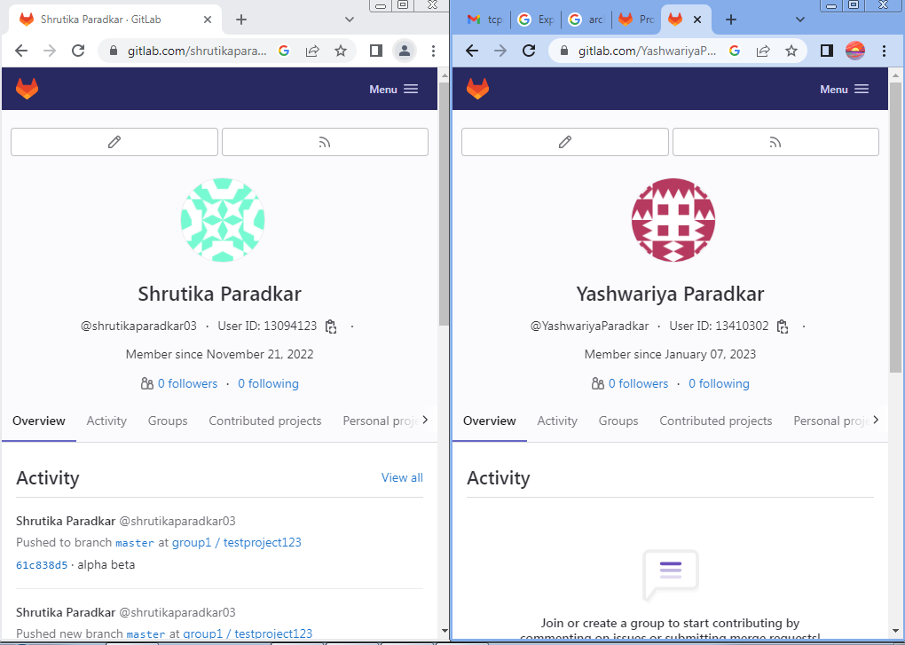
Person 1 (owner)
Person 2 (employee)

Slide 3
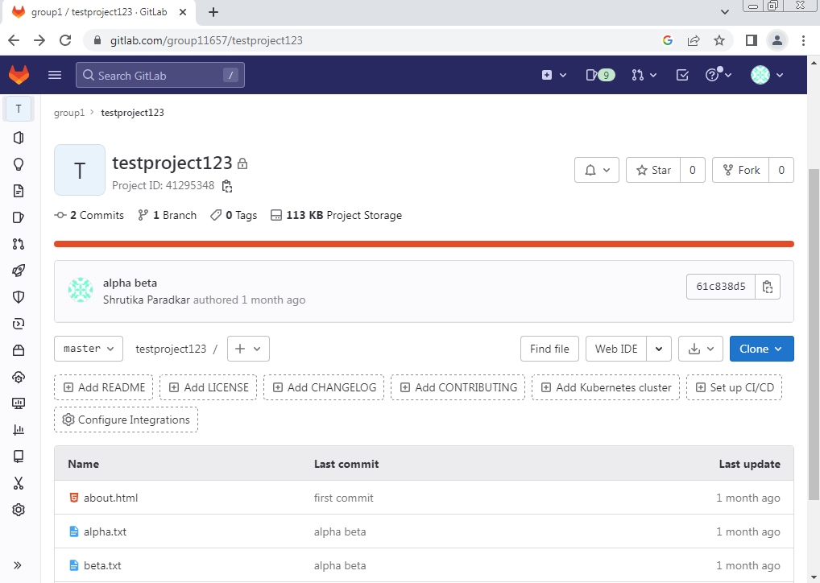
First we have to open the project in which we want to add members

Slide 4
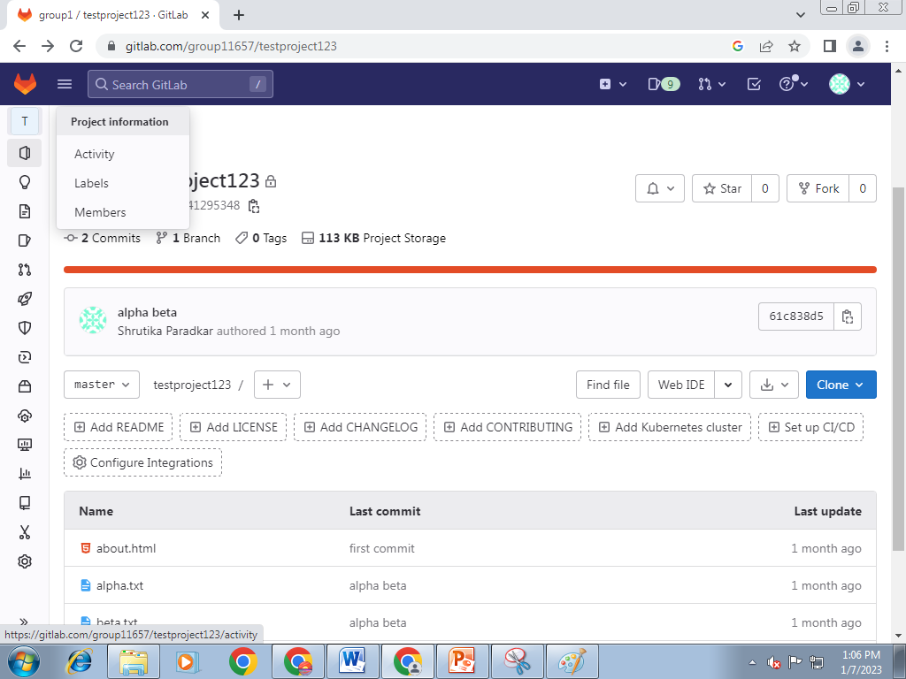
Go to project information
Click on ‘members’

Slide 5
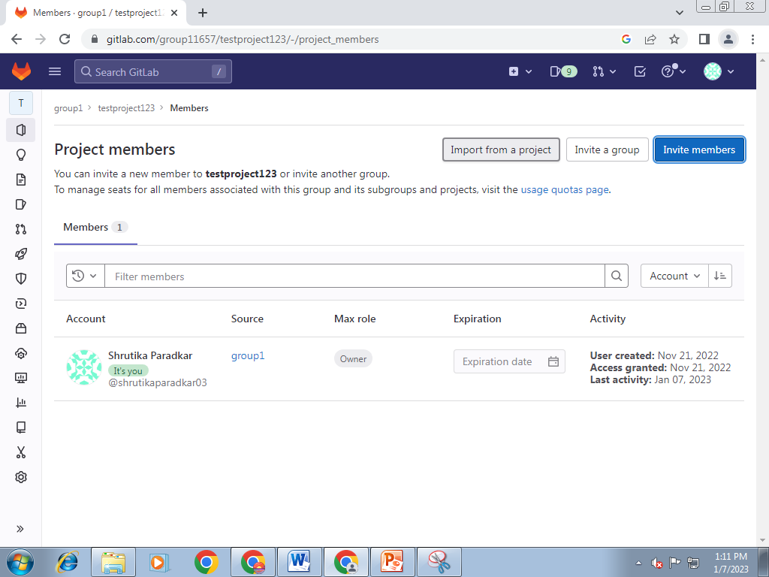
After clicking on ‘members’
This page will open
Click on ‘ INVITE MEMBERS’ present on top right corner

Slide 6
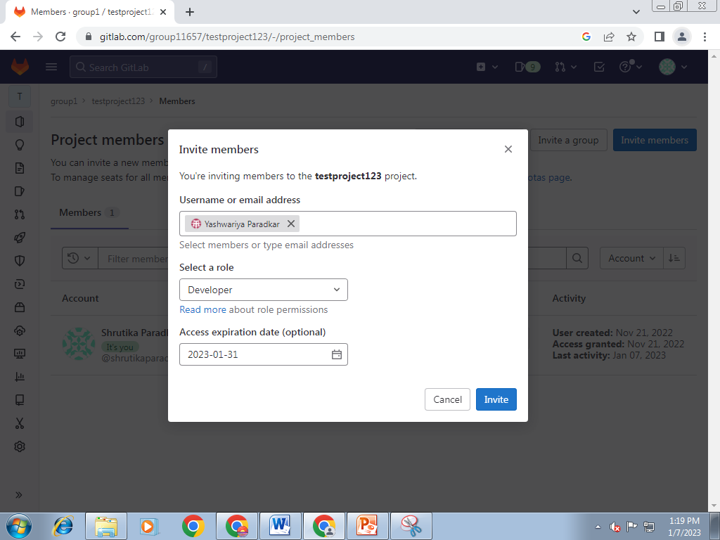
Now we are inviting the member to our project
Select the member
Select the role
Access expiration date (optional)

Slide 7
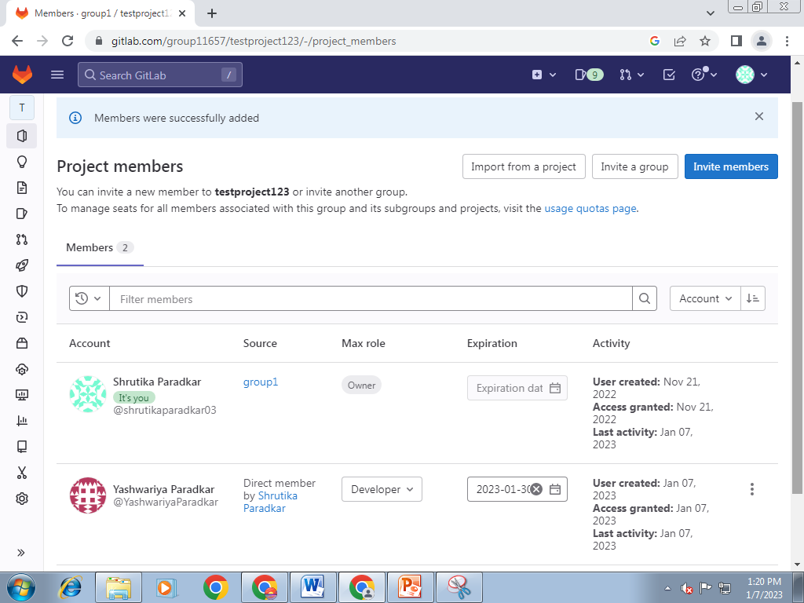
Now as you can see there is 2 members in a project
1 is a owner & the 2nd is a developer (role that owner assign)

Slide 8
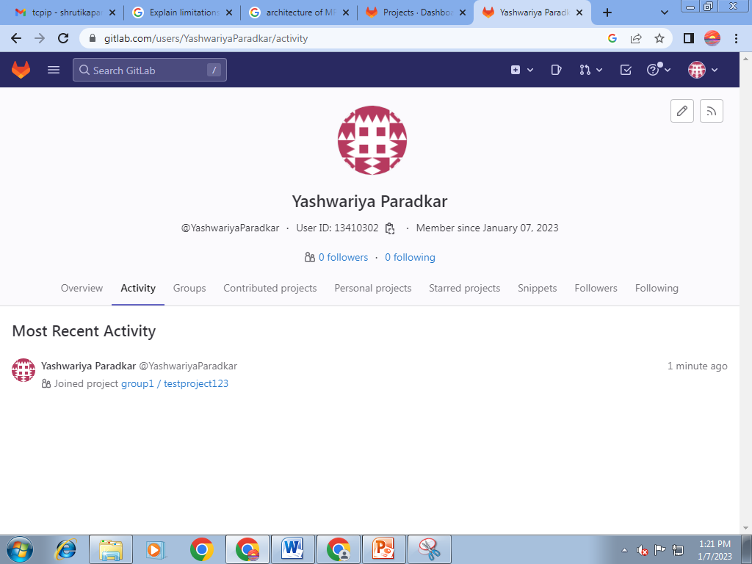
The developer gets notification that he added into the project

Slide 9
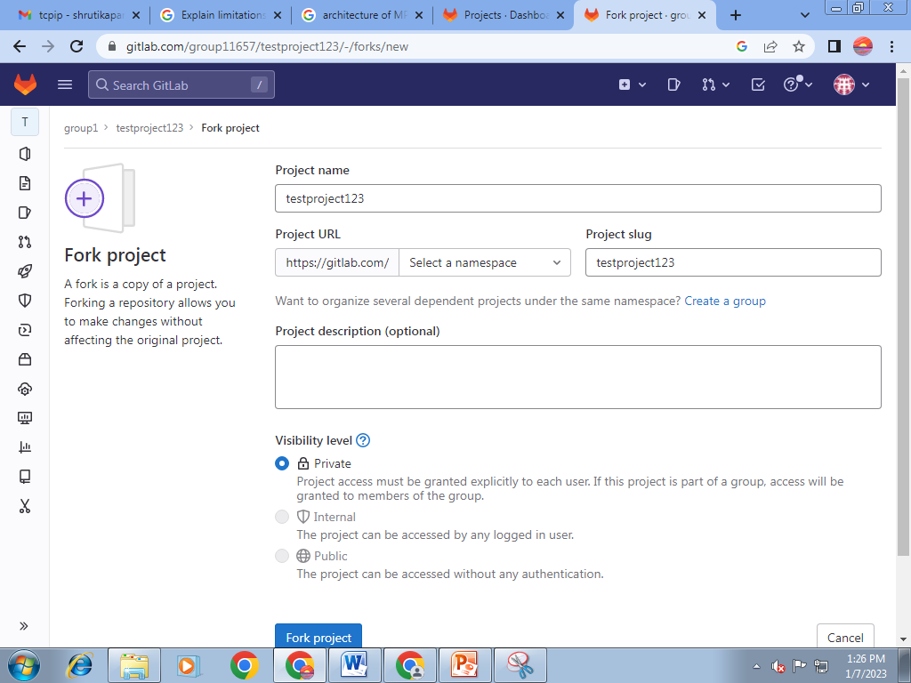
Fork project : A fork is a copy of a project . Forking a repo allows you to make changes without affecting the original project .

Slide 10
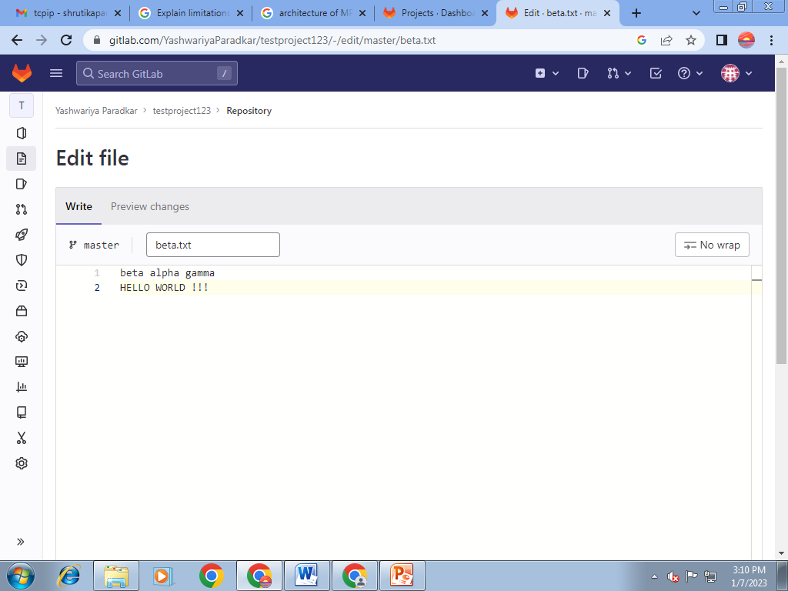
Developer then do the changes / edit the fork repo.

Slide 11
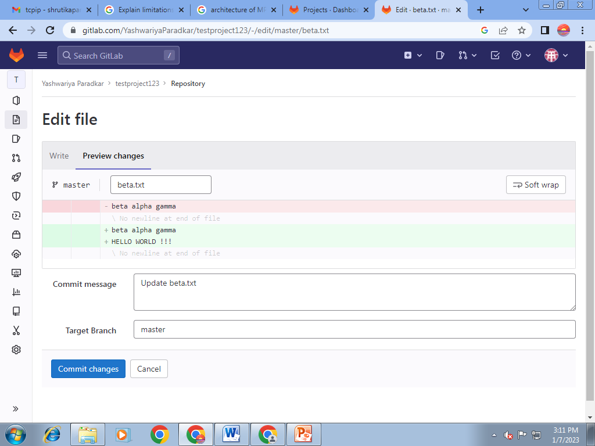
By clicking on ‘Preview Changes’ we can able to see the changes in green color
Write the commit message & mention the Targetb Branch
Click on ‘Commit Changes’

Slide 12
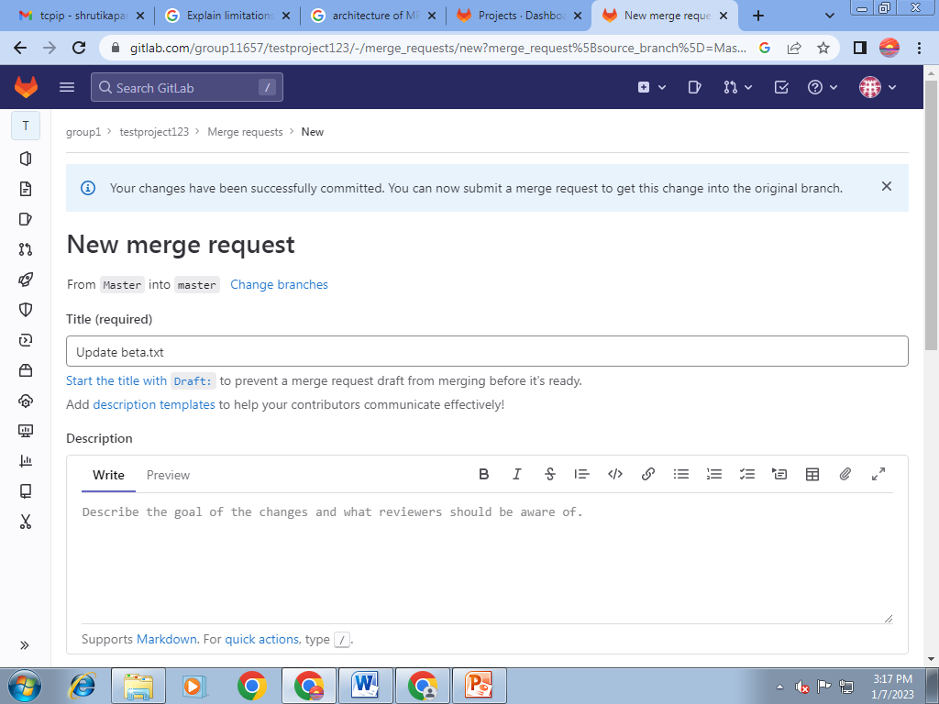
Create a NEW MERGE REQUEST
Give Title & Description

Slide 13
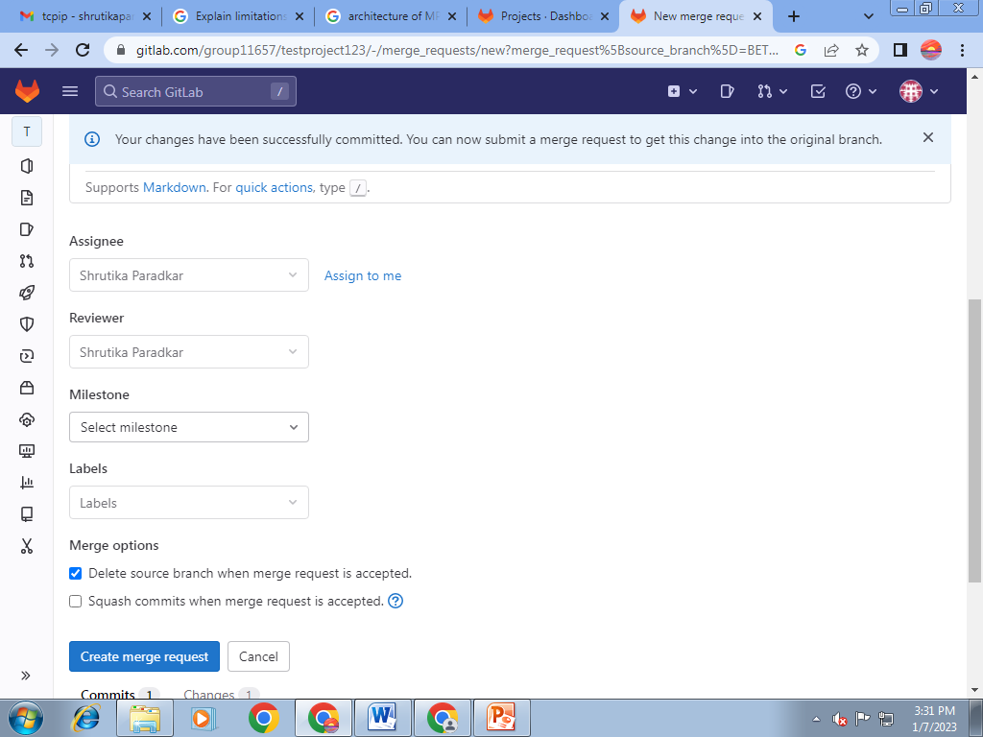
Select the Assignee & Reviewer
Click on ‘ CREATE MERGE REQUEST ‘

Slide 14
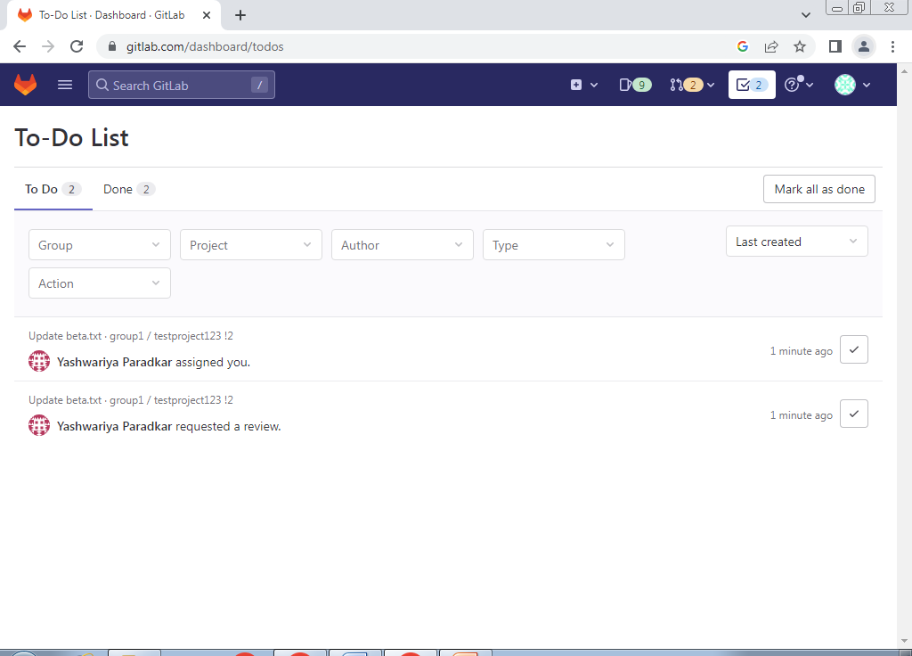
Owner gets a notification

Slide 15
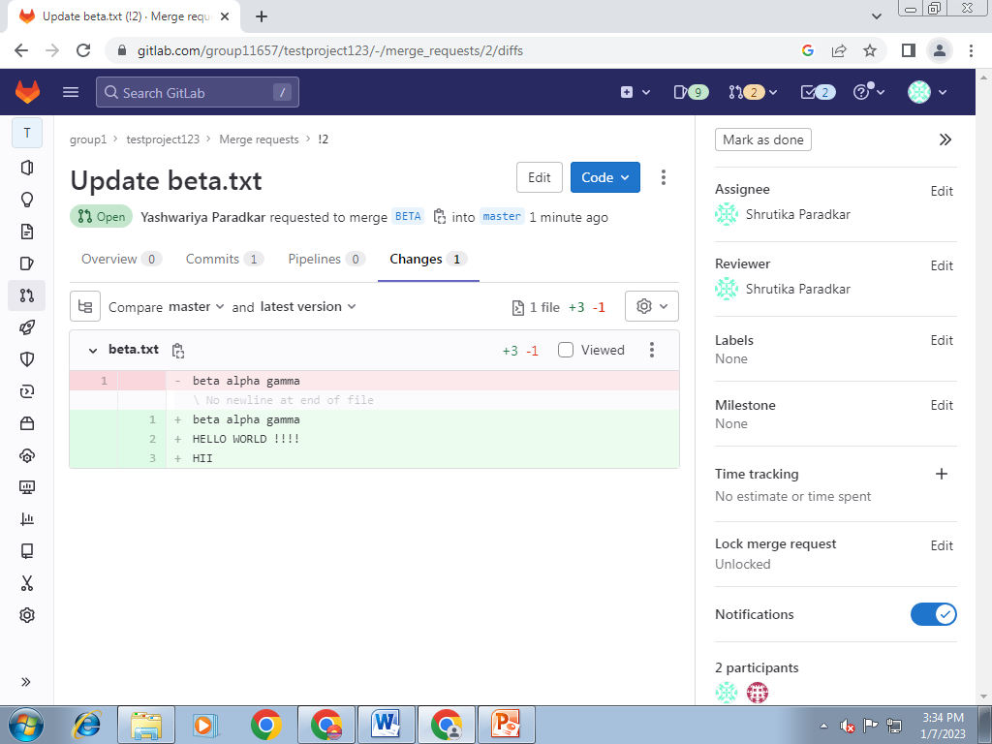
Owner view the changes made by the Developer

Slide 16
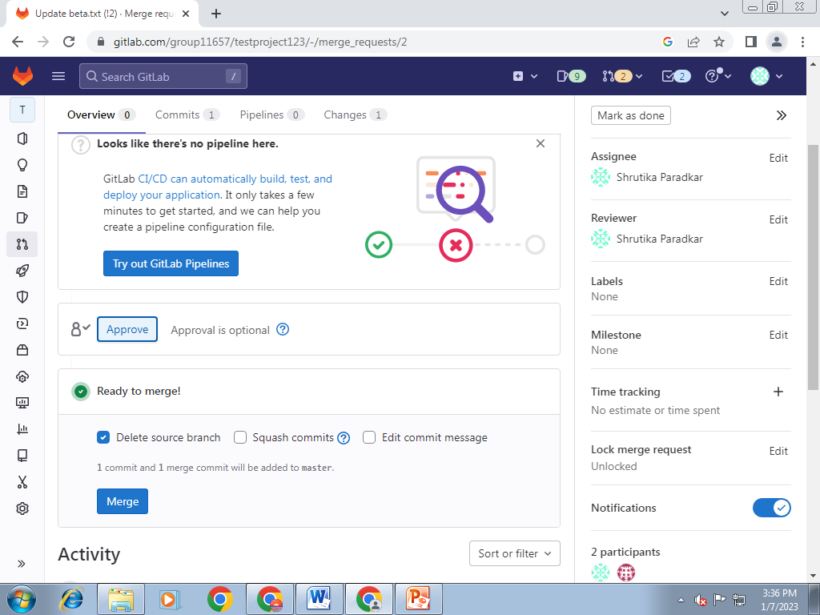
If Owner is ok with changes made by the Developer , then he will Approve the Merge Request

Slide 17
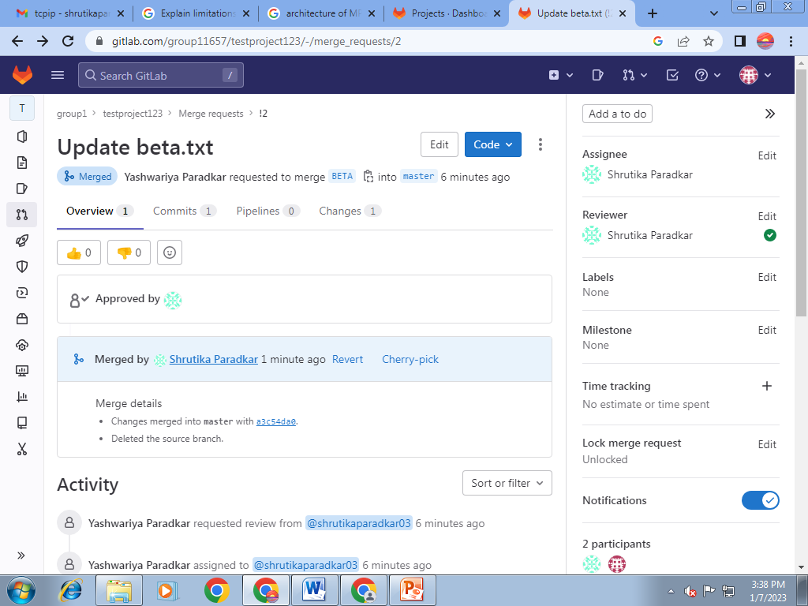
Developer gets notify that owner Approve the Merge Request

