Slide 1

GIT-HUB

Slide 2
WHAT IS GIT AND GITHUB
GIT:
Git is free and open source software for distributed version control: tracking changes in any set of files, usually used for coordinating work among programmers collaboratively developing source code during software development.
GITHUB:
GitHub is a code hosting platform for version control and collaboration. It lets you and others work together on projects from anywhere.
NOTE: Git can work without github but github can’t work without git.

Slide 3
WHAT IS THE DIFFERENCE GIT & GITHUB :
Git | GitHub
Git is software. | It is a service.
Linux maintains Git. | Microsoft maintains GitHub.
It is a command-line tool. | It is a graphical user interface.
You can install it locally on the system. | It is hosted on the web. It is exclusively cloud-based.
It is a VCS to manage source code history. | It is a hosting service for Git repositories.
It focuses on code sharing and version control. | It focuses on centralized source code hosting.

Slide 4
STEPS AFTER INSTALLATION:
After the installation done, click on ‘Launch Git Bash’ . It is a terminal just like a cmd . It runs like a unix
Now in this git bash we have to configure user name & email
$ git config --global user.Shrutika
$ git config --global user.abc@gmail.com
INTEGRATE THE VS CODE WITH GIT BASH:
open the terminal of vs code
Press ctrl+shift+P
In search bar type “select default profile”
Drop down appear, in that select the option of “Git Bash”.
Now open new terminal in Vs code (we can able to see in place of powershell Bash is written )
Integrated successfully.

Slide 5
BASIC COMMANDS:
$ git init ---------(Initialization command, it create empty git repository)
$ ls –lart ---------(To get hidden files, there is one file name .Git)
$ git status ------(To check the status of Vscode file / repository)
$ git add _ _ _ _ _ ---------(It add untracked file to staged area)
$ git add –A -----------------( Add all files at once)
$ git commit ----(It saves our work & changes we made in our project)
$ git commit -m “_ _ _ _ _ _ _ _ _ _ _ _” ----(shortcut for commit)
$ touch _ _ _ _ _ --------(create file in vs code)
$ checkout file name --------(undo the changes)
$ checkout –f --------------(undo more than one file)
$ git log ------------------------(check history)
$ git log –p -1/2/3/4……. -------(no. of commits u want to see)
$ git diff -----------------------(compare current working file with staging area file)
$ git diff --staged ------------(it will compare with last commit)
$ ls ------------------------------( list the files)
$ git rm -- cached file name ----------(delete file which is made by mistaken from staged area)
$ git rm file name ----------------------(delete file from work area)
$ touch .gitignore ------------------(it will a file .gitignore on desktop, in that we can add the file that we want to ignore in the project)
File name
Msg that we want to show in commit
File name

Slide 6
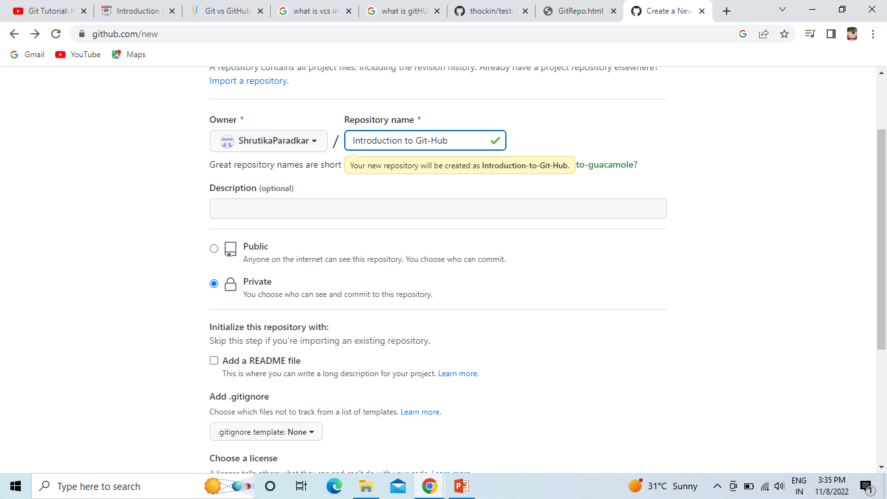
HOW TO ADD REPOSITORY :
Open the site ‘GitHub’
Create account
On top right corner there is ‘+’ sign , from there we can add a new repo.
Give repository name & description
Then there is option of public & private
- Public: Anyone on the internet can see this repo. You choose who can commit.
-Private: You choose who can see and commit to this repository.

Slide 7
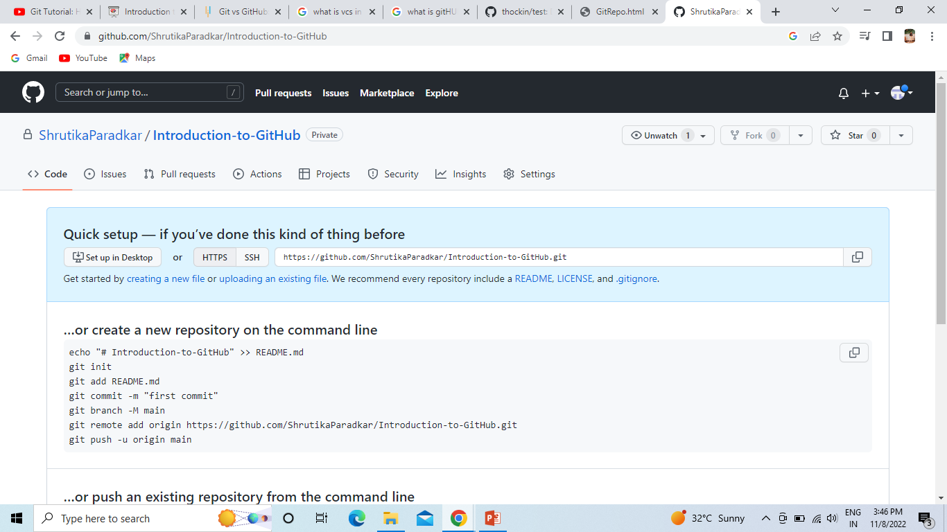
Repository added:

Slide 8
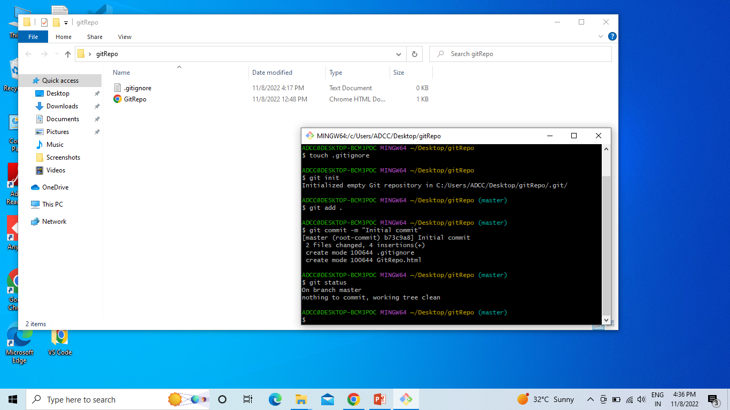
Now we can add our project files to our repository
-$ touch .gitignore : Command make a empty file, & in that we add the project files which we want to ignore .
-$ git add . : add files in staging area.
-$ git commit –m “Initial commit” : save the files on staging area.
-$ git status : Shows the status of our file.

Slide 9
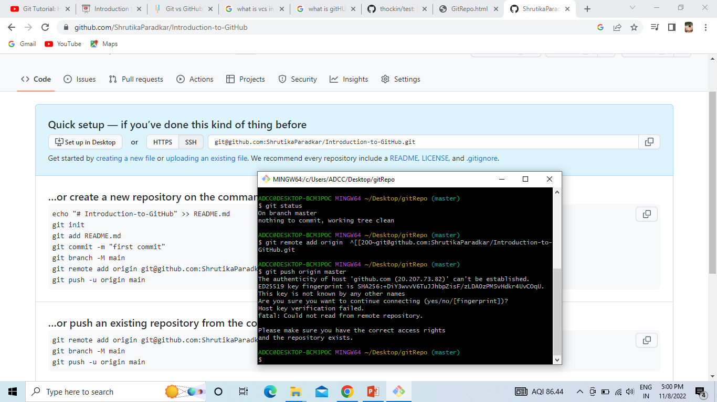
-$ git remote add origin ---(paste repo. url from github website) : It will link our project files to the repo url link.
-$ git push origin master:
This command push the files in repo. But here it will not able to push because our repository is private. So we need key to push the files into it.

Slide 10
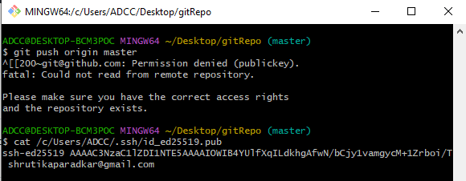
KEYS :
An SSH key is an access credential for the SSH (secure shell) network protocol. This authenticated and encrypted secure network protocol is used for remote communication between machines on an unsecured open network.
Command for key generation:
$ ssh-keygen -t ed25519 -C "your_email@example.com"
After this command we a path where our key is generated . Now copy that path & write one more command
$ cat paste the path
Now entering it we get a ssh key, copy whole key & we have to paste it in our github accounts ssh key field.
Our key is generated .

Slide 11
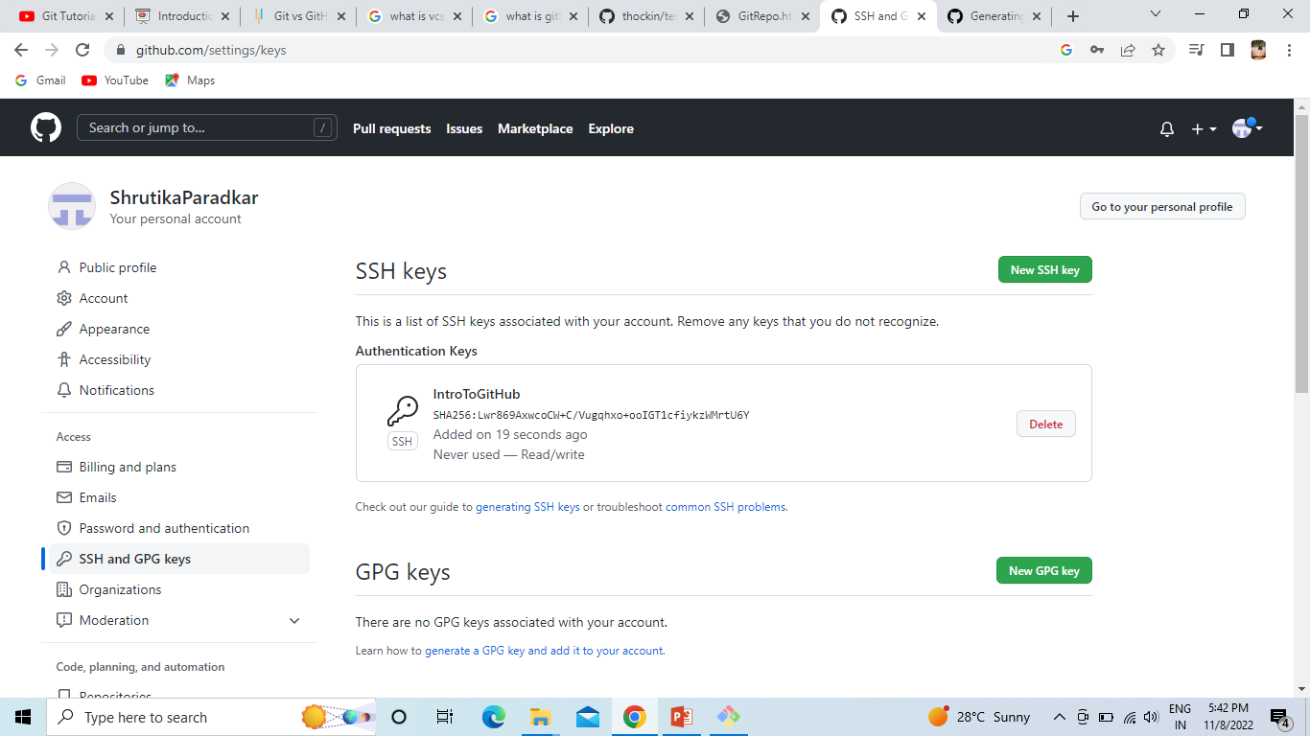
Key is generated on account level:

Slide 12
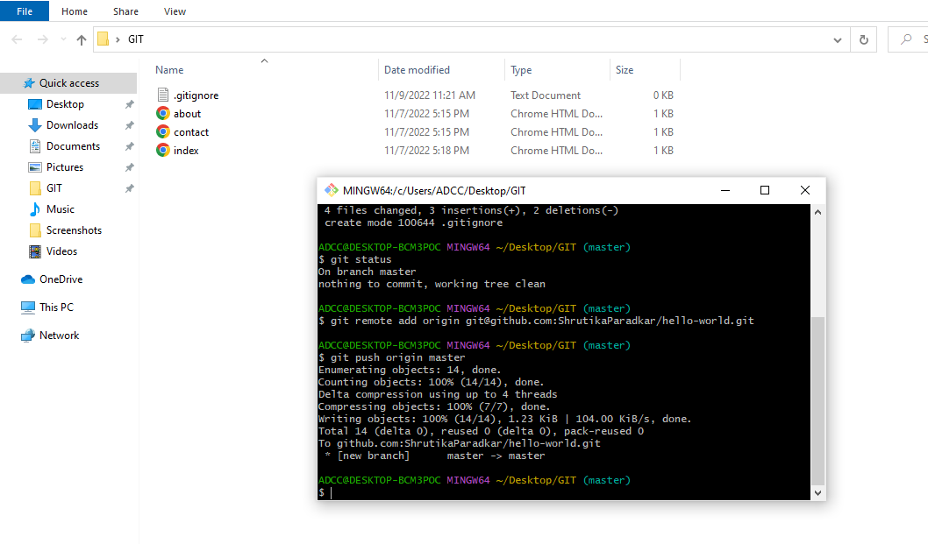
$ git push origin master
Now files are pushed into the repo

Slide 13
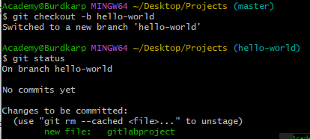
BRANCHES:
Whenever we hit command “git status” then it shows “On Branch Master” . Our whole project is present on this main branch.
If on practice level we want to make any changes to the project we can’t change it on master branch, it may disturb the project , So for that we make a copy of branch
#command to make a copy of branch
$ git branch ___________
let’s confirm that we have created a new branch:
$ git branch (enter)
Our branch is created but we are still in main branch .
CHECKOUT is the command used to check out a branch. Moving us from the current branch, to the one specified at the end of the command:
$ git checkout ________________ (enter)
Now we have moved our current workspace from the master branch, to the new branch.
Directly make a new branch & switch into it:
$ git checkout –b _____________________
Name of branch
Name of branch
Name of branch

Slide 14
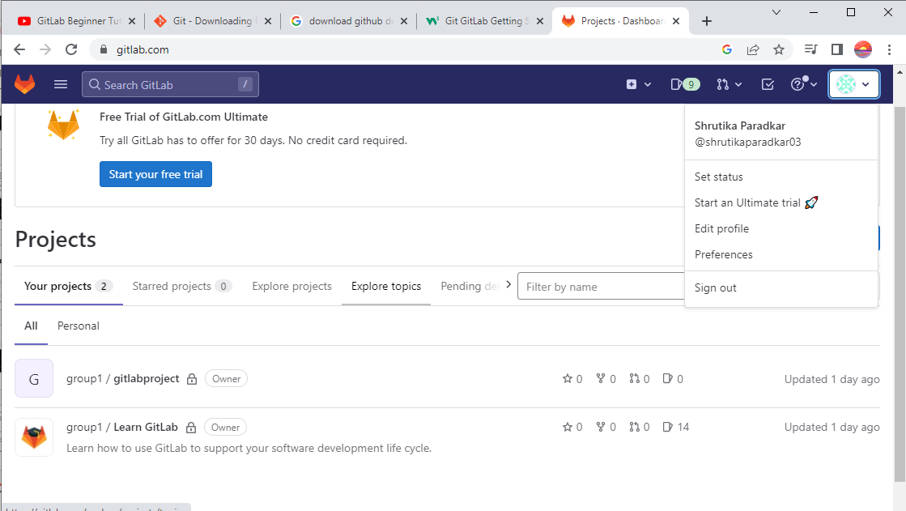
GITLAB:
-Here I logged in and also created a git repository:

Slide 15
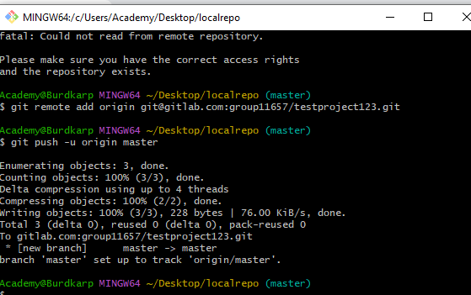
Push Local Repository to GitLab:
With the help of two commands we push local repository to gitlab
$ git remote add origin ---------------- (paste this command from gitlab account) (this command inform that at which location we have to push the local repo)
$ git push –u origin _______________ (it will push the local repo in gitlab project)
Branch name

Slide 16
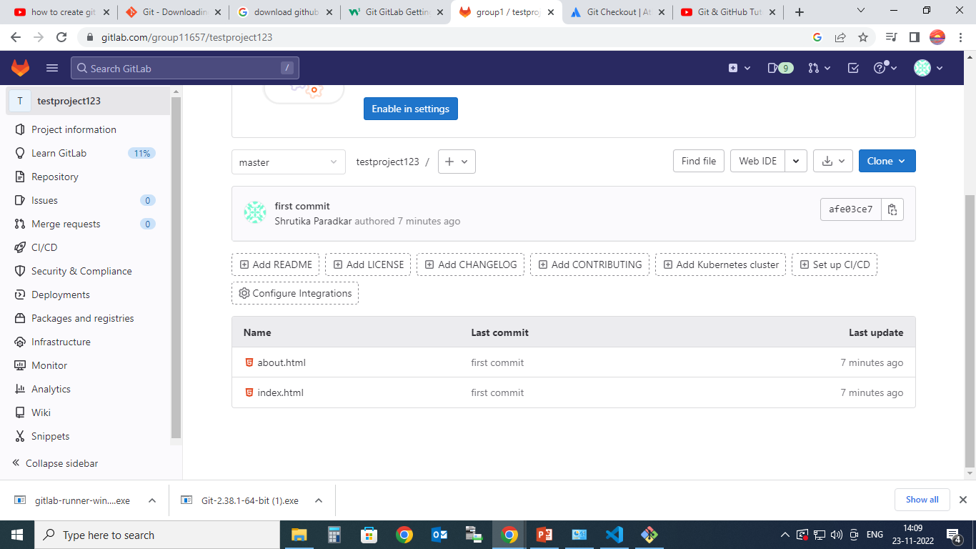
Refresh the account & we able to see our local repo files in gitlab

Slide 17
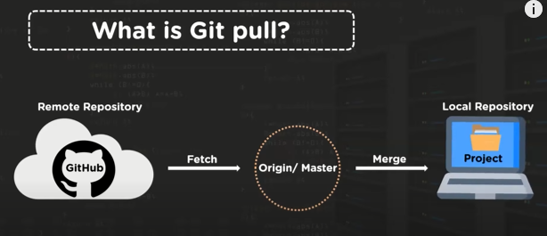
Git Pull from GitLab:
When working as a team on a project, it is important that everyone stays up to date.
Any time you start working on a project, you should get the most recent changes to your local copy.
With Git, you can do that with pull.
pull is a combination of 2 different commands:
fetch
merge
Fetch : Git fetch command downloads content from the required remote repository
Merge: Git merge command combines multiple sequences of commints into a single branch

Slide 18
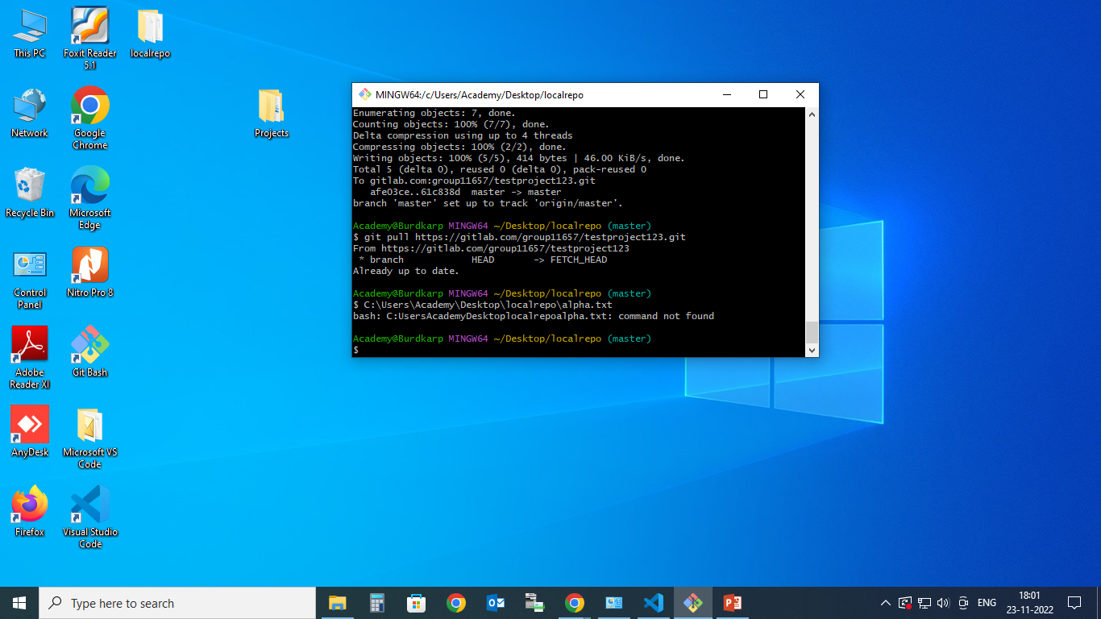
Here git pull command inform that from which location we want to retrieve file.
After that in next command we have enter the url of file that we want to retrieve

Slide 19
GITLAB – RUNNER:
GitLab Runner is an application that works with GitLab CI/CD to run jobs in a pipeline.
GitLab Runner is open-source and written in Go. It can be run as a single binary; no language-specific requirements are needed.
After you install the application, you register individual runners. Runners are the agents that run the CI/CD jobs that come from GitLab.
When you register a runner, you are setting up communication between your GitLab instance and the machine where GitLab Runner is installed.
When you register a runner, you must choose an executor. An executor determines the environment each job runs in.
Who has access to runners in the GitLab UI
Before you register a runner, you should determine if everyone in GitLab should have access to it, or if you want to limit it to a specific GitLab group or project.
There are three types of runners, based on who you want to have access:
Shared runners are for use by all projects
Group runners are for all projects and subgroups in a group
Specific runners are for individual projects
When you register a runner, you specify a token for the GitLab instance, group, or project. This is how the runner knows which projects it’s available for.

Slide 20

Tags
When you register a runner, you can add tags to it.
When a CI/CD job runs, it knows which runner to use by looking at the assigned tags.
For example, if a runner has the ruby tag, you would add this code to your project’s :
When the job runs, it uses the runner with the ruby tag

Slide 21
Thank You.

