Slide 1
Pricing Craigslist Vehicles
Data Science Intensive Capstone
Shrutika sankar

Slide 2
Context
Buyer’s Choice (BC) is a small used car company based in CT lead by CEO Dapper Dan.
With the advent of Covid, people just are not coming into the store. BC has therefore switched to selling their cars online. These prices often differ from the prices they would normally get at the store. BC has therefore created an algorithm to predict the value of a vehicle.
The company has recently been given the option to buy 25 vehicles. BC wants to know which of these 25 vehicles they should purchase.

Slide 3

Problem
Should used car dealership Buyer’s Choice buy any of the 25 gently used vehicles being offered?

Slide 4

Buyer’s Choice Buying Strategy
If the BC predicted price is more than $2k than the warehouse asking price, then BC buys the vehicle. They expect to run a profit at least 80 percent of the time.

Slide 5


Aims and Objective
Analyze what factors that affect online used vehicle prices
Create a model that predicts the Craigslist price for each of the 25 used vehicles
Using the predicted identify with of 25 vehicles they should buy

Slide 6


Intro to Dataset
Craigslist Data
Scraped by Austin Reese on Kaggle
Supplementary data
MSRP scraped by Cooper Union on Kaggle
Back4App
AAA
Household Income
Data Set Shape
114,810 vehicles and 19 variables

Slide 7
What contributes to Vehicle Price

Slide 8
What factors into the vehicle price?
Craigslist Price
Vehicle Model
Vehicle Condition
Seller
Vehicle Trim

Slide 9
What affects a vehicle’s Craigslist Price?
Vehicle Condition
Age
Mileage
Vehicle Model
Manufacturer
Vehicle Trim
# Cylinders
Drive type
Seller
Household Income
Gas Prices
Listed Condition
Color
Vehicle Category
Fuel type

Slide 10

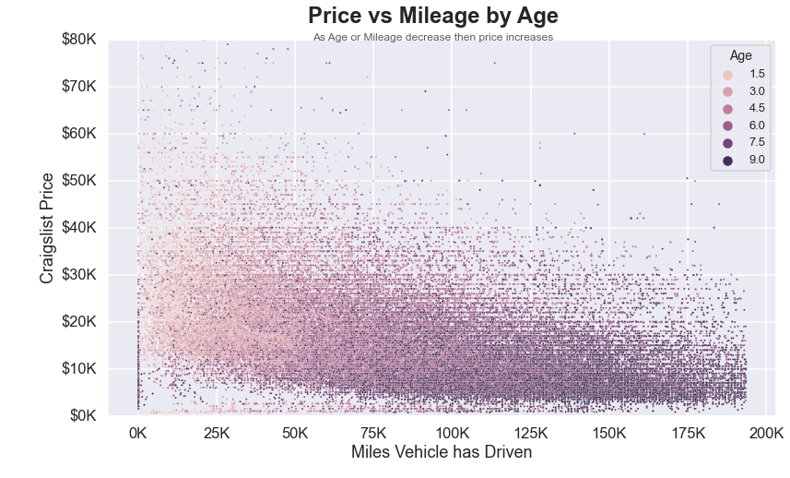
Price vs Vehicle Condition
As the vehicle ages the price decreases
As the number of miles the vehicle drives increases the price of the vehicle decreases

Slide 11

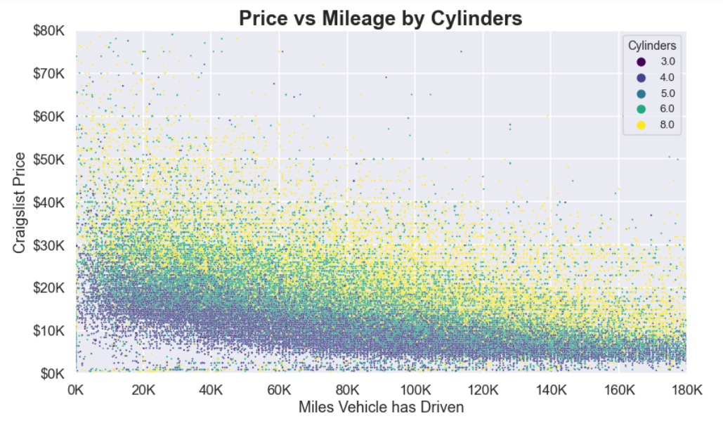
Price vs Interacting Factors
As the number of cylinders increase the price increases
As the number of cylinder increase the impact of mileage on price increases
Variables of two different factors enhance each others impact

Slide 12

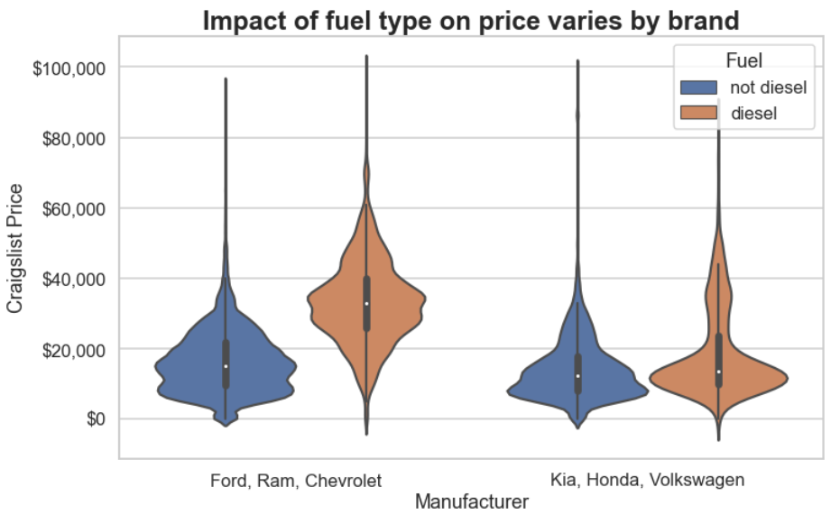
Price vs Interacting Factors II
Diesel Vehicles in general have a higher price than non diesel vehicles
This impact increases for Ford, Ram and Chevrolet vehicles

Slide 13
Creating the Model

Slide 14
Modeling Steps
Data Cleaning
Data Pre- Processing
Modeling 9 Algorithms with optimal hyper tuned parameters
Algorithms comparison
Further parameter on selected algorithm
Algorithm Evaluation

Slide 15
Data Cleaning Rules
Eliminate Vehicles where:
Price, manufacturer, model year, mileage or condition are not listed
Price< $100 or Price> $100K
Mileage >200K miles or Average Mileage > 36K miles per year
Age > 10 years
Condition is listed as poor or worse
Vehicle is a motorbike, or bus
Vehicle has more than than 10 cylinders

Slide 16
Pre Processing
Feature Imputation
Created Variables: Luxury, Average Mileage, Interaction
Labels Encoded
Data Split
Data split into Train, Test and Validation (55%, 25%, 20% respectively)
Data Scaled
Min Max Scaler
All categorical variables

Slide 17
Modeling (Choosing the Correct Algorithm)
Potential Algorithms
Linear
Ridge
Elastic net
Random Forest
Extra Tree
Gamma
Linear with PCA
Elastic net with PCA

Slide 18
Algorithm Processing
Hyper tune parameters for each regression with the training data set
Utilized sklearn grid search
Evaluate between Algorithms with on testing set
Testing Data set (25% of the total data)
Evaluation Visualization: Error histogram and Error vs Price scatterplot
Cross validate with 5 folds
Evaluation Metrics: MAE, MPE
Create model using optimal parameters
Only use training data set (55% of the total data)

Slide 19
Algorithm Evaluation Metrics
The Mean Absolute Error (MAE)
Measures overall fit of the model
Not effected by # parameters
In an accurate model the MAE is closer to zero.
The Median Percentage Error (MPE)
Measures bias of the model
In accordance to our dealer's risk aversion we prefer a negative MPE that's close to zero
Error vs Price Scatterplot
Measures how closely error correlates with Price

Slide 20
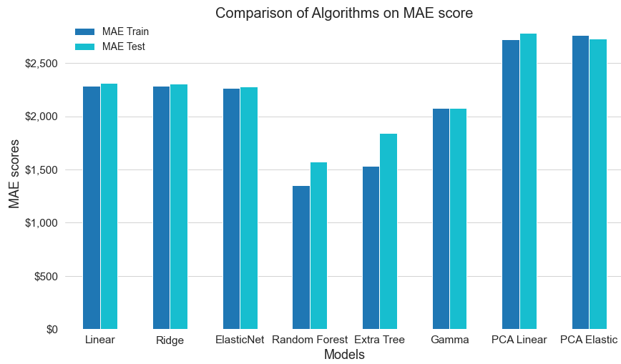
MAE Comparison

Slide 21
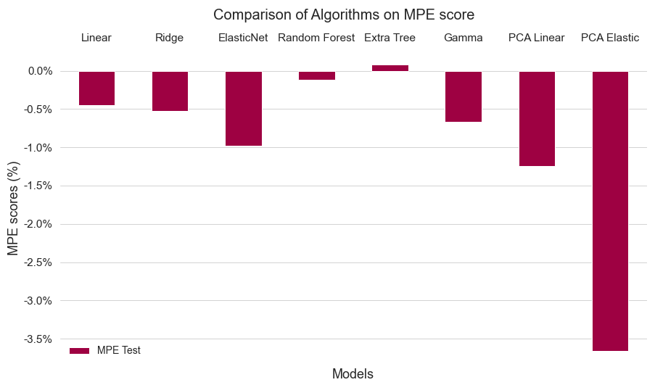
MPE Comparison

Slide 22
Model Comparison
Algorithm | MAE Train | MAE Test | MAE Test std | MPE Train | MPE Test | MPE Test std
Random Forest | 1,353 | 1,571 | 24.147 | -0.000 | -0.001 | 0.002
Extra Tree | 1,537 | 1,841 | 12.509 | 0.000 | 0.001 | 0.002
Gamma | 2,077 | 2,077 | 60.337 | -0.009 | -0.007 | 0.002
ElasticNet | 2,267 | 2,281 | 44.790 | -0.011 | -0.010 | 0.003
Ridge | 2,285 | 2,308 | 44.111 | -0.006 | -0.005 | 0.003
Linear | 2,290 | 2,315 | 38.152 | -0.005 | -0.004 | 0.003
PCA Elastic | 2,766 | 2,731 | 12.349 | -0.036 | -0.037 | 0.003
PCA Linear | 2,726 | 2,786 | 39.982 | -0.015 | -0.012 | 0.002
Tree methods had the best MAE and MPE scores
Random Forest has the mean absolute error (MAE) test results that are closest to 0.
Random Forest has the mean percentage error that is both negative and closest to 0.

Slide 23
Optimal model fine parameter training
Cross validate hyper tune parameters
9 cross folds within training data set
Utilized sklearn finer grid search
Random Forest Regression trained using optimal hyper parameters on training data
Evaluate on testing data set and validation data set
Validation data: hold out data- % of the overall data set

Slide 24
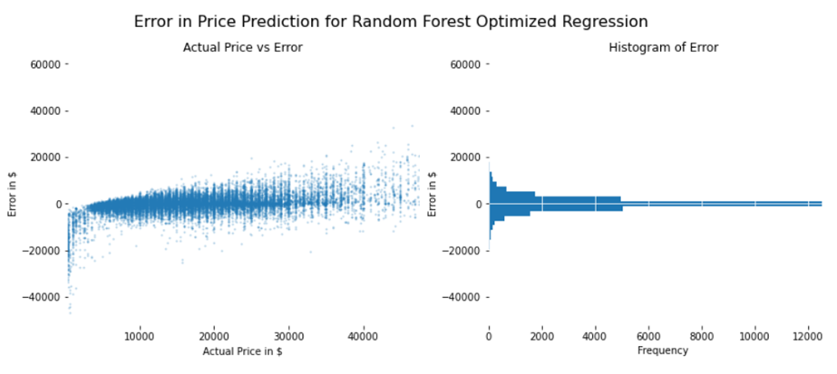
Model Test Error

Slide 25
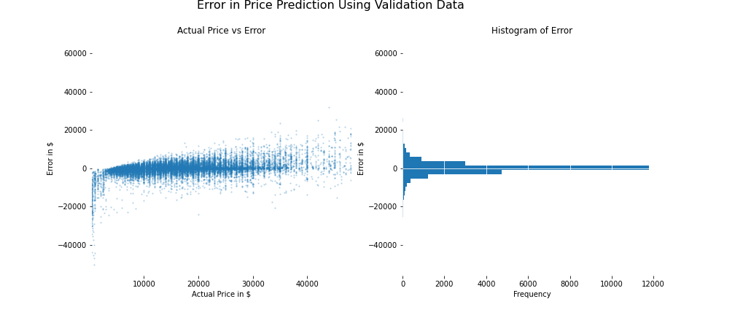
Model Validation Error

Slide 26
Do We Have a Good Model?

Slide 27
Model Qualifications
Error Magnitude Check
Previously if the BC predicted price was more than $2k than the warehouse asking price, then BC buys the vehicle. They expect to run a profit at least 80 percent of the time.
Predicted price is within $2000 or less of the asking Craigslist price online 80% of therefore
Over Fit Check
The difference in the mean error for validation error and training error should be within 0.1% of the average price
Bias Switch Check
The difference in the median error for validation error and training error should be within 0.1% of the average price.

Slide 28
Error Magnitude Check
Summary Statistics | Train Error | Test Error | Validation Error
# of Vehicles | 62,624 | 28,703 | 23,484
% of total data set | 55% | 25% | 20%
Mean Error | -1 | 23 | 9
Median Error | -1 | 5 | -$7
Error at the 80th percentile | $1,139 | $1,595 | $1,465
Error at the 84th percentile | $1,540 | $2,147 | $1,994
Maximum Error | $40,335 | $50,385 | $50,512
Previously if the BC predicted price was more than $2k than the warehouse asking price, then BC buys the vehicle. They expect to run a profit at least 80 percent of the time.
* 20% to 84.9% Refer to Percentiles
Notes:
Previously if the BC predicted price was more than $2k than the warehouse asking price, then BC buys the vehicle. They expect to run a profit at least 80 percent of the time.

Slide 29
Over fit Check and Bias Check
Over Fit Check
The difference in the mean error for validation error and training error should be within 1% of the average price
Bias Switch Check
The difference in the median error for validation error and training error should be within 1% of the average price.
Summary Statistics | Train list Price | Train Error | Validation Error | Difference as %
Count | 62,624 | 62,624 | 23,484 | —
Mean | $16,544 | -$1 | $9 | 0.03%
Median | $14,990 | -$1 | -$7 | -0.02%
80 percentile | $23,900 | $1,139 | $1,465 | 1.14%
* 20% to 84.9% Refer to Percentiles

Slide 30
Prediction Results
Returning to our motivating question,
Dapper Dan was offered 25 vehicle by their wholesaler.
BC should buy 9 of the 25 vehicles offered.

Slide 31
Prediction results (subset)
Craigslist Listing | Listed Price | Predicted Price | Difference | Buy
2011 Kia Optima | 4,950 | 6,811 | 1,861
2013 Volkswagen Jetta | 6,900 | 10,809 | 3,909 | Buy
2011 Elantra Limited for sale | 5,250 | 7,568 | 2,318 | Buy
2010 Honda | 5,500 | 9,368 | 3,868 | Buy
2012 Mercedes Benz C300 4MATIC Sport | 9,940 | 11,690 | 1,750
2013 Honda civic lx | 6,950 | 10,241 | 3,291 | Buy
2013 lincoln mkz | 11,000 | 11,028 | 28
2012 Chevrolet Cruze | 5,799 | 13,125 | 7,326 | Buy
2013 BMW X5 XDRIVE | 13,300 | 14,621 | 1,321
2011 Infiniti fx35 110k miles | 10,600 | 11,753 | 1,153
2013 FORD EXPLORER XLT 3.5L V6 4x4 ** MINT CONDITION ** | 11,500 | 15,342 | 3,842 | Buy

Slide 32
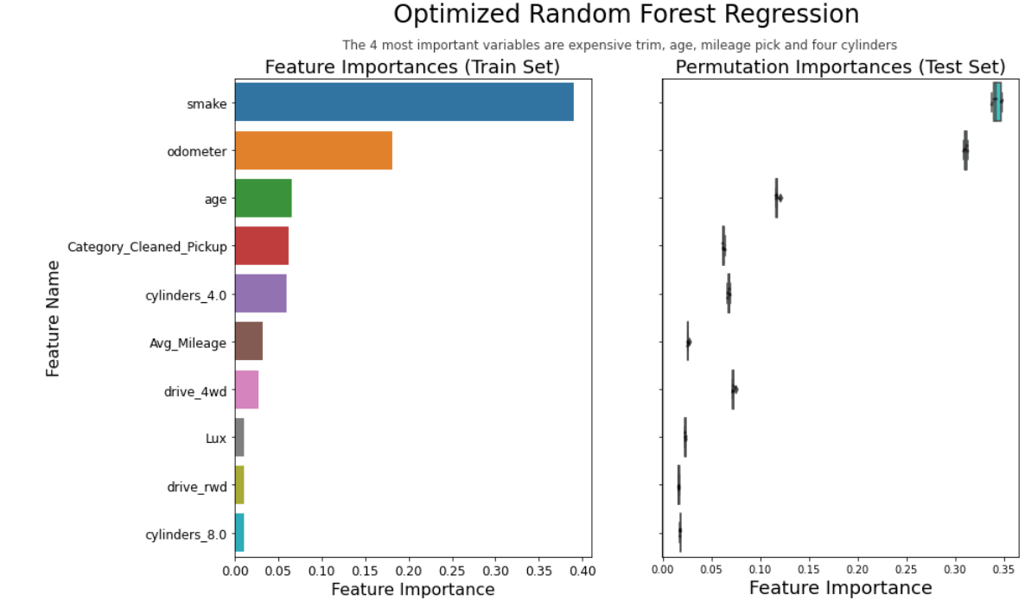

Slide 33
Model Limitations
This model was not as accurate vehicles over 35000 dollars. It biases downwards.
Similarly because these vehicles do not include salvage, for parts vehicles it’s not good with vehicles who are price less than 500 dollars. Admittedly BC would not want to buy vehicles whose list price is less than $2000 anyway.

Slide 34
Missing Data/Next Steps
Price vehicle was finally sold at
How long each vehicle was listed
If vehicle was in accident
Most of the MSRP data

Slide 35
Credits

Slide 36
Appendix I
General Slides

Slide 37
Prediction Performance results cont.
Name | Listed Price | Predicted Price | Difference | Buy
2007 Jeep Wrangler Sahara Unlimited 4x4 / 4dr FOR SALE | 11,500 | 12,222 | 722
2013 NISSAN PATHFINDER PLATINUM, LIKE NEW! 7 PASSENGER! CLEAN CARFAX! | 12,500 | 13,146 | 646
Amazing 7 seater BMW X5 for sale | 12,500 | 15,614 | 3,114 | Buy
2011 Toyota Highlander SE | 12,500 | 15,459 | 2,959 | Buy
2016 Lincoln Navigator L AWD 1 owner Navigation Sunroof | 12,995 | 12,424 | -571
2012 FORD EXPLORER LIMITED ALL WHEEL DRIVE | 13,499 | 12,701 | -798
2014 Honda Pilot EX low miles clean | 13,900 | 16,833 | 2,933 | Buy
2016 Lincoln Navigator L 4wd loaded sunroof one one owner | 13,995 | 12,377 | -1,618
BMW X5 2012 - excellent condition | 14,700 | 16,692 | 1,992
2019 Lincoln mkt one owner pano roof Navigation Camera Bluetooth | 19,995 | 20,071 | 76
NY 2019 Tesla Model 3 Standard Range RWD | 38,900 | 36,787 | -2,113
2011 BMW X3 XDRIVE 3.0 | 10,300 | 12,219 | 1,919

Slide 38
Appendix II
Model Variables

Slide 39
Appendix II: Model Variables
Variable | Description
Price | Craigslist Vehicle Price
Age | The age of the vehicle when it was listed
Odometer | Miles traveled by vehicle
Average Mileage | The average miles a vehicle was driven per year
Condition | Vehicles listed condition
Category | generic type of vehicle (example: "Sedan")
Manufacturer | manufacturer of vehicle (example: "BMW)
Size | Size of the vehicle (example: "Mid-size"
Cylinders | number of cylinders
Drive | type of drive (example: "rear wheel drive"
Fuel | fuel type
Paint Color | color vehicle
Transmission | transmission of vehicle
MSRP | Manufacturer Suggested Retail Price when New Vehicle
Average Gas Price | Average gas price in the state the vehicle was sold
Median Household Income | Median Household Income

Slide 40
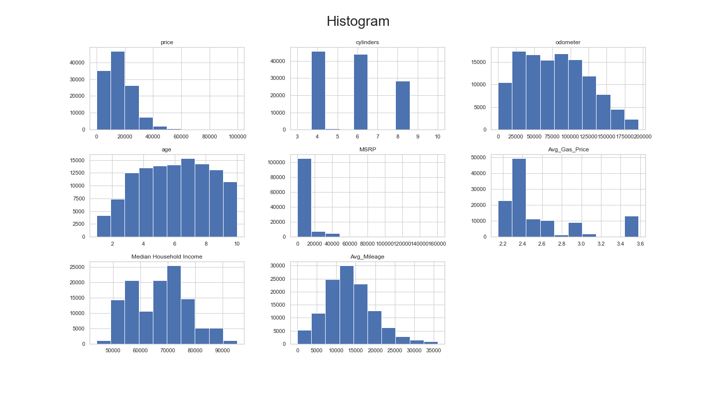
Appendix II: Histogram of Variables

Slide 41
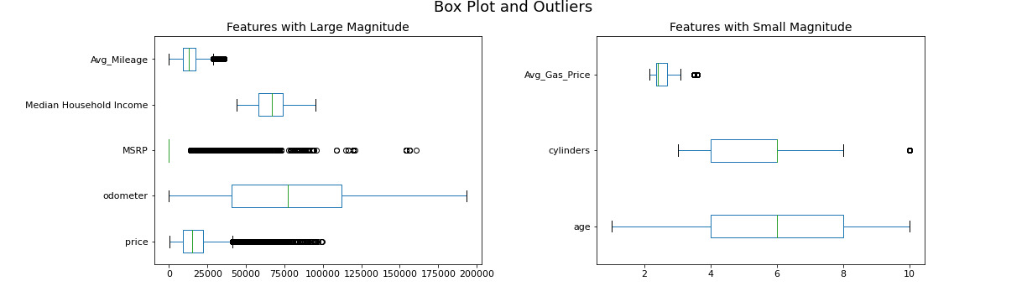
Appendix II: Boxplot of Variables

Slide 42
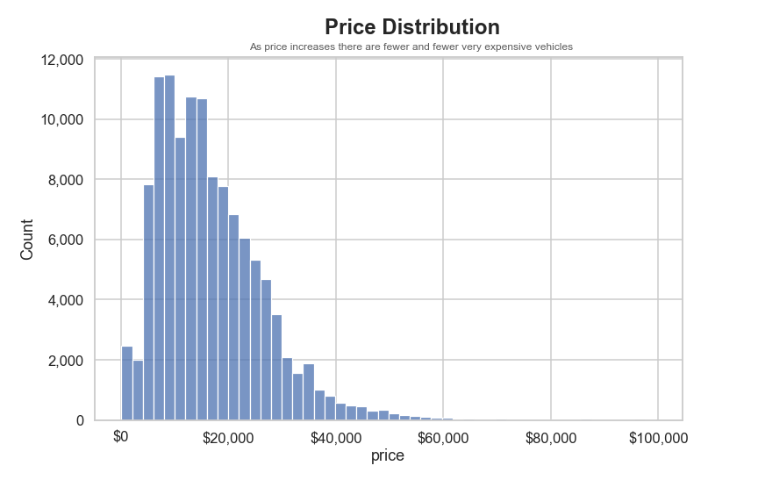
Appendix II: Histogram of Price

Slide 43
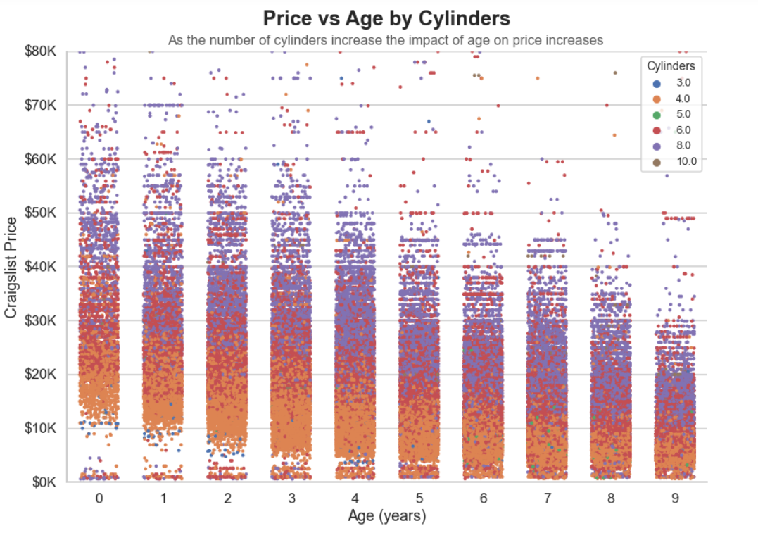

Slide 44
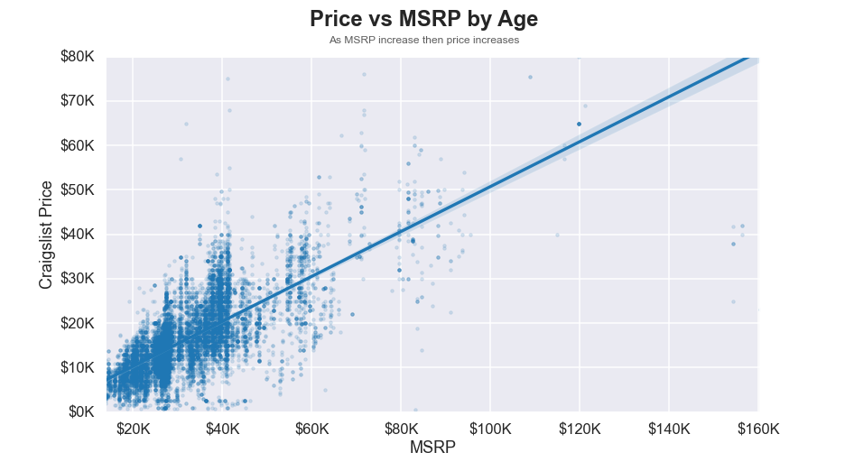

Slide 45
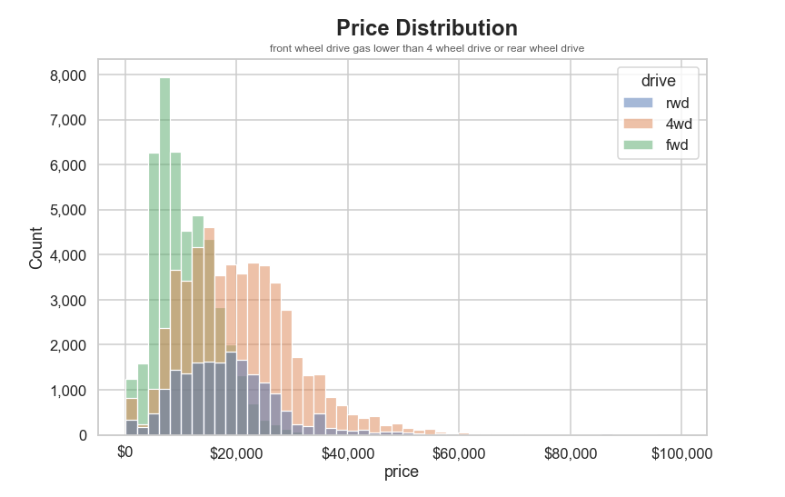

Slide 46
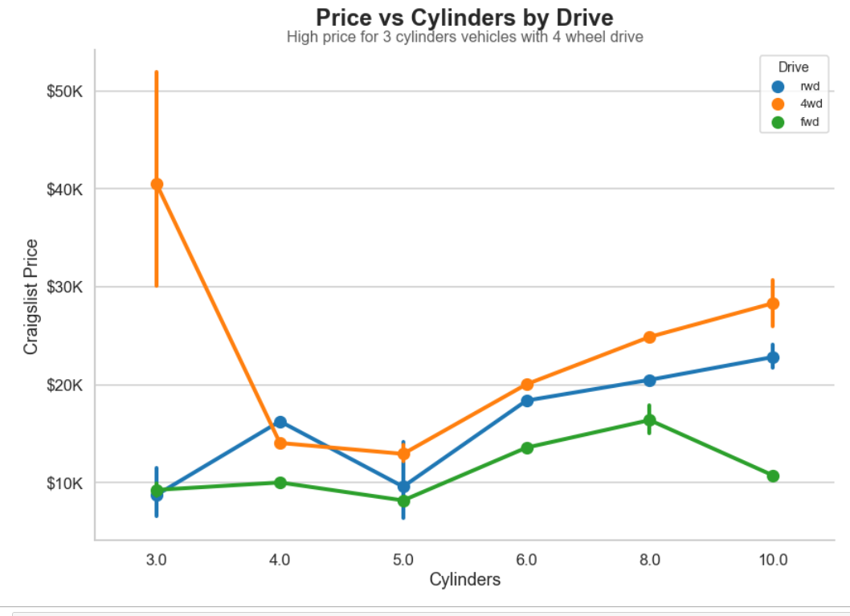

Slide 47
