Slide 1

SSC Active Learning Java Parser Generator – JavaCC
Done by:
PA29- Shrutika Singh
PA49- Shreya Sundkar
PA62- Shriyash Shingare
PA67- Neel Khalade

Slide 2
What is a Parser Generator?
A parser generator takes a grammar as input and automatically generates source code that can parse streams of characters using the grammar. The generated code is a parser, which takes a sequence of characters and tries to match the sequence against the grammar.The parser typically produces a parse tree, which shows how grammar productions are expanded into a sentence that matches the character sequence. The root of the parse tree is the starting nonterminal of the grammar. Each node of the parse tree expands into one production of the grammar.
Types of Java Parser Generator tools:
Bottom up Parser Generators Tools:
JavaCUP;
jay, YACC for Java
SableCC,The Sable Compiler Compiler
Topdown Parser Generators Tools:
ANTLR, Another Tool for Language Recognition
JavaCC, Java Compiler Compiler

Slide 3
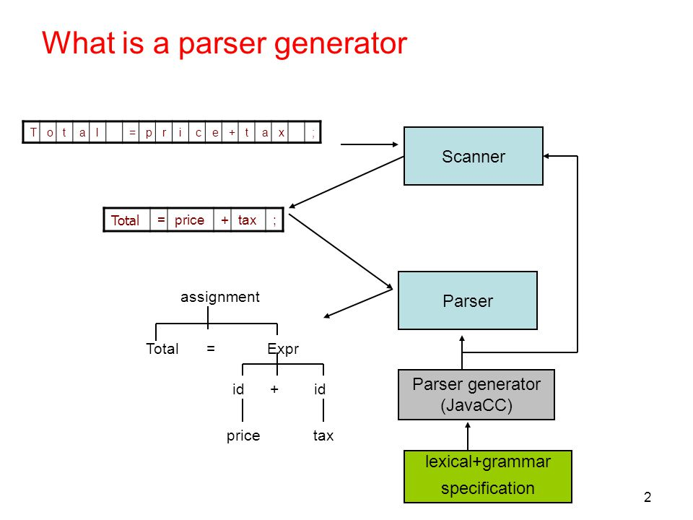
JavaCC
Java Compiler Compiler (JavaCC) is the most popular parser generator for use with Java applications.A parser generator is a tool that reads a grammar specification and converts it to a Java program that can recognize matches to the grammar.
In addition to the parser generator itself, JavaCC provides other standard capabilities related to parser generation such as tree building (via a tool called JJTree included with JavaCC), actions, and debugging. All you need to run a JavaCC parser, once generated, is a Java Runtime Environment (JRE).

Slide 4
Features of JavaCC
TopDown LL(K) parser genrator
Lexical and grammar specifications in one file
Tree Building preprocessor
with JJTree
Extreme Customizable
many different options selectable
Document Generation
by using JJDoc
Internationalized
can handle full unicode
Syntactic and Semantic lookahead

Slide 5
Permits extneded BNF specifications
can use | * ? + () at RHS.
Lexical states and lexical actions
Case-sensitive/insensitive lexical analysis
Extensive debugging capability
Special tokens
Very good error reporting

Slide 6
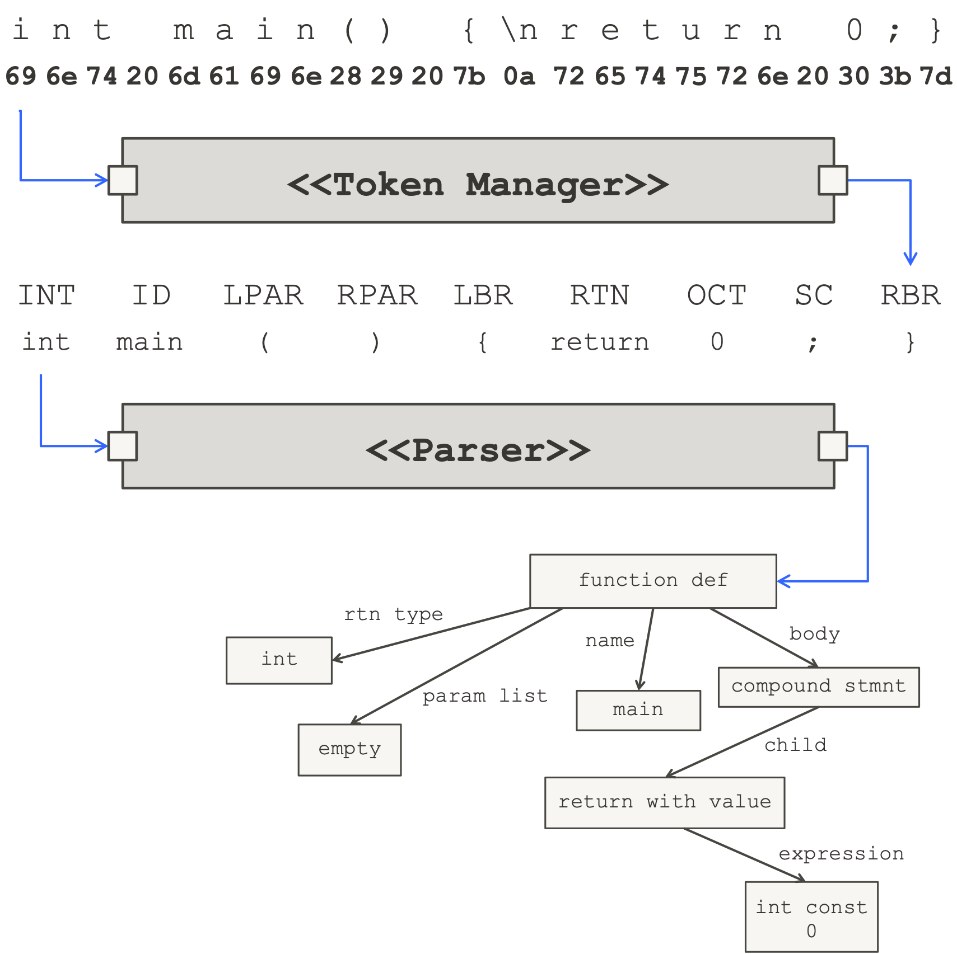
JavaCC Design
The following diagram shows the relationship between a JavaCC generated lexical analyzer (called a token manager in JavaCC parlance) and a JavaCC generated parser. The diagrams show the C programming language as the input, but JavaCC can handle any language (and not only programming languages) if you can describe the rules of the language to JavaCC.

Slide 7
Step to use JavaCC
Write a javaCC specification (.jj file)
Defines the grammar and actions in a file (say, calc.jj)
Run javaCC to generate a scanner and a parser
javacc calc.jj
Will generate parser, scanner, token,… java sources
Write your program that uses the parser
For example, UseParser.java
Compile and run your program
javac -classpath . *.java
java -cp . mainpackage.MainClass

Slide 8
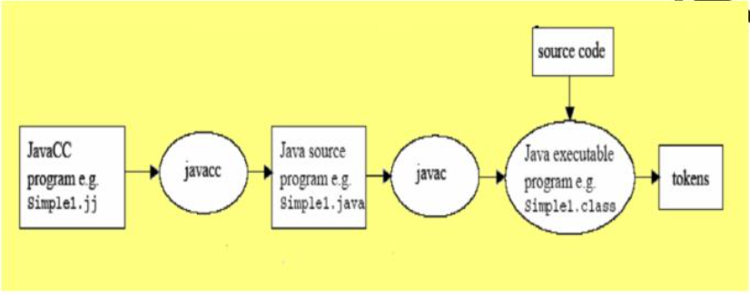
Flow for using JavaCC

Slide 9
Types of productions used in JavaCC
There can be four different kinds of Productions:
Javacode
For something that is not context free or is difficult to write a grammar for. eg) recognizing matching braces and error processing.
Regular Expressions
Used to describe the tokens (terminals) of the grammar.
BNF
Standard way of specifying the productions of the grammar.
Token Manager Declarations
The declarations and statements are written into the generated Token Manager (lexer) and are accessible from within lexical actions.

Slide 10
Thank You!

