Slide 1
DATA ANALYSIS FOR CAFETERIA VISITORS
Made by
- Shrutika Singodia

Slide 2
INPUT DATA
The data was collected from Japanese restaurants, by Hot Pepper Gourmet (hpg) and AirREGI (air)
The training data is based on the time range of Jan 2016 - most of Apr 2017.
Notes:
. The data comes in the shape of 8 relational files which are derived from two separate Japanese websites that collect user information: “Hot Pepper Gourmet (hpg): similar to Yelp” (search and reserve) and “AirREGI / Restaurant Board (air): similar to Square” (reservation control and cash register). The training data is based on the time range of Jan 2016 - most of Apr 2017.

Slide 3
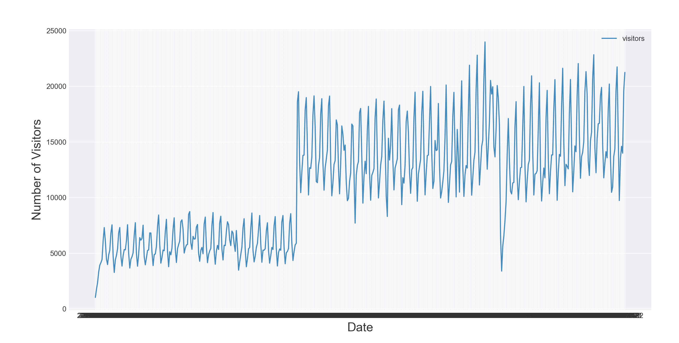
Number of visitors per day over the time range
AIR VISITS
Notes:
There is an interesting long-term step structure in the overall time series. Which might be due to the fact that new restaurants were being added to the data base. In addition, we already see a periodic pattern that most likely corresponds to a weekly cycle.

Slide 4
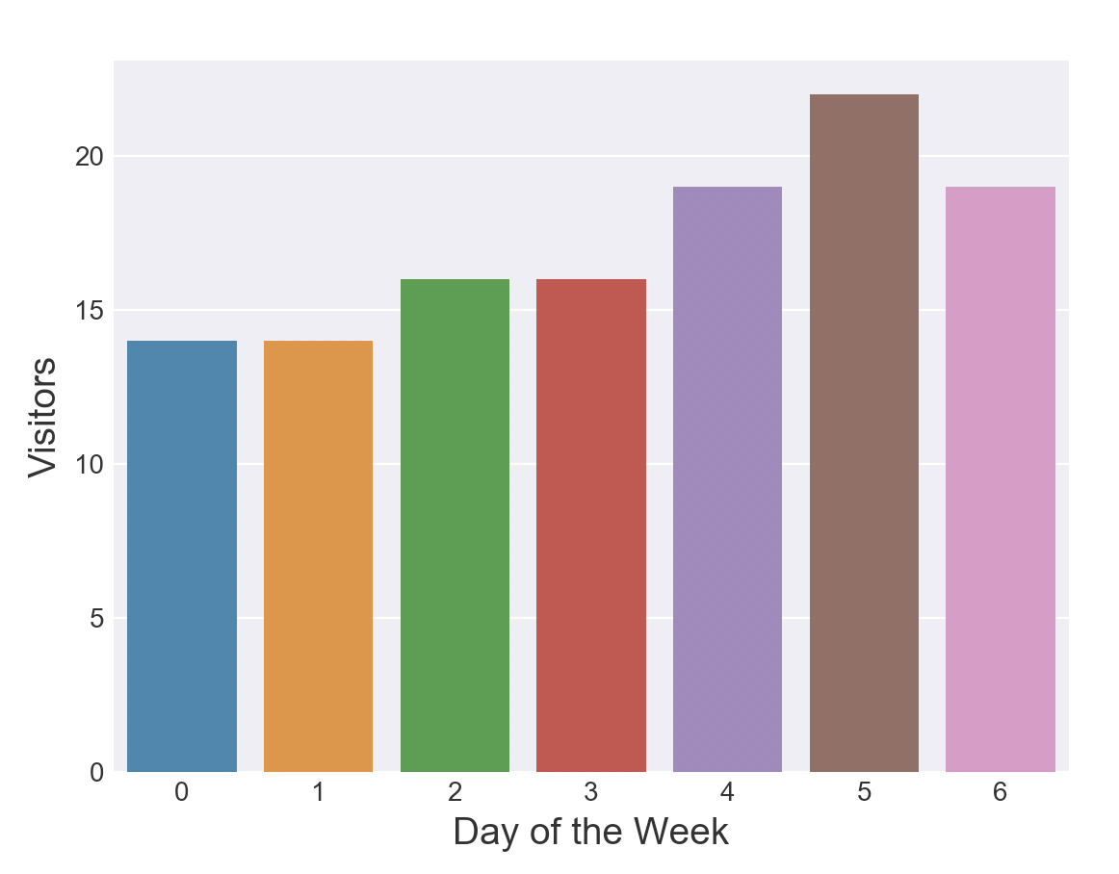
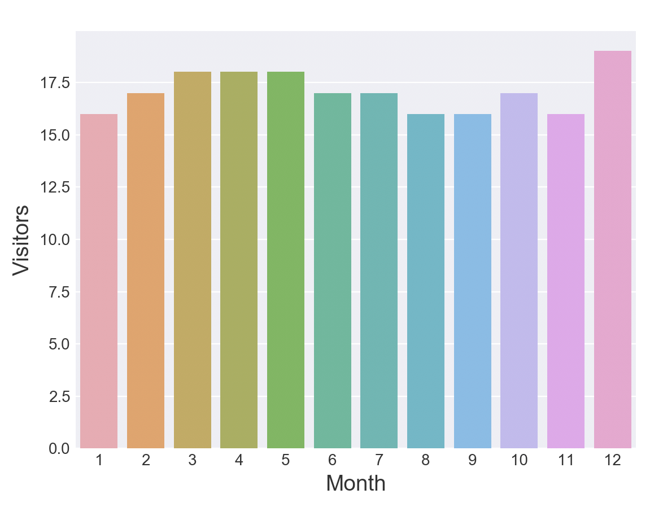
The median visitors per day of the week and month of the year are plotted
AIR VISITS
Notes:
Friday, Saturday and Sunday (weekend) appear to be the most popular days, while Monday and Tuesday have the lowest numbers of average visitors over the training time span of the data.
December appears to be the most popular month for restaurant visits. While, March, April and May appear to be consistently busy months.

Slide 5
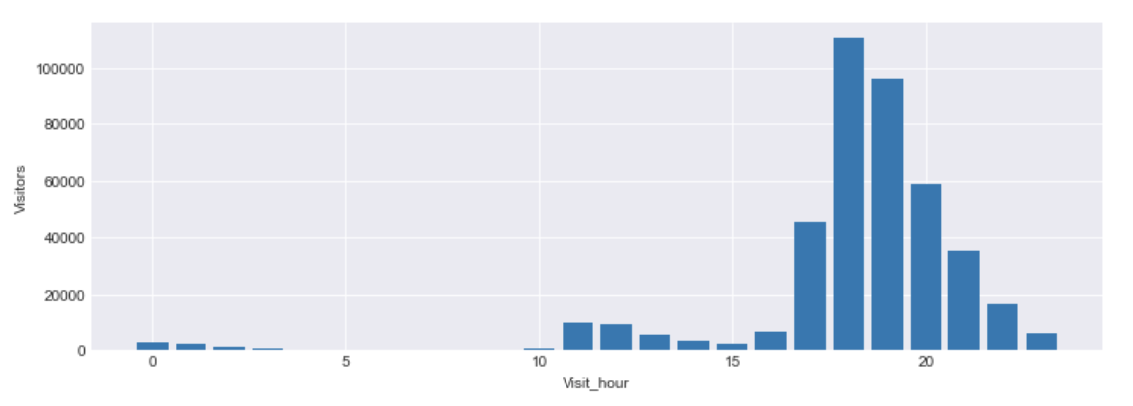
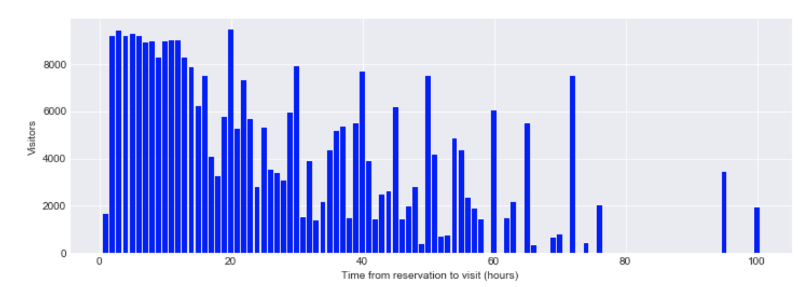
Time of the visit to the restaurant and the time between making a reservation and visiting the restaurant .
AIR RESERVATIONS
Notes:
Reservations are concentrated during the evening hours (i.e., for dinner).
The most popular strategy is to reserve a couple of hours before the visit, but if the reservation is made more in advance then it seems to be common to book a table in the evening for one of the next evenings. Very longtime gaps between reservation and visit are not very common.

Slide 6
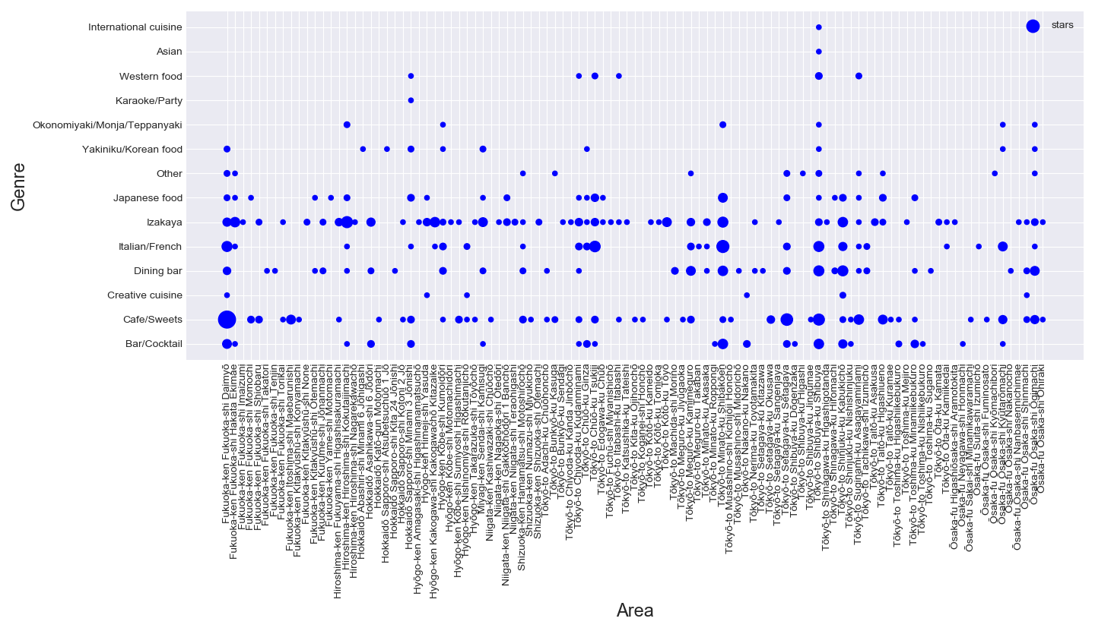
Plot of the genre in a restaurant and the frequency of the genres
AIR GENRE
Notes:
It can be seen that some restaurants have a lot of varieties in a particular cuisine while some only have a few varieties.

Slide 7
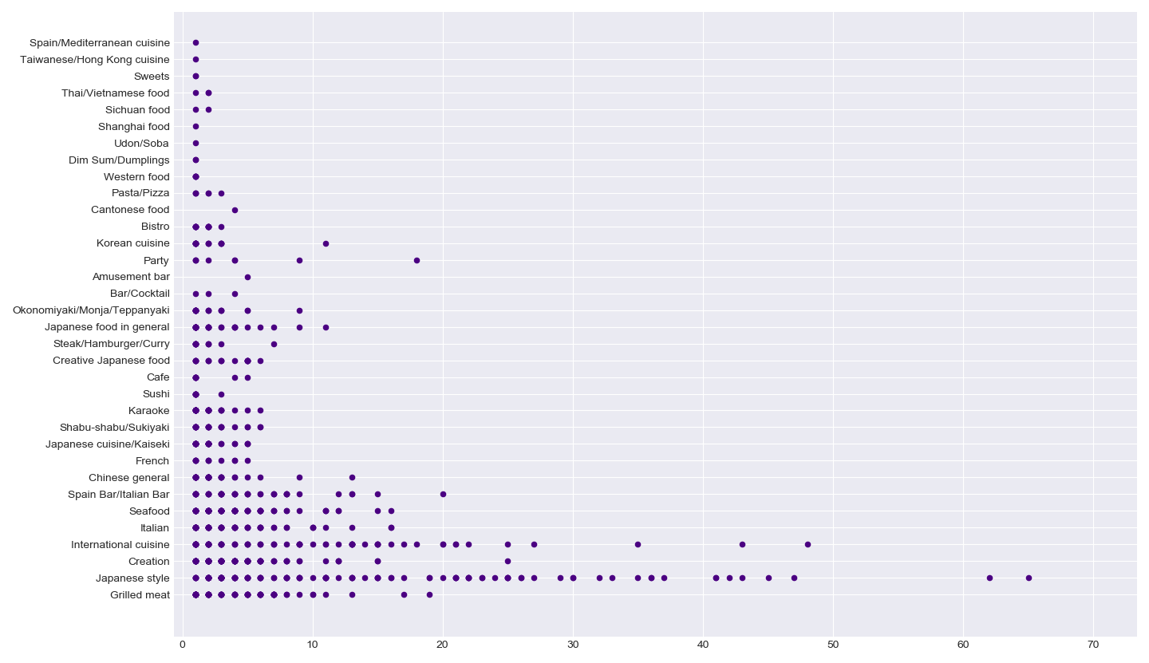
Plot of the frequency of each cuisine (genre), according to the data by hpg
FREQUENCY OF A CUISINE
Notes:
It can be observed that, the frequency of most genre is less than 10. Only a few genres like international cuisine, or Japanese style are in present in huge numbers.

Slide 8
THANK YOU

