Slide 1
Li-Fi Aided Under
Water Communication
Akhil Kalpesh Bachkaniwala 16UCC010
Anubhuti Jain 16UEC019
Jyoti Kumari 16UEC052
Shrutika Bansal 16UEC064
Supervisor Dr. Nikhil Sharma
Co-Supervisor Dr. Divyang Rawal

Slide 2

What is LiFi ?
LiFi is a wireless optical networking technology that uses light-emitting diodes (LEDs) for data transmission. In technical terms, Li-Fi is a visible light communications system that is capable of transmitting data at high speeds over the visible light spectrum, ultraviolet and infrared radiation.

Slide 3
Advantages of LiFi over RF
Speed: LiFi can provide speeds around 100 times faster than currently achievable speeds in WiFi.
Efficiency: LiFi is much more efficient when it comes to cost and power consumption.
Availability: Due to the use of LED bulbs, LiFi can be made available everywhere by replacing traditional LED bulbs with LiFi compatible bulbs.
Security: Since LiFi makes use of visible light spectrum, it cannot penetrate through optically opaque objects like walls making it difficult for unauthorised access unlike present WiFi.

Slide 4
Problem Statement
Present underwater communication systems involve the transmission of information in the form of sound or electromagnetic (EM) waves. Since radio waves cannot be used under water because these waves are strongly absorbed by sea water within feets of their transmission and this renders it unusable underwater. There is a need for a robust and reliable communication system which will not be affected severely due to thermal and chemical changes in water’s composition.

Slide 5
Solution
Since light can travel through water, Li-Fi based communications can offer much greater mobility. It is a method of communication via LED lights and can be a potential solution to this problem. Li-Fi devices have a system of blinking lights that are used for transmitting data. These rapidly changing LED lights flash to enable data to be transferred over a Morse code-esque system of blinks. The LED flashes emit lights that correspond with a computer language comprised of zeros and ones. The lights' emissions are then lodged in a gadget that computes and translates the signal into real-time data. As the flashes blink faster and faster, data is able to be transmitted more quickly.

Slide 6
Objectives:
Li fi based communication system for oceanic monitoring.
Serial data Communication.
Sensory data transmission and plotting the real time data using Arduino.
Image transmission by converting image into character strings using MATLAB.

Slide 7
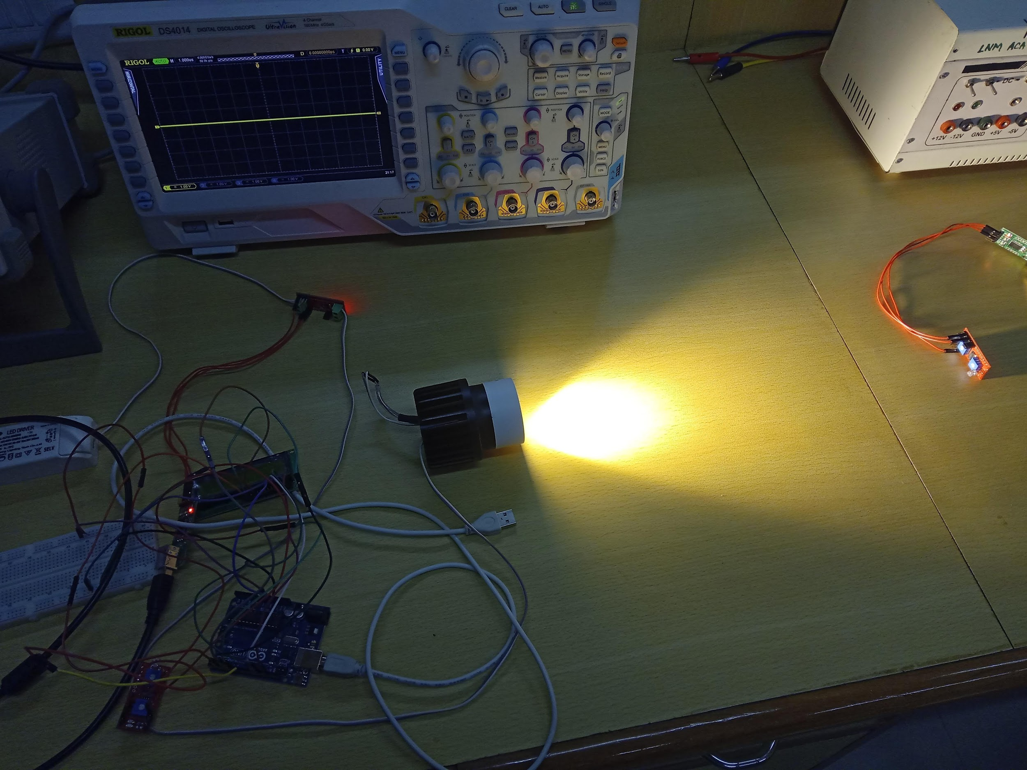
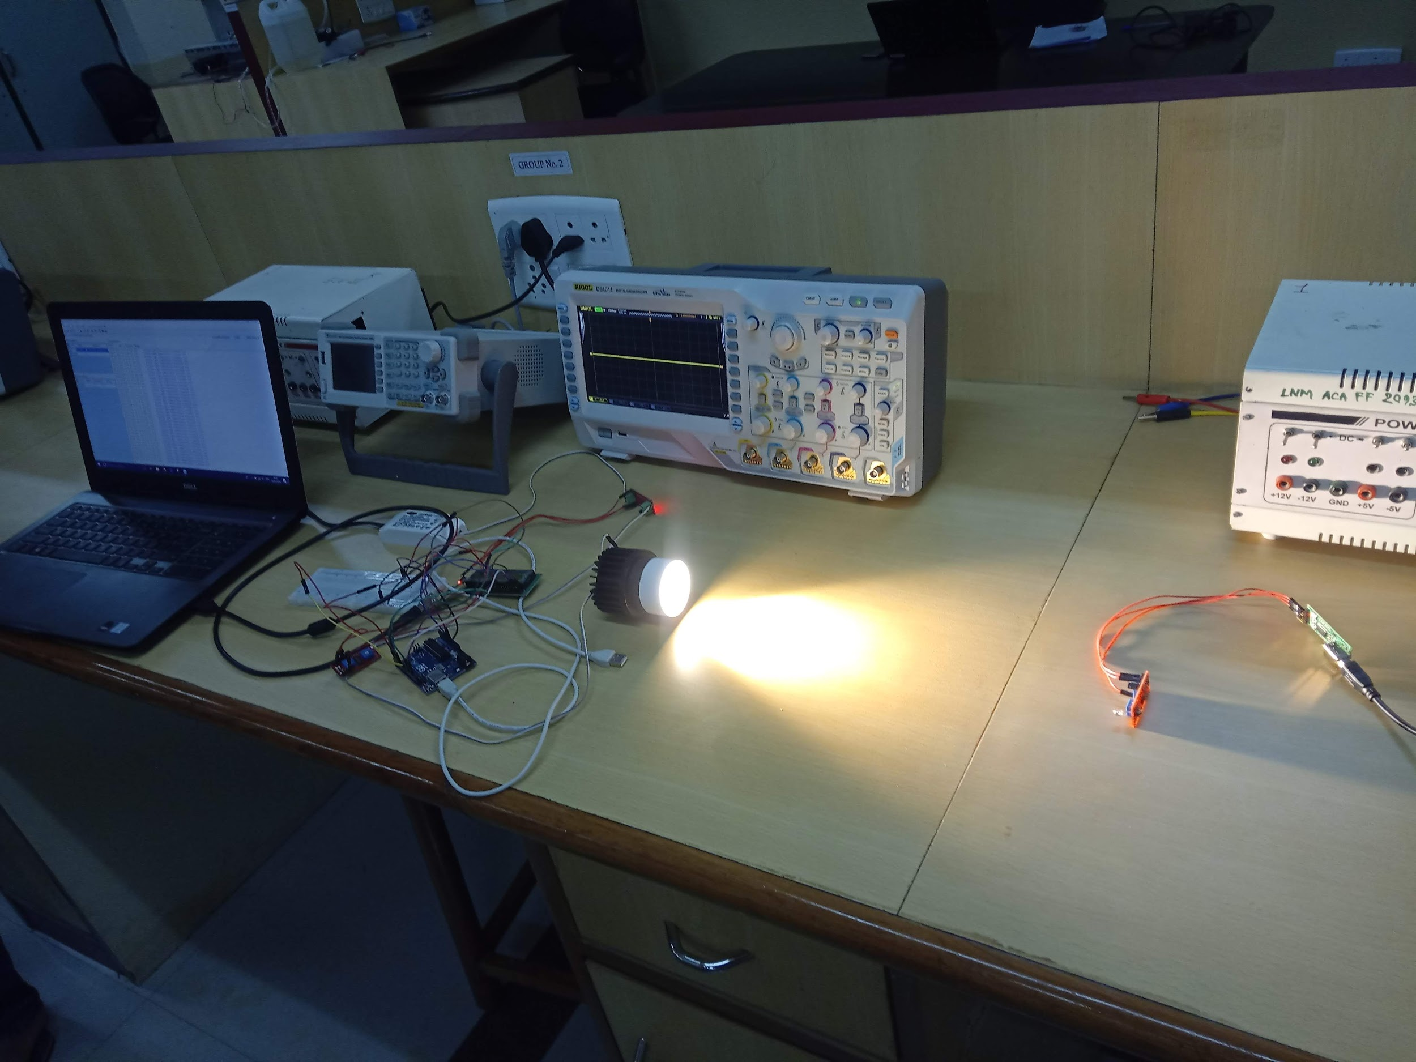
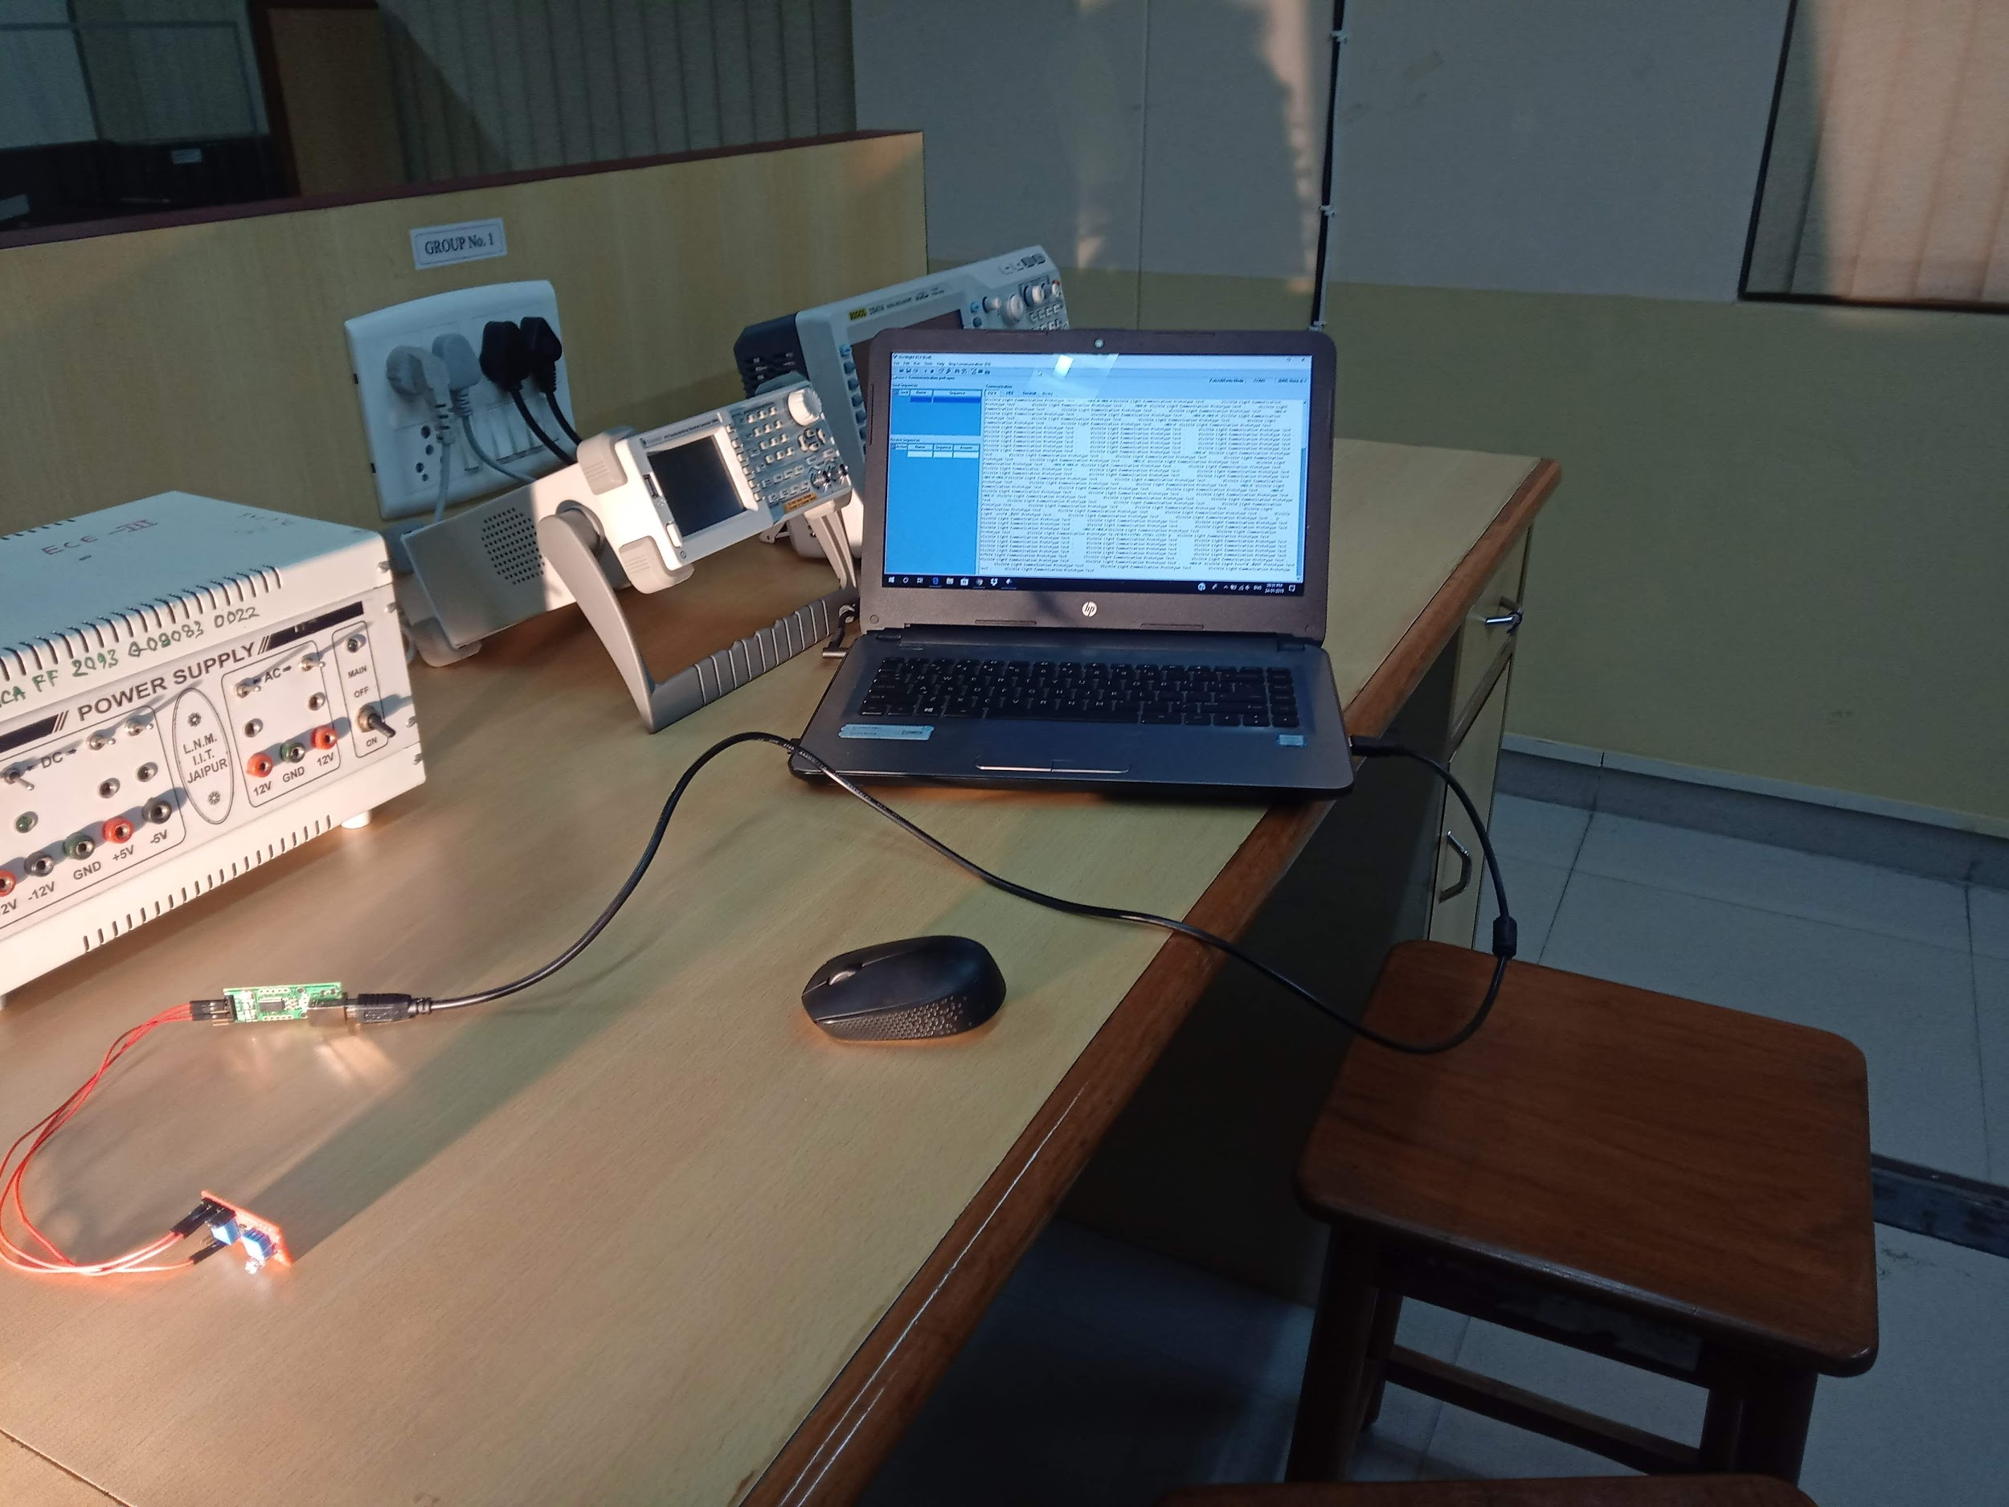
Setup
Transmitter Side
Complete Setup
Receiver Side

Slide 8
Serial Data Transmission
Our aim is to transmit data ( numerical and char) from serial monitor of transmitter side to that of receiver side.
Working:-
Model used for implementation of above task is LiFi Nano V2.
Were able to transfer small streams of data from the transmitter to the receiver after setting up a connection which is as follows:

Slide 9
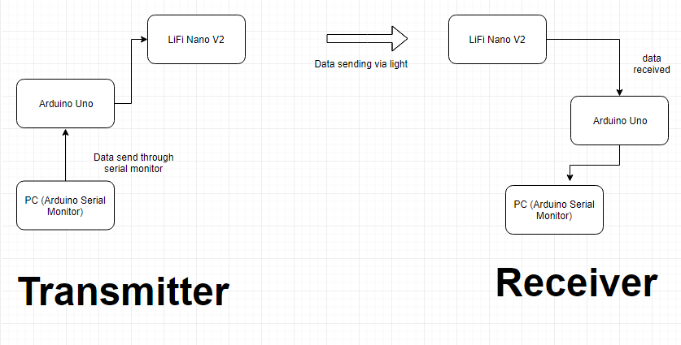
Block Diagram

Slide 10
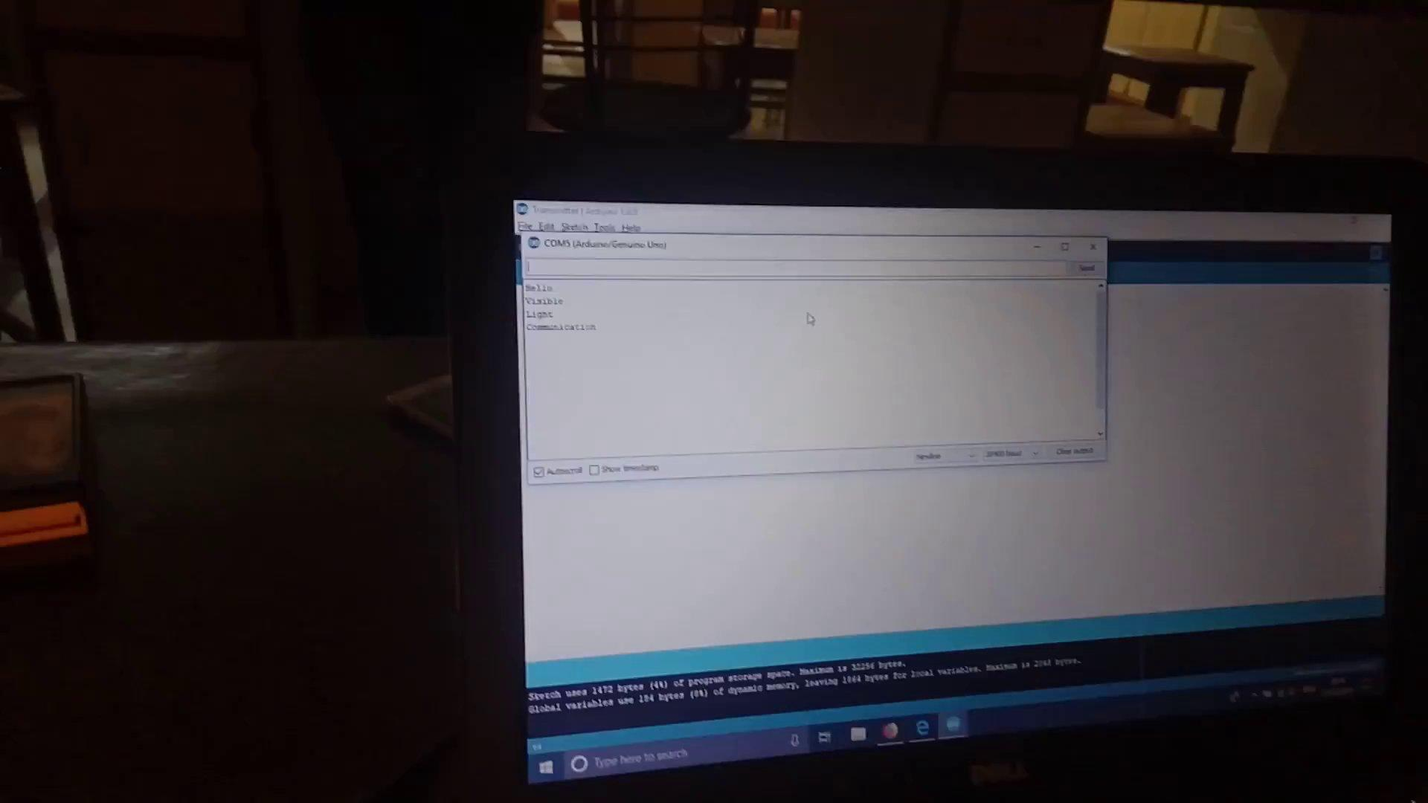
Results

Slide 11
2. Transmission of Sensor Data
Temperature Sensor is connected to the Arduino and the received temperature values are Transmitted via the Li-Fi Transmitter and the values received at the receiver of the Li-Fi Module are then plotted by using Arduino and Processing.
Software used to plot graph-Processing.

Slide 12
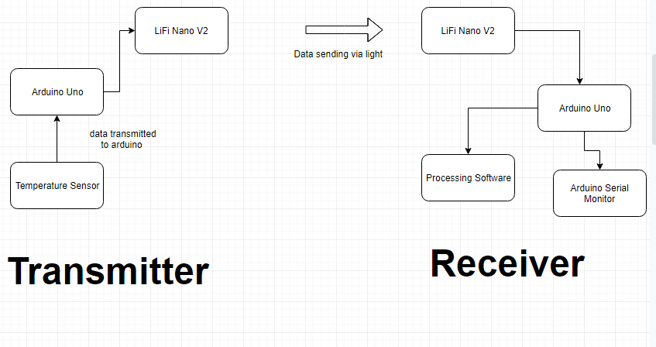
Block Diagram

Slide 13

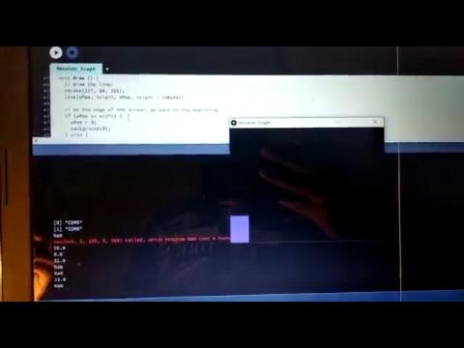
Results
Arduino Serial Monitor Graph
Processing Graph

Slide 14
3. Image Transmission
This task requires large data transfer unlike the tasks presented before. Certain limitations is to be overcome to make such large transmissions possible.
Working:-
Model used for implementation of above task is LiFi Nano V2.
Step two involved conversion of image to a matrix.
DCT values of the image are calculated using Matlab and stored in a text file.

Slide 15
The stored data was read using the processing script which divided the data into chunks of smaller data.
This was then sent to the Arduino for transmission.
At the receiver end the data was reconstructed back and stored in a data file.
This was then read again with Matlab and converted to image.

Slide 16
Problems faced
We are not able to retrieve the exact data values. Around 60-70% values obtained are correct values.
Data received is not arriving uniformly. Due to which we are facing problem in reconstructing back the image.
Calibration of the Module for the appropriate distance proved to be a challenge.

Slide 17
Steps taken to overcome the problems:
Introducing an end marker for each data transmission.
Making use of guard bits at start of transmission.
Making use of guard bits at end of transmission.
Padding the data segment with white spaces to prevent synchronization loss.

Slide 18
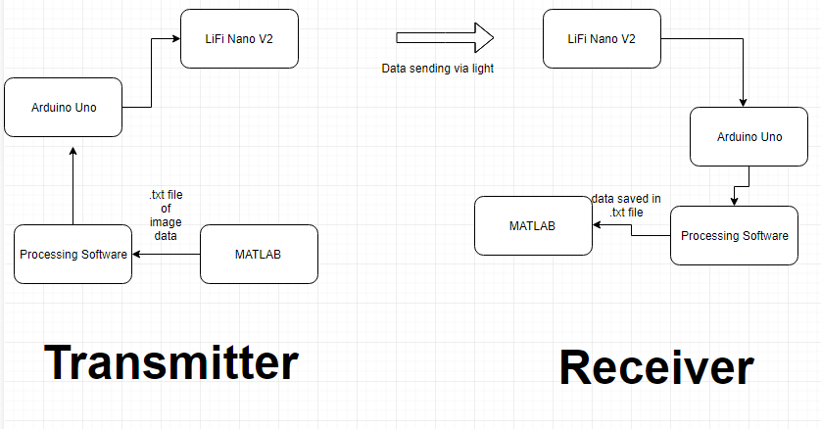
Block Diagram

Slide 19
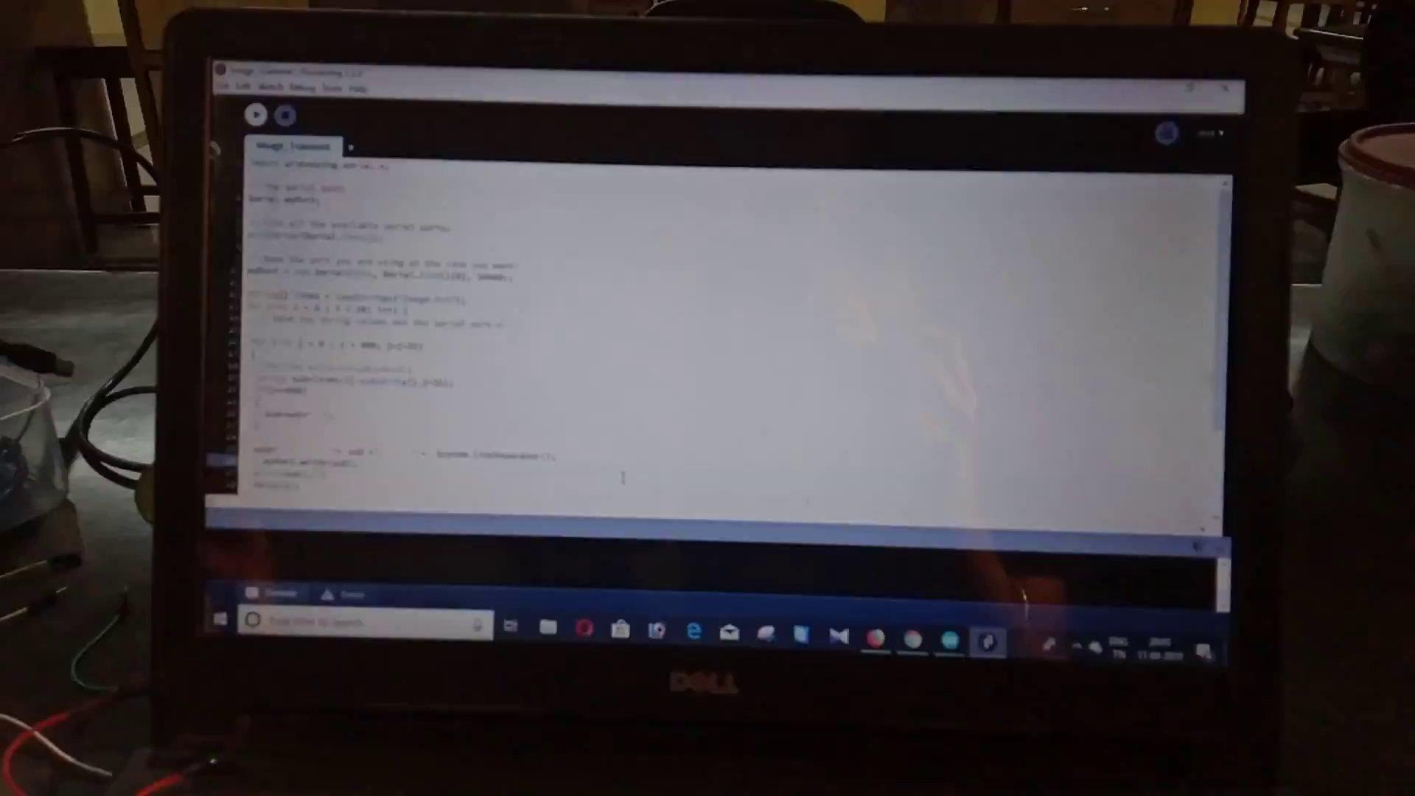
Results

Slide 20
Conclusion
Serial Data Transfer has being successfully achieved.
End to End sensor data transfer has also being achieved.
Image transmission model has also being prepared.
Hence a proof of concept of using LiFi in Underwater Communication has being demonstrated for atmospheric conditions.
Future Plans:
Underwater prototype implementations.
Further enhancements in speeds, distance and synchronisation.

