Slide 1
JOURNEY SCRAPBOOK
Shruti Katyal

Slide 2
Agenda
Database Management Fundamentals
Big data Fundamentals
Azure datalakes
Azure SQL database creation
Introduction about Structured Query language
Joins, group by clause , subqueries, Correlated queries
ER Diagram

Slide 3
DATABASE MANAGEMENT SYSTEM
Database Management System
What is DBMS?
A database management system (DBMS) is system software for creating and managing databases. A DBMS make it possible for end users to create, protect , read , update and delete data in a database.
Allows data to be organized into tables or collections , making it easier to access, retrieve and analyze information.
Provides features for access control and user authentication, ensuring that only authorized users can interact with the data.
Enforces rules to maintain data integrity , preventing inconsistencies and errors in the data.

Slide 4
ENTITY RELATIONSHIP DIAGRAM
Entity Relationship Diagram
An Entity-Relationship (ER) diagram is a visual representation used in database design to model the structure and relationships of data in a database. Here are some key points about ER diagrams:
Entities: Represents real-world objects, such as people, places, or things, that need to be stored in a database.
Attributes: Characteristics or properties of entities, which are used to describe and store data about them.
Relationships: Connections between entities that define how they are related or interact with each other.
Cardinality: Indicates the number of instances of one entity that can be related to another entity. Common cardinalities include one-to-one, one-to-many, and many-to-many.
Primary Key: An attribute (or combination of attributes) that uniquely identifies each instance of an entity. It's used for data integrity and efficient data retrieval.
Foreign Key: An attribute in one entity that links to the primary key of another entity, establishing a relationship between them.
Crows Feet: A graphical notation used to represent cardinality in ER diagrams, often depicting one end of a relationship with a crow's foot to indicate "many."
Weak Entities: Entities that do not have a primary key on their own and depend on another entity (called a strong entity) for identification.
Normalization: A process in database design that minimizes data redundancy by organizing data into separate tables and linking them through relationships.
Diagram Notation: Symbols like rectangles (entities), diamonds (relationships), lines (connectivity), and arrows (indicating direction) are used to create visual representations of the database structure.
Purpose: ER diagrams serve as a communication tool between stakeholders, helping to clarify data requirements, constraints, and the overall database design.
Software Tools: Various software tools are available for creating and managing ER diagrams, making it easier to design and maintain databases.

Slide 5
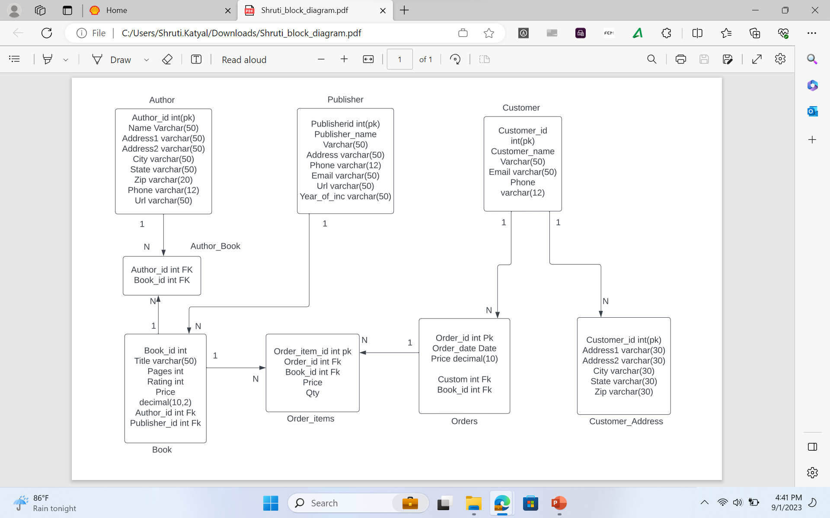
REPRESENTATION OF EntityRelationship Diagram
REPRESENTATION OF Entity-relationship Diagram

Slide 6
Big Data Fundamental
Big Data:
Big data refers to extremely large and complex datasets that cannot be effectively processed, managed, or analyzed using traditional data processing tools and methods.
It is characterized by its volume, velocity (speed of data generation), variety (diverse data types), and sometimes veracity (data quality). It requires specialized technologies and approaches to extract valuable insights from this vast amount of information.
Hadoop:
Hadoop is an open-source framework designed for storing and processing big data in a distributed and scalable manner.
It consists of two main components: the Hadoop Distributed File System (HDFS) for storage and the MapReduce programming model for processing. It allows organizations to store large datasets across multiple commodity servers and run parallel data processing tasks on those servers. Hadoop has become a cornerstone of big data analytics, enabling businesses to analyze and extract meaningful information from massive datasets.

Slide 7
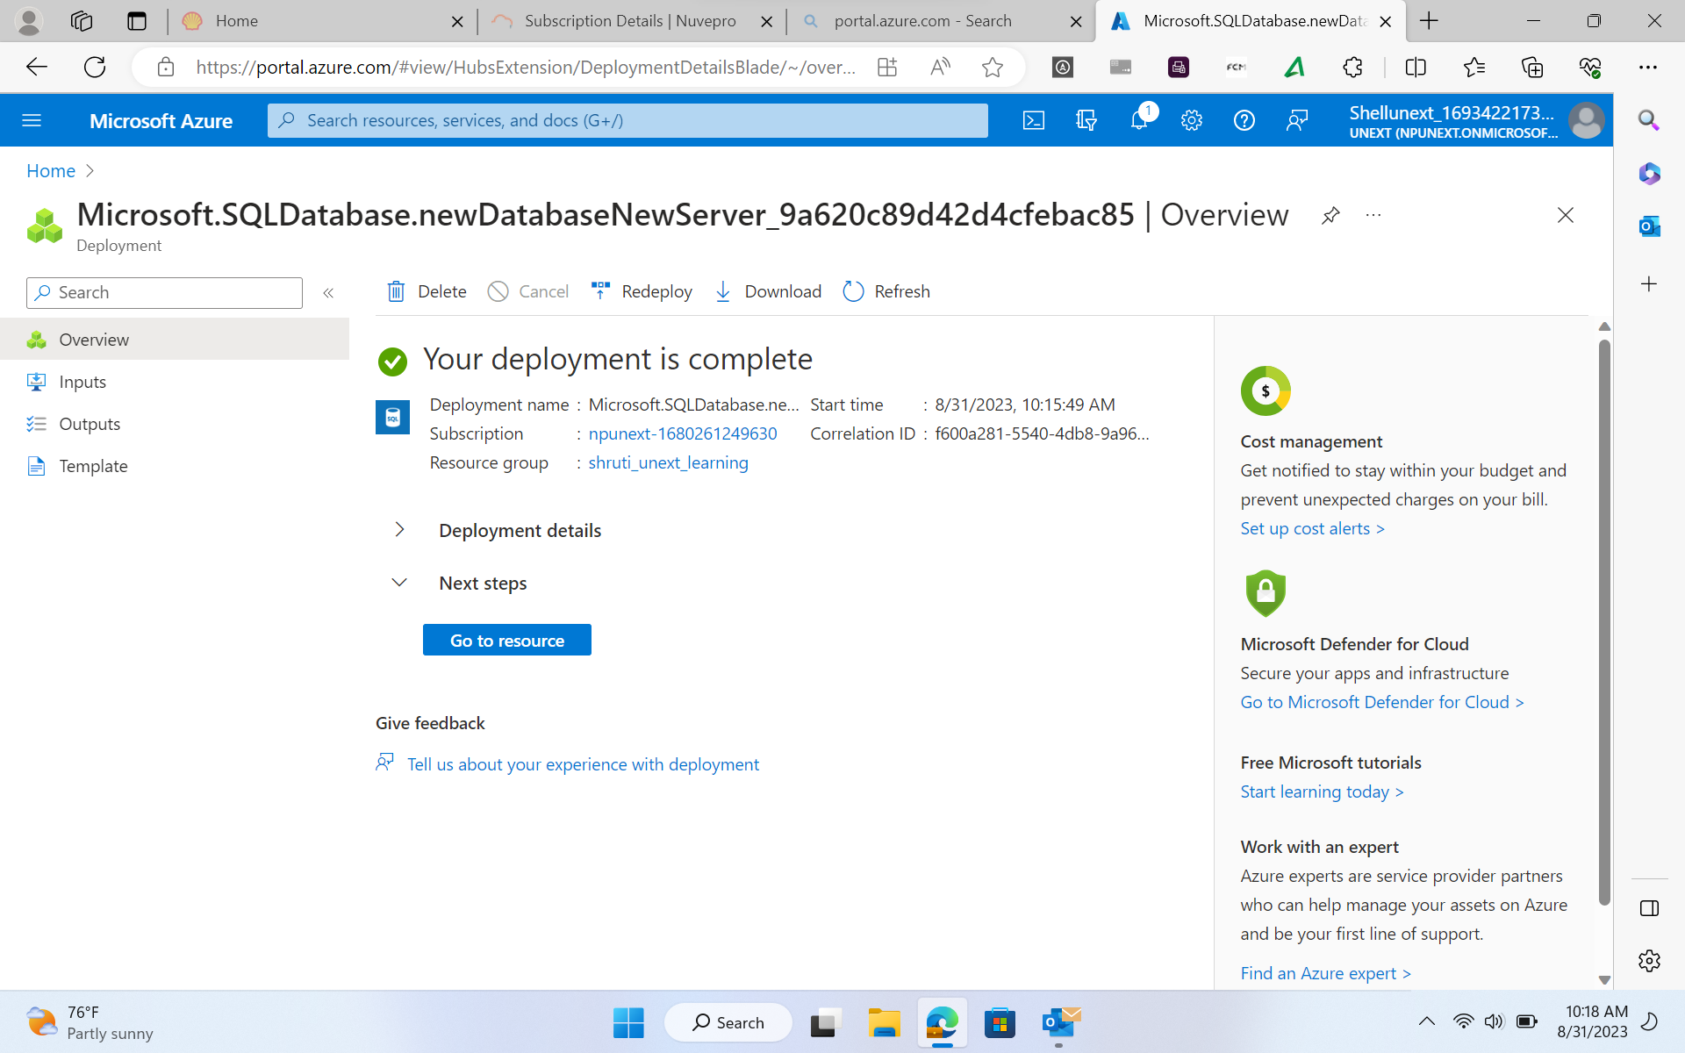
REPRESENTATION OF EntityRelationship Diagram
Creation of SQL Database Server

Slide 8
STRUCTURED QUERY LANGUAGE
SQL stands for structured query language . It is domain – specific programming language used for managing , querying and manipulating relational databases.
Key Learnings :
select, create, delete, update, alter, drop, grant , revoke commands.
Summarization of data using functions like SUM and avg .
Nested queries for advanced filtering and analysis .
Joins for combining data from multiple tables.

Slide 9

THANK YOU

