Slide 1
Journey SCRAPBOOK
Shruti Katyal​

Slide 2
AGENDA
Database Management System​
Structured Query Language
​Software Testing
DevOps
​Cloud Computing​

Slide 3
DATABASE MANAGEMENT SYSTEM
What is DBMS?
A database management system (DBMS) is system software for creating and managing databases. A DBMS make it possible for end users to create, protect , read , update and delete data in a database.
Allows data to be organized into tables or collections , making it easier to access, retrieve and analyze information.
Provides features for access control and user authentication, ensuring that only authorized users can interact with the data.
Enforces rules to maintain data integrity , preventing inconsistencies and errors in the data.

Slide 4
STRUCTURED QUERY LANGUAGE
SQL stands for structured query language . It is domain – specific programming language used for managing , querying and manipulating relational databases.
Key Learnings :
select, create, delete, update, alter, drop, grant , revoke commands.
Summarization of data using functions like SUM and avg .
Nested queries for advanced filtering and analysis .
Joins for combining data from multiple tables.

Slide 5





SOFTWARE TESTING
Software Testing is an activity that helps in identifying bugs in a software system under development , in order to provide a defect-free and reliable solution to the customer.
Key learnings from Software Testing :
STLC, SDLC
Unit testing , Automation testing
How to write a test case in java
Understanding about before each , before all , after all , after each , display name annotations.
Test case design , test planning and documentation.

Slide 6
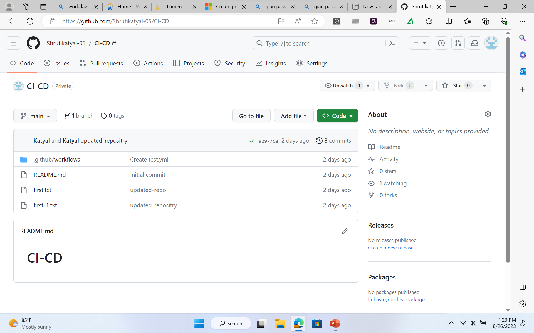
DEVops =“DEVELOPMENT” +“OPERATION”
DevOps is a set of practices, cultural philosophies , and tools aimed at automating and integrating the processes between software development and IT operations.
Key learnings:
Practical implementation about code pushing, pulling in GitHub using git commands.

Slide 7
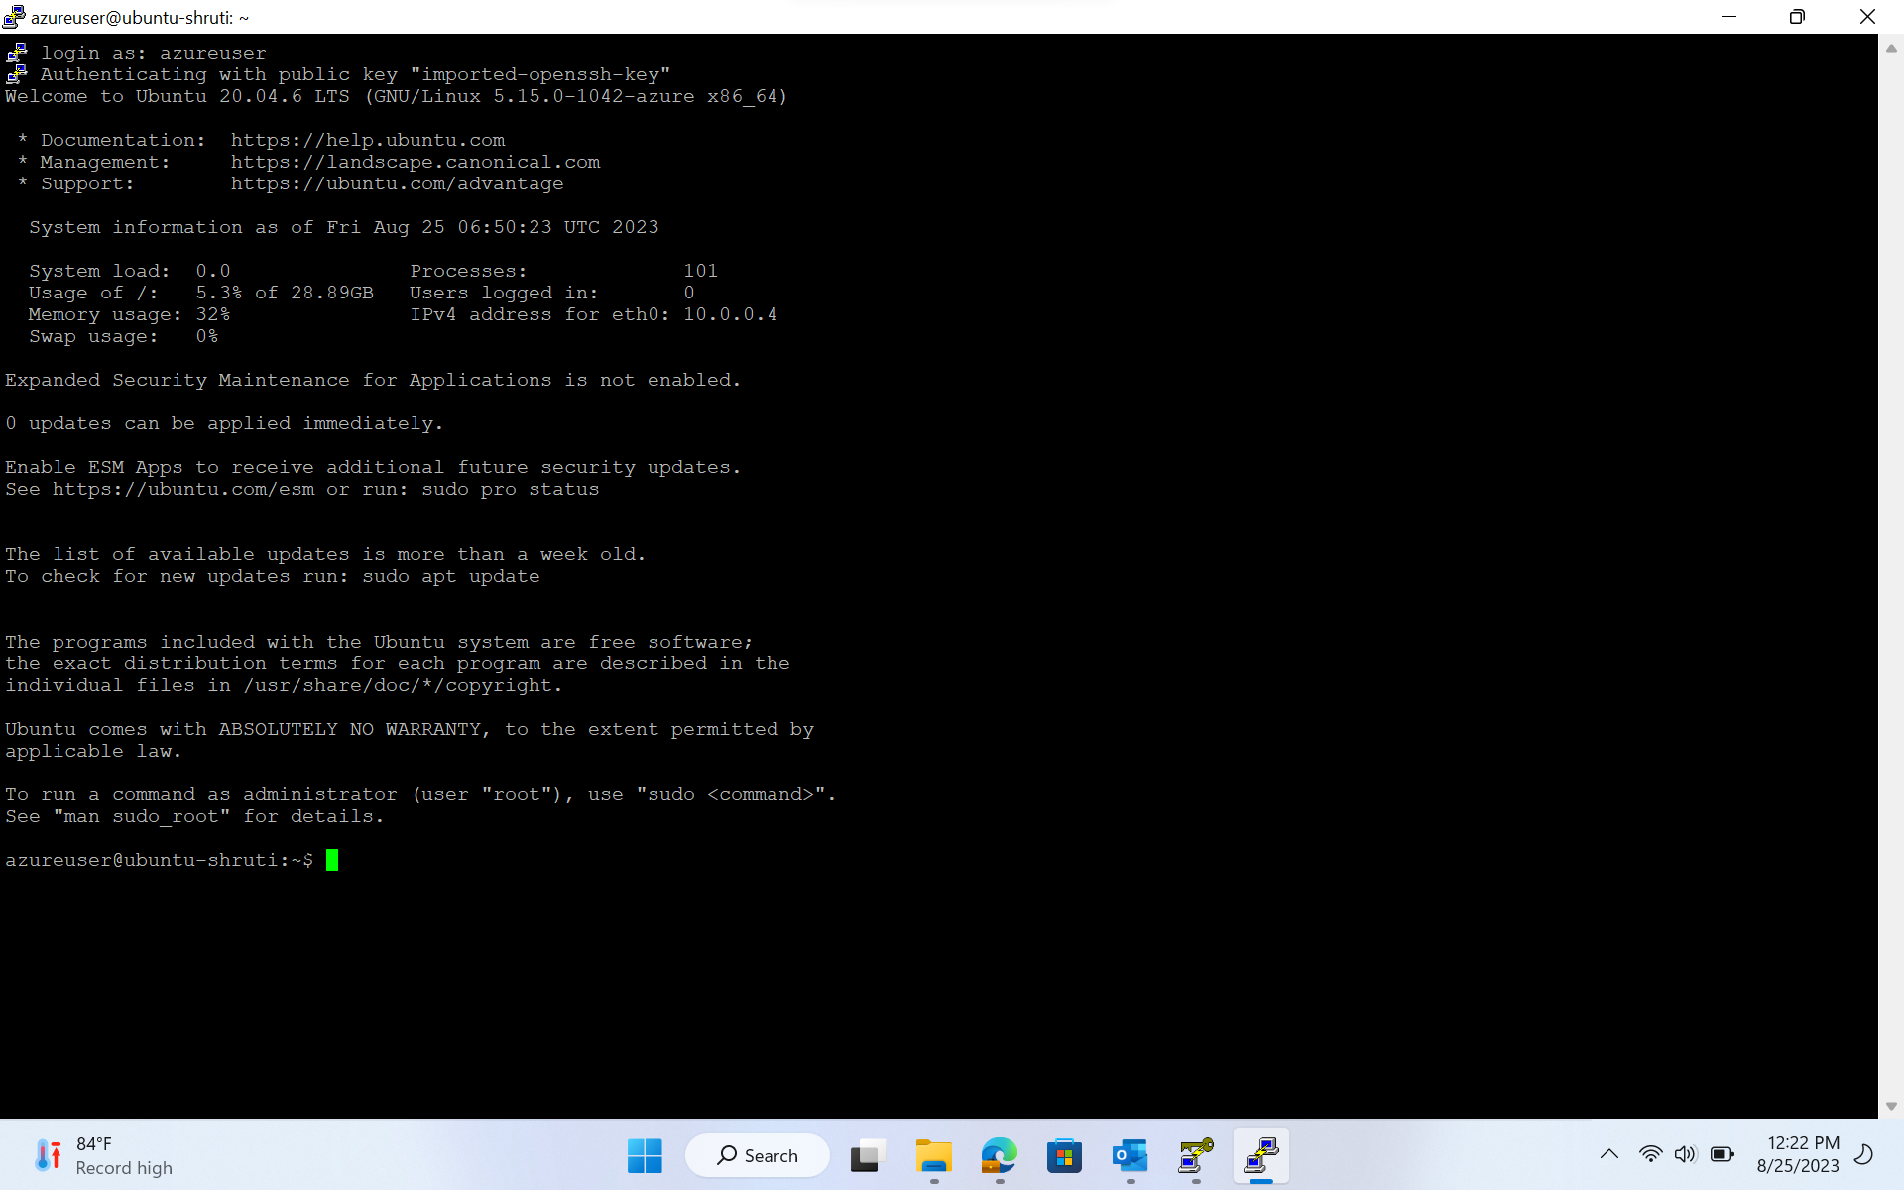
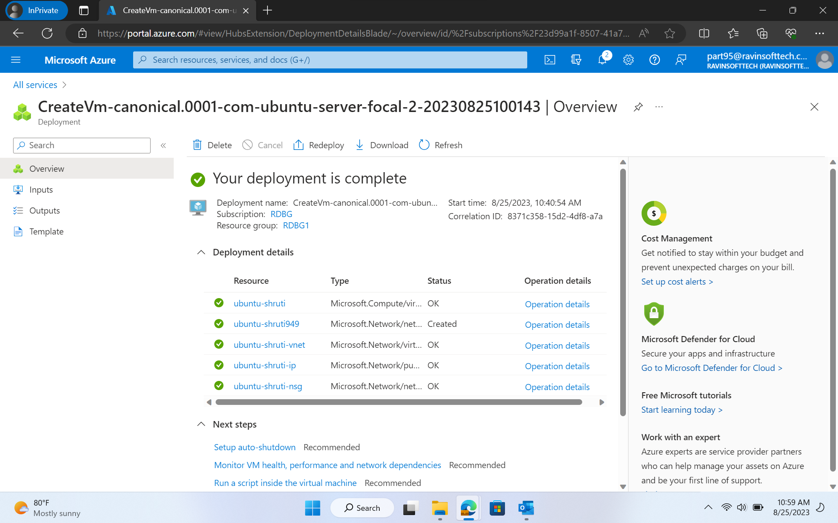
CLOUD COMPUTING
Cloud computing is the practice of using a network of remote servers hosted on the internet to store, manage, and process data, rather than a local server or a personal computer.
Key learnings from Cloud computing :
Creation of Virtual machine using azure
Hosting of static and dynamic websites.

Slide 8

THANK YOU

