Slide 1


Introduction to Networking Technologies: ATM, 802.11, and Routing
by
komal punwatkar
3rd year
Sec: A
Roll No.: A312
PRN No.: 2246491245012
Notes:
1

Slide 2

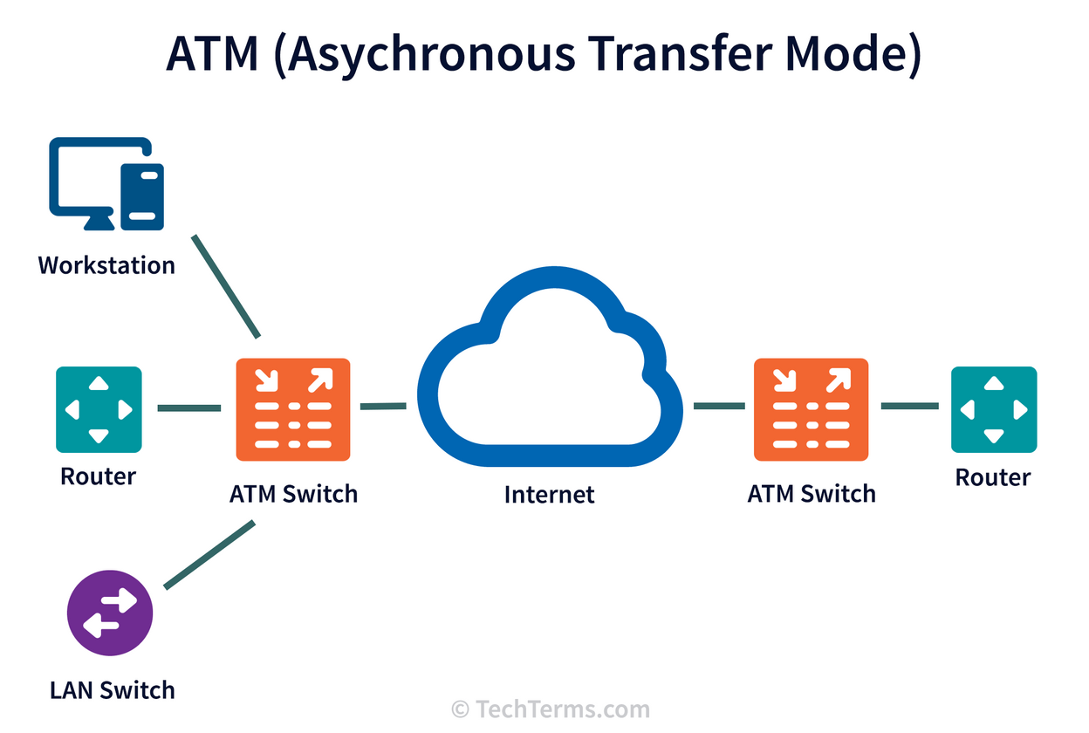
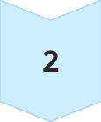

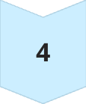


Asynchronous Transfer Mode (ATM)
Virtual Circuits (VCs)
Connection established before data transmission
VPI/VCI Identifiers
Unique IDs for virtual paths and channels
Signaling Protocols
Establish and release connections
Acknowledged Connection
Ensures end-to-end setup
Small Fixed Cells
53-byte cells (5-byte header, 48-byte payload)
Reduced Delays
Fixed cell size minimizes queuing time
Notes:
2

Slide 3






ATM Layers and Functions
Physical Layer
Transmission over physical media
ATM Layer
Cell multiplexing, switching, VPI/VCI translation
ATM Adaptation Layer (AAL)
Supports various traffic types (voice, data)
AAL5 is commonly used for data. ATM prioritizes real-time data and Quality of Service (QoS).
Notes:
3

Slide 4
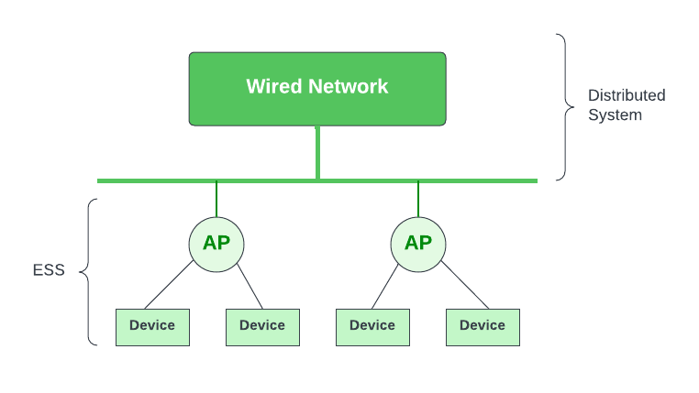
802.11 Architecture
Basic Service Set (BSS)
Infrastructure mode with Access Point (AP)
Extended Service Set (ESS)
Multiple BSSs via distribution system
Independent Basic Service Set (IBSS)
Ad-hoc network, no AP needed
Wireless Medium
CSMA/CA
Radio frequencies (2.4 GHz, 5 GHz, 6 GHz)
Collision Avoidance mechanism
DCF and PCF
Coordination functions
Notes:
4

Slide 5
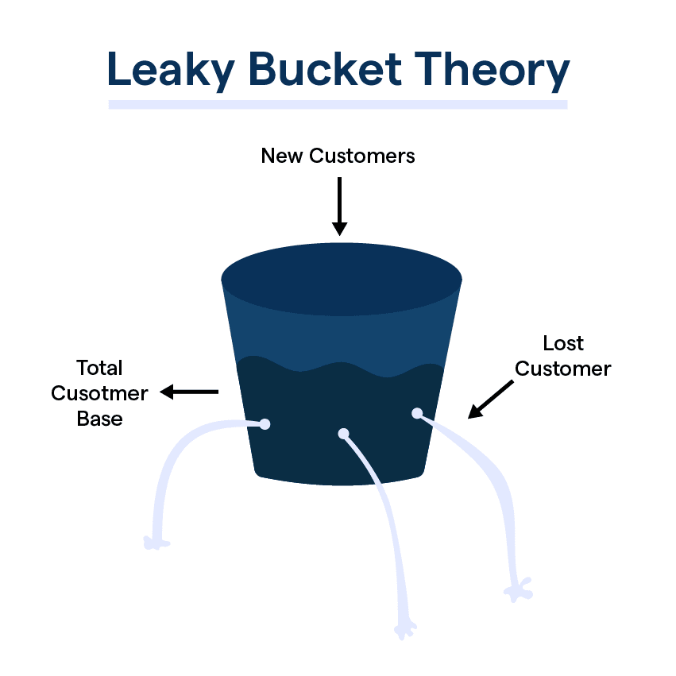




Leaky Bucket Algorithm
Traffic Shaping
Fixed Drain Rate
Manages Bursts
Controls data flow rate
Bucket with set output (bytes/second)
Discards or delays excess data
Smooth Flow
Ensures consistent traffic
Parameters include bucket size and leak rate. This algorithm is used in ATM and other networks for Quality of Service (QoS).
Notes:
5

Slide 6
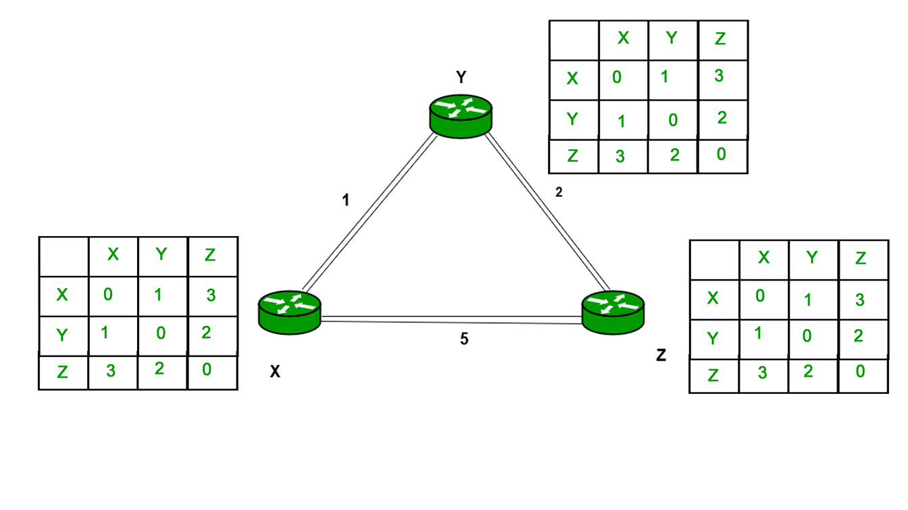
Distance Vector Routing
1
Distance Tables
Each router stores distances to others
2
Periodic Updates
Neighbors exchange distance estimates
3
Bellman-Ford Algorithm
Calculates shortest paths
4
RIP Protocol
Uses hop count as metric
5
Small Networks Only
Scalability issues limit usage
Notes:
6

Slide 7
Count-to-Infinity Problem
Routing Loop
Infinite Increments
Mitigation Strategies
Occurs when a link fails
Routers endlessly increase distance estimates
Triggered updates, split horizon
Poison Reverse
Path Vector Solution
Advertises unreachable routes with infinite metric (e.g., 16 hops in RIP)
BGP avoids loops using path information
Notes:
7

Slide 8


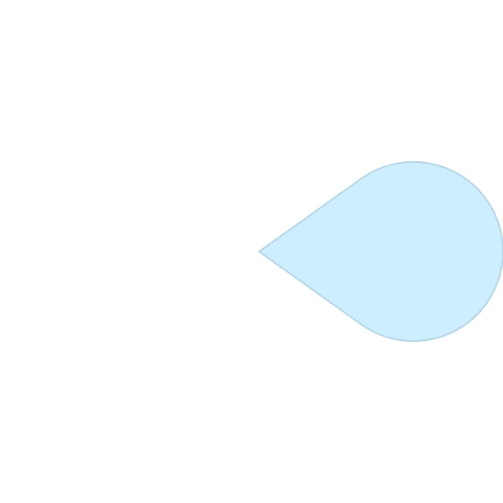


Domain Name System (DNS)
Hierarchical Structure
Name Translation
Root, TLDs, second-level domains
Converts domain names to IP addresses
2
1
3
DNS Resolvers
Query authoritative name servers
5
Record Types
4
A (address), MX (mail), CNAME (canonical)
Performance Boost
DNS caching improves speed
Notes:
8

Slide 9


