Slide 1
Evolution of Computer Vision Models
DFrom CNN to YOLOv10
Technical Deep Dive Session

Slide 2

01
Industry Problem Evolution
Phase 1: Image Classification (What?)
Phase 2: Object Detection (What + Where?)
Phase 3: Real-Time Systems (Low Latency)
Phase 4: Edge Deployment (Low Compute, Low Power)
Core Tradeoff: Accuracy vs FLOPs vs Latency

Slide 3
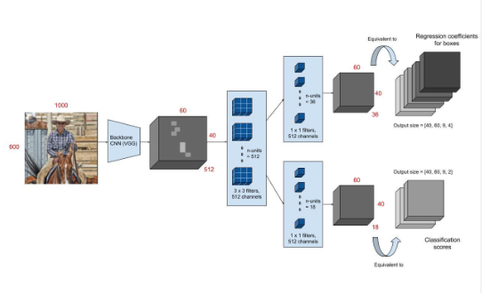
Faster R-CNN – Two-Stage Detection Pipeline
Backbone → RPN → ROI Align → Class + BBox
Anchor-Based Proposals
High Localization Accuracy
Sequential Pipeline Increases Latency
Strong Benchmark Model

Slide 4
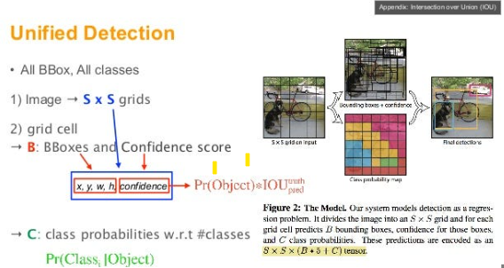
YOLO – Single-Stage Real-Time Paradigm
Unified Detection in Single Forward Pass
Grid-Based Prediction Mechanism
Objectness + Bounding Box Regression
YOLOv8: Anchor-Free Detection Head
Optimized for Deployment

Slide 5
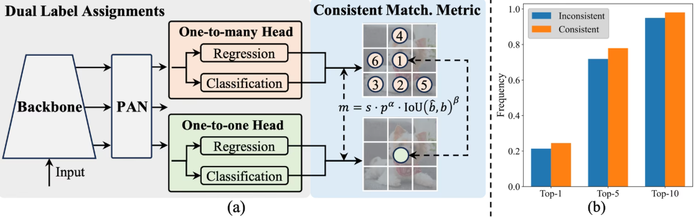
YOLOv10 – Latency Optimized Detection (2024)
NMS-Free Training Strategy
Structural Re-Parameterization
Improved Real-Time Efficiency
Edge & Production Optimization Focus

Slide 6
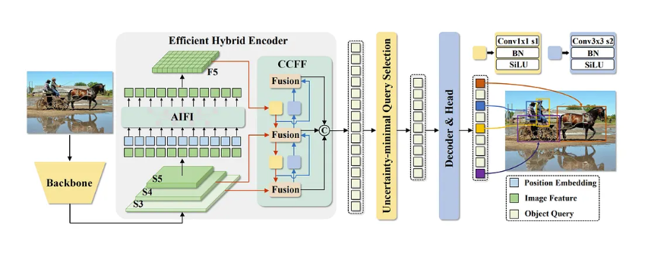
RT-DETR – Transformer-Based Detection
End-to-End Detection Architecture
Hungarian Matching (Set Prediction)
Eliminates NMS
Global Attention Mechanism
Bridging CNN & Transformer Paradigms

Slide 7
Architectural Comparison – Detection Models
Model | Type | Latency Profile | Key Property
Faster R-CNN | Two-Stage | High Latency | Anchor-Based
YOLOv8n | Single-Stage | Low Latency | Anchor-Free
RT-DETR | Transformer | Medium-High | NMS-Free
YOLOv10n | Single-Stage | Very Low | Optimized End-to-End

