Slide 1
R.SHRUTI
Final Project
3/21/2024 Annual Review

Slide 2
PROJECT TITLE
Facial Recognition using CNN

Slide 3
AGENDA
The aim of this project is to develop a facial recognition system using Convolutional Neural Networks (CNNs) that accurately identifies and verifies individuals from images or video streams. The system will be capable of robustly recognizing faces under varying conditions such as different lighting, poses, and facial expressions, with the ultimate goal of achieving high accuracy and efficiency in real-world applications.

Slide 4

PROBLEM STATEMENT
In the realm of facial classification using Convolutional Neural Networks (CNNs), the challenge lies in developing a system capable of accurately categorizing facial images into predefined classes or labels. Existing systems often encounter difficulties in handling variations in facial expressions, poses, lighting conditions, and image quality, which can lead to decreased classification accuracy. Moreover, issues related to overfitting, class imbalance, and generalization to unseen data pose additional hurdles in achieving reliable classification performance. Hence, there is a pressing need to design and implement a facial classification system utilizing CNNs that effectively addresses these challenges, aiming to achieve high accuracy and robustness across diverse datasets and real-world scenarios.

Slide 5

PROJECT OVERVIEW
Project aims to explore and compare neural network models for accurate facial classification in diverse applications.
1: Build a Shallow FCNN
Develop a FCNN with one hidden layer and ReLU activation.
Classify facial images using the FCNN model.
2: Construct a CNN
Design a CNN architecture comprising convolutional and pooling layers.
Specify parameters such as kernel size, stride size, and number of filters.
Compare model size and parameters between FCNN and CNN architectures.
Analyze theoretical strengths and drawbacks of CNNs for handling image data.
3: Visualize Convolutional Layer Filters
Visualize the weights (filters) connecting input images to each kernel in the convolutional layer.
Explain how each filter is applied to the input image to extract features.
4: Analyze Convolutional and Pooling Layer Outputs
Visualize the output after the convolution operation and max-pooling.
Describe how each layer transforms the input data, leading to feature extraction and dimensionality reduction.

Slide 6
OBJECTIVE:
Law Enforcement and Security Agencies:
Facial recognition technology assists law enforcement and security agencies in identifying suspects, monitoring public spaces, and enhancing public safety through proactive crime prevention measures.
Border Control and Immigration:
Facial recognition systems support border control and immigration authorities in verifying travelers' identities, detecting fraudulent documents, and enhancing border security by accurately identifying individuals crossing international borders.
Access Control and Authentication:
Facial recognition enables secure access control and authentication in various settings such as airports, government buildings, and corporate offices, enhancing security and preventing unauthorized access to sensitive areas and information.
Customer Experience and Personalization:
Businesses leverage facial recognition technology to enhance customer experience and personalize services by identifying and recognizing loyal customers, tailoring marketing messages, and offering personalized recommendations based on customer preferences and demographics.
Healthcare and Medical Diagnosis:
Facial recognition aids healthcare professionals in patient identification, medical diagnosis, and monitoring patient health by analyzing facial expressions, detecting signs of pain or discomfort, and facilitating telemedicine consultations for remote patient care.
Entertainment and Gaming:
Facial recognition technology enhances entertainment and gaming experiences by enabling personalized avatars, character recognition, and immersive augmented reality interactions, creating engaging and interactive user experiences.

Slide 7
YOUR SOLUTION AND ITS VALUE PROPOSITION
1. Cutting-edge Facial Recognition:
Our solution employs advanced facial recognition technology for accurate identification in real-world scenarios.
2. Enhanced Security:
Strengthen security measures and access control with reliable facial recognition capabilities.
3. Personalized Customer Experience:
Streamline authentication and offer tailored services for improved customer satisfaction.

Slide 8
The Wow Factor in Your Solution
1. Real-Time Recognition Accuracy:
Achieve unparalleled accuracy in facial recognition with our cutting-edge algorithms, ensuring swift and precise identification even in dynamic and challenging environments.
2. Scalability and Versatility:
Our solution is highly scalable and adaptable to various industries and use cases, offering seamless integration with existing systems and customizable features to meet diverse needs.
3. Robust Performance in Complex Environments:
Experience exceptional performance in complex scenarios, including low light conditions, varying angles, and crowded spaces, thanks to our advanced facial recognition technology's robustness and reliability.
4. Advanced Features for Enhanced Security:
Explore advanced features such as emotion detection, age estimation, and gender recognition, providing comprehensive insights and enhancing security measures beyond traditional identification capabilities.

Slide 9
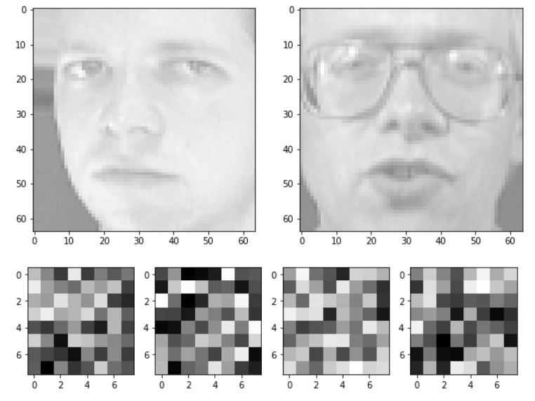
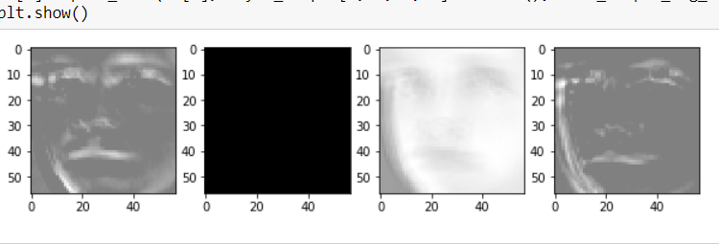
Results

Slide 10
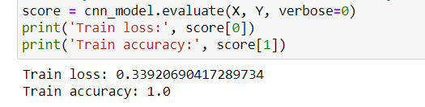
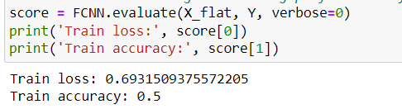
Accuracy of the model
CNN VS FCNN

