Slide 1

Deep Diving into DOM based XSS
-By
Shrutirupa Banerjiee

Slide 2
whoami
Web Application Security Research, WAF Research, Qualys
InfosecGirls Pune Chapter Lead
More than 2.5 years of experience
Speaker/Trainer at Conferences such as Bsides Singapore, OWASP Seasides, RootConf, Encypher 20, Cyberfrat and various meetups.

Slide 3
WHY this topic???
DOM has always been confusing
Definitions are easier to understand but complicated while playing real
We will understand the concept in a very simpler way

Slide 4

What is DOM???

Slide 5
DOM
Document
Object
Model
Ex: A web page
Every web page resides inside a browser window
A hierarchy
The way a document content is accessed and modified by the browser is called the Document Object Model

Slide 6
In short…
DOM is a way JavaScript sees its page’s data
it is a data representation of the objects that comprise the structure and content of a document on the web.

Slide 7
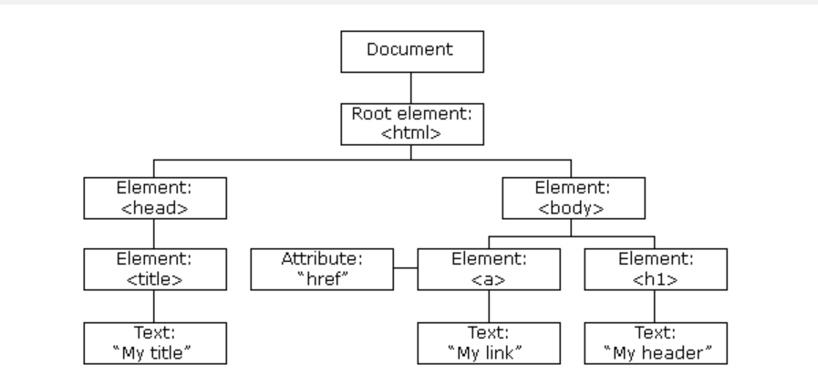

Slide 8
Debugger
It is used to examine the state of the program while it is running
We are using -> Developer’s tool – Chrome

Slide 9


Slide 10
It does not get reflected - we can’t find it in the source code
It helps to visualize what is happening at the DOM level

Slide 11
How do you do it?
You set the break point
You run the application with the payload
Analyze how the payload is working in the debugger by clicking on each step

Slide 12
Demo

Slide 13
References:
https://developer.mozilla.org/en-US/docs/Web/API/Document_Object_Model/Introduction
https://dev.to/joshcarvel/properly-understanding-the-dom-2cg0
https://www.tutorialspoint.com/javascript/javascript_html_dom.htm

Slide 14


Slide 15
Thank you

