Slide 1
Blockchain 101
-Shrutirupa BANERJIEE

Slide 2

$ whoami
Web Application Security Analyst, WAF Research, Qualys
InfosecGirls Chapter Lead, Pune
Mentor at CyberPreserve
Lead in Breaking Barriers, Lean – in Circle
WomenWhoCode, Pune Lead
Speaker/ Trainer
Blogger at https://shrutirupa.me

Slide 3


Slide 4
Blockchain
Chain of Blocks
Blocks are linked together with the help of hashes
The hash of each block is linked to it’s previous hash

Slide 5
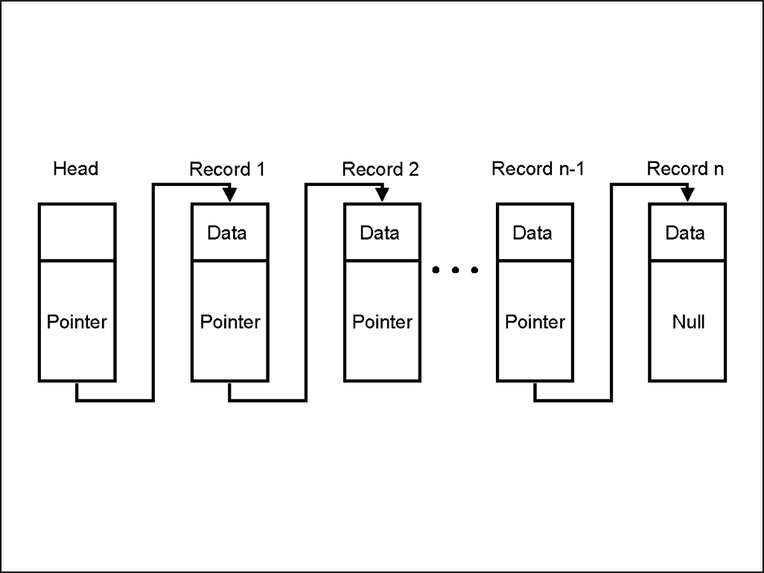

Slide 6
Key Points
Decentralised
Immutable
Transparent
Anonymous
Distributed Ledger

Slide 7
block
Transaction data is recorded in blocks
Formed by miners
a block is composed of a header and a long list of transactions.
The header contains metadata about a block.

Slide 8
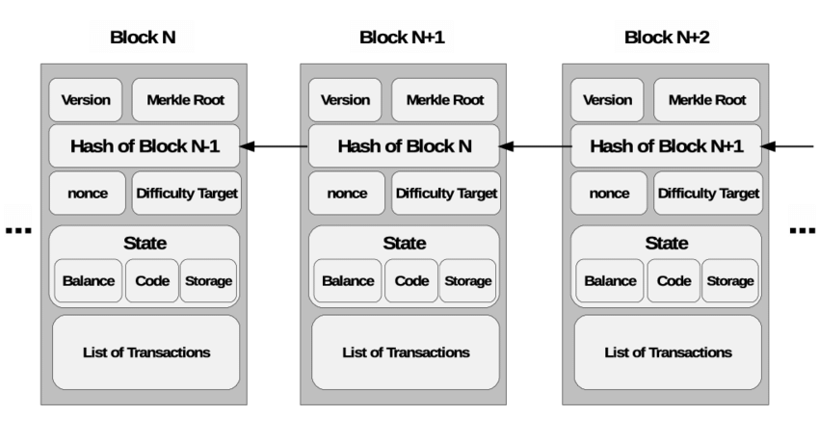

Slide 9
hashes
Hash is used to maintain the integrity of the blockchain
It is a one-way function
For every new block that is generated afterward, the previous block’s hash is also used, as well as its own transactions, as input to determine its block hash.
The first block ever created is known as the Genesis block

Slide 10
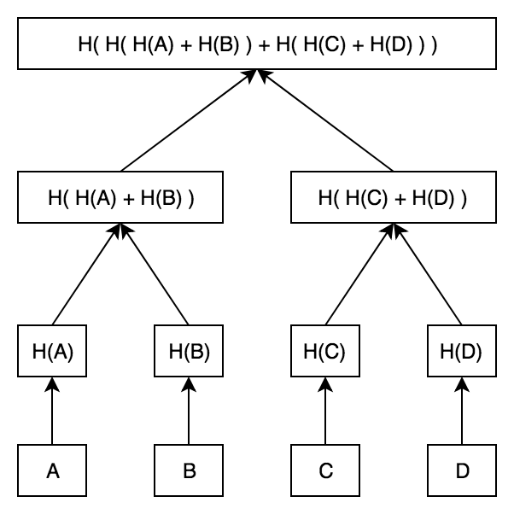
MERKEL Tree
Hash of all the hashes of all the transactions that are part of a block in a blockchain network.
Helps in verifying the data on a Merkle tree.

Slide 11
mining
Solving a computational problem which allows them to chain together blocks of transactions
This process is done to verify and validate a transaction in a block within the blockchain
Miners perform mining and are rewarded with newly created Bitcoins and transaction fees

Slide 12
wallets
A cryptocurrency wallet is a software program that stores private and public keys and interacts with various blockchain to enable users to send and receive digital currency and monitor their balance.
cryptocurrency wallets don’t actually contain any coins. Instead, they hold the keys necessary to conduct any kind of transaction and manage your digital currency.

Slide 13
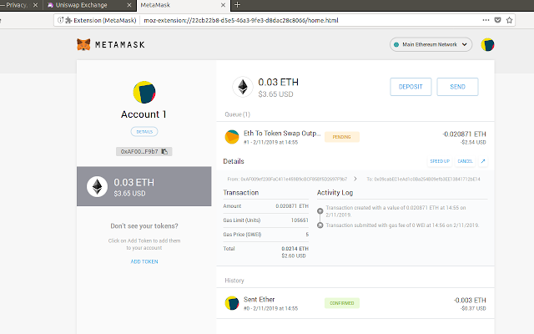

Slide 14
ONCE IN A BLOCKCHAIN, ALWAYS IN THE BLOCKCHAIN

Slide 15
Evolution of blockchain
Blockchain 1.0
Blockchain 2.0
Blockchain 3.0
Blockchain 4.0

Slide 16
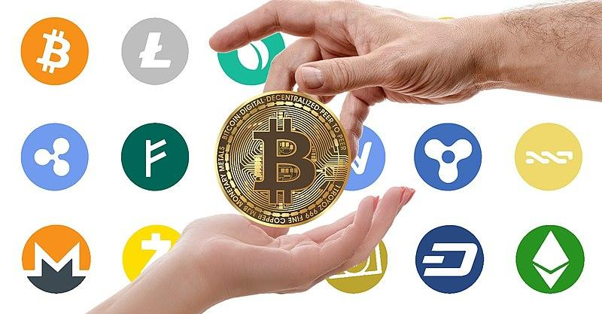
Blockchain 1.0 : cryptocurrency
Bitcoin
Digital asset designed to work as a medium of exchange
It is not controlled by any central authority
It is sent directly between two parties using public and private keys

Slide 17
BLOCKCHAIN 2.0: Smart Contracts
Introduced in Ethereum Blockchain Platform
Smart Contracts are pieces of code
Computerized transaction protocol
Works on conditions
Smart Contracts are written in Solidity/Vyper Language

Slide 18
BLOCKCHAIN 3.0: DAPPS
decentralized application avoiding centralized infrastructure
It uses decentralized storage and decentralized communication

Slide 19
BLOCKCHAIN 4.0: Making blockchain usable in industry
Industry 4.0 meaning in short terms automation, enterprise resource planning, and integration of different execution systems.

Slide 20
Some famous blockchain platforms
Ethereum
Hyperledger
Quorum
Corda
Ripple

Slide 21
Career in blockchain?
Developer
Blockchain Developer
Smart Contract Developer
Dapp Developer
Analyst
Risk Analyst
Business Analyst
Security
Smart contract Code review
Dapps security

Slide 22
CONTACT ME
LinkedIn – https://www.linkedin.com/in/shrutirupa-banerjiee/
Twitter – @freak_crypt
https://shrutirupa.me

Slide 23


Slide 24

THANK YOU

