Slide 1

INSTITUTE ENGINEERING
DEPARTMENT ACADEMIC UNIT-1
Bachelor of Engineering (Computer Science & Engineering)
Subject Name BEEE and Code ELT-112
Er. Navjeet Kaur
DC and AC CIRCUITS
DISCOVER . LEARN . EMPOWER

Slide 2
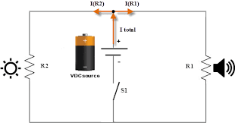
COURSE OBJECTIVES
Course Outcome
CO Number | Title | Level
CO1 | Students will be able to establish the equations that characterize the performance of an electric circuit as well as solving both single phase and three-phase AC circuits in sinusoidal steady state. | Remember
CO2 | Students will be made aware about the electrical safety and implementation of electric wiring. | Understand
CO3 | Introducing students to the areas of rotating electric machines, with application of motors in particular, transducers and electric batteries. | Understand
CO4 | Comprehension of different applications of Op-amps in electronic circuits and its interfacing with A/D-D/A converters.. | Understand
https://library.automationdirect.com/basic-electrical-theory/

Slide 3
LEARNING OUTCOMES
To make students understand the
Concepts of electricity and relate them to practical engineering systems.
Importance of comprehension of electrical systems from electrical safety point of view.
Fundamentals of electric current and its associated quantities.

Slide 4
CONTENT
1. Why electricity is important?
2. Electrical Current and Potential difference
3. How potential difference results in current?
4. Sources of potential difference in Electrical Engg.
5. Relationship between potential difference and current
6. Concept of resistance and Ohms Law
7. Advantages of AC over DC
8. Generation of AC
9.Features of AC
10. Summary
11. Application areas of electricity.

Slide 5
Why electricity is important.
ELECTRICITY IS EVERYWHERE.
There are billions of electrons flowing all around you :
in corridor and room lights, television monitors , oscilloscopes , ventilator controls, the computer screen and so on.
Video in next slide gives a glimpse how electricity is imp. In our lives.

Slide 6
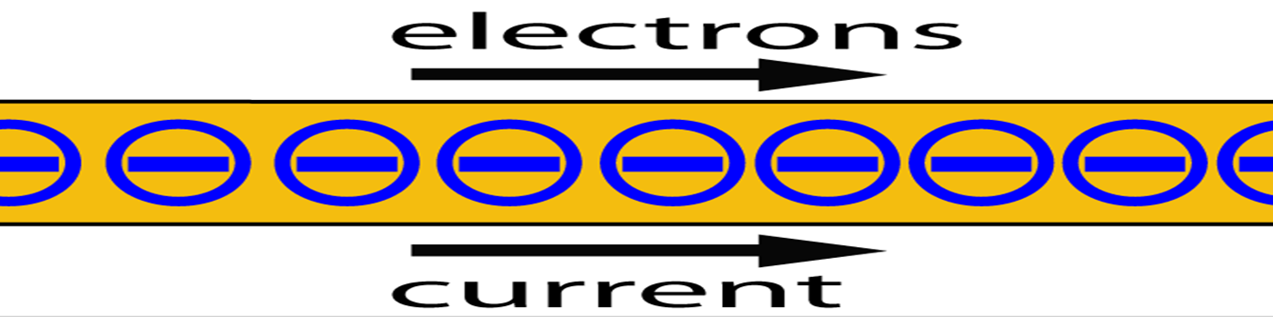
Electric Current
Let us start by explaining what electric current is
When we say that an electrical “current” is flowing, what is it that is actually flowing ? Current is the flow of electrons. Electrons can be thought of as negatively charged “particles”. The movement of these electrons is called current.
Source of
fig:-https://www.howequipmentworks.com/electricity_bas
ics/

Slide 7
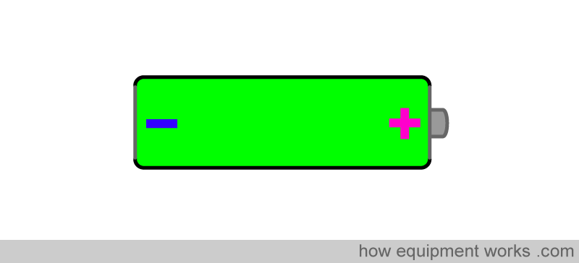
How potential difference results in electric current
A common potential difference source is the common disposable battery. Mostly batteries are used to power the light bulb.
Source of
fig:-https://www.howequipmentworks.com/electricity_basics

Slide 8
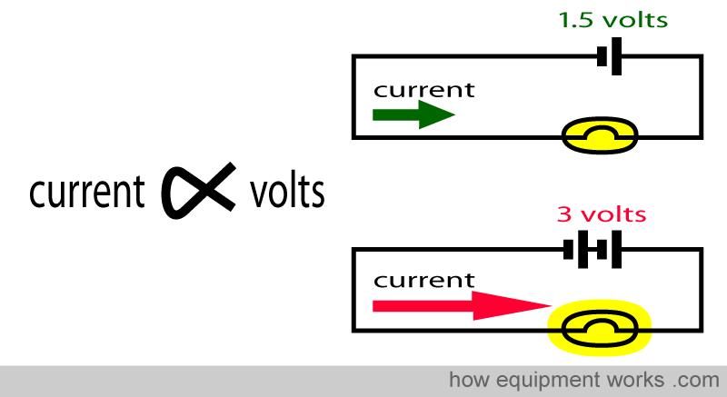
Relationship between potential difference and current
Higher the potential difference, more electrons will flow. Take the example below. In the top circuit, the potential difference is 1.5 volts and this results in a certain current flow. In the bottom circuit, the potential difference is doubled to 3 volts. This doubles the current flow, making the bulb light up brighter.
Source of
fig:-https://www.howequipmentworks.com/electricity_basics

Slide 9
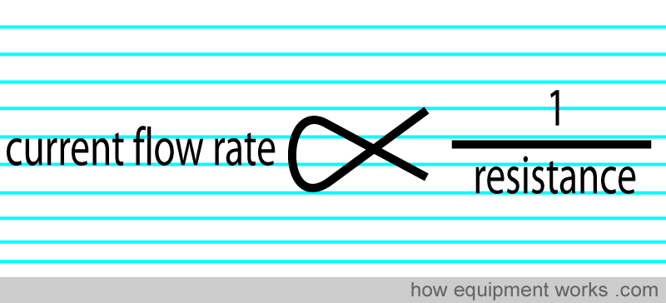
Concept of Resistance
In the world of electricity, there are three friends that are always present together and affect each other. We have already discussed two of them, i.e. current (amperes) and potential difference (volts). Now let us discuss the third friend, called resistance
Source of
fig:-https://www.howequipmentworks.com/electricity_basics

Slide 10
Ohms Law
Ohms Law states that: Current flow through a conductor (wire) between two points is directly proportional to the potential difference across the two points, and inversely proportional to the resistance between them provided the physical conditions like temperature remain constant.
V= IR

Slide 11
ADVANTAGES OF AC CIRCUIT OVER DC CIRCUIT
We all know that we got ac supply in our homes and we got this supply by transmitting ac over long distances. AC can be transmitted using step up transformers but direct current or dc can not be transmitted by this method.
The ac is easy to generate than dc.
It is cheaper to generate ac than dc.
The ac generators have higher efficiency than dc.
The loss of energy during transmission is negligible for ac.
The ac can be easily converted into dc.
The variation of ac can easily be done using transformers either step up or step down.
The value or magnitude of ac can be decreased easily without loss of excess of energy. This can be done by using choke coil.

Slide 12
KIRCHOFF’S LAWS
When given a circuit with sources and resistors having fixed values, you can use Kirchoff’s two laws and Ohm’s law to determine all branch voltages and currents
Node – any point where 2 or more circuit elements are connected together
Wires usually have negligible resistance
Each node has one voltage (w.r.t. ground)
Branch – a circuit element between two nodes
Loop – a collection of branches that form a closed path returning to the same node without going through any other nodes or branches twice

Slide 13
Kirchoff’s Voltage Law (KVL)
The algebraic sum of voltages around each loop is zero
Beginning with one node, add voltages across each branch in the loop (if you encounter a + sign first) and subtract voltages (if you encounter a – sign first)
Σ voltage drops - Σ voltage rises = 0
Or Σ voltage drops = Σ voltage rises

Slide 14
Kirchoff’s Current Law (KCL)
The algebraic sum of currents entering a node is zero
Add each branch current entering the node and subtract each branch current leaving the node
Σ currents in - Σ currents out = 0
Or Σ currents in = Σ currents out

Slide 15
Electric Circuit
It is a closed path, composed of active and passive elements.
Active Element : It supplies energy to the circuit.
Passive Element : It receives energy and then
1) either converts it to heat, as in a Resistance (R).
2) or stores it in
(a) Electric Field, as in a Capacitor (C).
(b) Magnetic Field, as in an Inductor (L).

Slide 16
Energy Sources
Classification
Independent Source Or Dependent Source
Voltage Source Or Current Source
DC Source Or AC Source
Ideal Source Or Practical Source

Slide 17
Independent Ideal Voltage Source
Note that the source determines the voltage, but the current is determined by the load. The source has zero internal resistance.
https://www.tutorialspoint.com/network_theory/network_theory_active_elements.htm

Slide 18
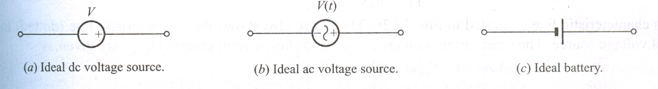
IDEAL DC SOURCE
The voltage source is said to be idle if the output terminals are open such that i = 0.
When turned off (killed or made inactive), so that v = 0, it is equivalent to a short circuit.
Reference Marks : One terminal is marked plus and the other minus. (Oversimplification; one mark can be omitted.)
When actual polarity is opposite to the reference marks, the voltage is a negative number.
https://www.tutorialspoint.com/network_theory/network_theory_active_elements.htm

Slide 19
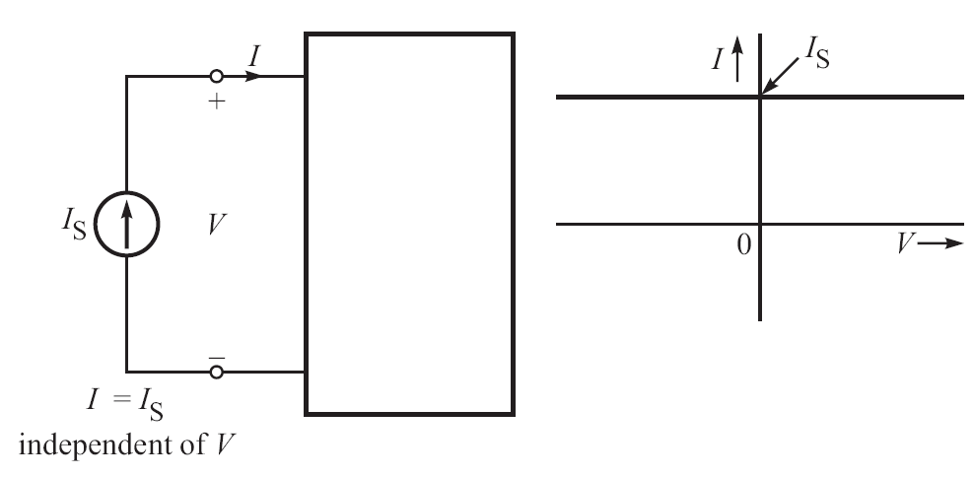
Independent Ideal Current Source
That the source determines the current, but the voltage is determined by the load. The Source has infinite internal resistance (R_{i}).
https://www.tutorialspoint.com/network_theory/network_theory_active_elements.htm

Slide 20
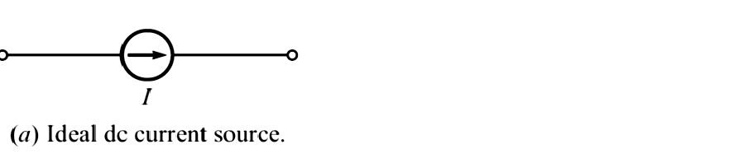
IDEAL DC CURRENT SOURCE
The current source is said to be idle if the output terminals are shorted together, such that v = 0.
When turned off (killed or made inactive), so that i = 0, it is equivalent to an open circuit.
Reference Marks : An arrow is put.
When actual direction of current is opposite to the reference (arrow) direction, the current is a negative number.
http://www.expertsmind.com/learning/dc-current-source-assignment-help-7342874024.aspx

Slide 21
GENERATION OF SINGLE PHASE
Consider a rectangular coil of N turns placed in a uniform magnetic field as shown in the figure. The coil is rotating in the anticlockwise direction with angular velocity.
When the coil is in the vertical position, the flux linking the coil is zero.
When the coil moves by some angle in the anticlockwise direction, there is a rate of change of flux linking the coil and hence an emf is induced in the coil.
When the coil reaches the horizontal position, the flux linking the coil is maximum, and hence the emf induced is also maximum.

Slide 22
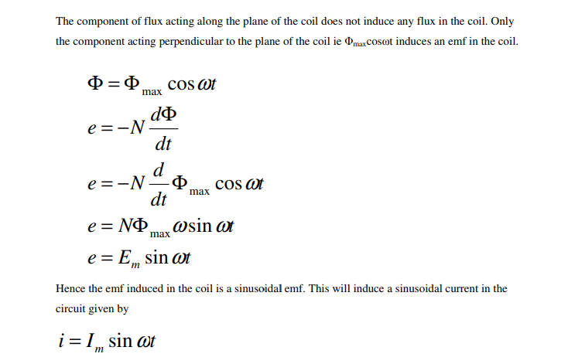
The generation of sinusoidal AC voltage can also be explained using mathematical equations.

Slide 23
Characteristics of a Sine Wave
The length of time it takes to complete one cycle or conversely the number of cycles that occur in one second.
Period
Frequency
Angular Frequency
The maximum and minimum voltage or current swing
Amplitude
Peak-to-peak amplitude
Value of the root mean square (RMS)
Average value of a sine wave
DC offset
Comparison between two sine waves
Phase angle
Lagging and leading signals

Slide 24
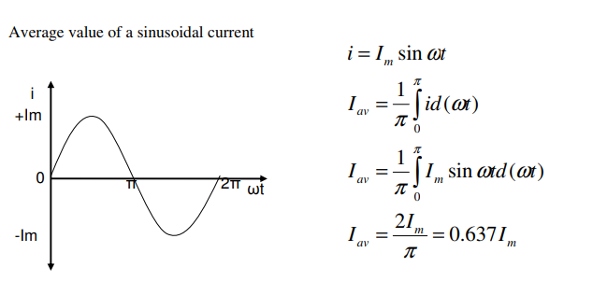
Average Value
The average value of a sinusoid signal is the integral of the sine wave over one full cycle. This is always equal to zero.
If the average of an ac signal is not zero, then there is a dc component known as a DC offset
https://electricalbaba.com/average-value-ac-current/

Slide 25
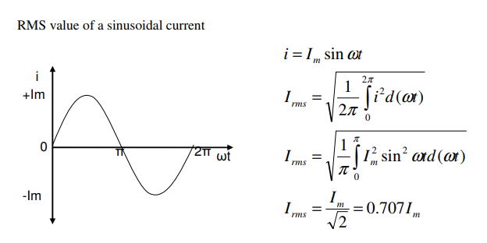
RMS VALUE
The effective or RMS value of an alternating quantity is that steady current (dc) which when flowing through a given resistance for a given time produces the same amount of heat produced by the alternating current flowing through the same resistance for the same time.
https://notes.tyrocity.com/

Slide 26
Phase Angle
. The phase angle is an angular measurement of the position of one sinusoid signal with respect to a reference.
The signal and reference must have the same frequency

Slide 27
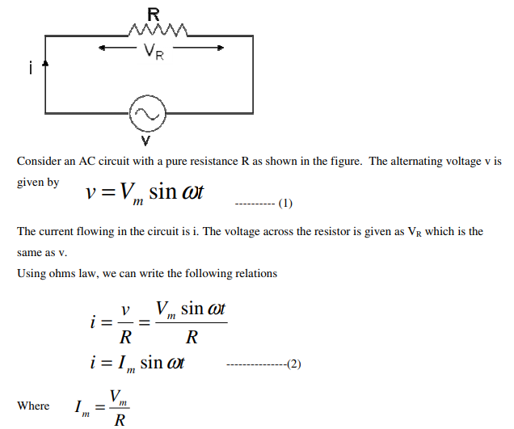
Pure resistive circuit
https://circuitglobe.com/what-is-pure-resistive-ac-circuit.html

Slide 28
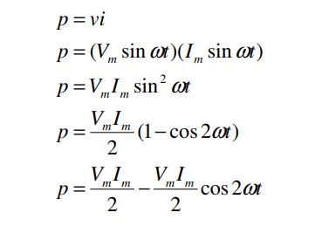
Power in Pure resistive circuit
https://circuitglobe.com/what-is-pure-resistive-ac-circuit.html

Slide 29
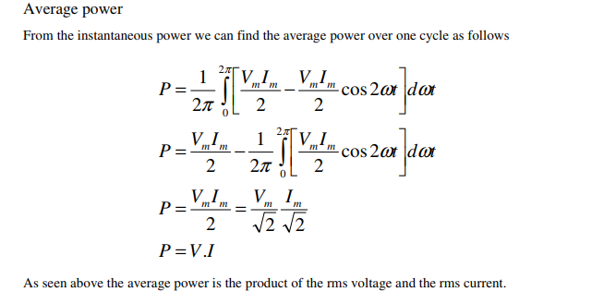
Average power in pure resistive
https://circuitglobe.com/what-is-pure-resistive-ac-circuit.html

Slide 30
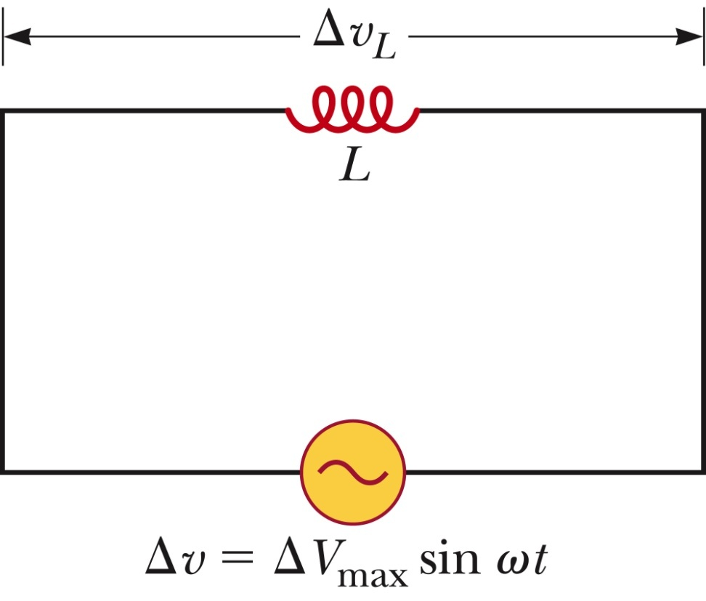
Pure inductive circuit
Kirchhoff’s loop rule can be applied and gives:
https://circuitglobe.com

Slide 31
Current in an Inductor
This shows that the instantaneous current i_{L} in the inductor and the instantaneous voltage Δv_{L} across the inductor are out of phase by (p/2) rad = 90^{o.}
https://circuitglobe.com

Slide 32
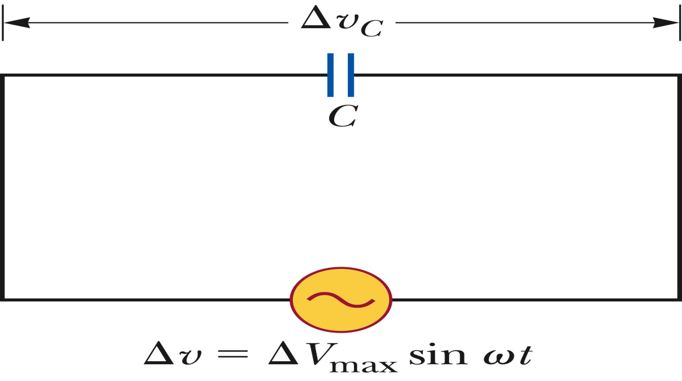
Pure Capacitive Circuit
The circuit contains a capacitor and an AC source.
Kirchhoff’s loop rule gives:
Δv + Δv_{c} = 0 and so
Δv = Δv_{C} = ΔV_{max} sin ωt
Δv_{c} is the instantaneous voltage across the capacitor.
https://circuitglobe.com

Slide 33
Capacitors in an AC Circuit
The charge is q = CΔV_{max} sin ωt
The instantaneous current is given by
The current is π/2 rad = 90º out of phase with the voltage

Slide 34
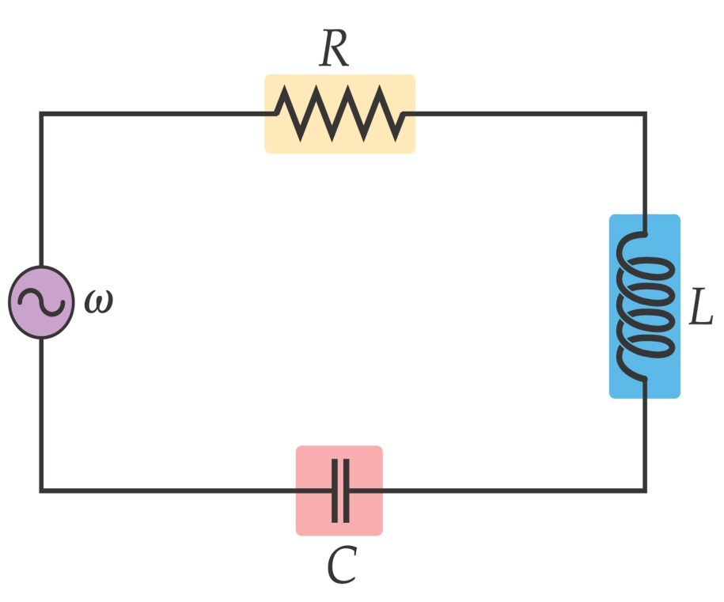
RLC Circuit
https://circuitglobe.com

Slide 35
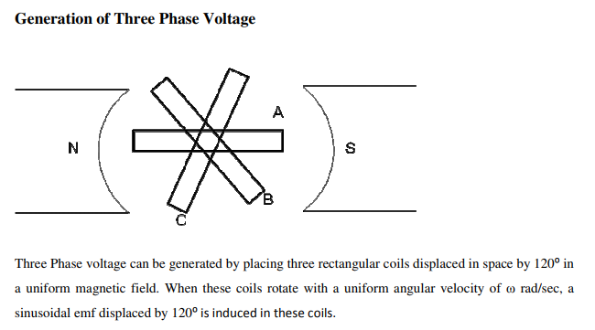
GENERATION OF THREE PHASE
https://circuitglobe.com

Slide 36
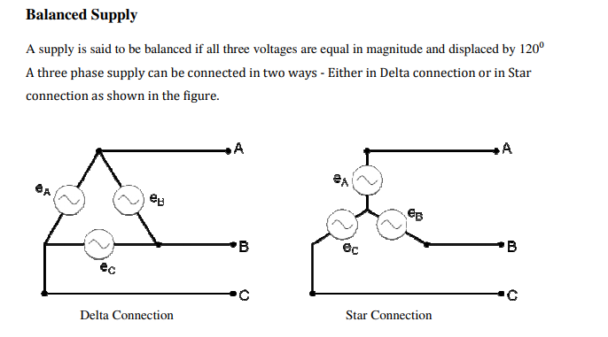
TYPES OF CONNECTION
https://circuitglobe.com

Slide 37
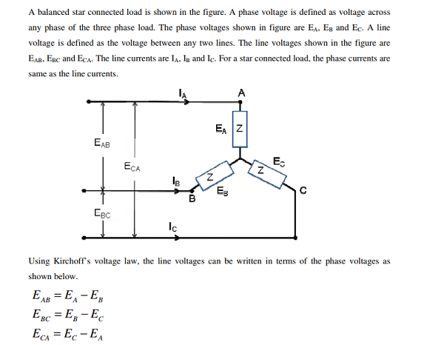
STAR CONNECTION
https://www.allaboutcircuits.com/

Slide 38
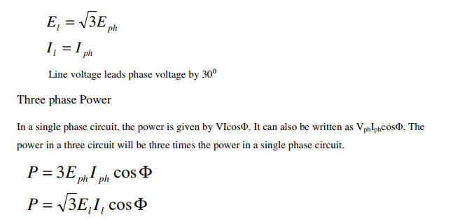
EQUATIONS OF CURRENT AND POWER IN STAR
https://www.allaboutcircuits.com/

Slide 39
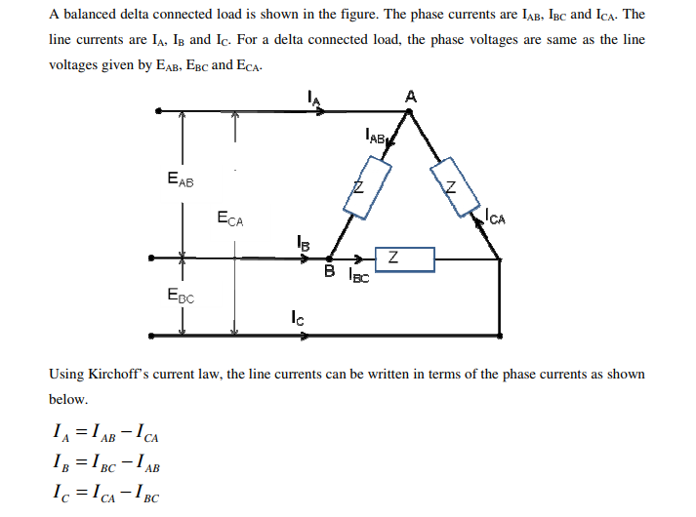
DELTA CONNECTION
https://www.allaboutcircuits.com/

Slide 40
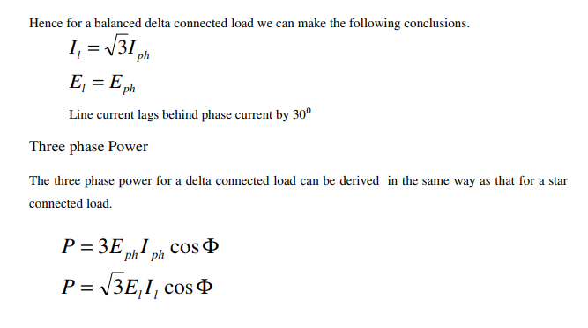
REALTIONSHIP OF CURRENT AND POWER IN DELTA CONNECTION
https://www.allaboutcircuits.com/

Slide 41
ASSESSMENT PATTERN
S.NO | ELEMENT | MARKS
1. | MST-1 | 36
2. | MST-2 | 36
3. | ASSIGNMENT(1+2+3) | 12
4. | SURPRISE TEST | 9
9 | TUTORIAL TEST | 9
6. | QUIZ | 12

Slide 42
APPLICATIONS
In DC circuits, electricity flows in constant direction with a fixed polarity that doesn’t vary with time. A DC Circuit uses steady current components like resistors and resistor combinations; transient components like inductors and capacitors; indicating meters like moving coil voltmeters and ammeters; power supply battery sources, and so on.
For analyzing these circuits, different tools like ohms law, voltage and current laws like KCL, KVL.
AC circuit behavior can also be analyzed by combining the above circuits like RL, RC and RLC circuits in series as well as in parallel combinations. And also the equations and formulas of the above circuits are exempted in this article to reduce the complexity, but the overall idea is to give a basic concept about the electrical circuits.
How to use intuition to describe the approximate time and frequency behavior of second-order circuits containing energy storage elements (capacitors and inductors)

Slide 43
REFRENCES
https://library.automationdirect.com/basic-electrical-theory/
fig:-https://www.howequipmentworks.com/electricity_basics/
https://www.tutorialspoint.com/network_theory/network_theory_active_elements.htm
https://www.howequipmentworks.com/electricity_basics
https://notes.tyrocity.com/

Slide 44
THANK YOU
For queries
Email: Manjeet.e7825@cumail.in

