Slide 1

INSTITUTE ENGINEERING
DEPARTMENT ACADEMIC UNIT-1
Bachelor of Engineering (Computer Science & Engineering)
Subject Name BEEE and Code ELT-112
Er. Navjeet Kaur
ELECTRICAL SAFETY
DISCOVER . LEARN . EMPOWER

Slide 2
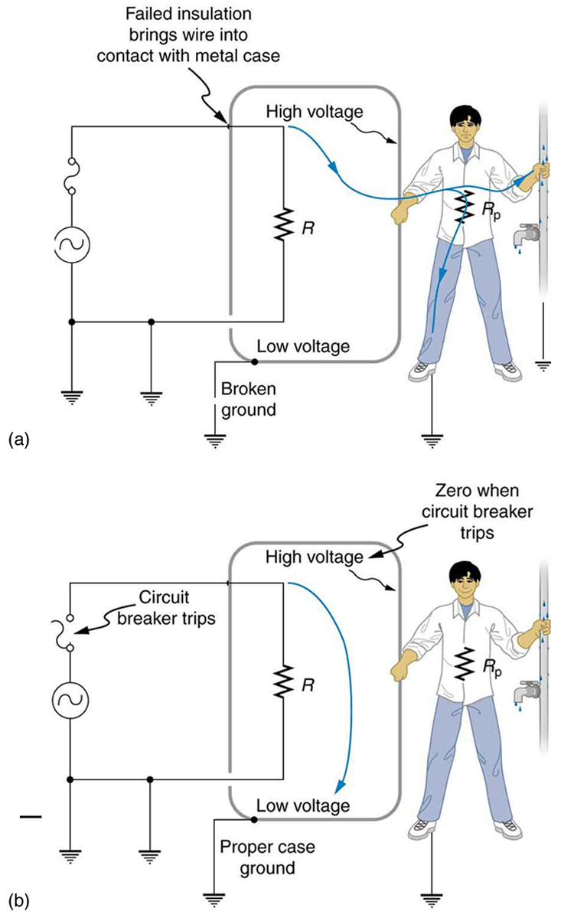
ELECTRICAL SAFETY AND WIRING SYSTEM
Course Outcome
CO Number | Title | Level
CO1 | Students will be able to establish the equations that characterize the performance of an electric circuit as well as solving both single phase and three-phase AC circuits in sinusoidal steady state. | Remember
CO2 | Students will be made aware about the electrical safety and implementation of electric wiring. | Understand
CO3 | Introducing students to the areas of rotating electric machines, with application of motors in particular, transducers and electric batteries. | Understand
CO4 | Comprehension of different applications of Op-amps in electronic circuits and its interfacing with A/D-D/A converters.. | Understand
Will be covered in this lecture

Slide 3
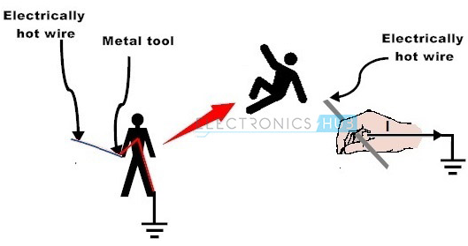
Electrical Safety
Electrical hazards are categorized into shocks, burns and electrocutions.
Electrical Shock
Burns
Electric Arc Blast
https://www.shutterstock.com/s

Slide 4
Electrical Safety Measures
Always use safety equipment and avoid the direct contact with live or energized circuits.
Have the skills and techniques to distinguish the exposed live parts of the electrical equipment.
Disconnect the source supply while installing or connecting wires.
The power supplied to the installation must be controlled on the main switchboard which should consist of circuit breaker.
Conductive tools and materials must be kept at a safe distance from live parts of the circuit or equipment.
Use non-conductive hand tools for which they are rated to perform electrical work. If they are used for voltage (or current) rating other than rated, the insulation strength of the tool breakdown and causes electric shock.

Slide 5
Electrical Wiring
Electrical wiring is the electrical power distribution through the wires in a perfect manner for economic use of wiring conductors inside a room or building with better load control.
Electrical wiring system is classified into five categories:
Cleat wiring
Wooden casing and capping wiring
CTS or TRS or PVC sheath wiring
Lead sheathed or metal sheathed wiring
Conduit wiring
Surface or open Conduit type
Recessed or concealed or underground type Conduit

Slide 6
Electrical Wiring
Cleat Wiring
Material Used in Cleat Wiring
VIR or PVC insulated wires
Weather proof cables
Porcelain cleats or plastic cleats (two or three grooves)
Screws
Advantages of Cleat Wiring
Cheap and easy wiring
Easy to fault detection
Easy to repair
Alteration and addition is easy.
Disadvantages of Cleat Wiring
Bad appearance
Exposed to weather to be affected by humidity, rain, smoke, sunlight etc
Chances for shock or fire
Used in only 220V in low ambient temperature.
Not long lasting Sag happens

Slide 7
Electrical Wiring
2: Casing and Capping Wiring
Material Used in Casing Wiring
VIR or PVC insulated wires
Casing Enclosure (made of wood or plastic)
Capping (made of wood or plastic)
Casing and capping joints.
Advantages of Casing Wiring
Cheap and easy to install
Strong and durable wiring
Customization can be done easily
Safe from smoke, dust, rain and steam etc.
Due to casing and capping no risk of shock.
Disadvantages of Casing Wiring
Very costly
Not suitable for weather with high humidity and acidic conditions.
Insect like termites or ants can damage wooden casing and capping.
High risk of fire.

Slide 8
Electrical Wiring
3:CTS or TRS or PVC sheath wiring
Material Used in Batten Wiring
CTS or TRS cable
Straight teak wooden batten (at 10 mm thick)
Tinned brass link clip ( buckle clip)
Brass pins
Advantages of Batten Wiring
Easy installation
Cheap in material cost
Appearance is better.
Customization is easy
Less chance of leakage current
Disadvantages of Batten Wiring
The disadvantages of batten wiring areNot suitable for outdoor wiring
Humidity, smoke, steam etc directly affect on wires.
Heavy wires are not recommended for this wiring scheme.
Only suitable for below 250 V.

Slide 9
Electrical Wiring
4: Conduit Wiring
Material Used in Conduit Wiring
Metallic Conduit
Class A conduit: thin layer steel sheet low gauge conduit
Class B conduit: thick sheet of steel high gauge conduit
Non-Metallic Conduit 13, 16.2, 18.75, 20, 25, 37, 50 and 63 mm (diameter) PVC conduit.
VIR or PVC insulated cables
GI wire of 18SWG
Screw
Coupling
Elbow
Rigid off set
2-hole strap
Lock nut

Slide 10
Applications
Electrical wiring finds applications in providing electric power supply in industries, commercial complexes and residential areas.
These are the integral part of the Electric Power Distribution Systems.

Slide 11
Neutral, Earthing & Grounding
Neutral is return path for an AC circuit which is supposed to carry current in normal condition.
So Neutral wire is always assumed to be charged (in active circuit).
To connect the metallic (conductive) parts of an Electric appliance or installations to the earth (ground) is called Earthing or Grounding.
In other words, to connect the metallic parts of electric machinery and devices to the earth plate or earth electrode (which is buried in the moist earth) through a thick conductor wire (which has very low resistance) for safety purpose is known as Earthing or grounding.

Slide 12
Earthing or Grounding
Below are the basic needs of Earthing.
To protect human lives as well as provide safety to electrical devices and appliances from leakage current.
To keep voltage as constant in the healthy phase (If fault occurs on any one phase).
To Protect Electric system and buildings form lighting.
To serve as a return conductor in electric traction system and communication.
To avoid the risk of fire in electrical installation systems.
Different Terms used in Electrical Earthing:
Earth
Earthed
Solidly Earthed
Earth Electrode
Earthing Lead
Earth Continuity Conductor
Sub Main Earthing Conductor
Earth Resistance

Slide 13
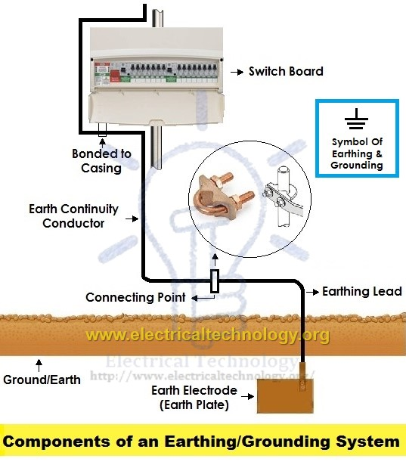
Earthing OR Grounding
Components of earthing system:
A complete electrical earthing system consists on the following basic components.
Earth Continuity Conductor
Earthing Lead
Earth Electrode

Slide 14
ASSESSMENT PATTERN
S.NO | ELEMENT | MARKS
1. | MST-1 | 36
2. | MST-2 | 36
3. | ASSIGNMENT(1+2+3) | 12
4. | SURPRISE TEST | 9
9 | TUTORIAL TEST | 9
6. | QUIZ | 12

Slide 15
Applications
Neutral finds its application in completing the electrical circuit wherever necessary.
Earthing and grounding are very important as far as safety of the personnel is concerned. It also prevents the device and the associated circuitry from damage .

Slide 16
REFRENCES
https://opentextbc.ca
https://www.shutterstock.com/s
WWW.ELECTRICTECHNOLOGY.ORG

Slide 17
THANK YOU
For queries
Email: Manjeet.e7825@cumail.com

