Slide 1

INSTITUTE UIE
DEPARTMENT ACADEMIC UNIT-1
Bachelor of Engineering (Computer Science & Engineering)
Subject Name BEEE and Code ELT-112
Er. Navjeet Kaur
Magnetic Circuits
DISCOVER . LEARN . EMPOWER

Slide 2
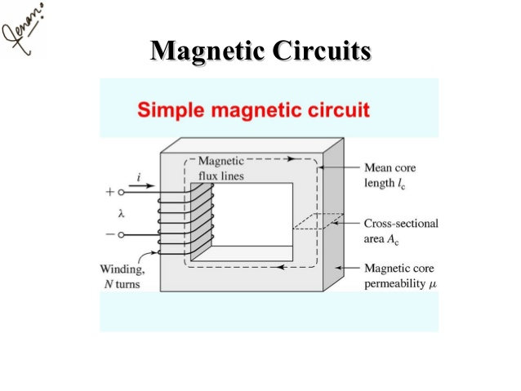
COURSE OBJECTIVES
Course Outcome
CO Number | Title | Level
CO1 | Students will be able to establish the equations that characterize the performance of an electric circuit as well as solving both single phase and three-phase AC circuits in sinusoidal steady state. | Remember
CO2 | Students will be made aware about the electrical safety and implementation of electric wiring. | Understand
CO3 | Introducing students to the areas of rotating electric machines, with application of motors in particular, transducers and electric batteries. | Understand
CO4 | Comprehension of different applications of Op-amps in electronic circuits and its interfacing with A/D-D/A converters.. | Understand
Will be covered in this lecture
https%3A%2F%2Fimage.slidesharecdn.com%2Fmagneticcircuit

Slide 3
MAGNETIC CIRCUIT
A magnetic circuit is made up of one or more closed loop paths containing a magnetic flux. The flux is usually generated by permanent magnets or electromagnets and confined to the path by magnetic cores consisting of ferromagnetic materials like iron, although there may be air gaps or other materials in the path. Magnetic circuits are employed to efficiently channel magnetic fields in many devices such as electric motors, generators, transformers, relays, lifting electromagnets, SQUIDs, galvanometers, and magnetic recording heads.

Slide 4
Magnetic Circuit Definitions
Magnetomotive Force
The “driving force” that causes a magnetic field
Symbol, F
Definition, F = NI
Units, Ampere-turns, (A-t)

Slide 5
Magnetic Circuit Definitions
Magnetic Field Intensity
mmf gradient, or mmf per unit length
Symbol, H
Definition, H = F/l = NI/l
Units, (A-t/m)
Flux Density
The concentration of the lines of force in a magnetic circuit
Symbol, B
Definition, B = Φ/A
Units, (Wb/m²), or T (Tesla)

Slide 6
Magnetic Circuit Definitions
Reluctance
The measure of “opposition” the magnetic circuit offers to the flux
The analog of Resistance in an electrical circuit
Symbol, R
Definition, R = F/Φ
Units, (A-t/Wb)
Permeability
Relates flux density and field intensity
Symbol, μ
Definition, μ = B/H
Units, (Wb/A-t-m)

Slide 7
FARADAYS LAWS OF EMI
The greater the number of flux lines cut per unit time (by increasing the speed with which the conductor passes through the field), or the stronger the magnetic field strength (for the same traversing speed), the greater will be the induced voltage across the conductor.
If the conductor is held fixed and the magnetic field is moved so that its flux lines cut the conductor, the same effect will be produced.

Slide 8
INDUCED VOLTAGES
The inductance of a coil is also a measure of the change in flux linking a coil due to a change in current through the coil
N is the number of turns,  is the flux in webers, and i is the current through the coil
https://www.allaboutcircuits.com/textbook/direct-current/chpt-14/electromagnetic-induction/

Slide 9
ENERGY STORED IN MAGNETIC FIELD
The ideal inductor, like the ideal capacitor, does not dissipate the electrical energy supplied to it. It stores the energy in the form of a magnetic field.
http://energy-stored-in-a-magnetic-field/

Slide 10
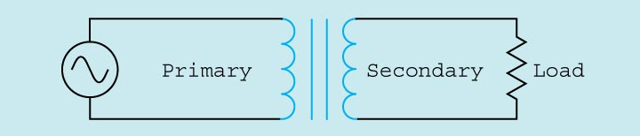
SINGLE PHASE TRANSFORMER
https://www.electronics-tutorials.ws

Slide 11
SINGLE PHASE TRANSFORMER
The primary winding is connected to the incoming power supply.
The secondary winding is connected to the driven load.
This is an isolation transformer. The secondary winding is physically and electrically isolated from the primary winding.

Slide 12
BASIC CONSTRUCTION OF TRANSFORMER
Each set of windings (primary and secondary) is formed from loops of wire wrapped around the core.
Each loop of wire is called a turn.
The ratio of the primary and secondary voltages is determined by the ratio of the number of turns in the primary and secondary windings.
The volts-per-turn ratio is the same on both the primary and secondary windings.
The distribution transformer is a common type of isolation transformer. This transformer changes the high voltage from the power company to the common 240/120 V.

Slide 13
TRANSFORMER FORMULAS
E_{P} / E_{S} = N_{P} / N_{S}
E_{P} x N_{S} = E_{S} x N_{P}
E_{P} x I_{P} = E_{S} x I_{S}
N_{P} x I_{P} = N_{S} x I_{S}
https://www.electronics-tutorials.ws

Slide 14
TRANSFORMER SYMBOLS
N_{P} = number of turns in the primary
N_{S} = number of turns in the secondary
E_{P} = voltage of the primary
E_{S} = voltage of the secondary
I_{P} = current in the primary
I_{S} = current in the secondary

Slide 15
ASSESSMENT PATTERN
S.NO | ELEMENT | MARKS
1. | MST-1 | 36
2. | MST-2 | 36
3. | ASSIGNMENT(1+2+3) | 12
4. | SURPRISE TEST | 9
9 | TUTORIAL TEST | 9
6. | QUIZ | 12

Slide 16
APPLICATIONS
Air gaps can be created in the cores of certain transformers to reduce the effects of saturation. This increases the reluctance of the magnetic circuit, and enables it to store more energy before core saturation. This effect is used in the flyback transformers of cathode-ray tube video displays and in some types of switch-mode power supply.
Variation of reluctance is the principle behind the reluctance motor (or the variable reluctance generator) and the Alexanderson alternator.
Multimedia loudspeakers are typically shielded magnetically, in order to reduce magnetic interference caused to televisions and other CRTs. The speaker magnet is covered with a material such as soft iron to minimize the stray magnetic field.
Reluctance can also be applied to variable reluctance (magnetic) pickups.

Slide 17
REFRENCES
https%3A%2F%2Fimage.slidesharecdn.com%2Fmagneticcircuit
https://www.allaboutcircuits.com/textbook/direct-current/chpt-14/electromagnetic-induction/
http://energy-stored-in-a-magnetic-field/

Slide 18
THANK YOU
For queries
Email: Manjeet.e7825@cumail.in

