Slide 1

UNIVERSITY INSTITUTE OF ENGINEERING
DEPARTMENT AU-1
Bachelor of Engineering (Computer Science & Engineering)
Basics of Electrical & Electronics Engineering
ELT- 112
Er. Akhil Nigam
Rotating Electrical Machines
DISCOVER . LEARN . EMPOWER

Slide 2
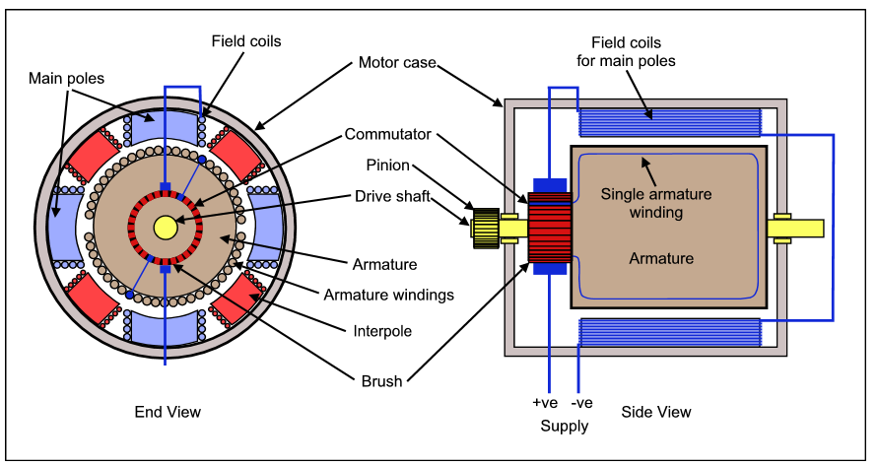
Rotating Electrical Machines
Course Outcome
CO Number | Title | Level
CO1 | Students will be able to establish the equations that characterize the performance of an electric circuit as well as solving both single phase and three-phase AC circuits in sinusoidal steady state. | Remember
CO2 | Students will be made aware about the electrical safety and implementation of electric wiring. | Understand
CO3 | Introducing students to the areas of rotating electric machines, with application of motors in particular, transducers and electric batteries. | Understand
CO4 | Comprehension of different applications of Op-amps in electronic circuits and its interfacing with A/D-D/A converters.. | Understand
http://www.railway-technical.com/trains/rolling-stock-index-l/train-equipment/electric-traction-control-d.html

Slide 3
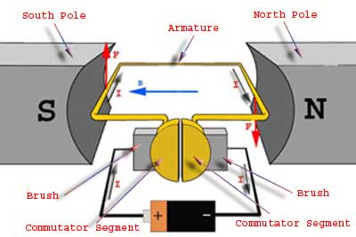
WORKING PRINCIPLE OF DC MOTOR
A DC motor is an electrical machine which converts electrical energy into mechanical energy. The working of DC motor is based on the principle that when a current carrying conductor is placed in a magnetic field, it experiences a mechanical force.
https://www.meee-services.com/quick-learning-dc-motors-work/

Slide 4
CHARACTERISTICS OF DC MOTOR
Motor is machine which convert electrical energy into mechanical energy.
Now the important characteristics of dc motor are:
(1) Torque/ Armature current ( T / Ia )
(2) Speed / Armature current ( N / Ia )
(3) Speed / Torque ( N / T )
These characteristics are determined by keeping the following two relations in mind. T_{a} ∝ ɸ.I_{a} and N ∝ E_{b}/ɸ

Slide 5
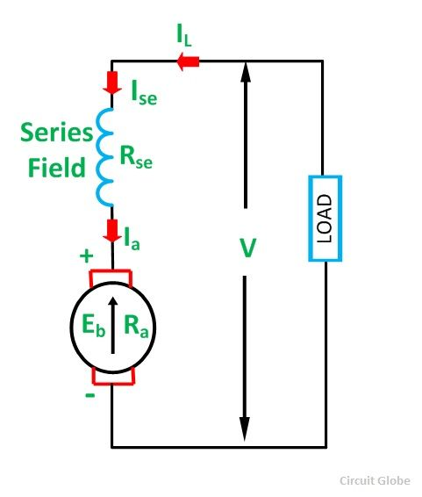
CHARACTERISTICS OF DC SERIESMOTOR
a) Torque Vs. Armature Current (T_{a}-I_{a})
This characteristic is also known as electrical characteristic.
In series motor
T α ØI_{a}
Ø α I_{a}
T α I_{a}².
After saturation flux is constant
so T α I_{a}
Therefore, the Ta-Ia curve is parabola for smaller values of Ia and after magnetic saturation, Ta-Ia curve becomes a straight line.
https://circuitglobe.com/types-of-dc-motor.html

Slide 6
CHARACTERISTICS OF DC SER IESMOTOR
b) Speed Vs. Armature Current (N-Ia)
We know the relation, N ∝ E_{b}/ɸ. For small load current (and hence for small armature current) change in back emf Eb is small and it may be neglected.
Eb is constant
Φ α Ia
So, N α 1/ Ia. Therefore, when armature current is very small the speed becomes dangerously high. That is why a series motor should never be started without some mechanical load.
C) Speed Vs. Torque (N-Ta)
N α Eb/Φ
Eb is constant
T α Φ Ia, so,
N α 1/T

Slide 7
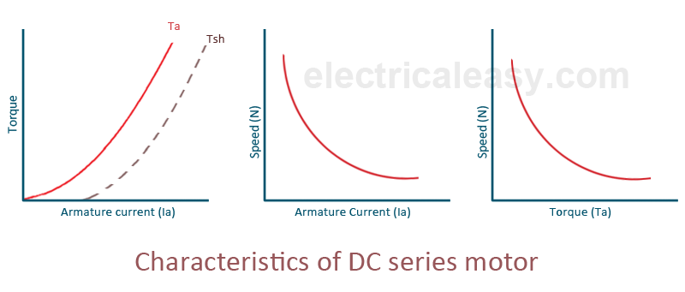
CHARACTERISTICS OF DC SER IESMOTOR
https://www.electricaleasy.com/2014/07/characteristics-of-dc-motors.html

Slide 8
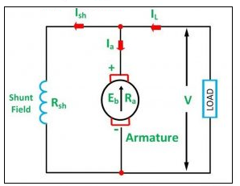
CHARACTERISTICS OF DC SHUNTMOTOR
Torque Vs. Armature Current (Ta-Ia )
T α Φ Ia
where, Φ is constant so, T α Ia , which gives straight line in practically.
Since heavy starting load needs heavy starting current, shunt motor should never be started on a heavy load.
b) Speed Vs. Armature Current (N-Ia)
N α Eb/Φ, Φ is constant,
https://www.top-ee.com/dc-shunt-motor/

Slide 9
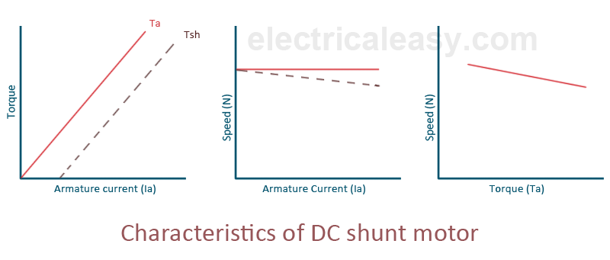
CHARACTERISTICS OF DC SHUNTMOTOR
C) Speed Vs. Torque (N-Ta)
N = E_{b} / Φ
In dc Motor Ta α Ia (Φ constant )
So if ( I_{a} ↑ ) then the ( T_{a} ↑ ) hence ( E_{b} ↓ )
so speed N will slightly decrease
https://www.quora.com/What-are-the-electrical-and-mechanical-characteristics-of-a-DC-shunt-motor

Slide 10
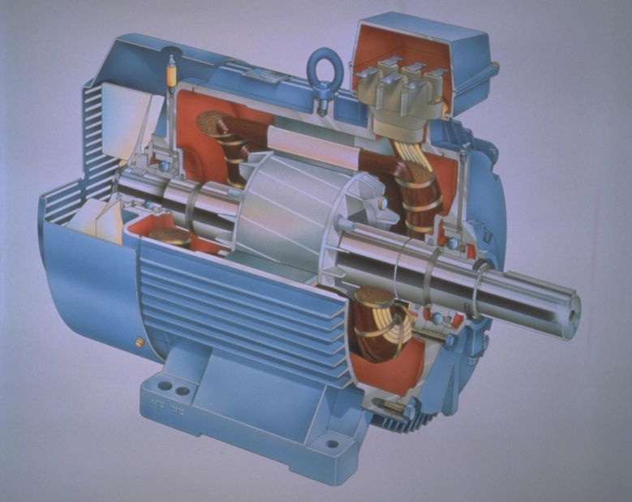
INDUCTION MOTOR
Introduction
Most common and frequently encountered machines in industry
Simple design
Rugged
Low-price
Easy maintenance
Wide range of power ratings: fractional horsepower to 10 MW run
essentially as constant speed from no-load to full load
http://lhp.co.in/index_without_right.php?file=motor_school

Slide 11
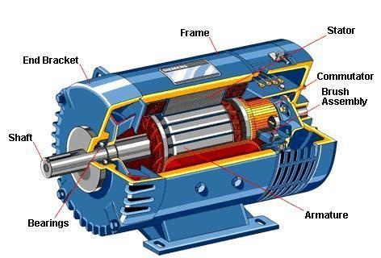
CONSTRUCTION OF INDUCTION MOTOR
Squirrel-Cage: Conducting bars laid into slots and shorted at both ends by shorting rings.
Wound-Rotor: Complete set of three-phase windings exactly as the stator. Usually Y-connected, the ends of the three rotor wires are connected to 3 slip rings on the rotor shaft. In this way, the rotor circuit is accessible.
https://automationforum.co/three-phase-induction-motor-basics/

Slide 12

SLIP OF INDUCTION MOTOR
Where s is the slip
Notice that : if the rotor runs at synchronous speed
s = 0
if the rotor is stationary
s = 1
Slip may be expressed as a percentage by multiplying the above eq. by 100, notice that the slip is a ratio and doesn’t have units

Slide 13
FREQUENCY AND TORQUE OF ROTOR SPEED
What would be the frequency of the rotor’s induced voltage at any speed n_{m}?
fr = s.fs
When the rotor is blocked (s=1) , the frequency of the induced voltage is equal to the supply frequency
On the other hand, if the rotor runs at synchronous speed (s = 0), the frequency will be zero.
Torque is given by:
While the input to the induction motor is electrical power, its output is mechanical power and for that we should know some terms and quantities related to mechanical power
Any mechanical load applied to the motor shaft will introduce a Torque on the motor shaft. This torque is related to the motor output power and the rotor speed

Slide 14
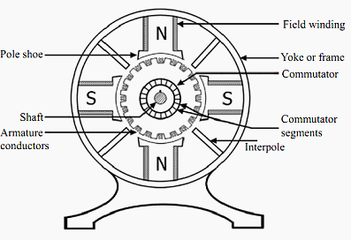
BRUSHED DC MACHINE
Brush DC Motor is to determine your maximum required speed. Brush DC Motor only if max speeds exceed 1000 RPM.
There are four basic motor components:
Stator
Rotor
Commutator
Brushes
https://electrical-engineering-portal.com/basics-of-dc-motors-for-electrical-engineers-beginners

Slide 15
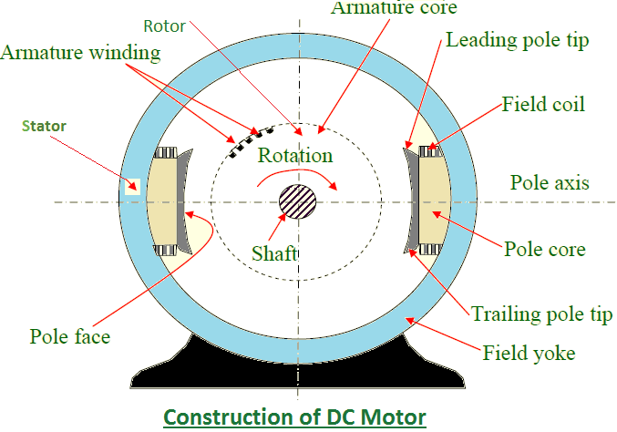
CONSTRUCTION
Generates a stationary magnetic field that surrounds the rotor, this field is generated by either: N S permanent magnets or electromagnetic winding.
http://workingprincipalofdcmotor.blogspot.com/2013/01/construction-of-dc-motor.html

Slide 16
ADVANTAGE AND DISADVANTAGE OF BRUSHED DC MOTOR
Advantages - Brush DC Motor
Low overall construction costs;
Can often be rebuilt to extend life;
Simple and inexpensive controller;
Controller not needed for fixed speed;
Ideal for extreme operating environments.
Disadvantages - Brush DC Motor
A Brush DC Motor is less reliable in control at lowest speeds
A Brush DC Motor is physically larger than other motors producing equivalent torque
A Brush DC Motor is considered high-maintenance, which is not true of brushless dc motor.
A Brush DC Motor are vulnerable to dust which decreases performance

Slide 17
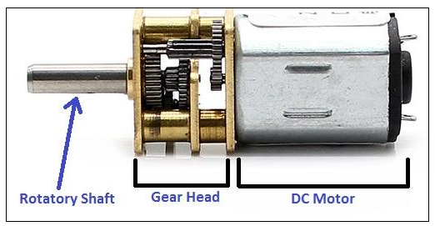
GEARED MOTOR
A "gear motor" may be an AC or DC
motor coupled with a gearbox.
It is designed to produce
- high torque
- maintaining a low horsepower
- low speed
First Goal:
To reduce the rotating shaft speed of a motor in the device being driven
Application: Small electric clock
Second Goal:
To use a small motor to generate a very large force albeit at a low speed.
Application: Lifting mechanisms on hospital beds, power recline
https://www.researchgate.net/publication/281707993_RF_Controlled_Robotic_System_for_Object_Transportation/figures?lo=1

Slide 18
BRUSHLESS DC MOTOR
A motor that retains the characteristics of a dc motor but eliminates
the commutator and the brushes is called a brushless Dc motor.
It consists of a multiphase winding wound on a non-salient stator
and magnetized PM rotor.
- A sensor is required for speed control.
It provides the advantage of a permanent magnet, which means that
all the power applied can be used for torque.
- Available in single-phase, 2-phase, and 3-phase configurations
https://www.renesas.com/eu/en/support/technical-resources/engineer-school/brushless-dc-motor-01-overview.html

Slide 19
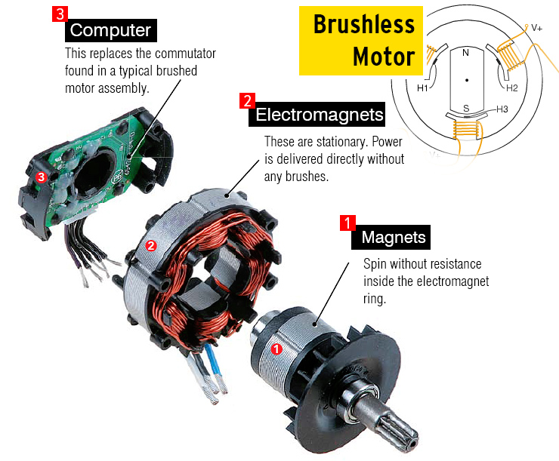
CONSTRUCTION OF BLDC
The construction of this motor has many similarities of three motor as well as conventional DC motor.
This motor has stator and rotor parts as like all other motors.
The rotor of BLDC motor is permanent magnet and stator is a coil arrangement
https://www.engineermind.in/2018/01/working-and-construction-of-brush-less-dc-motor.html

Slide 20
ADVANTAGE AND DISADVANTAGE OF BLDC MOTOR
Advantages:
No mechanical commutator and associated problems
High efficiency due to the use of permanent magnet rotor
High speed of operation even in loaded and unloaded conditions
Smaller motor geometry and lighter in weight than both brushed type DC and induction AC motors.
Disadvantages:
Electronic controller required control this motor is expensive
Not much availability of many integrated electronic control solutions, especially for tiny
BLDC motors
Requires complex drive circuitry

Slide 21
APPLICATIONS OF BLDC MOTOR
Instrumentation.
Medical.
Appliances.
Automotive
Factory Automation Equipment.
Aerospace.
Millitary.

Slide 22
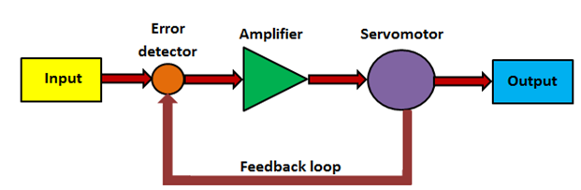
SERVOMOTOR
Not a special motor it may be DC or AC or brushless DC motor
Also called control motors as they are involved in controlling a mechanical system.
Servomotors provide accurate speed, torque, and have ability of direction control.
Widely used variable speed drives in industrial production and process automation and building technology worldwide
https://nptel.ac.in/courses/112103174/module4/lec2/2.html

Slide 23
WORKING AND OPEARTING PRINCIPLE OF SERVOMOTOR
A servo (servomechanism) is an electromagnetic device that converts electricity into precise controlled motion by use of negative feedback mechanisms.
Servo motors work on servo mechanism that uses position feedback to control the speed and final position of the motor shown in fig 2..
The servomotors are used in a closed-loop servo system as shown in . A reference input is sent to the servo amplifier, which controls the speed of the servomotor.
A feedback device is mounted on the machine, which is either an encoder or resolver. This device changes mechanical motion into electrical signals and is used as a feedback.
This feedback is sent to the error detector , which compares the actual operation with that of the reference input. If there is an error, that error is fed directly to the amplifier, which will be used to make necessary corrections in control action.
In many servo systems, both velocity and position are monitored. Servomotors provide accurate speed, torque, and have ability of direction control.

Slide 24
ADVANTAG AND DISADVANTAGE SERVOMOTOR
Advantages:
Provides high intermittent torque, high torque to inertia ratio, and high speeds
Work well for velocity control
Available in all sizes
Quiet in operation
Smoother rotation at lower speeds
Disadvantage:
More expensive than stepper motors
Require tuning of control loop parameters
Not suitable for hazardous environments or in vacuum
Excessive current can result in partial demagnetization of DC type servo motor

Slide 25
STEPPER MOTOR
A stepper motor is a pulse-driven motor that changes the angular position of the rotor in steps. Due to this nature of a stepper motor, it is widely used in low cost, open loop position control systems.
The stepper motor can be controlled with or without feedback.
The sequence of the applied pulses is directly related to the direction of motor shafts rotation.
The speed of the motor shafts rotation is directly related to the frequency of the input pulses.
The length of rotation is directly related to the number of input pulses appliedThese motors are also called stepping motors or step motors. because this motor rotates through a fixed angular step in response to each input current pulse received by its controller.

Slide 26
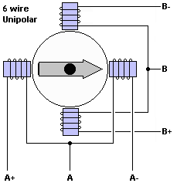
STEPPER MOTOR
http://www.piclist.com/techref/io/stepper/wires.htm

Slide 27
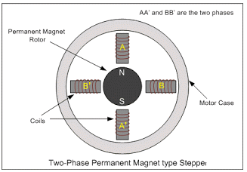
TYPES OF STEPPER MOTOR
There are three types of stepper motor:
Permanent magnet stepper motor
Variable reluctance stepper motor
Hybrid stepper motor
Permanent magnet stepper motor: It uses permanent magnet on rotor and electromagnet on stator. It operates on attraction and repulsion of stator and rotor poles.
https://www.quora.com/What-is-the-diagram-of-a-stepper-motor

Slide 28
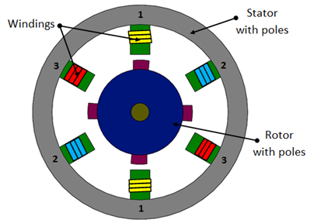
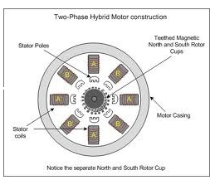
TYPES OF STEPPER MOTOR
2. Variable reluctance stepper motor: Variable reluctance (VR) motors have a plain iron rotor and operate based on the principle that minimum reluctance occurs with minimum gap, hence the rotor points are attracted toward the stator magnet poles.
https://nptel.ac.in/courses/112103174/module4/lec2/1.html
3. Hybrid stepper motor: Hybrid stepper motors are named because they use a combination of permanent magnet (PM) and variable reluctance (VR) techniques to achieve maximum power in a small package size.
https://www.indiamart.com/company/3978869/stepper-motor.html

Slide 29
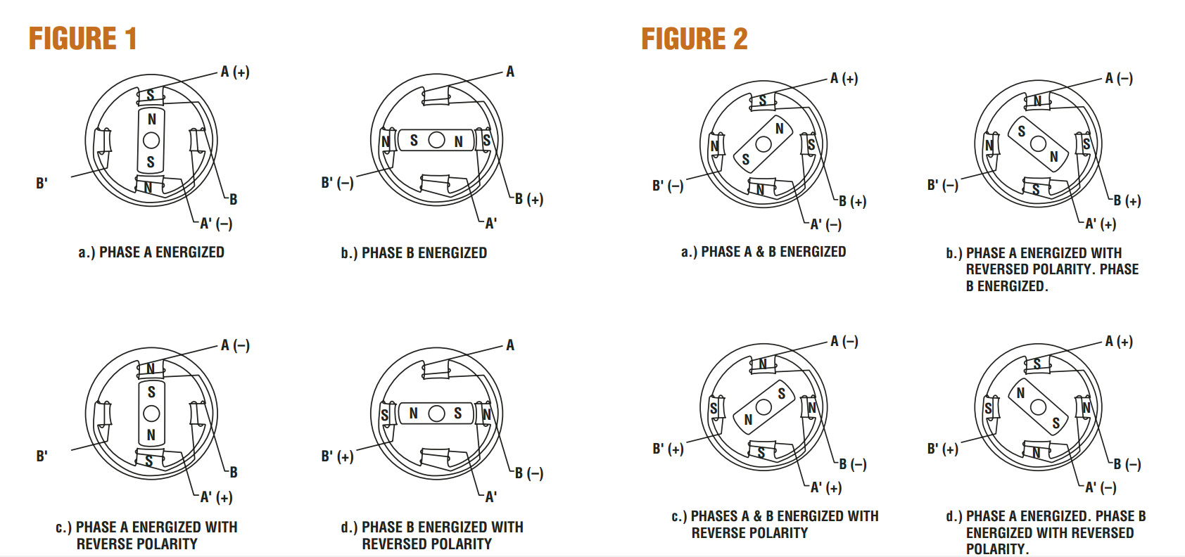
WORKING OF STEPPER MOTOR
https://www.omega.co.uk/prodinfo/stepper_motors.html

Slide 30
ADVANTAGE AND DISADVANTAGE OFSTEPPER MOTOR
Advantage:
Low cost for control achieved
Ruggedness
Simplicity of construction
Can operate in an open loop control system
Low maintenance
Disadvantage:
Require a dedicated control circuit
Use more current than D.C. motors
High torque output achieved at low speeds

Slide 31
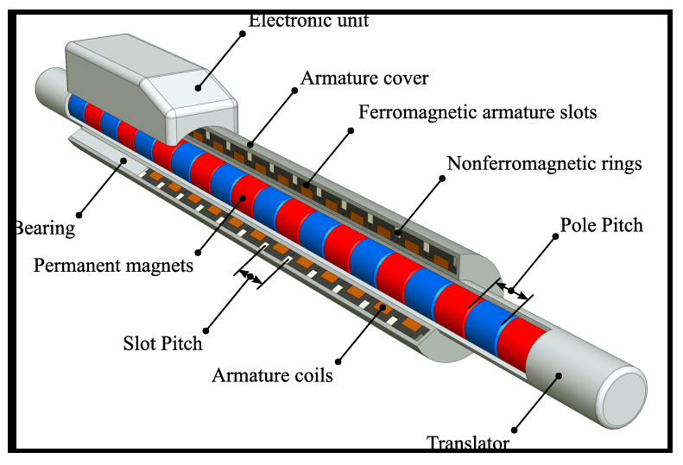
LINEAR MOTOR
Linear induction motor a special purpose motor that produce linear motion rather than rotational motion .
In a linear motor, the stator is unwrapped and laid out flat and the "rotor" moves past it in a straight line
Linear motor often use superconductor use magnets, which are cooled to low temperatures to reduce power consumption.
https://www.researchgate.net/publication/320410377_Identification_and_Compensation_of_Cogging_and_Friction_Forces_in_Tubular_Permanent_Magnet_Linear_Motors/figures?lo=1

Slide 32
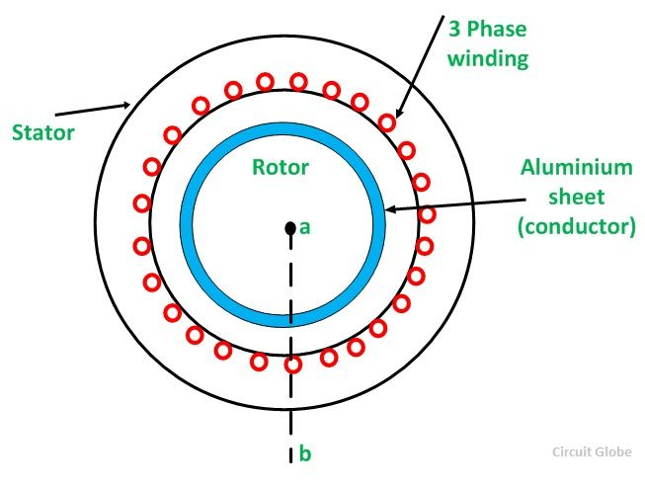
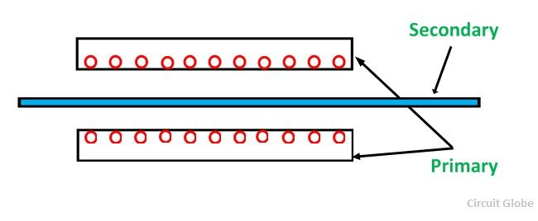
COMPONENTS OF LINEAR MOTOR
In an AC induction motor, electromagnets positioned around the edge of the motor are used to generate a rotating magnetic field in the central space between them. This "induces" (produces) electric currents in a rotor, causing it to spin.
https://circuitglobe.com/linear-induction-motor.html
https://circuitglobe.com/linear-induction-motor.html

Slide 33
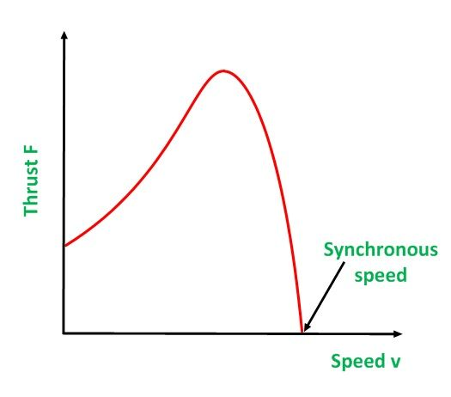
THURST VELOCITY CURVE
The thrust velocity curve of the linear induction motor is similar to that of the speed torque curve of rotary induction motor:
https://circuitglobe.com/linear-induction-motor.html

Slide 34
ADVANTAGE AND DISADVANTAGE OF LINEAR INDUCTION MOTOR
Advantage:
No magnetic attraction forces during assembly.
Long travel lengths possible.
high force can use for these kind of applications so it’s better for heavy duty applications.
Direct electromagnetic force (no mechanical elements, no limitations for speed).
Disadvantage:
Construction of this liner induction machines is some what complex .
complex controlling methods need to use to control this motor.
This motor do not produce any force at standstill.
Linear induction motors are physically larger compared with permanent magnet motors.

Slide 35
APPLICATIONS OF LINEAR MOTOR
Automatic sliding doors
Mechanical conveyor belt
liquid metal pumping
crane material handling
Electrical traction industries
High voltage circuit breakers
Electrical cranes
use as superconducting magnets
This principle of linear motors are widely use in rocket launching.
High speed moving magnetic trains

Slide 36
Assessment Pattern
S. No. | ELEMENTS | MARKS
1 | MST-1 | 36
2 | MST-2 | 36
3 | ASSIGNMENT (1+2+3) | 12
4 | SURPRISE TEST | 09
5 | TUTORIAL TEST | 09
6 | QUIZ | 12

Slide 37
REFERENCES
http://www.railway-technical.com/trains/rolling-stock-index-l/train-equipment/electric-traction-control-d.html
https://www.meee-services.com/quick-learning-dc-motors-work/
https://circuitglobe.com/types-of-dc-motor.html
https://www.electricaleasy.com/2014/07/characteristics-of-dc-motors.html
https://www.top-ee.com/dc-shunt-motor/
https://www.quora.com/What-are-the-electrical-and-mechanical-characteristics-of-a-DC-shunt-motor
http://lhp.co.in/index_without_right.php?file=motor_school
https://electrical-engineering-portal.com/basics-of-dc-motors-for-electrical-engineers-beginners
https://www.researchgate.net/publication/281707993_RF_Controlled_Robotic_System_for_Object_Transportation/figures?lo=1
https://circuitglobe.com/linear-induction-motor.html

Slide 38
THANK YOU
For queries
Email: manjeet.e7825@cumail.in

