Slide 1

Innovative Monitoring System for TeleICU Patients Using Video Processing and Deep Learning.
Group Name: HackElite
Group Members Name:
Rupsha Sarkar
Alfiya Jaffar Shaikh
Shruti Sunil Thokale
Vashi Ghatole

Slide 2
Problem Statement
Innovative Monitoring System for TeleICU Patients Using Video Processing and Deep Learning.
TeleICU is concept for monitoring ICU patients from remote locations to reduce the burden of on-site intensivist.
The proposed solution should work to reduce the burden of remote health care professional so, one remote health care professional can monitor 5 or more patients at single time.

Slide 3
TelIcu Project
KeyPoint Detection
Integration + Gui + Alert
Object Detection
Yes or No patient’s Motion Detection

Slide 4
Unique Idea Brief (Solution)
OUR APPROACH:
We have taken 2-3 videos of the ICU Room .
To work on the video and to detect the functionality of the patient , we first created the dataset using ROBOFLOW - which mainly include set of data’s for (Doctors, Nurse and Patient)
Now we have used three different deep learning and video processing techniques and models to build our project
Object Detection Model
Motion detect(yes or no) model
KeyPoint detection + alerting model
Then we have integrated the three models in order to simplify user experience.
Then we have also included the GUI where the user need to select the saved video and then process that video to get the integrated model working on the video.

Slide 5
Metholodogy:
Download high resolution ICU Room video.
we have created a folder in our Desktop then saved the downloaded videos from youtube.
Dataset Creation:
We used Roboflow platform for building, training and deploying different models.
We have created a folder of different images of Doctors, Nurse and Patients --> then we upload the folder then through auto labelling we created the three classes for Doctors, Nurse and Patients .
We have annotate the classes with unique features--→ then we fine tuned the model → then we labelled all the images, then create a Dataset of all the approved images.
After generating the Dataset we get Zip code which include the API Key, Data.yaml file, train valid and test folders.
Best.pt File:
Download the Dataset in yolov8 model format → then created a basic code in python -→ there we have trained our Data.yaml file using yolov8 model to obtain our best.pt file .

Slide 6
Models:
Object Detection Model:
Using of YOLOV8 and opencv2 library
Load the yolov8 model-> then mention the path of video as well as the output path where the detected frames will be saved.
Through this model ,we have identified different objects such as Doctors, Nurse and Patient within each frame of video and then the detected frames are saved in the specified folder.
Patient Motion Detected Yes or NO:
Using opencv2, Numpy, Mediapipe, Pygame and YOLOV8 library.
It only detects the “Patient” in the video using YOLOV8 and Mediapipe is used for tracking the motion of patient within the patients bounding box by comparing consecutive video frames.
If motion of the patient is detected then it raises an alert by playing an alert sound.

Slide 7
Keypoint Detection + Alerting:
Using of opencv2, Numpy, Mediapipe and YOLOV8 library.
It detects different objects(Doctor’s, Nurse’s, Patient’s) in the video using YOLOV8 and mediapipe is used for tracking the facial and hand landmarks to monitor specific movements of patient.
It detects and alerts for movements like mouth opening, eyes opening, head movements, and hand movements within the detected patient’s bounding box.
Then the detected frames / video get saved into the output folder.
GUI:
Using the Tkinter library.
We have provide two buttons → upload video button and process video button.
Using upload video button we upload the selected video for processing
Using the process video button we select the folder where the detected frames will be saved.
Then the video start’s processing.

Slide 8
Features Offered
We offer various features through our models which are mentioned below:
Data Collection and Annotation → for creating datasets
Training Process → including Data processing, augmentation techniques, video and image processing, fine tuning.
Integration → integrated all three models(object detection , motion detection and keypoint detection) into one single python code.
Realtime Processing → Realtime object detection and patient’s motion tracking.
Multi-object Tracking → used algorithms for tracking multiple objects (Doctors, nurses and patients) for each frame in a video.
Raising Sound Alerts → Specifically generate sound alerts for the motion of patient only.
Raising Text Alerts → Specifically generate text alerts for the type of motion of patient only using ()
GUI → create a user interface with two buttons(upload video button and process video button).
Real-world Application → using these three models we can even train the CCTVS footage .

Slide 9
Calculate performance metrices→
FOR Integration + GUI + Alert DETECTION:
FRAMES PER SECOND:
Total number of frames are 1538 of the video of 50 seconds then how many frames per second ?
INFERENCE:
Current Inference Time: 0.0396 seconds per frame
fps=video length in seconds total frames​
Given:
Total frames = 1538
Video length = 50 seconds
Let's do the calculation:
fps=1538 / 50 ≈ 30.76
So, the video has approximately 30.76 frames per second.

Slide 10
Inference Time Per Frame:
Total inference time: 839.5 ms
Number of frames: 1,538
Inference time per frame=839.5 ms / 1,538 frames≈0.546 ms
Inference time per frames: 0.546ms
Inference time for 30.76 frames :
ACCURACY:
80 % to 90 %

Slide 11
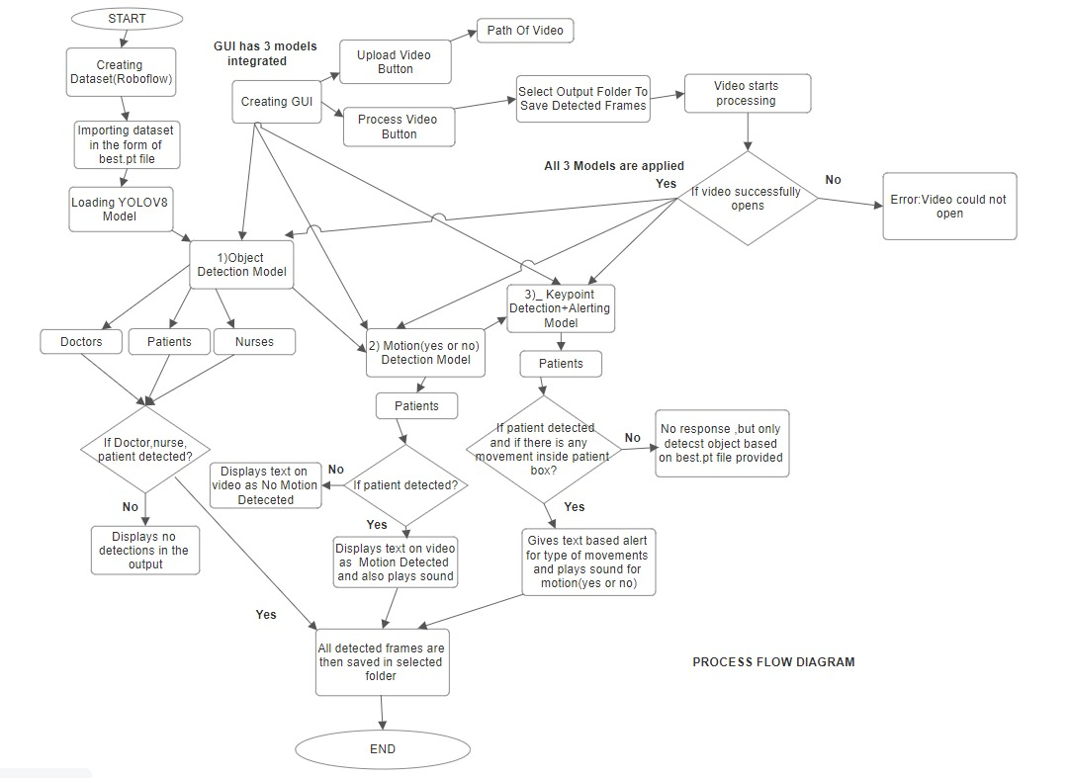
Process flow

Slide 12
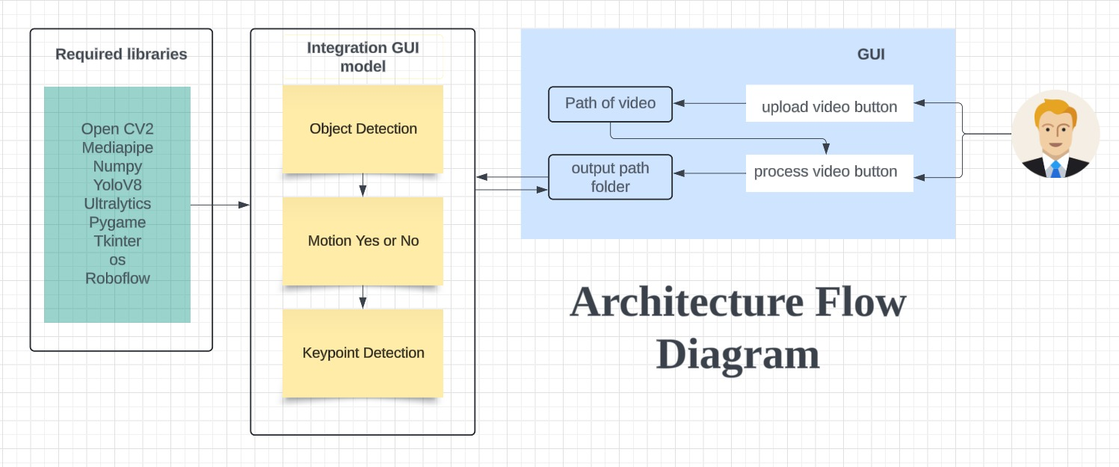
Architectural Flow

Slide 13
Technologies used:
We have used various technologies for Video Processing and Deep Learning:
Roboflow→ It offers functionalities such as annotation, augmentation, and easy export to various formats compatible with popular machine learning frameworks.
Yandex / iStock → for high resolution images of doctors, nurses and patients
Pycharm / Jupyter→ An open-source web application that allows you to create and share documents containing live code, equations, visualizations, and narrative text.
OpenCV and MediaPipe→ These are often used together for real-time video processing and computer vision tasks such as tracking and detecting human poses, faces, or hands.
YOLOv8→ Integrated for object detection tasks within video frames, allowing for real-time detection and tracking of multiple objects.
Tkinter→ Used to create simple GUI applications, such as file selection dialogs for choosing video files to process.
Pygame→ While primarily for game development, it can be used to handle multimedia tasks like playing audio or displaying graphics, which can be useful in video processing projects
NumPy (np)→ Provides support for arrays and matrices, along with a collection of mathematical functions to operate on these arrays.

Slide 14
Team members and contribution:
Rupsha Sarkar →
Object detection, Dataset Creation, Images and videos finding, Integration of codes , Sound alert, PPT, Github Repository
Alfiya Jaffar Shaikh→
Keypoint Detection + Alert, Dataset Creation, Images and videos finding, Integration of codes, GUI, PPT, Github Repository
Shruti Sunil Thokale→
Patient Motion detection Yes or no model, Dataset Creation, Images and videos finding, Integration of codes, 5-page Report, GUI, Github Repository
Vashi Ghatole→
Research work , Images and videos finding

Slide 15
Conclusion
The Innovative Monitoring System for TeleICU Patients project demonstrates the power of integrating video processing and deep learning techniques to enhance patient care in ICU settings.
By developing models for object detection, motion detection, and keypoint detection, we have created a comprehensive system capable of real-time monitoring and analysis.
The integration of these models, along with a user-friendly GUI, ensures seamless operation and valuable insights for healthcare providers.
This project not only improves patient safety and care but also optimizes the efficiency of medical staff, paving the way for future advancements in teleICU technology.

