Slide 1
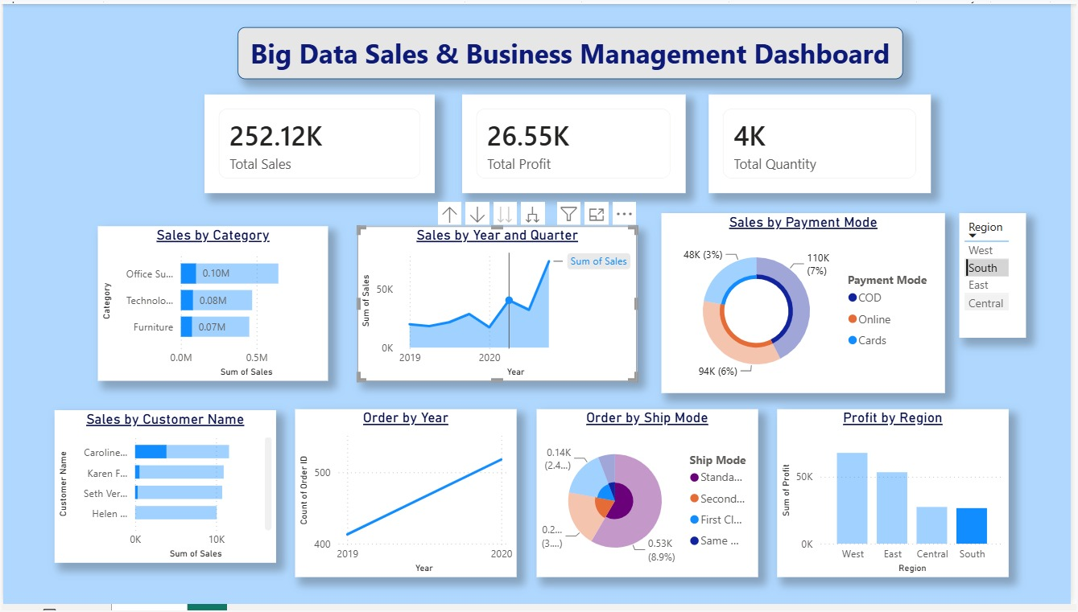
Big Data Sales &
Business Management
Dashboard
IBM Big Data Project • Superstore Sales Dataset • Power BI + Python
Sales Analytics
Power BI
Python Cleaning
Goal: Convert raw sales records into clear, decision-ready business insights.

Slide 2
Project Overview
A small but detailed BI project for sales, profit, quantity and customer performance analysis.
252.12K
26.55K
4K
5,901
20
South Sales
South Profit
Quantity
Dataset Rows
Columns
PURPOSE
FINAL OUTPUT
1
Analyze sales transactions using a visual dashboard.
Interactive Power BI Dashboard
2
Track KPIs and identify business performance quickly.
Includes KPI cards, category sales, sales trend, payment mode, customer sales, ship mode and regional profit charts.
3
Use region slicer for focused business comparison.
Business value: faster understanding of sales performance.

Slide 3
Problem Statement & Objectives
Raw CSV data needs cleaning, aggregation and visualization before it can support decisions.
PROBLEM STATEMENT
OBJECTIVES
Transaction-level Superstore data contains many details such as order date, customer, category, region, sales, quantity, profit and payment mode.
1
Clean and verify the CSV dataset using Python Pandas.
2
Create KPIs for sales, profit and quantity.
Management needs a simple dashboard to understand what is selling, where profit is high, and which operational areas need attention.
3
Build clean Power BI visuals with filters.
4
Compare region, category, payment and shipping results.
Main challenge: convert raw data into clear business insights.
5
Present useful insights for business management.

Slide 4
Dataset Details
Cleaned Superstore Sales Dataset contains 5,901 rows and 20 columns.
1.56M
175.26K
22.32K
0
0
Total Sales
Total Profit
Quantity
Missing Values
Duplicates
MAIN COLUMNS
DATA SOURCE
Order ID
Order Date
Source file: final_Superstore_Sales_Dataset.csv
Ship Mode
Customer Name
Used for Power BI dashboard visuals and management-level analytics.
Region
Category
Sales
Quantity
Time period in dashboard: 2019–2020.
Profit
Payment Mode

Slide 5
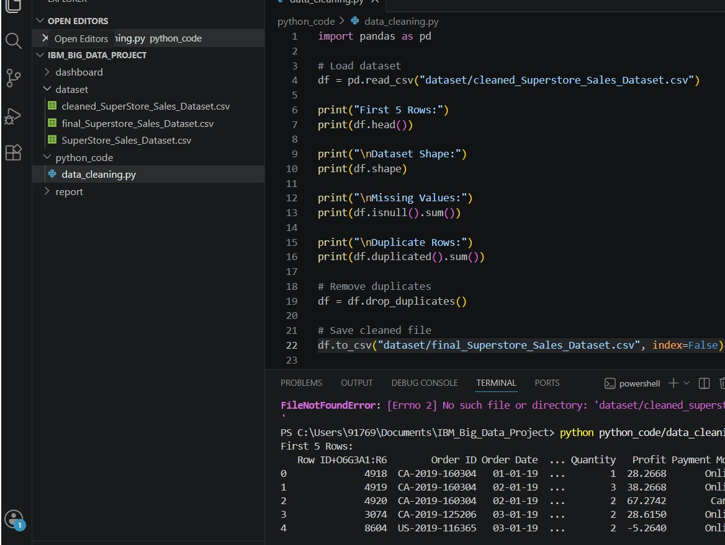
Project Structure & Files
The project folders are arranged clearly for dataset, Python code, dashboard and report work.
FOLDER ROLE
1
dashboard: Power BI dashboard file.
2
dataset: raw, cleaned and final CSV files.
3
python_code: data cleaning script.
4
report: documentation and submission files.
This structure makes the project easy to check, run and submit.

Slide 6
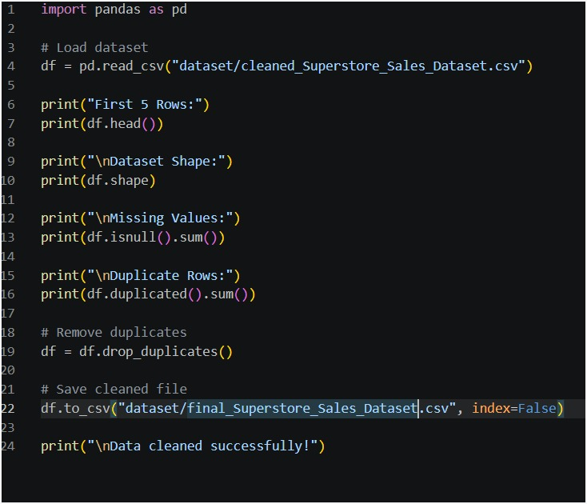
Data Cleaning Workflow
Python script checks quality and exports the final CSV used in Power BI.
Load CSV
Inspect Data
Check Quality
Clean Rows
Export CSV
pandas read_csv
head + shape
missing + duplicates
drop_duplicates
final dataset
WHY CLEANING
1
Removes duplicate records from analysis.
2
Confirms no missing values before visualization.
3
Creates a consistent final dataset for dashboard.

Slide 7
Dashboard UI Design
The dashboard follows a clean blue theme with rounded KPI cards and chart boxes.
UI ELEMENTS
1
Title bar with project name.
2
Top KPI cards for quick summary.
3
Rounded chart containers with soft shadows.
4
Region filter/slicer for dashboard interaction.
5
Consistent blue color palette for a professional look.

Slide 8
KPIs & Dashboard Filters
KPI cards provide fast summary and slicers make the dashboard interactive.
252.12K
26.55K
4K
Region Filter
South Sales
South Profit
Quantity
West • South • East • Central
SALES KPI
PROFIT KPI
QUANTITY KPI
252.12K
26.55K
4K
Selected region sales value shown for quick business comparison.
Profit card helps understand earning performance in the selected segment.
Quantity card reflects the volume of products sold in the filtered view.

Slide 9
Visual Analysis
Dashboard visuals explain performance by category, year, payment mode and shipping mode.
Sales by Category
Yearly Sales Trend
Payment Mode
Ship Mode Orders
COD has the highest sales contribution, followed by Online and Cards.
Standard Class is the most used shipping method in the dataset.

Slide 10
Regional Business Performance
West and East show stronger sales/profit, while South has lower sales but useful filtered insights.
Sales by Region
Profit by Region
Insight: West region leads both sales and profit; South filter highlights 252.12K sales and 26.55K profit.

Slide 11
Key Findings
Short business insights generated from the dashboard visuals.
252.12K
26.55K
4K
South Sales
South Profit
Quantity
1
West region has the highest sales and profit.
2
Office Supplies is the top sales category.
3
Sales improved strongly from 2019 to 2020.
4
COD is the leading payment mode by sales.
5
Standard Class is the most common shipping mode.
6
Region slicer makes focused business comparison simple.

Slide 12
Conclusion & Future Scope
The project connects Python data preparation with Power BI business visualization.
CONCLUSION
FUTURE SCOPE
The project successfully converts Superstore sales data into an interactive business dashboard. It highlights important sales, profit, quantity, category, payment, shipping and regional trends.
1
Add monthly sales forecasting using machine learning.
2
Connect dashboard to live database or cloud storage.
3
Add alerts for low profit or low-performing regions.
Final Outcome
4
Publish dashboard for web-based access.
A neat dashboard that supports faster sales and business management decisions.
5
Add more filters for state, segment and product.

Slide 13
Thank You
Big Data Sales & Business Management Dashboard
Presented by: Shruti Vinod Urkude
IBM Big Data Project

