Slide 1


Empowering Informed Consumer Choices Through Ingredient Label Scanning.
Name: Shashank Sreenivasa Reddy
Student ID: 2488129
Project Supervisor: Jacqueline Chetty
Course: MSc Computer Science

Slide 2
Problem Statement
The Lack of accessible and user-friendly information about food ingredients and their potential health effects.
People often struggle to decipher complex ingredient labels, identify allergens, and determine the unhealthy ingredients of the products they consume.
Additionally, the process of manually searching for ingredient information online is time-consuming and inconvenient.
This problem poses a significant challenge for individuals with dietary restrictions, allergies, or those who aim to make informed and healthy food choices.
It can lead to the consumption of ingredients that may trigger allergic reactions, compromise personal health goals, or unknowingly introduce harmful substances into their diets.
There is a pressing need for a user-friendly, digital solution that simplifies the interpretation of food labels, enhances allergen awareness, promotes healthier choices, and fosters environmentally conscious consumer behavior.

Slide 3
Research and Requirement Analysis
Lieberman, J.A., Sicherer, S.H. Diagnosis of Food Allergy: Epicutaneous Skin Tests, In Vitro Tests, and Oral Food Challenge
This article discusses the importance of accurate allergen identification and the role of technology, including apps, in diagnosing and managing food allergies.
Sicherer, S. H. (2018). Epidemiology of Food Allergy. Journal of Allergy and Clinical Immunology
This review paper provides insights into the prevalence of food allergies and the need for tools like apps to help individuals avoid allergenic ingredients.
Gupta, R. S., Kim, J. S., Springston, E. E., Pongracic, J. A., Wang, X., Holl, J. L., ... & Smith, B. (2013). Food allergy knowledge, attitudes, and beliefs in the United States. Annals of Allergy, Asthma & Immunology
This study examines the knowledge and attitudes of individuals with food allergies and highlights the potential role of technology in improving allergen avoidance.

Slide 4
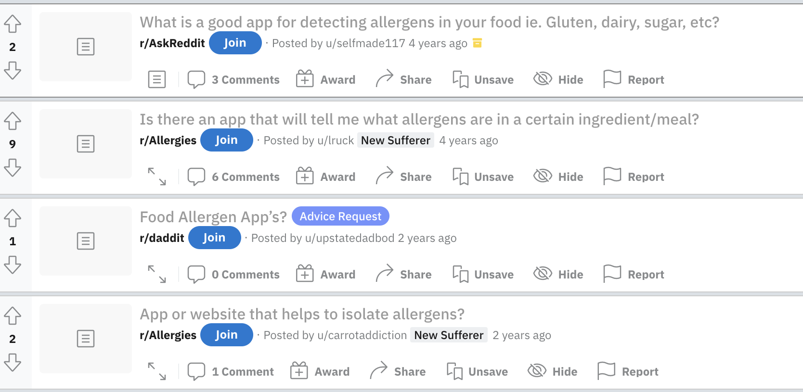
Research and Requirement Analysis

Slide 5
Software Review
Soosee is an ingredient parsing application which scans the ingredient labels and alerts potential allergens according to the dietary preferences set by the user. However it does not provide detailed descriptions of Ingredients as it does not scan the entire ingredient list but selectively scans only those inputs that are set by the user.
Fooducate is an this app allows users to scan food product barcodes and provides information about ingredients, nutrition facts, and health ratings. However since it relies on scanning only the barcodes and checking the serial id with the database to find the product associated with it, this is a major flaw as there are so many products that aren’t listed and the database is not up to date. Users have experienced problems when they tried to scan the barcodes of products that don’t exist in the database.

Slide 6
Project Aim
The goal is to develop an ingredient parser app that scans food product labels, extracts ingredient information, and presents it in a user-friendly format. The app should provide descriptions of ingredients, highlight potential allergens, and warn the user about ingredients that are deemed to be unhealthy. By doing so, users can make informed decisions about the foods they consume, easily identify potential allergens, and have a clear understanding of the ingredients being used.
Features :
Ingredient Categories, Personalization.
Provide clear and informative description of the ingredients detected.
Warn users about potential allergens present.
Warn users about potential ingredients that belong to a certain category. (Allergens, Non-Vegan, Environment)
Highlight unhealthy ingredients.
Gamification for promoting user engagement and rewarding healthy choices

Slide 7
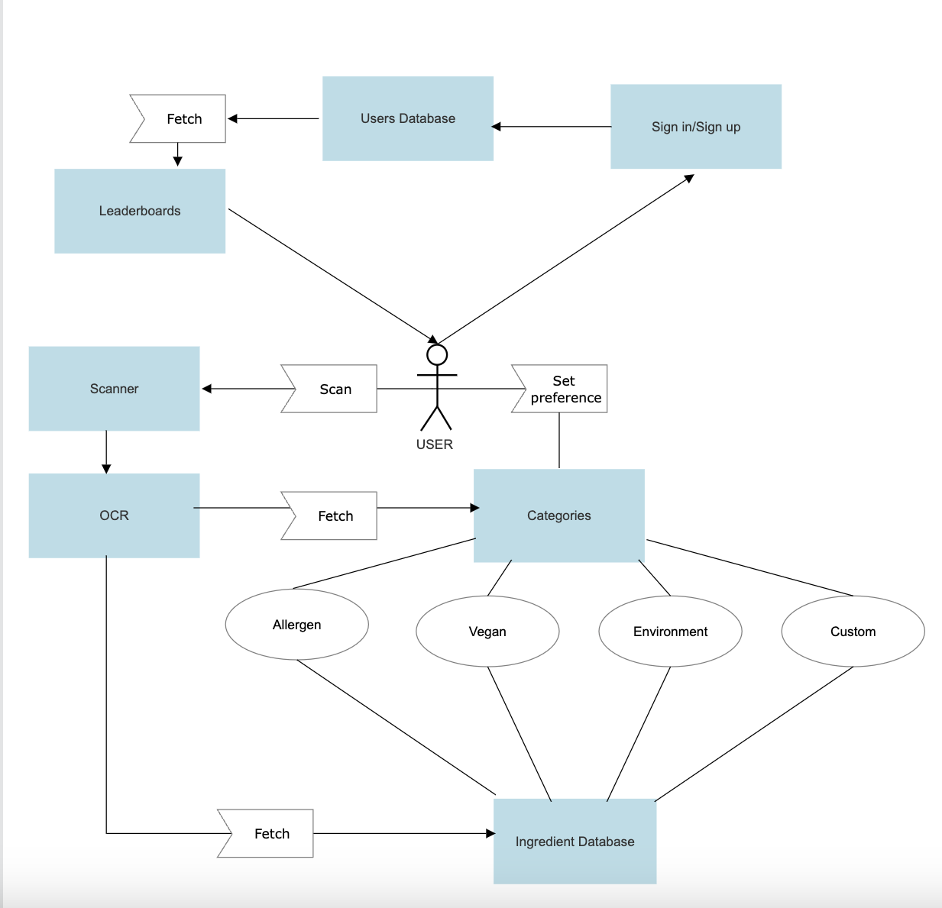
UML use case diagram

Slide 8
Gamification for promoting user engagement and rewarding healthy choices
User Badges: Users earn badges by scanning healthy and eco-friendly ingredients. Progress is made through different tiers and users gain exclusive badges.
Leaderboards: Promotes healthy competition and user engagement by competing with other users globally.
Impact:
Motivates users to make healthier choices.
Educates users on nutrition and sustainability.
Encourages users to establish lasting habits of selecting products that align with their health and environmental values.
Kim, Y. S., & Lee, H. G. (2015). Gamification in Mobile Apps for Health and Wellness. Journal of Computer-Mediated Communication

Slide 9
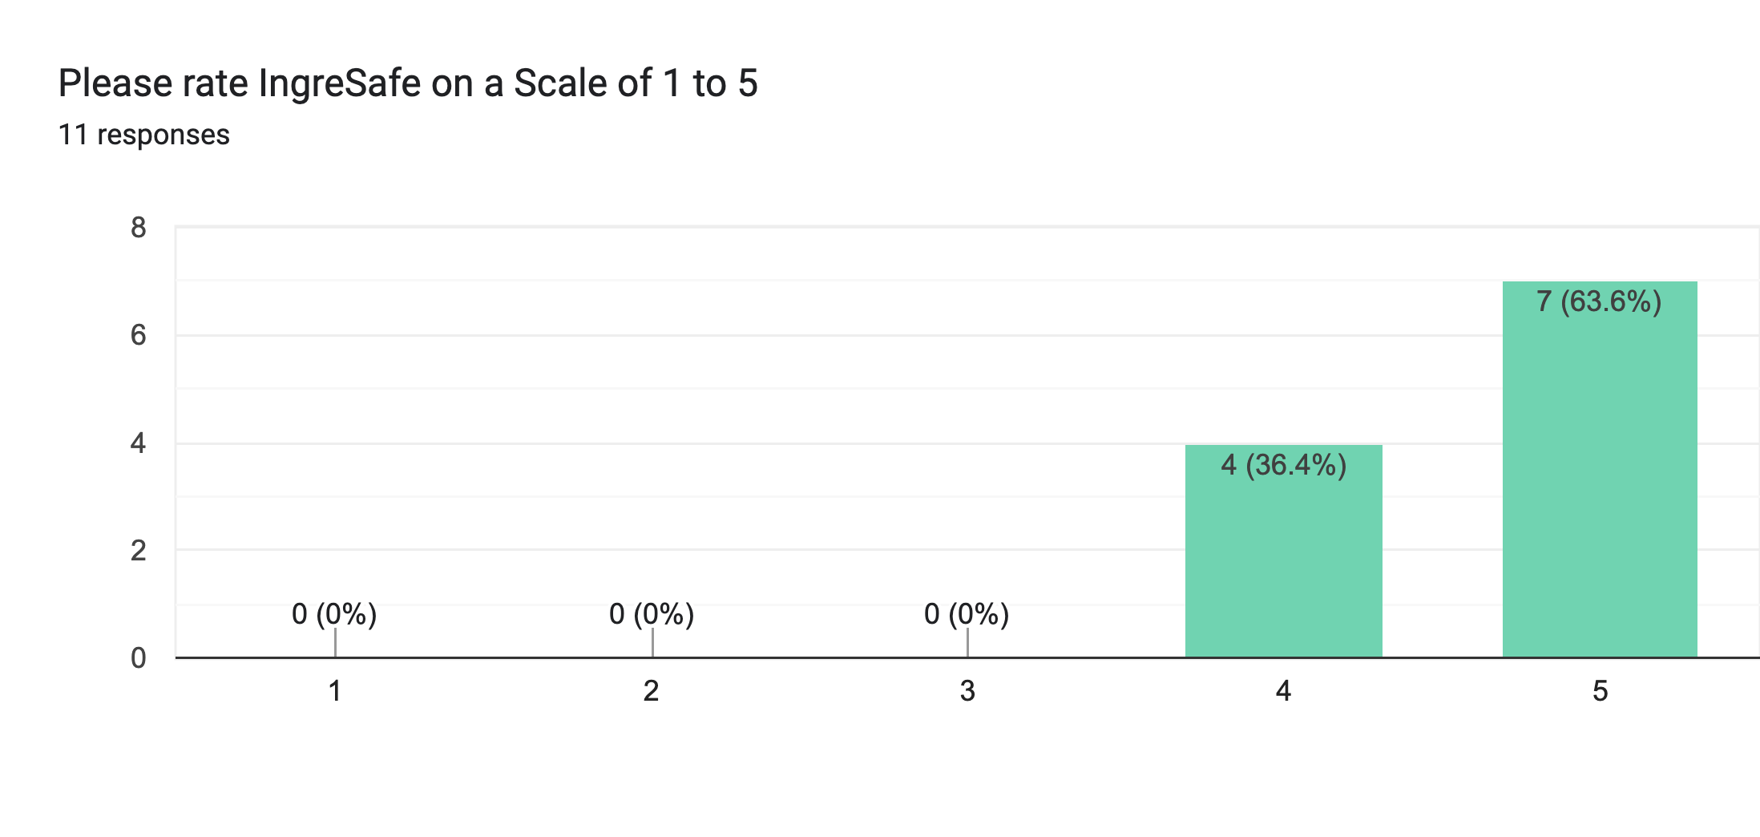
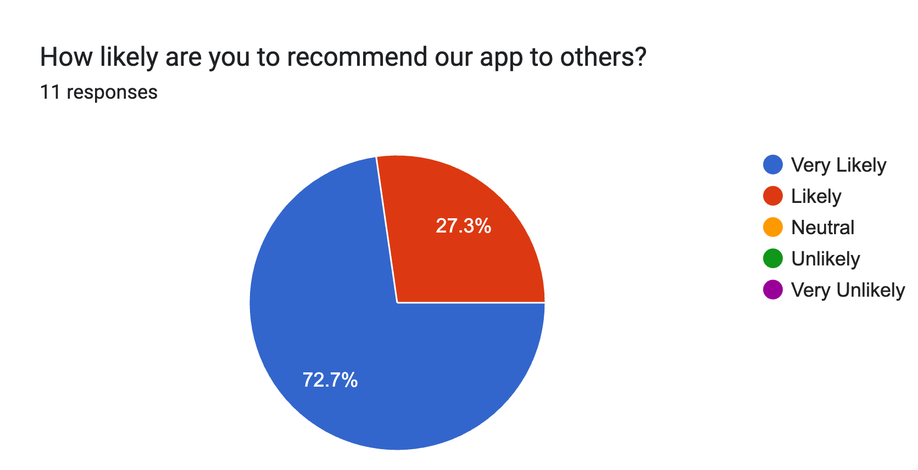
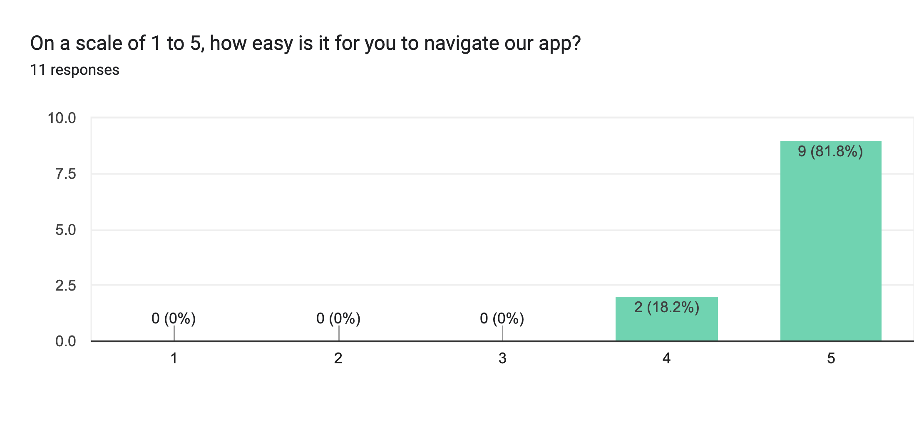
User testing and evaluation

Slide 10
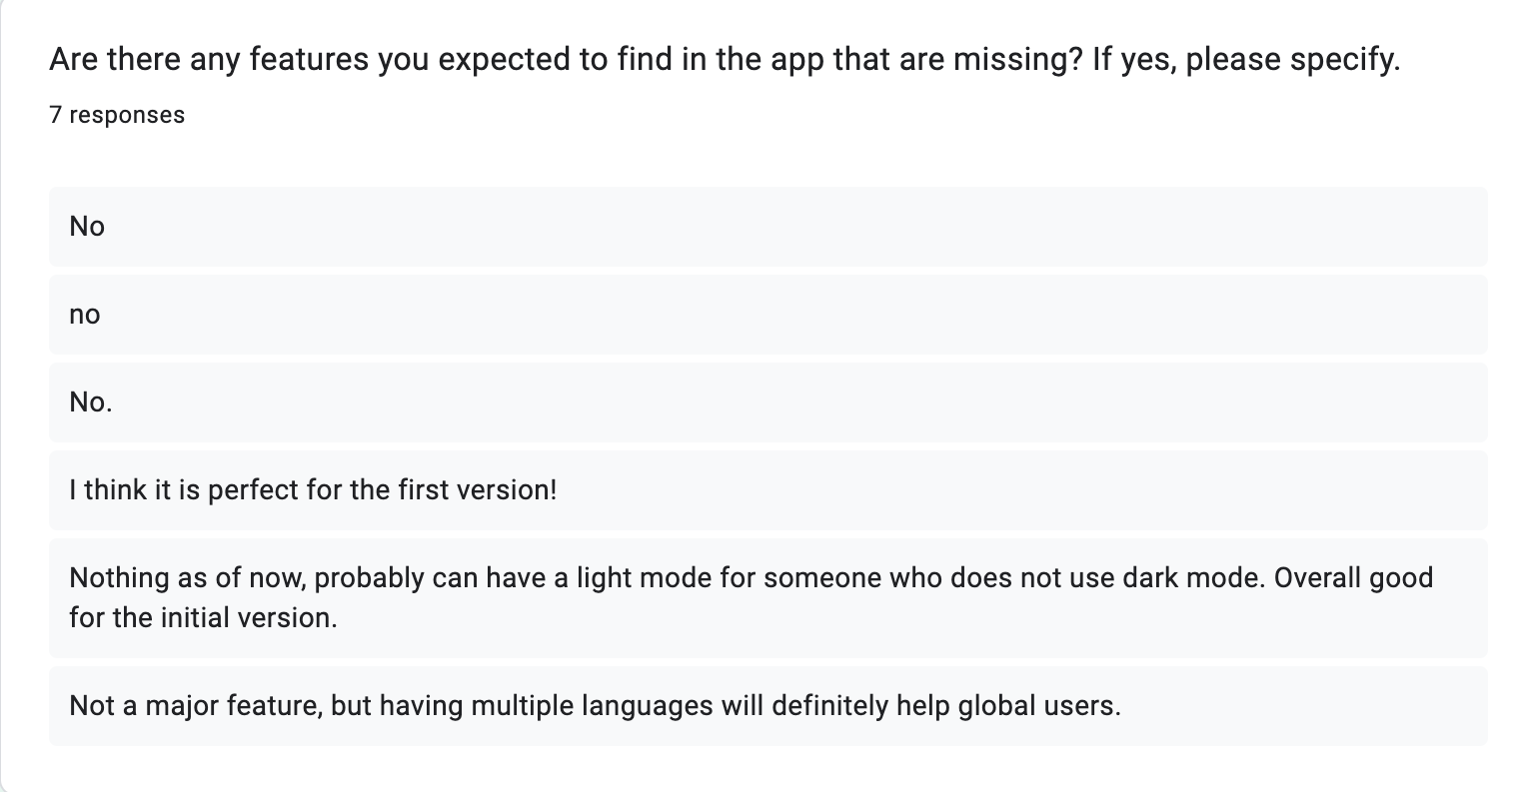
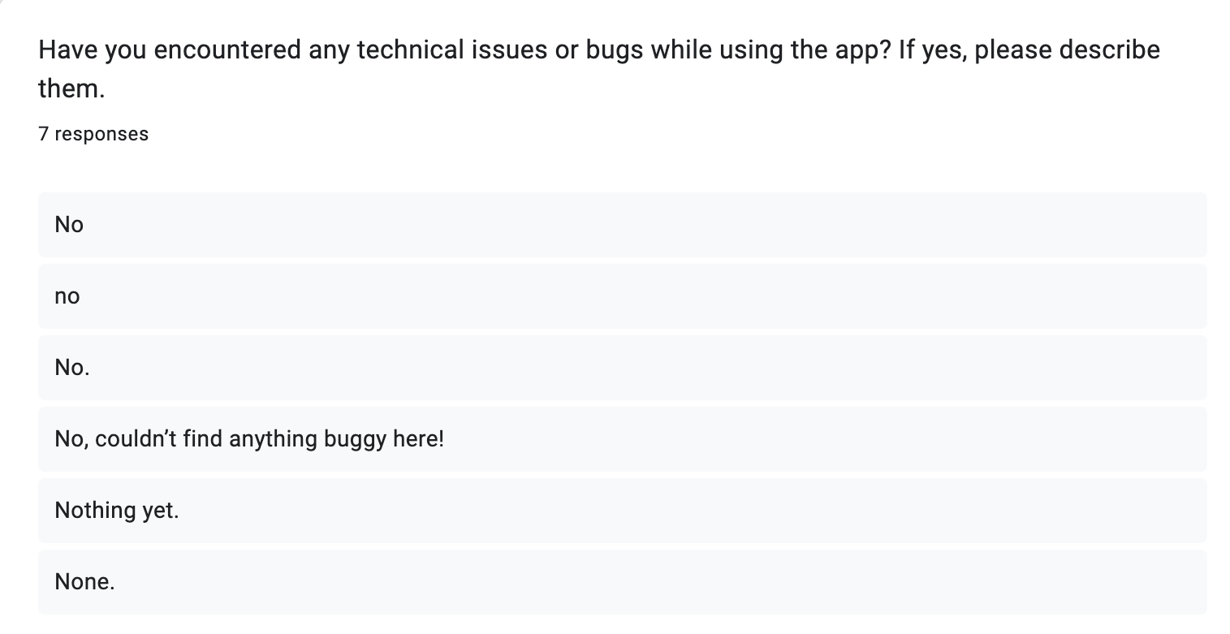
User testing and evaluation

Slide 11
Concerns, Ethics and Future plans
The app strives for high accuracy in its results, although it cannot guarantee a 100% accuracy due to potential factors such as varying scanning conditions, including camera quality, low-light situations, and rare OCR misreadings.
Every time a user scans a label, the app includes disclaimers, emphasizing the importance of seeking personalized advice from healthcare professionals or allergists when needed, particularly in cases involving severe allergies or specific medical conditions.
All possible allergens and ingredients were obtained from the NHS https://www.nhs.uk/conditions/food-allergy/
Ensuring accuracy in recommendations is paramount for the IngreSafe app. This will be accomplished through rigorous testing, regular updates to ingredient and allergen databases, and ongoing enhancements based on user feedback.

Slide 12
Thank you!

