Slide 1
House Price Prediction Using Linear Regression

Slide 2
OBJECTIVE OF PROJECT
To build a machine learning model using Linear Regression
Predict house prices based on features like:
Title
Number of Bathrooms
Number of Balconies
Price, Location, etc.

Slide 3
PROBLEM STATEMENT
Estimating house prices manually is time-consuming and error-prone.
Need for a reliable, automated prediction model
Model should generalize well on unseen data

Slide 4
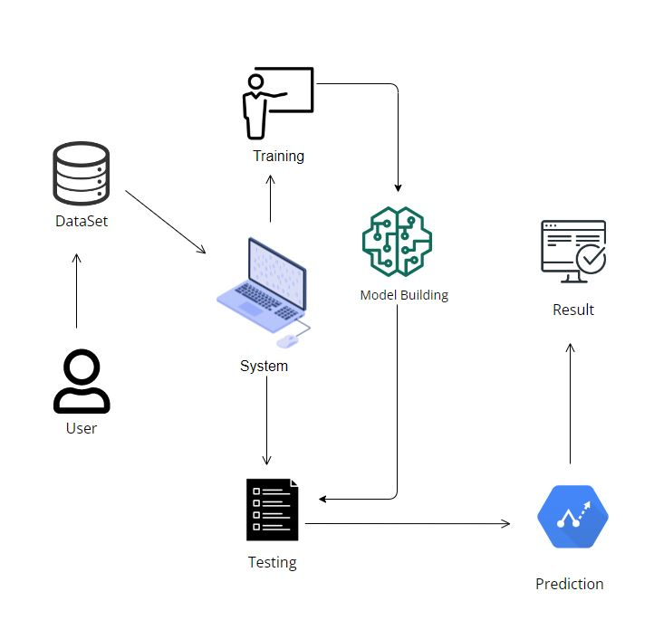
PROJECT FLOW

Slide 5
PROJECT FLOW
Data Collection
Data Cleaning
Feature Engineering
Encoding Categorical Variables
Model Training (Linear Regression)
Model Evaluation
Results & Conclusion

Slide 6
HARDWARE & SOFTWARE REQUIREMENTS
Hardware:
PC/Laptop with minimum 4GB RAM
Internet connection (for research/tools)
Software:
Python 3.x
Jupyter Notebook
Libraries:
Pandas, NumPy, Matplotlib
Scikit-learn

Slide 7
Architecture
Raw Data
↓
Data Cleaning & Preprocessing
↓
Feature Engineering & Encoding
↓
Model Training (Linear Regression)
↓
Model Evaluation
↓
Prediction

Slide 8
Conclusion
Successfully built a Linear Regression model to predict house prices
Achieved good accuracy after cleaning and preparing the data

