Slide 1

Do Healthcare Cost affect per capita income
Shreya Bhattacharjee
3108
Advanced Statistic

Slide 2

Introduction
The relationship between healthcare costs and per capita income is a crucial topic in understanding the economic impact of healthcare systems on individuals and societies
Importance of Analysis
Analysing this relationship can provide insights into the affordability of healthcare services, the financial burden on individuals and families, and the overall economic health of a country.

Slide 3

Problem Definition
The analysis aimed to investigate the relationship between various factors related to healthcare, socio-economic status, and their impact on individuals' financial well-being.
Null Hypothesis (H0): There is no significant relationship between healthcare costs and per capita income.
Alternative Hypothesis (H1): There is a significant relationship between healthcare costs and per capita income.

Slide 4

Descriptive statistics
It provide a summary of the main characteristics of a dataset. In R, common descriptive statistics for numerical variables include measures of central tendency (mean, median), measures of dispersion (range, variance, standard deviation)
Mean
Calculation: mean(income)
Output: 323275.9
Interpretation: The mean of ‘income’ column in the Dataset is 323275.9
Median
Calculation: median(income)
Output: 100000
Interpretation: The median of ‘income’ column in the Dataset is 100000
Max
Calculation: max(income)
Output:5,000,000
Interpretation: The max of ‘income’ column in the Dataset is 5000000
Min
Calculation :min(income)
Output:25000
Interpretation: The min of ‘income’ column in the Dataset is 25000

Slide 5

r
Range
Calculation: range(income)
Output: 25000- 5000000
Interpretation: Maximum and Minimum values of ‘income’ column in Dataset is 25000 5000000
Variance
Calculation: var(income)
Output: 486,071,536,600
Interpretation: The variance of the ‘income’ column is approximately 486,071,536,600
Standard Deviation
Calculation: sd(income)
Output:697188.3
Interpretation: The Sd of ‘income’ column in the dataset is 697188.3
Summary
Calculation: summary(income)
Output: Min. 1st Qu. Median Mean 3rd Qu. Max.
25000 50000 100000 323276 500000 5000000
Interpretation: The income summary: Min: 25,000, 1st Qu: 50,000, Median: 100,000, Mean: 323,276, 3rd Qu: 500,000, Max: 5,000,000.

Slide 6

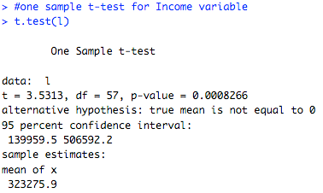
Hypothesis Testing
T –test
T-tests are used to compare the means of two groups and determine if they are significantly different. They are commonly used in hypothesis testing and can help identify relationships between variables
Null Hypothesis (H0​): There is no significant difference between the means.
Alternative Hypothesis (H1​ ​): There is a significant difference between the means.
Conclusion:The one-sample t-test conducted on the income variable indicates a statistically significant difference from zero (p = 0.0008266), with a mean income of 323,275.90. Therefore, we reject the null hypothesis that the true mean income is equal to zero.

Slide 7

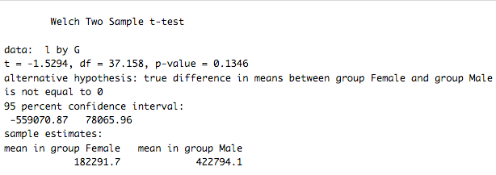
Two Sample T-test
The two-sample t-test comparing income between genders yielded a p-value of 0.1346, suggesting no significant difference in income between females and males.
Null Hypothesis (H0​): There is no significant difference in the means Income of between the groups represented by Gender(Male & Female)
Alternative Hypothesis (H1​​): There is a significant difference in the means of Income between at least two of the groups represented by Gender(Male &Female)
Conclusion:Since the p-value (0.1346) is greater than the typical significance level of 0.05, we fail to reject the null hypothesis

Slide 8

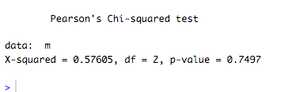
The chi-square test is a statistical test used to determine whether there is a significant association between categorical variables. It is typically applied when you have categorical data from two or more groups and you want to assess if there is a relationship between them H0 (Null Hypothesis): There is no significant association between the categorical variables. H1 (Alternative Hypothesis): There is a significant association between the categorical variables.
Chi –Square Test
Conclusion: The p-value of 0.7497, and considering a typical significance level of 0.05, we fail to reject the null hypothesis.

Slide 9

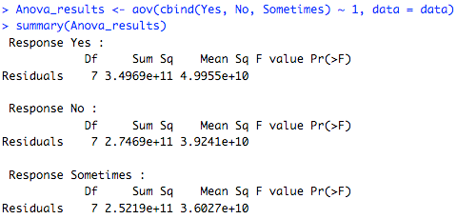
Anova
ANOVA is commonly used in experimental research settings, especially when comparing means across different treatment groups or conditions. It's essential to ensure that the assumptions of ANOVA are met, such as the assumption of normality and homogeneity of variances, to interpret the results accurately.
Null Hypothesis (H0): The means of the groups labeled "Yes," "No," and "Sometimes" are equal.
Alternative Hypothesis (H1): At least one of the means of the groups labeled "Yes," "No," and "Sometimes" is different.
Conclusion: There are no significant differences in mean responses across the groups labelled "Yes," "No," and "Sometimes."

Slide 10

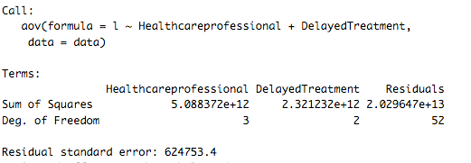
Two Way Anova
Two-way ANOVA, also known as two-factor ANOVA, is an extension of the one-way ANOVA that allows you to analyze the effect of two categorical independent variables (factors) on a continuous dependent variable.
Null Hypothesis (H0): The mean response variable ("l") does not significantly differ across levels of "Healthcareprofessional" and "DelayedTreatment" factors.
Alternative Hypothesis (H1): At least one of the factors ("Healthcareprofessional" or "DelayedTreatment") has a significant effect on the mean response variable ("l").
Conclusion:Both Healthcare Professional and Delayed Treatment seem to have a significant effect on the response variable, based on the ANOVA results

Slide 11

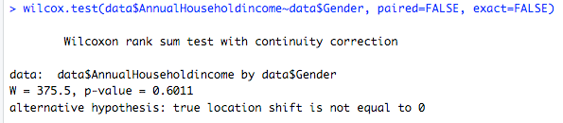
Wilcoxon signed-rank test
The Wilcoxon signed-rank test is commonly used in various fields, especially when dealing with non-normally distributed data or small sample sizes.
Null Hypothesis (H0): The median annual household income for males is equal to the median annual household income for females.
Alternative Hypothesis (H1): The median annual household income for males is not equal to the median annual household income for females.
Conclusion: The p-value of 0.6011 and assuming a significance level of 0.05, we fail to reject the null hypothesis.

Slide 12
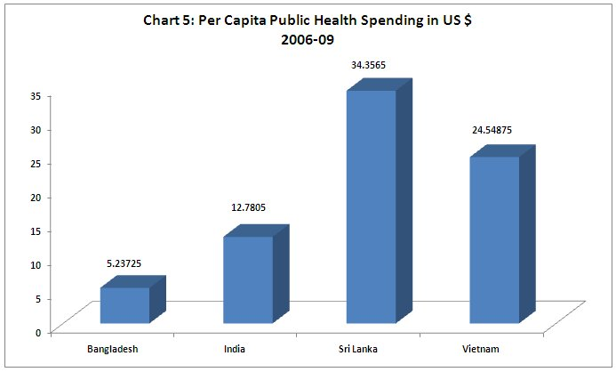
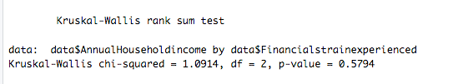
Kruskal-Wallis test
The Kruskal-Wallis test is a non-parametric method used to determine whether there are statistically significant differences between two or more independent groups. It's an extension of the Wilcoxon rank-sum test (Mann-Whitney U test) to more than two groups.
Null Hypothesis (H0): The distributions of annual household income across the different levels of financial strain experienced are equal.
Alternative Hypothesis (H1): At least one group of financial strain experienced differs from the others in terms of their distributions of annual household income
Conclusion: The p-value of 0.5794 and assuming a significance level of 0.05, we fail to reject the null hypothesis.

Slide 13
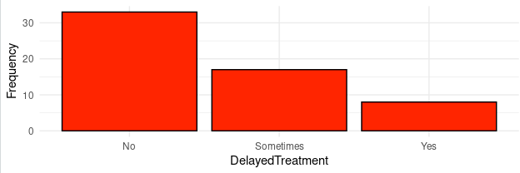
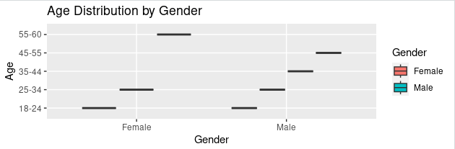
Visualization
Conclusion: Bar Plot suggests that a significant portion of observations did not experience delayed treatment, while fewer observations experienced it either "Yes" or "Sometimes."
Conclusion:Both genders (presumably "Male" and "Female") exhibit similar median ages, as indicated by the position of the horizontal line within each box.
There are no outliers visible beyond the whiskers in either group, suggesting that the age distribution is relatively consistent within each gender category.

Slide 14
Conclusion
The data shows that people have different views and experiences with healthcare and how it affects their finances. Some have health insurance and feel satisfied with their healthcare, while others struggle with financial strain and find healthcare less accessible. People also have varying levels of awareness about healthcare policies and their impact on the economy.

Slide 15

Thanks!

