Slide 1
Team E - Drinking Buddy
The objective of our application is to give bar owners and drinking enthusiasts a place to discuss, share and hear other people’s opinions on the bars near them.
Everyone will be able to view the list of nearby bars which can be sorted from best to worst by category.
Users will be able to create an account and leave reviews and ratings on the bars they choose to, as well as view others reviews.
Bar owners will be able to upload their bar to the site and include pictures and descriptions, as well as read what people are saying about their bar.

Slide 2
Requirements
User should be able to create/edit/delete account.
User must be able to log in and out of their account.
Bar owners and site admins should have different access rights- they should be able to add/edit/delete bars for the users to rate.
Anyone should be able to view bars and their ratings, regardless of whether or not they have an account or what account they have.
Users should be able to rate bars based on certain criteria (price, quality, atmosphere) and leave a more detailed comment if they wish.
Users should be able to sort bars by category. For example: bars sorted from lowest to highest prices.
Users should be able to find a map/address/directions for each bar via Google Maps.

Slide 3

Persona One
This is Christine. She is a 32-year old female from Glasgow. She has recently opened a bar on Byers Road called ‘The Library’, which is primarily aimed at students. She wants to spread the word about her trendy, new bar. In addition to this she wants to hear the opinions of the people who visit her bar, so that she can make improvements and attract more customers. She wants somewhere that she can get honest reviews from her target audience.

Slide 4

Persona Two
Adam is a 19 year old student from Hungary. He has just moved to Glasgow to study Business at the university. He loves socialising, drinking and wants to make friends but he doesn’t know where to do it because he is not familiar with the area. He wants somewhere relaxed and cheap for when he goes out with friends but he might want to take his family somewhere a bit more luxurious when they visit. He finds that most of the reviews already on the internet are outdated and don’t tell him the info that he wants to know- like where the cheapest pint is.

Slide 5
System Architecture
Google search and maps API
Client
Middleware
User
Database

Slide 6
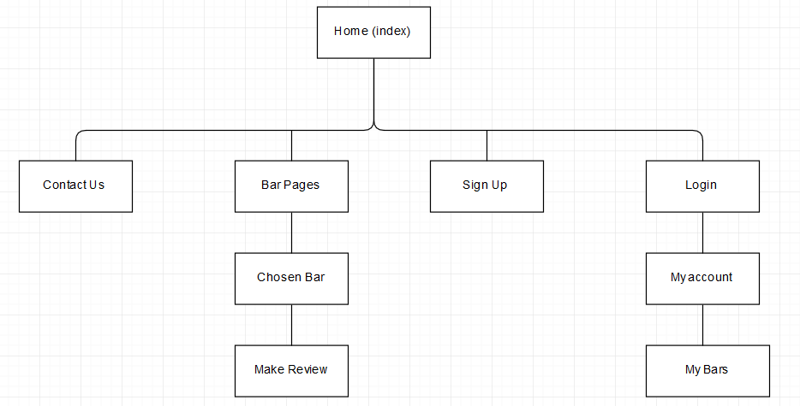
Site Map

Slide 7
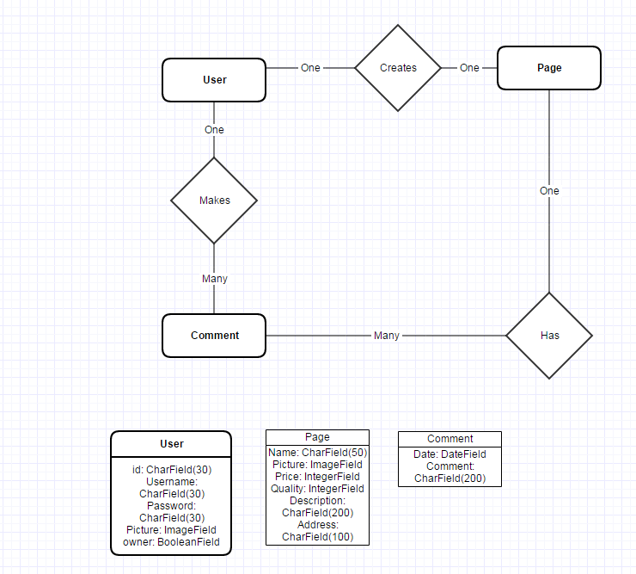
ER Diagram

Slide 8
URLS
/Home
/ContactUs
/BarPages
/BarPages/ChosenBar
/BarPages/ChosenBar/MakeReview
/SignUp
/Login
/Login/MyAccount
/Login/MyBars

Slide 9
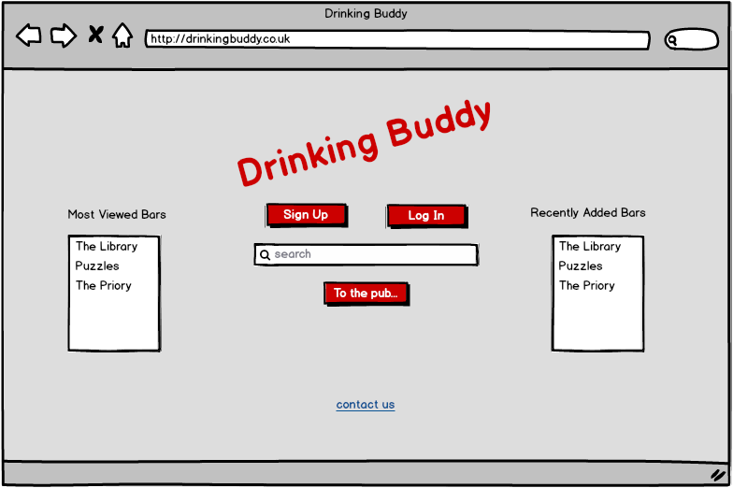
Wireframe 1 – Home Page

Slide 10
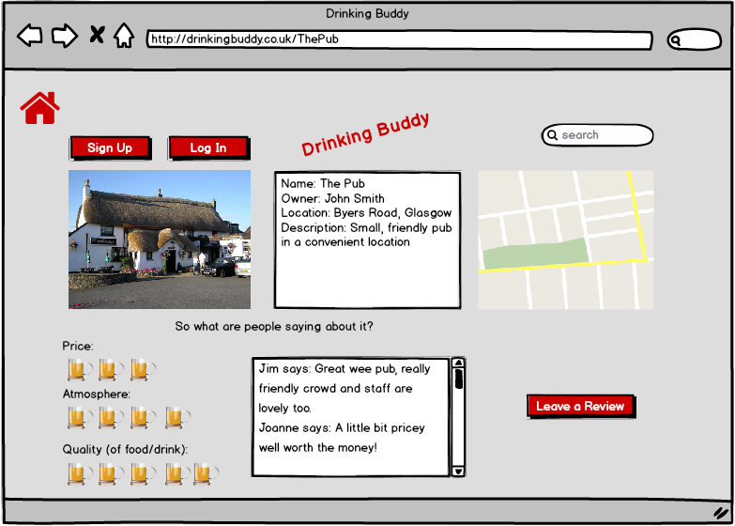
Wireframe 2 – Pub’s Review Page

Slide 11
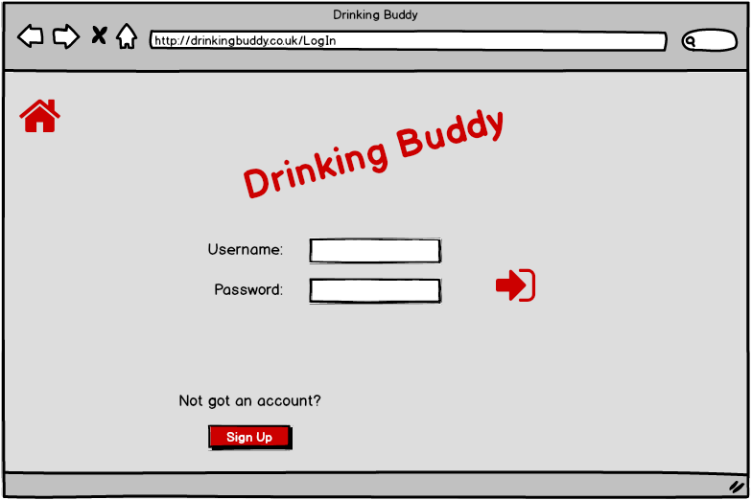
Wireframe 3 – Log In Page

Slide 12
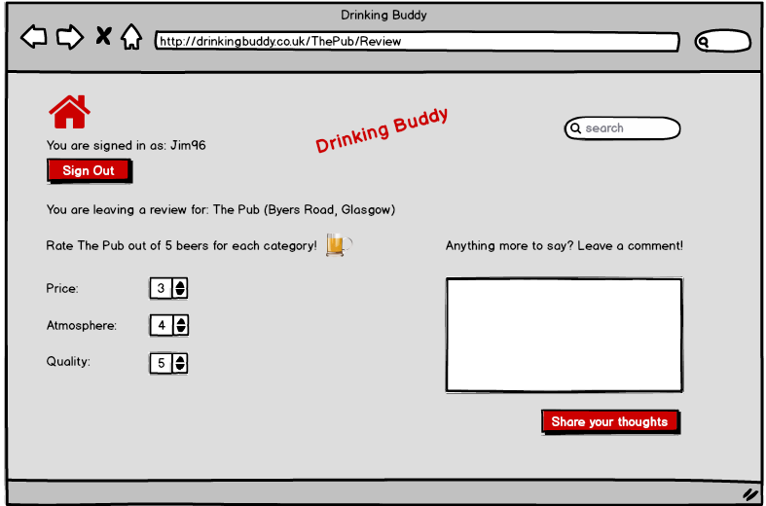
Wireframe 4 – Make Review Page

Slide 13
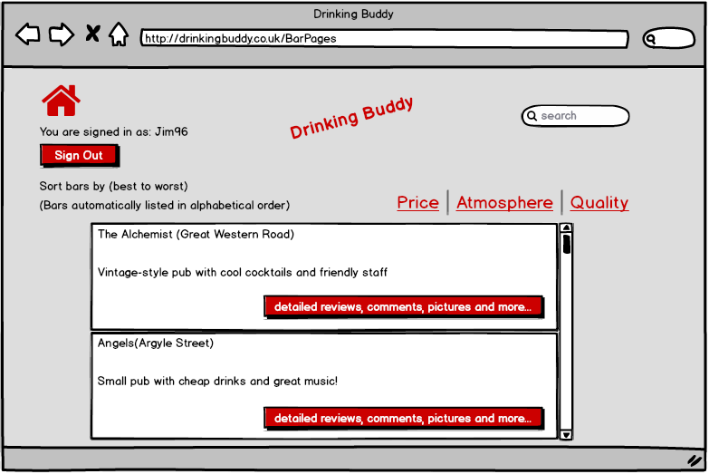
Wireframe 5 – Bar Overviews Page

