Slide 1

Bash Scripting. Automation
Bash Scripting Building Blocks
Repetitive Tasks Automation
SoftUni Team
Technical Trainers
Software University
https://softuni.bg

Slide 2
You Have Questions?
sli.do
#LSA-April
facebook.com
/groups/LinuxSystemAdministrationApril2021

Slide 3
Homework Progress
M7 can be submitted
until 14:59:59 on 19.06
M8 can be submitted
until 14:59:59 on 19.06

Slide 4

Previous Module (M7)
Quick Overview

Slide 5
What We Covered
Web Servers (Apache HTTP)
Relational Databases (MariaDB / MySQL)
Dynamic Web Content Generation (PHP)
Web-based Management Interfaces

Slide 6

This Module (M8)
Topics and Lab Infrastructure

Slide 7

Table of Contents
Scheduled task execution
Writing scripts in bash
Additional information and tools
Exam simulation

Slide 8
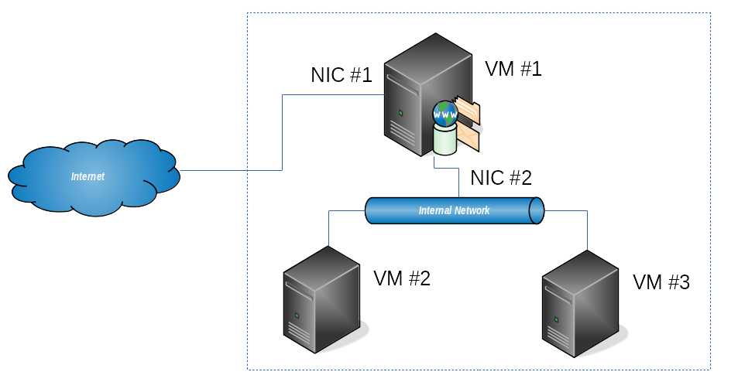
Lab Infrastructure

Slide 9
The End is Here
THIS IS OUR
LAST MODULE
FIRST EXAM IS THIS
SUNDAY

Slide 10
Exam is Coming, Prepare Yourself
Test Your Knowledge
https://zahariev.pro/q/lsa-202104

Slide 11
Book Your Exam
Check Your Profile
at SoftUni Web Site
There Should be a Questionnaire

Slide 12
Exam Reminder
Components, Logistics, and Scoring

Slide 13






Scoring for Linux System Administration
TEST
40 pts.
TEAM
PLAY
HOMEWORK
PRACTICE
EXAM
60 pts.
BONUS
10 pts.
EVALUATION
CRITERIA

Slide 14
Practice
You will be presented with a few machines
They will be connected in certain way
You are expected to:
Install and configure a set of services
Create set of users and groups
Set the appropriate permissions
Write a script that does what requested
Fulfill any additional tasks as per the exam requirements

Slide 15
Test
30
minutes
20
single-choice
questions
10
multi-choice
questions

Slide 16

Scheduling
Periodical Task Execution

Slide 17
Purposes
Regular and repetitive tasks
Cleaning, archiving, monitoring, …
Runtime varies
Schedule based or one-time, but at specific moment
Defined on system or user level

Slide 18
cron
Cron is the main task scheduler in Linux
Components
crond => Daemon
crontab => Management tool
Configuration files
/etc/cron*
Per user jobs
/var/spool/cron/*

Slide 19
cron
* * * * * /path/to/executable
Command to Execute
Day of Week (0-7)
Month (1-12)
Day of Month (1-31)
Hour (0-23)
Minute (0-59)

Slide 20
cron
# Execute every minute
* * * * * /utilities/backup.sh
# Run every noon at 12:00
0 12 * * * /utilities/backup.sh
# Run on 1st of January at 00:00
0 0 1 1 * /utilities/backup.sh
# Run every Monday at 5:30
30 5 * * 1 /utilities/backup.sh
# Run at 00:00 and at 12:00 every day
0 0,12 * * * /utilities/backup.sh
# Run every two hours every day
0 */2 * * * /utilities/backup.sh
# Run hourly between 9 and 17 o’clock every day
0 9-17 * * * /utilities/backup.sh

Slide 21
anacron
Runs commands periodically with frequency in days
It does not assume that the machine is non-stop powered
For each job anacron checks if it has been executed in the last n days, where n is the interval specified for the job
Jobs are stored at /etc/anacrontab
Configuration can be tested with anacron -T
Shortcuts – @daily or 1, @weekly or 7, and @monthly or 30

Slide 22
at
Run a task once at a specific time (you may need to install at package)
Each task is queued at /var/spool/at
Security is defined through /etc/at.allow and /etc/at.deny
Tools
at => Main utility
batch => Auxiliary utility can be used as at to schedule commands
atq => Show jobs at at’s queue
atrm => Delete at jobs
Shortcuts – today, midnight, noon, teatime, date, now + time

Slide 23
Live Demonstration in Class
Practice: Scheduling Tasks

Slide 24

Scripts
Structure and Variables

Slide 25
Structure
#!/bin/bash
#
# hello.sh
#
attn = "dear"
echo "Hello $attn $USER"
Execution: bash hello.sh or ./hello.sh or just hello.sh
Script Signature
Comments
Local Variable
Command

Slide 26
Special Variables
Name of the script $0
Positional arguments $1 .. $9, ${10}, ${11} …
Total number of arguments $#
List of positional parameters $* or $@

Slide 27

Commands and Flow Control

Slide 28
echo
Description
Display line of text
Example
[user@host ~]$ echo 'Hello world!'
Hello world!
[user@host ~]$ echo 'Current user: '$USER
Current user: user

Slide 29
read
Description
Read a line from the standard input and split it into fields
Example
[user@host ~]$ read -p "Enter name:" NM_ENT
Enter name: James
[user@host ~]$ echo $NM_ENT
James

Slide 30
if
Description
Execute commands based on conditional
Example
count=1
if [ $count -eq 0 ]; then
echo 'Equal to 0'
else
echo 'Not equal to 0'
fi

Slide 31
test
Description
Evaluate conditional expression
Example
# Compare numbers: OP1 -eq|-ne|-lt|-le|-gt|-ge OP2
# Compare strings: ST1 =|!=|<|> ST2
# Compare files: FL1 -nt|-ot FL2
# File tests: -d|-e|-f|-x FILE

Slide 32
case
Description
Execute commands based on conditional
Example
count=1
case $count
1) echo 'One'
;;
*) echo 'Not one'
esac

Slide 33
seq
Description
Count from starting to ending point
Example
$ seq 1 5
1 2 3 4 5
$ seq 1 2 5
1 3 5
$ seq -w 5 10
05 06 07 08 09 10

Slide 34
for
Description
Execute command for each member in a list
Example
# List all files with prefix “item:”
for i in $( ls ); do
echo item: $i
done
# Create files fileXX.txt where XX is between 05 and 10
for i in $( seq -w 5 10 ); do
touch file$i.txt
done

Slide 35
for
# Iterate over the elements of a list
for i in {1..10}; do
echo item: $i
done
# C-style for loop
for ((i=1;i<=10;i++)); do
echo item: $i
done
# Nested loops
for i in {1..10}; do
for j in {1..10}; do
echo $i-$j
done
done

Slide 36
while
Description
Execute commands as long as a test succeeds
Example
# Print numbers from 1 to 5
count=1
while [ $count -le 5 ]; do
echo $count
count=$((count+1))
done

Slide 37
until
Description
Execute commands as long as a test does not succeed
Example
# Print numbers from 1 to 5
count=1
until [ $count -gt 5 ]; do
echo $count
count=$((count+1))
done

Slide 38

Simple Scripts
Using Parameters and Prompts

Slide 39
Work with Prompt
Interactive prompt for user input
#!/bin/bash
# Ask for user input
read -p 'Enter your name: ' USR_NAME
echo 'Hello, '$USR_NAME

Slide 40
Accept One Parameter
Check and accept just one parameter
#!/bin/bash
# Accept one parameter
if [ $# -ne 1 ]; then
echo 'Usage: '$0' your_name‘;
exit 1;
fi
echo 'Hello, '$1

Slide 41
Live Demonstration in Class
Practice: Creating Simple Scripts

Slide 42
A Few More Details
Exam

Slide 43
Exam(s) Details
Dates:
20/06/2021 - 10:00 - 14:00, Regular exam (included in the price)
26/06/2021 - 10:00 - 14:00, Re-take exam (paid separately)
Additional 30 minutes for the theory (start it until 14:29)
Place: On-line
Practice: Approximately 5 task groups each with 3-5 subtasks
Test: 30 questions: 20 single and 10 multiple (two) choice
Communication: FB Group & Sli.do

Slide 44
Exam Preparation Materials
Exam Like Tasks
File: M8-Exam-Simulation.docx
Exam Like Questions
File: M8-Exam-Simulation.pptx
More Exam Like Questions
https://zahariev.pro/q/lsa-202104
Will be available until 23:59:59 on 26.06.2021

Slide 45
Live Demonstration in Class
Practice: Exam Simulation

Slide 46
Summary
Sourcing is an alternative approach to script execution
Sourcing can be done in two ways source script.sh or . script.sh
cron and at are tools for scheduling tasks execution
There is set of special permissions – SUID, SGID, and sticky bit
…
…
…

Slide 47
Summary
locate and updatedb provide an alternative option for finding files
Bash scripts are built from comments (#) and commands
Bash scripts can accept parameters on the command line and user input
We can use flow-control (if, case) and loop (for, while, until) commands
…
…
…

Slide 48
Resources
Bash Programming – Introduction How-To
http://tldp.org/HOWTO/Bash-Prog-Intro-HOWTO.html
Bash Reference Manual
https://www.gnu.org/software/bash/manual/html_node/index.html
Cron How-To
https://help.ubuntu.com/community/CronHowto
Cron Schedule Expressions Editor
https://crontab.guru/

Slide 49
Questions?
Notes:
49

Slide 50











SoftUni Diamond Partners

Slide 51



Educational Partners

Slide 52

License
This course (slides, examples, demos, exercises, homework, documents, videos and other assets) is copyrighted content
Unauthorized copy, reproduction or use is illegal
© SoftUni – https://softuni.org
© Software University – https://softuni.bg
Notes:
52

Slide 53
Trainings @ Software University (SoftUni)
Software University – High-Quality Education, Profession and Job for Software Developers
softuni.bg, softuni.org
Software University Foundation
softuni.foundation
Software University @ Facebook
facebook.com/SoftwareUniversity
Software University Forums
forum.softuni.bg
Notes:
53

