Slide 1

Linux System Administration (LSA)
Course Introduction
SoftUni Team
Technical Trainers
Software University
https://softuni.org

Slide 2
You Have Questions?
sli.do
#LSA-April
facebook.com
/groups/LinuxSystemAdministrationApril2021

Slide 3
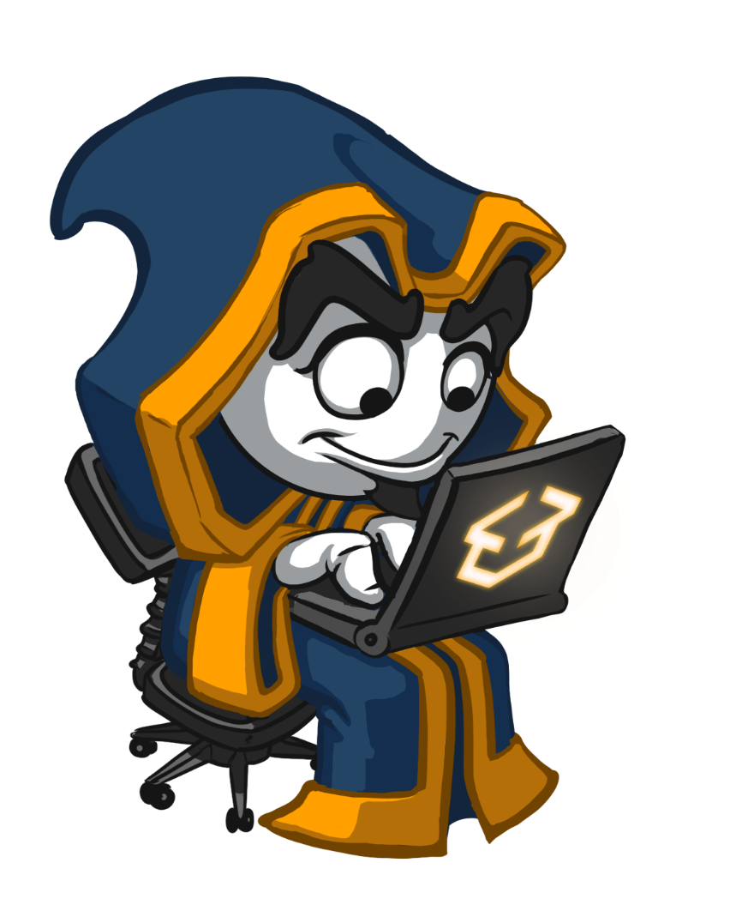
Table of Contents
Course objectives, scope, and schedule
Infrastructure
Exercises and labs
Examination

Slide 4











SoftUni Diamond Partners

Slide 5

What and When Will Be Covered
LSA: Scope and Objectives

Slide 6
Course Objectives
Installation and Configuration of Linux Servers
Feel Comfortable to Work in the Console
Users and Access Management
Software and Services Management
Network Management
BASH Scripting and Basic Tasks Automation

Slide 7
Course Scope and Schedule (1)
Week #1
Introduction to Linux
Virtualization and Installation of a Linux distribution
First Steps in the Console
Week #2
Console Navigation. Getting Help
Working with Files and Folders
Access Rights. Users and Groups

Slide 8
Course Scope and Schedule (2)
Week #3
Text Editors. Regular Expressions
Search for Files. Extract Information from Files
Standard Streams. Command Chains
Week #4
Network and Network Services Management
Packages. Package Managers. Software Management
Services Management

Slide 9
Course Scope and Schedule (3)
Week #5
Boot Process. Boot Loaders and Managers
System Startup Process. Runlevels/Targets
Processes and Resources Monitoring
Week #6
Disks and Partition Management
File Systems and FHS
Backup and Restore Files

Slide 10
Course Scope and Schedule (4)
Week #7
Relational Databases
Web Servers. Languages for Dynamic Web Content
Web-based Management Solutions
Week #8
BASH in Detail
Script Creation
Tasks Automation
+ Exam Preparation

Slide 11

Requirements and Landscape
LSA: Infrastructure

Slide 12
Required Resources
CPU with VT-x/AMD-V
4 GB+ of Free RAM
80 GB+ of Free HDD Space
Virtualization Software (VirtualBox, VMware …, Hyper-V)
ISOs for CentOS*, openSUSE*, and Ubuntu*
* Install Media ~ 100 MB - 8 GB/ISO
* Virtual Machines ~ 4 GB+/VM
* Templates ~ 4 GB+/VM
* VM Snapshots
* You can experiment with others as well, but mind that there could be some differences

Slide 13
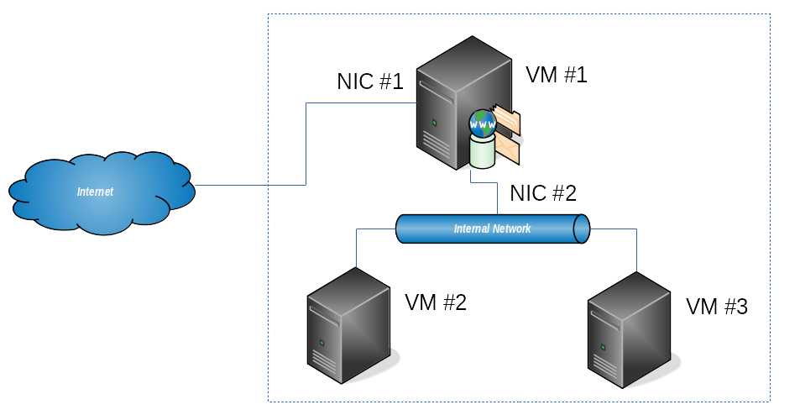
Lab Infrastructure*
* VM type, amount and purpose will vary, but at most, we will have 3 VMs running simultaneously

Slide 14

Duration, Languages, …
LSA: Additional Details

Slide 15

Why English?
Why the slides are in English?
English is the native language of the IT people
Specific terminology should be in English
Translations are inaccurate and funny
Just learn English!
No excuses

Slide 16

Training Duration
Lectures: ~ 14 hours (online)
Practical exercises (online): ~ 10 hours
Homework: ~ 12 hours
Schedule: April 2021 – June 2021
Every Wednesday between 18:30 and 21:30
Exam: 20 June 2021
Retake exam: 26 June 2021
18:30 – 19:30 Part 1
19:30 – 19:40 Break 1
19:40 – 20:30 Part 2
20:30 – 20:40 Break 2
20:40 – 21:30 Part 3

Slide 17
We Will Cover
More than 250 commands
3 distribution families
3 file systems
… and many other interesting things ☺

Slide 18
Is This Enough?
The short answer is NO ☺
Learning by doing is the key
Experiment with different distributions
Use various platforms (virtual and physical)
Try different scenarios and solve variety of tasks
Read a book or two (or even more) on the subject
Attend other courses on the subject as well

Slide 19

Exam and Evaluation Criteria
LSA: Exam Information

Slide 20






Scoring for Linux System Administration
TEST
40 pts.
TEAM
PLAY
HOMEWORK
PRACTICE
EXAM
60 pts.
BONUS
10 pts.
EVALUATION
CRITERIA

Slide 21
Practice
(Install and) configure few machines
Connect them in a certain way
Install and configure a set of software and services
Create a set of files, folders, users and groups
Set the appropriate permissions
Write a script that does what requested
Additional tasks as per the exam requirements

Slide 22
Test
30
minutes
20
single-choice
questions
10
multi-choice
questions

Slide 23
Homework
Every week there will be a homework
You must submit the solution within 7 days
8 assignments worth 1,25 points each
10 bonus points in total

Slide 24

Just a Few Words
About Me

Slide 25
The Trainer
Dimitar Zahariev
During office hours work as BI/DI Consultant
Passionate about technology and teaching
Other side activities:
openSUSE Advocate
VMUG Bulgaria Co-Leader
VP IT & Web PMI Bulgaria Chapter
Communication channels:
SoftUni Forum
Facebook Group
Sli.do

Slide 26



About You
Just a Short Form

Slide 27
About you
Go here: https://zahariev.pro/go/lsa-form
A few words about your
Environment
Experience
Expectations

Slide 28

Summary
We are ready to move forward.

Slide 29
Questions?
Notes:
29

Slide 30

License
This course (slides, examples, demos, exercises, homework, documents, videos and other assets) is copyrighted content
Unauthorized copy, reproduction or use is illegal
© SoftUni – https://about.softuni.bg/
© Software University – https://softuni.bg
Notes:
30

Slide 31
Trainings @ Software University (SoftUni)
Software University – High-Quality Education, Profession and Job for Software Developers
softuni.bg, about.softuni.bg
Software University Foundation
softuni.foundation
Software University @ Facebook
facebook.com/SoftwareUniversity
Software University Forums
forum.softuni.bg
Notes:
31

