Slide 1

Network. Software. Services
Basic Network Configuration. Software and Services Management
SoftUni Team
Technical Trainers
Software University
https://softuni.bg

Slide 2
You Have Questions?
sli.do
#LSA-April
facebook.com
/groups/LinuxSystemAdministrationApril2021

Slide 3
Homework Progress
M3 can be submitted
until 23:59:59 on 23.05
Requested feedback
will be published in the
coming days

Slide 4

Quick Overview
Previous Module (M3)

Slide 5
What We Covered
Working with Input/Output streams
Executing command sequences
Controlling the environment
Working with text editors and files
Using simple regular expressions
Searching for files
SUDO management

Slide 6

Topics and Lab Infrastructure
This Module (M4)

Slide 7

Table of Contents
Network and Services
Software Management
Basic Network Services

Slide 8
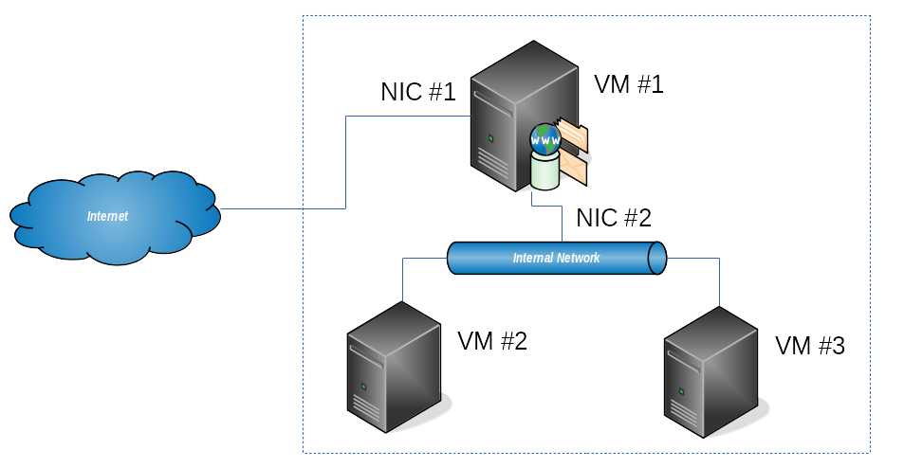
Lab Infrastructure

Slide 9

Network Fundamentals
Basics. OSI vs TCP. IP Addressing

Slide 10
Reference Network Models
Application
Application
RIP
FTP
SNMP
SMTP
Presentation
Telnet
DNS
Session
Transport
Host-to-Host
Transport
TCP
UDP
Network
Internet
IP
IGMP
ICMP
Data-Link
Network Interface
ARP
Physical
Ethernet
...
Token Ring
OSI Model
Layers
TCP/IP Protocol
Architecture Layers
Protocols

Slide 11
Networking Protocols*
IP (Internet Protocol)
Handles addressing and communication between devices
TCP (Transmission Control Protocol)
It complements IP and focuses on the transport of data packages
UDP (User Datagram Protocol)
It is like TCP, but it is connectionless, no error checking
ICMP (Internet Control Message Protocol)
Networking devices such as routers are using it
* Brief list of protocols that most likely we will be exposed to.

Slide 12
Port Numbers
Used to identify a network service
Network services registry in /etc/services
Classification
Well-known (or system) ports: 0 – 1023
Registered (or user) ports: 1024 – 49151
Dynamic (and / or private) ports: 49152 – 65535
Some of them are
22 – SSH, 53 – DNS, 80 – HTTP, 110 - POP3, 123 - NTP , 143 - IMAP

Slide 13
IP General Information
Main terms
IP address - either static or dynamic
Network mask - also known as subnet mask, it marks the border between two networks or subnets
Gateway address - it connects two networks
Broadcast address - used for communication to all hosts on a network. It is the last address of a subnet and it is same for all
Two versions - IPv4 (4,3 Billion) and IPv6 (340 Undecillion)

Slide 14
IPv4 Address Rules
32 bits grouped in 4 octets of 8 bits, which is equal to 4 Bytes
Written in binary or decimal format separated by dots
Ranging from 0.0.0.0 to 255.255.255.255
Divided in two parts – network and host part
Calculation can be made bin-to-dec and dec-to-bin
192.168.200.156
11000000.10101000.11001000.10011100
Value | 128 | 64 | 32 | 16 | 8 | 4 | 2 | 1
Bit # | 8 | 7 | 6 | 5 | 4 | 3 | 2 | 1
Weight | 7 | 6 | 5 | 4 | 3 | 2 | 1 | 0

Slide 15
IPv4 Address Classes and Ranges
Five address classes
Class D and E are reserved and are not for public usage
CIDR = Classless Inter-Domain Routing, a method for allocating IP addresses
Class | Leading Bits | Start | End | Default mask | CIDR Notation | Network Bytes | Host Bytes
Class A | 0 | 0.0.0.0 | 127.255.255.255 | 225.0.0.0 | /8 | 1 | 3
Class B | 10 | 128.0.0.0 | 191.255.255.255 | 255.255.0.0 | /16 | 2 | 2
Class C | 110 | 192.0.0.0 | 223.255.255.255 | 255.255.255.0 | /24 | 3 | 1
Class D | 1110 | 224.0.0.0 | 239.255.255.255 | n/a | n/a | n/a | n/a
Class E | 1111 | 240.0.0.0 | 255.255.255.255 | n/a | n/a | n/a | n/a

Slide 16
Special IPv4 Addresses
Three private (not-routable) addresses ranges
Private address are usually used with custom masks
Block | Start | End | Default mask | Notation | Addresses
24 bit | 10.0.0.0 | 10.255.255.255 | 225.0.0.0 | /8 | 16 777 216
20 bit | 172.16.0.0 | 172.31.255.255 | 255.240.0.0 | /12 | 1 048 576
16 bit | 192.168.0.0 | 192.168.255.255 | 255.255.0.0 | /16 | 65 536

Slide 17
Special IPv4 Addresses (2)
127.0.0.0/8 is reserved for loopback
Network address (all host bits are set to 0), can not be assigned
For 192.168.1.100/24 it is 192.168.1.0
Broadcast address (all host bits are set to 1), can not be assigned
For 192.168.1.100/24 it is 192.168.1.255

Slide 18
IPv4 Address Exercise (Standard Mask)
Class C address
IP 192.168.23.48/24
Result
Network mask: 255.255.255.0
Network: 192.168.23.0
Broadcast: 192.168.23.255
Hosts: 254
(2⁽³²⁻²⁴⁾ - 2 => 2⁸ - 2 => 256 - 2)

Slide 19
IPv4 Address Exercise (Non-Standard Mask)
Class C address
IP 192.168.23.48/27
Result
Network mask: 255.255.255.224
Network: 192.168.23.32
Broadcast: 192.168.23.63
Hosts: 30
(2⁽³²⁻²⁷⁾ - 2 => 2⁵ - 2 => 32 - 2)

Slide 20

Network Device Naming
In Modern Linux Distributions

Slide 21
Naming Schemes
Traditional
eth[0123...], wlan[0123...], ... - eth0
Advantage: Easy to read
Disadvantage: Unpredictable
Current
Could include type, location, etc. - enp0s3
Advantage: Predictable
Disadvantage: Hard to read

Slide 22
Naming Rules
Name Prefixes
en for Ethernet
wl for wireless LAN (WLAN)
ww for wireless wide area network (WWAN)
Name Types
PCI Bus #0
enp0s3
Ethernet
Slot #3
Format | Description
o<index> | On-board device index number
s<slot>[f<function>][d<dev_id>] | Hotplug slot index number
x<MAC> | MAC address
p<bus>s<slot>[f<function>][d<dev_id>] | PCI geographical location
p<bus>s<slot>[f<function>][u<port>][…][c<config>][i<interface>] | USB port number chain

Slide 23

Network Stack
Configuration and Testing

Slide 24
General Information
Managed by Network Manager, SystemD Network or Wicked
Common Tools
Management – (old) ifconfig, (old) route, (new) ip
Testing – ping, arp, arping, traceroute, tracepath, nmap
Monitoring – (old) netstat, (new) ss, tcpdump

Slide 25
General Information
Common Files
Network name information – /etc/networks
Resolver configuration file – /etc/resolv.conf
Static name resolution with IP-name pairs – /etc/hosts
Name Service Switch configuration – /etc/nsswitch.conf

Slide 26



Option #1
Managed by Network Manager
Service is NetworkManager.service
Management Tools
nmcli
nmtui
Configuration Files
/etc/NetworkManager/*
/etc/sysconfig/network-scripts/*

Slide 27
Option #2
Managed by SystemD Network (networkd)
Service is systemd-networkd.service
Management Tools
networkctl
Configuration Files
/etc/network/*
/etc/systemd/network/*

Slide 28
Option #3
Managed by Wicked
Services are wicked.service and wickedd.service
Management Tools
wicked
Configuration Files
/etc/wicked/*
/etc/sysconfig/network/*

Slide 29
Netplan
Network configuration abstraction
Introduced in Ubuntu 16.04, but default since Ubuntu 17.10
Supports NetworkManager and networkd
Network structure is described in YAML
Configuration Files
/etc/netplan/*

Slide 30
ip
Description
Show / manipulate routing, devices, policy routing and tunnels
Show information about links, addresses, and routes
Add/remove address to/from an interface
[root@host ~]# ip {link|address|route|...}
[root@host ~]# ip addr add 192.168.1.44/32 dev enp3s0 label enp3s0:0
[root@host ~]# ip addr del 192.168.1.44/32 dev enp3s0

Slide 31
nmcli
Description
Command line tool for controlling NetworkManager
Example
[user@host ~]$ nmcli
...
[user@host ~]$ nmcli device show
...
[user@host ~]$ nmcli connection show
...

Slide 32
nmtui
Description
Text user interface for controlling NetworkManager
Example
# general utility
[user@host ~]$ nmtui
# specialized sub-utilities
[user@host ~]$ nmtui-connect
[user@host ~]$ nmtui-edit
[user@host ~]$ nmtui-hostname

Slide 33
wicked
Description
Command line tool for controlling wickedd
Example
[user@host ~]$ sudo wicked show eth0
eth0 up
link: #2, state up, mtu 1500
type: ethernet, hwaddr 08:00:27:e3:1b:45
config: compat:suse:/etc/sysconfig/network/ifcfg-eth0
leases: ipv4 dhcp granted
addr: ipv4 10.0.2.15/24 [dhcp]
route: ipv4 default via 10.0.2.2 proto dhcp

Slide 34
networkctl
Description
Query the status of network links managed by networkd
Example
[user@host ~]$ networkctl list
IDX LINK TYPE OPERATIONAL SETUP
1 lo loopback carrier unmanaged
2 enp0s3 ether routable configured
2 links listed.
[user@host ~]$

Slide 35
ping
Description
Send ICMP ECHO_REQUEST to network hosts
Example
[user@host ~]$ ping -c 4 192.168.1.1
PING 192.168.1.1 (192.168.1.1) 56(84) bytes of data.
64 bytes from 192.168.1.1: icmp_seq=1 ttl=128 time=0.76 ms
64 bytes from 192.168.1.1: icmp_seq=2 ttl=128 time=0.56 ms
64 bytes from 192.168.1.1: icmp_seq=3 ttl=128 time=0.54 ms
64 bytes from 192.168.1.1: icmp_seq=4 ttl=128 time=0.63 ms
...
[user@host ~]$

Slide 36
arp
Description
Manipulate or display the system ARP cache
Example
[user@host ~]$ arp
Address Hwtype Hwadress Flags Mask Iface
10.0.2.2 ether 52:54:00:12:35:02 C eth0
...
[user@host ~]$ sudo arp -i eth0 -d 10.0.2.2
...
[user@host ~]$ sudo arp -i eth0 -s 10.0.2.2 52:54:00:12:35:02
...

Slide 37
arping
Description
Send ARP REQUEST to a neighbor host
Example
[user@host ~]$ arping -c 4 192.168.1.1
ARPING 192.168.1.1 from 192.168.1.100 enp0s3
Unicast reply from 192.168.1.1 [00:1B:FC:02:16:9E] 1.321ms
Unicast reply from 192.168.1.1 [00:1B:FC:02:16:9E] 1.271ms
Unicast reply from 192.168.1.1 [00:1B:FC:02:16:9E] 1.205ms
...
[user@host ~]$

Slide 38

Services Control
Manage Services with systemctl

Slide 39
systemctl
Purpose
System service manager
Syntax
List all active services
systemctl [OPTIONS] COMMAND [NAME]
[root@host ~]# systemctl list-units --type=service --state=active
...

Slide 40
Common Systemctl Scenarios
Start a service
Stop a service
Reload a service
Restart a service
[root@host ~]# systemctl start sshd.service
[root@host ~]# systemctl stop sshd.service
[root@host ~]# systemctl reload sshd.service
[root@host ~]# systemctl restart sshd.service

Slide 41
Common Systemctl Scenarios
Show runtime status of a service
Show properties of a service
Enable a service
Disable a service
[user@host ~]$ systemctl status sshd.service
[user@host ~]$ systemctl show sshd.service
[root@host ~]# systemctl enable sshd.service
[root@host ~]# systemctl disable sshd.service

Slide 42
Practice: Network and Services
Live Demonstration in Class

Slide 43

Software Management
Applications. Libraries. Packages

Slide 44
Applications and Libraries
Software Components
Binaries
Libraries
Configuration
Documentation
Data
Problem One: Hard to manage all files and locations, update and keep track of changes
Usually are stored in different locations

Slide 45
Static vs Dynamic Linking
Static Linking
Dynamic Linking
Problem Two: More Space & No Dependency Issues OR Less Space & Dependency Hell
Application 1
Application 2
+ All is here
- Big in size
Lib 1
Lib 1
Application 1
Application 2
+ Small in size
- Dependencies
Lib 1
Lib 1
Lib 1

Slide 46
Packages Are the Solution
Packages and Packaging Systems
Dependency tracking
Easier installation and update
Two* main and widespread formats
rpm - Red Hat packages
deb - Debian packages
* There are others as well

Slide 47
Packages Are the Solution (2)
Packages are available
Locally as individual files
Through local or remote repositories (package catalogs)
Package
System data
Name, Version, …
Actual content
Binary files
Configuration files
Documentation files

Slide 48
rpm
Stands for
Package format
Package database
Package management tool
With rpm we can install, update, and remove local packages
Different set of tools is used to work with repositories
Fedora family is using YUM and DNF
openSUSE family is using Zypper

Slide 49

deb
dpkg is the package management tool
It is used to install, update, and remove local packages
For working with repositories - searching and downloading
Pure text based - APT tools
Pseudo graphical - aptitude
Graphical - synaptic
aptitude, synaptic, …
APT tools (apt, apt-*)
dpkg

Slide 50
ldd
Description
Print shared object dependencies
Example
[user@host ~]$ ldd /bin/ls
linux-vdso.so.1 => (0x00007ffda9378000)
libselinux.so.1 => /lib64/libselinux.so.1 (0x00007f644da11000)
libcap.so.2 => /lib64/libcap.so.2 (0x00007f644d80c000)
libacl.so.1 => /lib64/libacl.so.1 (0x00007f644d602000)
libc.so.6 => /lib64/libc.so.6 (0x00007f644d241000)
libpcre.so.1 => /lib64/libpcre.so.1 (0x00007f644cfe0000)
libdl.so.2 => /lib64/libdl.so.2 (0x00007f644cddb000)

Slide 51

Package Management
Local Packages and RPM

Slide 52
RPM Database
Collection of Berkeley database files
Data is located in /var/lib/rpm
In case of corruption, it can be fixed by the root
Only one user can access the database at a time
It is implemented through lock file /var/lib/rpm/.rpm.lock
[root@host ~]# rpm --rebuilddb
...
[root@host ~]#

Slide 53
RPM Package Files
Source and binary
Full, patch, and delta
Typically they consists of
Compressed binary files
Name and version of the package's software
Build date and host on which it was built
Description of the package and its purpose
Checksums and dependencies required

Slide 54
RPM Package Files
When asking for information
For installed packages - it comes from the database
For not installed packages - it comes from packages themselves
Package naming
packagename-a.b.c-build.arch.rpm
Architecture - x86_64
Build number - 514.el7
Version number - 3.10.0
Package name - kernel

Slide 55
rpm Command
Installing packages
Upgrading packages
Removing and uninstalling packages
Querying the RPM database for information
Verifying the package file
Checking installed files

Slide 56
Common rpm Scenarios
Query for all installed packages
Query for a specific installed package
Query local, but not installed package
List all files in a package
[user@host ~]$ rpm -qa
[user@host ~]$ rpm -q kernel
[user@host ~]$ rpm -qip package.rpm
[user@host ~]$ rpm -ql vim-minimal

Slide 57
Common rpm Scenarios
Query for file dependency
Find package configuration files
Install specific package
Install all packages in current folder
[user@host ~]$ rpm -qf /etc/fstab
[user@host ~]$ rpm -qc openssh
[root@host ~]# rpm -ivh package.rpm
[root@host ~]# rpm -ivh *.rpm

Slide 58
Common rpm Scenarios
Upgrade (and install) all packages from files in folder
Freshen (upgrade if installed) packages
Remove specific package
Remove specific package with specific version
[root@host ~]# rpm -Uv *.rpm
[root@host ~]# rpm -Fvh *.rpm
[root@host ~]# rpm -e package
[root@host ~]# rpm -e package-3.17.0-200.el7

Slide 59

Package Management
Repositories and YUM/DNF

Slide 60
YUM/DNF
Yellowdog Updater Modified
Used by most of the Red Hat based distributions
Related files
Main configuration /etc/yum.conf
Repositories /etc/yum.repos.d/*.repo
Cache files /var/cache/yum
Log file /var/log/yum.log
Replaced by DNF (dandified yum) in Fedora 22+ and CentOS 8+

Slide 61
Common yum/dnf Scenarios (1/4)
List all available packages in the enabled repositories
Search for specific package
Search for all packages starting with a word
Search for a concept
[user@host ~]$ yum list
[user@host ~]$ yum list httpd
[user@host ~]$ yum list http*
[user@host ~]$ yum search "web server"
* dnf can be used instead of yum in above examples

Slide 62
Common yum/dnf Scenarios (2/4)
Search package details for a given string
Display details about a package
List available groups
Search what package provides the given value
[user@host ~]$ yum search http
[user@host ~]$ yum info httpd
[user@host ~]$ yum groups list
[user@host ~]$ yum provides httpd
* dnf can be used instead of yum in above examples

Slide 63
Common yum/dnf Scenarios (3/4)
Install a package
Install two packages without confirmation
Install group of packages
Update the whole system
[root@host ~]# yum install httpd
[root@host ~]# yum -y install httpd php
[root@host ~]# yum groups install "GNOME Desktop"
[root@host ~]# yum upgrade
* dnf can be used instead of yum in above examples

Slide 64
Common yum/dnf Scenarios (4/4)
Update specific package
Remove cached data
Remove installed package
Remove installed group
[root@host ~]# yum upgrade httpd
[root@host ~]# yum clean
[root@host ~]# yum erase httpd
[root@host ~]# yum groups erase "GNOME Desktop"
* dnf can be used instead of yum in above examples

Slide 65
Install EPEL Repository
Extra Packages for Enterprise Linux (EPEL)
Open source and free community-based repository project from Fedora team
Install EPEL repository
[root@host ~]# yum install epel-release
...
[root@host ~]# yum repolist
...
epel/x86_64 Extra Packages for Enterprise ...
...

Slide 66

Package Management
Repositories and zypper

Slide 67
zypper
Used by openSUSE based distributions
CLI (Zypper) and package manager (ZYpp or libzypp)
Related files
Configuration /etc/zypp/zypper.conf and /etc/zypp/zypp.conf
Repositories /etc/zypp/repos.d/*.repo
Cache files /var/cache/zypp
Log file /var/log/zypper.log and /var/log/zypp/history

Slide 68
Common Zypper Scenarios (1/4)
List all available packages in the enabled repositories
Shows details for a specific package
Search for all packages that have a httpd in their name
Search packages by specific word
[user@host ~]$ zypper packages
[user@host ~]$ zypper info wget
[user@host ~]$ zypper search http
[user@host ~]$ zypper what-provides httpd

Slide 69
Common Zypper Scenarios (2/4)
Install a package
Remove a package
Update installed packages
Perform a distribution upgrade
[root@host ~]# zypper install nano
[root@host ~]# zypper remove nano
[root@host ~]# zypper update
[root@host ~]# zypper dist-upgrade

Slide 70
Common Zypper Scenarios (3/4)
List all defined repositories
Add a new repository
Remove specified repository
Refresh all repositories
[user@host ~]$ zypper repos
[root@host ~]# zypper addrepo -r repository.repo
[root@host ~]# zypper removerepo 15
[root@host ~]# zypper refresh

Slide 71
Common Zypper Scenarios (4/4)
List all defined patterns
Install a pattern
Remove a pattern
Clean both metadata and package caches
[user@host ~]$ zypper patterns
[root@host ~]# zypper install -t pattern lxde
[root@host ~]# zypper remove -t pattern lxde
[root@host ~]# zypper clean --all

Slide 72

Package Management
Local Packages and dpkg

Slide 73
DEB Database
Collection of files and folders
Data is located in /var/lib/dpkg
In case of corruption, it can be fixed by following a procedure
Only one user can write to the database at a time
It is implemented through lock file /var/lib/dpkg/lock

Slide 74
DEB Package Files
Source and binary
ar archive file
Three parts
Header - debian-binary
Control Archive - control.tar.{gzip, xz}
Data Archive - data.tar.{gzip, bzip2, lzma, xz}

Slide 75
DEB Package Files
When asking for information
For installed packages - it comes from the database
For uninstalled packages - it comes from the packages themselves
Package naming
packagename_ver-rev_arch.deb
Architecture - amd64
Revision number - 5
Version number - 4.7.2
Package name - gcc-4.7-base

Slide 76
Common dpkg Scenarios (1/2)
List currently installed packages
Print information about installed package
List installed files associated with a package
Locate the package that own a file
[user@host ~]$ dpkg --list
[user@host ~]$ dpkg --status wget
[user@host ~]$ dpkg --listfiles wget
[user@host ~]$ dpkg --search /etc/bash.bashrc

Slide 77
Common dpkg Scenarios (2/2)
Install specific package
Remove a package but leave the configuration files
Remove a package including the configuration files
Reconfigure an installed package
[user@host ~]$ sudo dpkg --install package.deb
[user@host ~]$ sudo dpkg --remove package
[user@host ~]$ sudo dpkg --purge package
[user@host ~]$ sudo dpkg --configure package

Slide 78

Package Management
Repositories and apt/apt-*

Slide 79
apt
Command line package manager
Used by Debian-based distributions
Handles search, install, remove, and update of packages
Offers options more suitable for interactive use
Configuration is stored in /etc/apt/*

Slide 80
Common apt Scenarios (1/2)
List all available packages based on package names
Install a package
Remove a package
Update list of available packages
[user@host ~]$ apt list apache* php*
[user@host ~]$ sudo apt install apache2 php
[user@host ~]$ sudo apt remove apache2
[user@host ~]$ sudo apt update

Slide 81
Common apt Scenarios (2/2)
Get list of packages with available upgrades
Show package details
Upgrade the system
Edit the source information file
[user@host ~]$ apt list --upgradable
[user@host ~]$ apt show apache2
[user@host ~]$ sudo apt upgrade
[user@host ~]$ sudo apt edit-sources

Slide 82
apt-* Tools
Used by Debian-based distributions
It runs on top of APT
It is a lower-level tool compared to aptitude and synaptics
The package includes tools for every task. Some of them are:
Installation, update, and removal of packages - apt-get
Package searching - apt-cache
Key management - apt-key
Configuration management - apt-config

Slide 83
Common apt-* Scenarios (1/3)
List cache statistics
Search for package
List stored keys
Add key
[user@host ~]$ apt-cache stats
[user@host ~]$ apt-cache search wget
[user@host ~]$ apt-key list
[user@host ~]$ sudo apt-key add docker-ce.gpg

Slide 84
Common apt-* Scenarios (2/3)
Remove installed key
List configured repositories and their priorities
Add repository
Remove repository
[user@host ~]$ sudo apt-key remove 0EBFCD88
[user@host ~]$ apt-cache policy
[user@host ~]$ sudo apt-add-repository http://repo.url.com
[user@host ~]$ sudo apt-add-repository –r http://repo.url.com

Slide 85
Common apt-* Scenarios (3/3)
Synchronize package index files with their sources (repositories)
Install the newest versions of all currently installed packages
Install package
Remove package with all configuration files
[user@host ~]$ sudo apt-get update
[user@host ~]$ sudo apt-get upgrade
[user@host ~]$ sudo apt-get install httpd
[user@host ~]$ sudo apt-get purge httpd

Slide 86
Practice: Working with Packages
Live Demonstration in Class

Slide 87

Firewall
Basic Operations and Commands

Slide 88
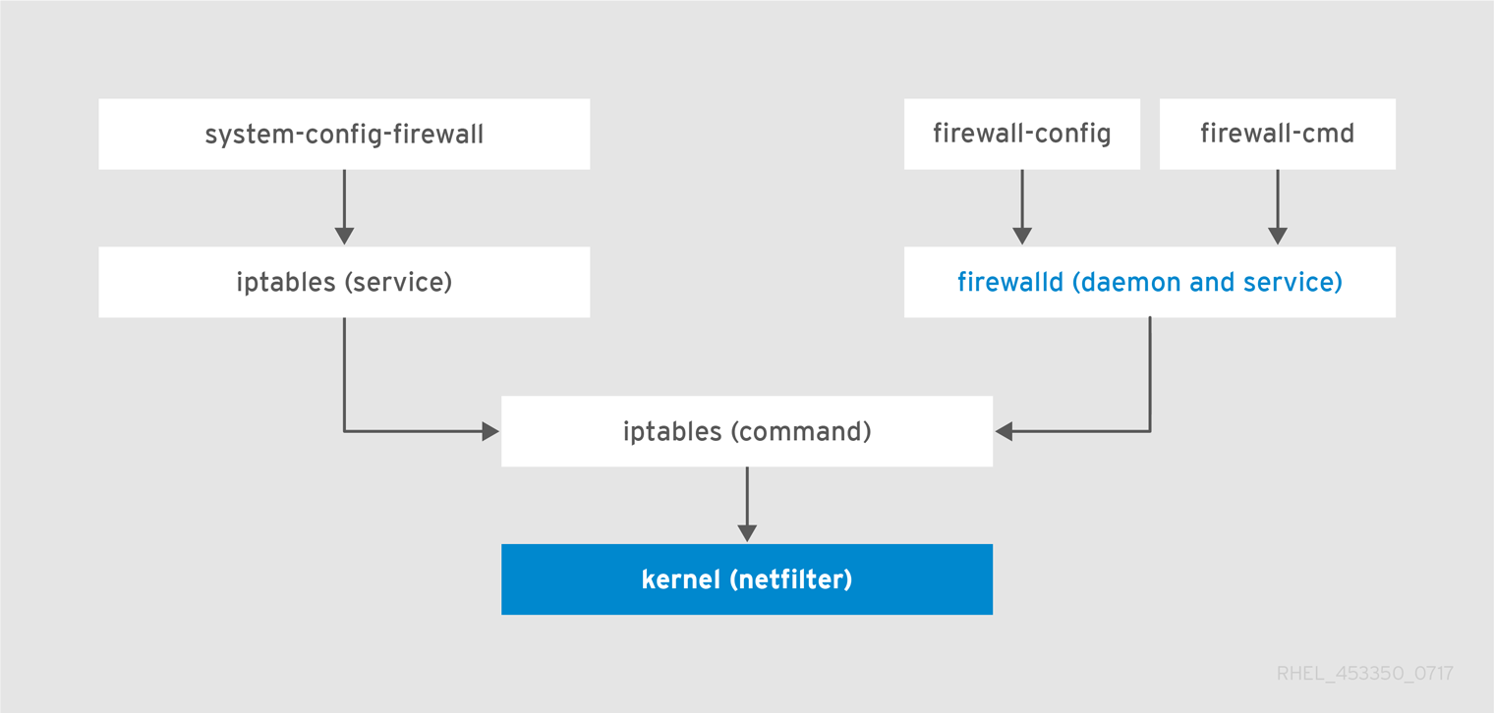
Linux Firewall
https://access.redhat.com/documentation/en-US/Red_Hat_Enterprise_Linux/7/html/Security_Guide/sec-Using_Firewalls.html

Slide 89
Firewall #1
firewalld
Dynamically managed firewall with support for zones
Managed through
Command line interface - firewall-cmd
Special offline tool - firewall-offline-cmd
Graphical application - firewall-config
Configuration files:
/etc/firewalld/* and /usr/lib/firewalld/*

Slide 90
Common firewall-cmd Commands (1/2)
Check if firewall is running
Get firewall zones
Check the default zone
Set default zone
[user@host ~]$ sudo firewall-cmd --state
[user@host ~]$ firewall-cmd --get-zones
[user@host ~]$ firewall-cmd --get-default-zone
[user@host ~]$ sudo firewall-cmd --set-default-zone=internal

Slide 91
Common firewall-cmd Commands (2/2)
Get firewall services
Add firewall service*
Add firewall port*
Reload firewall configuration
[user@host ~]$ firewall-cmd --get-services
[user@host ~]$ sudo firewall-cmd --add-service=http --permanent
[user@host ~]$ sudo firewall-cmd --add-port=22/tcp --permanent
[user@host ~]$ sudo firewall-cmd --reload
* To remove service or port, change the add prefix to remove. Equal signs (=) could be skipped.

Slide 92
Firewall #2
ufw
The Uncomplicated Firewall is a frontend for iptables
ufw provides a framework for managing netfilter
and command-line interface for manipulating the firewall
Managed through
Command line interface - ufw
Configuration files:
/etc/default/ufw and /etc/ufw/*

Slide 93
Common ufw Commands (1/2)
Check if firewall is running
Show extended firewall status
Report ports that are in listening state tcp or open state for udp
Complete firewall report
[user@host ~]$ sudo ufw status
[user@host ~]$ sudo ufw status verbose
[user@host ~]$ sudo ufw show listening
[user@host ~]$ sudo ufw show raw

Slide 94
Common ufw Commands (2/2)
List allowed applications
Allow port rule*
Allow application rule*
Reload firewall configuration
[user@host ~]$ sudo ufw app list
[user@host ~]$ sudo ufw allow 80/tcp
[user@host ~]$ sudo ufw allow OpenSSH comment 'allow ssh app'
[user@host ~]$ sudo ufw reload
* To remove port or application, use the delete command

Slide 95

Secure Shell (SSH)
Introduction

Slide 96
Secure Shell (SSH)
Provides secure way to access computer over an unsecured network
By default, it is installed on CentOS and openSUSE
By default, it is started on CentOS
Package
openssh-server
openssh

Slide 97
Secure Shell (SSH)
Configuration:
Server - /etc/ssh/sshd_config
Client - /etc/ssh/ssh_config
Listens on TCP port 22
Popular clients for Windows – PuTTY, KiTTY, WinSCP, OpenSSH
Our task: Explore SSH connectivity

Slide 98
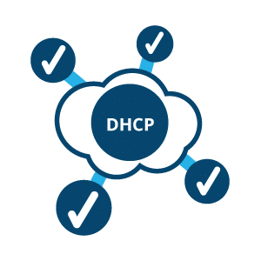
Dynamic Host Configuration Protocol
Introduction

Slide 99
Dynamic Host Configuration Protocol
Commonly referred to as DHCP
Dynamically sets network configuration for connected devices
By default, only the client is installed
Package name
dhcp-server
isc-dhcp-server

Slide 100
Dynamic Host Configuration Protocol
Configuration:
CentOS & Ubuntu: /etc/dhcp/dhcpd.conf
openSUSE:
/etc/sysconfig/dhcpd
/etc/dhcpd.conf
Listens on UDP port 67
Our task: Configure client-server environment

Slide 101

Network Time Protocol (NTP)
Introduction

Slide 102
Network Time Protocol (NTP)
Allows time synchronization of machines over the network
By default, it is
Installed on openSUSE
Not installed on CentOS and Ubuntu
Typical servers Chrony, NTP, …

Slide 103
Network Time Protocol (NTP)
Configuration:
NTP: /etc/ntp.conf
Chrony: /etc/chrony.conf
Listens on UDP port 123
Our task: Install and configure NTP

Slide 104

File Transfer Protocol (FTP)
Introduction

Slide 105
File Transfer Protocol (FTP)
Allows transfer of files between a client and server systems
By default, it is not installed
Typical servers ProFTPD, vsftpd, …
Configuration:
ProFTPD - /etc/proftpd.conf
vsftpd - /etc/vsftpd/* , /etc/vsftpd.conf
Listens on TCP port 21
Our task: Install and configure FTP server - vsftpd

Slide 106
Practice: Basic Network Services
Live Demonstration in Class

Slide 107
Summary
We know that there are multiple network models
There are also two addressing schemes IPv4 and IPv6
Modern Linux support multiple network device naming schemes
There are at least three software solutions for network management
…
…
…

Slide 108
Summary
deb and rpm are the two most popular packaging formats
Each one has its own set of tools both low and high level, cli and gui based
Debian family is dpkg as low-level tool and apt tools as high level
Fedora family is using rpm as low-level tool and yum or dnf as high level
openSUSE family is using combination of rpm and zypper
…
…
…

Slide 109
Resources
…
…
…
RPM packages
https://en.wikipedia.org/wiki/Rpm_(software)
DEB packages
https://en.wikipedia.org/wiki/Deb_(file_format)
https://www.debian.org/doc/manuals/debian-faq/ch-pkg_basics.en.html
Netplan Documentation
https://wiki.ubuntu.com/Netplan
https://wiki.ubuntu.com/MigratingToNetplan

Slide 110
Resources
…
…
…
Ubuntu Uncomplicated Firewall
https://wiki.ubuntu.com/UncomplicatedFirewall
https://help.ubuntu.com/lts/serverguide/firewall.html
Red Hat Networking and Security (incl. Firewall) Documentation
https://access.redhat.com/documentation/en-us/red_hat_enterprise_linux/7/html/networking_guide/
https://access.redhat.com/documentation/en-us/red_hat_enterprise_linux/7/html/security_guide/index
openSUSE Leap Documentation https://doc.opensuse.org/

Slide 111
Questions?
Notes:
111

Slide 112











SoftUni Diamond Partners

Slide 113



Educational Partners

Slide 114

License
This course (slides, examples, demos, exercises, homework, documents, videos and other assets) is copyrighted content
Unauthorized copy, reproduction or use is illegal
© SoftUni – https://about.softuni.bg/
© Software University – https://softuni.bg
Notes:
114

Slide 115
Trainings @ Software University (SoftUni)
Software University – High-Quality Education, Profession and Job for Software Developers
softuni.bg, about.softuni.bg
Software University Foundation
softuni.foundation
Software University @ Facebook
facebook.com/SoftwareUniversity
Software University Forums
forum.softuni.bg
Notes:
115

