Slide 1

Advanced Console Techniques
Command Sequences. Streams. Text Editing. Searching for and Within Files. SUDO Management
SoftUni Team
Technical Trainers
Software University
https://softuni.bg

Slide 2
You Have Questions?
sli.do
#LSA-April
facebook.com
/groups/LinuxSystemAdministrationApril2021

Slide 3
Homework Progress

Slide 4
Poll #1: Host OS
124 participants / data as of 12.05.2021

Slide 5
Poll #2: CPU Architecture
124 participants / data as of 12.05.2021

Slide 6
Poll #3: Virtualization Solution
124 participants / data as of 12.05.2021

Slide 7
Poll #4: Linux Experience
124 participants / data as of 12.05.2021

Slide 8
Poll #5: Linux Experience Type
124 participants / data as of 12.05.2021

Slide 9
Poll #6: Windows Experience
124 participants / data as of 12.05.2021

Slide 10
Poll #7: Windows Experience Type
124 participants / data as of 12.05.2021

Slide 11
Poll #8: Profile
124 participants / data as of 12.05.2021

Slide 12

Previous Module (M2)
Quick Overview

Slide 13
What We Covered
Console Deep Dive
Getting Help
Files and Folders
Users and Groups
Access Rights

Slide 14

This Module (M3)
Topics and Lab Infrastructure

Slide 15

Table of Contents
Input / Output Streams
Command Sequences
Regular Expressions
Advanced File Techniques
Screen Editors
SUDO Management

Slide 16
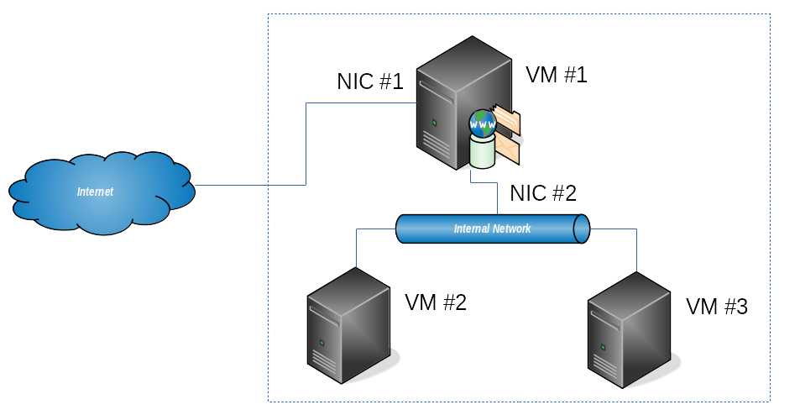
Lab Infrastructure

Slide 17
Input / Output Streams
stdin stdout
stderr
Standard File Descriptors. Redirection

Slide 18
Standard File Descriptors
Terminal
Application
Monitor
#2 stderr
#1 stdout
Keyboard
#0 stdin

Slide 19
Redirect Input (<)
Description
Redirect input stream (stdin). Usually, it is omitted
Example
[user@host ~]$ cat < hello.txt
Hello!
...
[user@host ~]$ cat hello.txt
Hello!
...

Slide 20
Redirect Output (>)
Description
Redirect output streams (stdout or stderr) with target overwrite
Example
[user@host ~]$ echo 'Hello!' > hello.txt
...
[user@host ~]$ echo 'Hello!' 1> hello.txt
...
[user@host ~]$ cat hello.txt
Hello!
...

Slide 21
Redirect Output with Append (>>)
Description
Redirect output streams (stdout or stderr) with target append
Example
[user@host ~]$ cat file.txt
Line #1
[user@host ~]$ echo 'Line #2' >> file.txt
[user@host ~]$ cat file.txt
Line #1
Line #2

Slide 22
Set -/+o Noclobber
Description
(Dis)allow existing regular files to be overwritten by redirection
Example
[user@host ~]$ set -o noclobber
[user@host ~]$ echo 'Hi!' > file.txt
[user@host ~]$ echo 'Hi!' > file.txt
bash: file.txt: existing file cannot be overwritten
[user@host ~]$

Slide 23
Redirection Order
Order is important
Redirection instructions are processed left to right
Example
[user@host ~]$ cat missing.txt > out.txt 2>&1
# is different compared to this
[user@host ~]$ cat missing.txt 2>&1 > out.txt

Slide 24
Redirection Recipes
Only stdout
Both stdout and stderr – different targets
Both stdout and stderr – same target
[user@host ~]$ ls -alF > dir_list.txt
[user@host ~]$ ls -al file.txt > ok.txt 2> err.txt
[user@host ~]$ ls -al file.txt > res.txt 2>&1

Slide 25
Problem: Create Document
Description
Create text document on the command line (on the fly)
Example
[user@host ~]$ cat file.txt
Line #1
Line #2
Line #3

Slide 26
Solution(s): Create Document
Solution #1 (heredoc)
Solution #2 (echo)
[user@host ~]$ cat > file.txt << EOF
>Line #1
>Line #2
>EOF
[user@host ~]$ cat file.txt
Line #1
Line #2
[user@host ~]$ echo 'Line #1' > file.txt
[user@host ~]$ echo 'Line #2' >> file.txt
[user@host ~]$ cat file.txt
Line #1
Line #2
Same result different approaches

Slide 27

Command Sequences
Execute Multiple Commands. Substitution

Slide 28
Commands Sequences
Execute in order (disconnected)
Sequence: command1 ; command2
Execute in order (connected)
Pipe: command1 | command2
Execute conditionally
On Success: command1 && command2
On Failure: command1 || command2

Slide 29
Sequence (;)
Description
Always execute next command
Example
[user@host ~]$ ls non-existing-file.txt ; echo Ok
ls: cannot access non-existing-file.txt: No such file or directory
Ok
[user@host ~]$

Slide 30
Pipe (|)
Description
Chaining two or more programs' output together
Example
[user@host ~]$ ls | sort | head -n 3
abcde.txt
bad_words.txt
file2.txt
[user@host ~]$

Slide 31
On Success (&&)
Description
Next command is executed if previous one exited with status of 0
Example
[user@host ~]$ ls non-existing-file.txt && echo Ok
ls: cannot access non-existing-file.txt: No such file or directory
[user@host ~]$ ls existing-file.txt && echo Ok
existing-file.txt
Ok

Slide 32
On Failure (||)
Description
Next command is NOT attempted if previous one exited with 0
Example
[user@host ~]$ ls existing-file.txt || echo Ok
existing-file.txt
[user@host ~]$ ls non-existing-file.txt || echo Ok
ls: cannot access non-existing-file.txt: No such file or directory
Ok

Slide 33
Command Substitution
Description
Substitute the command output for the command itself
Example
# file_name.txt contains the text /etc/os-release
[user@host ~]$ cat `cat file_name.txt`
...
[user@host ~]$ cat $(cat file_name.txt)
...

Slide 34
Breaking Long Commands
Instead of having this
We could do it this way
[user@host ~]$ cut -d : -f 7 /etc/passwd | sort | uniq | wc -l
[user@host ~]$ cut -d : -f 7 /etc/passwd \
| sort \
| uniq \
| wc -l

Slide 35
tee
Purpose
Read from standard input and write to standard output and files
Syntax
Examples
tee [options] [file]
# Show file content on screen and save it to file
[user@host ~]$ cat list.txt | tee listed.txt
# List directory on the screen and append to file
[user@host ~]$ ls -al / | tee -a root-dir.txt

Slide 36
xargs
Purpose
Build and execute command lines from standard input
Syntax
Examples
xargs [options] [command [initial arguments]]
# Delete list of files read from a text file
[user@host ~]$ cat file_list.txt | xargs rm –rf
# Show file content of every *.conf file in /etc
[user@host ~]$ ls /etc/*.conf | xargs cat

Slide 37
Practice: Redirection and Sequences
Live Demonstration in Class

Slide 38
Regular Expressions
^[abc]\.??
Know them. Use them

Slide 39
Wildcards
*
Any characters
?
Any single character
[characters]
Any character that is a member of the set characters
[!characters]
Any character that is not a member of the set characters
[[:class:]]
Any character that is a member of the specified class

Slide 40
Character Classes
Frequently used
Class | Description
[:alnum:] | Alphanumeric characters A-Z, a-z, and 0-9
[:word:] | Same as [:alnum:] including underscore (_)
[:alpha:] | Alphabetic characters A-Z and a-z
[:digit:] | Numeric characters 0-9
[:lower:] | All lowercase letters a-z
[:upper:] | All uppercase letters A-Z

Slide 41
Globing Examples
*
All files
a*
Any file beginning with a
a*.txt
Any file beginning with a and ending with .txt
[abc]???
Any file beginning with either a, b, or c, and followed by 3 chars

Slide 42
Bracket Expressions
Inclusion
Exclusion
Ranges
[user@host ~]$ ls [abc]*.txt
[user@host ~]$ ls [^abc]*.txt
[user@host ~]$ ls [a-z]*.txt

Slide 43
Regular Expressions
Consists of literals and metacharacters
Basic Regular Expressions (BRE)
^ , $ , . , [ , ] , *
Extended Regular Expressions (ERE)
BRE + ( , ) , { , } , ? , + , |

Slide 44
Control Characters
.
any single character - (.text) => atext, btext2, 2text, …
^
Begging of the line - (^text) => text, textone, texttwo, …
$
End of the line - (text$) => text, newtext, lasttext, …
\
Escape character - (.\.text) => new.text, new.text2, …

Slide 45
Quantifiers
?
Match an element zero times or one time
*
Match an element zero or more times
+
Match an element one or more times
{}
Match an element a specific number of times
Rule | Meaning
{n} | Exactly n times
{n,m} | At least n times, but not more than m times
{n,} | n or more times
{,m} | No more than m times

Slide 46
grep
Purpose
Print lines matching a pattern
Syntax
Examples
grep [options] patterns [files]
# Display lines containing the false word #1
[user@host ~]$ grep -n false /etc/passwd
# Display lines containing the false word #2
[user@host ~]$ cat /etc/passwd | grep -n false

Slide 47
Few Usage Scenarios
Display all lines starting with one or two
Display all lines starting with one or containing two
Display all lines containing first one and then two
Display all lines containing one and two in any order
[user@host ~]$ grep -E '^(one|two)' list.txt
[user@host ~]$ grep -E '^one|two' list.txt
[user@host ~]$ grep -E 'one.*two' list.txt
[user@host ~]$ grep one list.txt | grep two

Slide 48

Advanced File Techniques
Find them. Work with them

Slide 49
find
Purpose
Search for files in a directory hierarchy
Syntax
Examples
find [options] [starting point] [expression]
# Find all *.txt files starting from current dir
[user@host ~]$ find . -type f -name *.txt
# Search for files executable by others
[user@host ~]$ find . -type f -perm /o+x

Slide 50
Common Find Scenarios
All files owned by particular user
All files that do not belong to particular user
All files bigger than 10 MB
All files changed today
[root@host ~]# find /tmp -type f -user root
[root@host ~]# find /tmp -type f ! -user root
[root@host ~]# find / -type f -size +10M -ls
[root@host ~]# find /tmp -type f -mtime 0 -ls

Slide 51
locate*
Purpose
Find files by name
Syntax
Examples
locate [options] pattern
# Locate all readme files
[root@host ~]# locate readme
# Locate all readme files in a case insensitive way
[root@host ~]# locate -i readme
* It is not installed automatically in every distribution. You may have to install it additionally

Slide 52
updatedb*
Purpose
Update a database for mlocate
Syntax
Examples
updatedb [options]
# Update the database
[root@host ~]# updatedb
# Write the update to a file
[root@host ~]# updatedb -o output.txt
* It is not installed automatically in every distribution. You may have to install it additionally

Slide 53

Extract Data
Extract Data from Files. Combine Files

Slide 54
tac
Purpose
Concatenate and print files in reverse
Syntax
Examples
tac [options] [files]
# Print one file in reverse
[user@host ~]$ tac readme.txt
# Print /etc/*.conf files in reverse
[user@host ~]$ tac /etc/*.conf

Slide 55
more
Purpose
A filter for paging through text one screen at a time
Syntax
Examples
more [options] [files]
# Open one file for reading
[user@host ~]$ more /etc/services
# Open two files for reading
[user@host ~]$ more /etc/os-release /etc/services

Slide 56
less*
Purpose
It is similar to more, but allows movement in both directions
Syntax
Examples
less [options] [files]
# Open one file for reading
[user@host ~]$ less /etc/services
# Open two files for reading
[user@host ~]$ less /etc/os-release /etc/services
* A common joke says that less is more ☺

Slide 57
head
Purpose
Output the first part (10 lines by default) of files
Syntax
Examples
head [options] [files]
# Show first ten lines of a file
[user@host ~]$ head /etc/passwd
# Show first three lines of a file
[user@host ~]$ head -n 3 /etc/passwd

Slide 58
tail
Purpose
Output the last part (10 lines by default) of files
Syntax
Examples
tail [options] [files]
# Show last ten lines of a file
[user@host ~]$ tail /etc/passwd
# Show last three lines of a file
[user@host ~]$ tail -n 3 /etc/passwd

Slide 59
uniq
Purpose
Report or omit repeated lines
Syntax
Examples
uniq [options] [files]
# Print only duplicate lines
[user@host ~]$ uniq -D file.txt
# Print contents with repeated lines omitted
[user@host ~]$ uniq file.txt

Slide 60
sort
Purpose
Sort lines of text files
Syntax
Examples
sort [options] [files]
# Print sorted content of a file
[user@host ~]$ sort file.txt
# Print sorted only unique lines of a file
[user@host ~]$ sort -u file.txt

Slide 61
wc
Purpose
Print newline, word, and byte counts for each file
Syntax
Examples
wc [options] [files]
# Print statistics for a file
[user@host ~]$ wc /etc/service
# Print number of newlines in a file
[user@host ~]$ wc -l /etc/service

Slide 62
nl
Purpose
Add number to the beginning of every line in a file
Syntax
Examples
nl [options] [files]
# Print numbered lines read from a file
[user@host ~]$ nl /etc/service
# Print numbered lines with leading zeroes
[user@host ~]$ nl -w 4 -nrz /etc/service

Slide 63
cut
Purpose
Remove sections from each line of files
Syntax
Examples
cut options [files]
# Cut field #1 (username) from /etc/passwd
[user@host ~]$ cut -d : -f 1 /etc/passwd
# Cut fields #1 and #7 from /etc/passwd
[user@host ~]$ cut -d : -f 1,7 /etc/passwd

Slide 64
paste
Purpose
Merge lines of files
Syntax
Examples
paste [options] [files]
# Merge two files
[user@host ~]$ paste day_num.txt day_name.txt

Slide 65
join
Purpose
Join lines of two files on a common field
Syntax
Examples
join [options] file1 file2
# Join two files
[user@host ~]$ join -t : -j 1 f1.txt f2.txt

Slide 66
split
Purpose
Split a file into pieces
Syntax
Examples
split [options] [input [prefix]]
# Split file in multiple files 50 lines each
[user@host ~]$ split -l 50 services
# Split file in multiple files 50 lines each #2
[user@host ~]$ split -a 3 –d -l 50 services part

Slide 67
expand
Purpose
Convert tabs to spaces
Syntax
Examples
expand [options] [files]
# Convert tabs to four spaces each
[user@host ~]$ expand -t 4 file.txt

Slide 68
unexpand
Purpose
Convert spaces to tabs
Syntax
Examples
unexpand [options] [files]
# Convert every four spaces to tab
[user@host ~]$ unexpand -t 4 file.txt

Slide 69
fmt
Purpose
Provides simple text formatting
Syntax
Examples
fmt [options] [files]
# Format the text to 60 columns
[user@host ~]$ fmt --width 60 file.txt

Slide 70
tr
Purpose
Translate or delete characters
Syntax
Examples
tr [options] set1 [set2]
# Convert every : to |
[user@host ~]$ tr ':' '|' < /etc/passwd
# Delete all occurrences of :
[user@host ~]$ tr -d ':' < /etc/passwd

Slide 71
od
Purpose
Dump files in octal or other formats
Syntax
Examples
od [options] [files]
# Print file’s content in octal format
[user@host ~]$ od /etc/passwd
# Print file’s content using named characres
[user@host ~]$ od -a /etc/passwd

Slide 72
Practice: Patterns, Files. Extract Data
Live Demonstration in Class

Slide 73

Screen Editors
Characteristics. vim

Slide 74
Screen Editors*
Characteristics
File content is seen one screen at a time
Offer content navigation (line-by-line and page-by-page)
Commands are invoked from a menu or key combinations
Offer syntax highlighting, line numbering, etc.
User experience varies
Typical Screen Editors
vi (vim), nano, pico, joe, emacs
* Screen text editor available by default varies between distributions

Slide 75
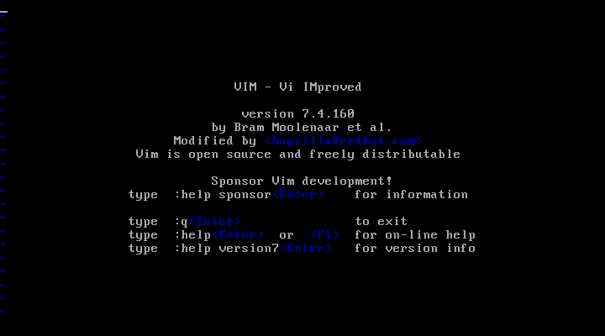
VIM (Vi IMproved)

Slide 76
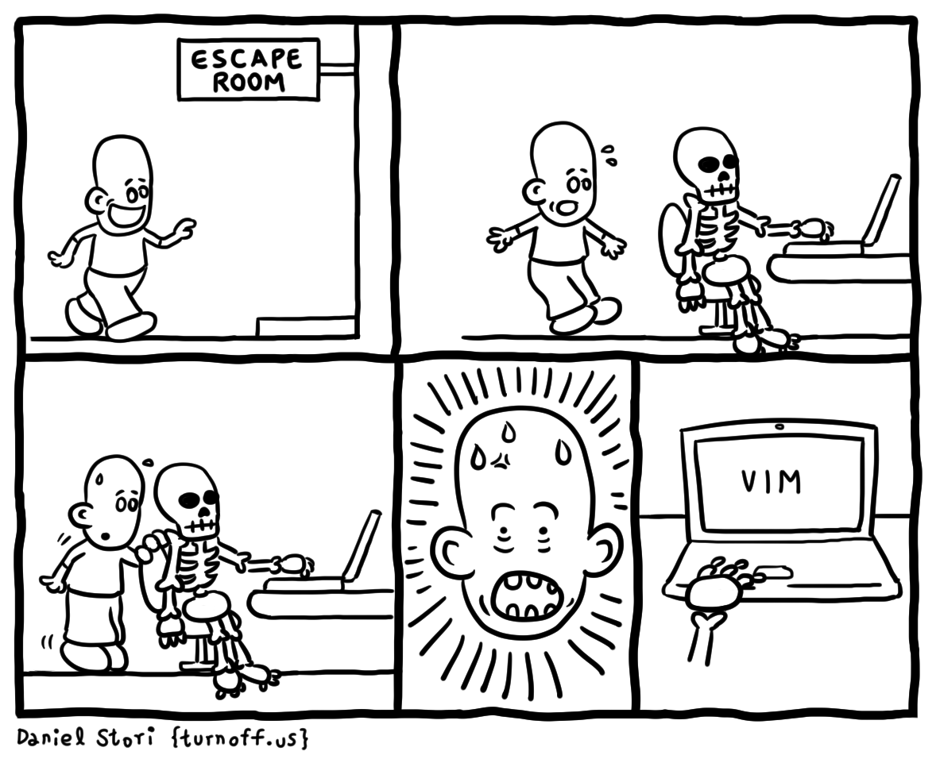
Quit VIM If You Can
http://turnoff.us/geek/escape-room/

Slide 77
VIM Modes
Normal (command)
Navigation
Command (ex command or last line mode)
Commands are entered after the : symbol
Insert
Replace
Visual

Slide 78
Navigation in Normal Mode
Using keys h, j, k, and l
Key | Action
Ctrl + b | Moves backward a page
Ctrl + u | Moves backward a half-page
k
Key | Action
Ctrl + f | Moves forward a page
Ctrl + d | Moves forward a half-page
h
l
Key | Action
^ (Shift + 6) | Moves to the line start
$ (Shift + 4) | Moves to the line end
b | Moves backward a word
w | Moves forward a word
Key | Action
gg | Moves to the first line
G | Moves to the last line
15G or 15gg | Goes to line 15
j

Slide 79
Enter in Insert Mode
i key - Insert here
I key (Shift + i) - Insert at the beginning of the line
a key - Append after current position
A key (Shift + a) - Append to the end of the line
o key - Open a new line bellow
O key (Shift + o) - Open a new line above

Slide 80
Enter in Replace and Visual Mode
r key
Replace one symbol under the cursor
R key (Shift + r)
Enters in replace mode
v key
Enters in visual mode with custom selection allowed
V key (Shift + v)
Enters in visual mode with line selection enabled

Slide 81
Deleting Text and Lines
Key | Delete action
x | Single character under the cursor
X | Single character before the cursor
dw | To the end of a single word under the cursor
3dw | Three words
dd | Current line
d^ or d0 | All text from the beginning of the line to the cursor
D or d$ | All text from cursor position to the end of the line
dL | All text from the cursor to the end of the screen
dG | All text from the cursor to the end of the document

Slide 82
Copy, Paste, and Join
Key | Action
yy | Copies a line of text
3yy | Copies three lines of text
yw | Copies from the cursor to the end of the word
3yw | Copies three words
p | Pastes to the right of the cursor
P (Shift + p) | Pastes to the left of the cursor
J (Shift + j) | Joins current line to the previous

Slide 83
Searching and Replacing
Search only
Forward /string and backward ?string
Move between occurrences n (same direction) and N (opposite)
Search-and-Replace Syntax
action/string-to-find/replace-with/modifier
First instance on the current line - :s/tcp/TCP/
All instances on the current line - :s/tcp/TCP/g
All instances - :%s/tcp/TCP/g

Slide 84
Undo Changes
u key
Undo one change
:e!
Re-read the file, discarding all changes

Slide 85
Save Changes
:w
Save the file
:wq
Save the file and quit
:x
Save the file and quit
ZZ (Shift + z + z)
Save the file and quit

Slide 86
Quit Commands
:q
Quit if no changes are made without save
:q!
Quit without save

Slide 87
Few More Scenarios
:w another-file.txt
Save the file as another-file.txt
:20,30w /tmp/file.txt
Save the lines between 20 and 30 to /tmp/file.txt
:r another-file.txt
Insert the contents of another-file.txt at the cursor position
:r ! uname -a
Insert the result from the uname -a command at the cursor

Slide 88
VIM Options
Set an option
:set number - turn on line numbering
:set nonumber - turn off line numbering
List options
All options :set all or for the current user :set
Store options in a configuration file
System level /etc/virc or /etc/vimrc
On user level ~/.vimrc

Slide 89
Screen Editors
nano

Slide 90
nano *
Easier for most newcomers
Offers menu-like navigation
Most commands are available as key combinations
Usually, Ctrl (displayed as ^) and Alt (displayed as M) are used
Should you need help, you can always press Ctrl+G
* Depending on the distribution and the installation type, additional steps may be required.

Slide 91
Stream Editors
[~]$ sed
Characteristics. sed

Slide 92
Stream Editors
Characteristics
Treat the text as stream of characters
Can apply transformations on the fly
Typical stream editors
sed, awk

Slide 93
sed
Description
Stream editor for filtering and transforming text
Example
[user@host ~]$ echo 'one twenty-one' | sed s/one/ONE/g
ONE twenty-ONE
...
[user@host ~]$ sed s/one/ONE/g filein.txt > fileout.txt
...

Slide 94
Common Sed Scenarios #1
Replace first instance
Replace all instances
Two consecutive search and replace operations
[user@host ~]$ sed s/tcp/TCP/ file.txt
[user@host ~]$ sed s/tcp/TCP/g file.txt
[user@host ~]$ sed 's/tcp/TCP/g ; s/TCP/UDP/g' file.txt
...
[user@host ~]$ sed -e s/tcp/TCP/g -e s/TCP/UDP/g file.txt
...

Slide 95
Common Sed Scenarios #2
Replace pattern with spaces
Replace all instances, but print only the changed ones
Search and replace in rage of lines
Delete comment and empty lines and create a backup
[user@host ~]$ sed 's/is not/is too/g' file.txt
[user@host ~]$ sed -n s/dns/DNS/pg /etc/services
[user@host ~]$ sed -n '1,10s/dns/DNS/pg' services
[user@host ~]$ sed –i.bak '/^#/d;/^$/d' services

Slide 96
Stream Editors
[~]$ awk
awk

Slide 97
awk
Each line of text is a record
Lines are separated based on the carriage return/line feed char
Every record can have different amount of fields
Each word in the line, separated by a space or tab is a field
Fields are referenced by $numbers
The first field is $1, second is $2 and so on

Slide 98
awk
Description
Pattern scanning and processing language
Example
# print the first two fields of every line
[user@host ~]$ cat file.txt | awk '{print $1,$2}'
# using different field separator
[user@host ~]$ cat /etc/passwd | awk -F ':' '{print $1,$7}'
# use only lines containing the word text
[user@host ~]$ cat file.txt | awk '/text/ {print $1,$7}'

Slide 99

Other Use Cases
Other use Cases of Vim

Slide 100
vipw
Description
Edit the passwd or shadow-password file
Example
[root@host ~]# vipw
...
user:x:1000:1000::/home/user:/bin/bash
devops:x:1001:1001::/home/devops:/bin/bash
clerk:x:1002:1002::/home/clerk:/bin/bash
...

Slide 101
vigr
Description
Edit the group or shadow-group file
Example
[root@host ~]# vigr
...
user:x:1000:user
devops:x:1001:devops
clerk:x:1002:clerk
...

Slide 102
visudo
Description
Edit the sudoers file
Example
[root@host ~]# visudo
...
# Allow root to run any commands anywhere
root ALL=(ALL) ALL
...

Slide 103

SUDO Management
Other means of controlling SUDO

Slide 104
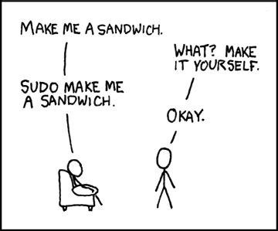
The Sandwich Request ☺
https://xkcd.com/149/

Slide 105
SUDO Configuration
Control who can do what and from where
Main configuration file
/etc/sudoers
Additional configuration files
/etc/sudoers.d/
Can be managed with group membership as well
wheel (CentOS, openSUSE), admin (Ubuntu), sudo (Ubuntu)
Supports aliases for users, hosts, and commands

Slide 106
SUDO File Format
Main configuration instructions
For user: user (host)=(user:group) [options] commands
For group: %group (host)=(user:group) [options] commands
Examples
# root can execute any command as anyone from anywhere
root ALL=(ALL:ALL) ALL
# (alternative)
root ALL=(ALL) ALL
# members of group can execute any command as anyone from anywhere
%wheel ALL=(ALL) ALL
# user can execute any command as anyone from anywhere w/o password
demo ALL=(ALL) NOPASSWD: ALL
# user can execute specific command as anyone from anywhere w/o password
demo ALL=(ALL) NOPASSWD: /usr/bin/command

Slide 107
Practice: vim, sed, vipw, vigr, visudo
Live Demonstration in Class

Slide 108
Summary
…
…
…
stdin, stdout, and stderr are the three system streams or descriptors
They can be redirected with operators like <, >, <<, and >>
Multiple redirection instructions are read from left to right
We can create command sequences with the help of ;, |, &&, ||
Commands in the sequences can be (in)dependent on each other

Slide 109
Summary
…
…
…
We can link the output of one command to the next, and then to another, …
wc, cut, tac, head, tail, and sort are just several of the text processing tools
grep and find allow us to search in or for files
Vim is integral part of our toolset. It is very powerful and minimalistic editor
However, sed and awk cover tasks that require stream editing

Slide 110
Resources
The Linux Command Line
http://linuxcommand.org/tlcl.php
Bash Guide for Beginners
http://tldp.org/LDP/Bash-Beginners-Guide/html/index.html
Bash Reference Manual
https://www.gnu.org/software/bash/manual/html_node/index.html
Vim Home
http://www.vim.org/
Vim Adventures
https://vim-adventures.com/
sed Manual
https://www.gnu.org/software/sed/manual/sed.html

Slide 111
Questions?
Notes:
111

Slide 112











SoftUni Diamond Partners

Slide 113

License
This course (slides, examples, demos, exercises, homework, documents, videos and other assets) is copyrighted content
Unauthorized copy, reproduction or use is illegal
© SoftUni – https://about.softuni.bg/
© Software University – https://softuni.bg
Notes:
113

Slide 114
Trainings @ Software University (SoftUni)
Software University – High-Quality Education, Profession and Job for Software Developers
softuni.bg, about.softuni.bg
Software University Foundation
softuni.foundation
Software University @ Facebook
facebook.com/SoftwareUniversity
Software University Forums
forum.softuni.bg
Notes:
114

