Slide 1
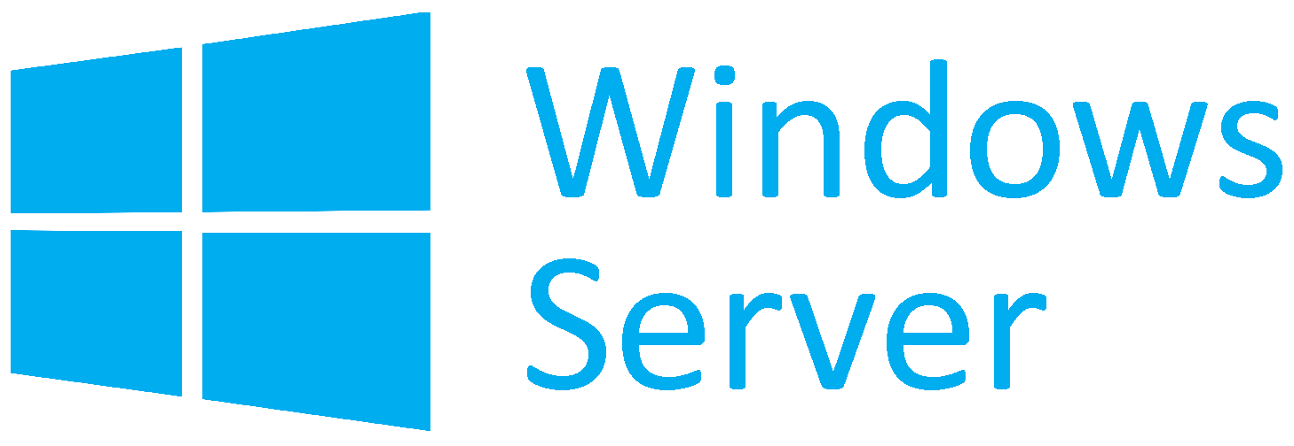
Virtualization
Virtualization with Hyper-V
SoftUni Team
Technical Trainers
Software University
https://softuni.org

Slide 2
Have a Question?
sli.do
#WSA-Advanced
facebook.com
/groups/WindowsSystemAdministrationAdvancedJune2021

Slide 3
Homework Progress
Solutions for M1
can be submitted
until 23:59 on 11.07.2021

Slide 4

Previous Module (M1)
Quick Overview

Slide 5
What We Covered
Storage Overview
Shared Storage
Server Storage
Additional Storage Techniques

Slide 6
This Module (M2)
Topics

Slide 7
Table of Contents
Hyper-V Installation and Configuration
Hyper-V Virtual Machines
Hyper-V Storage and Networking
Additional Techniques

Slide 8
Lab Infrastructure
WSAA.LAB
VM1
(DC)
VM2
(SERVER1)
VM3
(SERVER2)
.2
.101
.102
vSwitch
NAT Network: 192.168.99.0/24
Hyper-V / VirtualBox / VMware
Windows / Linux / macOS

Slide 9
Lab Infrastructure
WSAA.LAB
VM1
(DC)
VM2
(SERVER1)
VM3
(SERVER2)
.2
.101
.102
vSwitch
NAT Network: 192.168.99.0/24
Hyper-V / VirtualBox / VMware
Windows / Linux / macOS

Slide 10
Virtualization
Level 101

Slide 11
Virtualization in General
“
The act of creating a virtual (rather than actual) version of something, including virtual computer hardware platforms,
storage devices, and computer network resources
”
https://en.wikipedia.org/wiki/Virtualization

Slide 12
Virtualization Terminology
The layer of software that sits above the hardware and below one or more operating systems is called hypervisor
The hypervisor provides isolated execution environments called partitions. Each partition has its own set of virtualized hardware resources. The hypervisor controls and arbitrates access to the underlying hardware
Software that is running in a partition is called guest. It can be a full-featured operating system or a small, special-purpose kernel. The hypervisor is guest-agnostic
Virtual processor is a virtual abstraction of a processor that is scheduled to run on a logical processor. A virtual machine can have one or more virtual processors
Virtual machine is a virtual computer that was created by software emulation and has the same characteristics as a real computer
https://docs.microsoft.com/en-us/windows-server/administration/performance-tuning/role/hyper-v-server/terminology

Slide 13
Types of Virtualization
Host
Operating
System
Guest OS
Guest OS
Guest OS
Guest OS
Virtual Machine
Virtual Machine
Virtual Machine
Virtual Machine
Parent Partition
Child Partition
(VM)
Child Partition
(VM)
Child Partition
(VM)
Child Partition
(VM)
Virtual Machine Monitor (VMM)
Hypervisor
Hardware
Hardware
Type 2
Type 1

Slide 14
Hyper-V Architecture
Virtual Service Providers (VSPs)
Allow support for non-CPU and memory hardware
Virtual Machine Bus (VMBus)
Enables communication between VSPs and VSCs. It is not shared - one channel between each child and the parent
Virtual Service Clients (VSCs)
Make requests to the corresponding VSP hosted on the parent partition
Virtual Machine Management Service (VMMS)
Manages the states of the VMs and launches VMWPs
Virtual Machine Worker Process (VMWP)
One for each child partition. Controls the state and enables certain types of emulated hardware
Management
(Parent Partition)
VM1
(Child Partition)
VM2
(Child Partition)
VMWP.EXE
User Mode
Application
Application
VMMS.EXE
VSPs
Virtual Drivers
(I/O Stack)
Virtual Drivers
(I/O Stack)
Kernel Mode
I/O Stack
VSCs
VSCs
Drivers
VMBus
VMBus
VMBus
Hypervisor
Ring -1
Hardware
https://docs.microsoft.com/en-us/windows-server/administration/performance-tuning/role/hyper-v-server/architecture

Slide 15
Hyper-V Requirements
A 64-bit CPU with
Hardware-assisted virtualization (Intel VT-x or AMD-V)
Second level address translation (Intel EPT or AMD NPT)
Hardware-enforced Data Execution Prevention (DEP)
For Intel it is the XD bit, while for AMD it is NX bit
VM Monitor Mode extensions
Virtualization support turned on in the BIOS or UEFI
At least 4GB of RAM
https://docs.microsoft.com/en-us/windows-server/virtualization/hyper-v/system-requirements-for-hyper-v-on-windows

Slide 16
Hyper-V Options and Licensing
Available in two flavors
Stand-alone – Hyper-V Server
Role-based addition to Windows Server (or Windows 8.x/10)
For the client version, it is supported officially only on Windows 10 Enterprise, Pro, or Education
From licensing point of view
Hyper-V is free but offers no licenses for the guest operating systems
Windows Server Standard comes with two licenses
Windows Server Datacenter comes with unlimited licenses

Slide 17
Hyper-V Installation
Stand-alone
Separate installation media
Add-on to Windows
Via DISM either on-line or off-line
Via PowerShell on Windows Server
Via PowerShell on Windows 10
Server Manager > Manage > Add Roles and Features for Windows Server
Settings > Apps and Features > Programs and Features for Windows 10
dism /online /enable-feature /all /featurename:microsoft-hyper-v
Install-WindowsFeature -Name Hyper-V -IncludeManagementTools -Restart
Enable-WindowsOptionalFeature -Online -FeatureName Microsoft-Hyper-V -All

Slide 18
Hyper-V Control and Delegation
Installed with a member of Domain Admins or local Administrator
Once installed use the local Hyper-V Administrators group
Specific privileges can be controlled via Authorization Manager (azman.msc). Marked as deprecated since Windows Server 2012 R2
System Center Virtual Machine Manager is the current method for managing roles and permissions. It is a separate non-free product
Windows Admin Center is also an option, and it is free

Slide 19
Hyper-V Management Tools
Hyper-V Manager and PowerShell module
Both can manage local and remote Hyper-V servers
GUI installation follows the same path as with the main component
In PowerShell we can install the whole pack:
Just the Hyper-V Manager
Or only the PowerShell module:
Install-WindowsFeature -Name RSAT-Hyper-V-Tools
Install-WindowsFeature -Name Hyper-V-Tools
Install-WindowsFeature -Name Hyper-PowerShell

Slide 20
Hyper-V Remote Management*
On the remote (managed) server
Create the required firewall rules
Enable the use of CredSSP for authentication
On the local (management) station
Add the managed server to the trusted hosts list
Enable CredSSP on the station
Enable-PSRemoting
Enable-WSManCredSSP -Role "Server"
Set-Item wsman:\localhost\client\trustedhosts -value "hyperv.wsaa.lab"
Enable-WSManCredSSP -Role Client -DelegateComputer "hyperv.wsaa.lab"
* Needed only when both the managed server and management station are not in the same domain, or not in any domain

Slide 21
VM Generations
Generation 1
Supports both 32 and 64-bit guest operating systems
Emulates typical devices like AMI BIOS, S3 video card, etc.
Generation 2
Supports only 64-bit guest operating systems
Uses synthetic drivers and software-based devices
Supports newer hardware like UEFI, SCSI, etc.
Supports newer Windows (8+ and Server 2012+), Linux and FreeBSD
https://docs.microsoft.com/en-us/windows-server/virtualization/hyper-v/plan/should-i-create-a-generation-1-or-2-virtual-machine-in-hyper-v

Slide 22
VM Versions
Hypervisor version and VM version are linked
VM version indicates the available features
A hypervisor can run VMs with a lower version
Get information about each machine and its version
Check what are the supported VM versions
Upgrade a VM
Get-VM
Get-VMHostSupportedVersion
Update-VMVersion -VM Machine1

Slide 23
VM Files
Configuration file (*.vmc or *.vmcx)
VMC (XML files, up to 2012) and VMCX (binary, 2016+) contain the VM configuration information plus all its settings
Hard disk (*.vhd or *.vhdx)
One or more files used to store the guest operating system, applications, and data
(Runtime) state file (*.bin or *.vmrs)
Contains the memory (BIN, up to 2012) or the runtime state (VMRS, 2016+) of the VM

Slide 24
VM Creation
Using the New Virtual Machine wizard
Specify name and location
Select a generation
Set memory options
Set networking options
Select an existing or create a new hard disk
Set the operating system installation options
With PowerShell
New-VM -Name Machine1 -Generation 2 -MemoryStartupBytes 1gb

Slide 25
VM Memory Management
Dynamic memory allows automatic allocation and deallocation of memory as needed
RAM specifies the allotted amount of memory when VM starts
Minimum RAM specifies the least amount of memory that can be left to a VM when dynamic memory is reducing the allocation
Maximum RAM specifies the maximum amount of memory that dynamic memory can ever allocate to a VM
Memory buffer specifies the percentage of the currently allocated memory that dynamic memory should retain for further expansion
Since Windows Server 2016 Hyper-V memory of a running VM can be changed for both Generation 1 and 2

Slide 26
VM Integration Services
A software package that runs on a guest operating system. Enables the communication between the guest and the host
There are six* components
Operating system shutdown
Time synchronization
Data exchange
Heartbeat
Backup (volume shadow copy)
Guest services
Turned on by default
https://docs.microsoft.com/en-us/virtualization/hyper-v-on-windows/reference/integration-services

Slide 27
VM Export and Import
Used to move a VM to another server or create a new copy of a VM
Export a VM using the Hyper-V Manager or with PowerShell
When importing a VM there are three options
Register the VM in-place leaves the files where they are and uses the existing VM ID
Restore the VM copies the files to a new location and uses the existing VM ID
Copy the VM copies the files to a new location and generates a new ID
Export-VM -Name Machine1 -Path D:\Backup

Slide 28
Practice: Virtualization
Level 101

Slide 29
Virtualization
Level 102

Slide 30
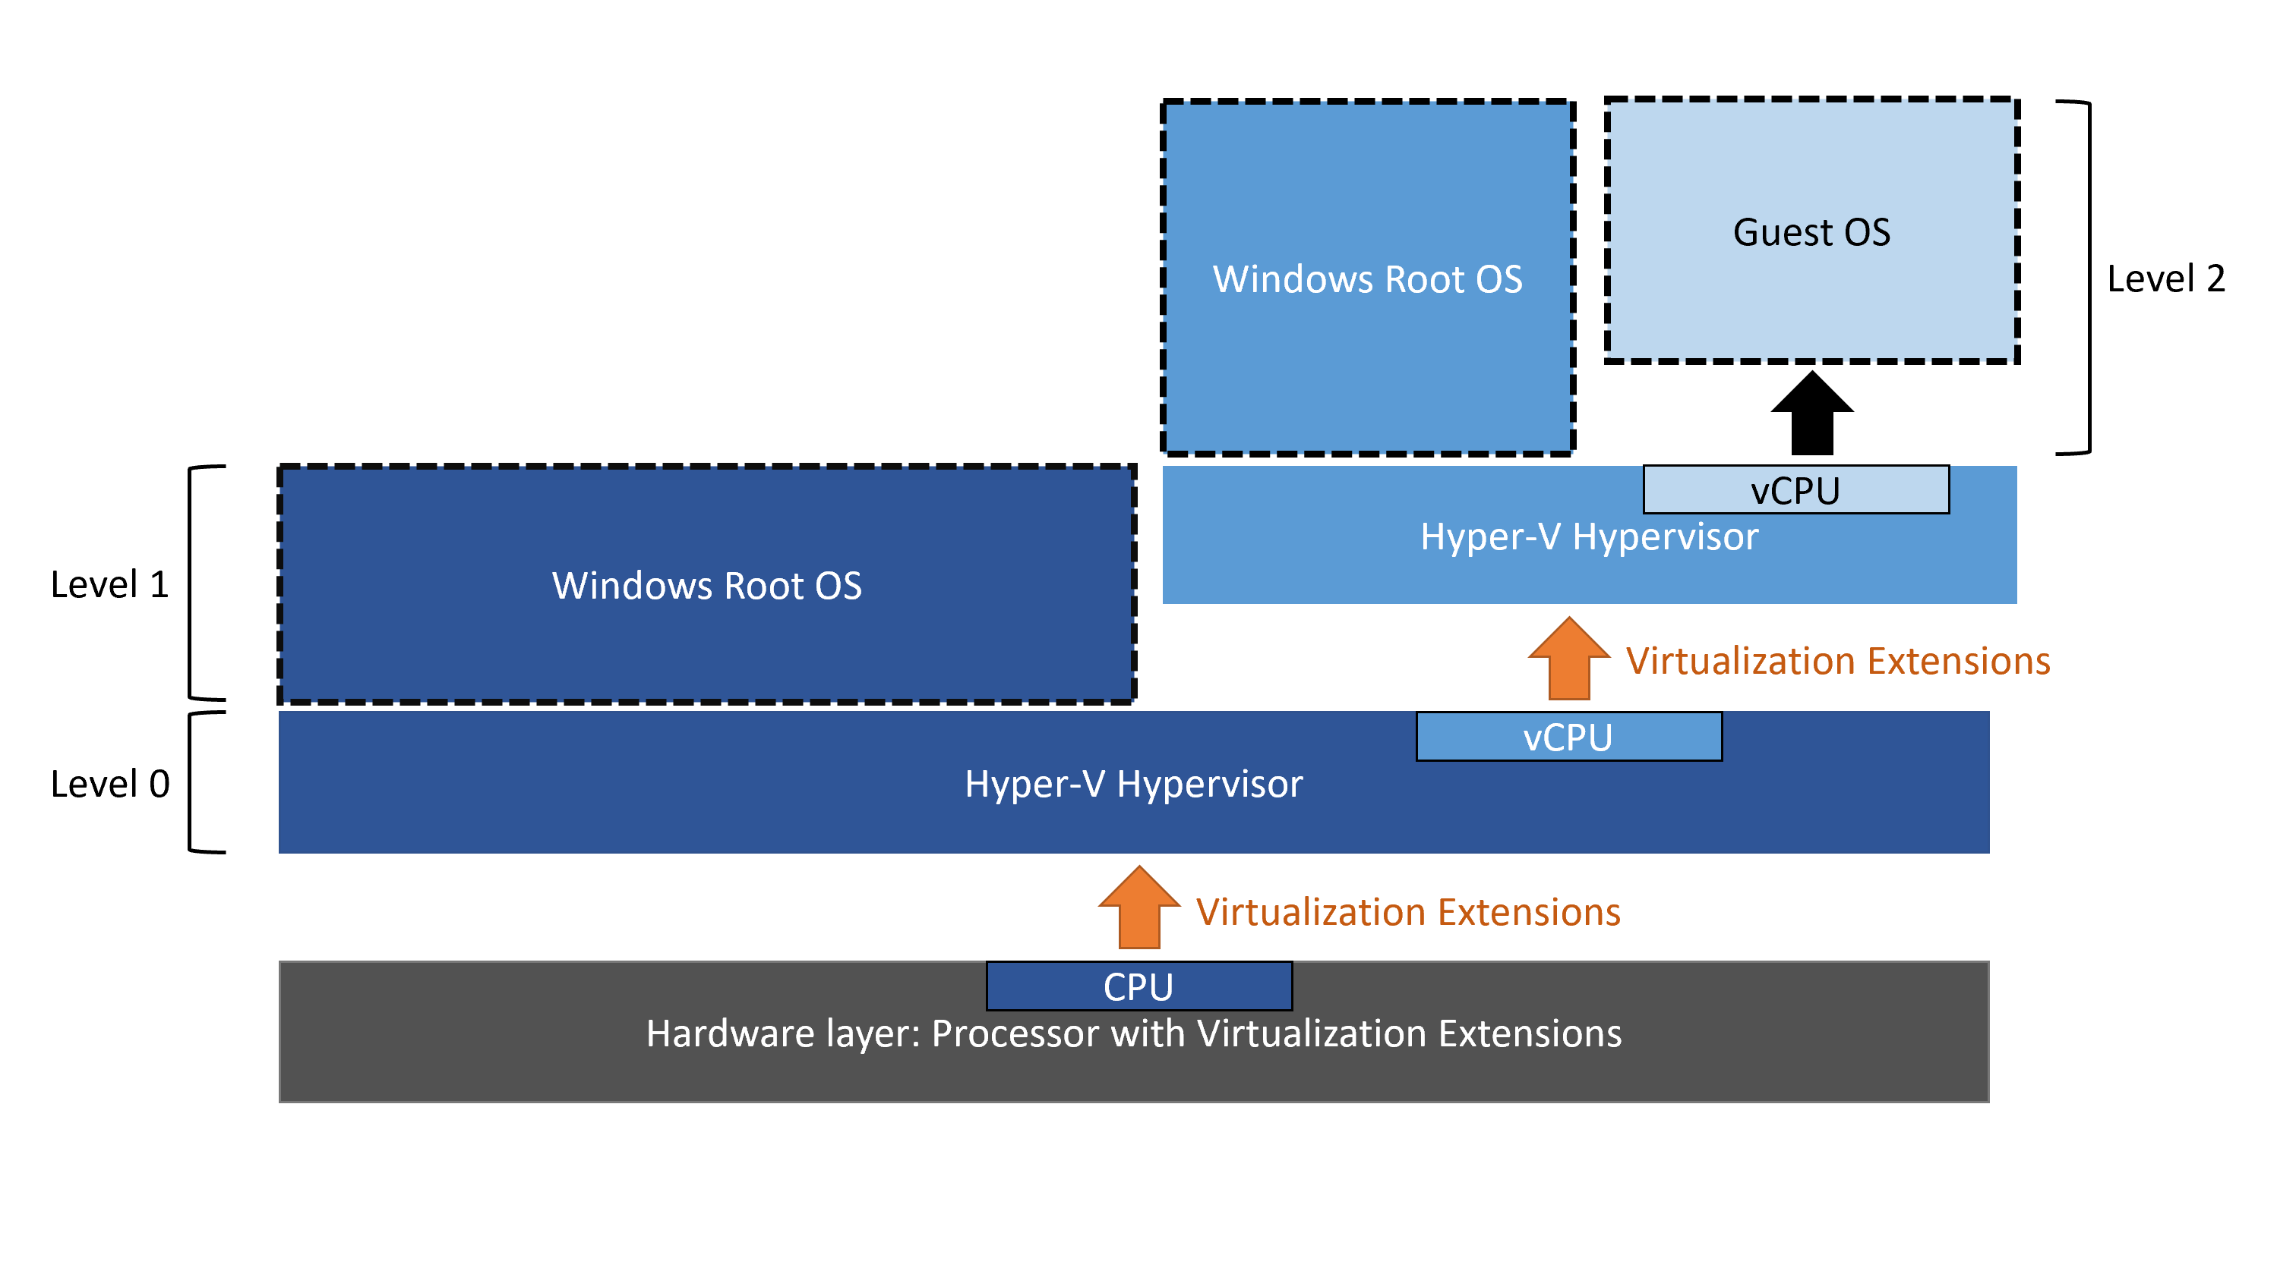
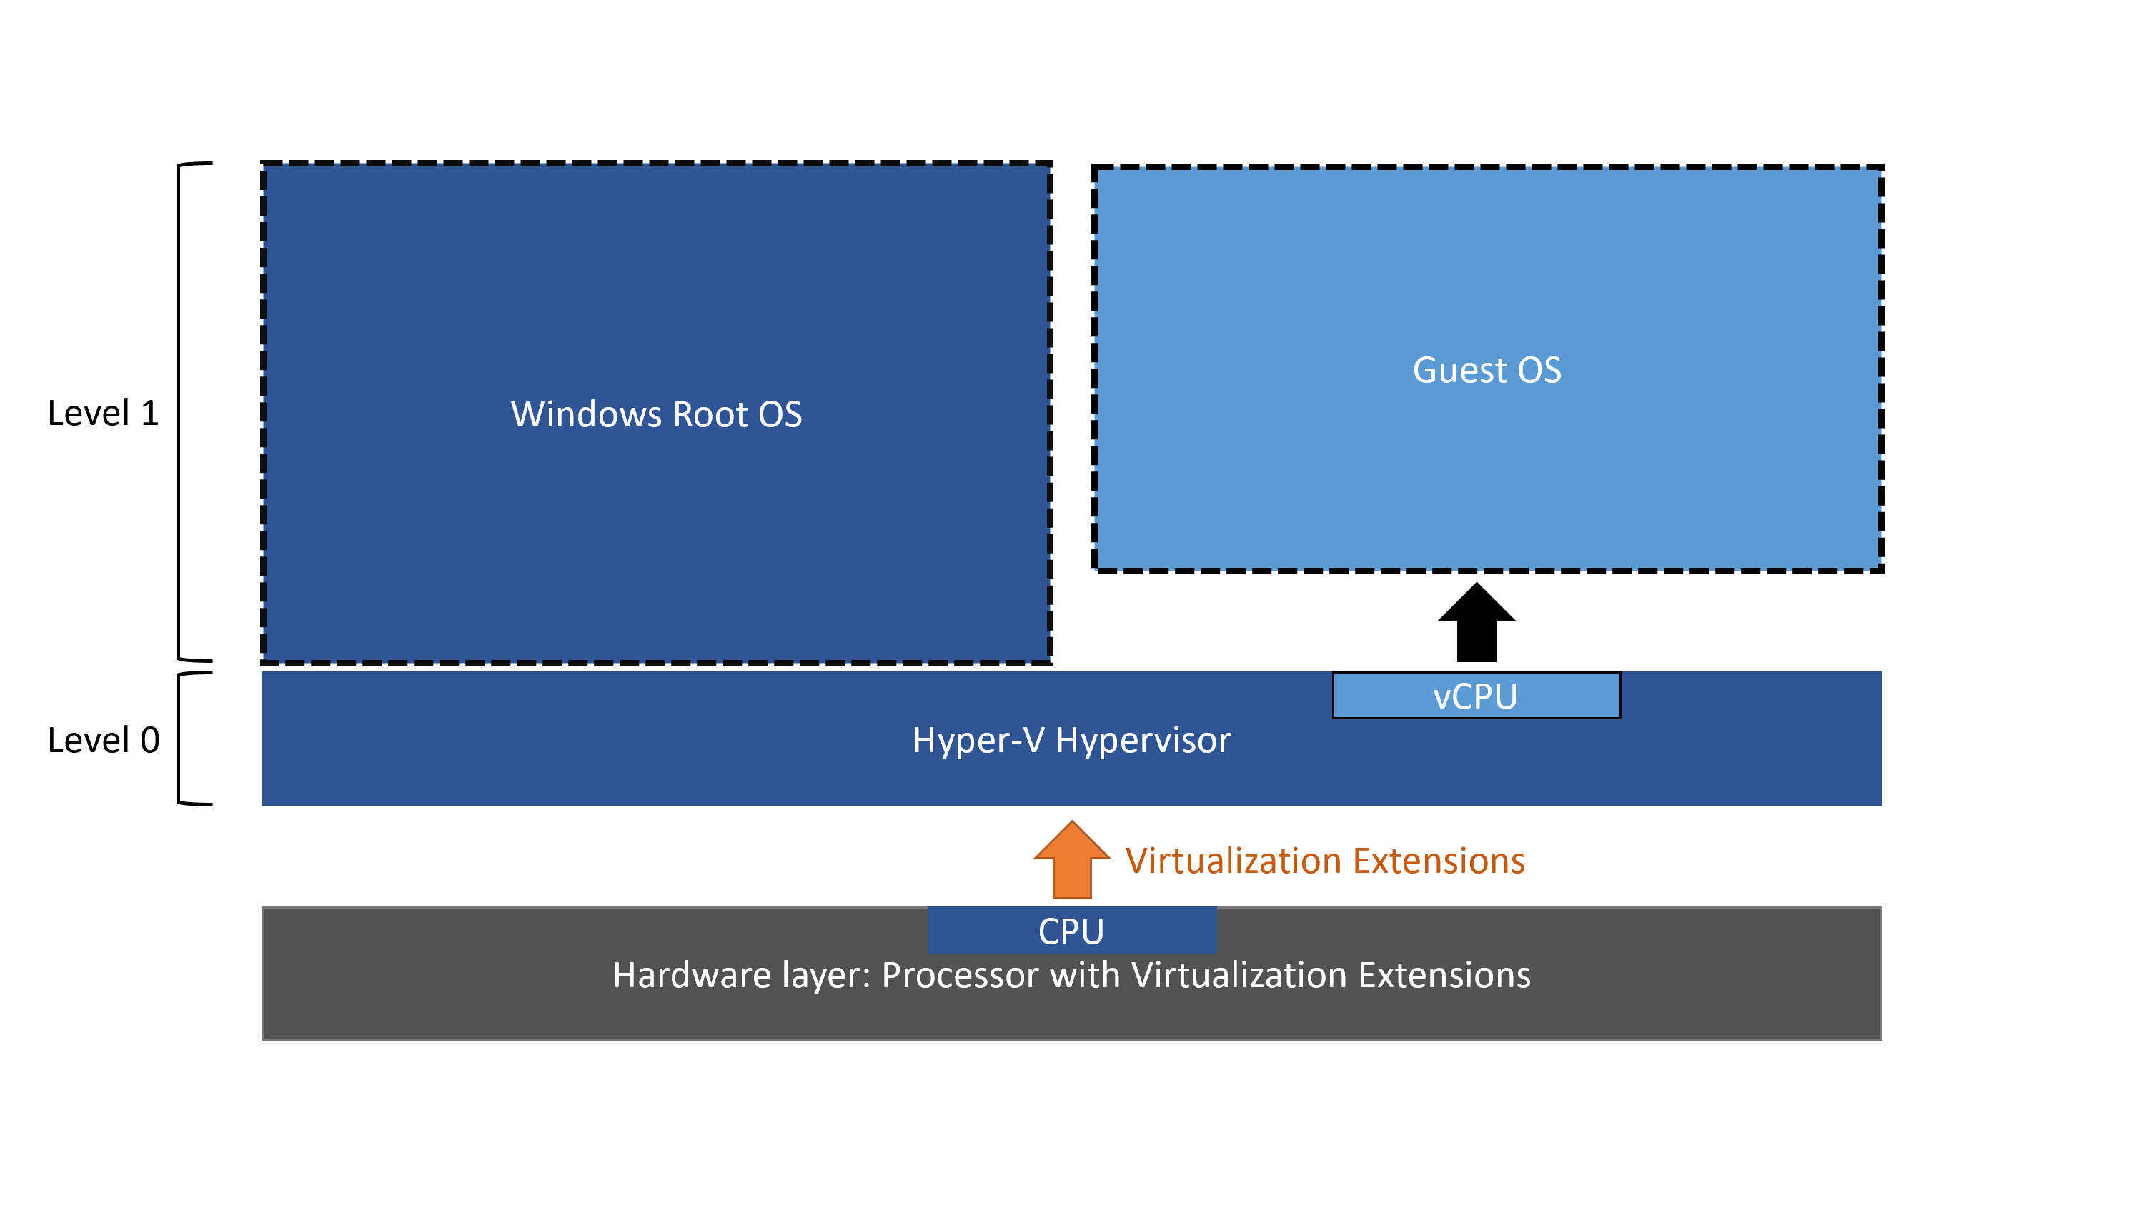
VM in a VM
Running a VM in another VM in nested virtualization
Supported on Windows Server 2016+
https://docs.microsoft.com/en-us/virtualization/hyper-v-on-windows/user-guide/nested-virtualization

Slide 31
Enable Nested Virtualization
Turn off the VM and execute the following on the host
Enable the nested virtualization
Disable Dynamic Memory on the Memory page or:
Turn on MAC address spoofing on the Network Adapter page or:
Set-VMProcessor -VMName Machine1 -ExposeVirtualizationExtensions $true
Set-VMMemory -VMName Machine1 -DynamicMemoryEnables $false
Set-VMNetworkAdapter -VMName Machine1 -Name "Lan" -MACAddressSpoofing on
https://docs.microsoft.com/en-us/virtualization/hyper-v-on-windows/user-guide/nested-virtualization

Slide 32
pCPU vs vCPU vs …
Each core of a multi-core CPU is considered a pCPU
Hyper-Threading if turned on, should not be accounted*
Start small, with 1 or 2 vCPUs per VM and measure constantly
CPU over-commit* is possible. There are many “golden” rules, but it all depends on the workload
Observe and measure
Test
Observe
Measure
Adjust

Slide 33
Virtual Disks
Disk Formats
VHD is up to 2 TB in size and is backward compatible
VHDX is up to 64 TB in size and not supported before Windows Server 2012
VHD Set is used to create shared virtual disks
Disk Types
Fixed Size is an image file with a specified size with all disk space taken upfront
Dynamically Expanding is an image with a specified size which start small and expands when needed
Differencing (or child) is associated with a specific parent image. All new data and changes to existing data is written to the child

Slide 34
Fixed Virtual Disks
Stored in *.vhd or *.vhdx files
All space must be available at the time of creation
Considered efficient from a performance standpoint
No overhead due to dynamic expansion
Less fragmentation
Can be created in Hyper-V Manager or with PowerShell
New-VHD -Path C:\VM\Disk.vhdx -Fixed -SizeBytes 10gb

Slide 35
Dynamic Virtual Disks
Stored in *.vhd or *.vhdx files
Only maximum size is specified. No need to have all the space available
Considered not very efficient from a performance standpoint
Overhead due to dynamic expansion
High fragmentation
When data is removed the disk doesn’t shrink back automatically
Can be created in Hyper-V Manager or with PowerShell
New-VHD -Path C:\VM\Disk.vhdx -Dynamic -SizeBytes 10gb

Slide 36
Differencing Virtual Disks
Stored in *.vhd or *.vhdx files
Follows the format of the parent disk
Multiple generations are supported (child of a child of a …)
Multiple children can be linked to the same parent
The parent should be considered read-only
Can be used for creation of cloned VMs, testing with rollback, etc.
There is negative impact on the performance
Can be created in Hyper-V Manager or with PowerShell
New-VHD -Path C:\VM\DiffDisk.vhdx -Differencing -ParentPath C:\VM\Parent.vhdx

Slide 37
Pass-through Disks
Permits a VM to access an actual disk on the host directly
The VM must have exclusive access to the disk
The target disk must be taken offline (for example with Disk Management)
In order to connect a pass-through disk to the VM’s SCSI controller the VM doesn’t need to be turned off. This doesn’t apply when connecting disk to the IDE controller

Slide 38
Virtual Disk Management
Compact is used to reduce the size of not mounted dynamically expanding disk
Convert allows format or type change by making a copy
Expand increases the capacity of disk by adding empty storage space
Shrink reduces the capacity by deleting empty (unpartitioned space at the end) storage space
Merge combines the data on a differencing disk with that on its parent
Optimize-VHD -Path C:\D.vhdx -Mode Full
Convert-VHD -Path C:\D1.vhd -DestinationPath C:\D2.vhdx -VHDType Dynamic
Resize-VHD -Path C:\D.vhdx -SizeBytes 80gb
Merge-VHD -Path C:\Child.vhdx -DestinationPath C:\Parent.vhdx

Slide 39
VM Checkpoints
Standard checkpoint is a captured image of the state, data, and hardware configuration of a running VM at a specific point in time
Production checkpoint is a point in time image of a VM created using a backup technology inside the guest (Volume Shadow Copy in Windows or File System Freeze in Linux)
Before Windows Server 2012 R2 they were known as snapshots
AVHD or AVHDX file is created for each hard disk
Can reduce the overall performance of a VM
Production checkpoints are default (since 2016) and preferred

Slide 40
Virtual Networking
By default, each VM has only one virtual network adapter
It can be either connected to a virtual switch or in a not-connected state
Up to eight virtual network adapters can be added per VM
Addition or changes to a virtual network adapter on a Generation 2 VM could be done while the machine is running
Each virtual network adapter could be associated with a VLAN
Adding a virtual network adapter with PowerShell
Removal of a virtual network adapter with PowerShell
Add-VMNetworkAdapter -VMName Machine1 -Name NIC1 -SwitchName MyPrivateSwitch
Remove-VMNetworkAdapter -VMName Machine1 -Name NIC1

Slide 41
Virtual Switches
A virtual switch is a device that functions at layer 2 of the OSI model
External virtual switch maps to a physical network adapter on the host. It is bound to the networking protocol stack in the host. VMs can access the physical network
Internal virtual switch permits communication between virtual machines on a Hyper-V host and between them and the host itself. It is bound to a separate networking protocol stack in the host
Private virtual switch permits communication between virtual machines on a Hyper-V host. No communication is possible between the VMs and the host
New-VMSwitch -Name MyPrivateSwitch -SwitchType Private

Slide 42
VM Resource Metering
Tracks usage of CPU, memory, network, and disk
Enable resource metering
Display statistics
Reset statistics
Disable metering
Enable-VMResourceMetering -VMName Machine1
Measure-VM -VMName Machine1
Reset-VMResourceMetering -VMName Machine1
Disable-VMResourceMetering -VMName Machine1

Slide 43
Practice: Virtualization
Level 102

Slide 44
Virtualization
Level 103

Slide 45
High availability and Disaster recovery
Hyper-V Replica
Live Migration
Storage Migration
Share Nothing Live Migration

Slide 46
Hyper-V Replica
Hyper-V replica creates an offline virtual machine copy of a running virtual machine
Hyper-V replica is a disaster recovery technology
Hosts participating in Hyper-V replica don’t need to be clustered or domain members. They can be at the same or different sites
Hyper-V replica uses change tracking and creates and maintains a log file that captures changes on a virtual machine disk
Extended (chained) replication is possible. A virtual machine is replicated from the primary to a secondary host. Then, it can be replicated from the second to a third host
If an outage occurs in our primary location, we can manually start a test, planned or unplanned failover
We can specify recovery points (up to 24 hours in the past) to store for a VM. Those are snapshots in time. We lose less data if we recover from recent recovery point

Slide 47
Hyper-V Replica Considerations
To conserve a network bandwidth, we must decide which disks to replicate
Data on the replica server synchronizes per the replication frequency (synchronization schedule) we configure. Possible intervals are 30 seconds, 5 minutes, or 15 minutes. When deciding we must consider recovery point objective (RPO), bandwidth, and how critical the VM is
Decide how many recovery points to store
Knowing our machines, we must determine which workloads and how to be replicated
Decide how and when the initial replication will be done

Slide 48
Hyper-V Replica Failovers
Test is used to test how the failover will work. It is invoked on the replica VM. Only one can be run for a VM at a time. After we are done testing, we must stop the test failover
Planned makes a series of checks. It sends the last set of tracked changes. It is invoked on the primary VM
Unplanned is invoked on the replica VM. We can recover from the latest recovery point or from previous one if this is configured

Slide 49
Live Migration
Live migration moves running virtual machines from one host to another with no noticeable impact on the availability of virtual machines to users
A user with permissions is required. Depending on the process it must be with a member of the local Hyper-V Administrators or the Administrators group on both the source and destination. Membership in Domain Administrators group is required when constrained delegation is used
Same versions of the Hyper-V role, same processor and virtual switch. Migration can be done between hosts with different versions of Hyper-V, for example from 2012 R2 to 2016 but the VM must be version 5+
Source and destination hosts must belong the same AD domain or to domains that trust each other
Hyper-V management tools are required

Slide 50
Storage Migration
Live migration is designed to move a VM from one host to another without touching the files (they must reside on a shared storage)
Storage migration is the exact opposite. It moves the files to another location, while the VM remains in place
Storage migration can occur while the VM is running or stopped
VMs that use pass-through disks cannot be migrated
Storage migration can be used to migrate configuration files, checkpoints, and smart paging files

Slide 51
Shared Nothing Live Migration
Initial requirements for Live migration were restrictive. A cluster and a shared storage were required
Since Windows Server 2016 things have changed. Now we can live migrate VMs without almost any restrictions
This method is essentially a combination of Live migration and Storage migration
More or less the same prerequisites as with the Live migration are valid here as well

Slide 52
Practice: Virtualization
Level 103

Slide 53
Questions?
Notes:
53

Slide 54
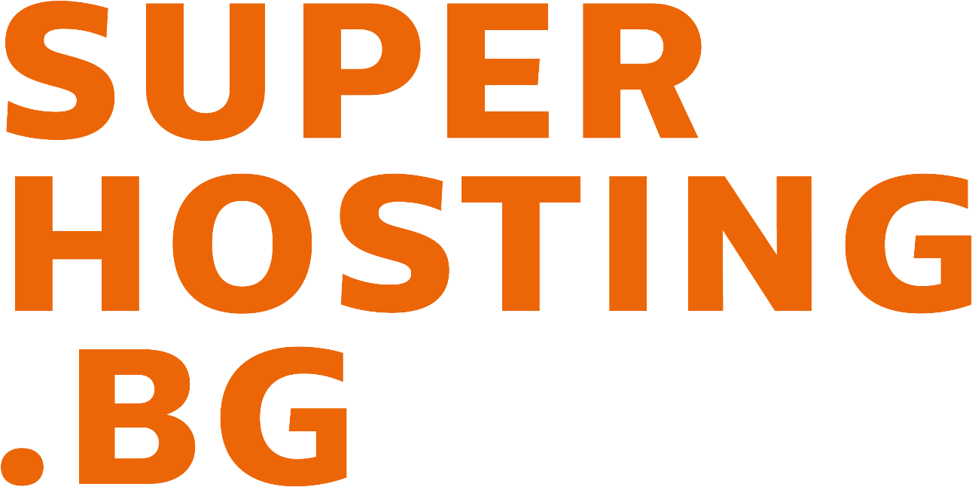


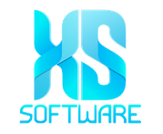







SoftUni Diamond Partners

Slide 55

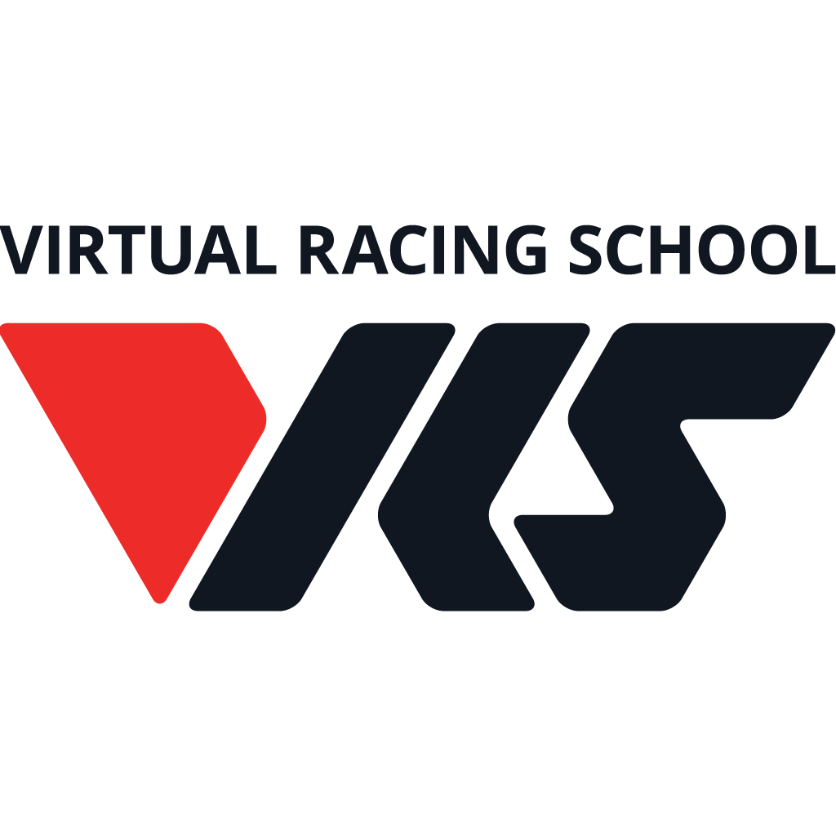
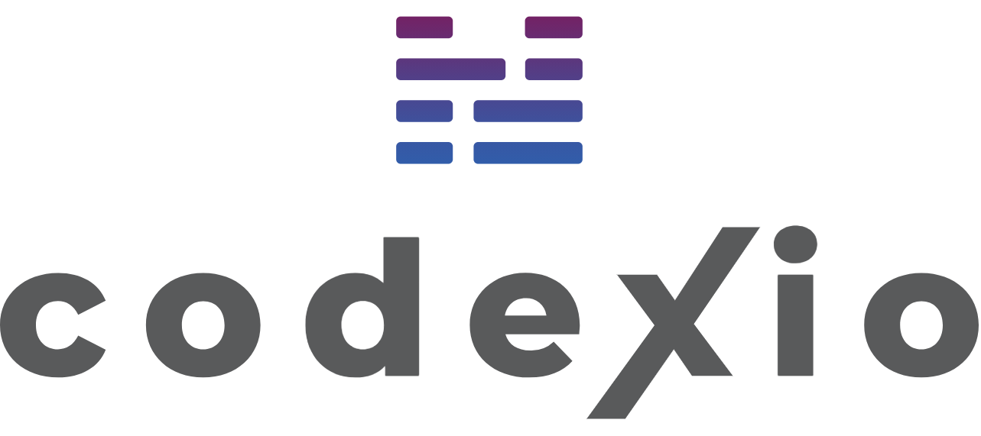
Educational Partners

Slide 56
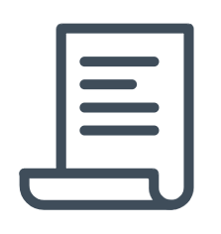
License
This course (slides, examples, demos, exercises, homework, documents, videos and other assets) is copyrighted content
Unauthorized copy, reproduction or use is illegal
© SoftUni – https://softuni.org
© Software University – https://softuni.bg
Notes:
56

Slide 57
Trainings @ Software University (SoftUni)
Software University – High-Quality Education, Profession and Job for Software Developers
softuni.bg, softuni.org
Software University Foundation
softuni.foundation
Software University @ Facebook
facebook.com/SoftwareUniversity
Software University Forums
forum.softuni.bg
Notes:
57

