Slide 1

Containerization
Docker on Windows
SoftUni Team
Technical Trainers
Software University
https://softuni.org

Slide 2
Have a Question?
sli.do
#WSA-Advanced
facebook.com
/groups/WindowsSystemAdministrationAdvancedJune2021

Slide 3
Homework Progress
Solutions for M2
can be submitted
until 23:59 on 18.07.2021
Solutions for M3
can be submitted
until 23:59 on 25.07.2021

Slide 4

Previous Module (M2)
Quick Overview

Slide 5
What We Covered
Hyper-V Installation and Configuration
Hyper-V Virtual Machines
Hyper-V Storage and Networking
Additional Techniques

Slide 6
This Module (M3)
Topics

Slide 7
Table of Contents
Containerization in General
Containers in Windows
Working with Containers
Image Creation

Slide 8
Lab Infrastructure
WSAA.LAB
SERVER1
(DC)
SERVER2
(M1)
SERVER3
(M2)
.2
.101
.102
vSwitch
NAT Network: 192.168.99.0/24
Hyper-V / VirtualBox / VMware
Windows / Linux / macOS

Slide 9
Containerization
Level 101

Slide 10
Containerization
“
OS-level virtualization refers to an operating system paradigm in which the kernel allows the existence of multiple isolated user space instances known as containers, zones, jails, …
”
https://en.wikipedia.org/wiki/OS-level_virtualization

Slide 11
VMs vs Containers
VMs virtualize the hardware
Complete isolation
Complete OS installation. Requires more resources
Runs almost any OS
Containers virtualize the OS
Lightweight isolation
Shared kernel. Requires fewer resources
Runs on the same OS
…

Slide 12
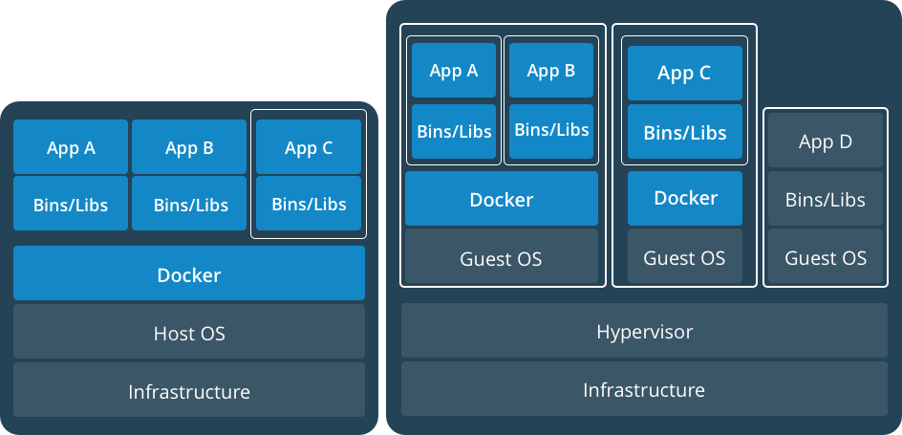
Together: VMs and Containers
https://www.docker.com/what-container

Slide 13
Containers Concepts
Container host is a physical or virtual computer system configured with Windows Container feature
Container image shows the state of a container, including registry or file system changes
Container OS image is the first layer of potentially many image layers that make up a container
Container repository stores container images and their dependencies

Slide 14
Definitions
Container
A runnable instance of an image. Containers are processes with much more isolation
Image
A read-only template of a container built from layers. Images provide a way for simpler software distribution
Repository
A collection of different versions of an image identified by tags
Registry
A collection of repositories
Writable Layer
a
bb
Volume
c:/1.txt
c:/2.txt
Internet Information
Services
bb
Image
c:/2.txt
Layers
Windows
Server Core
a
b
c:/1.txt
c:/2.txt
Container

Slide 15
Containers on Windows
Windows Server containers achieve isolation through namespace and process isolation. A container shares a kernel with the container host and all other containers running on it
Hyper-V containers encapsulate each container in a lightweight virtual machine. The kernel of the host is not shared. Greater isolation is achieved
Linux containers on Windows (LCOW)* is experimental new feature that utilizes the idea behind the Hyper-V containers
* https://docs.microsoft.com/en-us/virtualization/windowscontainers/quick-start/quick-start-windows-10-linux

Slide 16
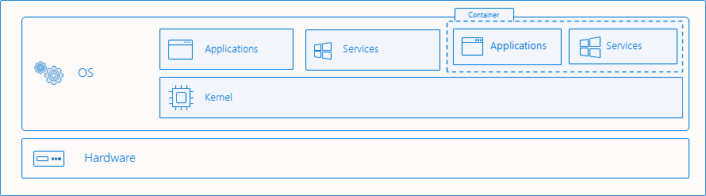
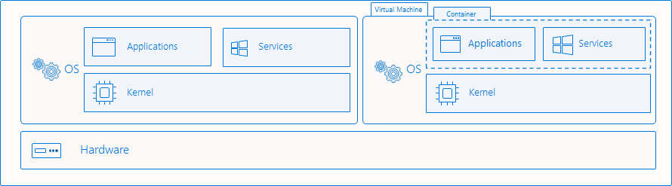
Isolation Modes
Process Isolation
Hyper-V Isolation
https://docs.microsoft.com/en-us/virtualization/windowscontainers/manage-containers/hyperv-container

Slide 17
Requirements
Windows Server containers
Windows Server 2016+ or Windows 10 Pro / Enterprise
Windows Server on the host must be installed to C:
Container role must be installed
Hyper-V containers
Windows Server 2016+ or Windows 10 Pro / Enterprise
Hyper-V role must be installed

Slide 18
Docker on Windows
Provides container capabilities to Windows
Two main components
Dockerd.exe is the Docker engine that runs on background
Docker.exe is the command line client tool for container management
Other important resources
Dockerfiles are scripts used to create container images
Docker Hub is a cloud-based registry for container images

Slide 19
Installing Docker on Windows
Windows Server
Install DockerMsftProvider module
Install Docker engine and client
Windows 10
Download and install Docker Desktop for Windows
Install-Module -Name DockerMsftProvider -Repository PSGallery -Force
Install-Package -Name Docker -ProviderName DockerMsftProvider
https://docs.docker.com/ee/docker-ee/windows/docker-ee/

Slide 20
Configuring Docker on Windows
By modifying of the Docker service parameters
By editing (or creating) Docker daemon configuration file
C:\ProgramData\docker\config\daemon.json
Sample parameters that usually are changed include hosts, dns, graph, group, etc.
Not all parameters in the documentation are applicable to Docker on Windows
https://docs.docker.com/engine/reference/commandline/dockerd/

Slide 21
Container Base Images
Windows Server Core is a medium size, and it is a good option for “lifting and shifting” Windows applications. Supports traditional .NET framework applications
https://hub.docker.com/_/microsoft-windows-servercore
Nano Server is an ultralight Windows offering for new application development. Built for .NET Core apps
https://hub.docker.com/_/microsoft-windows-nanoserver
Windows is the largest image and has full Windows API support for workloads
https://hub.docker.com/_/microsoft-windows
Windows Server is slightly smaller than the Windows image, has full Windows API support, and allows us to use more server features. It is available only with the Windows Server 2022 Insider preview release
https://hub.docker.com/_/microsoft-windows-server-insider
https://docs.microsoft.com/en-us/virtualization/windowscontainers/manage-containers/container-base-images

Slide 22
Working with Container Images
Search
docker search
Pull
docker pull
or
docker image pull
List
docker images
or
docker image ls
Remove
docker rmi
or
docker image rm

Slide 23
Working with Containers
Run container
docker run
or
docker container run
Stop container
docker stop
or
docker container stop
Start container
docker start
or
docker container start
List containers
docker ps
or
docker container ls
Remove container
docker rm
or
docker container rm
Show processes
docker top
or
docker container top

Slide 24
Practice: Containerization
Level 101

Slide 25
Containerization
Level 102

Slide 26
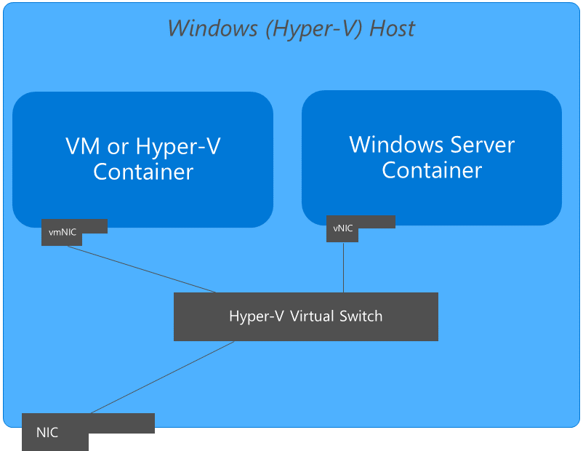
Container Networking Architecture
Windows containers function similarly to virtual machines regarding networking
Each container has a virtual network adapter (vNIC) which is connected to a Hyper-V virtual switch (vSwitch)
Windows supports nat, overlay, transparent, l2bridge, and l2tunnel
The first time the docker engine runs, it will create a default NAT network
https://docs.microsoft.com/en-us/virtualization/windowscontainers/container-networking/architecture

Slide 27
Containers and Networks
Modifying NAT (modify daemon.json)
Port mapping
Transparent network (directly connected to the physical network)
Define the network
Start a container attached to the new network
{ "fixed-cidr": "192.168.0.0/24" }
docker run -d -p 8000:80 <image-id>:<tag>
docker network create -d transparent <network-id>
docker run -it --network <network-id> <image-id>:<tag>

Slide 28
Persistent Storage in Containers
Bind mounts allow containers to share a directory with the host
The permission model used for bind mounts varies based on the isolation level
Hyper-V isolation use a simple read-only or read-write permission model. Files are accessed on the host using the LocalSystem account
Containers using process isolation use the process identity within the container to access data. These identities only exist within the context of the container and not on the host where the files are stored. So, we must use a well-known security group such as Authenticated Users
An SMB mounts can be used to share data between containers running on different hosts
Named volumes allow us to create a volume by name, assign it to a container, and reuse it later by the same name
https://docs.microsoft.com/en-us/virtualization/windowscontainers/manage-containers/persistent-storage

Slide 29
Containers and Data Persistency
Persistent data is stored to a sub-folders in
C:\ProgramData\docker\volumes
Create a bind mount in read-write (default mode)
Create a bind mount in read-only mode
Create a named volume
docker run -it -v <host-folder>:<container-folder> <image-id>:<tag> <command>
docker run -it -v <host-folder>:<container-folder>:ro <image-id>:<tag> <command>
docker volume create <volume-name>

Slide 30
Containers and Resource Control
Set container name
Limit container memory
Limit container CPU cycles
docker run -it --name <container-name> <image-id>:<tag> <command>
docker run -it --memory <memory-amount> <image-id>:<tag> <command>
docker run -it --cpu-shares <share-amount> <image-id>:<tag> <command>

Slide 31
Practice: Containerization
Level 102

Slide 32
Containerization
Level 103

Slide 33
Creating and Publishing Images
From a container
From a Dockerfile
Tag existing image
Publish the resulting image to a registry
docker [container] commit <container-id> <new-image-id>:<new-tag>
docker [image] build -t <new-image-id>:<new-tag> .
docker tag <existing-image>:<tag> <new-image-id>:<new-tag>
docker push <new-image-id>:<new-tag>

Slide 34
General Structure (Dockerfile)
Script, composed of commands and arguments
Always begins with the FROM instruction
Comment
# Set the base image
FROM nginx
# Set the maintainer
LABEL maintainer="John Smith"
# Copy files
COPY index.html c:/www/
Command
(Instruction)

Slide 35
FROM
Purpose
Defines the base image to use to start the build process
Syntax
Example
FROM <image>[:<tag>] [AS <name>]
# it is a good practice to state a version (tag)
FROM mcr.microsoft.com/windows/servercore:2009
# for the latest version, the tag could be skipped
FROM ubuntu # it equal to ubuntu:latest

Slide 36
LABEL
Purpose
Adds metadata to the image
Syntax
Example
LABEL <key>=<value> <key>=<value> <key>=<value> ...
# single key-value pair
LABEL maintainer="John Smith"
# multiple key-value pairs
LABEL maintainer="John Smith" version="1.0"

Slide 37
RUN
Purpose
Used during build process to add software (adds another layer)
Syntax
Example
RUN <command>
# single command
RUN powershell -Command Add-WindowsFeature Web-Server
# more than one command
RUN powershell -Command Do-One ; Do-Two ; ...

Slide 38
COPY
Purpose
Copy files between the host and the container
Syntax
Example (note that the / is used instead of \)
COPY <source> <destination>
# Copy single file
COPY readme.txt c:/temp/
# Copy multiple files
COPY *.html c:/www/

Slide 39
ADD
Purpose
Copy files to the image
Syntax
Example (note that the / is used instead of \)
ADD <source> <destination>
# Add single file from URL
ADD https://softuni.bg/favicon.ico c:/www/favicon.ico
# Add tar file content
ADD readme.txt c:/temp/

Slide 40
CMD
Purpose
Sets the default command to be run when deploying an instance
Syntax (either use / instead of \ or escape it like \\)
# exec form
CMD ["<executable>","<param>"]
# shell form
CMD <command>
# example
CMD c:\\Apache24\\bin\\httpd.exe -w

Slide 41
ENTRYPOINT
Purpose
Allows us to configure a container that will run as an executable
Syntax (either use / instead of \ or escape it like \\)
# exec form
ENTRYPOINT ["executable", "param1", "param2"]
# shell form
ENTRYPOINT command param1 param2
# example
ENTRYPOINT ["C:\\ServiceMonitor.exe", "w3svc"]

Slide 42
EXPOSE
Purpose
Informs Docker that the container listens on the specified network ports at runtime
Syntax
# expose port (by default is used tcp)
EXPOSE 80
# expose one port on udp
EXPOSE 80/udp

Slide 43
More Information
A repository with sample Dockerfile files
https://github.com/MicrosoftDocs/Virtualization-Documentation/tree/master/windows-container-samples
Documentation on how to create a Dockerfile
https://docs.microsoft.com/en-us/virtualization/windowscontainers/manage-docker/manage-windows-dockerfile
Documentation on how to optimize a Dockerfile
https://docs.microsoft.com/en-us/virtualization/windowscontainers/manage-docker/optimize-windows-dockerfile

Slide 44
Practice: Containerization
Level 103

Slide 45
Questions?
Notes:
45

Slide 46











SoftUni Diamond Partners

Slide 47



Educational Partners

Slide 48

License
This course (slides, examples, demos, exercises, homework, documents, videos and other assets) is copyrighted content
Unauthorized copy, reproduction or use is illegal
© SoftUni – https://softuni.org
© Software University – https://softuni.bg
Notes:
48

Slide 49
Trainings @ Software University (SoftUni)
Software University – High-Quality Education, Profession and Job for Software Developers
softuni.bg, softuni.org
Software University Foundation
softuni.foundation
Software University @ Facebook
facebook.com/SoftwareUniversity
Software University Forums
forum.softuni.bg
Notes:
49

