Slide 1

Local Storage and Additional Techniques
Local Storage. Advanced Filesystems. Additional Techniques
SoftUni Team
Technical Trainers
Software University
https://softuni.bg

Slide 2
Have a Question?
sli.do
#LSA-Advanced
facebook.com/groups/
LinuxSystemAdministrationAdvancedSeptember2021

Slide 3

This Module (M1)
Topics and Infrastructure

Slide 4
Table of Contents
Storage Overview
Local Storage
Advanced Filesystems
Additional Storage Techniques

Slide 5
Lab Infrastructure
NETWORK: 10.0.2.0/24
External, NAT or Internal / Private
.15
VM
(Linux)
OS
20 GB
20 GB
20 GB
20 GB
VirtualBox | KVM | Hyper-V | VMware (…)
Linux | Windows | macOS

Slide 6
Local Storage
Storage Types. Disks

Slide 7
Storage Types
Local
Internal
External
Remote
File-based – network-attached storage (NAS)
Block-based – storage area network (SAN)
Spindle or solid-state
Various interfaces
Direct-attached
Storage (DAS)

Slide 8
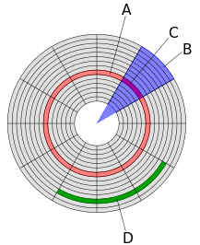
Disks Innerworkings
Each platter is split to circular tracks (A)
Each track is split to sectors (C)
A cluster (D) or allocation unit is the smallest logical amount of disk space that can be allocated to hold a file
https://en.wikipedia.org/wiki/Disk_sector

Slide 9
Disks Partitioning
Master Boot Record (MBR)
Up to 4 primary or 3 primary + 1 extended (with multiple logical)
Volumes up to 2 terabytes
GUID Partition Table (GPT)
Supports up to 128 primary partitions
Supports volumes up to 18 exabytes
Provides partition table protection
Requires UEFI

Slide 10
Local Storage
Device Mapper

Slide 11
Device Mapper
A framework provided by the Linux kernel for mapping physical block devices onto higher-level virtual block devices
Foundation of the logical volume manager (LVM), software RAIDs and dm-crypt disk encryption
Offers additional features such as file system snapshots
Passes data from a virtual block device to another block device
Data can be also modified in transition
https://en.wikipedia.org/wiki/Device_mapper

Slide 12
Local Storage
Software RAID

Slide 13
Introduction
mdadm is a Linux utility used to manage and monitor software RAID devices
Supports
RAID configurations (0, 1, 4, 5, 6, 10)
Non-RAID configurations (linear, multipath, faulty, container)
Standard naming convention for devices is /dev/md<n>
Configuration is stored in /etc/mdadm.conf
Can be monitored via the utility or /proc/mdstat
Not suitable for /boot
https://en.wikipedia.org/wiki/Mdadm

Slide 14
Blocks, Chunks, and Stripes
Block size
Linux block size is 4K
Device block size can be either 512 bytes or 4K
Chunk size
Number of consecutive blocks written to each drive
It's a multiple of the Linux 4K block size
Stripe size
Number of chunks by the number of drives
Includes parity and/or mirror information so the data stored per stripe is usually less than the size of the stripe
https://raid.wiki.kernel.org/index.php/A_guide_to_mdadm

Slide 15
Common RAID Types
Stripe (RAID 0)
Mirror (RAID 1)
Parity (RAID 5)
mdadm --create /dev/md0 --level 0 --raid-devices 2 \
/dev/sda1 /dev/sdb1
mdadm --create /dev/md0 --level 1 --raid-devices 2 \
/dev/sda1 /dev/sdb1
mdadm --create /dev/md0 --level 5 --raid-devices 3 \
/dev/sda1 /dev/sdb1 /dev/sdc1
https://raid.wiki.kernel.org/index.php/A_guide_to_mdadm

Slide 16
Command Groups
Assemble
--assemble
Create
--create
Grow
--grow
Manage
[--manage]
Monitor
--monitor
Build
--build
Misc
[--misc]
https://raid.wiki.kernel.org/index.php/A_guide_to_mdadm

Slide 17
Local Storage
Logical Volume Manager

Slide 18
Logical Volume Manager (LVM)
A device mapper target providing logical volume management
Physical Volume (PV)
Physical Extent (PE)
Volume Group (VG)
Logical Volume (LV)
File System (FS)
Mount Point (MP)
VG (vg1)
PV (/dev/sda1)
PV (/dev/sdb1)
PV (/dev/sdc1)
PE
4 MB
PE
4 MB
PE
4 MB
PE
4 MB
PE
4 MB
PE
4 MB
LV (lv1)
PE
4 MB
PE
4 MB
PE
4 MB
PE
4 MB
PE
4 MB
PE
4 MB
PE
4 MB
PE
4 MB
LV (lv2)
PE
4 MB
PE
4 MB
PE
4 MB
PE
4 MB
FS (ext4)
FS (xfs)
MP (/mnt/ext4)
MP (/mnt/xfs)
https://en.wikipedia.org/wiki/Logical_Volume_Manager_(Linux)

Slide 19
LVM Features
Volume groups and logical volumes can be resized online
Read only and read/write snapshots
Hybrid volumes which allow for using cache
Thin provisioning of logical volumes
Multipathing
RAID implementations
Different high availability options
https://en.wikipedia.org/wiki/Logical_Volume_Manager_(Linux)

Slide 20
Command Groups
Physical Volumes (PV)
pvcreate
pvremove
pvs
pvscan
pvdisplay
Volume Groups (VG)
vgcreate
vgremove
vgextend
vgreduce
vgs
vgscan
vgdisplay
Logical Volumes (LV)
lvcreate
lvremove
lvextend
lvreduce
lvs
lvscan
lvdisplay
https://raid.wiki.kernel.org/index.php/A_guide_to_mdadm

Slide 21
Practice: Local Storage
mdadm and LVM2

Slide 22
Local Storage
Advanced File systems

Slide 23
BTRFS
Copy on Write (COW)
Read-only and read/write snapshots
Sub-volumes
Compression and deduplication
Multiple device support (pooling and RAID)
Eliminates the need of (hardware) raid or volume manager
Not very popular (default on SUSE/openSUSE and Fedora) but gaining popularity
https://btrfs.wiki.kernel.org/index.php/Main_Page

Slide 24
(Open)ZFS (On Linux)
Copy on Write (COW)
Read-only and read/write snapshots
Compression and deduplication
Multiple device support (pooling and RAID)
Datasets can be file systems, volumes, snapshots or clones
Eliminates the need of (hardware) raid or volume manager
Relatively popular (supported on multiple platforms)
ds
ds
ds
pool
vdev
vdev
disk
disk
disk
disk
https://zfsonlinux.org/

Slide 25
Practice: Advanced Filesystems
BTRFS and ZFS

Slide 26
Additional Techniques
Encryption. Quotas. Automount

Slide 27
Quotas
EXT4
Control space usage on user and group level
Soft and hard limits on disk space (block) and file (inode) level
XFS
Control space usage on user, group, and project level
Soft and hard limits on disk space (block) and file (inode) level
Allows for soften the hard limits (to avoid interruptions)
Has own xfs_quota tool, but generic ones can be used as well

Slide 28
Disk Encryption
Linux Unified Key Setup (LUKS) is a disk encryption solution
Uses dm-crypt kernel module for block level encryption
A password or a key can be used to open an encrypted device
Predictable naming via /etc/crypttab
Supported by many tools
https://www.redhat.com/sysadmin/disk-encryption-luks

Slide 29
Automounting
AutoFS provides automounting of removable media or network shares when they are inserted or accessed
Supports multiple devices and filesystems
Managed via a set of configuration files
Main files are /etc/autofs.conf and /etc/auto.master
Auxiliary files /etc/auto.* and /etc/auto.master.d/
https://help.ubuntu.com/community/Autofs

Slide 30
Easier Local Storage Management
Stratis provides ZFS/Btrfs-style features
Integrates layers of existing technology - Linux’s device mapper subsystem, and the XFS filesystem
The stratisd daemon manages collections of block devices, and provides a D-Bus API
The stratis-cli provides a command-line tool stratis which itself uses the D-Bus API to communicate with stratisd
https://stratis-storage.github.io/

Slide 31
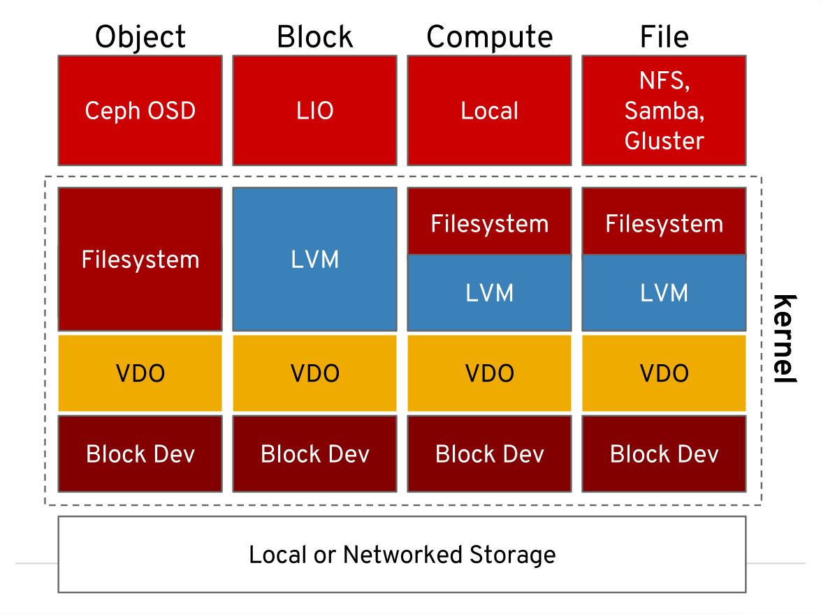
Compression and Deduplication
Virtual Data Optimizer (VDO) is the answer
Provides a solution for transparent compression and deduplication layer
Under filesystems, iSCSI or Ceph
https://www.redhat.com/en/blog/look-vdo-new-linux-compression-layer

Slide 32
Secure Remote File Systems
SSHFS allows us to mount remote file systems over SSH
It is a FUSE-based (Filesystem in Userspace) filesystem client
Easy to setup and use
Supported by multiple platforms
https://github.com/libfuse/sshfs

Slide 33
Practice: Additional Techniques
Quotas. Encryption. Automount

Slide 34
Questions?
Notes:
34

Slide 35

License
This course (slides, examples, demos, exercises, homework, documents, videos and other assets) is copyrighted content
Unauthorized copy, reproduction or use is illegal
© SoftUni – https://about.softuni.bg
© Software University – https://softuni.bg
Notes:
35

Slide 36
Trainings @ Software University (SoftUni)
Software University – High-Quality Education, Profession and Job for Software Developers
softuni.bg, about.softuni.bg
Software University Foundation
softuni.foundation
Software University @ Facebook
facebook.com/SoftwareUniversity
Software University Forums
forum.softuni.bg
Notes:
36

