Slide 1

Virtualization and Containerization
Virtualization with KVM. Containers with LXC and Docker
SoftUni Team
Technical Trainers
Software University
https://softuni.bg

Slide 2
Have a Question?
sli.do
#LSA-Advanced
facebook.com/groups/
LinuxSystemAdministrationAdvancedSeptember2021

Slide 3

Previous Module (M4)
Quick Overview

Slide 4
What We Covered
Web Servers
Printing Services
Directory Services
Mail Services

Slide 5
Homework Progress
Solutions for M3 could be submitted until 23:59:59 on 03.10.2021
Solutions for M4 could be submitted until 23:59:59 on 10.10.2021
Solutions for M5 could be submitted until 23:59:59 on 17.10.2021

Slide 6

This Module (M5)
Topics

Slide 7
Table of Contents
Virtualization with KVM
Containerization with LXC
Containerization with Docker

Slide 8
Virtualization with KVM

Slide 9
Virtualization in General
“
The act of creating a virtual (rather than actual) version of something, including virtual computer hardware platforms,
storage devices, and computer network resources
”
https://en.wikipedia.org/wiki/Virtualization

Slide 10
Virtualization Terminology
A hypervisor or virtual machine monitor is the software layer between the virtual machines and the underlying hardware.
Hypervisors are responsible for resource sharing and guest operating systems isolation.
In full virtualization the underlying hardware is fully emulated. This approach does not require guest OS modification but incurs performance penalty.

Slide 11
Virtualization Terminology
Later, the paravirtualization were introduced (by Xen). It requires guest OS modification for the particular hypervisor but achieves better performance.
With Intel VT and AMD-V the hardware assisted virtualization were introduced. With this approach the CPU and the memory controller are virtualized by the hardware and controlled by the hypervisor. No modification is required of the guest OS. Very good performance.

Slide 12
Types of Virtualization
Guest OS
Guest OS
Guest OS
Guest OS
Guest OS
Guest OS
Guest OS
Guest OS
Host OS
Hypervisor
Hypervisor
Hardware
Hardware
Type 1
Type 2

Slide 13
Virtualization with Linux (Xen vs KVM)
Xen is stand-alone project
Some Linux distributions offer native support
Offers both paravirtualization and full virtualization
Linux kernel-based virtual machine (KVM) turns the Linux kernel into a hypervisor
It is integrated into the mainline Linux kernel
KVM supports only full virtualization
Both can be managed with the same tools
…

Slide 14
KVM Components
QEMU performs virtual hardware emulation
LIBVIRT provides means for virtual machine management
Host Userspace
Virtual Machine
Virtual Machine
Guest OS Applications
Guest OS Applications
Guest OS Kernel
Guest OS Kernel
LIBVIRT
QEMU
QEMU
Host Linux Kernel
KVM
kvm-(intel|amd).ko
kvm.ko
Hardware
https://www.linux-kvm.org/

Slide 15
QEMU
QEMU is a generic and open source machine emulator and virtualizer
Full-system emulation - run operating systems for any machine, on any supported architecture
User-mode emulation - run programs for another Linux/BSD target, on any supported architecture
Virtualization - run KVM and Xen virtual machines with near native performance
https://www.qemu.org/

Slide 16
Libvirt
A toolkit to manage virtualization platforms
Supports KVM, QEMU, Xen, LXC, etc.
Accessible from C, Python, Perl, Java, etc.
https://libvirt.org/

Slide 17
Tools
virt-manager
GUI VM Management
virt-install
VM Creation
vmbuilder
VM Creation
qemu*
virt-viewer
Connecting to VMs
virsh
CLI VM Management
virt-clone
VM Cloning

Slide 18
Practice: Virtualization
KVM

Slide 19
Containerization with LXC

Slide 20
Containerization
“
OS-level virtualization refers to an operating system paradigm in which the kernel allows the existence of multiple isolated user space instances known as containers, zones, jails, …
”
https://en.wikipedia.org/wiki/OS-level_virtualization

Slide 21
VMs vs Containers
VMs virtualize the hardware
Complete isolation
Complete OS installation. Requires more resources
Runs almost any OS
Containers virtualize the OS
Lightweight isolation
Shared kernel. Requires fewer resources
Runs on the same OS
…

Slide 22
Road to Containers
Companies and Solutions
2004
Solaris Containers
(zones)
2011
Warden
By CloudFoundry
2000 - 2001
1) FreeBSD Jails
2) Virtuozzo
3) Linux VServer
2005
Virtuozzo OpenVZ
2007
HP-UX Containers
IBM WPAR
2013
Docker
By Docker Inc
2014
Rkt
By CoreOS
1979
chroot
1999
1) Capabilities
2) AppArmor
3) SELinux
2002
Mount Namespaces
2006
1) Process Containers (cgroups) by Google
2) UTS and IPC Namespaces
2008
1) cgroups in kernel
2) PID and Network Namespaces
3) User Namespace
4) LXC
Enablement Technologies

Slide 23
Solutions
LXC + LXD + LXCF by Canonical
Container hypervisor (system containers)
https://linuxcontainers.org/
rkt by CoreOS
Application container engine
https://coreos.com/rkt
Docker by Docker Inc
Application container engine
https://www.docker.com/

Slide 24
Linux Containers (LXC)
LXC is a userspace interface for the Linux kernel containment features
It lets Linux users easily create and manage system or application containers
LXC containers are often considered as something in the middle between a chroot and a full-fledged virtual machine
Some of the kernel features used by LXC include kernel namespaces, chroots, control groups, etc.
https://linuxcontainers.org/lxc/introduction/

Slide 25
LXC Components
The liblxc
Library
API Language Bindings
Management Tools
(lxc-xxxxxx)
Container Templates
https://linuxcontainers.org/lxc/introduction/

Slide 26
LXC Commands*
Create container (interactively)
Show container information
Start a container
Get a shell inside a container
$ lxc-create -t download -n <container-name>
$ lxc-info -n <container-name>
$ lxc-start -n <container-name> -d
$ lxc-attach -n <container-name>
https://linuxcontainers.org/lxc/manpages/

Slide 27
LX Daemon (LXD)
LXD is a next generation system container manager
It is built on top of LXC to provide a new, better user experience
Offers a user experience like virtual machines but using Linux containers instead
Image based with pre-made images
lxc
Client tools
lxd Daemon
liblxc
The core library
https://linuxcontainers.org/lxd/introduction/

Slide 28
LXD Commands*
Basic initial configuration
Show configuration
Launch a container
Show containers
# lxd init
$ lxc config show
$ lxc launch <image>:<tag> <container-name>
$ lxc list
https://linuxcontainers.org/lxd/docs/master/

Slide 29
LXC vs LXD
Mature solution for virtualizing software at the OS system level
Multiple separate binaries for container management
Containers can be managed locally
For new developments we should stick with LXD
LXD is an alternative to LXC’s tools and distribution template system
It a layer on top of LXC
Offers single client tool
Containers can be managed over the network
…

Slide 30
Practice: Containerization 1
Working with LXC/D

Slide 31
Containerization with Docker

Slide 32
Containers Concepts (Docker View)
Container host is a physical or virtual computer system configured with a container engine
Container image shows the state of a container, including registry or file system changes
Container OS image is the first layer of potentially many image layers that make up a container
Container repository stores container images and their dependencies

Slide 33
LXC+LXD vs Docker
Like VMs with a fully functional OS
Data can be saved in a container or outside
Designed for long running environments
Made up of read only layers
Designed to support a single application
Ephemeral, stateless, minimal containers
…

Slide 34
Definitions
Container
Containers are processes with much more isolation
Image
Images provide a way for simpler software distribution
writable layer
Volume
NGINX
Layers
Ubuntu
Container

Slide 35
Registries
Provided by Docker
Cloud
Docker Hub (https://hub.docker.com/explore/)
Docker Store (https://store.docker.com/)
On-premise
Standalone
Containerized
Provided by 3rd parties
Quay.io, Artifactory, Google Container Registry

Slide 36
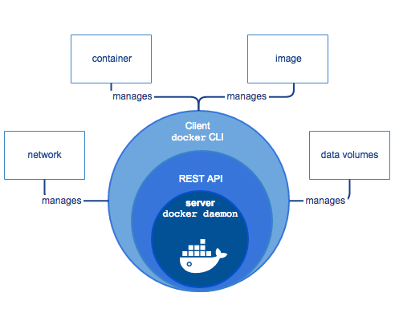
Docker Engine
Client-server application
Components
docker daemon
REST API
docker CLI
https://docs.docker.com/engine/docker-overview

Slide 37
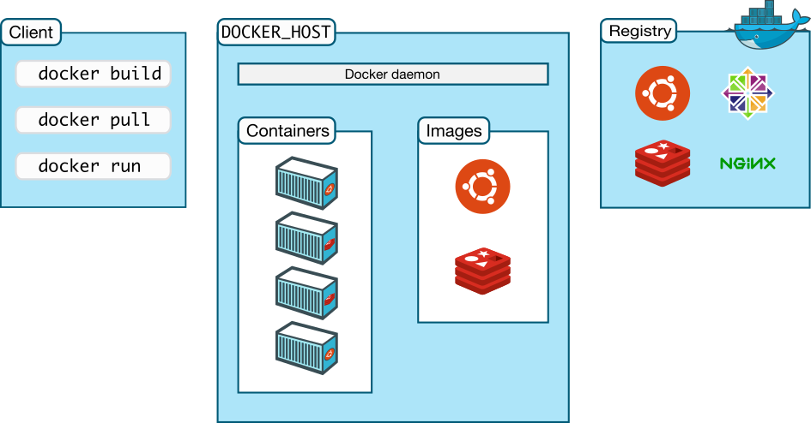
Workflow
1
3
2
https://docs.docker.com/engine/docker-overview

Slide 38
What We Need to Know?
Two Editions (Community and Enterprise)
Native Options
Docker for Linux
Docker for MAC
Docker for Windows
Docker for Cloud (AWS/Azure)
Docker Toolbox (deprecated) - All-in-one solution
For Mac and Windows
Deployment via package system, script, or archive
Specific requirements: OS version, Hypervisor, etc.

Slide 39
Working with Containers
Search for image
docker search
Run container
docker run
or
docker container run
Stop container
docker stop
or
docker container stop
Start container
docker start
or
docker container start
List containers
docker ps
or
docker container ls
Remove container
docker rm
or
docker container rm
List images
docker images
or
docker image ls
Remove image
docker rmi
or
docker image rm
Show processes
docker top
or
docker container top
Inspect object
docker inspect
or
docker <obj> inspect

Slide 40
Containers and Networks
Modifying NAT (modify /etc/docker/daemon.json)
Port mapping
Transparent network
Define the network
Start a container attached to the new network
{ "fixed-cidr": "192.168.0.0/24" }
docker run -d -p 8000:80 <image-id>:<tag>
docker network create -d transparent <network-id>
docker run -it --network <network-id> <image-id>:<tag>

Slide 41
Containers and Data Persistency
Persistent data is stored to a sub-folders in
/var/lib/docker/volumes/
Create a data volume
Create a data volume in read-only mode
Mount host folder
docker run -it -v <container-folder> <image-id>:<tag> <command>
docker run -it -v <container-folder>:ro <image-id>:<tag> <command>
docker run -it -v <host-folder>:<container-folder> <image-id>:<tag> <command>

Slide 42
Containers and Resource Control
Set container name
Limit container memory
Limit container CPU cycles
docker run -it --name <container-name> <image-id>:<tag> <command>
docker run -it --memory <memory-amount> <image-id>:<tag> <command>
docker run -it --cpu-shares <share-amount> <image-id>:<tag> <command>

Slide 43
Creating and Publishing Images
From a container
From a Dockerfile
Tag existing image
Publish the resulting image
docker commit <container-id> <new-image-id>:<new-tag>
docker build -t <new-image-id>:<new-tag> .
docker tag <existing-image>:<tag> <new-image-id>:<new-tag>
docker push <new-image-id>:<new-tag>

Slide 44
General Structure (Dockerfile)
Script, composed of commands and arguments
Always begins with FROM instruction
Comment
# Set the base image
FROM nginx
# Set the maintainer
MAINTAINER John Smith
# Copy local files
COPY index.html /usr/share/nginx/html/
Command
(Instruction)

Slide 45
Dockerfile Instructions
FROM defines the base image to use to start the build process
RUN used during build process to add software
COPY copies files between the host and the image
ADD copies files to the image
EXPOSE informs Docker that the container listens on the specified ports
https://docs.docker.com/engine/reference/builder/

Slide 46
Practice: Containerization 2
Working with Docker

Slide 47
Questions?
Notes:
47

Slide 48

License
This course (slides, examples, demos, exercises, homework, documents, videos and other assets) is copyrighted content
Unauthorized copy, reproduction or use is illegal
© SoftUni – https://about.softuni.bg
© Software University – https://softuni.bg
Notes:
48

Slide 49
Trainings @ Software University (SoftUni)
Software University – High-Quality Education, Profession and Job for Software Developers
softuni.bg, about.softuni.bg
Software University Foundation
softuni.foundation
Software University @ Facebook
facebook.com/SoftwareUniversity
Software University Forums
forum.softuni.bg
Notes:
49

Slide 50











SoftUni Diamond Partners

Slide 51




Educational Partners

