Slide 1
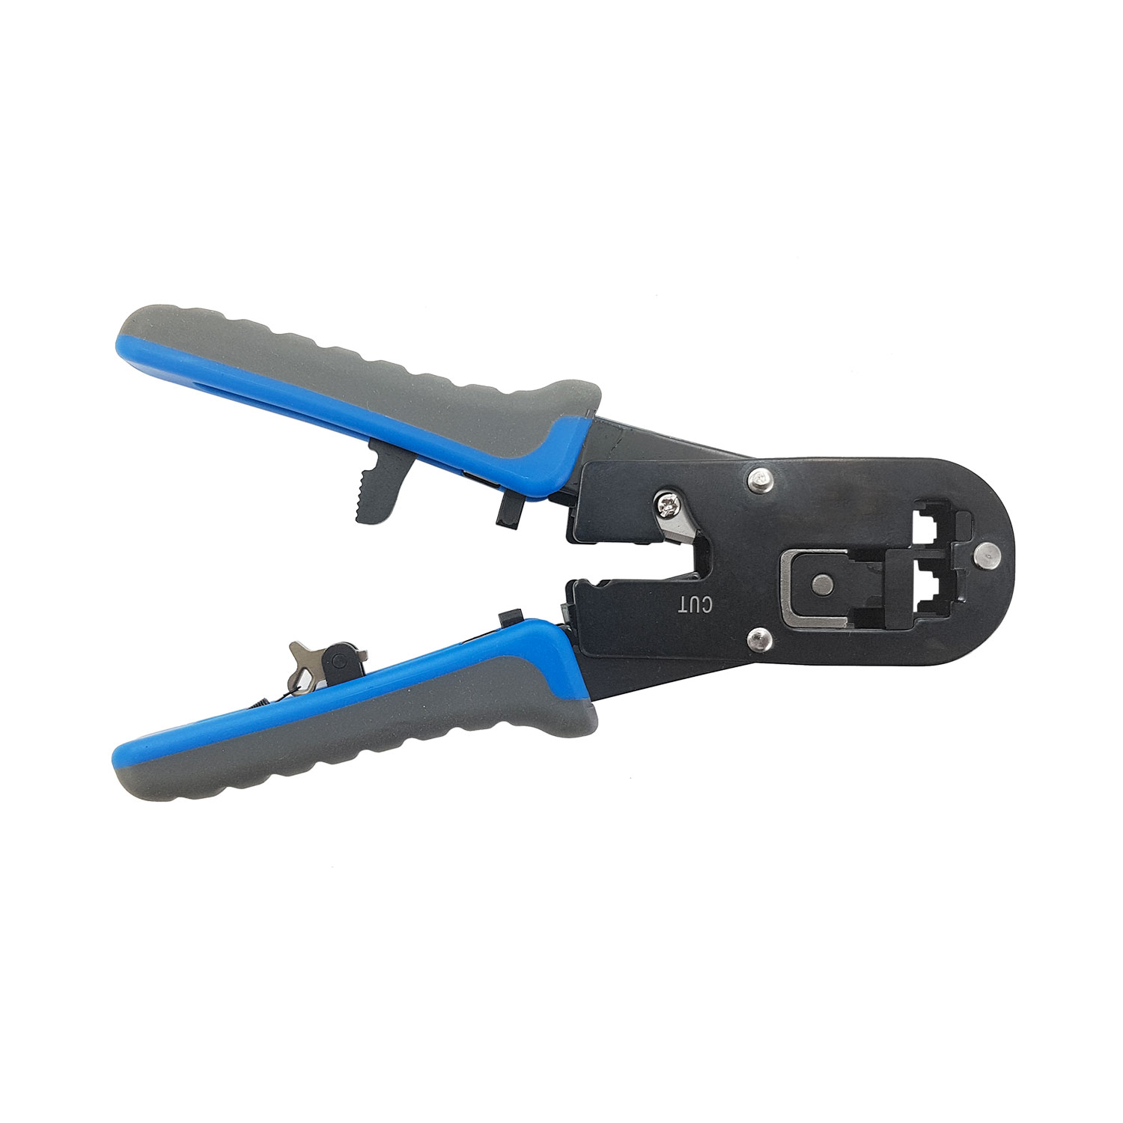
Demonstrations with physical devices
Lecture 7
SoftUni Team
Technical Trainers
Software University
http://softuni.bg

Slide 2
Table of Contents
Demo – scenario 1
Demo – scenario 2

Slide 3
Demo – scenario 1

Slide 4


Slide 5










VLAN 5 (guest): 10.5.5.0/24
Internet
VLAN 10 (corporate): 10.10.10.0/24
Corporate WEB and DNS Server
SSID:
NetFund-Guest
SSID:
NetFund-Corporate
ge1/0/3
ether 1
fa0/1
fa0/2
ge1/0/1
ge1/0/2
ether 5
Ruckus AP
ZoneFlex 7363
Cisco 3560 PoE
3COM 4500G
MikroTik
RB951Ui-2HnD
Demo - scenario 1

Slide 6
Topology details – scenario 1
DHCP server for both VLANs is the Cisco device
MikroTik is routing the VLANs and making NAT to “outside”
Device, interface | IP address
Cisco, VLAN 5 | 10.5.5.3
Cisco, VLAN 10 | 10.10.10.3
3COM, VLAN 5 | (10.5.5.2)
3COM, VLAN 10 | (10.10.10.2)
Corporate server (Web and DNS) | 10.10.10.101
MikroTik, VLAN 5 | 10.5.5.1
MikroTik, VLAN 10 | 10.10.10.1

Slide 7
Demo – scenario 2

Slide 8
VLAN 5 (guest): 10.5.5.0/24
Corporate WEB, DNS and DHCP Server
Internet
VLAN 10 (corporate): 10.10.10.0/24
SSID:
NetFund-Guest
SSID:
NetFund-Corporate
10.13.13.0/24
fa0/3
ether 1
fa0/1
fa0/2
10.23.23.0/24
ether 5
Ruckus AP
ZoneFlex 7363
Cisco 3560 PoE
MikroTik
RB951Ui-2HnD
Demo - scenario 2

Slide 9
Topology details – scenario 2
DHCP server for both VLANs is the (Windows) Server
Cisco is routing the VLANs, MikroTik is making NAT to “outside”
Device, interface | IP address
Cisco, VLAN 5 | 10.5.5.3
Cisco, VLAN 10 | 10.10.10.3
Cisco, fa0/3 | 10.13.13.3
Cisco, fa0/2 | 10.23.23.3
Corporate server (Web and DNS) | 10.13.13.101
MikroTik, ether 5 | 10.23.23.1

Slide 10

Summary
Demo – scenario 1
Demo – scenario 2
…
…
…

Slide 12












SoftUni Diamond Partners

Slide 13


Educational Partners

Slide 14
Trainings @ Software University (SoftUni)
Software University – High-Quality Education, Profession and Job for Software Developers
softuni.bg, about.softuni.bg
Software University Foundation
softuni.foundation
Software University @ Facebook
facebook.com/SoftwareUniversity
Software University Forums
forum.softuni.bg
Notes:
14

