Slide 1
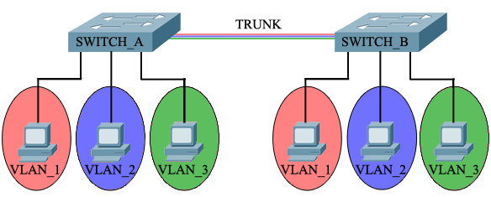
Network Access, Security and VLANs
Lecture 3
SoftUni Team
Technical Trainers
Software University
http://softuni.bg

Slide 2
Table of Contents
Device memory components
Accessing network devices
Securing network device access
Introduction to VLANs
VLAN details
Demo

Slide 3
Device memory components

Slide 4
Main memory components in a network device
RAM (Random Access Memory )
stores the running configuration file
loses content when the power goes down
NVRAM (NonVolatile RAM)
stores the startup configuration file
retains content when the power goes down

Slide 5
Main memory components in a network device (2)
Flash memory
stores the device image (operating system)
retains content when the power goes down
ROM (Read-Only Memory)
maintains instructions for power-on self test (POST) diagnostics
Stores bootstrap program and basic operating system software
retains content when the power goes down

Slide 6
Saving the configuration
The configuration file must be saved to survive reboot
To save the running configuration file (stored in RAM) to the startup configuration file (stored in NVRAM), use either:
copy run start
write memory
configuration
changes
running config
startup config

Slide 7
Loading the configuration
The saved configuration file (startup config file) will go in the RAM (the running config file) when:
the device is restarted
a copy start run command is executed
running config
startup config

Slide 8
Accessing network devices

Slide 9
Out-of-band vs in-band management
Out-of-band:
Management traffic uses separate path from the user traffic
Typical protocol: Console
In-band management
Management traffic travels the same path as user traffic
Typical protocols: Telnet, SSH, SNMP, Web

Slide 10
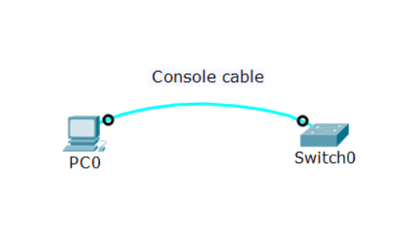
Out-of-band management
Dedicated channel for management only
Needs terminal emulator software (Putty, SecureCRT, etc.)
No IP addresses are required
More secure & reliable for management
Traffic is local and not routed

Slide 11
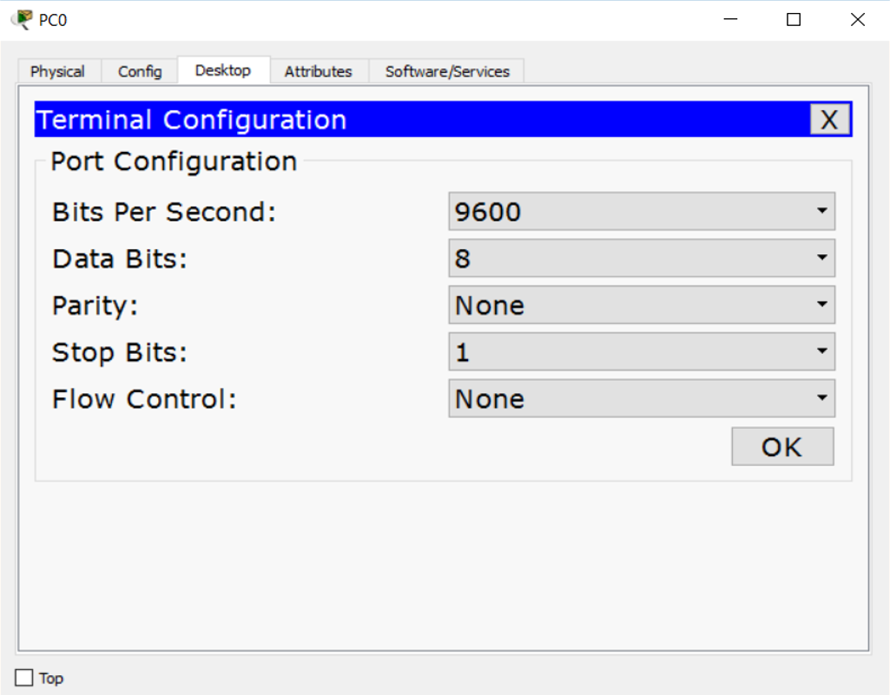
Out-of-band management (2)
Typical default configuration for a terminal emulator
Consult the device documentation if not using the defaults

Slide 12
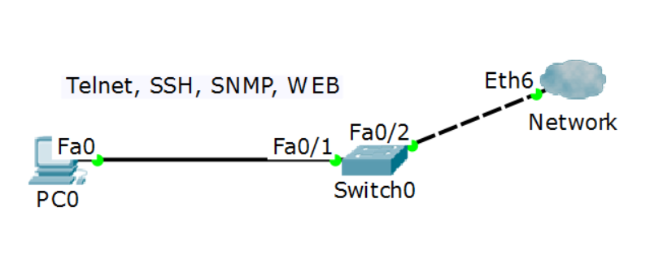
In-band management
Management session on top of existing data connection
Needs L3 connectivity – IP addresses are required
More convenient to use but not always secure and reliable

Slide 13
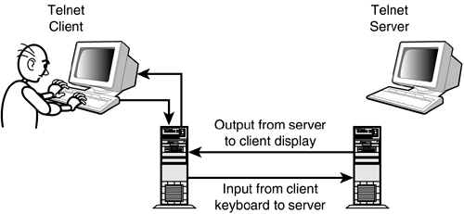
Telnet
Common protocol for managing networking devices
Works on TCP port 23 (by default)
Low security – does not provide encryption
Easy to configure and use

Slide 14
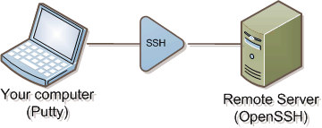
SSH (Secure Shell)
SSH (Secure Shell) – the secure alternative of Telnet
Uses public-key cryptography to authenticate the remote computer
Works on TCP port 22 (by default)
A bit more difficult to setup

Slide 15
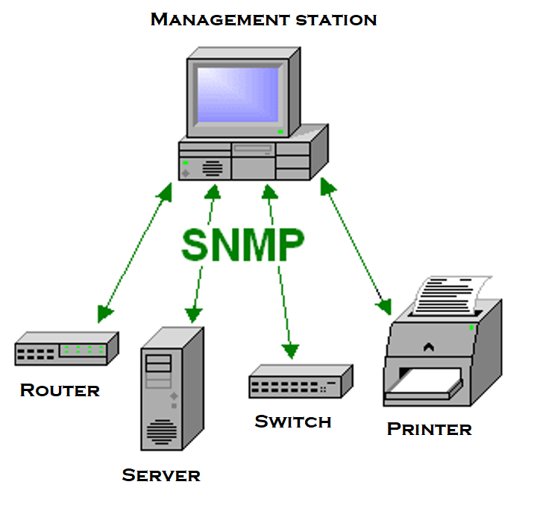
SNMP overview
SNMP - Simple Network Management Protocol
Used to collect data about managed devices on an IP network
Can also be used to push configurations to the devices
A lot of Network Management Systems use SNMP as their underlying protocol

Slide 16
SNMP Versions
SNMP v1
poor security
not very good performance
SNMP v2c
poor security
better performance
SNMP v3
Secure and with good performance
More difficult to configure

Slide 17
Securing network device access

Slide 18
Where to apply device access security?
Physical security (often underestimated)
Set passwords and privileges
Implement ACLs (will be discussed in the advanced course)
NOTE: Different vendors use different methods for setting and resetting passwords. The next slides will focus on some general Cisco concepts

Slide 19
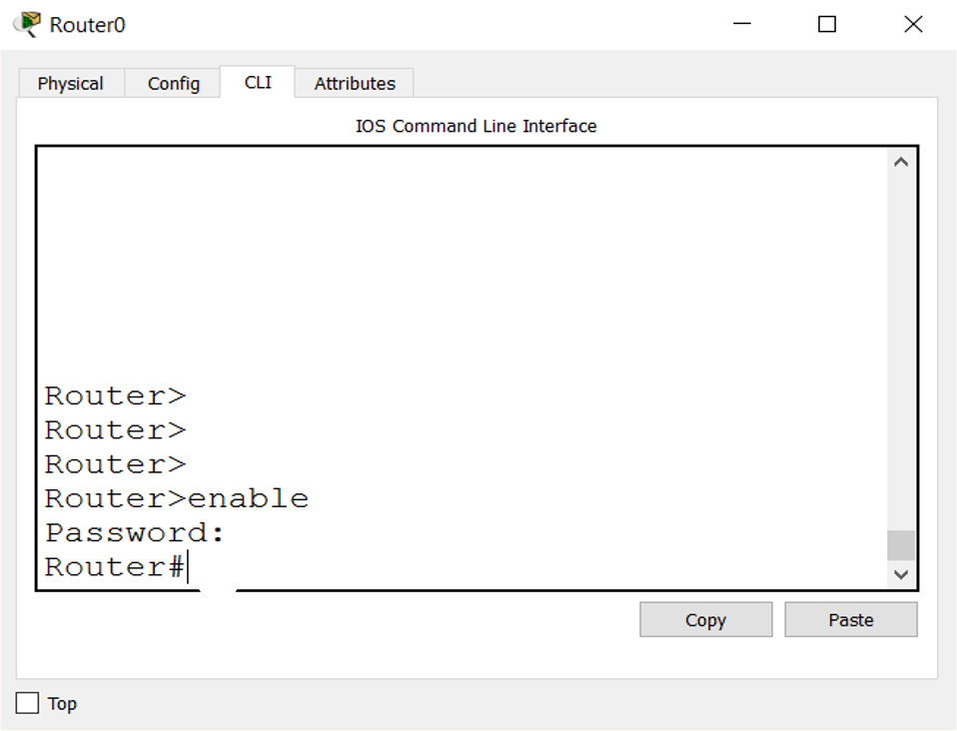
The enable password/secret
The password to protect the privilege exec mode (privilege level 15)
Can be set with either:
enable password
enable secret
Recommended to use enable secret for better security

Slide 20
Interfaces to protect
Two important interfaces to be protected:
Line Console 0 – the console access (out-of-band)
Line VTY 0 N* – the Telnet and/or SSH access connections (in-band)
*N depends on the OS, usually is 15 or 63

Slide 21
Authentication methods
Each interface (console or VTY) can be configured to:
Does not ask for a password: no login
Asks for a password: login
Asks for a username and password: login local (Local accounts must exist to support it)
* These are Non-AAA Authentication methods

Slide 22
Privilege levels
Two default privilege levels are configured:
privilege 1 - this is the user exec mode >
privilege 15 - this is the privileged exec mode #
You can also define custom levels numbered from 2 to 14 and:
Associate each level with allowed commands (use the privilege command)
Assign a password to level n (enable secret level n password)

Slide 23
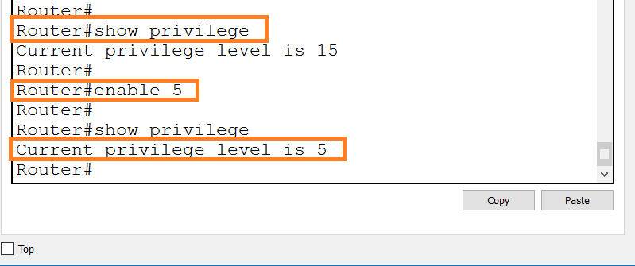
Privilege levels (2)
To check your current privilege level, use show privilege
To change your privilege level to “n”, use enable n

Slide 24
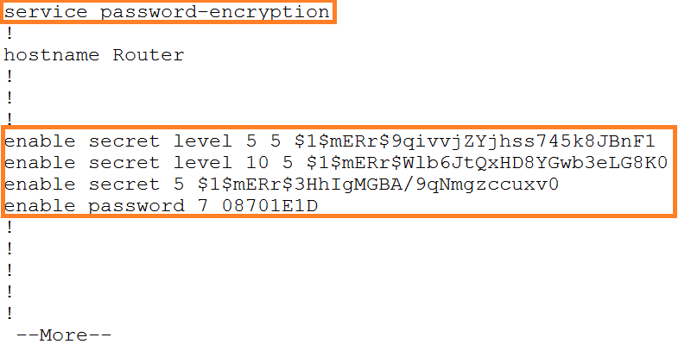
Encrypting all passwords
To encrypt all passwords in the configuration, use the service password-encryption command

Slide 25
Password reset
Lost or forgotten passwords can be reset if you have local access to the device, typically with console connection
A password is not recovered meaning that you typically can not find the lost one
Instead, you specify a new password (or delete the old one)

Slide 26
Password reset procedure
Enter into the emergency (rommon) mode
Instruct the device to bypass its config file (set the configuration register to 0x2142)
Load the device without configuration
Make “copy start run”
Delete the password or configure a new one
Save the config
Set the configuration register back to 0x2102
Reboot

Slide 27
Secure Access - best practices
Physically secure the devices
Use SSH instead of Telnet
Use SNMPv3 instead of v1 or v2
Use HTTPS instead of HTTP
Out-of-band management (console) is considered more secure than in-band management
Create strong passwords for each privilege level and method of access (console, VTY)

Slide 28
Introduction to VLANs

Slide 29
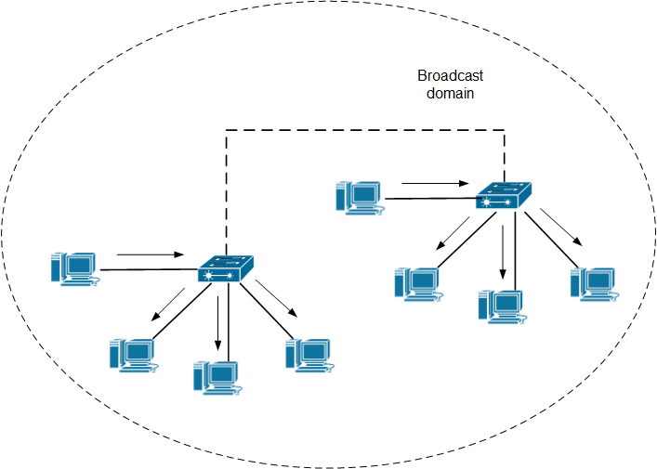
A network without (V)LANs
A single LAN with many computers have some drawbacks:
Low performance - bigger broadcast domain means less efficient utilization of the links
Bad security - each user can configure an IP address from the same network and there is no L2 isolation

Slide 30
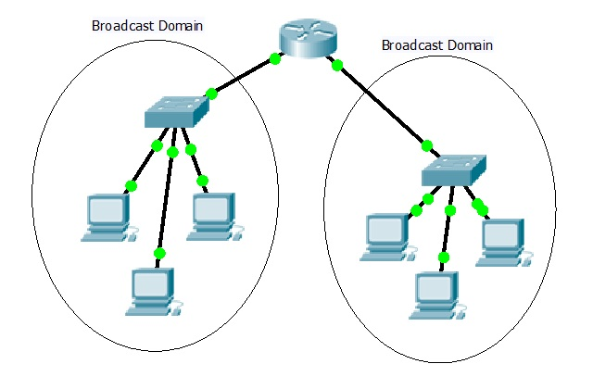
Multiple LANs separated with a router
A router may connect multiple LANs, which provides:
better performance (multiple broadcast domains)
better security (controlled by the router)

Slide 31
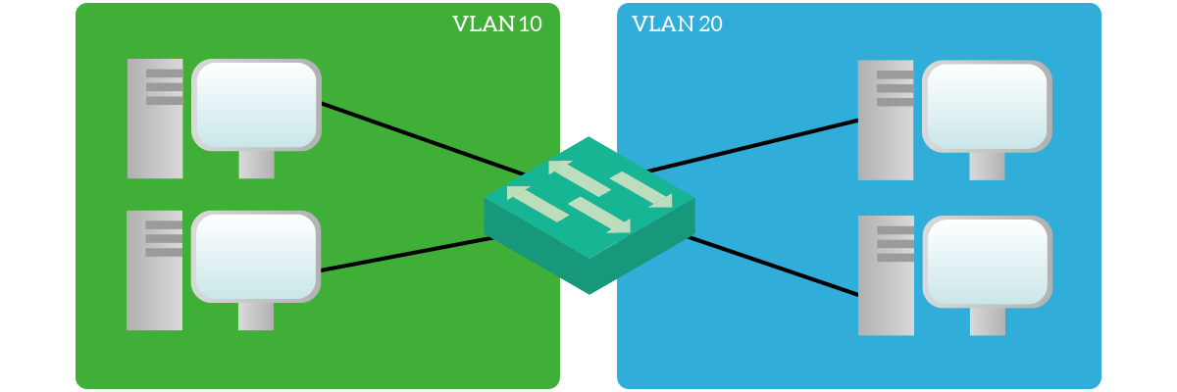
VLANs: Virtual LANs
Logical division of computer networks
One VLAN = One broadcast domain
One VLAN = One IP subnet

Slide 32
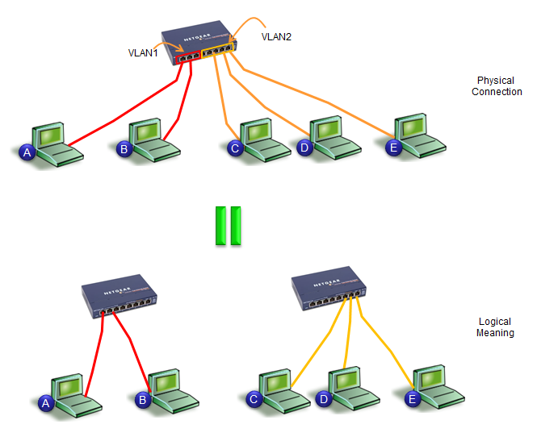
The benefits of the VLANs
Better performance (multiple broadcast domains)
Better security - no connection between the VLANs (unless a L3 device is configured to do this)
Flexibility - regardless of a user’s location, he/she can belong to any VLAN configured by administrator

Slide 33
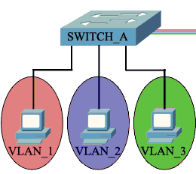
Access (untagged) ports
Used to connect to end-user devices
Can be associated with only one VLAN
Uses the “normal” ethernet frame where there is no VLAN information - no VLAN tag

Slide 34
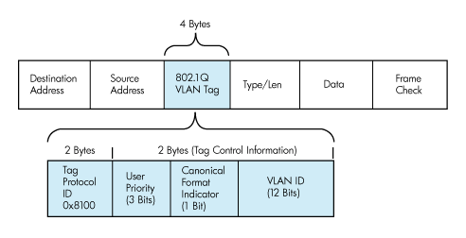
Trunk (tagged) ports
Used to connect between switches
Can carry information from/to multiple VLANs
Uses the 802.1Q tagged frame

Slide 35
Tagging between switches
VLAN 2
Untagged
Untagged

Slide 36
VLAN details

Slide 37
VLANs: defaults and rules
By default, there is only VLAN 1 in each switch
By default, ALL ports belong to VLAN 1 untagged (access ports)
VLAN 1 can not be deleted
Each port must be member of at least one VLAN
Untagged port can belong to only one VLAN at a time
Trunk ports can belong to multiple VLANs at the same time (tagged)

Slide 38
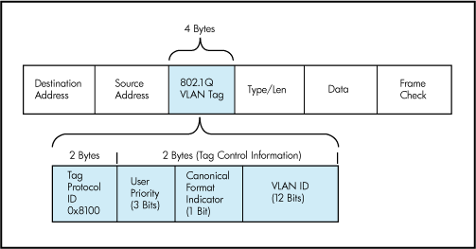
Trunk port details
Uses IEEE 802.1Q tag to identify each frame
A trunk carries multiple tagged VLANs and (maximum) one untagged VLAN
The untagged VLAN on a trunk is called:
Native VLAN (Cisco)
PVID (HPE Comware)
Untagged VLAN (HPE Provision)

Slide 39
Trunk port details (2)
When a port is configured as a trunk port, different vendors may have different default behavior:
All VLANs are automatically allowed on the trunk - Cisco
None of the VLANs (except VLAN 1) are auto-allowed on the trunk - HPE Comware
The configuration can be changed to overwrite the default behavior depending on your needs

Slide 40
Common VLAN terms
Default VLAN - all ports belong there by default
Data VLAN - for the end users
Native VLAN (PVID) - untagged
Management VLAN - type of out-of-band management
Voice VLAN - typically has higher priority
Private VLAN - a.k.a. port isolation

Slide 41
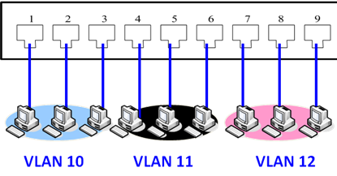
Types of VLANs
Port based VLANs
MAC address based VLANs
IP subnet based VLANs
Protocol based VLANs
Others

Slide 42
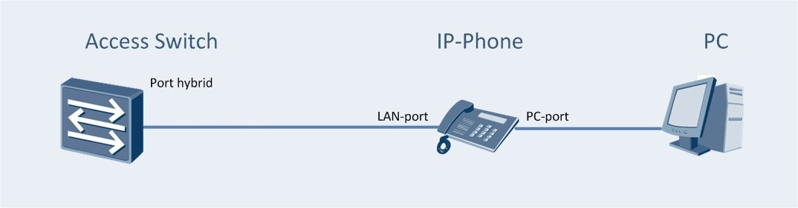
Example: MAC address based VLANs
The Switch will put the frames from the IP-phone in VLAN 100 and the frames from the PC in VLAN 200
How? By reading the frame’s source MAC Address
VLAN 100
VLAN 200
untagged link

Slide 43
Inter-VLAN routing
Traffic is transferred from one VLAN to another via routing
Layer 3 device with IP address in each VLAN is required
Do I have Layer 3 support on my switch?
Cisco – L3 default state depends on the device
HPE Comware - L3 is always on
HPE Provision - need to manually turn on the ip routing

Slide 44
Demonstration

Slide 45

Summary
Device Memory Components
Accessing Network Devices
Securing Network Device Access
Intro to VLANs
VLAN Details
…
…
…

Slide 47












SoftUni Diamond Partners

Slide 48


Educational Partners

Slide 49
Trainings @ Software University (SoftUni)
Software University – High-Quality Education, Profession and Job for Software Developers
softuni.bg, about.softuni.bg
Software University Foundation
softuni.foundation
Software University @ Facebook
facebook.com/SoftwareUniversity
Software University Forums
forum.softuni.bg
Notes:
49

