Slide 1
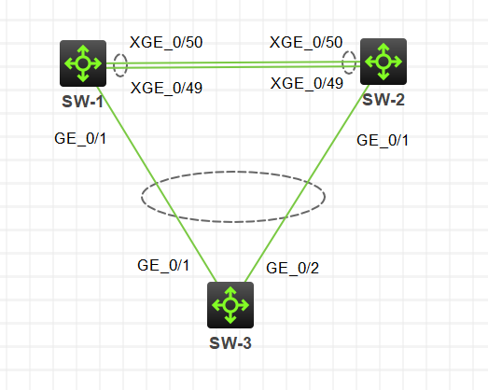
Layer 2 technologies advanced
Lecture 1
SoftUni Team
Technical Trainers
Software University
http://softuni.bg

Slide 2
Table of Contents
Spanning tree protocol advanced: MSTP and PVST+
Link aggregation
Device stacking: IRF

Slide 3
Spanning tree protocol advanced

Slide 4
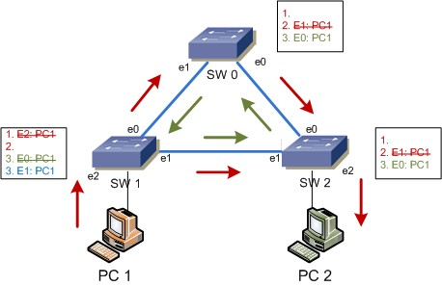
What is the Spanning Tree Protocol?
It addresses a problem which switches can not handle alone: the broadcast storms
Without STP, a L2 loop will:
Overload the links
Affect the end devices
Cause MAC table instability
…never stop

Slide 5
The STP algorithm
Elect the Root switch (Root bridge)
This is the switch with the lowest BID (Bridge ID)
BID = Switch Priority and MAC
Select the root ports
They have the best cost (lowest) to the Root
Selected per switch
Select the designated ports
They have the best cost (lowest) to the Root
Selected per segment (connection)
All other ports go to blocking state

Slide 6
STP tie-breakers
If there is a tie situation - the same path cost via different paths, use the following tie-breakers:
When selecting Root port or Designated port, chose the neighboring switch which has the lowest Bridge ID
If the Bridge ID is the same, select the lowest Port ID (PID)
Port ID = Port priority and port number

Slide 7
Spanning Tree Protocol – Main Flavors
STP - Spanning Tree Protocol, IEEE 802.1D
RSTP - Rapid STP, IEEE 802.1W
MSTP - Multiple STP, IEEE 802.1S (802.1Q-2005)
PVST+ - Per-VLAN STP, Cisco proprietary

Slide 8
MSTP
Multiple Spanning Tree Protocol
Creates multiple instances of the physical STP topology
Can have different Root switches - one for each instance
Provides load-sharing because of the multiple Roots
It is also “rapid”
One instance is mapped to one or multiple VLANs
Needs additional configuration

Slide 9

PVST+: Root switch per VLAN
Priority: 0
Priority: 4096
Priority: 4096
Priority: 0
Vlan 1
Vlan 2
Vlan 1
Vlan 2
Switch 1
port 1
Switch 2
port 1
R
R
port 2
port 2
port 1
port 2
Switch 3
Priority: 32768
Priority: 32768
Vlan 1
Vlan 2

Slide 10
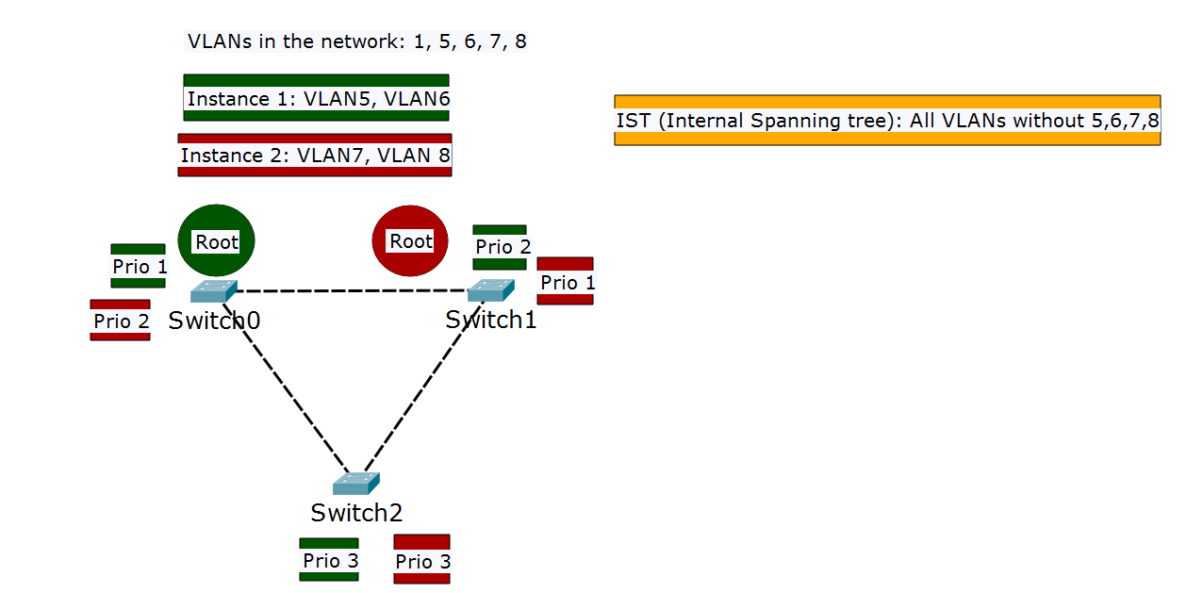
MSTP: Root switch per instance

Slide 11
MSTP instances
By default all VLANs exist inside Instance 0 (a.k.a. IST)
The benefit of MSTP comes when:
There are multiple VLANs
Other (custom) instances are created
VLANs are distributed across instances
Different priorities are set for the different instances
All switches are in the same region

Slide 12
MSTP configuration
All switches in the MSTP domain must be in the same region
Three parameters should be configured equally on all switches:
Configuration Name (region name)
Revision number
VLAN-to-instance mappings
The priorities are configured on a per instance basis

Slide 13
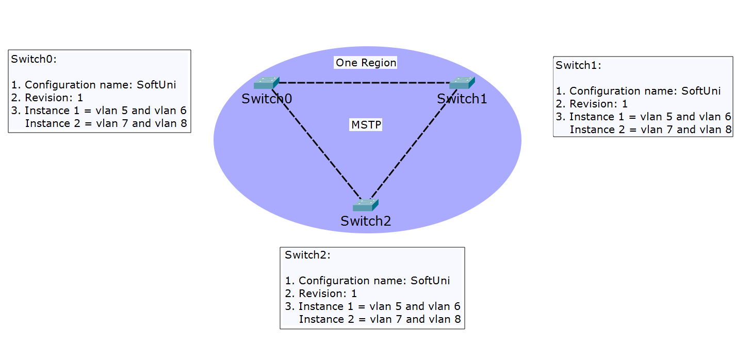
MSTP: All switches in the same region

Slide 14
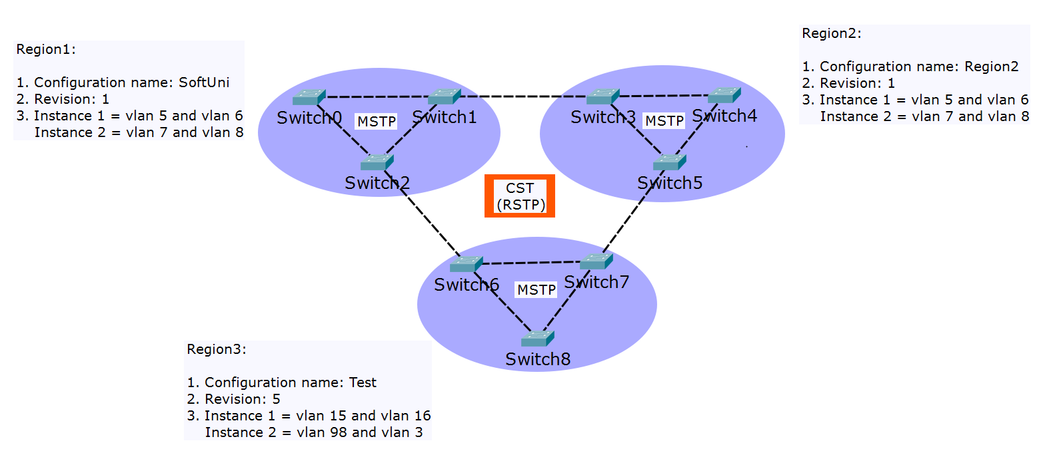
MSTP: Multiple regions

Slide 15
MSTP defaults
On many switches, when spanning tree is enabled, they use MSTP by default …but there is no custom MSTP configuration
So each switch will be in its own region and CST (RSTP) will run between these switches

Slide 16
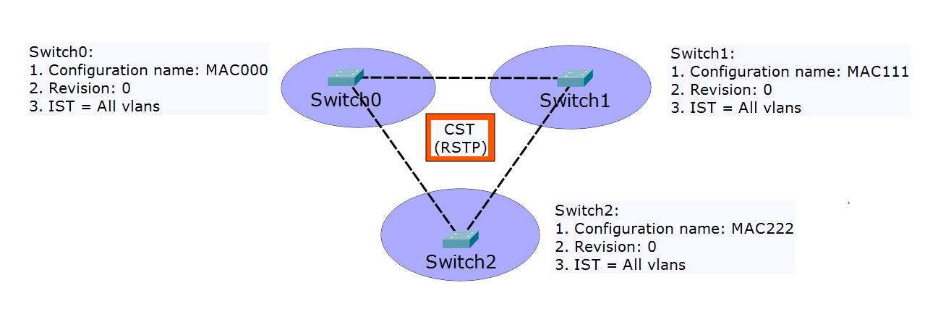
MSTP defaults (2)

Slide 17
MSTP vs PVST+
Two similar protocols, which one is better?
PVST+ advantages:
triggers STP calculation only if there is a potential loop in a particular VLAN
detailed “look” of the network – does not block ports when there is no loop on the trunks for a given VLAN
PVST+ disadvantages
generates a lot of overhead in the network
proprietary protocol

Slide 18
MSTP vs PVST+ (2)
MSTP advantages:
uses less BPDUs and generates less overhead
open standard
MSTP disadvantages:
not VLAN aware (does not look which VLANs are on the trunk ports)
Harder to configure
Recommendation: use MSTP if you have more than 100 VLANs

Slide 19
Link aggregation

Slide 20
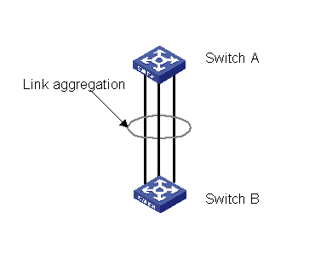
What is link aggregation?
Combination of two or more physical interfaces to create one logical link or port
Other terms with the same meaning:
Port trunking (HPE Provision)
EtherChannel (Cisco)
Link bundling
NIC bonding/teaming
etc.

Slide 21
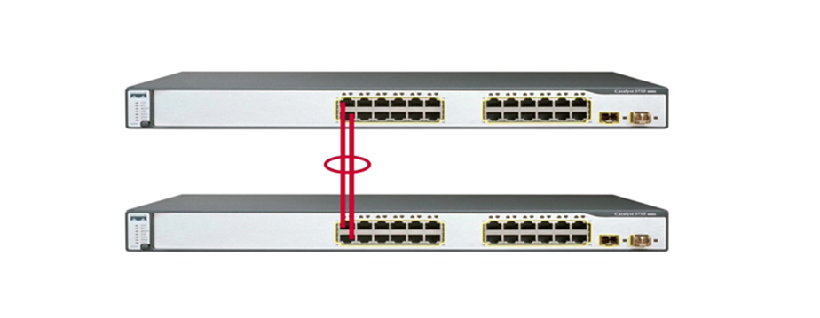
Why to use link aggregation?
To increase the bandwidth
To provide redundancy

Slide 22
Link aggregation protocols
Static (no protocol) option for link aggregation
LACP - IEEE 802.1AX (formerly 802.3ad)
Static
Dynamic
PAgP - Cisco Proprietary
Each protocol has configuration options for different scenarios
LACP configuration and naming can be interpret (slightly) different between the vendors

Slide 23
Interface requirements
In general, the physical interfaces which participate in a link aggregation group, should have the same:
Speed
Duplex
VLAN
All other settings – recommended

Slide 24
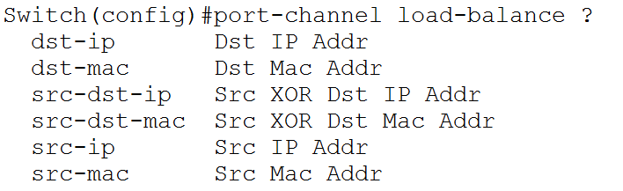
Load sharing modes
Multiple physical links form one logical but at the end the traffic uses the physical links
Which exact link to use - random decision based on “conversations”
Conversations depend on the load sharing mode

Slide 25
Device stacking: IRF

Slide 26
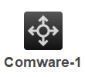
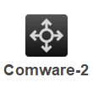
What is device stacking?
Combination of two or more physical devices to form one logical
One logical device

Slide 27
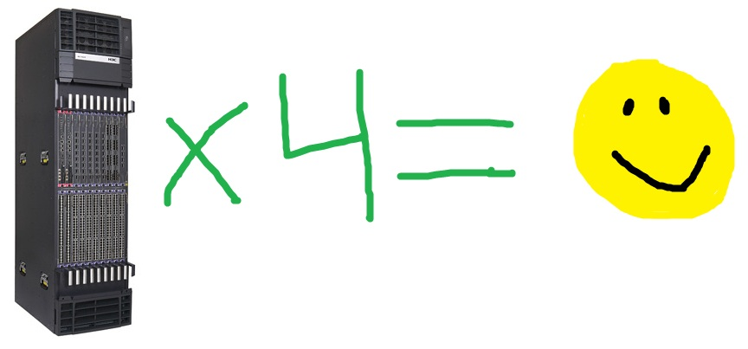
Why device stacking?
More resilient
Does not block ports (like STP)
Simple management
Simple design

Slide 28
What is IRF?
IRF – Intelligent Resilient Framework
HPE proprietary stacking technology
Uses HPE Comware switches (or routers) only
The devices need to be from the same type
One device is elected as a master
The stack takes the master’s configuration

Slide 29
Master election
When creating the IRF stack:
The member with highest priority wins
If no member has a higher priority, the member with the longest system up-time wins (rounded to 10 minutes)
If no member has a longer up-time, the member with the lowest bridge MAC address wins
When joining another device to the IRF stack:
The current master wins

Slide 30

IRF ports and connections
Single physical cable Must be at least 10Gbps
SW-1
1/1
2/2
SW-2
x/y
IRF port – memberID/port
1/2
2/1
Only connect IRF port 1 to IRF port 2!
Possible connections | 1/1 -> 2/2 | 1/2 -> 2/1
Not possible connections | 1/1 -> 2/1 | 1/2 -> 2/2
3/1
3/2
SW-3

Slide 31
IRF topologies
Daisy chain:
Ring:
SW-1
SW-2
SW-3

Slide 32
IRF split stack
When there is a split stack situation, each of the two parts assumes “I am the new master”
This can create problems
Additional Multi Active Detection (MAD) algorithm needs to be configured:
LACP MAD
BFD MAD
ARP MAD

Slide 33
Detect IRF split stack with LACP MAD
I am the master!
I am the master!
Additional Comware switch is required
Extended LACPDU are exchanged
If split stack, MAD triggers election
Smaller member ID wins
The other device(s) put in recovery state (shuts down the ports)

Slide 34
Demonstration

Slide 35

Summary
Spanning tree protocol advanced: MSTP and PVST+
Link aggregation
Device stacking technologies - IRF
…
…
…

Slide 37












SoftUni Diamond Partners

Slide 38


Educational Partners

Slide 39
Trainings @ Software University (SoftUni)
Software University – High-Quality Education, Profession and Job for Software Developers
softuni.bg, about.softuni.bg
Software University Foundation
softuni.foundation
Software University @ Facebook
facebook.com/SoftwareUniversity
Software University Forums
forum.softuni.bg
Notes:
39

