Slide 1
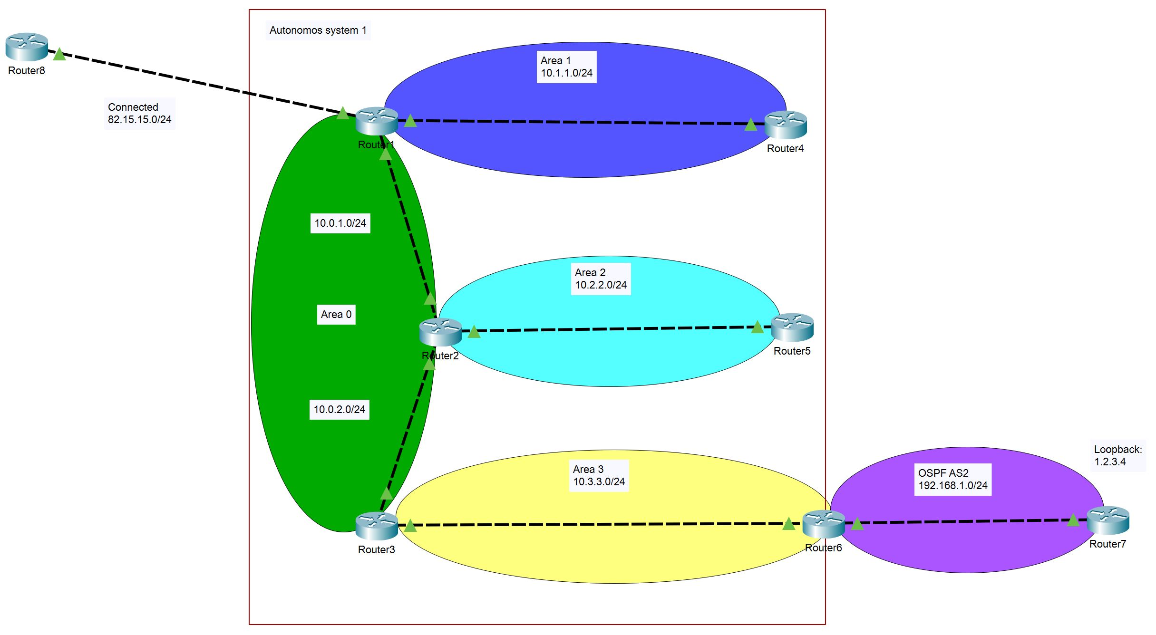
OSPF advanced
Lecture 2
SoftUni Team
Technical Trainers
Software University
http://softuni.bg

Slide 2
Table of Contents
Basic concepts and single area OSPF
Multi area OSPF
Connecting OSPF to external networks
LSA and area types
Demonstration

Slide 3
Basic concepts and single area OSPF

Slide 4
OSPF advantages
Fast convergence with triggered updates
Hierarchical structure (areas)
VLSM support (classless protocol)
Efficient communication with neighbors
Uses intelligent metric (cost)
Open standard

Slide 5
OSPF disadvantages
Requires more RAM and CPU on the devices – maintains different tables (neighbor, topology, routing)
Requires good and careful design when multiple areas are needed
More complex to configure and troubleshoot

Slide 6
OSPF terms
LSA – Link state advertisement
LSDB – Link state database
Router ID
Area
ABR – Area border router
Autonomous system
ASBR – Autonomous system boundary router

Slide 7
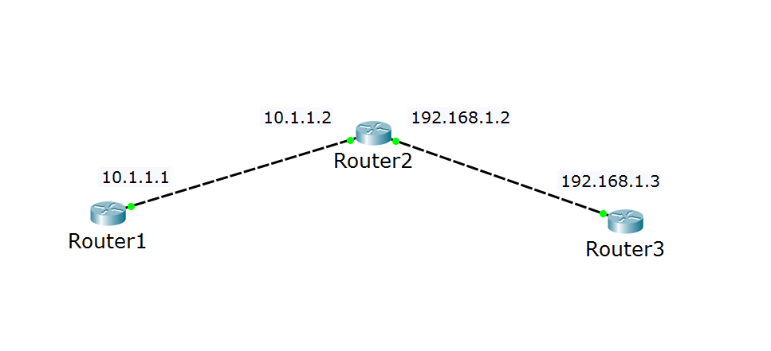
OSPF terms: router ID
I have many names (interfaces), but just call me 2.2.2.2
Hi, 2.2.2.2!
Hi, 2.2.2.2!

Slide 8
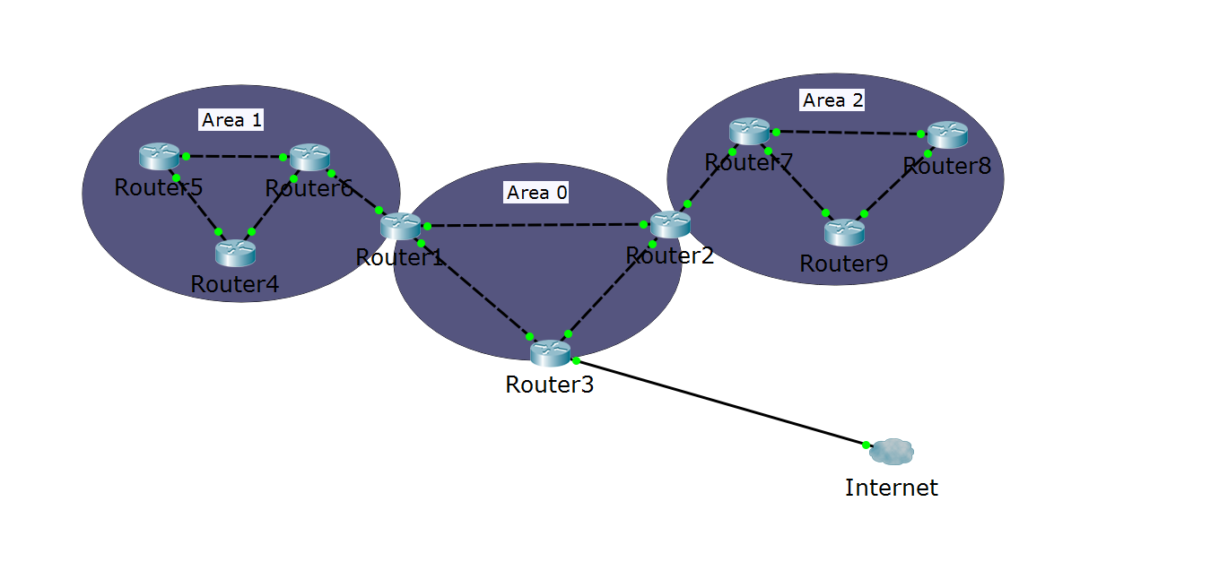
OSPF terms (2)
Autonomous system
ABR
ABR
ASBR
Area 0 = the backbone area

Slide 9
Neighbor relationships
If multiple routers are connected to a switch, we use designated router (DR) and backup designated router (BDR)
This minimizes LSA traffic
Other routers are referred to as DROTHER (DR other)
The DR and the BDR ensure that all routers receive all the required updates

Slide 10
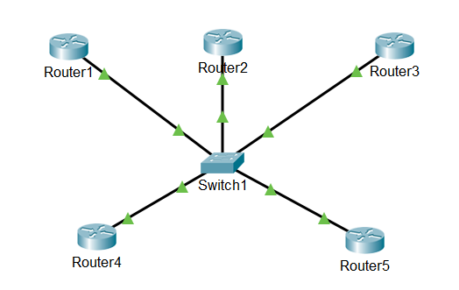
Neighbor relationships (2)
The DR, the BDR and the DROTHERs
DR
BDR
DROTHER
DROTHER
DROTHER

Slide 11
DR/BDR Election Process
The first router that is active on the link becomes the DR
The second router that is active on the link becomes the BDR
Link/interface priority is used for a re-election if the DR/BDR fails
Default priority is 1
Highest priority is elected; if a tie, the highest router ID (not IP address on the interface) is elected
A priority of 0 prevents a router from becoming a DR or BDR

Slide 12
Multi area OSPF

Slide 13
Why multiple areas?
When the OSPF domain is segmented to areas:
Inter-area routes can be summarized
Router’s LSDBs are not too big
The protocol is faster
Stability and control is increased

Slide 14
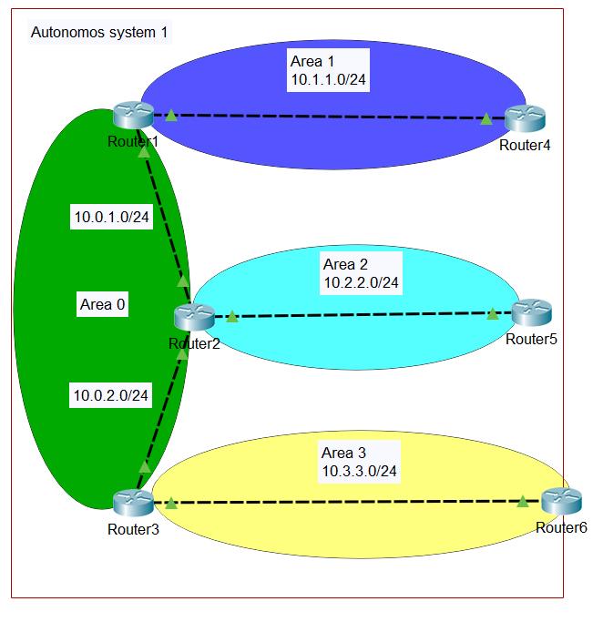
Multiple areas example
All other areas connect to Area 0 (the backbone area)
ABR routers in the example:
Router1
Router2
Router3

Slide 15
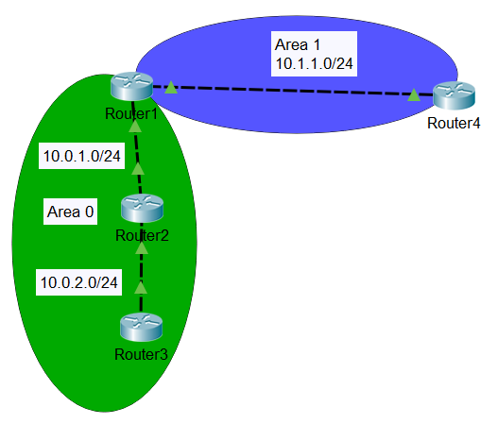
How to configure an ABR
There is no specific command to become an ABR
When you configure a router in more than one area, it becomes ABR
Router1:
router ospf 1
network 10.0.1.0 0.0.0.255 area 0
network 10.1.1.0 0.0.0.255 area 1

Slide 16
Connecting OSPF to external networks

Slide 17
OSPF autonomous system and external networks
ASBR routers in the example:
Router1
Router6

Slide 18
Redistribute between protocols
You need to import or redistribute routes to your AS
Some options for redistribution:
redistribute RIP
redistribute ospf [process_id]
redistribute static
redistribute connected

Slide 19
LSA and area types

Slide 20
OSPF LSA types
LSA type 1: Router
LSA type 2: Network
LSA type 3: Summary
LSA type 4: ASBR summary
LSA type 5: ASBR external
LSA type 6: Multicast OSPF
LSA type 7: Not-so-stubby area LSA

Slide 21
OSPF area types
Standard area
Stub area
Totally stubby area
Not-so-stubby area (NSSA) ☺

Slide 22
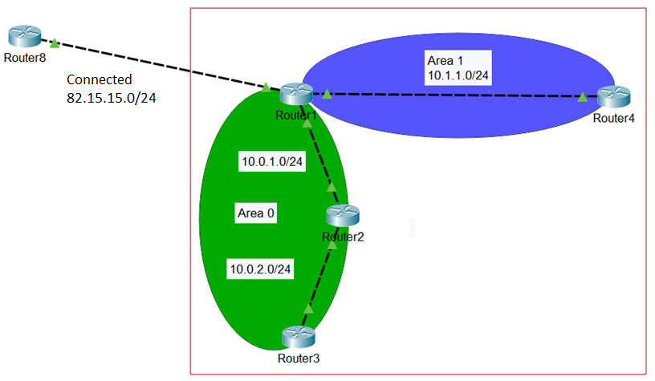
OSPF stub area
Uses LSA types 1, 2, 3 + default route (for external networks)
Blocks LSA types 4 and 5
Area 1 is stub
Router1 injects:
Routes from area 0
Default route to externals

Slide 23
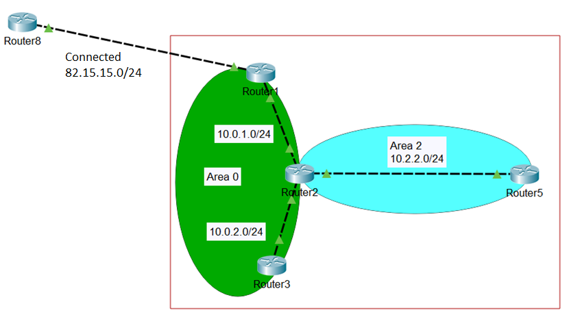
OSPF totally stubby area
Uses LSA types 1 and 2 + default route (for the other areas and external networks)
Blocks LSA types 3, 4 and 5
Area 2 is totally stubby Router2 injects:
Default route to externals
(everything outside of Area 2)

Slide 24
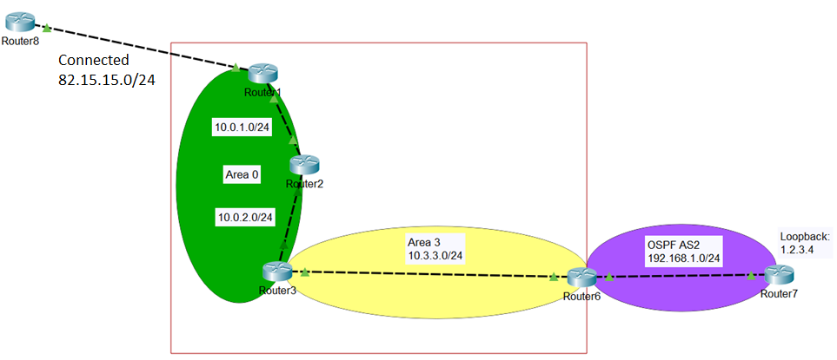
OSPF not-so-stubby area (NSSA)
Uses LSA types 1, 2, 3 and 7
Blocks LSA types 4 and 5
Area 3 is NSSA Router6 injects:
Routes in AS2
Router3 injects:
Routes from other areas
(Route to 82.15.15.0/24 not advertised)

Slide 25
Common area types and LSAs
Stub Area
No LSA type 4
No LSA type 5
Totally Stubby Area
No LSA type 3
No LSA type 4
No LSA type 5
NSSA Area
Uses LSA type 7
No LSA type 5

Slide 26
Demonstration

Slide 27

Summary
Basic concepts and single area OSPF
Multi area OSPF
Connecting OSPF to external networks
LSA and area types
Demonstration
…
…
…

Slide 29












SoftUni Diamond Partners

Slide 30


Educational Partners

Slide 31
Trainings @ Software University (SoftUni)
Software University – High-Quality Education, Profession and Job for Software Developers
softuni.bg, about.softuni.bg
Software University Foundation
softuni.foundation
Software University @ Facebook
facebook.com/SoftwareUniversity
Software University Forums
forum.softuni.bg
Notes:
31

