Slide 1
Exploratory Data Analysis

Slide 2
Relationships Between Features
Feature Selection
Identifying Outliers
Visualization (Seaborn)
Model Selection
Distribution of Continuous Variables
Communication with Stakeholders
Feature Engineering
Distribution of Categorical Variables

Slide 3
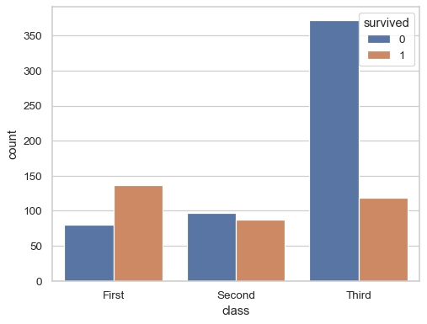
countplot
sns.countplot(titanic, x="class", hue="survived")
https://seaborn.pydata.org/generated/seaborn.countplot.html

Slide 4
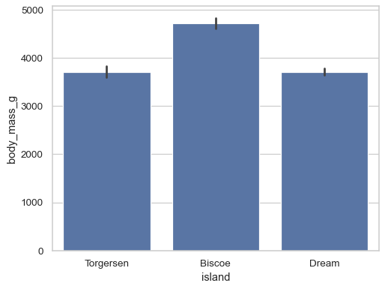
barplot
sns.barplot(penguins, x="island", y="body_mass_g")
https://seaborn.pydata.org/generated/seaborn.barplot.html

Slide 5
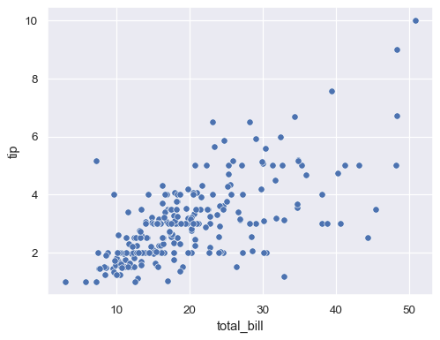
scaterplot
sns.scatterplot(data=tips, x="total_bill", y="tip")
https://seaborn.pydata.org/generated/seaborn.scatterplot.html

Slide 6
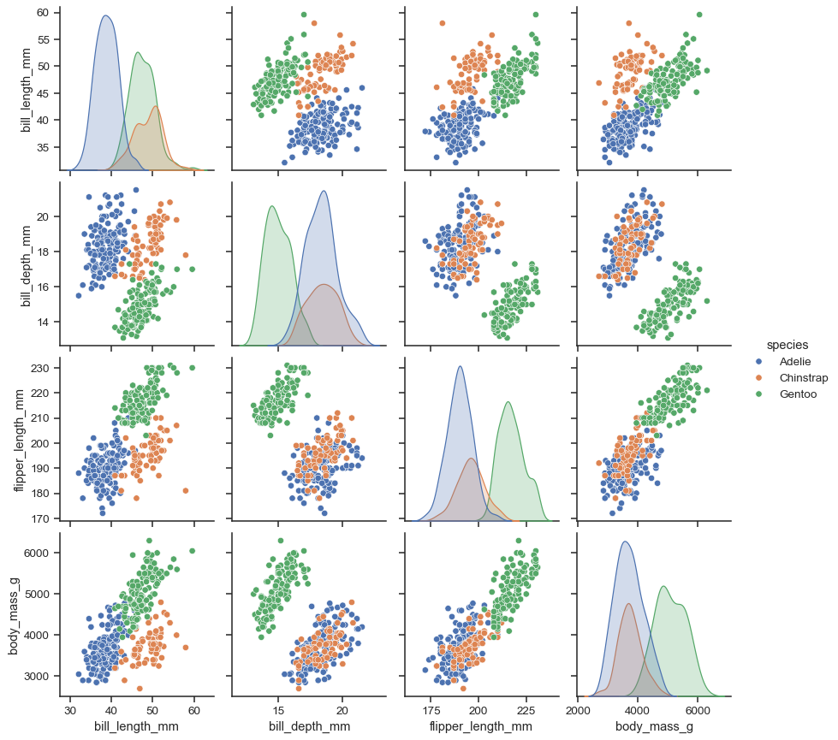
pairplot
sns.pairplot(penguins, hue="species")
https://seaborn.pydata.org/generated/seaborn.pairplot.html

Slide 7
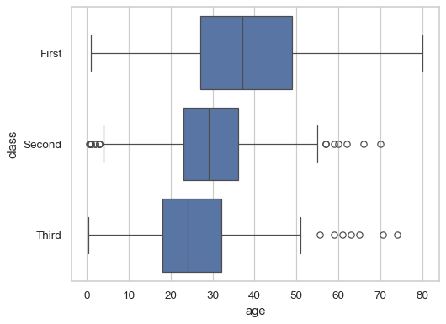
boxplot
sns.boxplot(data=titanic, x="age", y="class")
https://seaborn.pydata.org/generated/seaborn.boxplot.html#seaborn.boxplot

Slide 8
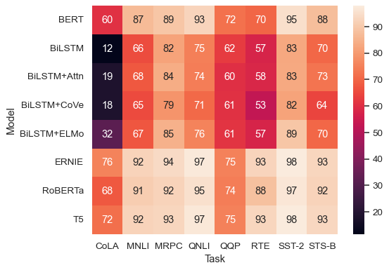
heatmap
sns.heatmap(glue, annot=True)
https://seaborn.pydata.org/generated/seaborn.heatmap.html

Slide 9
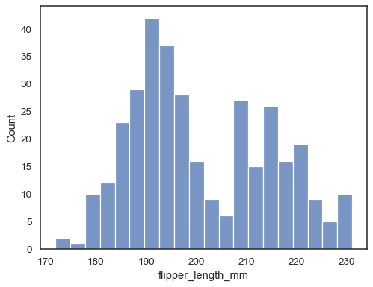
histplot
sns.histplot(data=penguins, x="flipper_length_mm", binwidth=3)
https://seaborn.pydata.org/generated/seaborn.heatmap.html

Slide 10
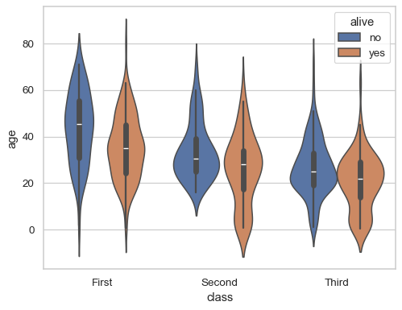
violinplot
sns.violinplot(data=df, x="class", y="age", hue="alive")
sns.violinplot(data=df, x="class", y="age", hue="alive")
https://seaborn.pydata.org/generated/seaborn.violinplot.html

Slide 11
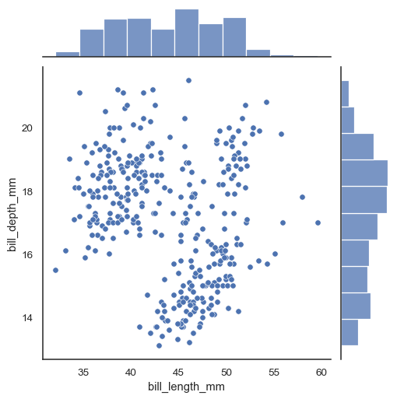
jointplot
penguins = sns.load_dataset("penguins")
sns.jointplot(data=penguins, x="bill_length_mm", y="bill_depth_mm")
https://seaborn.pydata.org/generated/seaborn.jointplot.html

