Slide 1
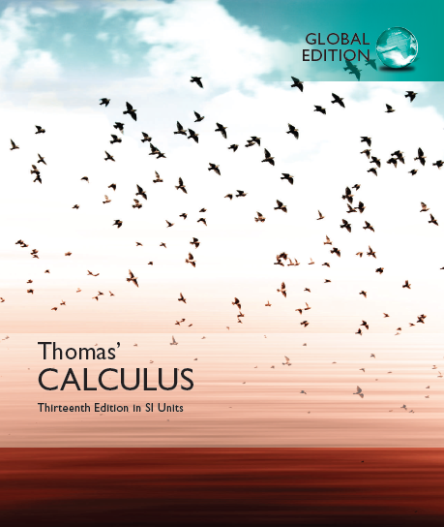

Slide 2
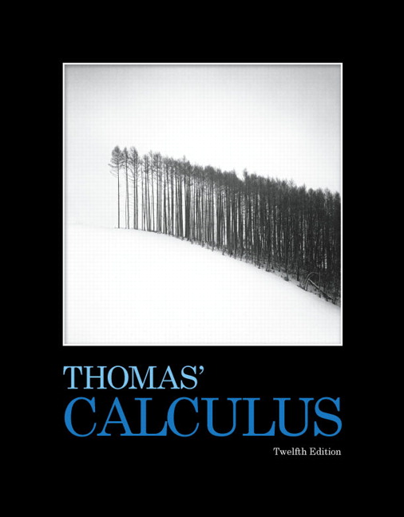

Higher/Advanced Mathematics
© 2017 Pearson Education, Inc. All rights reserved

Slide 3
Textbook & References
  Thomas(at the page 11 of Preface): www.pearsonglobaleditions/thomas
  Tongji(←Bible)
  Resources
    http://www.icourses.cn
    http://open.163.com
Teaching arrangement//Assignment work
Examination score:
  30%x + 70%y≥ 60
  Test bank

Slide 4
Chapter 1
Functions
The Study Object of Calculus.
Copyright © 2010 Pearson Education, Inc. Publishing as Pearson Addison-Wesley

Slide 5
1.1
Functions and Their Graphs
(Functions From Real World)
Copyright © 2010 Pearson Education, Inc. Publishing as Pearson Addison-Wesley

Slide 6
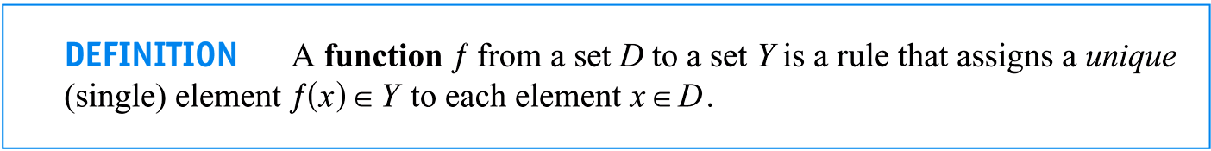
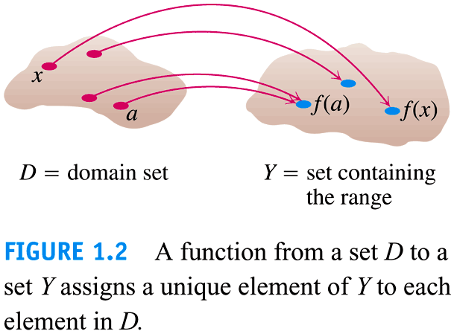
1. Definition of the function

Slide 7
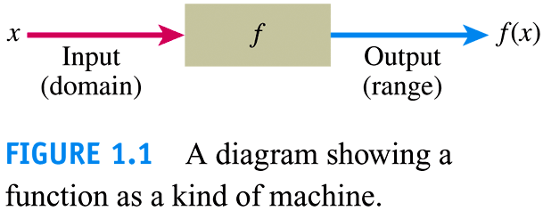

Slide 8
(a) f ≠ f(x).
f, g, h, …, F, G, …, ϕ, ψ, …, sin, cos, exp,…,
void hanoi(int n, char one, char two, char three)
(b) function = mapping
(c) uniqueness.
(d) domain D: y = x².
  Natural domain(P16): (-∞, + ∞).
  Given a domain: D = [-3, 7].
  Domain determined by practical problem: h = 1/2gt², t >=0.

Slide 9
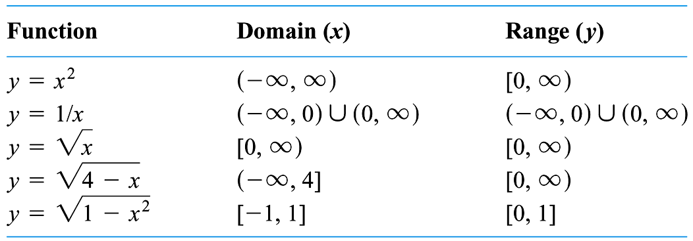

Slide 10
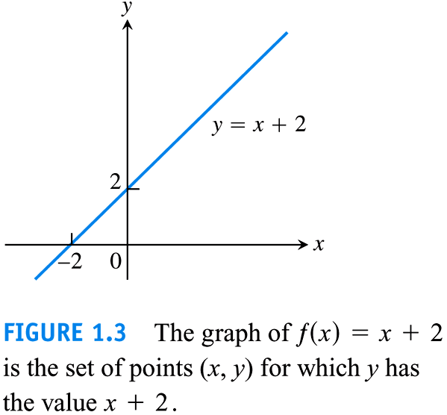

Slide 11
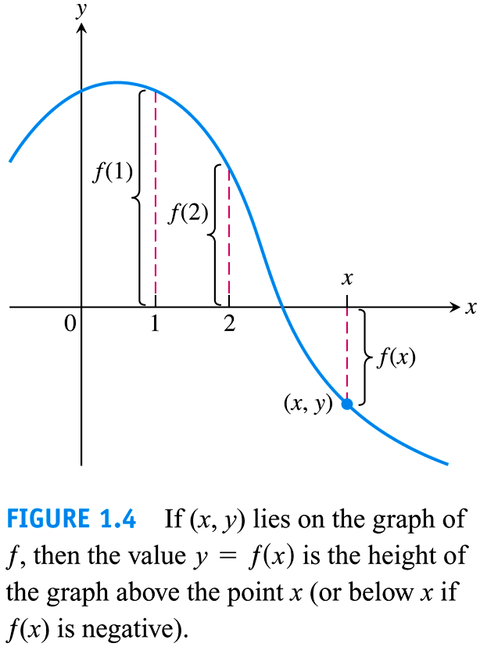

Slide 12
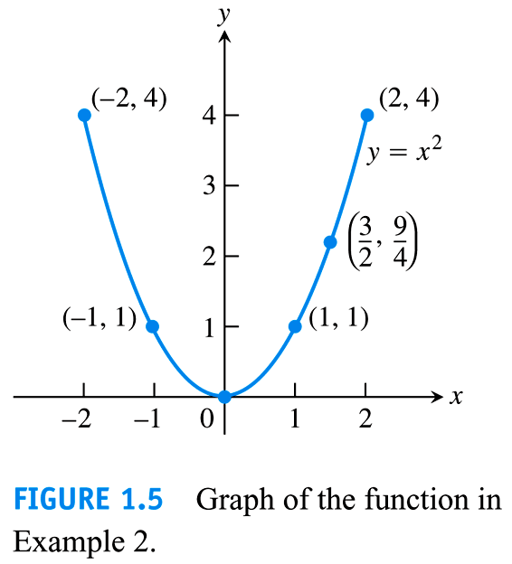
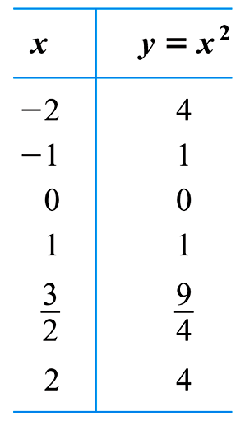

Slide 13
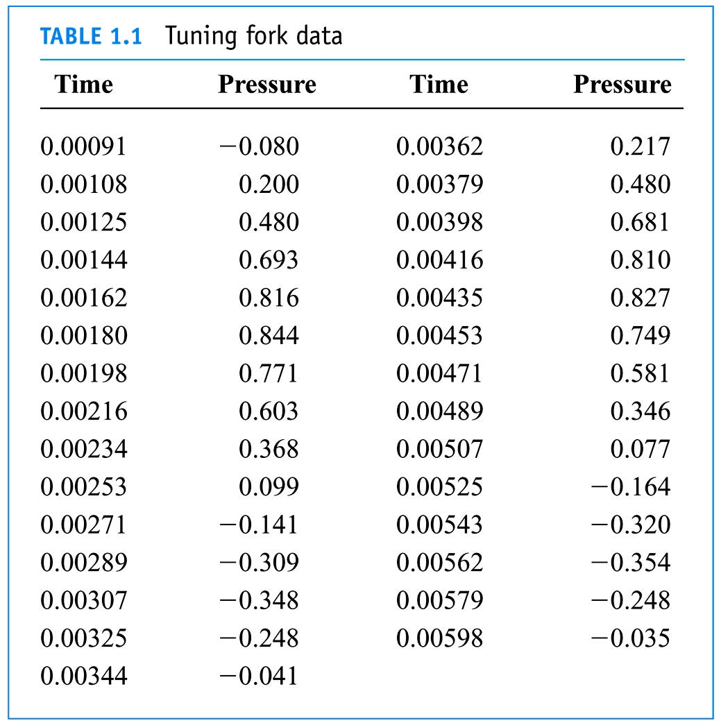

Slide 14
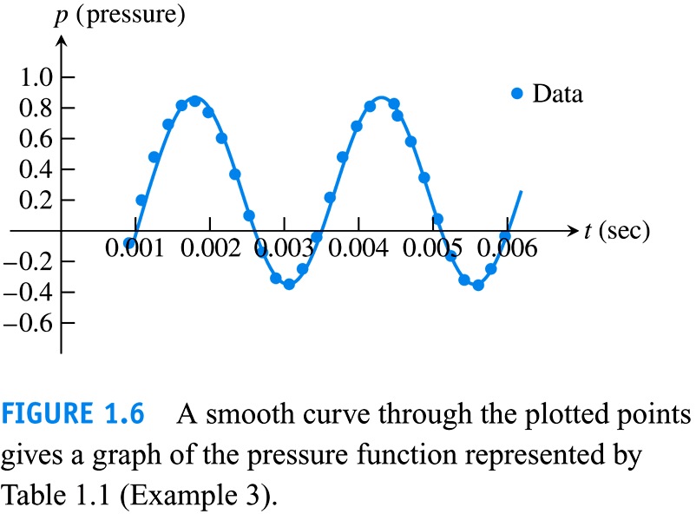

Slide 15
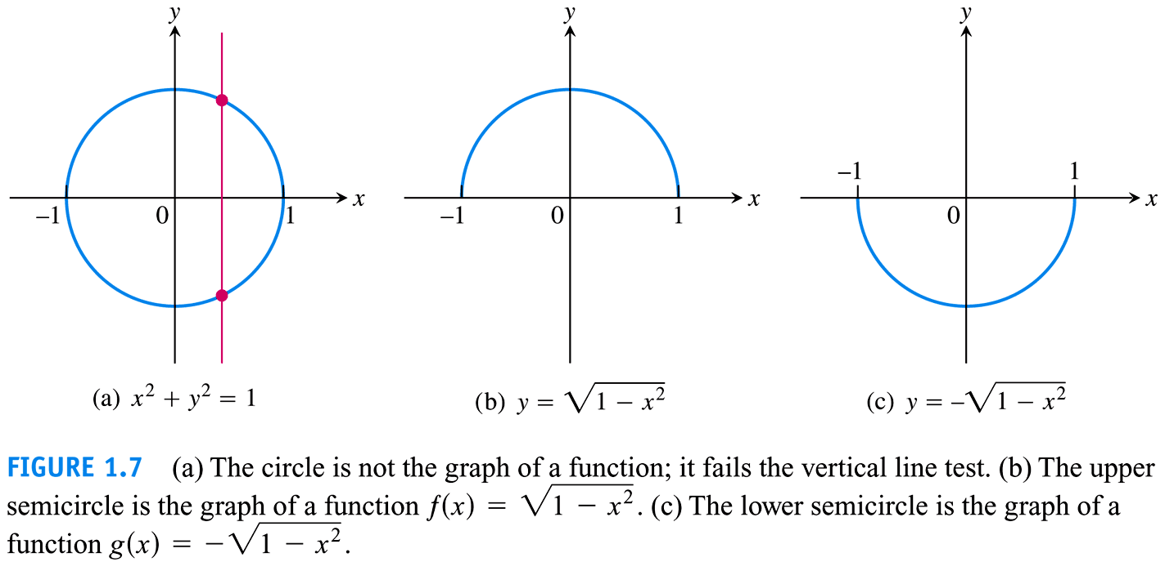

Slide 16
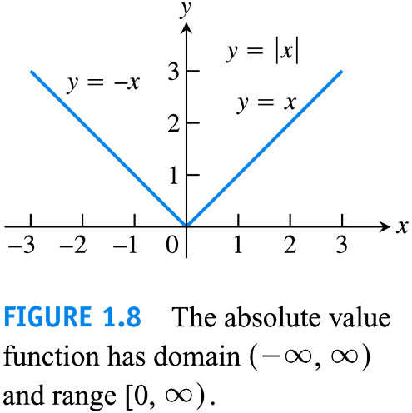
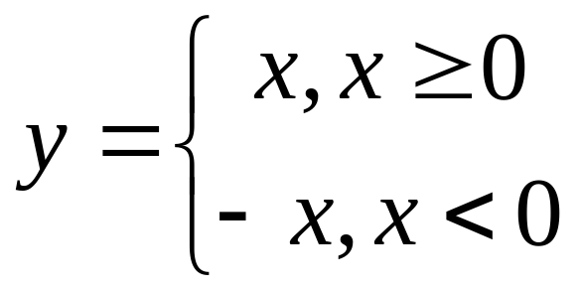

Slide 17
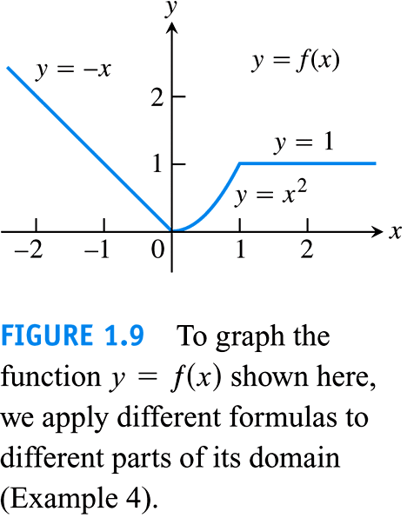

Slide 18
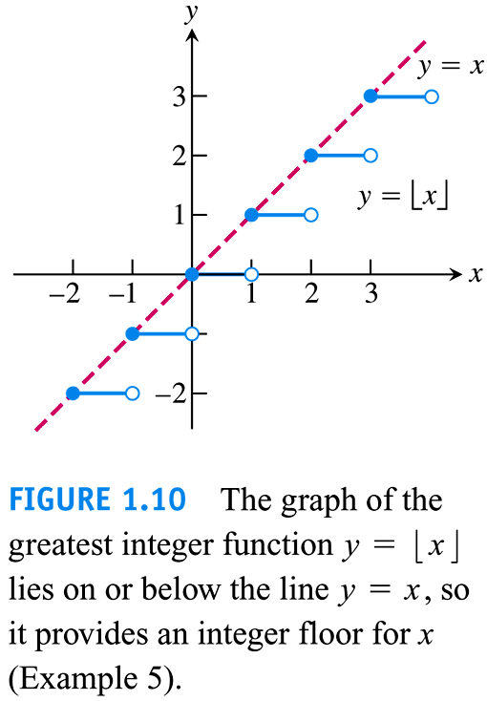

Slide 19
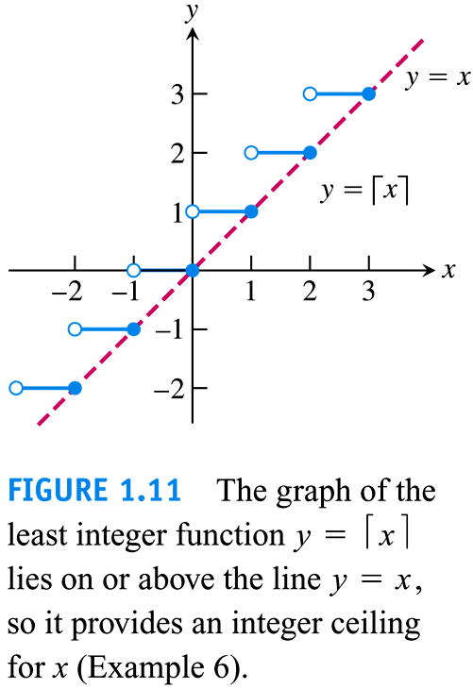

Slide 20
2. Properties of functions (P20)
(1) Monotonic Functions

Slide 21
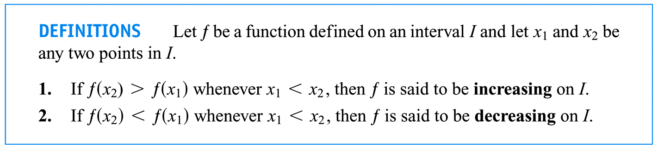
Domain D

Slide 22
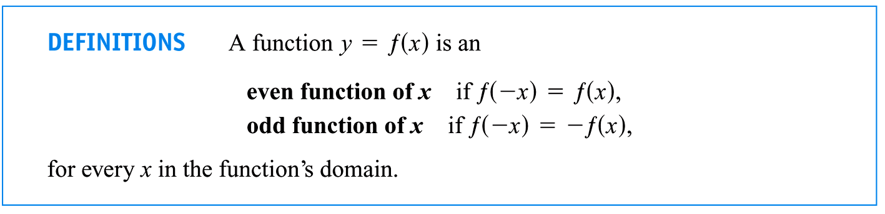
(2) Even and Odd Functions

Slide 23
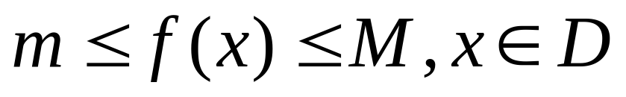

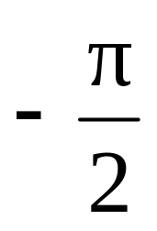
(3) Bounded Functions
y = f(x) = sin(x).
y = f(x) = arctan(x).

Slide 24
(4) Periodic Functions (Section 1.3 P38)

Slide 25
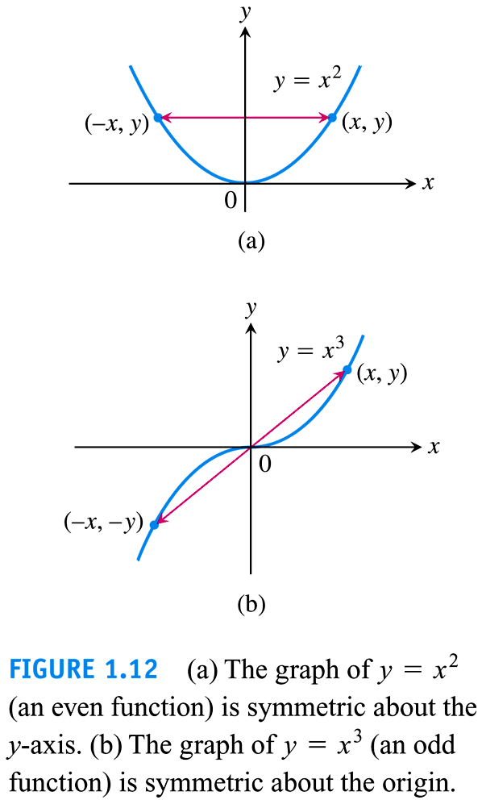

Slide 26
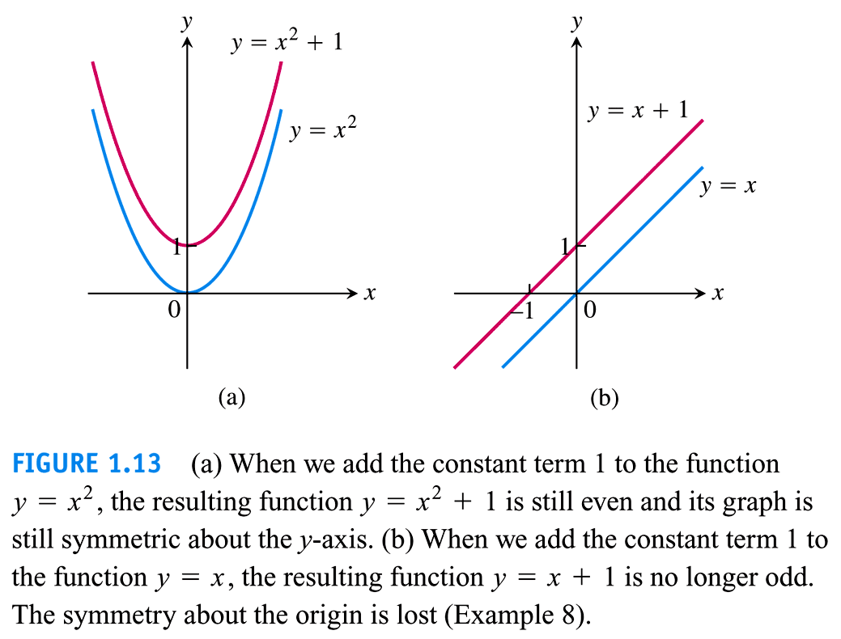

Slide 27
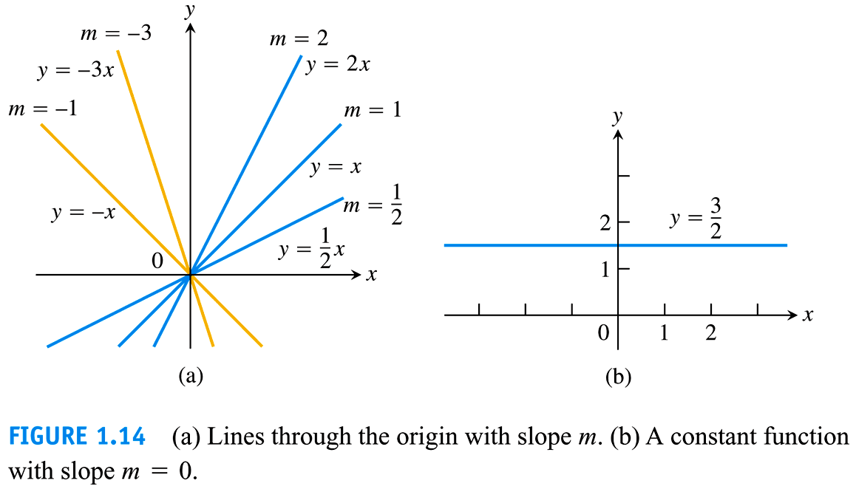

Slide 28
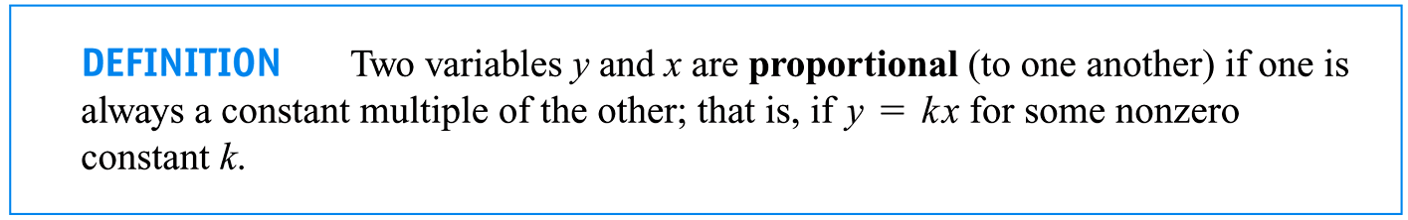

Slide 29
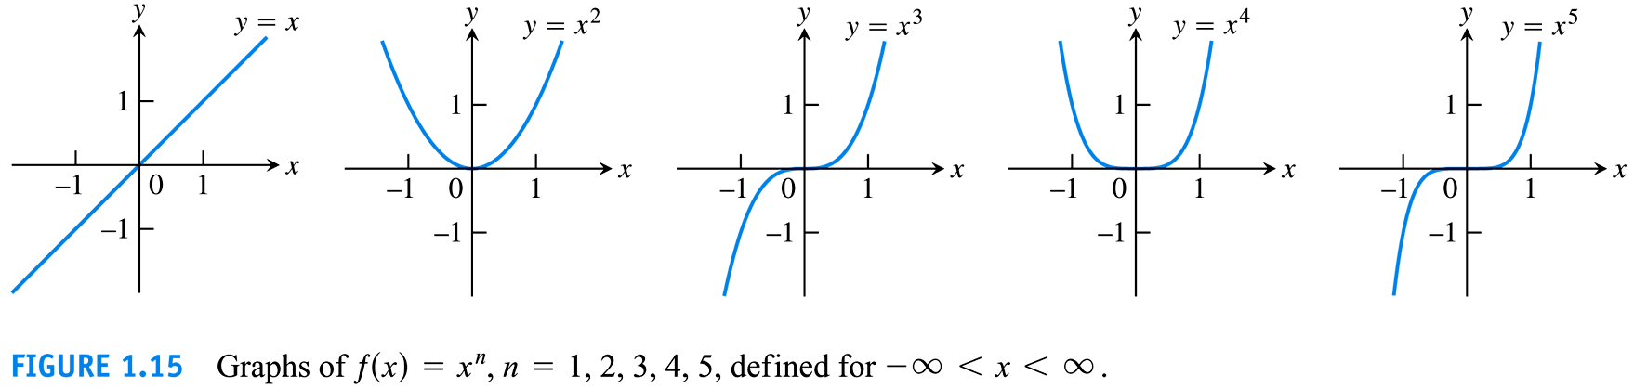

Slide 30
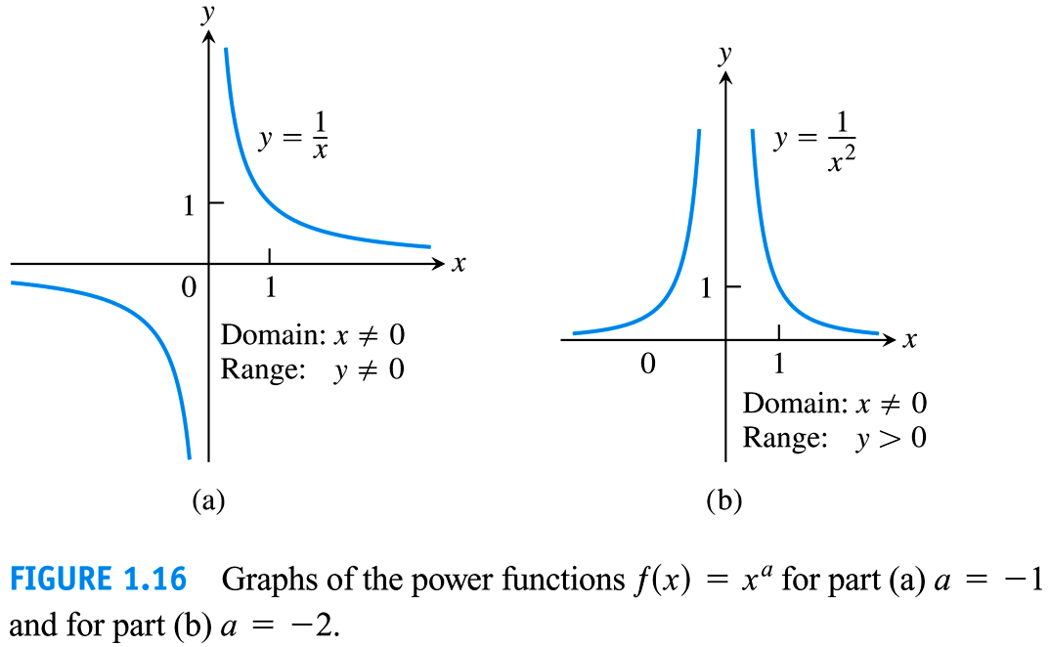

Slide 31
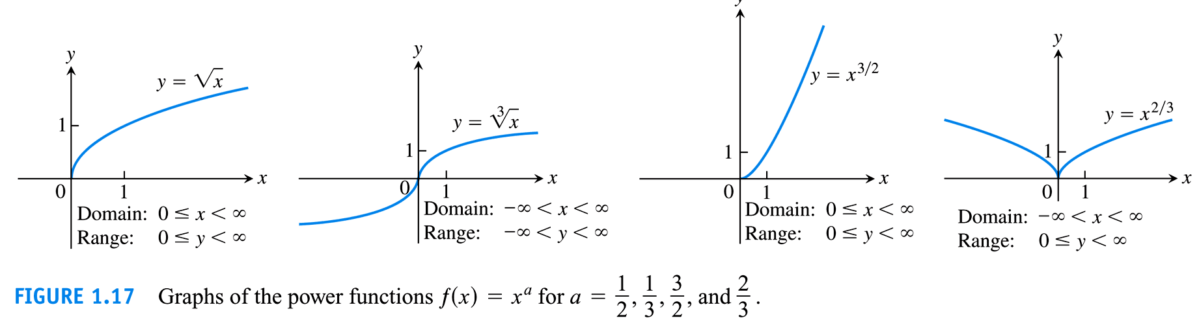

Slide 32
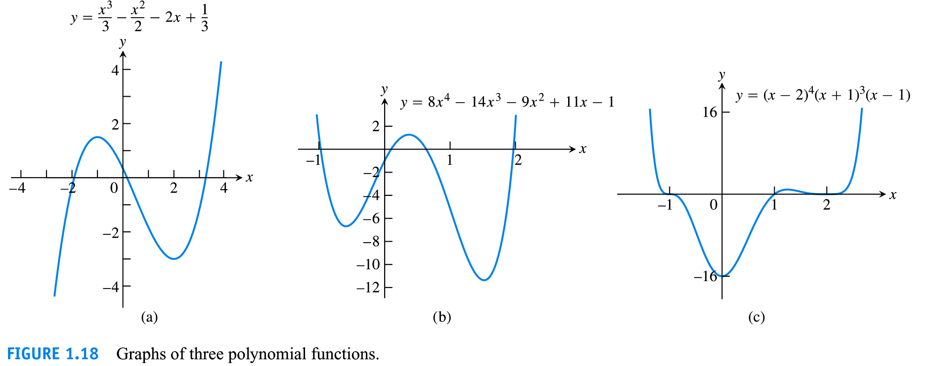

Slide 33
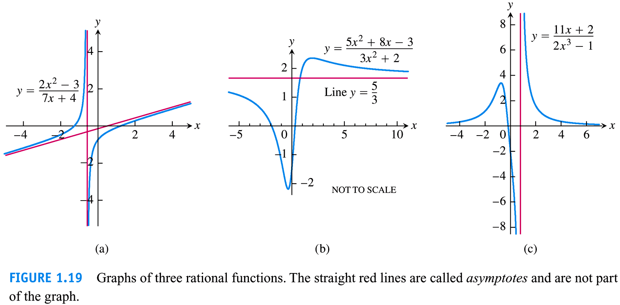

Slide 34
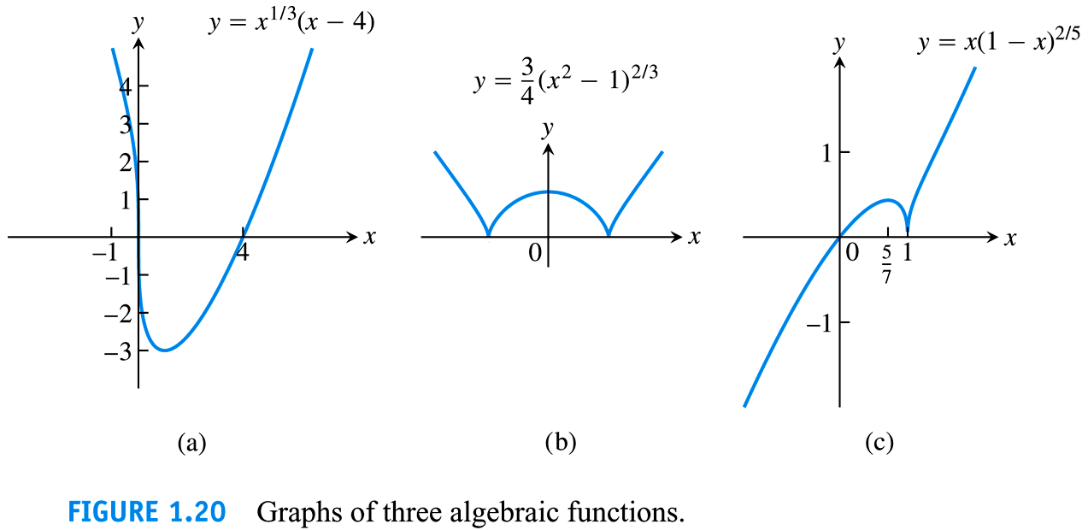

Slide 35
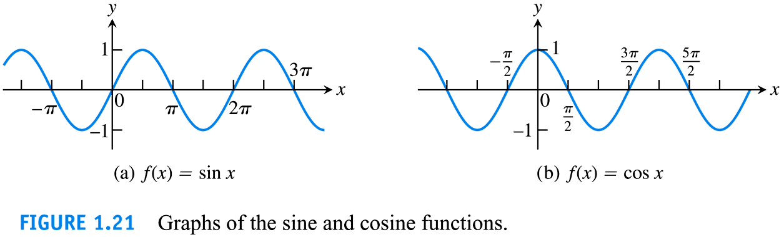

Slide 36
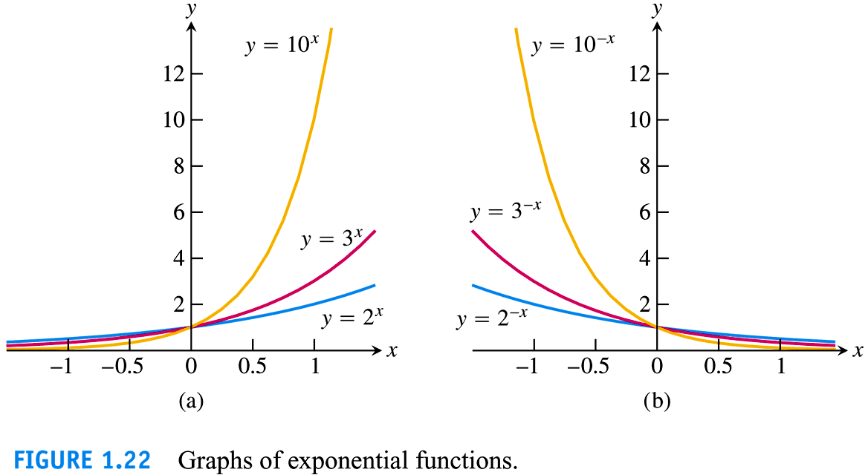

Slide 37
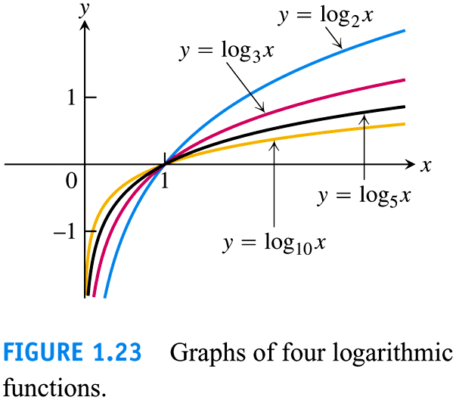

Slide 38
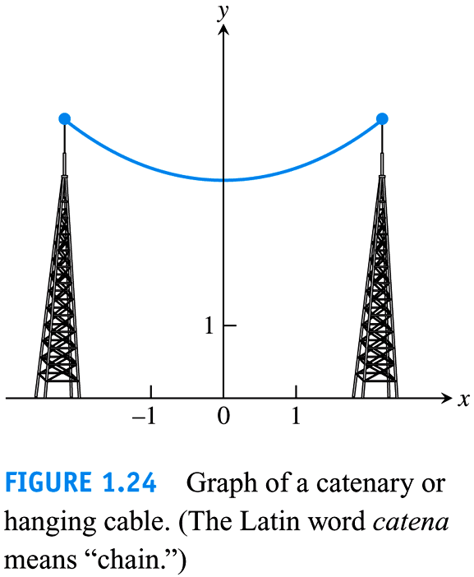

Slide 39
1.2
Combining Functions;
Shifting and Scaling Graphs
Copyright © 2010 Pearson Education, Inc. Publishing as Pearson Addison-Wesley

Slide 40
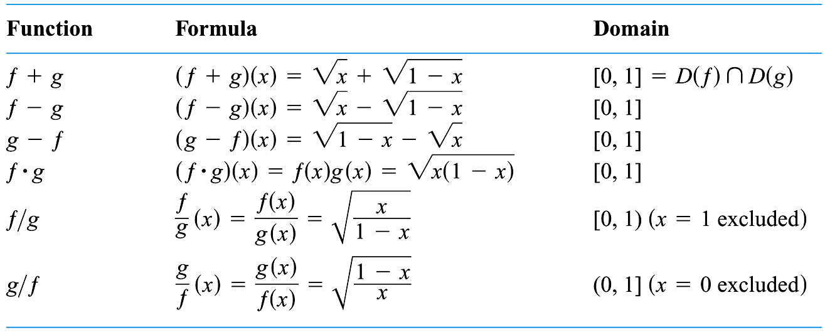

1. f + g, . f - g, . f g, . f / g: P28

Slide 41
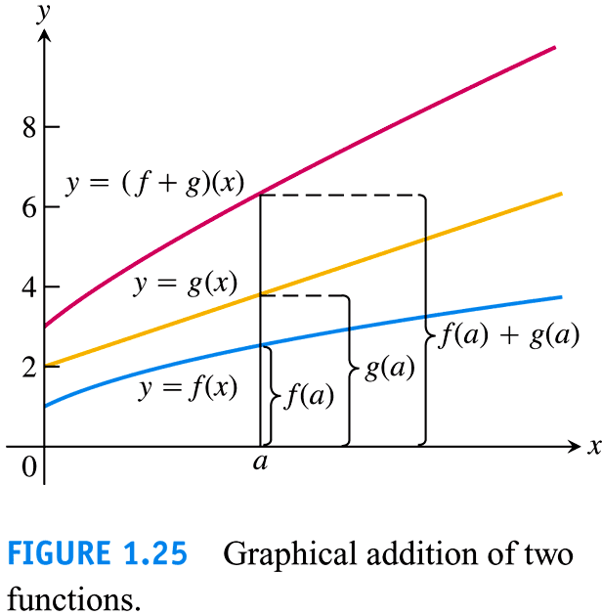

Slide 42
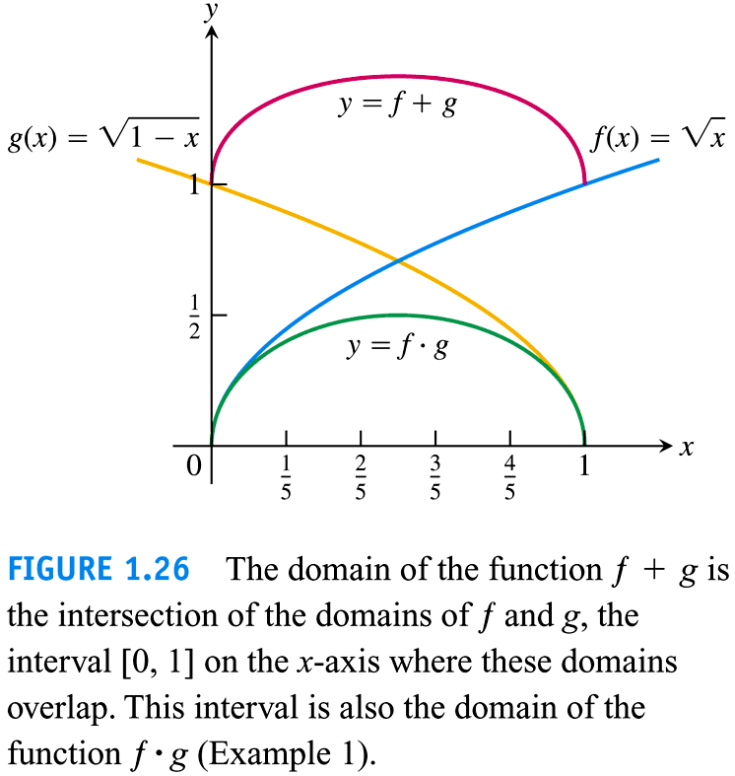

Slide 43
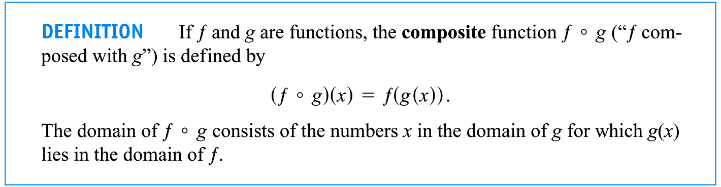
2. f ◦ g: P29

Slide 44
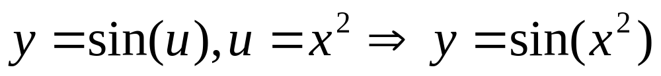
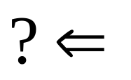
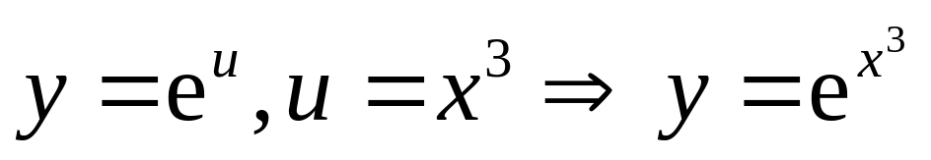
(a)
(b)

Slide 45
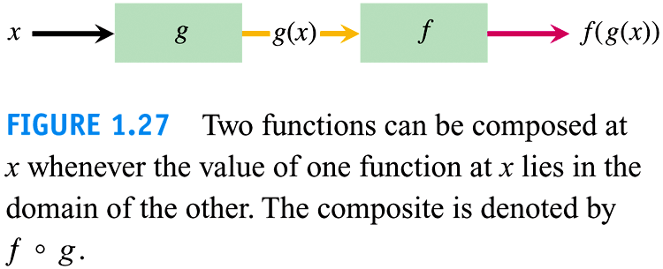

Slide 46
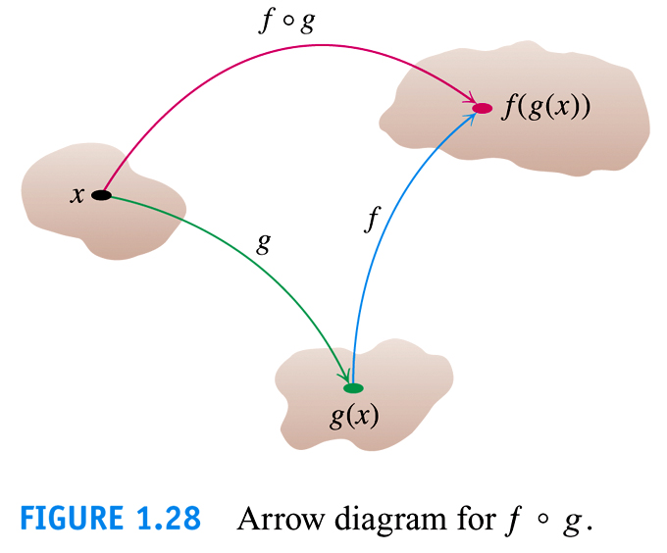

Slide 47
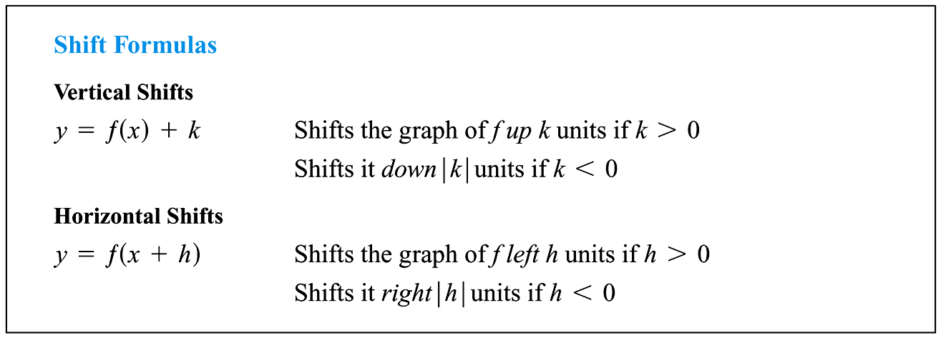

Slide 48
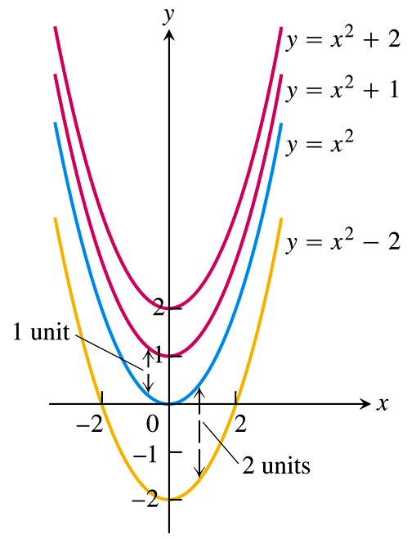
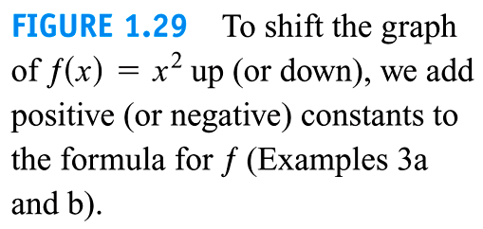

Slide 49
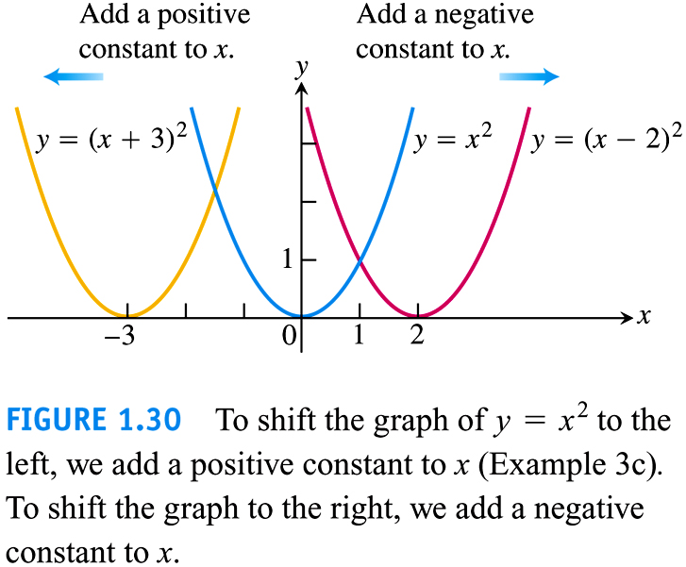

Slide 50
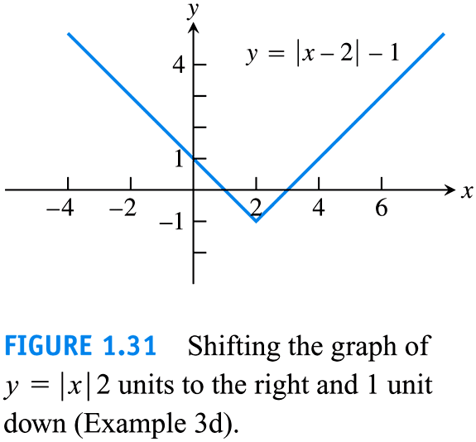

Slide 51


Slide 52


Slide 53


Slide 54


Slide 55


Slide 56


Slide 57


Slide 58
1.3
Trigonometric Functions
Copyright © 2010 Pearson Education, Inc. Publishing as Pearson Addison-Wesley

Slide 59


Slide 60


Slide 61


Slide 62


Slide 63


Slide 64


Slide 65



1. Definitions of Trig Functions
(Jack Ma)Why do we study trigonometric functions?

Slide 66


Slide 67


Slide 68


Slide 69


Slide 70


Slide 71


Slide 72


Slide 73

2. Graphs of Trig Functions
P38: sin, cos, tan

Slide 74


Slide 75


Slide 76


Slide 77
3. Trig Formulas
They are located at the bottom of the book Behind the T-6

Slide 78



Slide 79




Slide 80


Slide 81


Slide 82


Slide 83


Slide 84
4. Inverse Functions
See Section 7.1(P380)

Slide 85
5. Inverse Trig Functions
Not study “Inverse Trig Functions” in the high school.
See Section 7.6(P425)

Slide 86
6. Elementary Functions
Nonelementary Functions (P494)
… elementary functions (the functions we have been studying)
Basic elementary functions = Common functions (P21)?

Slide 87


(0) Constant functions: y = c: y =-1, y = 3,…
(1) Power functions
(2) Exponential functions(?)

Slide 88
(3) Logarithmic functions
(4) Trigonometric functions
(5) Inverse trigonometric functions

Slide 89

A function which can be constructed in finite times using sum, difference, product, quotient and composition operations of the above functions is called the elementary function.
Piecewise defined function: y = |x|?

Slide 90
1.4
Graphing with
Calculators and Computers
Copyright © 2010 Pearson Education, Inc. Publishing as Pearson Addison-Wesley

Slide 91
Matlab
Mathematica

Slide 92


Slide 93


Slide 94


Slide 95


Slide 96


Slide 97


