Slide 1
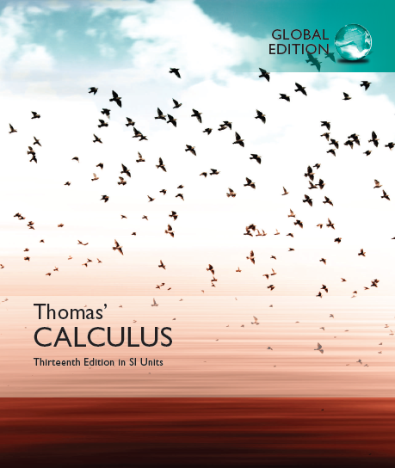

© 2017 Pearson Education, Inc. All rights reserved

Slide 2
Chapter 3
Derivatives
(= Differentiation)
Copyright © 2017 Pearson Education, Inc. Publishing as Pearson Addison-Wesley

Slide 3
3.1
Tangents and the
Derivative at a Point
Copyright © 2017 Pearson Education, Inc. Publishing as Pearson Addison-Wesley

Slide 4
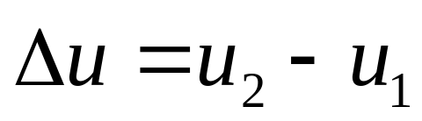
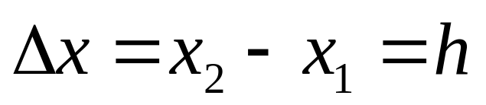
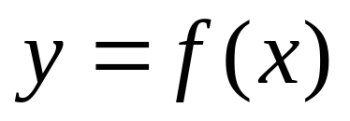
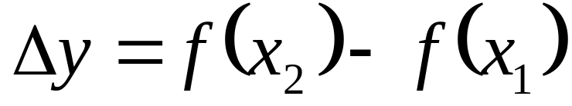




For any variable u, we consider its increment △u:

Slide 5
1. The definition of derivative of a function at a point x₀
Why discuss the derivative? (See the following three examples)

Slide 6
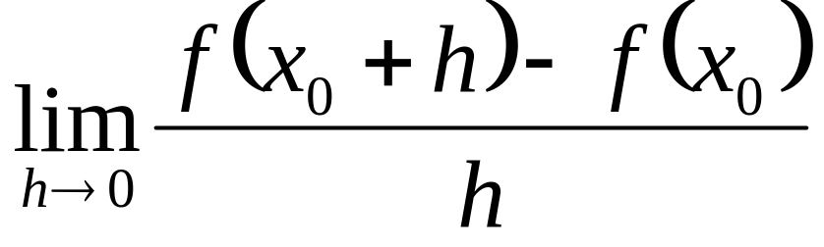
Example A The slope of the tangent line at P(x₀, f(x₀))
Key: How to get the tangent line (see below)?

Slide 7
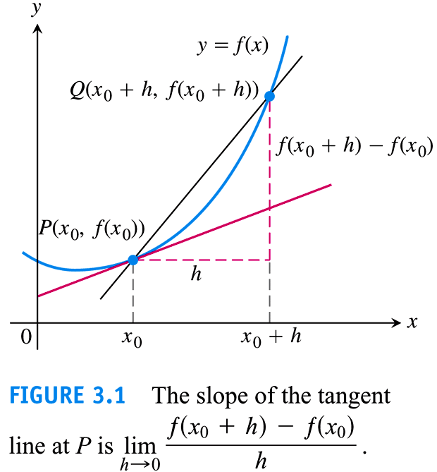

Slide 8
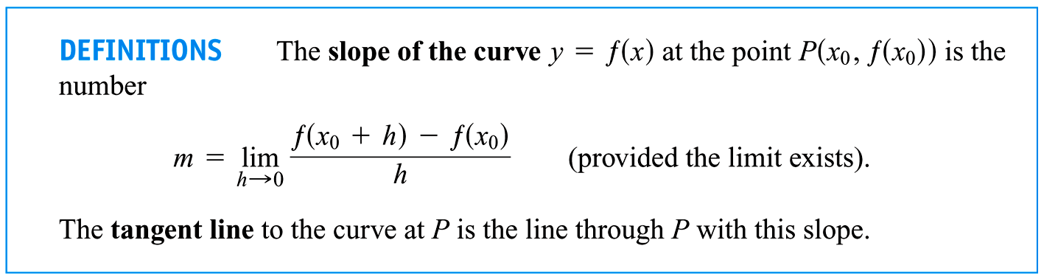

Slide 9
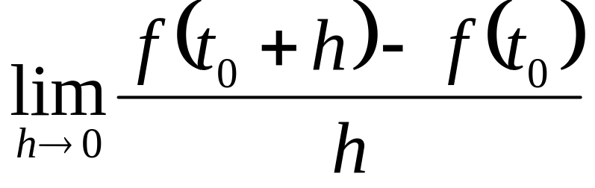


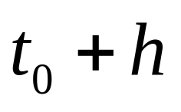
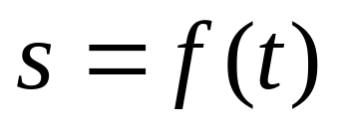
Example B(See Section 3.4) Instantaneous velocity at time t₀.

Slide 10
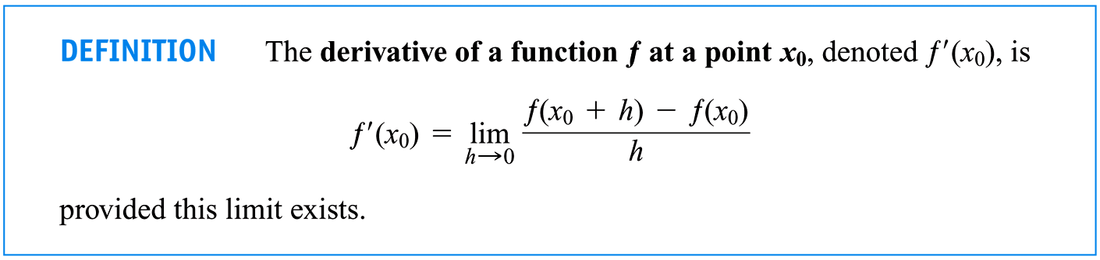
The definition of derivative of a function at a point x₀:

Slide 11
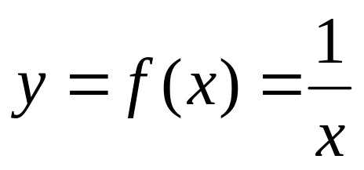
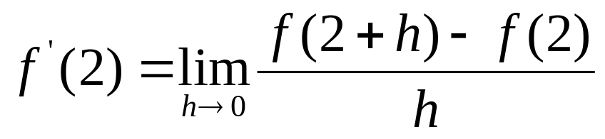
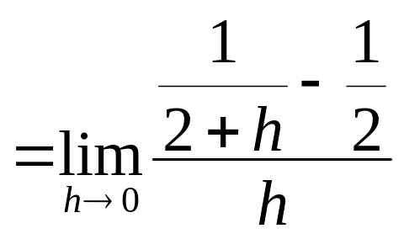
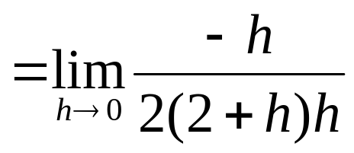
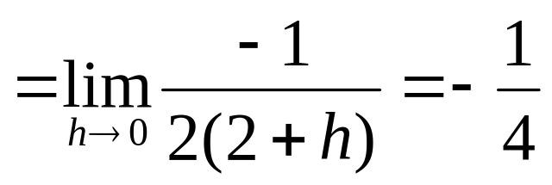

Slide 12
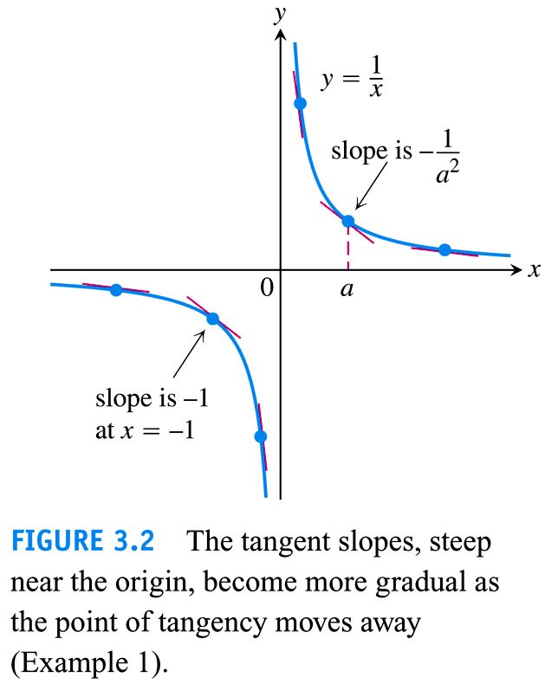

Slide 13
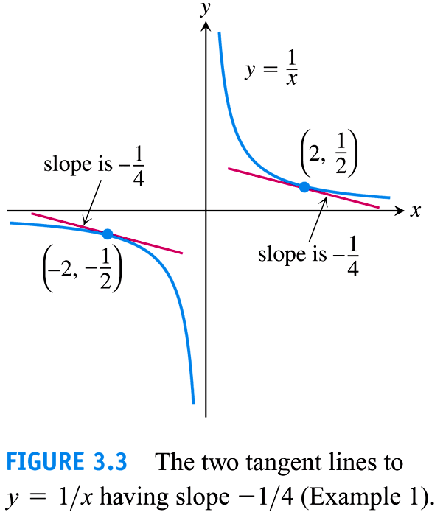

Slide 14
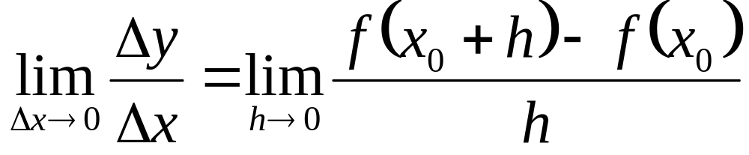
Example C The instantaneous rate of change of the function f at x₀(See Section 3.4)

Slide 15
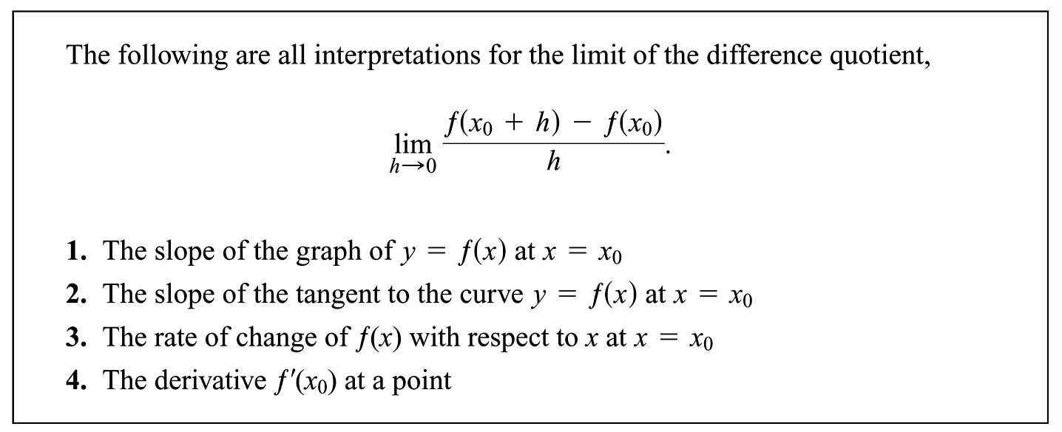

Slide 16
2. Geometric interpretation of derivative

Slide 17
Intuitive meaning(P127): General speaking, the function f is derivable at a point x₀ implies the curve of f is smooth at (x₀, f(x₀)).
A train moves along the curve?

Slide 18
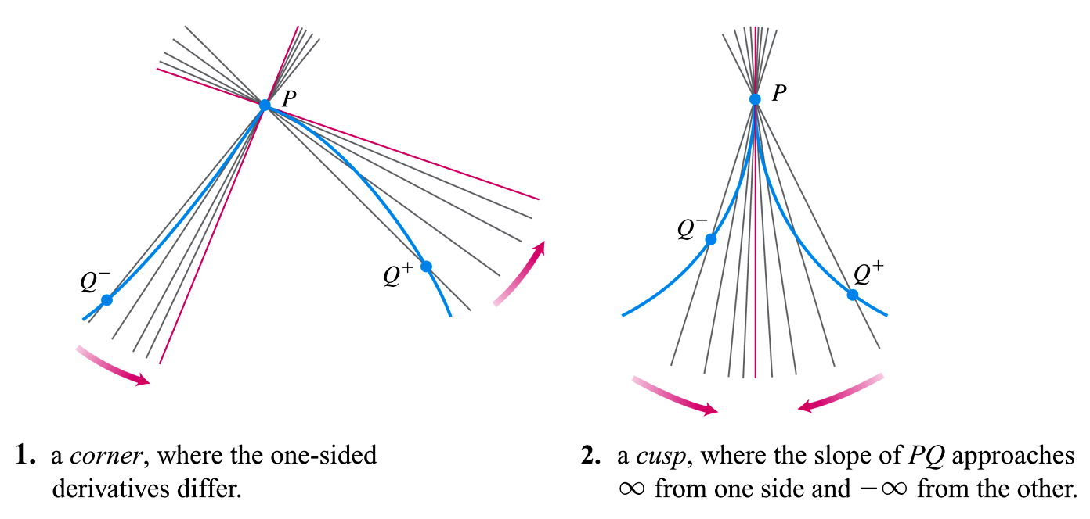

Slide 19
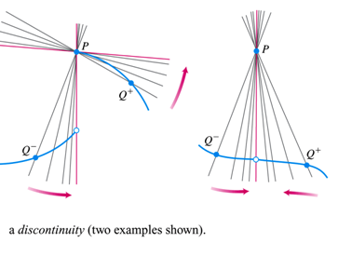

Slide 20
Class Work: P123 35

Slide 21
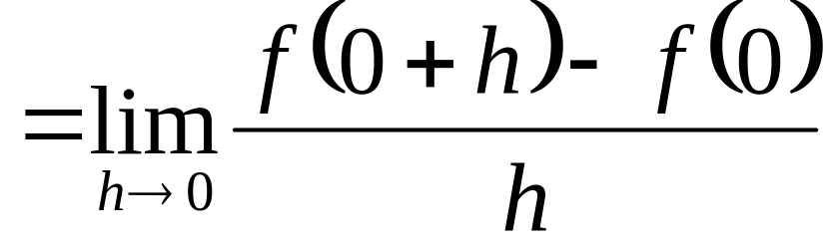
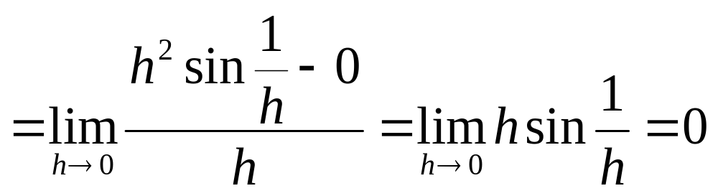
P123 35:
Solution

Slide 22
3.2
The Derivative as a Function
Copyright © 2010 Pearson Education, Inc. Publishing as Pearson Addison-Wesley

Slide 23
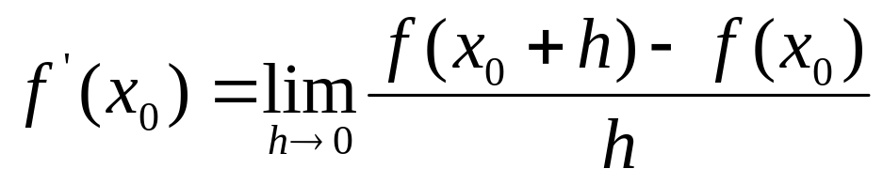
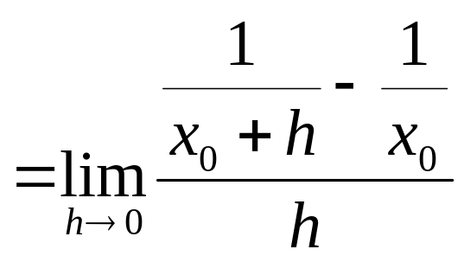
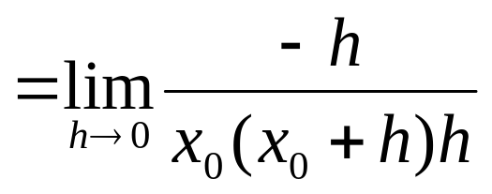
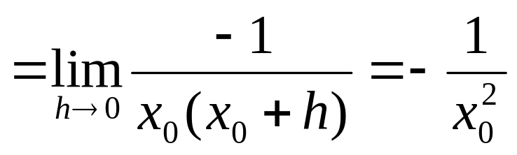
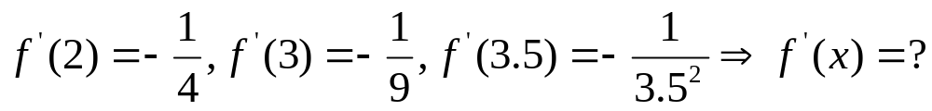

Slide 24
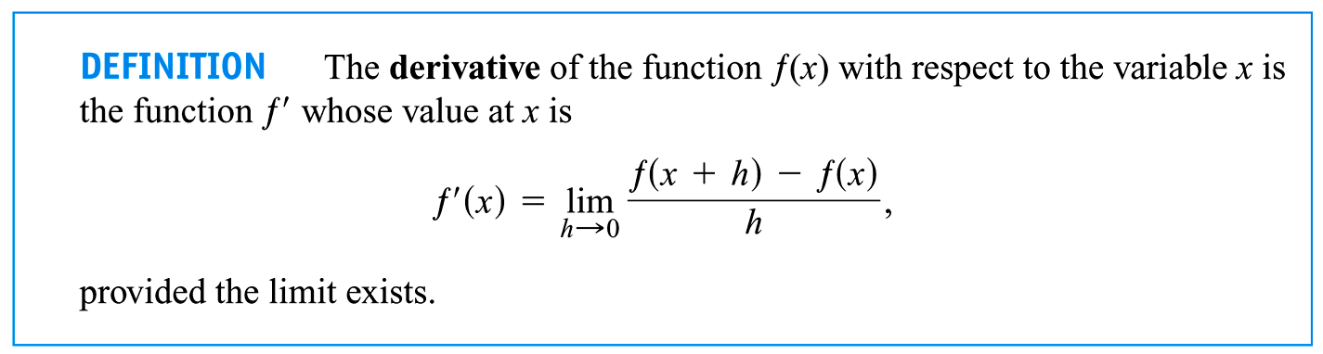

Slide 25
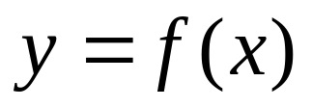
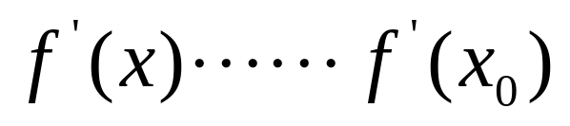
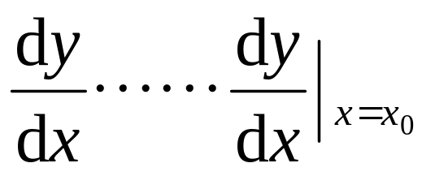
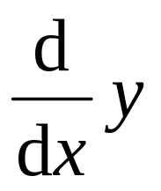
(1) Notations
Newton’s
Leibniz’s

Slide 26
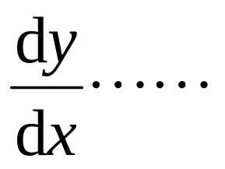
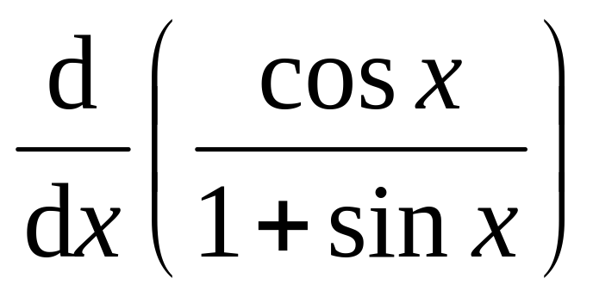

Slide 27
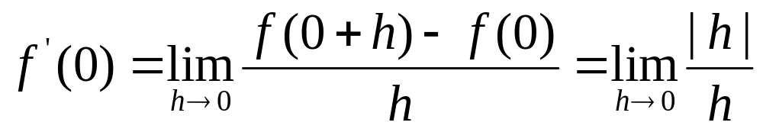
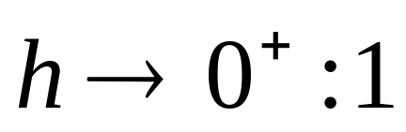
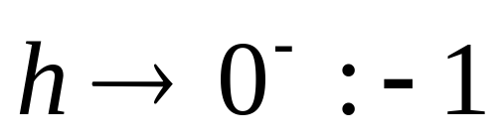
(2) f(x) is not derivable at x₀
A. f(x) = |x|, x = 0.

Slide 28
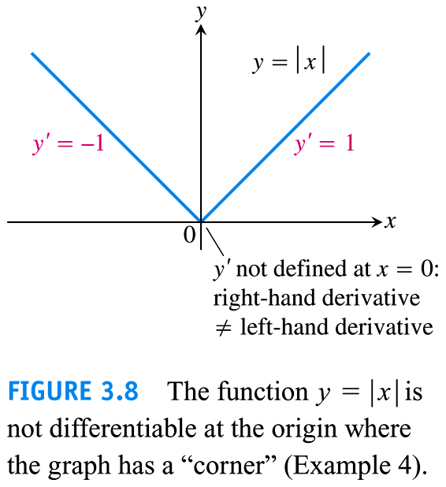

Slide 29
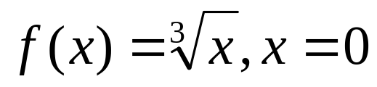
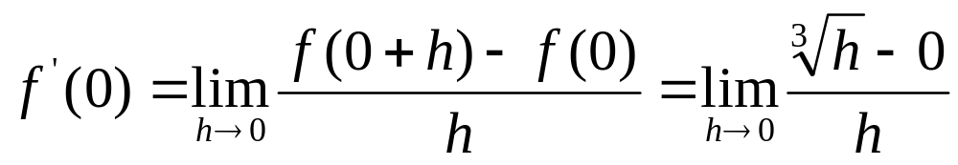
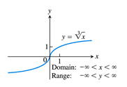
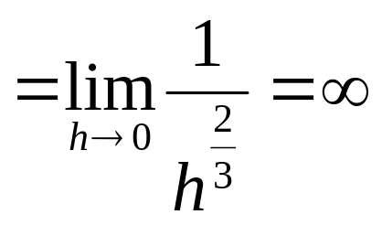
B(P123).

Slide 30
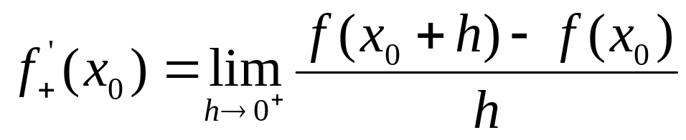

C. Right-hand derivative at x₀:
Left-hand derivative at x₀:

Slide 31
D. Differentiable on an Interval:
(a, b)
[a, b)
(a, b]
[a, b]
(-∞, b)
(-∞, b]
(a, + ∞)
(- ∞, + ∞)

Slide 32

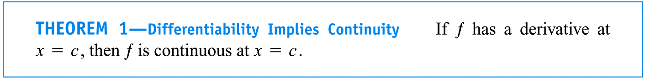
(3) Derivable ⇒ Continuous【P128】

Slide 33
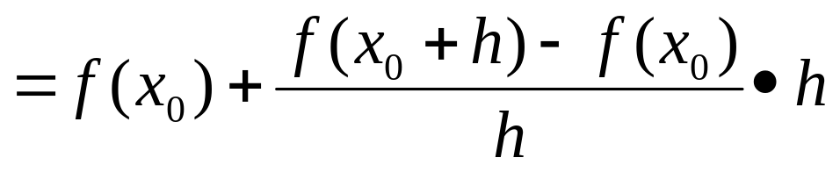
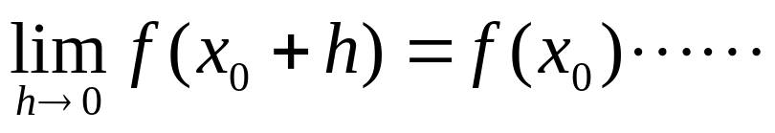
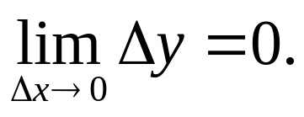

Proof
Let h→ 0:

Slide 34


(4) Other form of derivative

Slide 35



Slide 36


Slide 37
Class Work: P129 31?

Slide 38



P129, 31:
is not defined at x= 0,1, 4.

Slide 39
3.3
Differentiation Rules
(Rules of Derivatives)
Copyright © 2010 Pearson Education, Inc. Publishing as Pearson Addison-Wesley

Slide 40

1. The derivatives of common functions
Without taking limits each time.
Review: (1) definition of derivative.
(2) another view: the average rate of change and instantaneous rate of change

Slide 41


Slide 42


Slide 43




Proof

Slide 44

we postpone its proof until Chapter 7(P381)

Slide 45



The derivatives of other functions (Chapter 7):

Slide 46


Derivatives of Trigonometric Functions (Section 3.5)
Class work:
Show that

Slide 47






Proof 1 f(x) = sin(x)

Slide 48


Proof 2 f(x) = sin(x)

Slide 49









(1) (2)
(3) (4)
(5)
(6)
(7) (8)
(9) (10)

Slide 50


Slide 51
2. Rules of Derivative Operations
Methods of Derivatives

Slide 52

(1)

Slide 53
(2)

Slide 54


Slide 55

(3)

Slide 56




Proof

Slide 57




Slide 58

Clearly, we have

Slide 59

(4)

Slide 60


Some examples:

Slide 61
Derivative of a Composite Function (Section 3.6)?

Slide 62




3. Higher-order Derivatives

Slide 63




P123 35:
Hint
(1)
(2) x = 0:
?

Slide 64


0

Slide 65
3.4
The Derivative as a Rate of Change
Copyright © 2010 Pearson Education, Inc. Publishing as Pearson Addison-Wesley

Slide 66


Slide 67


Slide 68


Slide 69


Slide 70


Slide 71


Slide 72



Slide 73


Slide 74



Slide 75


Slide 76


Slide 77


Slide 78
3.5
Derivatives of Trigonometric Functions
Copyright © 2010 Pearson Education, Inc. Publishing as Pearson Addison-Wesley

Slide 79


Slide 80
Proof f(x) = sin(x)
Chapter 2
0
1

Slide 81


Slide 82


Slide 83


Slide 84


Slide 85

Examples

Slide 86


More examples:

Slide 87
3.6
The Chain Rule
Copyright © 2010 Pearson Education, Inc. Publishing as Pearson Addison-Wesley

Slide 88
(1) (2)
(3) (4)
(5)
(6)
(7) (8)
(9) (10)

Slide 89





Differentiation Rules?

Slide 90


Slide 91




1. The Chain Rule
y = f(u), u = g(x) ⇒ y = f(g(x))

Slide 92


Slide 93



2. Examples

Slide 94




Slide 95



Slide 96



3. Proof
(1) Proof with flaw(?):

Slide 97
Why do we give out the proof with flaw?
What does the Chain means?

Slide 98





(2) Precise Proof
Proposition
(⇒) Let
For every ε > 0, since
(⇐)

Slide 99


Proof of the Chain Rule:

Slide 100




Slide 101





Slide 102


Slide 103
3.7
Implicit Differentiation
Copyright © 2010 Pearson Education, Inc. Publishing as Pearson Addison-Wesley

Slide 104


1. Examples of implicit function
Explicit function
Example 1

Slide 105


Slide 106

Example 2
(1) Existence?
(2) Derivable property?

Slide 107


Slide 108


Example 3(P167)

Slide 109

Example 5(P168)

Slide 110


Slide 111

2. Implicit derivative

Slide 112


Example 3

Slide 114


Slide 115



Example 5

Slide 116

Class Work: P169, 12

Slide 117


Slide 118
(left to discuss)
Section 11.2 Calculus with Parametric Curves

Slide 119
Implicit differentiation allows us to find the derivative of any inverse function (see Chapter 7)

Slide 120
3.8
Related Rates
Copyright © 2010 Pearson Education, Inc. Publishing as Pearson Addison-Wesley

Slide 121


Problem:

Slide 122


Example 1
r

Slide 123


Slide 124


Example 2

Slide 125


Slide 126


Slide 127


Slide 128



Slide 129
3.9
Linearization and Differentials
Copyright © 2010 Pearson Education, Inc. Publishing as Pearson Addison-Wesley

Slide 130

Differential of A Function
1. Definition of differential
(1) Example The area y of square with edge x: y = x².

Slide 131




y = 3² if x = 3; y = (3 + Δx)² if x = 3 + Δx.
Δy = 6 Δx + (Δx)² : Δy = 6 Δx + α⋅Δx

Slide 132


Slide 133


Definition y = f(x)
If Δy = A·Δx + α · Δx, then A·Δx is called the differential of f(x) at x₀.
x = x₀:

Slide 134




(one variable) Function f(x) is differential at x₀ ⇔ f(x) is derivable at x₀.
Proof(⇒) Δy = A Δx + α⋅Δx and
(⇐)

Slide 135



(2) Geometric interpretation: What is dy?
T
y
y = f(x)
N
M
P
Q
O
x₀
x₀+ Δ x

Slide 136





Idea of Differential:
Idea: Substituting Line for Curve
Differentiating Grief!

Slide 137

(3) Linearization:

Slide 138


Slide 139


Slide 140


Slide 141


Slide 142


Slide 143


Slide 144




(4) Approximation computation ﹏ integral
Δy ≈ dy

Slide 145


Slide 146






If x is an independent variable，then Δx = dx ?
(Differential Quotient)

Slide 147


2. Computation of Differentials
A. Formula: dy = f´(x) dx
B. Rules

Slide 148


C. Rule for composite function
y = f(u) , dy = f´(u) du (1)
y = f(u) , u = g(x), y = f(g(x))
(2)

Slide 149


Example
Solution

Slide 150



Example 6
(1)d( ) = xdx;
(2)
Solution
(1)
(2)

