Slide 1
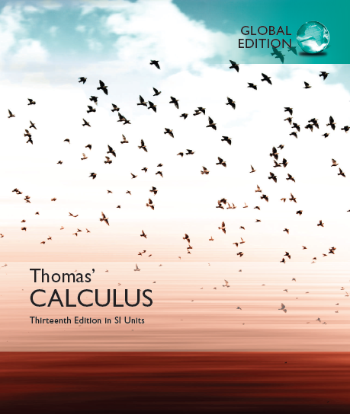

© 2017 Pearson Education, Inc. All rights reserved

Slide 2
Chapter 4
Applications of Derivatives
Copyright © 2017 Pearson Education, Inc. Publishing as Pearson Addison-Wesley

Slide 3
4.1
Extreme Values of Functions
(4.5 Applied Optimization ?)
Copyright © 2017 Pearson Education, Inc. Publishing as Pearson Addison-Wesley

Slide 4
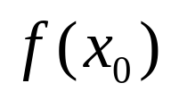

1. Global Maximum/Minimum
Let y = f(x) be a function with domain D. Then f has a global maximum on D at a point x₀ if f(x) ≤ f(x₀) for all x in D.

Slide 5
Let y = f(x) be a function with domain D. Then f has a global minimum on D at a point x₀ if f(x) ≥ f(x₀) for all x in D.

Slide 6
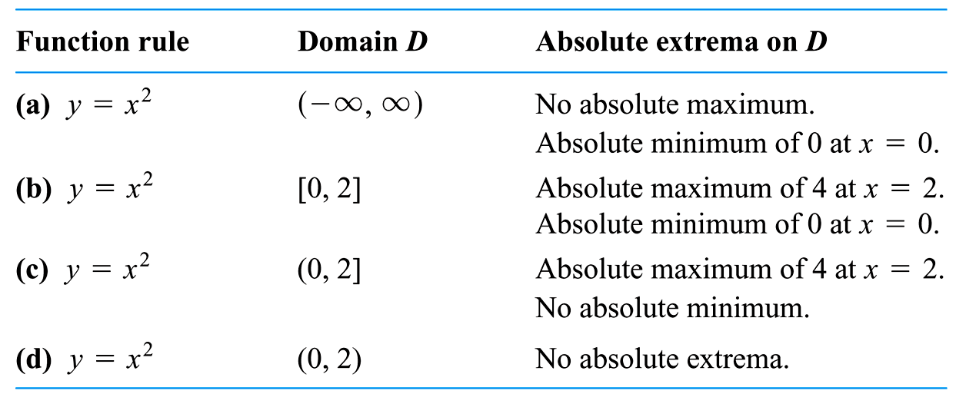

Slide 7
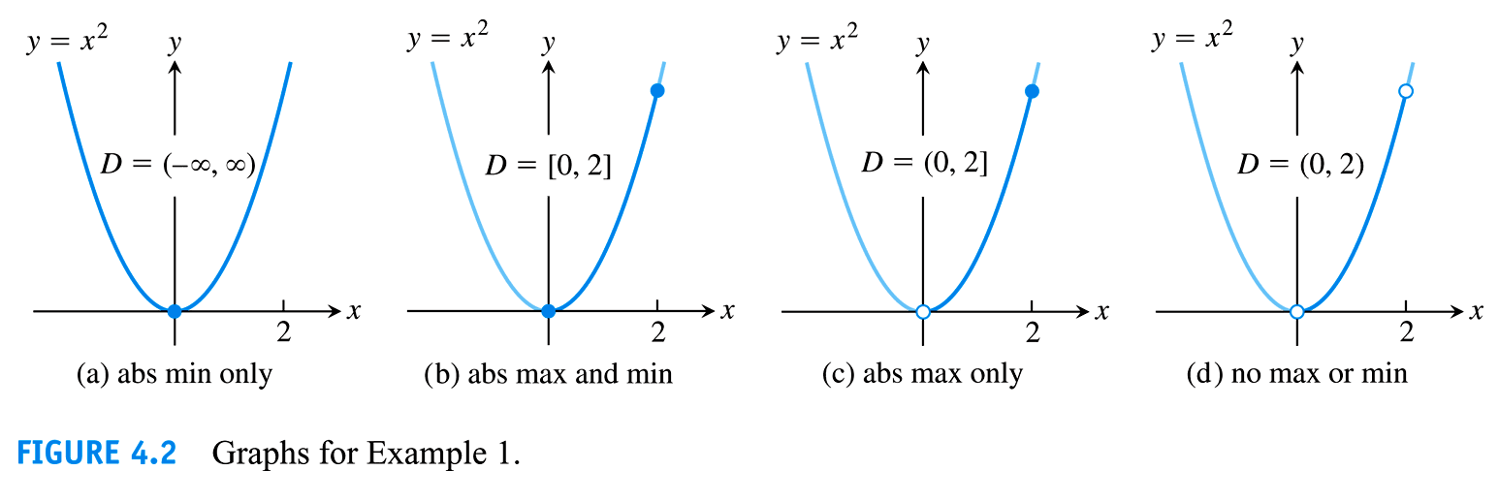

Slide 8
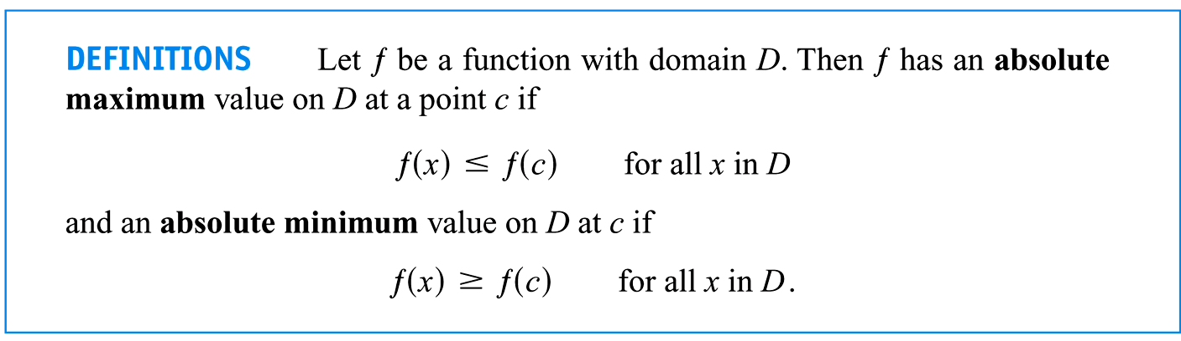

Slide 9
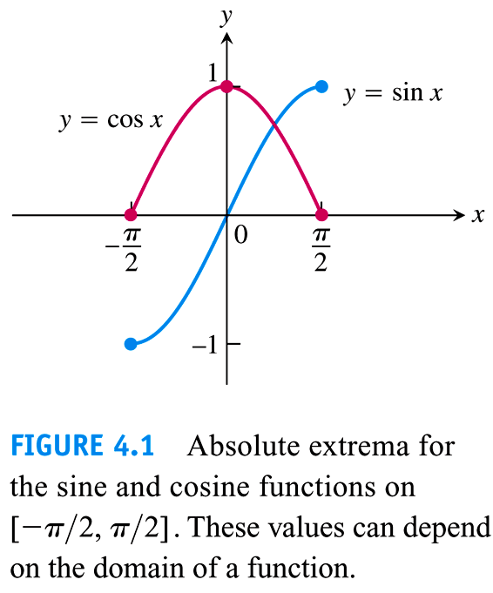

Slide 10
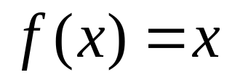


(1) Globally Max/Min may be gotten at the Endpoint
(2) Existence:
f(x) ∈ C[a, b]?

Slide 11
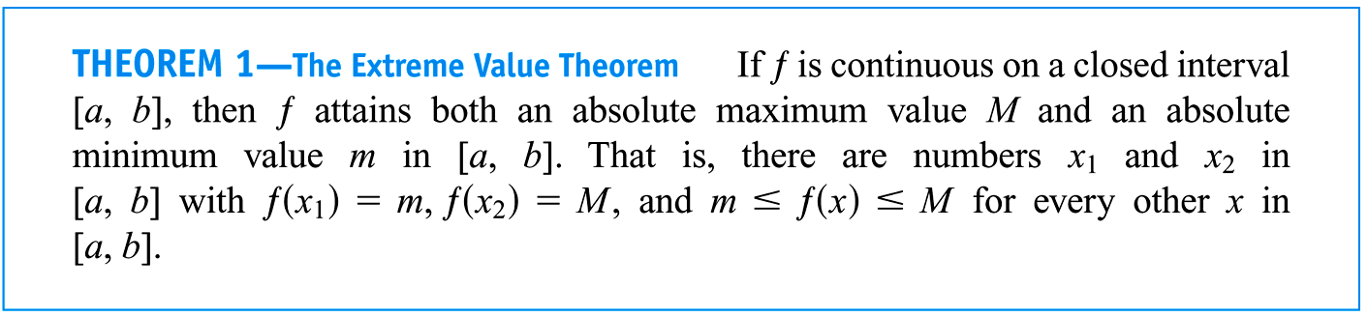

Slide 12
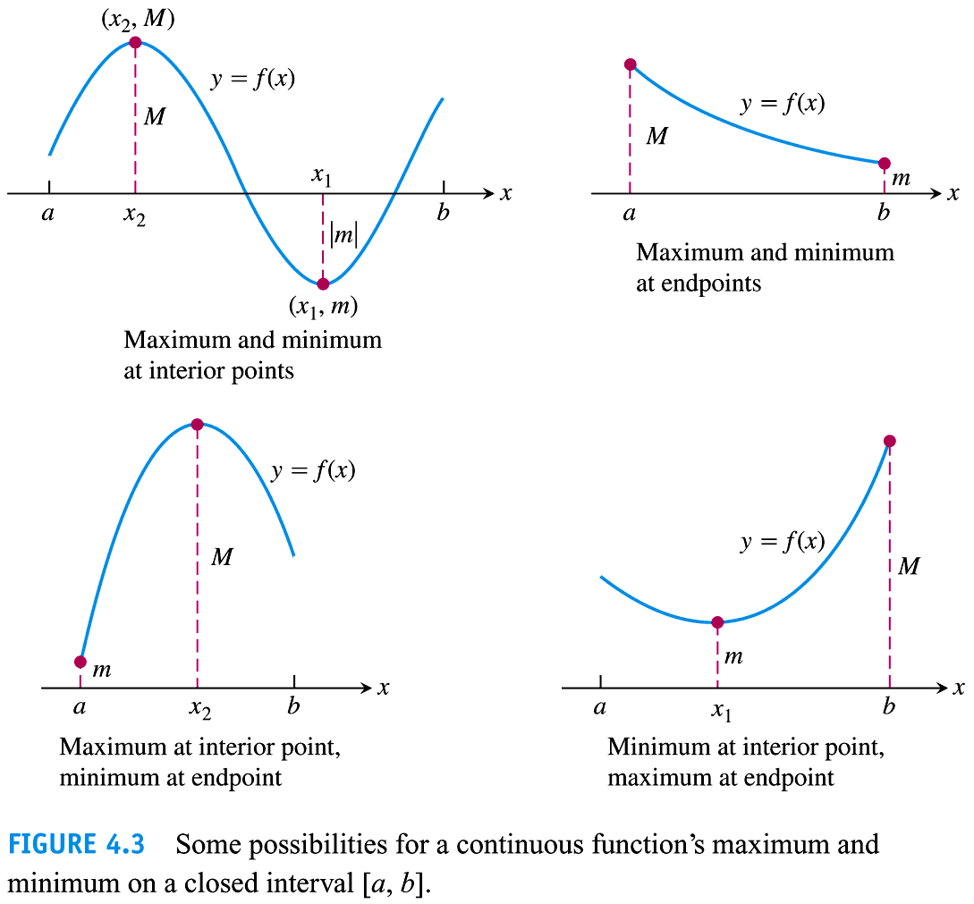

Slide 13
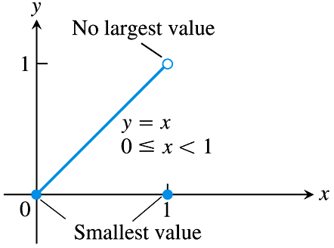
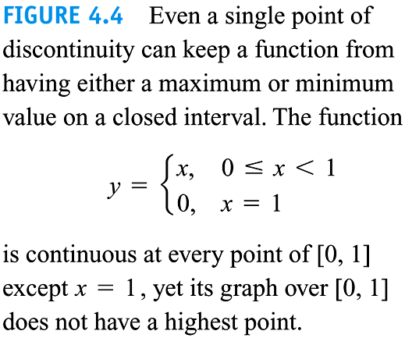

Slide 14
2. Local Maximum/Minimum
Let y = f(x) be a function with domain D. Then f has a local maximum at a point x₀ if f(x) ≤ f(x₀) for all x in some open interval in D containing x₀.

Slide 15
Let y = f(x) be a function with domain D. Then f has a local minimum at a point x₀ if f(x) ≥ f(x₀) for all x in some open interval in D containing x₀.

Slide 16
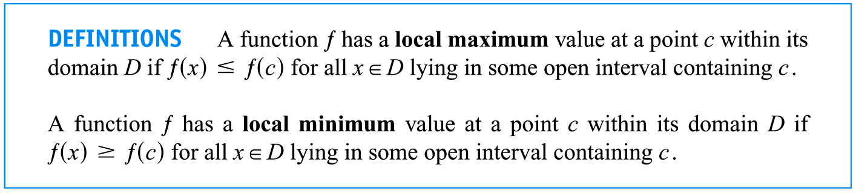
Cautious locally Max/Min must NOT be gotten at the Endpoint

Slide 17
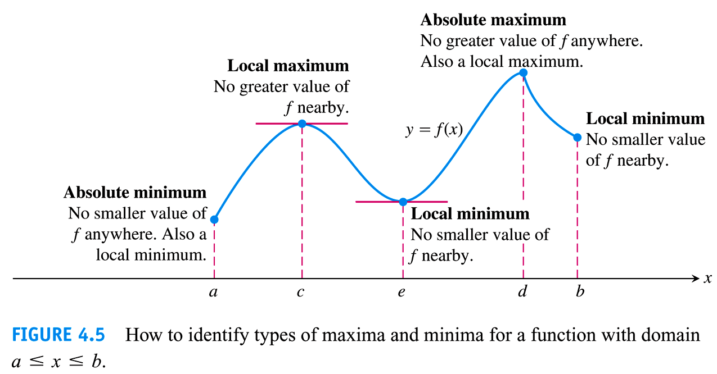


Slide 18
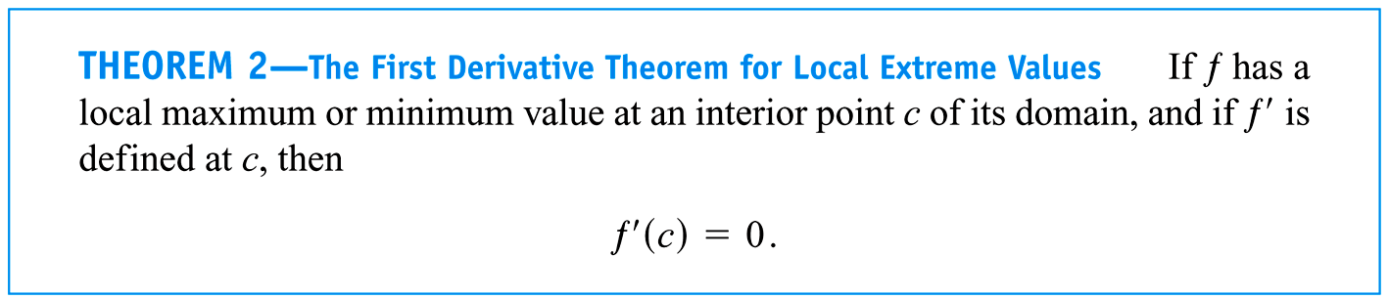
Proof ?

Slide 19
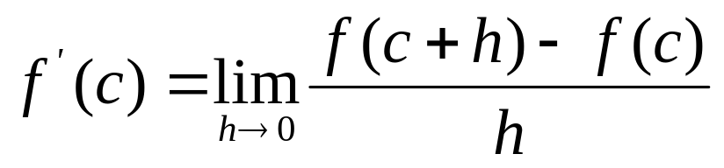
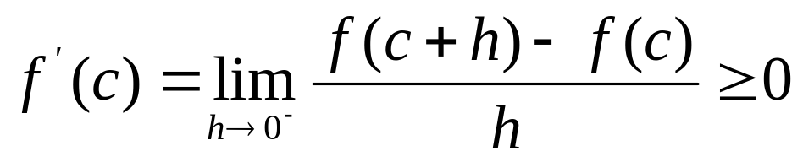




Slide 20
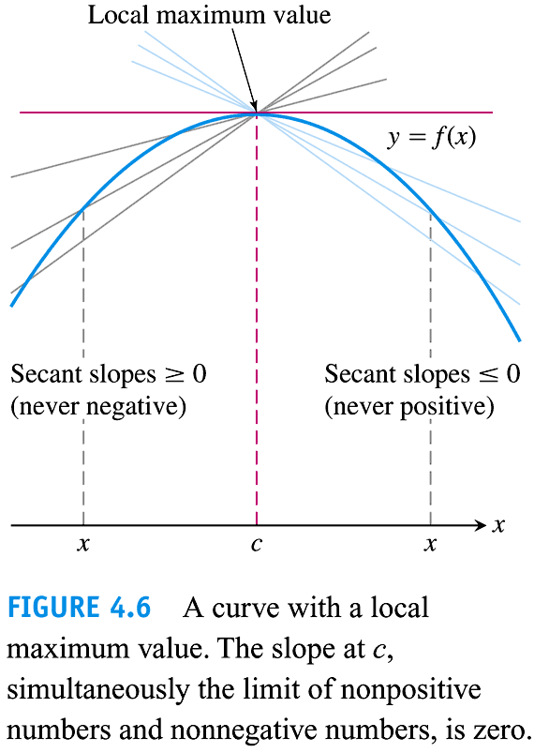

Slide 21
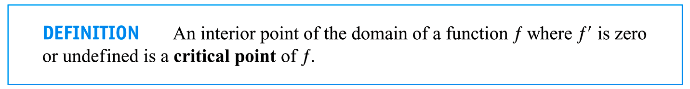

Slide 22
If y = f(x) has a local maximum/minimum at a point x₀, then x₀ is the critical point. But the converse does not hold.
(1) By definition;
(2) The first derivative test (Section 4.3)
(3) The second derivative test (Section 4.4)

Slide 23
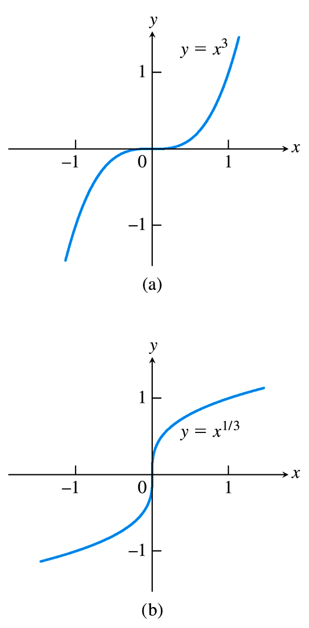
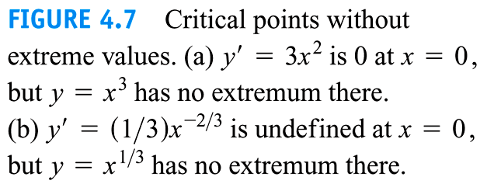

Slide 24
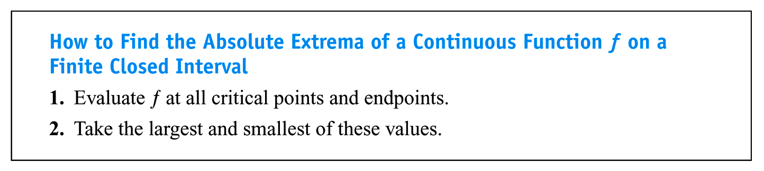
3. How to find the global max/min of continuous function on the closed interval

Slide 25
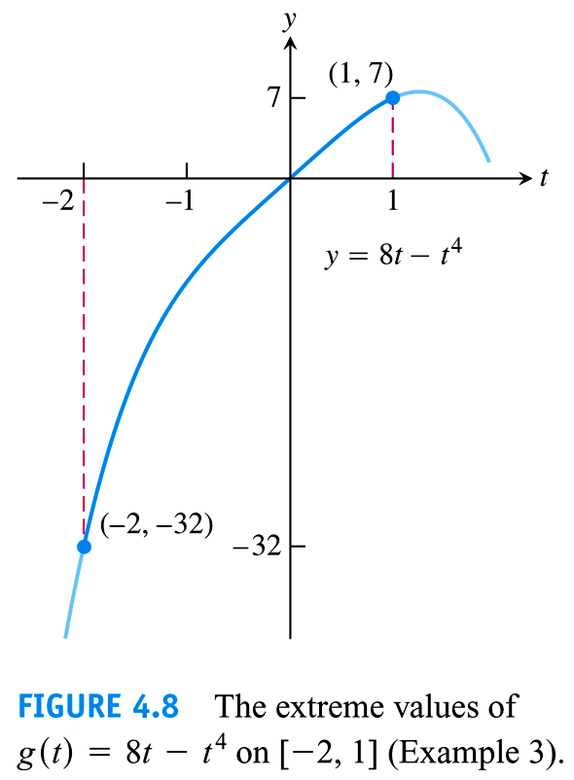
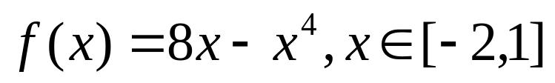
Example 3

Slide 26
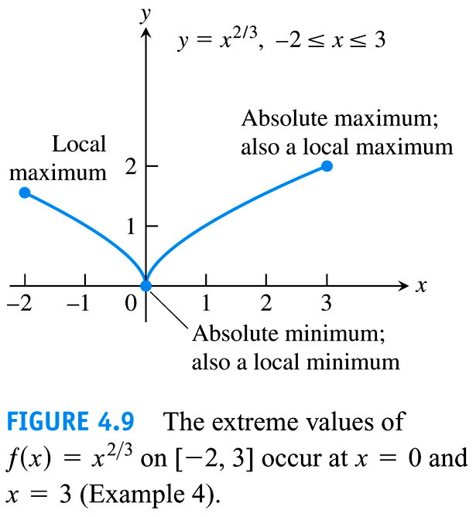
Example 4

Slide 27
4.2
Differential Mean Value Theorems
(Mean Value Theorems for Differentials)
Copyright © 2010 Pearson Education, Inc. Publishing as Pearson Addison-Wesley

Slide 28
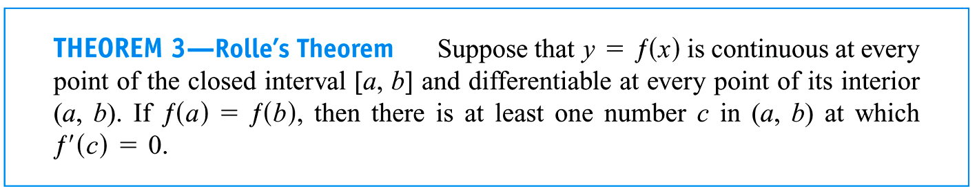
1. Rolle’s Theorem
Proof (1) m = M
(2) m < M

Slide 29
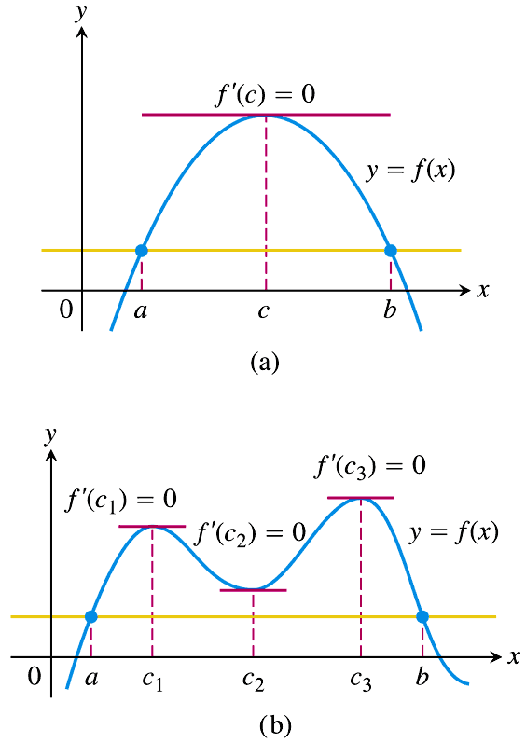
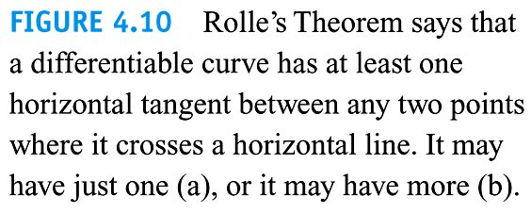

Slide 30
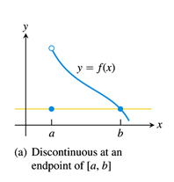
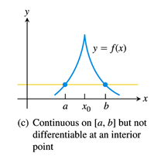
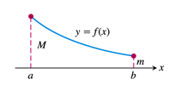
The three hypotheses of Rolle’s Theorem are essential:

Slide 31
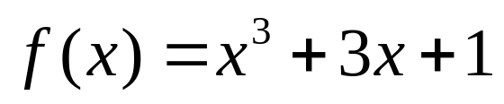
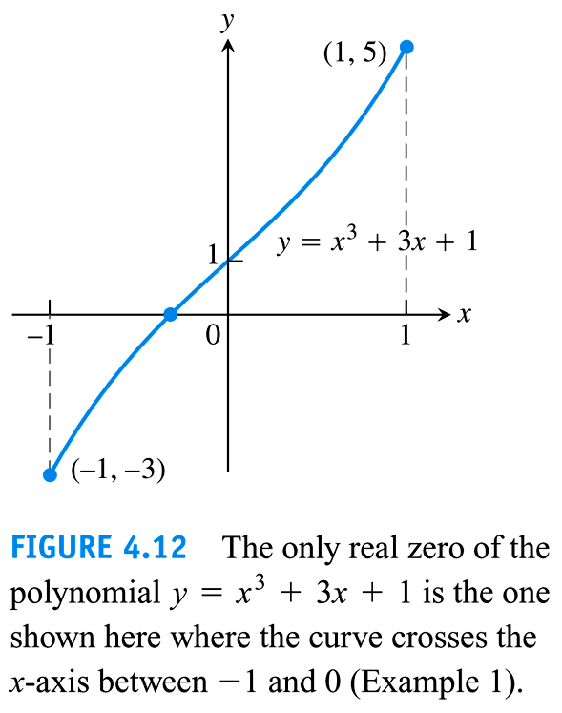
Example 1

Slide 32
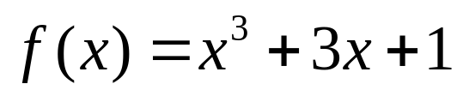
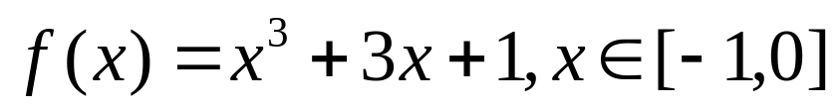
Solution
(1) Existence by zero point theorem
(2) Uniqueness by Rolle’s theorem

Slide 33
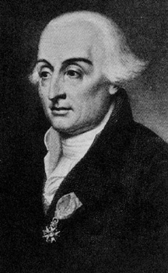
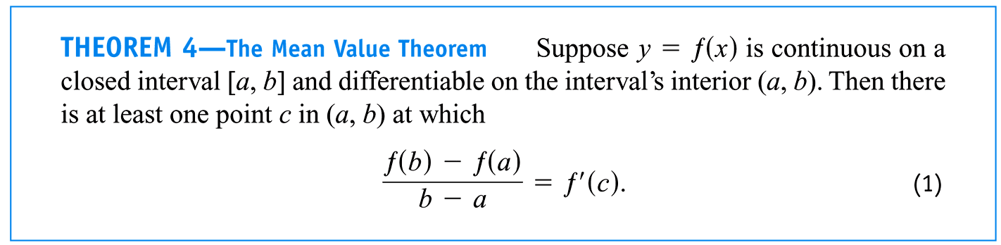
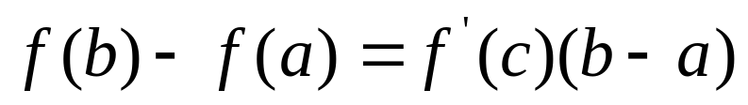
2. Lagrange’s Mean Value Theorem

Slide 34
Generalization of Rolle’s Theorem
Proof of Lagrange’s Mean Value Theorem by Rolle’s Theorem

Slide 35
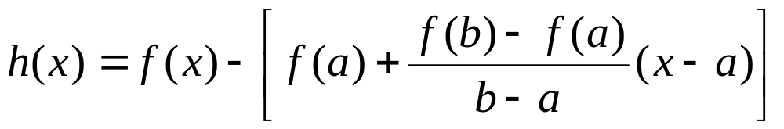

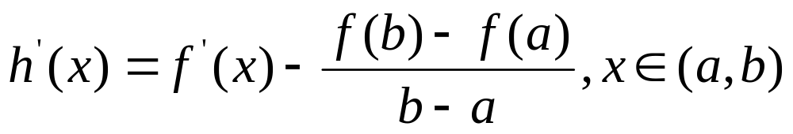

Proof
(?)
(1)
(2)
(3)

Slide 36
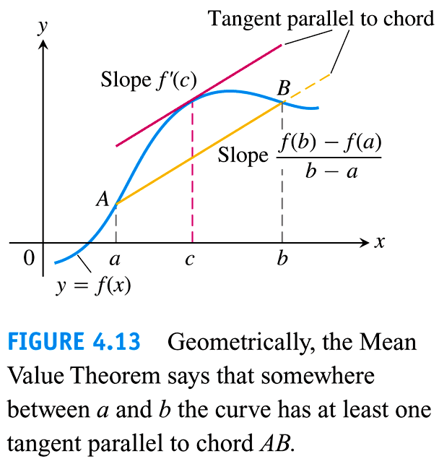

Slide 37
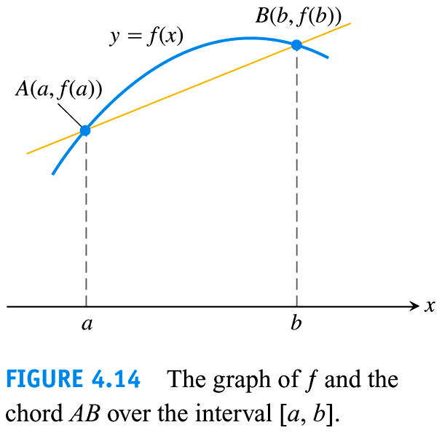

Slide 38
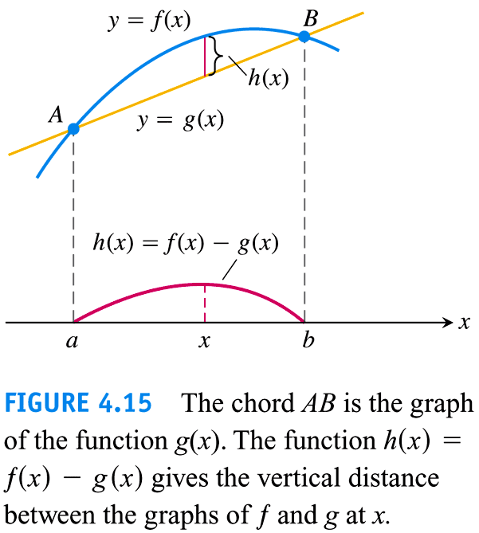

Slide 39
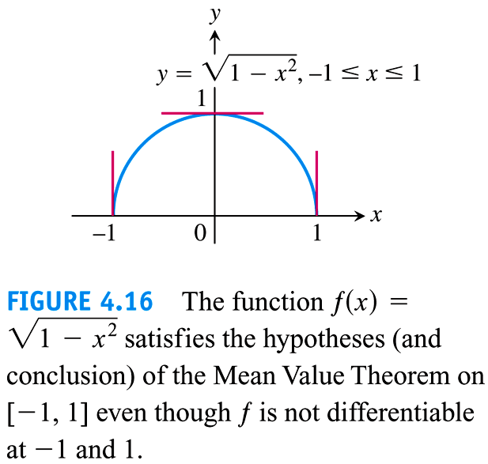

Slide 40
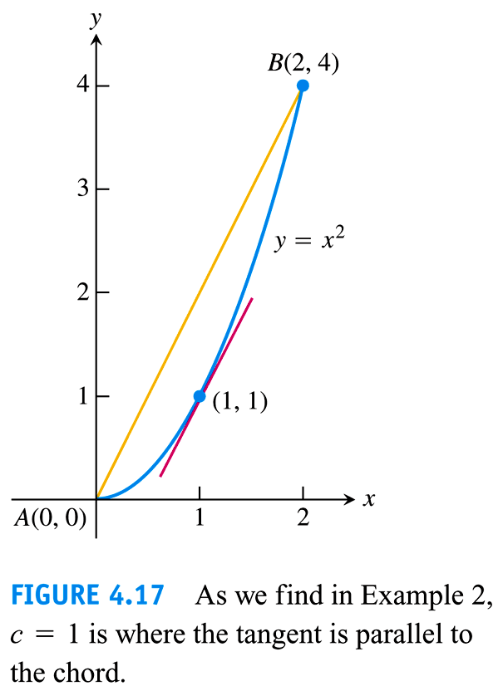

Slide 41
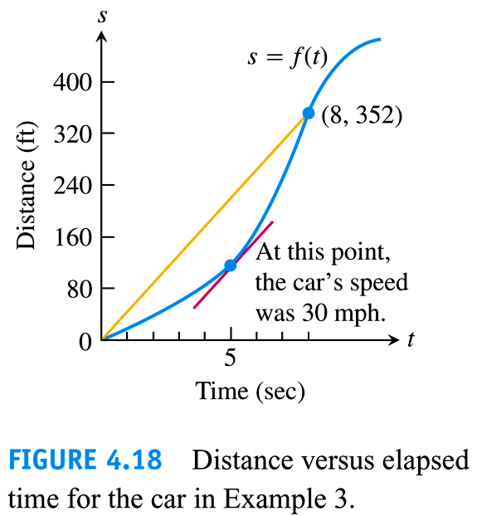

Slide 42

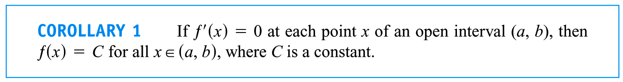
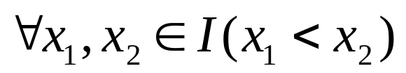
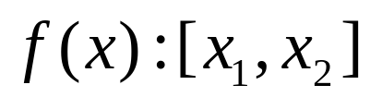



Slide 43
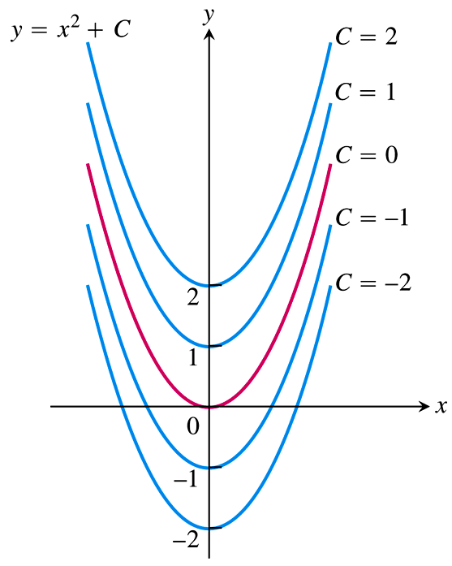
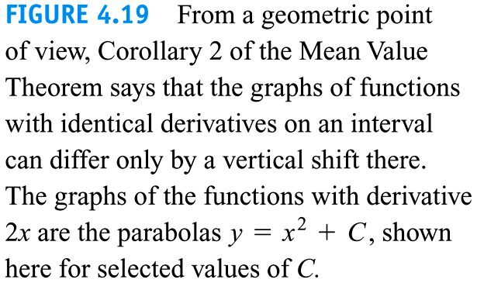

Slide 44
3. Cauchy’s Mean Value Theorem
(Section 7.5)
4. Taylor’s Mean Value Theorem
(Section 10.9)

Slide 45
4.3
͵Mono′tonic Functions and the First Derivative Test
Copyright © 2010 Pearson Education, Inc. Publishing as Pearson Addison-Wesley

Slide 46
1. ͵Monoto′nicity of functions
(A) Definitions
(B) Theorems

Slide 47


Theorem

Slide 48


Proof by Lagrange’s Mean Value Theorem?
(1)
(2)

Slide 49
2. How to find the intervals on which f is in′creasing or de′creasing?
(1) Domain D.
(2) Critical points
(3) Test

Slide 50


Slide 51


Slide 52

3. First Derivative Test for Local maximum and minimum

Slide 53


Slide 54


Slide 55


Slide 56


Slide 57
4.4
Concavity and Curve Sketching
Copyright © 2010 Pearson Education, Inc. Publishing as Pearson Addison-Wesley

Slide 58
1. Concavity of Curves
(1) [intuitive]Concave up/down

Slide 59


Slide 60


Slide 61

(2) Definition

Slide 62


Slide 63

(3) Test

Slide 64

How to find the intervals on which the graph of f is concave up or down?
(1) Domain D.
(2) Find all points at which or fails to exist.
(3) Test

Slide 66

Points of Inflection

Slide 67


Slide 68




Slide 69


Slide 70


Slide 71


Slide 72



Slide 73

Second Derivative Test for Local maximum/Minimum
knowing?

Slide 74



Proof (1)

Slide 75


Slide 76




Slide 77


Slide 78

od'evity &͵perio′dicity
2. Graph a function

Slide 79




Example 8 Sketch the graph of
Solution
1.
2.

Slide 80



3.
4. Monotonicity and concavity on each interval of the following;

Slide 81





Slide 82








D

Slide 83




D

Slide 84




D

Slide 85


5. (Horizontal/Vertical?) asymptotes

Slide 86
6. Plot the asymptotes and key points (add more points if necessary)

Slide 87


Slide 88
Class Work:
Exercises 4.4 11

Slide 89


Slide 90
4.5
Applied Optimization
Copyright © 2010 Pearson Education, Inc. Publishing as Pearson Addison-Wesley

Slide 91


Example 1

Slide 92



Slide 93


Slide 94


Slide 95

Example 2

Slide 96



Solution

Slide 97



Slide 98


Slide 99

Example 3

Slide 100



Solution

Slide 101


Slide 102


Slide 103


Slide 104


Slide 105


Slide 106
4.6
Newton’s Method
Copyright © 2010 Pearson Education, Inc. Publishing as Pearson Addison-Wesley

Slide 107

1. Basic idea

Slide 108


Slide 109


Slide 110

2. Examples
Key: x₀?

Slide 111


Slide 112


Slide 113


Slide 114


Slide 115

3. Newton’s method fails

Slide 116


Slide 117
4.7
Antiderivatives
Copyright © 2010 Pearson Education, Inc. Publishing as Pearson Addison-Wesley

Slide 118


1. Antiderivatives of a function

Slide 119


Slide 120

Does F exist?

Slide 121


Slide 122


Slide 123

2. In'definite Integrals

Slide 124










Indefinite Integral Formulas(Sec. 8.1):

Slide 125


Slide 126


Properties of Indefinite Integrals:
(1)

Slide 127





(2)
Proof

Slide 128

How to use:

Slide 129


Slide 130



Examples

