Slide 1
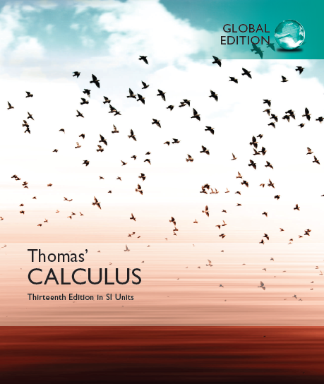

© 2017 Pearson Education, Inc. All rights reserved

Slide 2
Chapter 7
Transcendental Functions
Copyright © 2010 Pearson Education, Inc. Publishing as Pearson Addison-Wesley

Slide 3
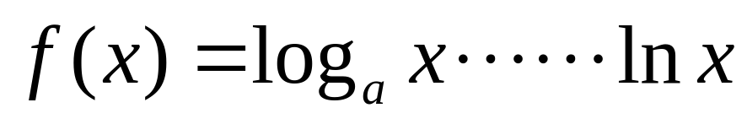
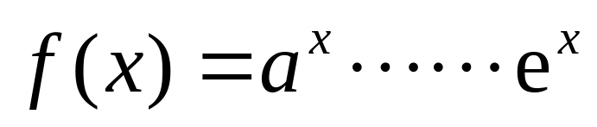
Transcendental Functions
(1) Trigonometric functions and inverse trigonometric functions
(2) Logarithm functions and exponential functions

Slide 4
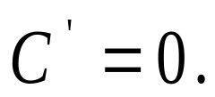
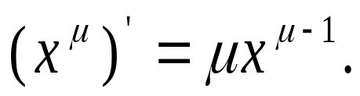
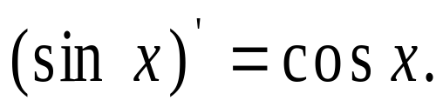
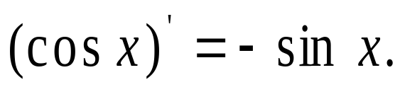
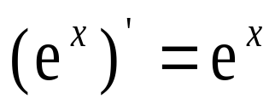
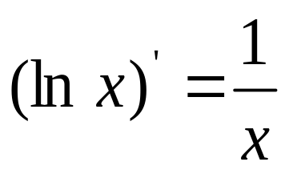
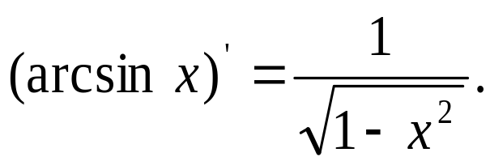
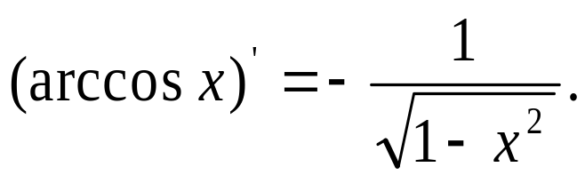
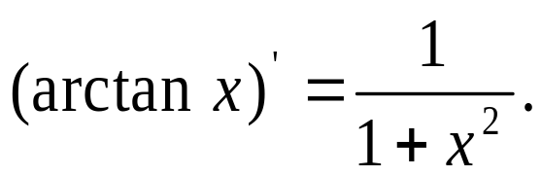
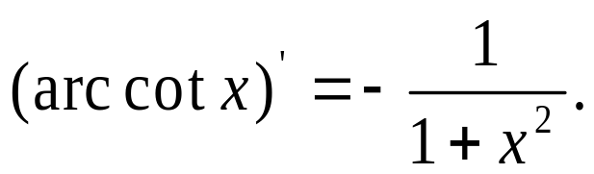
(1) (2)
(3) (4)
(5)
(6)
(7) (8)
(9) (10)

Slide 5
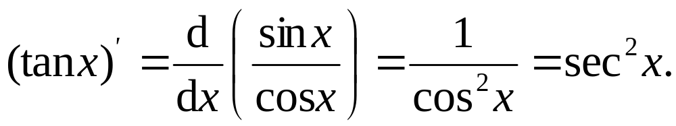
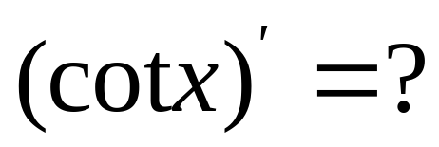

Slide 6
7.1
Inverse Functions and Their Derivatives
Copyright © 2010 Pearson Education, Inc. Publishing as Pearson Addison-Wesley

Slide 7
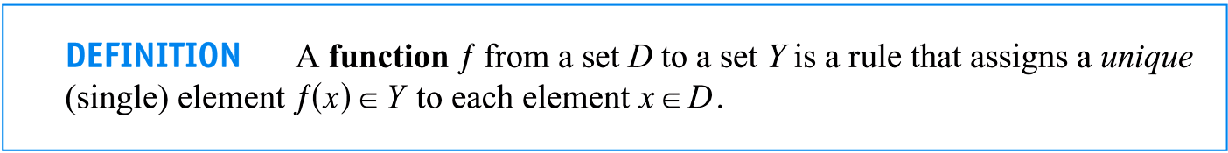

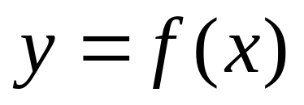
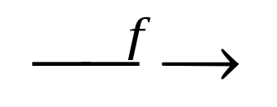

1. ֽIn'verse Functions
Recall the definition of function:
P15:
D
Y

Slide 8
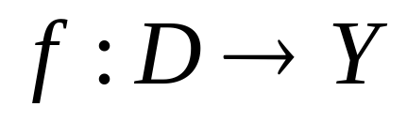
α
f
a
β
b
γ
c
δ
D
Y

Slide 9
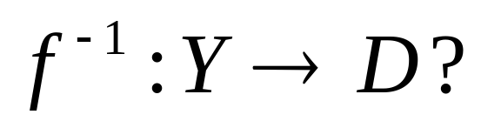
Inverse the direction of f:
α
f ⁻¹
a
β
b
γ
c
δ
D
Y

Slide 10
How about this f ?
α
f
a
β
b
γ
c
δ
D
Y

Slide 11
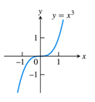


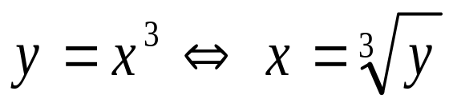
Function y = f(x), x∈D?

Slide 12
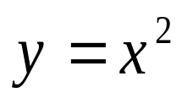
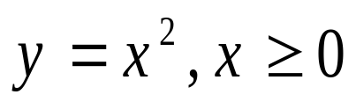
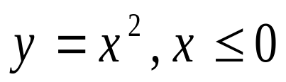
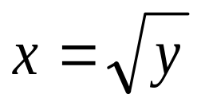
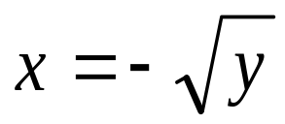
Existence of the inverse function?

Slide 13
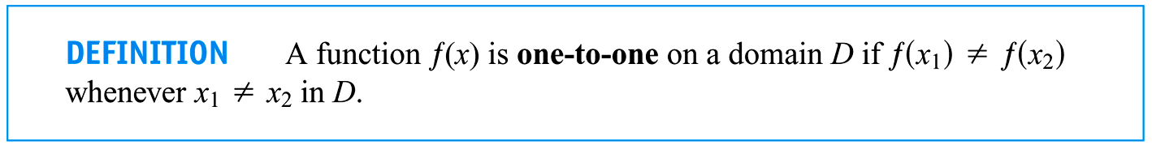
The conditions for existence of the inverse function: f is bijective (f is one to one correspondence)
(1) f is injective
(2) f is surjective
(Slightly different from the book)

Slide 14
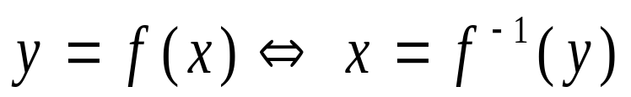
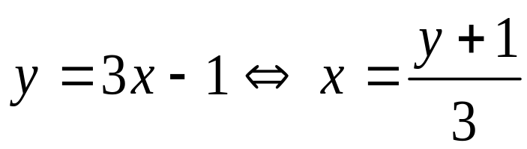
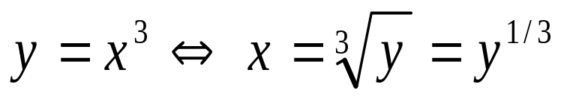
Symbol:
They have the same graph?!

Slide 15
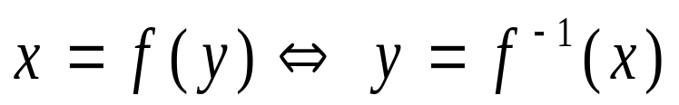
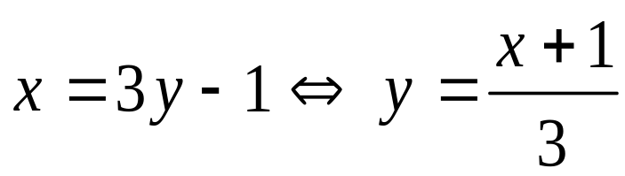
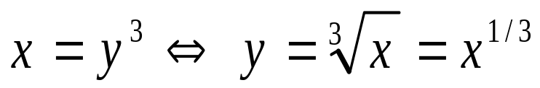
If we regard x as independent::

Slide 16
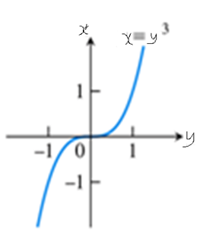

Slide 17
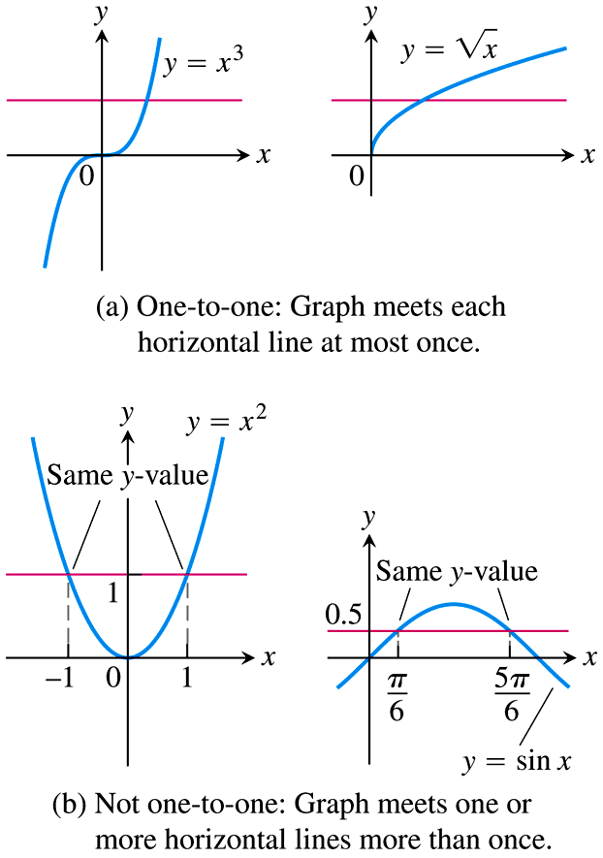
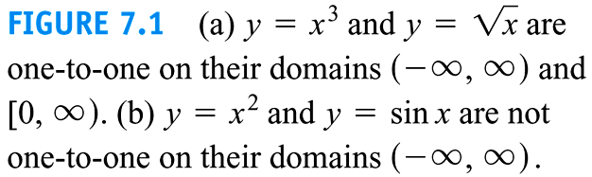

Slide 18
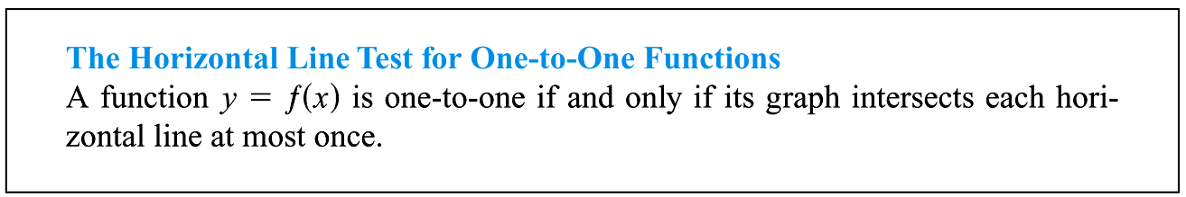

Slide 19
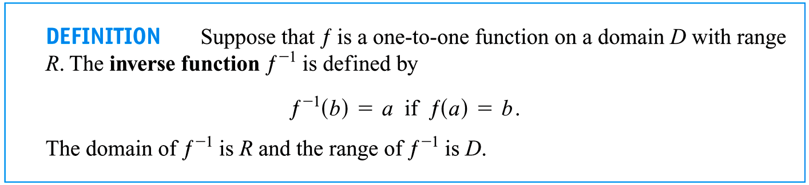

Slide 20
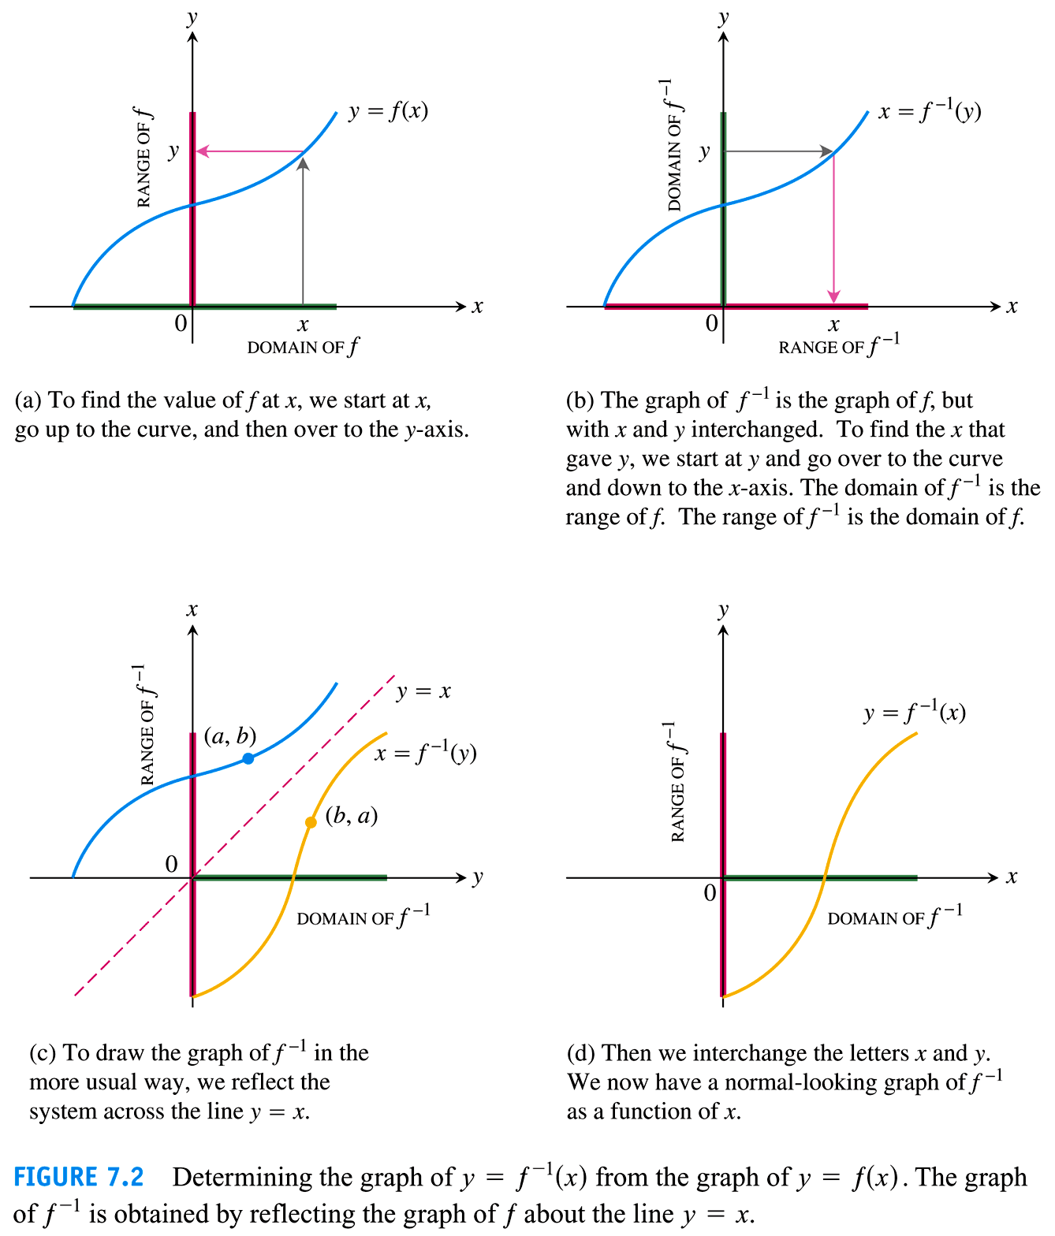

Slide 21
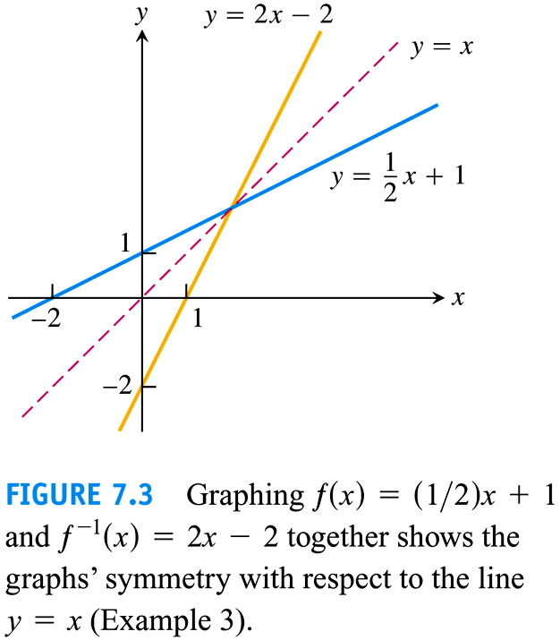

Slide 22
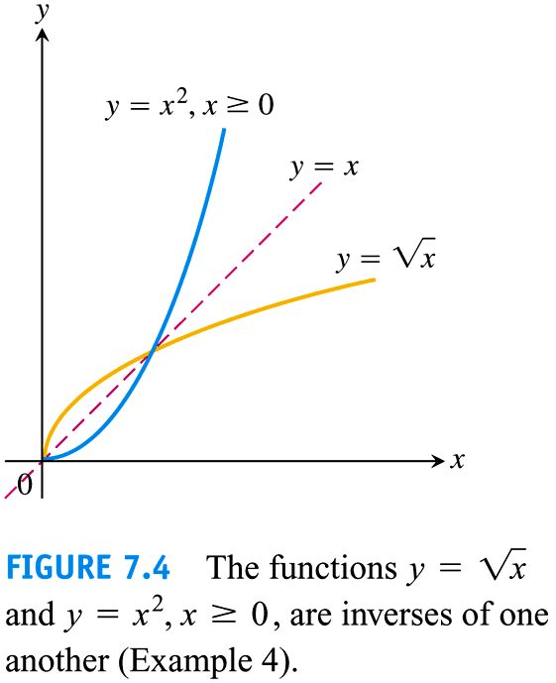

Slide 23
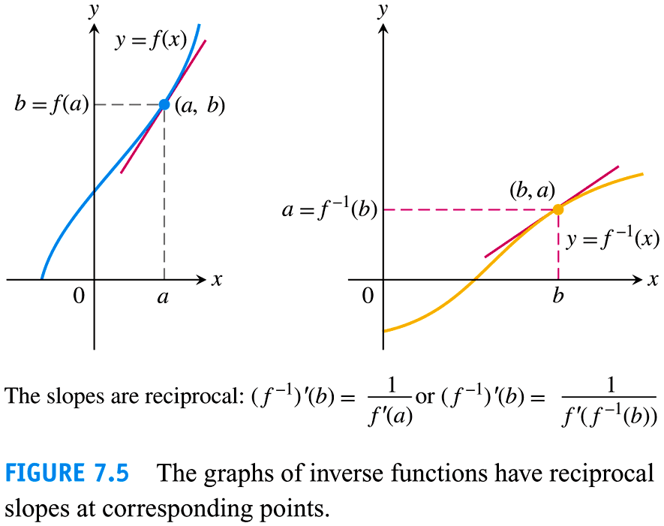

Slide 24
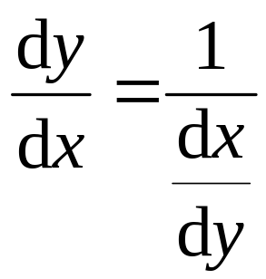
2. The Derivative Rule for Inverse
Clearly.

Slide 25
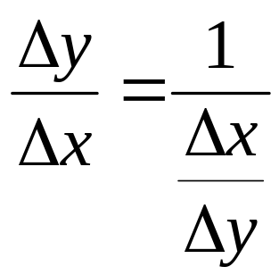
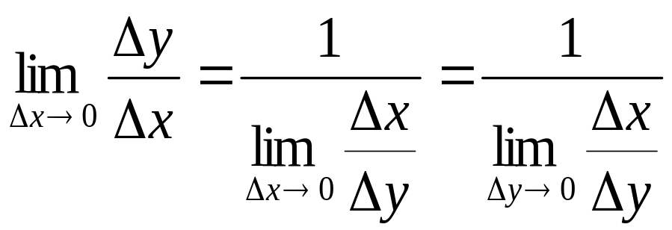
Proof

Slide 26
If we regard x as independent::

Slide 27
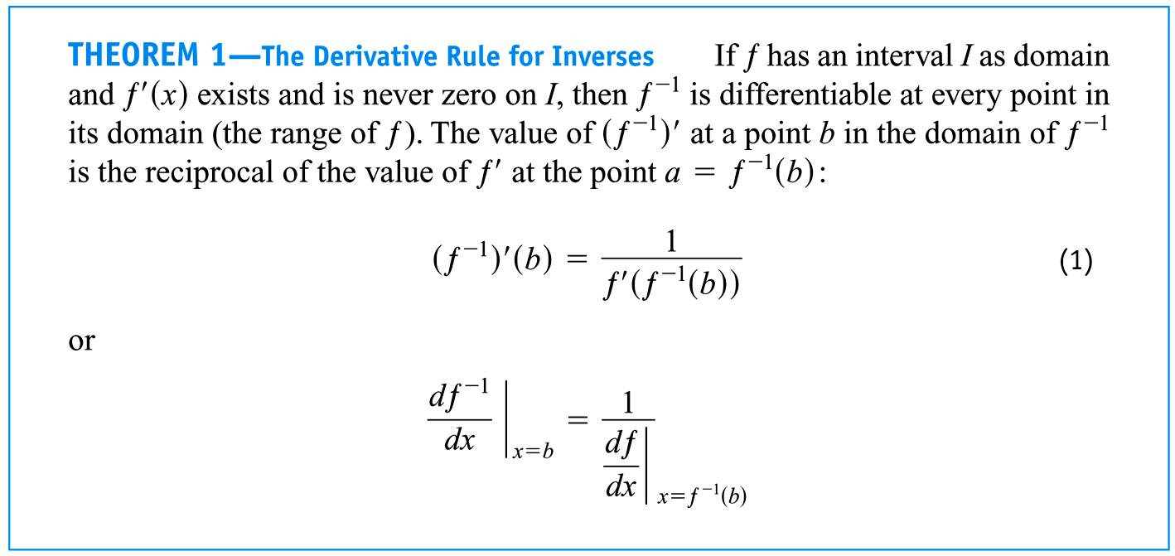

Slide 28
7.6
Inverse Trigonometric Functions
Copyright © 2010 Pearson Education, Inc. Publishing as Pearson Addison-Wesley

Slide 29
1. The definition of Inverse Trig Functions
2. Derivative formulas for Inverse trigonometric functions
3. Indefinite Integral Formulas related to Inverse Trigonometric Functions

Slide 30
P425: Inverse Trig Functions
Note Not study “Inverse Trig Functions” in the high school.

Slide 31
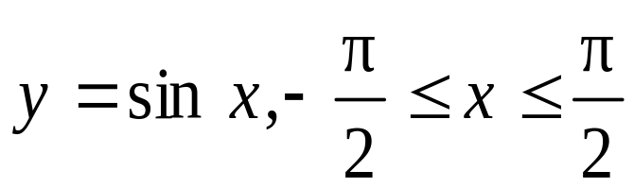

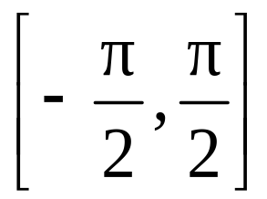
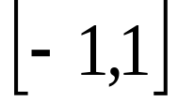
1. The definition of Inverse Trig Functions

Slide 32


Slide 33



Slide 34




Slide 35





Slide 36


Slide 37




2. Derivative formulas for Inverse trigonometric functions (Section 7.6)

Slide 38



Slide 39


Proof

Slide 40



Use implicit differentiation, we have

Slide 41


Slide 42


Slide 43


3. Indefinite Integral Formulas related to Inverse Trigonometric Functions
See Section 7.6 “Inverse Trigonometric Functions”

Slide 44


(1)

Slide 45


(2)

Slide 46


P432:

Slide 47






Proof

Slide 48


Slide 49


Slide 50



Slide 51


Slide 52


Slide 53



Slide 54



Slide 55




Slide 56


Slide 57


Slide 58


Slide 59


Slide 60



Slide 61



Slide 62


Slide 63



Slide 64


Slide 65


Slide 66


Slide 67


Slide 68


Slide 69
7.2
The Natural Logarithm Function
Copyright © 2010 Pearson Education, Inc. Publishing as Pearson Addison-Wesley

Slide 70

1. Definition of the Natural Logarithm Function
2. Euler Number e
3. The Derivative of y = ln x
4. Properties of Natural Logarithm
5. The Integral

Slide 71

1. Definition of the Natural Logarithm Function

Slide 72


Slide 73



Slide 74

2. Euler Number e

Slide 75



3. The Derivative of y = ln x
Example 1
(a)
(b)

Slide 76



Slide 77

4. Properties of Natural Logarithm

Slide 78





Proof

Slide 79



Slide 80



5. The Integral
(1) x∈ I =(0, +∞) :
(2) x ∈I = (-∞, 0) :

Slide 81


Slide 82



Example 3

Slide 83




P394:

Slide 84


Slide 85


Slide 86
7.3
The (Natural) Exponential Functions
(cf. Applications Appear in Section 7.4)
Copyright © 2016 Pearson Education, Inc. Publishing as Pearson Addison-Wesley

Slide 87
1. Definition of The Natural Exponential Function
2. The Derivative of e^{x}
3. The Indefinite Integral of e^{x}
4. Laws of Exponents
5. The General Exponential Function a^{x}
6. The derivative of General Power Function
7. The Power-Exponential Function
8. Euler Number e Expressed as a Limit
9. Logarithms with Base a: log_{a}x

Slide 88

1. Definition of The Natural Exponential Function

Slide 89





Slide 90


Slide 91

that is the inverse function of x = e^{y}

Slide 92


Slide 93


2. The Derivative of e^{x}
10 derivative formulas (see below)

Slide 94




Example 3
(a)
(b)
(c)
(d)

Slide 95


Slide 96

3. The Indefinite Integral of e^{x}
10 integration formulas (see below)

Slide 97










Indefinite Integral Formulas(Sec. 8.1):

Slide 98


Example 4
(a)
(b)

Slide 99

4. Laws of Exponents
Proof ?

Slide 100





Proof Let

Slide 101




5. The General Exponential Function a^{x}

Slide 102


6. The derivative of General Power Function
Hint

Slide 103


Slide 104
(1) (2)
(3) (4)
(5)
(6)
(7) (8)
(9) (10)

Slide 105
Indefinite Integral Formulas(Sec. 8.1):

Slide 106




7. The Power-Exponential Function
Example 5

Slide 107



Slide 108


Slide 109

8. Euler Number e Expressed as a Limit
Proof Let f(x) = ln x.

Slide 110






Slide 111


Remark

Slide 112




Slide 113



9. Logarithms with Base a: log_{a}x

Slide 114



Slide 115


Slide 116


Slide 117


Slide 118




Slide 119


Slide 120
7.4
Exponential Change and Separable Differential Equations
Copyright © 2010 Pearson Education, Inc. Publishing as Pearson Addison-Wesley

Slide 121


1. Differential Equations
Differential Equation:
Initial condition:
Solution: y = f(x)?

Slide 122


Any equation in which the unknown is a function and that involves derivatives (or differential) of this unknown function is called a differential equation.

Slide 123


Slide 124



2. Separable Differential Equations
Example 1
Any differential equation that can be written as h(y)dy = g(x)dx, i.e. one side just has y and dy, and the other side just has x and dx, is called a separable differential equation.

Slide 125


(1)

Slide 126




(2) P408:
y = 0.

Slide 127
(3)

Slide 128


Slide 129

Example 2

Slide 130


Slide 131
7.5
Indeterminate Forms and L’ Hopital’s Rule
^
Copyright © 2010 Pearson Education, Inc. Publishing as Pearson Addison-Wesley

Slide 132



1. Two Basic Indeterminate Forms

Slide 133




Why are theyֽinde'terminate forms ?
(1)
(2)

Slide 134


Slide 135



L’Hospital’ Rule:
(1)
(2)When x changes to some extent, f´(x) and g´(x) exist, and g´(x) ≠ 0;
(3) exists or ∞

Slide 136




Example 1
(a)
(b)
(c)
(d)

Slide 137


Example 2 Be careful to apply L’Hospital’s Rule correctly.
(1)

Slide 138



(2)

Slide 139



Example 4
(a)
(b)
(c)

Slide 140
Proof of L’Hospital’ Rule
(i) Cauchy’s Mean Value Theorem
(ii) L’Hospital’ Rule

Slide 141


Slide 142



Proof
By Rolle’s Theorem:

Slide 143



Hint of L’Hospital’s Rule: x → a⁺, 0/0.
Applying Cauchy’s Mean Value Theorem to the closed interval [a, x]:

Slide 144


Slide 145




2. Other Indeterminate Forms
(1)
Example 5
(a)
(b)

Slide 146


(2)
Example 6

Slide 147






(3)
Example 7 Show that

Slide 148

Example 8 Find

Slide 149
7.7
Hyperbolic Functions
Copyright © 2010 Pearson Education, Inc. Publishing as Pearson Addison-Wesley

Slide 150


Slide 151


Slide 152



Slide 153


Slide 154


Slide 155


Slide 156


Slide 157


Slide 158
7.8
Relative Rates of Growth
Copyright © 2010 Pearson Education, Inc. Publishing as Pearson Addison-Wesley

Slide 159


Slide 160


Slide 161


Slide 162


Slide 163


