Slide 1
Implement Rumor Detection on Twitter
Shu Hwai Teoh
Purdue University
November 18, 2019
A Top-down Tree-structured Recursive Neural Networks

Slide 2
Motivation
“Rumor is information that emerges and spreads among people whose truth value is unverified or intentionally false. ” (source)
Rumor diffuses more quickly and more broadly than truth in the social media.

Slide 3

Retrieved from: https://www.washingtonpost.com/news/worldviews/wp/2013/04/23/syrian-hackers-claim-ap-hack-that-tipped-stock-market-by-136-billion-is-it-terrorism/

Slide 4
Motivation
Automatic rumor detection
“Self-correct” by users through sharing evidence and opinions with one another

Slide 5
Problem Setting
Jing et al. tree-structured recursive model
A set of tweets
Classify each source tweet
false rumor
true rumor
non-rumor (news)
unverified rumor
Model each source tweet and its relevant responsive posts as a tree structure

Slide 6
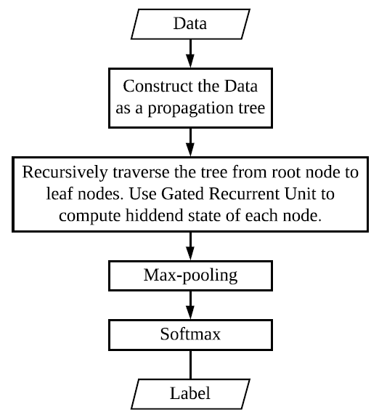
Approach
Top-down propagation tree
Gated Recurrent Unit (GRU)
Recursive Neural Network

Slide 7
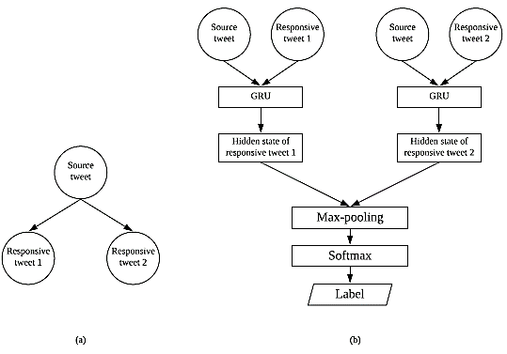

Slide 8
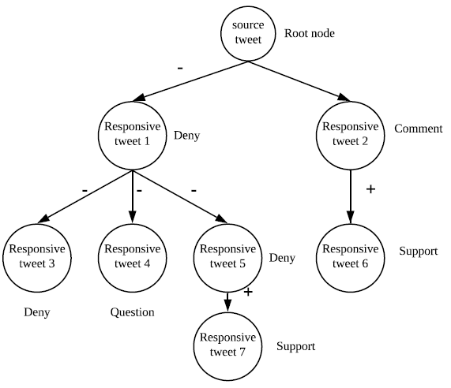

Slide 9
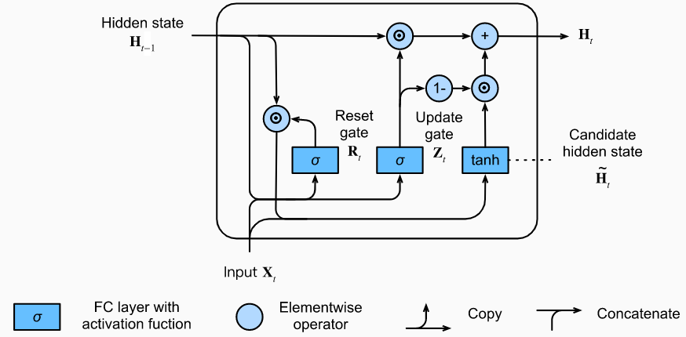
Retrieved from: https://d2l.ai/chapter_recurrent-neural-networks/gru.html

Slide 10
Implementation
The origin author
Theano
Stochastic gradient descent (SGD) + adaptive gradient algorithm (AdaGrad)
My implementation
PyTorch
ADAM

Slide 11
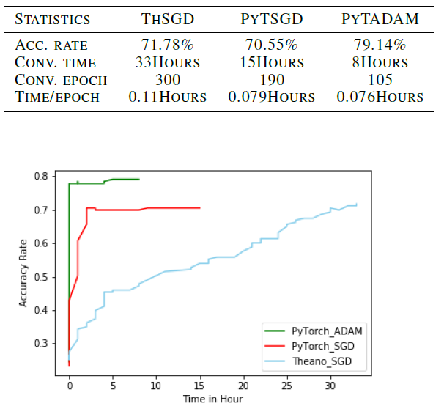
Experiments/Results
Datasets
Twitter15
Twitter16
Models
Theano + SGD + AdaGrad (the origin author)
PyTorch + SGD + AdaGrad (my implement)
PyTorch + ADAM
(my implement)
Accuracy rate | Twitter15 | Twitter16
Origin author | 72.30% | 73.70%
My implementation | 77.70% | 79.14%

Slide 12
Conclusion
Use Pytorch as the framework to build the tree- structured recursive neural network model can speed up the training and testing process.
On detecting rumor with the tree- structured recursive, ADAM can converge at a higher accuracy rate more rapidly which performs better than SGD optimizer (with Adagrad rule)

Slide 13
Reference
Cho, K., van Merrienboer, B., Bahdanau, D., and Bengio, Y.
On the properties of neural machine translation: Encoder decoder approaches, 2014.
DiFonzo, N. and Bordia, P. Rumor, gossip and urban legends.
Diogenes, 54(1):19–35, 2007.
Liu, Y. and Wu, Y.-F. Early detection of fake news on social
media through propagation path classification with recurrent
and convolutional networks. In AAAI Conference on
Artificial Intelligence, 2018.

Slide 14
Ma, J., Gao, W., and Wong, K.-F. Detect rumors in microblog
posts using propagation structure via kernel learning.
In Proceedings of the 55th Annual Meeting of the
Association for Computational Linguistics (Volume 1:
Long Papers), pp. 708–717, Vancouver, Canada, 2017.
Association for Computational Linguistics.

Slide 15
Ma, J., Gao, W., and Wong, K.-F. Rumor detection on
twitter with tree-structured recursive neural networks. In
Proceedings of the 56th Annual Meeting of the Association
for Computational Linguistics (ACL), pp. 1980–1989,
Melbourne, Australia, 2018. Association for Computational
Linguistics.

Slide 16
Vasu, N., Ang, B., Teo, T.-A., Jayakumar, S., Raizal, M.,
and Ahuja, J. Fake news: National security in the posttruth
era. RSIS, 2018.
Vosoughi, S., Roy, D., and Aral, S. The spread of true and
false news online. Science, 359(6380):1146–1151, 2018.
Yang, S., Shu, K., Wang, S., Gu, R., Wu, F., and Liu, H.
Unsupervised fake news detection on social media: A
generative approach. In AAAI Conference on Artificial
Intelligence, pp. 5644–5651, 2019.

Slide 17
Zubiaga, A., Aker, A., Bontcheva, K., Liakata, M., and
Procter, R. Detection and resolution of rumours in social
media: A survey. ACM Computing Surveys (CSUR), 51
(2):32, 2018.

