Slide 1

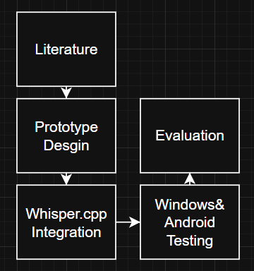
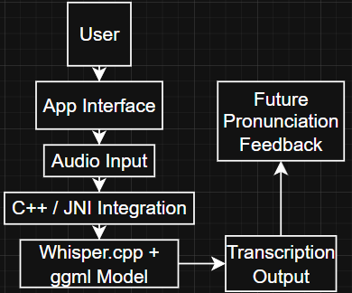
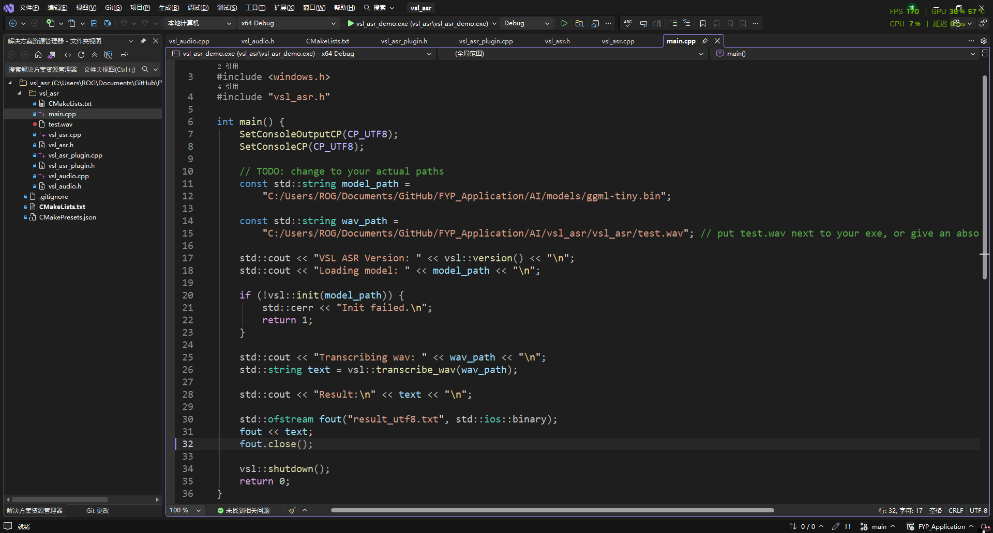
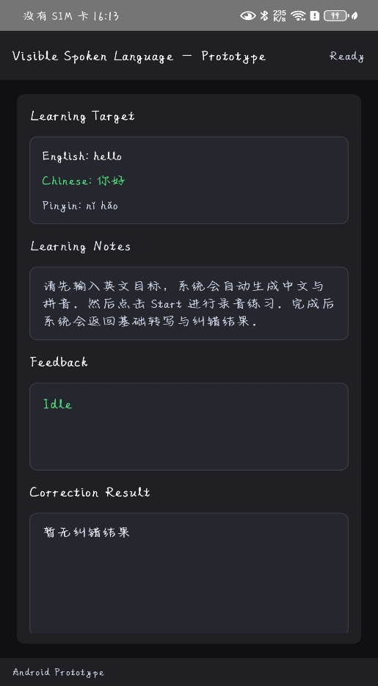
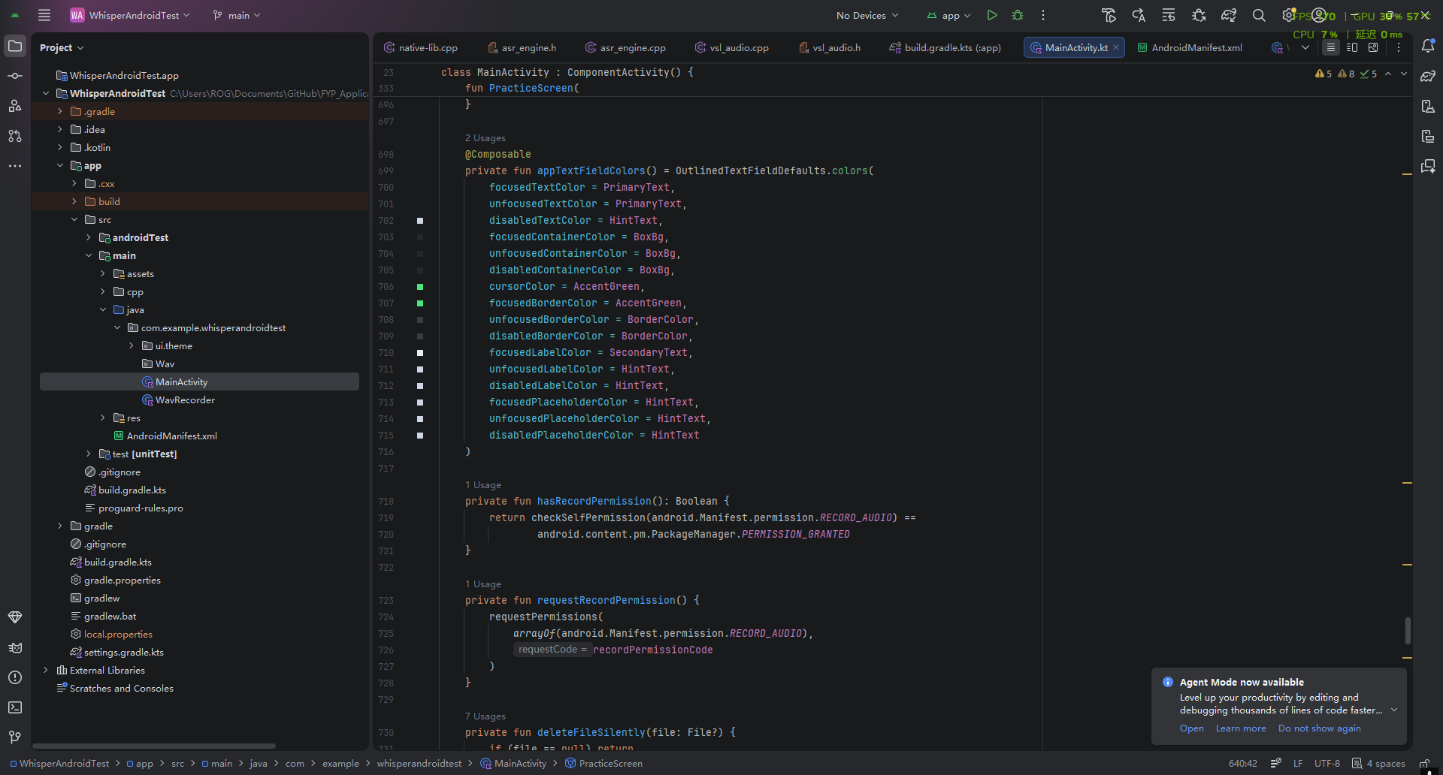
An Offline Speech Recognition-Assisted Application for Chinese and Other Language Learning
Shu Wang| Richard Davies | BSc (Hons) Computer Game Technology
Chinese pronunciation is difficult for beginners because Mandarin is a tonal language.
Many existing learning apps provides simple “correct” or “incorrect” feedback most.
This project explores offline speech recognition as a foundation for future pronunciation feedback.
Existing apps provide limited pronunciation feedback.
Cloud-based recognition may cause privacy, latency, and internet-dependency issues.
Beginners need clearer and faster support when practising pronunciation independently
Methods
Aim: To build an offline speech recognition prototype for Chinese language learning and future pronunciation feedback.
Object: Use whisper.cpp for local speech recognition.
Create a basic recording and transcription interface.
Test phrase-level Chinese recognition.
Explore Android deployment.
Identify limitations and future improvements.
Design
The prototype can load local speech recognition models.
Basic Chinese phrase-level recognition was achieved.
A Windows prototype and a basic Android version were implemented.
Offline recognition was feasible, but performance depends on device environment and noise level.
The project shows that offline ASR can support privacy-friendly and low-latency language learning.
However, the current version is still a technical prototype, not a complete pronunciation-learning product.
The main challenges were Android integration, model loading, dependency linking, and noise sensitivity.
Acknowledgements | GitHub | QR Code
This project successfully developed a working offline speech recognition prototype for Chinese language learning.
Will add pronunciation scoring and tone feedback. Also, will improve Android performance.
Radford et al. (2023) / ggml-org (2026) / Han et al. (2019) /Farran & Morett (2024)
Acknowledgements | GitHub | QR Code

