Slide 1
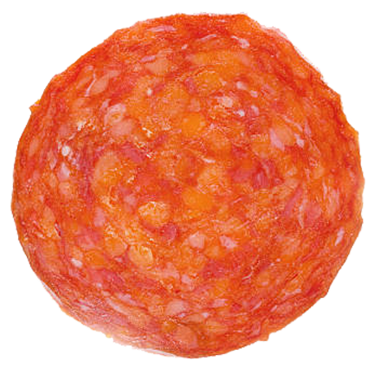
Predicting Pizzas
Amber Chen, Dustin Cox, Heather Heck, & Laura Treider

Slide 2
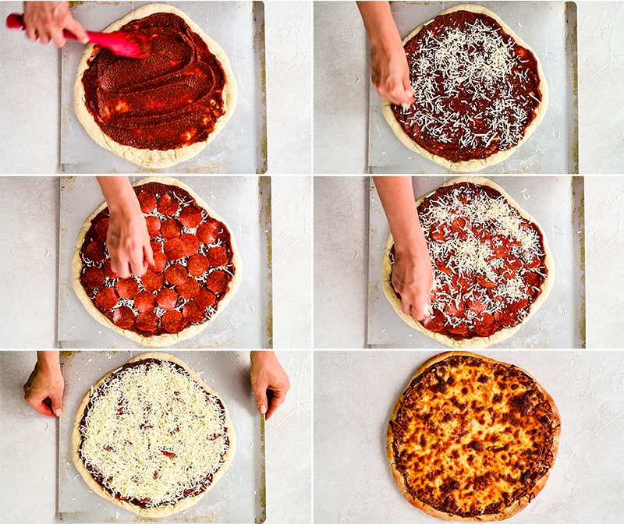
Recipe
1 Kaggle Challenge
1 Team Approach
4 Parts Exploratory Data Analysis
1 Dash of Feature Engineering
5 Rounds of Modeling
1 Part Performance Summary
1 Heap of Learning
Bake in it for a few weeks, and enjoy!

Slide 3
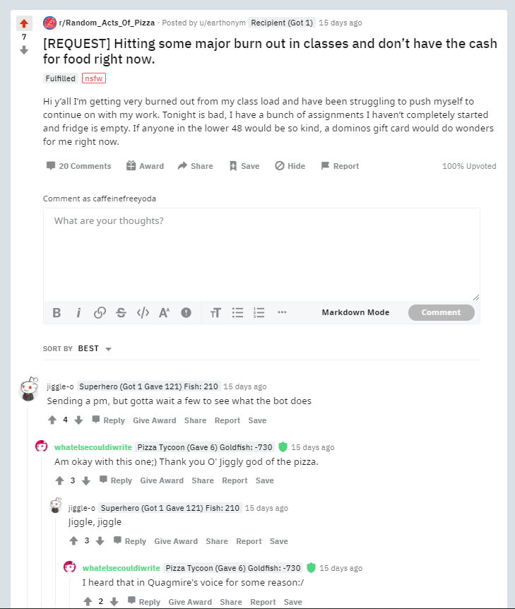
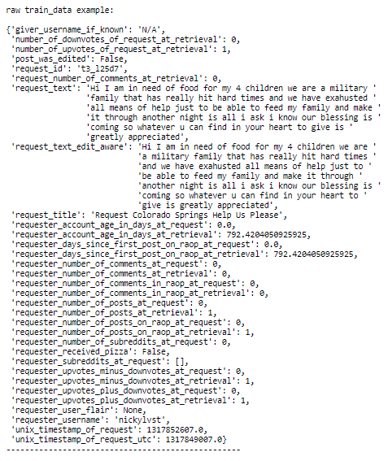
The Kaggle Challenge
4,040 train data examples
1,631 test data examples
2 outcome categories to predict
Pizza!
No pizza. ☹
Kaggle Top 100 accuracy to beat:
69.2%

Slide 4

Team Approach
Exploratory Data Analysis
Understand fields
Baseline Model
Guess all 1 category to determine the underlying distribution and simplest model to beat
Engineer Features
Decompose from existing features
Pre-process fields
Iterate through various models
Iterate through Ensembles
Combine promising and complimentary models
Tune hyperparameters for test data accuracy
Select Best-Performing Model
Find data quality issues
Uncover interesting relationships
Cluster analyses to group logically
Regression (linear / logistic)
Decision tree / forest
…
We have a winner!

Slide 5
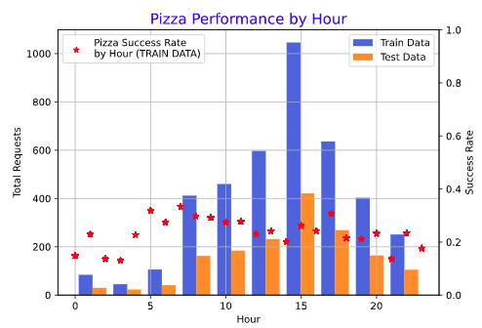
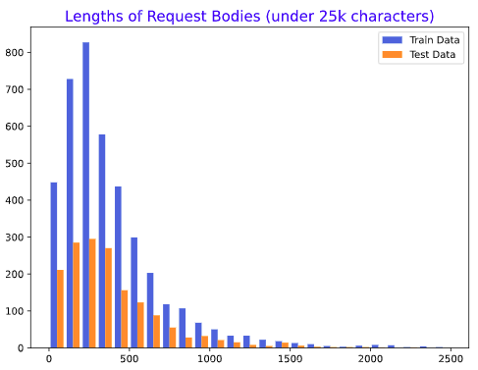
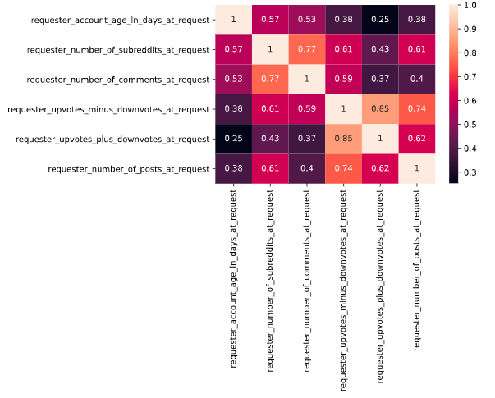
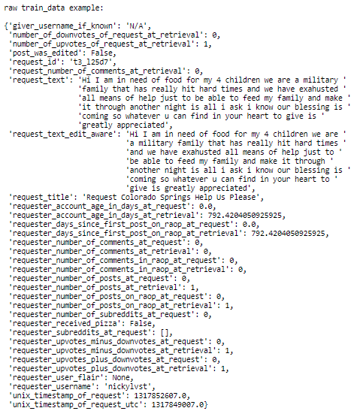
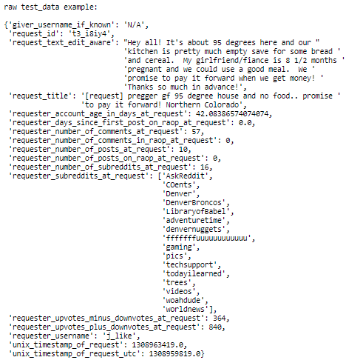
Exploratory Data Analysis
Train vs. Test Data Differences
Train: Everything Pizza
Test: Pepperoni Pizza
Pizza Success Rates
Time of day
Post Submission Attributes
Post lengths
i.e., various columns in the train set not present in test, and therefore unusable
Half of month
Throwaway accounts
Poster Attributes
Contains image(s)
Highly active users
Posts
Comments
Upvotes / downvotes
Contains URL(s)
Subreddit membership

Slide 6
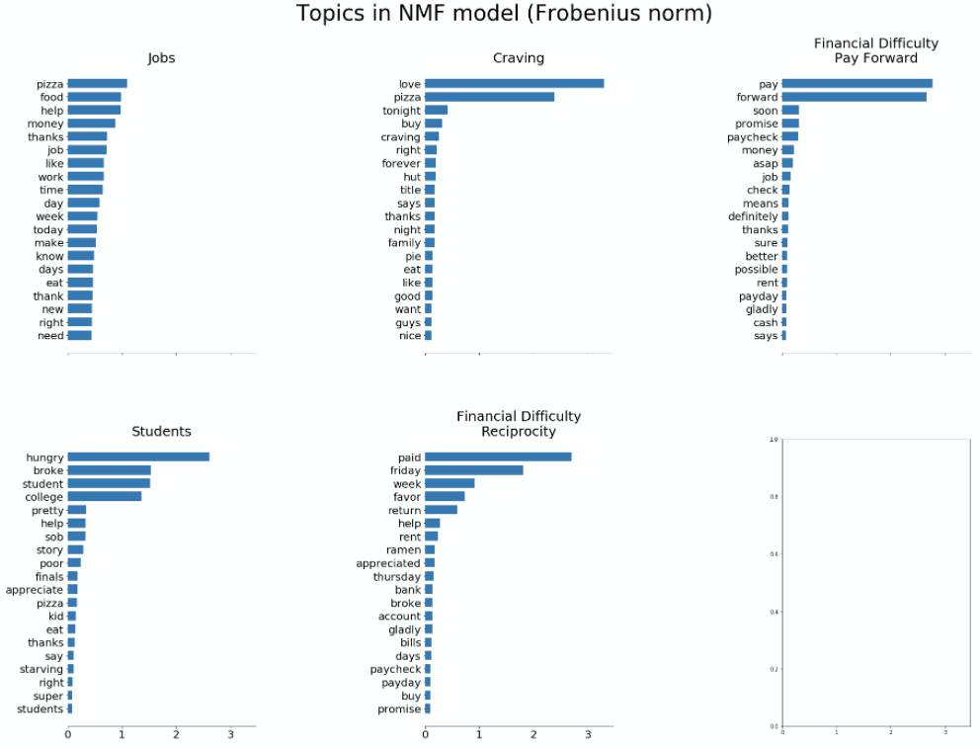
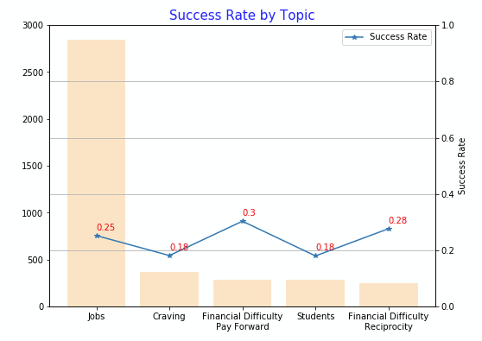
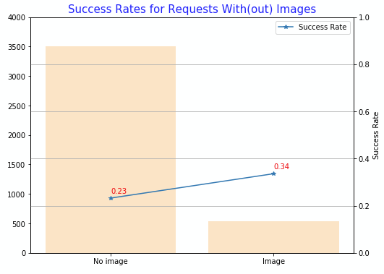
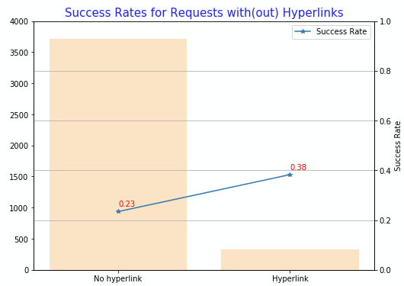
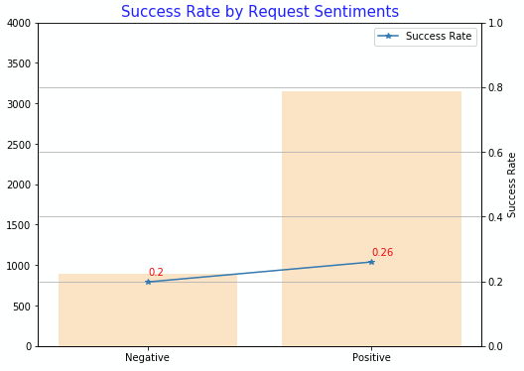
Feature Engineering
Textual Analysis on Requesters’ Posts
5 topics defined using K-means, PCA and NMF models
Pizza Success Rates
Vary among different groups
Higher for posts that include image(s)/URL(s)/positive sentiment
Sentiment analysis
Contains image(s)
Contains URL(s)

Slide 7
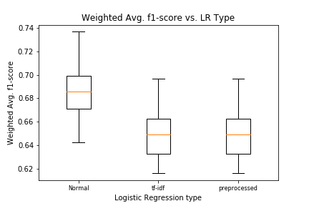
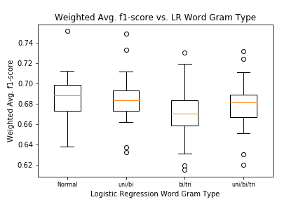
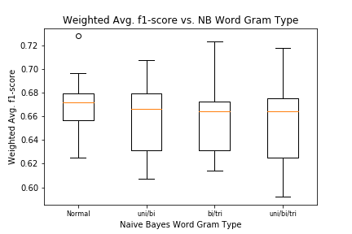
Modeling: LR Tuning Gram Bag
Request Text Only: Tuning LR Model / Gram Bag
Used 25-fold cross-validation to optimize model to dev data.
Model based on plain linear regression performed better than tf-idf, and also better than preprocessed text model.
Unigrams weren’t outperformed by combinations with bigrams and trigrams.
Logistic regression of text outperformed the Naïve Bayes model for all word gram types.

Slide 8
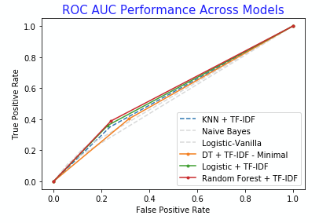
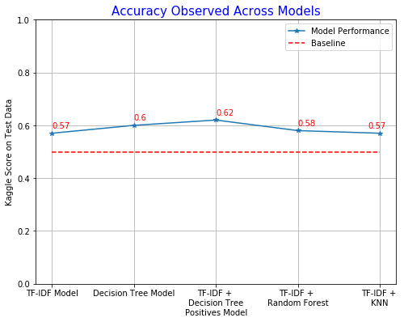
Modeling & Performance Summary
'requester_account_age_in_days_at_request',
'requester_days_since_first_post_on_raop_at_request',
'requester_number_of_comments_in_raop_at_request',
'requester_number_of_posts_on_raop_at_request',
'requester_upvotes_minus_downvotes_at_request',
'Length_of_Post',
'RAOP_member_at_time_of_request',
'zero_to_three',
'four_to_seven',
'eight_to_eleven',
'twelve_to_fifteen',
'sixteen_to_nineteen',
'twenty_to_twentythree',
'beg_month_of_request',
'includes_visuals',
'includes_hyperlink',
'Topic1_dec’,
'Topic2_dec’,
'Topic3_dec',
'Topic4_dec’,
'Topic5_dec',
'sentiment_bin'
Natural Features
Engineered
Features
Notes:
Talk Track
Most models leveraged the set of features displayed here
Natural Features
The only raw features that we found useful were the ones around age of the user’s account, and some metrics about their activity on the platform and subreddit
Engineered Features included the following
Textual (Sentiment, Clustering, TF-IDF, Length)
Topical (Clustering)
Time
Metadata (User)
In the top, right chart you can see the ROC AUC Performance of various of the models we attempted to score based on Dec data
As can be seen, there were only small performance differences among all the approaches the team took
In the bottom right chart, we’ve plotted those same charts performance against the test data
There were major deviations from the models’ performance against dev and test data, because the test data looked materially different from the training data they provided – this posed challenges for generalization
Ultimately, a relatively simple ensemble model combining a LR and DT positives performed best against the test data at 62%

Slide 9
Learning
Theory and Practice
Teaching grants access to understanding, range of tools and approaches
No substitute for practice and application
Art and Science
Infinite combinations of features, models, hyperparameters, ensembles to try
What to go after is a combination of domain knowledge, experience, clues from the data, gut intuition, and creativity
Train and Test
If train and test data look materially different, it opens a whole set of problems for which the team must correct

Slide 10
THANK YOU
Q&A

Slide 11

Team Approach
Exploratory Data Analysis
Understand fields
Baseline Model
Guess all 1 category to determine the underlying distribution and simplest model to beat
Engineer Features
Decompose from existing features
Pre-process fields
Iterate through various models
Iterate through Ensembles
Combine promising and complimentary models
Tune hyperparameters for test data accuracy
Select Best-Performing Model
Find data quality issues
Uncover interesting relationships
Cluster analyses to group logically
Regression (linear / logistic)
Decision tree / forest
…
We have a winner!

