Slide 1
Graph Databases
Richard L, Josh E, and Josh E

Slide 2
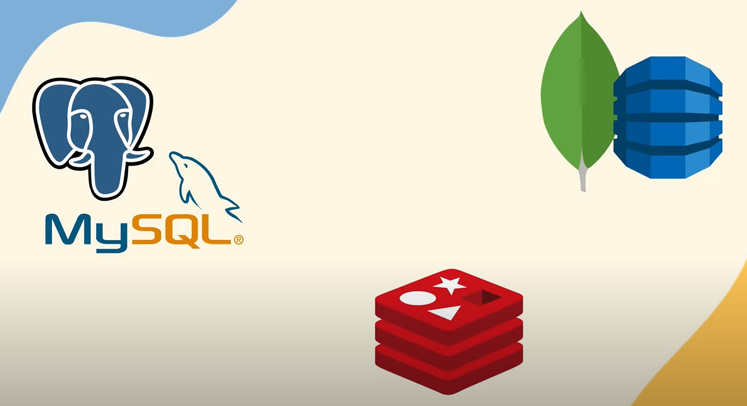
What are Graph Databases?
Multiple database paradigms
Relational (MySQL)
Key-value pairs (redis)
Document (MongoDB)
Graph Database (Neo4j)

Slide 3
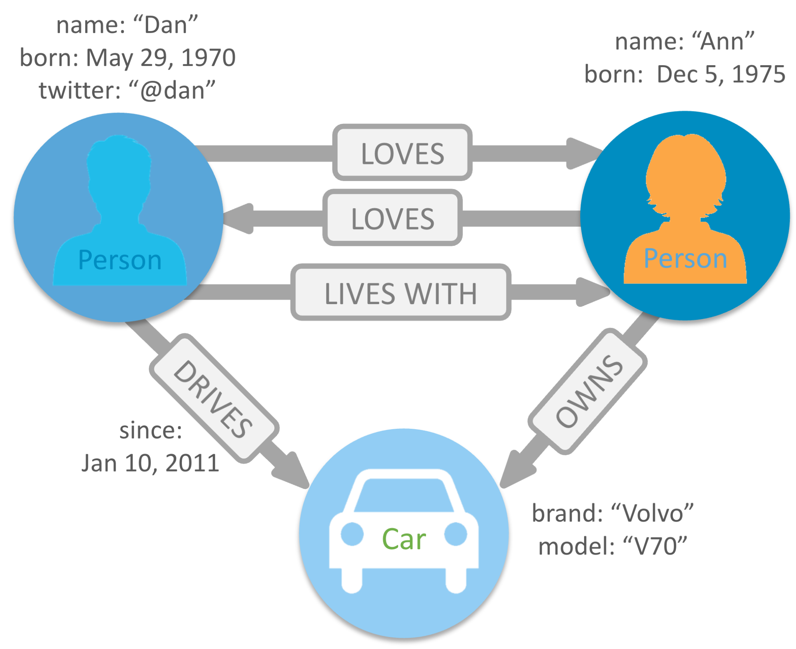
What are Graph Databases?
NoSQL
Non-tabular
Don’t use relational tables
Graph Databases
Nodes
Entities or objects
Edges
Represent relationships or connections between entities

Slide 4
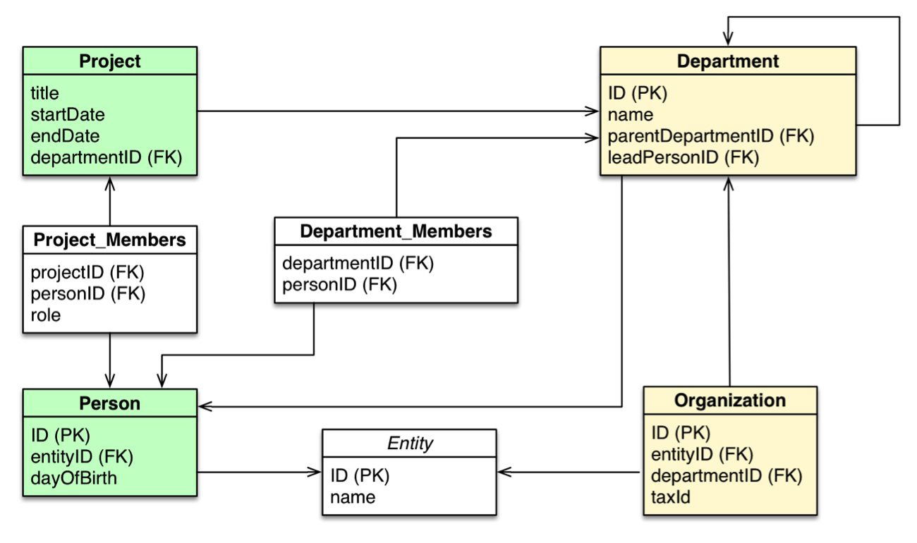
History of/Why use Graph Database?
Relational databases
Edgar F. Codd
Revolutionized database world
More flexible, intuitive, and easier to implement and maintain
Dominated database industry
Early 2000s
Rise of internet
Large volumes of unstructured data
Scaling

Slide 5
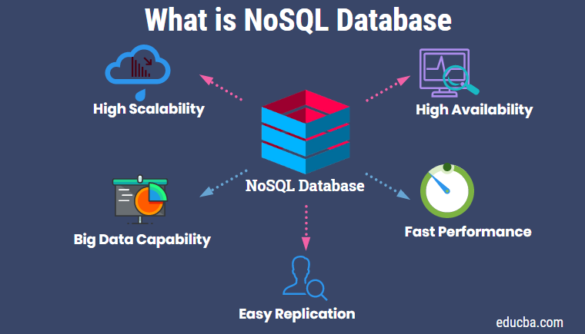
History of/Why use Graph Databases
NoSQL databases
Large volumes of unstructured data
Scalability
Grow horizontally across multiple servers
Rise of NoSQL databases
Exploration of new paradigms
Graph databases
Graph Databases
Social Networks
Recommendation Engines
Fraud detection

Slide 6

Example of a Graph Database
Neo4j
One of the most popular graph databases
Used by multiple high profile companies
eBay
Levi’s
Adobe
Volvo
Verizon

Slide 7
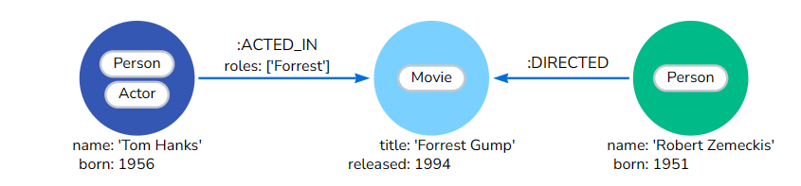
Neo4j Nodes
Nodes
Entities
Labels
Properties
Key-value pairs

Slide 8
Neo4j Nodes
Cypher
CREATE (:Person:Actor {name: 'Tom Hanks', born: 1956})-[:ACTED_IN {roles: ['Forrest']}]->(:Movie {title: 'Forrest Gump'})<-[:DIRECTED]-(:Person {name: 'Robert Zemeckis', born: 1951})

Slide 9
Neo4j Edges
Edges/Relationships
Connection between a source node and a target node
Contains
Direction
A Singular Type
Properties (key-value pairs)

Slide 10
Neo4j Edges
Cypher
CREATE (:Person:Actor {name: 'Tom Hanks', born: 1956})-[:ACTED_IN {roles: ['Forrest']}]->(:Movie {title: 'Forrest Gump'})<-[:DIRECTED]-(:Person {name: 'Robert Zemeckis', born: 1951})

Slide 11
General Pros and Cons
Advantages:
Structures are flexible
Index-free adjacency
Queries produce relatively fast output
Disadvantages:
No standard query language
Poor spanning of entire database
User-base is small

Slide 12
Graph Database Improper Use
Examples:
Performing (simple) mass analytics queries across all objects
"Who were all the customers with income over $100K between the ages of 35 and 50?”
“What order numbers in the database where the first three digits are 314?”
Representing Data with few/no interactions
Transactional Data
Key/Value Pairs

Slide 13
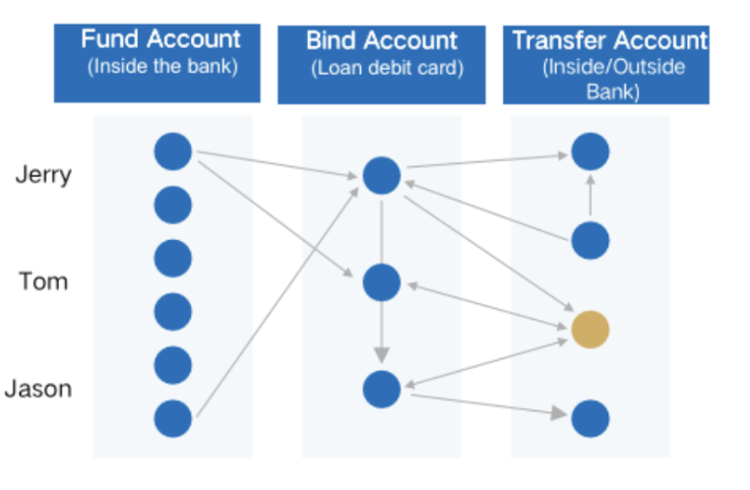
Graph Database Proper Use
Example: Fraud Detection
Contains three steps to implement:
Expert rules
Machine Learning Model
Relational Graphs
Uncovering patterns of behavior across multiple transactions
Multiple Informational Sources
Secondary verification
Faster Querying

Slide 14
Applications and Use Cases
Connections (Social Media)
Recommendation Engines
Evolutionary Computation Research

Slide 15
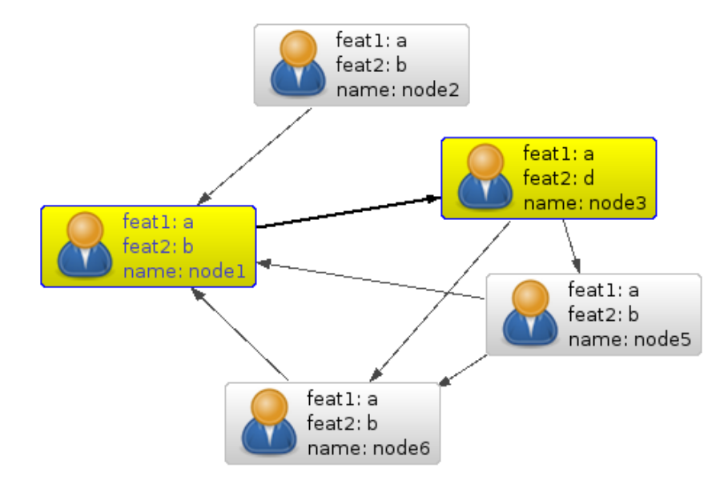
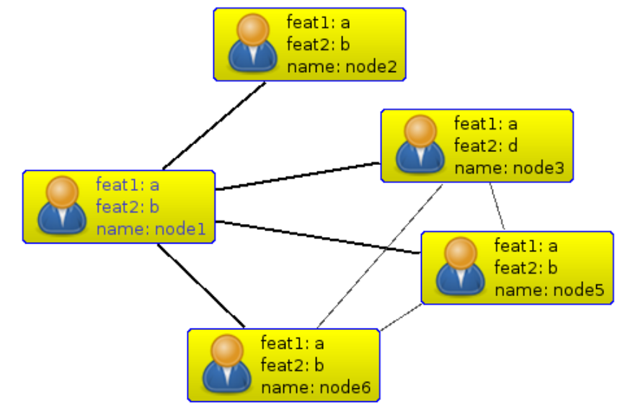
Connection Data (Nawroth)
Nodes represent people
Vertices represent connections
Incoming, outgoing, both

Slide 16
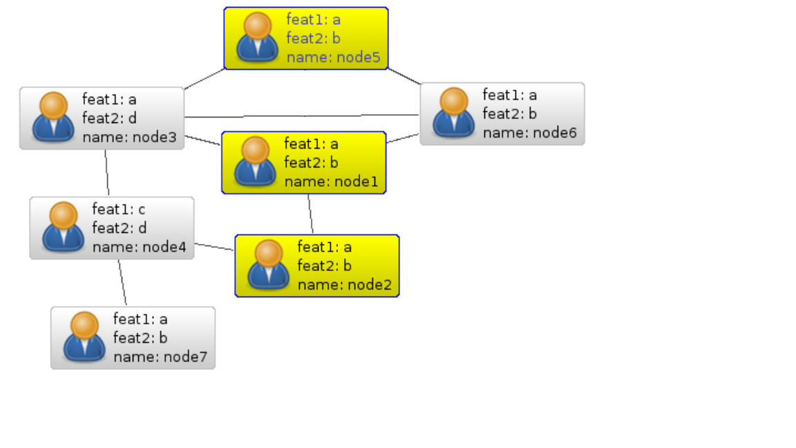
Recommendation Engines (Nawroth)
Degrees of separation
How similar people behave
Social Media
Movies/TV Shows

Slide 17
Evolutionary Computation Research (McPhee)
Used by Nic McPhee in 2016 research
Evolving programs to solve a problem
Track which programs make which offspring

Slide 18
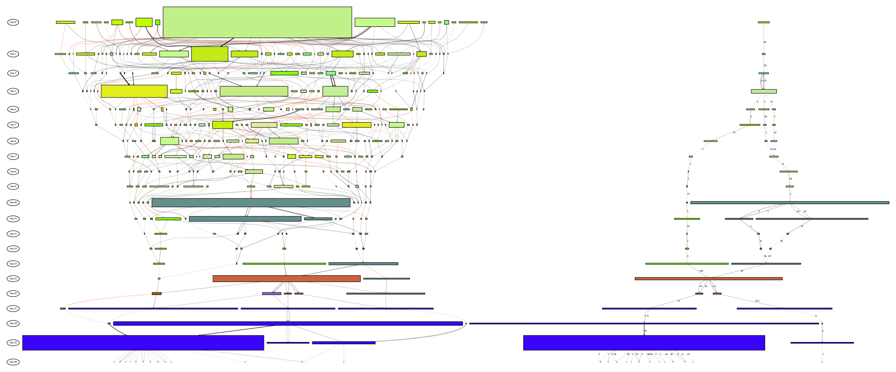
Evolutionary Computation Research Cont. (McPhee)
Nodes represent best individuals of a population
Vertices represent offspring of each individual
Outgoing connection (parent -> child)

Slide 19
Questions?

Slide 20
References
“7 Database Paradigms.” Tudip Digital, 30 Dec. 2020, https://tudip.com/blog-post/7-database-paradigms/.
"A Brief History of Databases." YouTube, uploaded by CockroachDB, 12 Nov. 2019, www.youtube.com/watch?v=PA3LtpwfFwQ.
“Graph Database Concepts - Getting Started.” Neo4j , https://neo4j.com/docs/getting-started/appendix/graphdb-concepts/. Accessed 30 Apr. 2023.
Hunger, Michael, et al. “RDBMS & Graphs: SQL vs. Cypher Query Languages.” Neo4j, 7 Mar. 2016, https://neo4j.com/blog/sql-vs-cypher-query-languages/.
McPhee, Nic. “Gecco 2016 VizGEC.” GitHub, 30 Mar. 2016, https://github.com/nicmcphee/gecco-2016-ancestry-poster.
Nawroth, Anders. “Social Networks in the Database: Using a Graph Database.” Neo4j, 15 Sept. 2009, https://neo4j.com/blog/social-networks-in-the-database-using-a-graph-database/.
"Neo4j (Graph Database) Crash Course." YouTube, uploaded by Laith Academy, 29 Nov. 2021, www.youtube.com/watch?v=8jNPelugC2s&t=110s.

Slide 21
References
Thakker, Pranav. “What Is NoSQL? Why It’s Gaining Popularity?” Sufalam Technologies, 12 Mar. 2015, https://www.sufalamtech.com/blog/what-is-nosql-why-its-gaining-popularity.
“What Is a Graph Database? - Developer Guides.” Neo4j , https://neo4j.com/developer/graph-database/. Accessed 30 Apr. 2023.
Wu, Min. “What Is a Graph Database and What Are the Benefits of Graph Databases.” Open Source Distributed Graph Database, https://www.nebula-graph.io/posts/what-is-a-graph-database.

