Slide 1
Y-DATA: Yandex School of Data Analysis — 2021
End2End ML
Lior Sidi & Noa Lubin

Slide 2

What you will learn today
Formulating a business problem to a machine learning one Best practices in data science
Creating real impact with your models by scoping it Evaluating and hypertunning models
Understand your models and improving them
How to become a Lego-Master-Builder

Slide 3

What you will NOT learn today
Coding best practices (but you might see some nice python tricks) MLOps and model deployment
Scaling learning on bid datasets Learn how to do nice plots
New algorithm

Slide 4
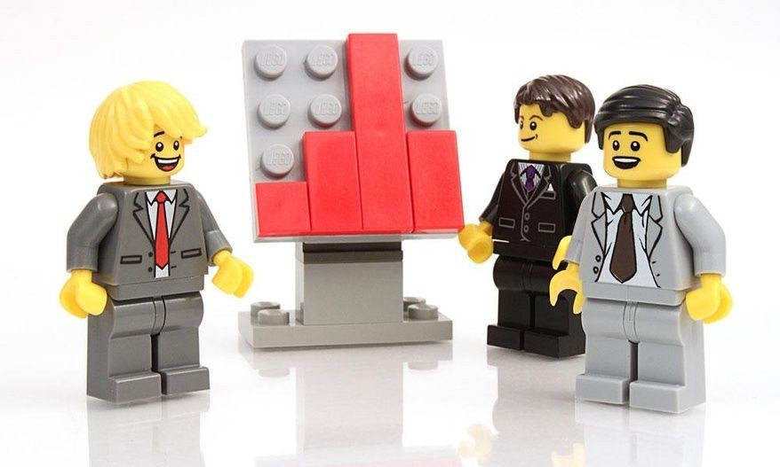
You are a...
A Data scientist who works in a big electronic online retailer (i.e Best Buy). Millions of users enter the company sites daily.
KPI is to improve sales on the site:
Improve experience
Improve offerings

Slide 5

You build superpowers
Improve experience
Product recommendation
Chatbot & Sentiment analysis
Improve sites navigation
Improve offerings
Optimize price with discounts, coupons and bundles
Identify new products to sell
Inventory prediction

Slide 6

Why personalization is important?
Each customer has different:
Products needs
Budget
Intent

Slide 7


What is intent?
Intent
Give
Discount
Interaction
Customer

Slide 8

Customer Purchase Intent
The willingness of a customer to buy a product or service in a certain condition*
Informational intent
All sessions
Awareness
Investigation intent
Product views
Consideration
Navigation intent
Add to Cart
Transactional intent
Conversion
Purchase
*https://www.igi-global.com/dictionary/purchase-intention/24144

Slide 9
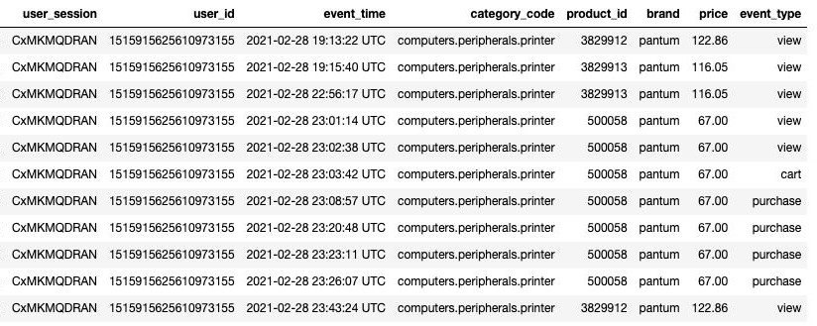
How Customer interaction looks like?
https://www.kaggle.com/mkechinov/ecommerce-events-history-in-electronics-store

Slide 10
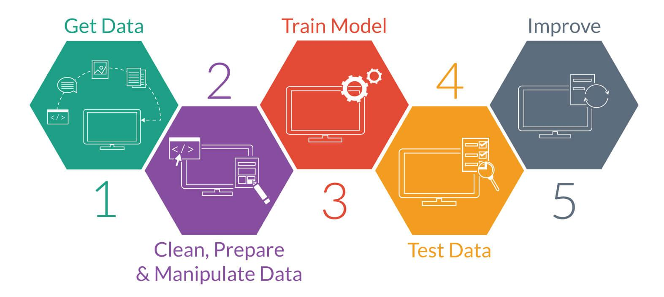


Steps to Predictive Modeling
Productize
0
6
Deﬁne
5
Improve

Slide 11

Let's Start!!!!

Slide 12
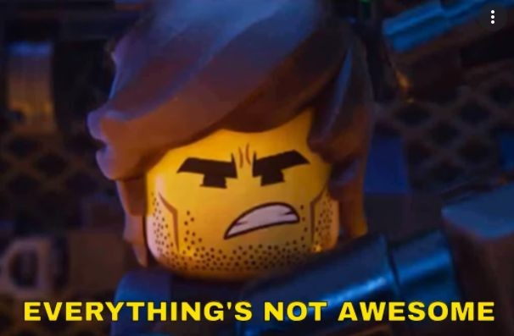

Slide 13

Wake up from LA LA LAND!
Split
Based on time
Feature_extraction
Deal with NA badly
Aggregation keys on entire sessions and not windows
Non relevant aggregations function
Unique_event_type + session size- Leakage!!!
Feature_extraction is also need to be fitted!

Slide 14

Wake up from LA LA LAND!
Split
Based on time
Feature_extraction
Deal with NA badly
Aggregation keys on entire sessions and not windows
Non relevant aggregations function
Unique_event_type + session size- Leakage!!!
Feature_extraction is also need to be fitted!

Slide 15
Wake up from LA LA LAND!
Model
Didn’t hypertuned the model
Didn’t tried other models - validation set?
Evaluation
Using Accuracy for imbalance data
Not using relevant metrics
Error analysis
Understanding when your model mistakes and try to improve

Slide 16
Why this is happening?
“Kaggle mindset” - ready data, just fit predict
Focus on modeling and not data and product
Non skeptical about problem and data

Slide 17
Why this is happening?
“Kaggle mindset” - ready data, just fit predict
Focus on modeling and not data and product
Non skeptical about problem and data
How to solve it?
Gain EXPERIENCE
Be skeptical
Work with Product definition

Slide 18
Why this is happening?
“Kaggle mindset” - ready data, just fit predict
Focus on modeling and not data and product
Non skeptical about problem and data
How to solve it?
Gain EXPERIENCE
Be skeptical
Work with Product definition
Do Exploratory Data Analysis

Slide 19
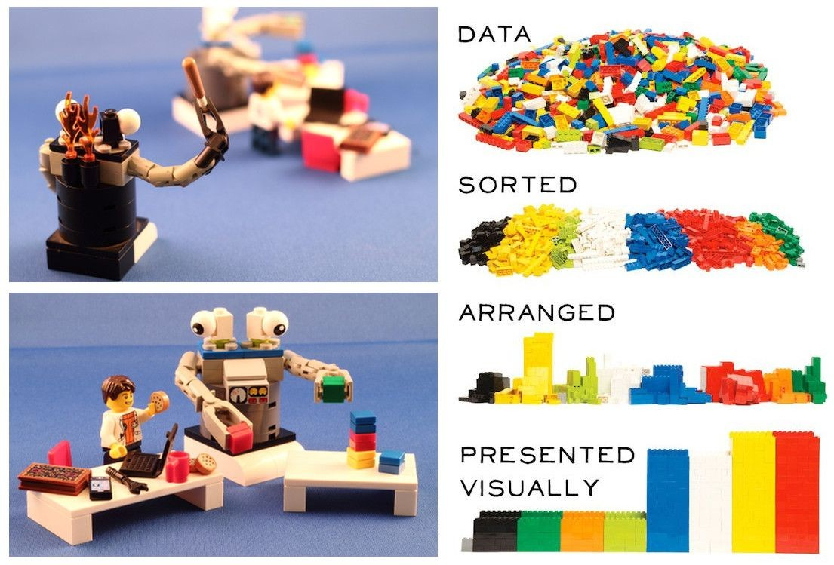
What we want to achieve in EDA
Understanding what and when we calling the model
Understanding how that data and features behave - do we have signal? Identify possible pitfalls - evaluation, leakage, noise, imbalance

Slide 20
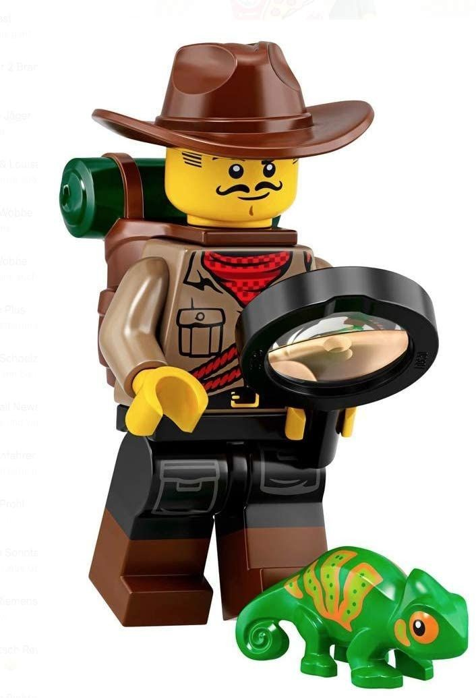
Back to reality - EDA

Slide 21
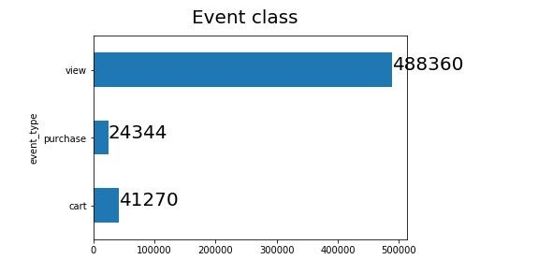
Label distribution
Labeling insights: there is imbalance, also might consider using cart over purchase

Slide 22
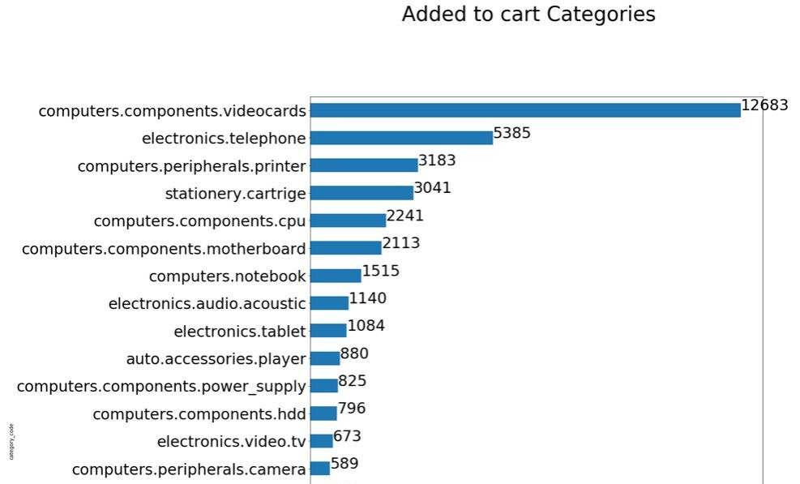
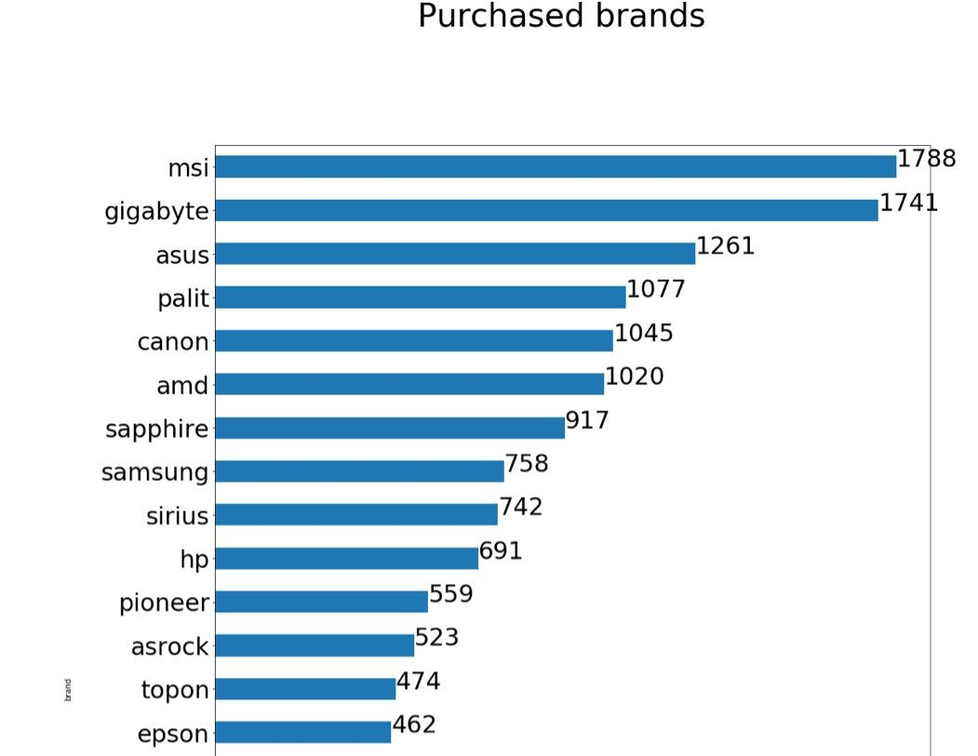
Categories correlation with label

Slide 23
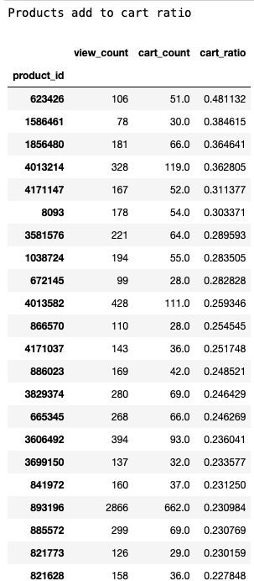
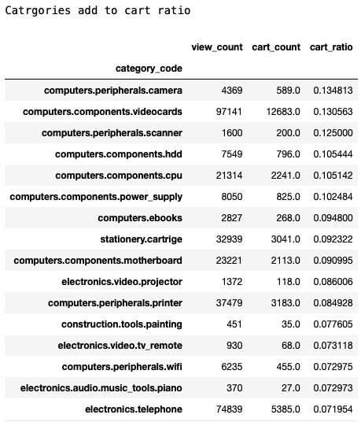
Categories insights: categories do matter for classification, need to incorporate them correctly in the features. like using the prior.

Slide 24
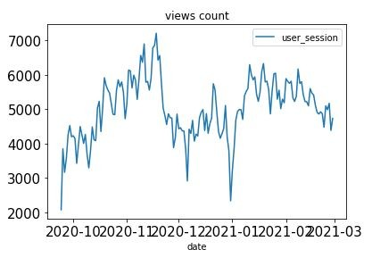
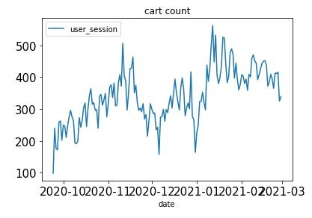
Macro understanding
Macro insights : there is seasonality in the data which requires from us to evaluate properly by time.

Slide 25
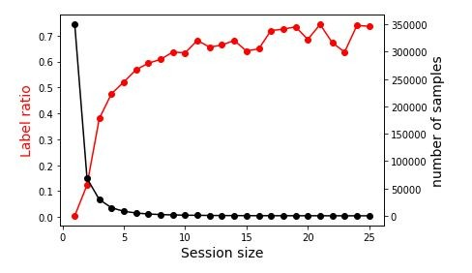
Session size analysis
Session size insights: we can use 3 events that has signal of 40% target labels, this is a great start and will allow us to detect intent in very early stage.

Slide 26
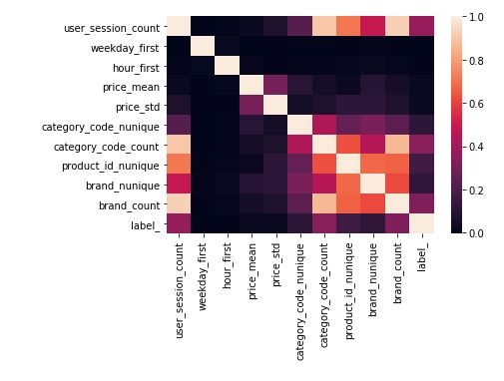
Features understanding
Features insights: there is a small correlation between the session count, barnd, and category code with the label. other features are not correlate and can be used together

Slide 27
What did we learn?
The problem is imbalance
Some categories and product has strong prior There is seasonality in the data
The session size is critical for framing the solution
Also Try Pandas GUI -
https://towardsdatascience.com/pandasgui-analyzing-pandas-dataframes-with-a-g raphical-user-interface-36f5c1357b1d

Slide 28
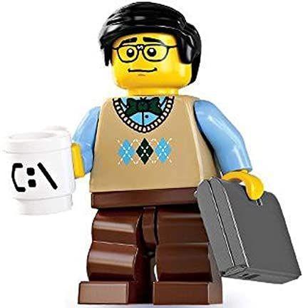
Back to reality - Modeling

Slide 29
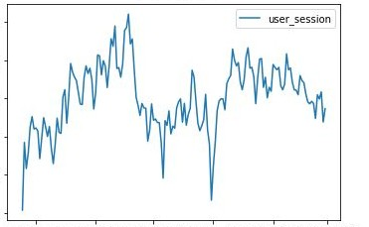
Temporal cross validation

Slide 30



Temporal cross validation
Fold 1
30d 7d 7d
Train Validation
Test

Slide 31
Temporal cross validation
Fold 1
Fold 2
30d 7d 7d
Train Validation
Test
slide

Slide 32

Fold 1
Fold 2
Fold 3
slide
slide
Score 1
Score 2
Score 3
Mean score

Slide 33
The Evaluation loop
All data
Split to folds
For each i in Folds:
Fold i
For each v in Feature extractors:
Extract features on fold i
features v on Fold i
For each m in model configurations:
Hypertune model m on v_i
Predict best model on test_v_i
Evaluate performance of m_v_i
Performance model m on features v, Fold i

Slide 34
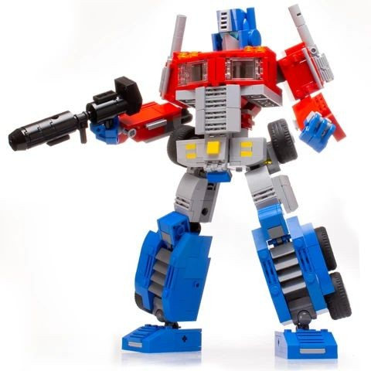
Optimizing

Slide 35
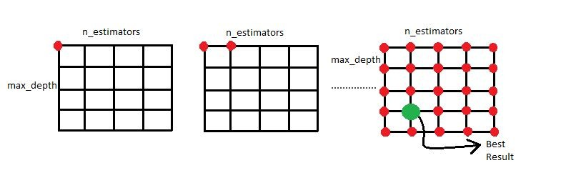
Grid Search

Slide 36
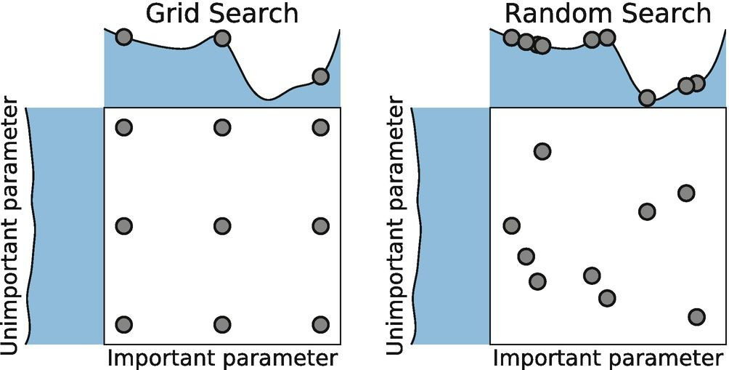
Hyper parameter tuning

Slide 37
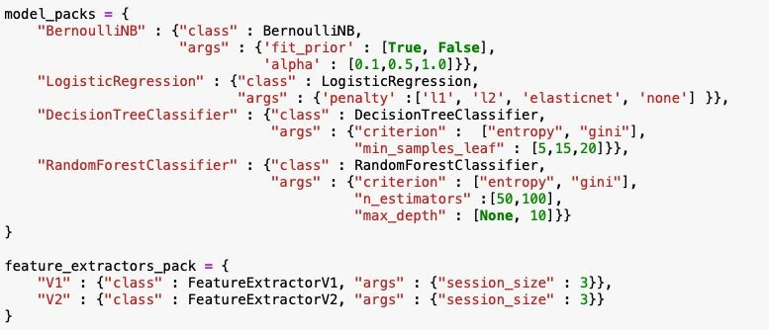

Optimization configuration

Slide 38
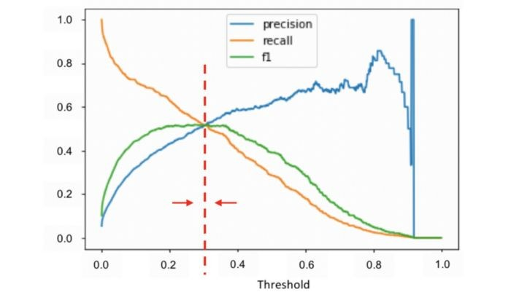
Threshold optimization

Slide 39
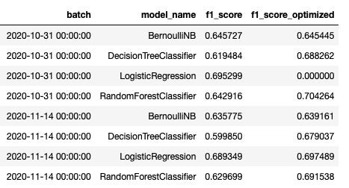
Batch Evaluation

Slide 40
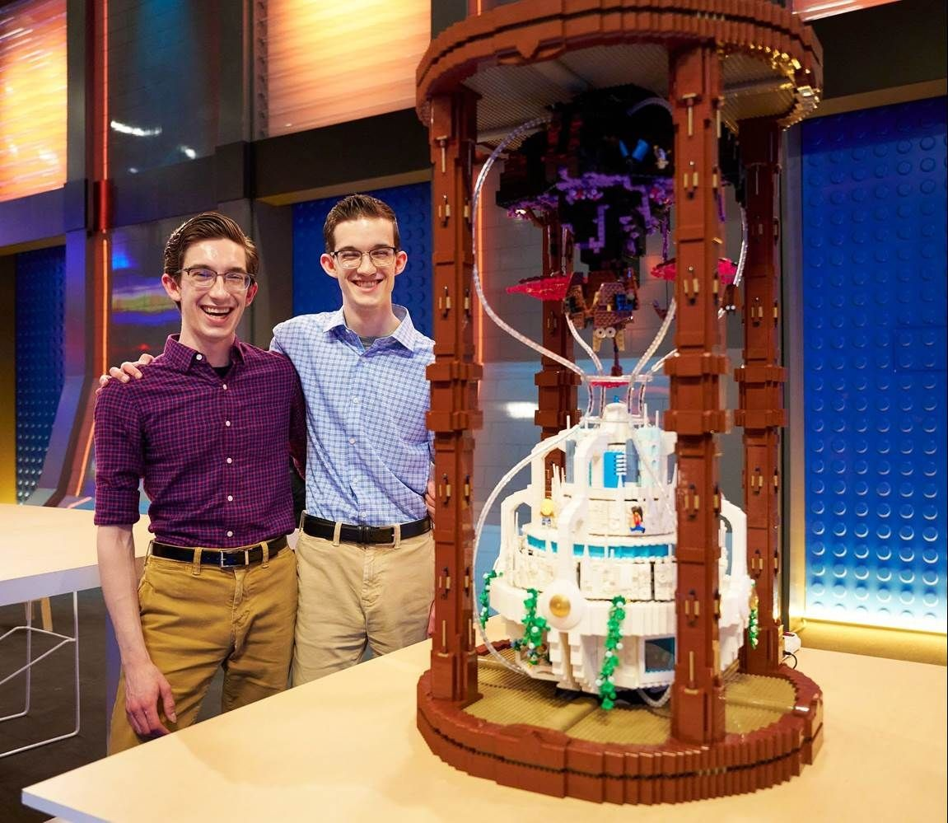

Show your model to the world!
https://streamlit.io/gallery

Slide 41
Back to reality - Error Analysis

Slide 42
Back to reality - Improve your signal!

Slide 43
Steps to Predictive Modeling
Productize
0
6
Deﬁne
5
Improve

Slide 44
Code Tricks Summary
Save prepared data and load if not os.path.isfile. Use kwargs - class(**kwargs_dict)
Use classes to separate code ares
Use list of dictionaries to build data frame.

Slide 45
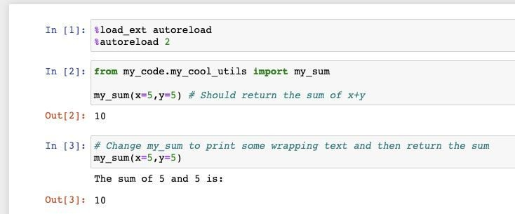
How to Dev?
Jupyter
Analysis and demoing
In memory context - fast but cause mistakes with variables
Pycharm
Organized code
Debuggable
Auto-complete
Argument with bash
Combine
Use Classes developed in pycharm at jupyter

Slide 46
Future steps
More Error analysis - going back the the raw data and aggregations Extract session features: duration, average time between views Reduce Features with Chi2 selection or PCA
Undersample / oversample the data

Slide 47
Q&A

Slide 48
Pandas GUI -
https://towardsdatascience.com/pandasgui-analyzing-pandas-dataframes-with-a-g raphical-user-interface-36f5c1357b1d

