Slide 1
Probability
Probability and Statistics for Data Science
Part 1
Notes:
probability is a mathematical branch. Statistics is more similar to physics: probability we “hallusinate”-- there is a random eventm a sampling space, a possible result- and bbased on our assumptions about these sets, we can do calculations. Its a good way to find random relationships.
Statistics, however, deals with real data- we don’t start with assumptions.
In descriptive statistics, we are dealing with summarizing data, and we just want something concise (a students grades that we want summarized).
…. deals with infering things about the data (how likely is it that with this collection with coin tosses, that this coin is fair). To answer questionis we have on our data, we take the data, calculate statistics. Then given an hypothesis, how would these statistics behave. We then create a distribution, and based on the distribution, we have a probabilistic question.
We can also model data:
How these foundations connect to machine learning (which industrially mostly deals predicting), we will deal with later.
(Infering vs. predicting: Economists build models, but they don’t try to predict anything, rather explain. The main goal is to understand relationships. Paypal, however for example, most data scientists are trying to predict future events of a transaction)

Slide 2
About me
Moni Shahar
Scientific Manager of the TAU AI and Data Science Center
Background:
ML & Vision (25 years in the industry)
PhD. In theoretical computer science
Slides are based on a course given last year by David Dale

Slide 3
Our course
Probability
Formalize the modeling of random events
Describe and predict properties of random variables
Reason about systems of multiple random variables
Statistics
Describe and summarize data
Learn parameters to match the data
Test whether the data supports your assumptions
Build models to predict and explain real world

Slide 4
Course logistics
Each week:
Lecture slides
Paper-and-pencil assignments
Assignments in Python
Platforms:
Google Classroom
Discussions in Slack
2 weeks to complete
We’ll send invitations soon

Slide 5
Course logistics
Study groups
Pairs; same for Python and Probability courses
By Oct 19 – form study groups
if you don’t, we assign you randomly
By Oct 24 – try the assigned groups
tell us, if randomly assigned group is not working for you (logistics, whatever)
Do homework together, discuss, have fun

Slide 6
Random events and probability

Slide 7
Why probability
Probability & statistics are tools for solving problems with uncertainty
Why uncertainty?
Some things are intrinsically uncertain (e.g. quantum effects)
Some things are practically unpredictable (e.g. weather)
Some things depend on unknowns (e.g. medical diagnoses)
Some things are modelled inexactly (e.g. discretization)
Some things are just easier to compute with probability (e.g. large system)
Notes:
We use probability when dealing with cases of uncertainties.
Somethings are intrinsically uncertain, but some are technically certain (large systems), but since they are just too complicated to know, we model it as an uncertainty.

Slide 8
Random experiment
Sample space – set of all possible outcomes.
Sample spaces are MECE (mutually exclusive, collectively exhaustive)
It means, an experiment always results in one and only one outcome
Sample space depends on what outcomes we can actually observe
The same experiment can have different sample spaces with different granularity
Random event – a subset of outcomes
Events that consist of a single outcome are called elementary=atomic=simple
For any event, we should be able to tell whether it happens or not*
For any countable set of events, we should be able to tell whether at least one of them happens**
Conditions * and ** determine that the set of all events is a σ-algebra – a space on which probability can be properly defined.
Notes:
Sample space is a basic definition of probability, and is the set of all possible outcomes (die has a sample space of 1-6. Three dice have a sample of space of 6^3).
Random event is a subset of the sample space, which is an aggregation of events from the sample space (In the case of three dice, there would be 16 random events of 3-18, if we were just worrie about summation).
Random events can be disjoined or intersect.

Slide 9
A few random experiments
Tossing a die
Tossing a coin 3 times
Picking a random phrase from a book
Asking a random person about age and political preferences
Shooting into a target (and maybe missing)
Generating random characters until a period character is sampled
Opening 3 envelopes in a random order
Lending money and waiting for its return

Slide 10
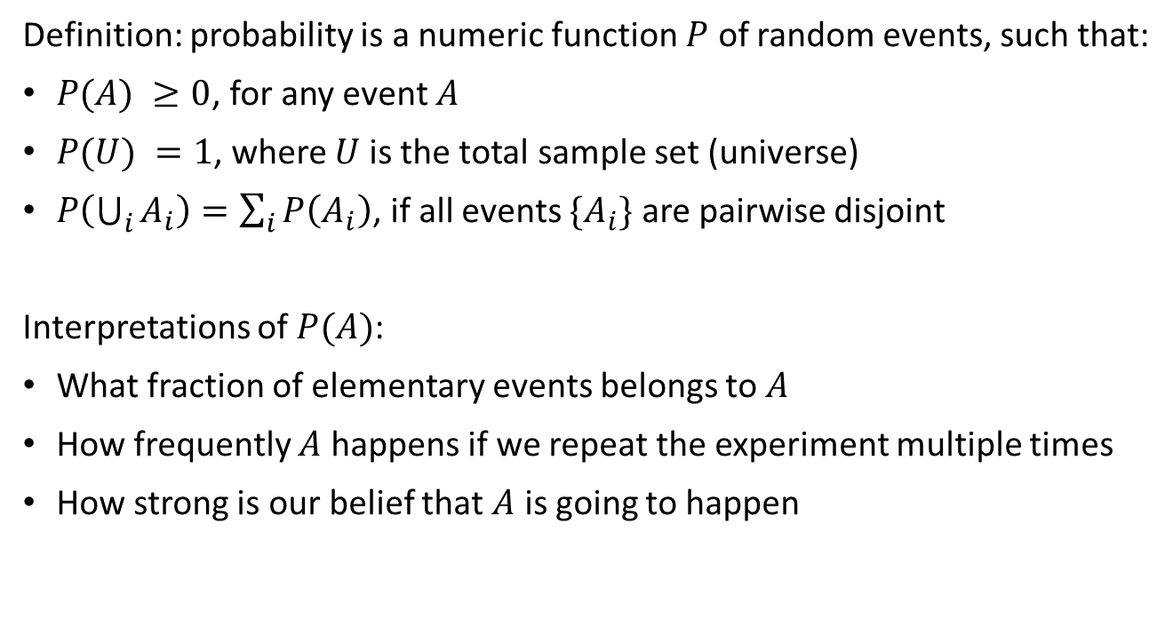
Probability

Slide 11
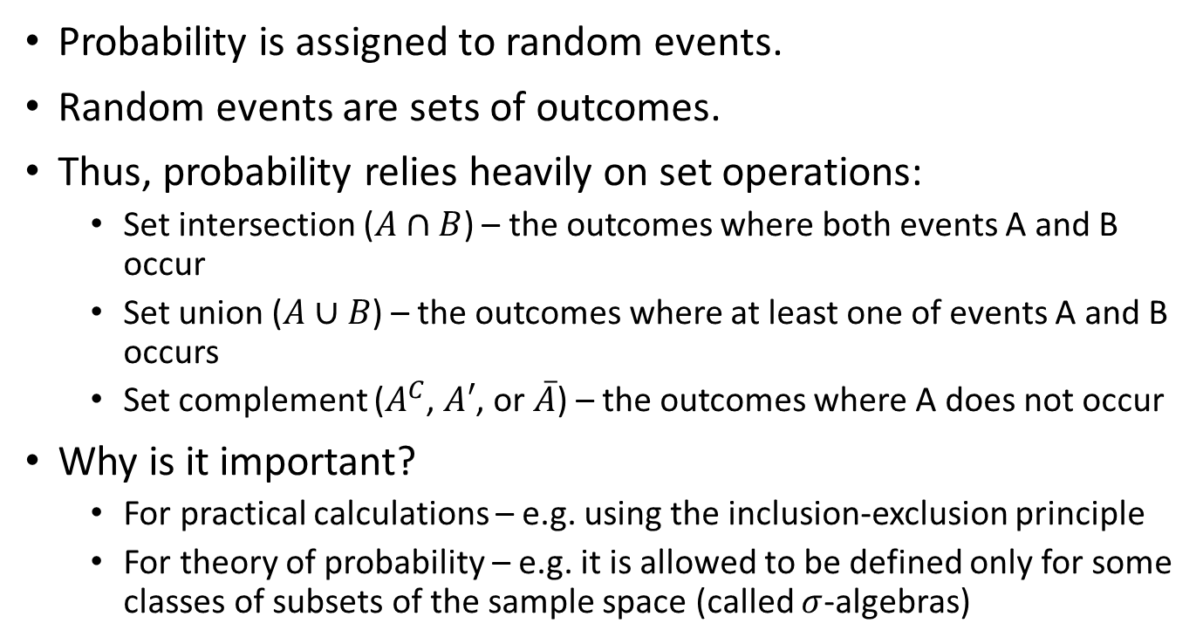
Probability and set theory

Slide 12
Linda
«Linda is 31 years old, single, outspoken, and very bright. She majored in philosophy. As a student, she was deeply concerned with issues of discrimination and social justice, and also participated in anti-nuclear demonstrations».
Which is more probable?
Linda is a bank teller.
Linda is a bank teller and is active in the feminist movement.
An example from Thinking, Fast and Slow by Kahneman
Notes:
The first option here is more probable, as there is only one event. The second has two events, and whenever we have the union of two events, we make our sample smaller.

Slide 13
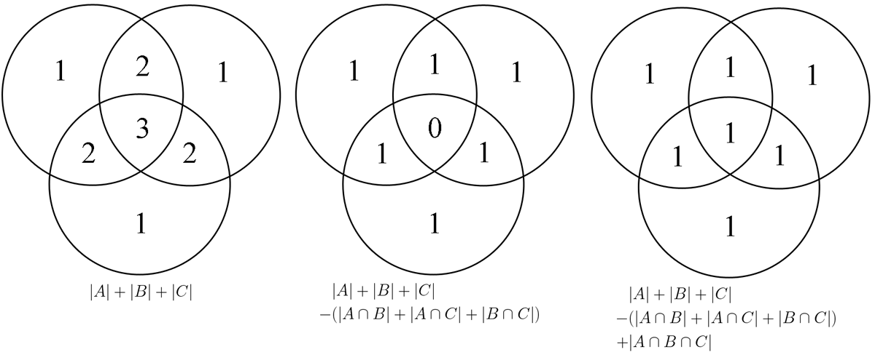
Inclusion-exclusion principle

Slide 14
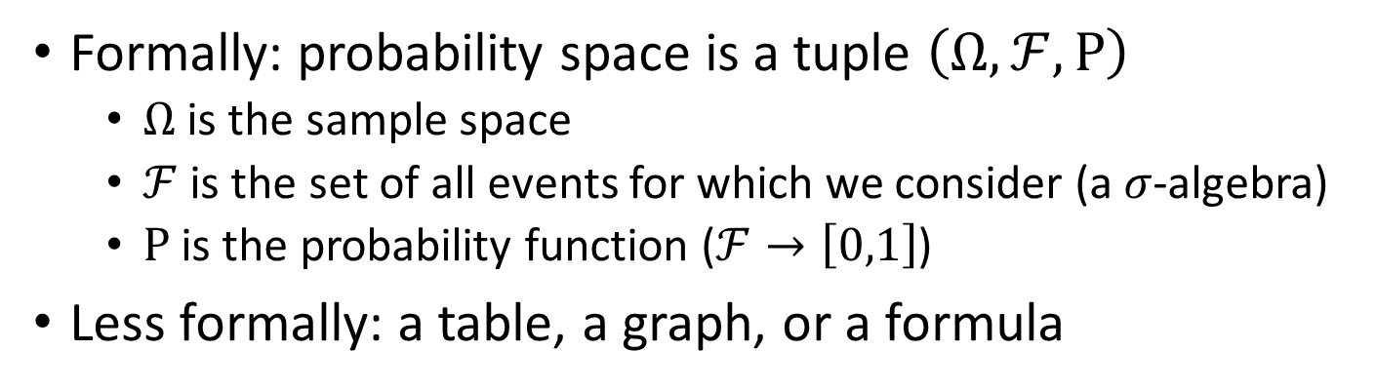



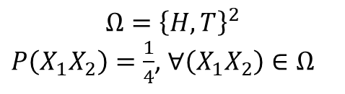



Representations of probability spaces
Outcome | Probability
 | 1/4
 | 1/4
 | 1/4
 | 1/4
P=1/4
P=1/4
P=1/4
P=1/4

Slide 15
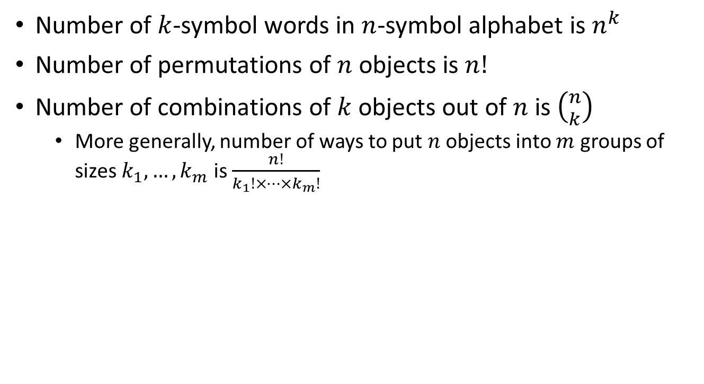
Basic combinatorics
Notes:
Need more examples here (and the Pascal triangle)
Combinatorics is the theory of counting.
A permutation is a function which wraps 1-n, to itself (meaning, then shuffling it).
Suppose you have ten elements, you can choose a place for the first element (1-10), but after this for the next element, you only have 9 available options, and continues to decrease (represented by n!).
If you want to choose k elements out of n, regardless of the order, we have the ‘n’ over ‘k’ formula. (n!/(k!(n-k)!))
This is the same as the formula above, m = (n-k)!

Slide 16
Example: Letters
A letter taken from a word “mathematics” and a letter from “statistics”. What is the probability that there the same letters?
Solution. If we believe that all combinations have the same probability, then it is 14/110 (the fraction of successful combinations)
 | M | A | T | H | E | M | A | T | I | C | S
S |  |  |  |  |  |  |  |  |  |  | +
T |  |  | + |  |  |  |  | +
A |  | + |  |  |  |  | +
T |  |  | + |  |  |  |  | +
I |  |  |  |  |  |  |  |  | +
S |  |  |  |  |  |  |  |  |  |  | +
T |  |  | + |  |  |  |  | +
I |  |  |  |  |  |  |  |  | +
C |  |  |  |  |  |  |  |  |  | +
S |  |  |  |  |  |  |  |  |  |  | +
Notes:
The sampling space is pairs, where the first element is a letter from ‘mathematics’, and the second element is an element from the word ‘statistics’.
11*10 = 130 sampling space.
There are 14 events we are interested, which all have the same probability, and therefore a combinatoric.
However, if the question wanted unique pairs, the sampling space would be 8 *5 = 40
The events are more complicated, because the probability of each pair is different.

Slide 17
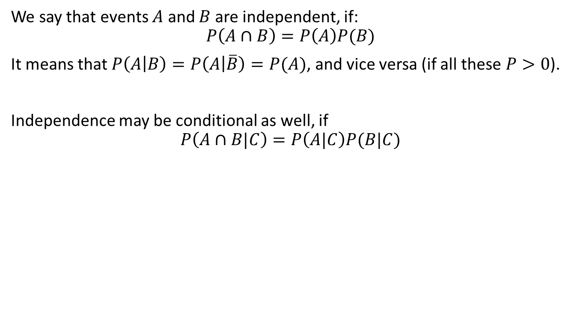
Independence
Notes:
We say something is independent when the probability of the unification of the set is the same as the probability of the multiplication of the sets. Meaning, what you do in the first eventn doesn’t effect what you do in the second event.
The roll of the first die is not related to the roll of the second die. Therefore we can multiply each together to get the probability.
This is different than the probability of the weather today and the weather tomorrow, which are coorelated. Another is first name and last name (most popular first name is Muhammed, most popular last is Cohen. However, there are no Muhamed Cohens.)
Indepedence is a restriction of our sampling space.
Throwing two dice, there are 4 possibilities [(T,T), (T,H), (H,H), (H,T)]. Probability A= getting a tail in the first coin. Probability B = Tail in the second coin.
By conditioning A/B, it doesn’t change the probability of A happening, because A and B are independent.
Given a different example though, we could give two dependent conditions...

Slide 18
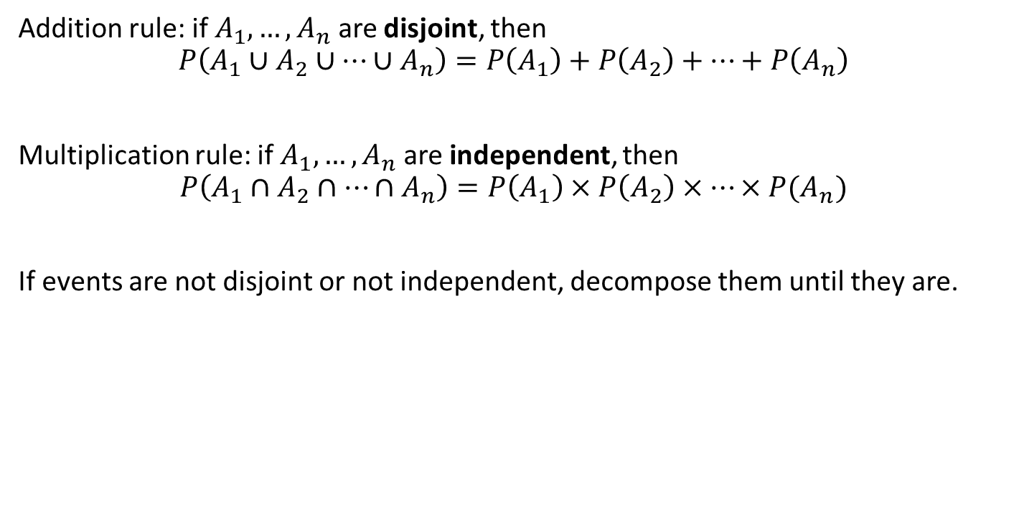
Addition and multiplication rules

Slide 19
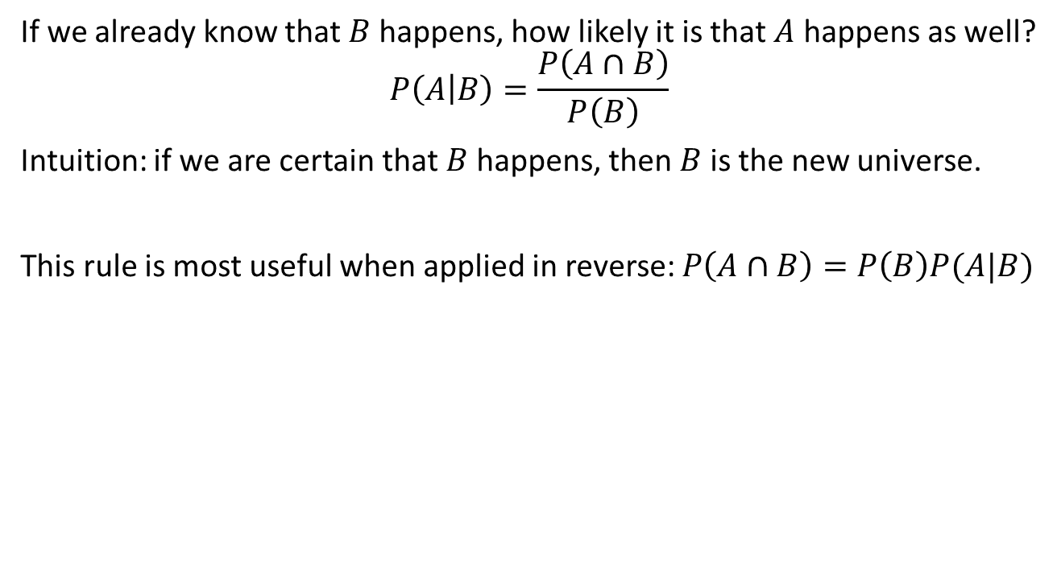
Conditional probability
Notes:
Need a very simple example here.
Need a slide on the chain rule!!!

Slide 20
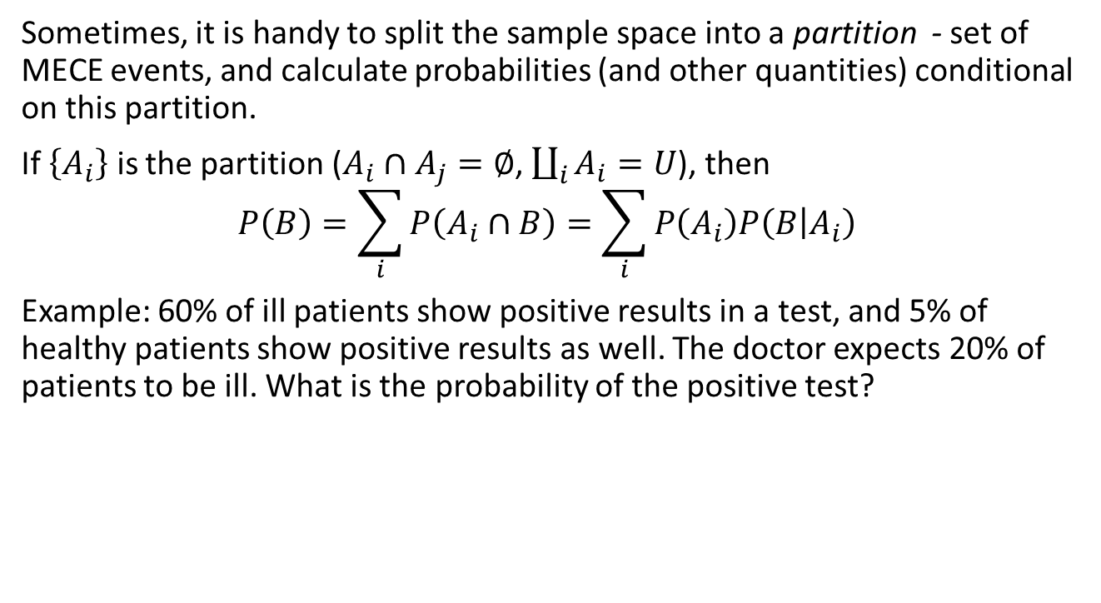



Law of total probability
Notes:
Here we have an event B. We need to decompose it into event A. We sum the parts of B, over the possibilities of the decomposition. We do this by assuming that A is disjointed.

Slide 21
Marginal probability
A compound sample space can be partitioned in multiple ways. Each partition can be used as a new sample space; probability of each its element is just the sum of probabilities of its parts.
Example: partition results of 2 die tosses by:
First result
Sum of results
Parity of the sum of the results
Difference of results
 | 1 | 2 | 3 | 4 | 5 | 6 |  |  | 1 | 2 | 3 | 4 | 5 | 6
1 | 1 | 1 | 1 | 1 | 1 | 1 |  | 1 | 2 | 3 | 4 | 5 | 6 | 7
2 | 2 | 2 | 2 | 2 | 2 | 2 |  | 2 | 3 | 4 | 5 | 6 | 7 | 8
3 | 3 | 3 | 3 | 3 | 3 | 3 |  | 3 | 4 | 5 | 6 | 7 | 8 | 9
4 | 4 | 4 | 4 | 4 | 4 | 4 |  | 4 | 5 | 6 | 7 | 8 | 9 | 10
5 | 5 | 5 | 5 | 5 | 5 | 5 |  | 5 | 6 | 7 | 8 | 9 | 10 | 11
6 | 6 | 6 | 6 | 6 | 6 | 6 |  | 6 | 7 | 8 | 9 | 10 | 11 | 12
 | 1 | 2 | 3 | 4 | 5 | 6 |  |  | 1 | 2 | 3 | 4 | 5 | 6
1 | 0 | 1 | 0 | 1 | 0 | 1 |  | 1 | 0 | -1 | -2 | -3 | -4 | -5
2 | 1 | 0 | 1 | 0 | 1 | 0 |  | 2 | 1 | 0 | -1 | -2 | -3 | -4
3 | 0 | 1 | 0 | 1 | 0 | 1 |  | 3 | 2 | 1 | 0 | -1 | -2 | -3
4 | 1 | 0 | 1 | 0 | 1 | 0 |  | 4 | 3 | 2 | 1 | 0 | -1 | -2
5 | 0 | 1 | 0 | 1 | 0 | 1 |  | 5 | 4 | 3 | 2 | 1 | 0 | -1
6 | 1 | 0 | 1 | 0 | 1 | 0 |  | 6 | 5 | 4 | 3 | 2 | 1 | 0
Notes:
Marganilization is used to check for independence. First we would marginalize over the first coin, and then marginalize over the second coin. Then we would check to see if...

Slide 22
Steve
Steve is a randomly selected American. He has been described by a neighbor as follows:
“Steve is very shy and withdrawn, invariably helpful but with little interest in people or in the world of reality. A meek and tidy soul, he has a need for order and structure, and a passion for detail.”
Is Steve more likely to be a librarian or a farmer?
Notes:
Even though this description is more adequate to a librarian, if there are siginifcantly more farmers than there are librarians, the likelyhood is still that we chose a farmer. This leads to the Bayes theorem

Slide 23
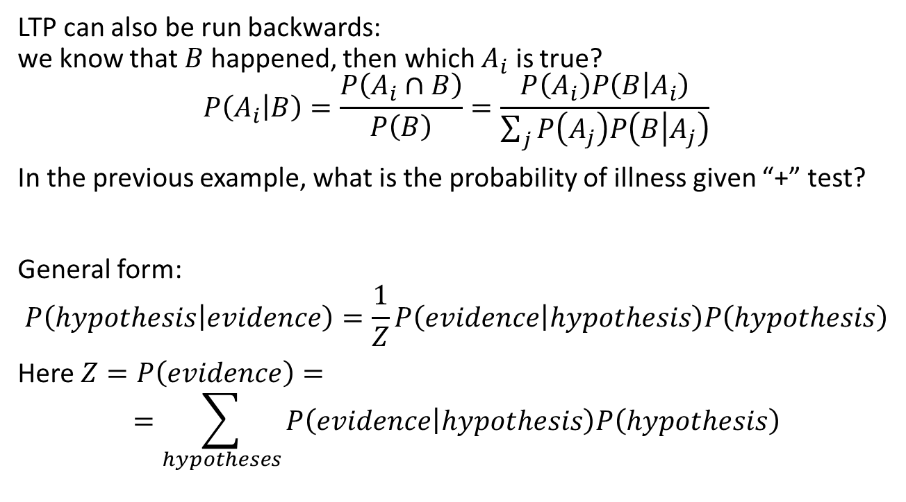
Bayes theorem

Slide 24
Example: Berries
After studying Potions for 10 years, you know than 10% of magic berries are poisonous. Moreover, 50% of poisonous berries are red, and 80% of edible berries are red (the rest are black). Now you encounter a magic bush with long red berries.
What is the probability that the berries are poisonous, conditional on being red?
You also learned that 10% of poisonous berries are long, and 30% of edible berries are long. In what range can the probability that these berries are poisonous be?
If you know that color and shape of berries are independent conditional on their edibility, what is the conditional probability of the berries being poisonous now?
 | R | B
E | 0.72 -- (o.9*0.8 | 0.9-0.72
P | 1- 0.72

Slide 25
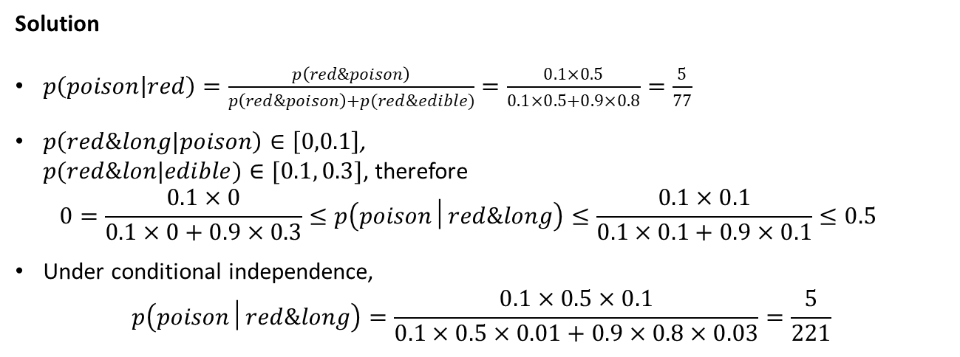
Example: Berries

Slide 26
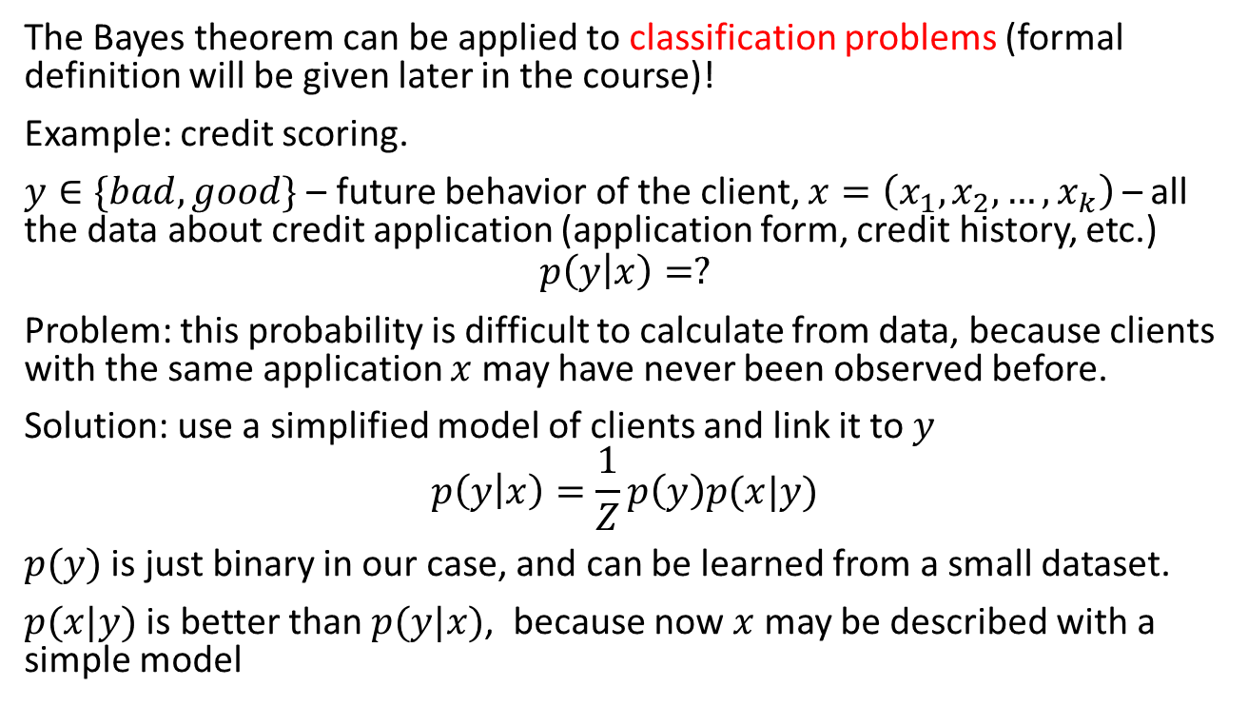
Bayesian classifier
Notes:
When we do classification, we aren’t interested in the exact probabitliy, rather the proportion of probabilities…. (explaining 1/Z)
The idea of the classifier is that sometimes, calculating p(y\x) is easier if we calculate p(x\y).

Slide 27
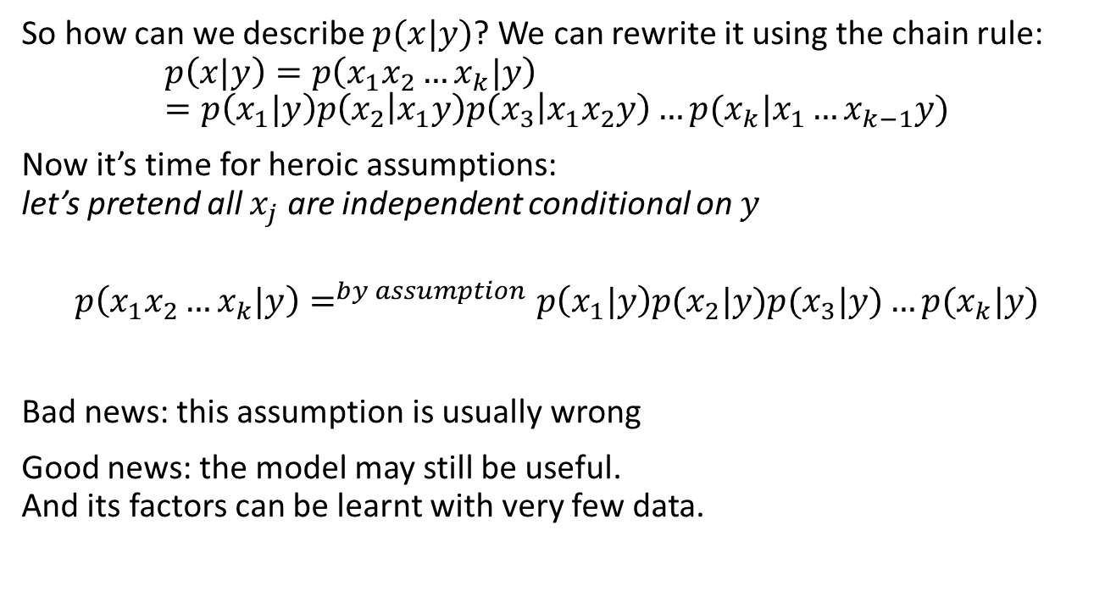
Naïve Bayesian classifier
Notes:
IF we have several variables that we need interpretated aggreagtely to either, lets say, good or bad, we can use the Naive Bayesian classifier. We take each variable independently, and aggregate their indiviudaly probabilities given y (which gives an apporximation, but its close enough).

Slide 28
Variables and distributions

Slide 29
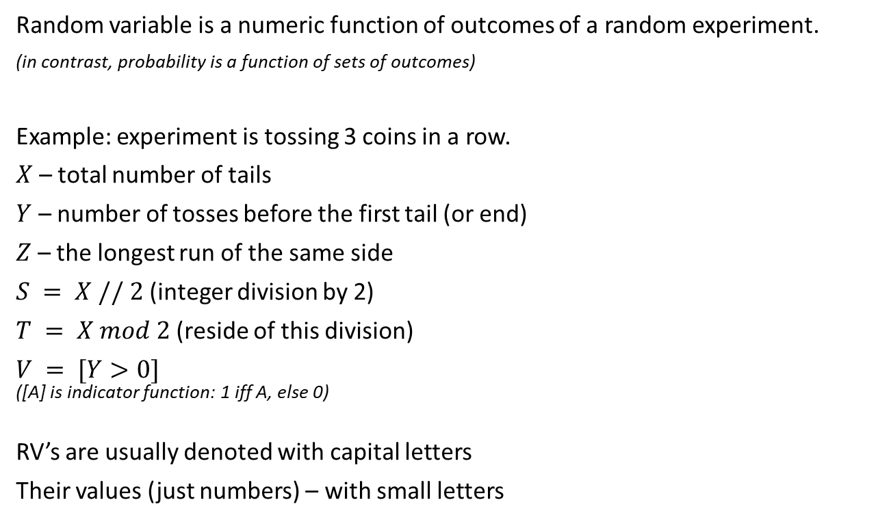
Random variable
Outcome | X | Y | Z | S | T | V
HHH | 0 | 3 | 3 | 0 | 0 | 1
HHT | 1 | 2 | 2 | 0 | 1 | 1
HTH | 1 | 1 | 1 | 0 | 0 | 1
HTT | 2 | 1 | 2 | 1 | 1 | 1
THH | 1 | 0 | 2 | 0 | 0 | 0
THT | 2 | 0 | 1 | 1 | 1 | 0
TTH | 2 | 0 | 2 | 1 | 0 | 0
TTT | 3 | 0 | 3 | 1 | 1 | 0
Notes:
A random variable is a function of each event. In many cases, we are interested in the probability that the random variable would be something. For example, in both throws of the dice, we would get more than 7. The random variable is the sum, and we ask if the sum is greater than 7. Translating back to sets: Interested in all of events where the sum is greater than 7.
In the example in the slide, x,y,z are all random variables.

Slide 30


Probability mass function
Usually, we don’t need to distinguish the outcomes with the same value of a RV.
We can glue such outcomes together, and add up their probabilities.
PMF (probability mass function) is the map from values of RV to their probabilities.
This function can help to answer practical questions about random variables, like:
What is probability of having 9 heads out of 10 tosses of a fair coin?
What is probability of having a positive payoff in a certain card game?
CDF (cumulative distribution function) is the running sum of PMF
PMF and CDF are alternative (and equivalent) ways to specify a discrete distribution.
 | X | Y | Z | S | T | V
0 | 1/8 | 4/8 | 0 | 4/8 | 4/8 | 4/8
1 | 3/8 | 2/8 | 2/8 | 4/8 | 4/8 | 4/8
2 | 3/8 | 1/8 | 4/8 | 0 | 0 | 0
3 | 1/8 | 1/8 | 2/8 | 0 | 0 | 0
 | X | Y | Z | S | T | V
0 | 1/8 | 4/8 | 0 | 4/8 | 4/8 | 4/8
1 | 4/8 | 6/8 | 2/8 | 8/8 | 8/8 | 8/8
2 | 7/8 | 7/8 | 6/8 | 8/8 | 8/8 | 8/8
3 | 8/8 | 8/8 | 8/8 | 8/8 | 8/8 | 8/8
Notes:
PMF is the probabiltiy of each outcome of the random event. Going back to 10 throws of a coin, and instead of head and tail we call it 1 and 0. Random variable is sum of the throws. The random variable can take up to 11 values (include 0, meaning all tails). What is the probability our random variable comes out as 0? the probability that it is 3? (10!/3!7!) * 2^-10
The Cumulative Distribution (CDF) is the running sum of the values from the PMF, which tells us probabilities of having greater than or equal to a random variable. Probability of having less than or equal to 2 is the sum of 0, 1, and 2.
When we have a discrete random variable, a charted graph of this would like steps, summing up the previous values with its own. The size of the jump would be the values PMF.

Slide 31
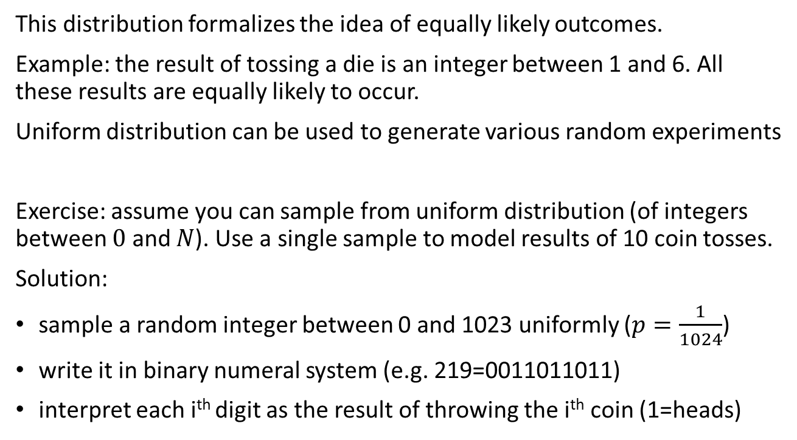
Uniform distribution
Notes:
Uniform distribution gives each of its values the same probability.

Slide 32
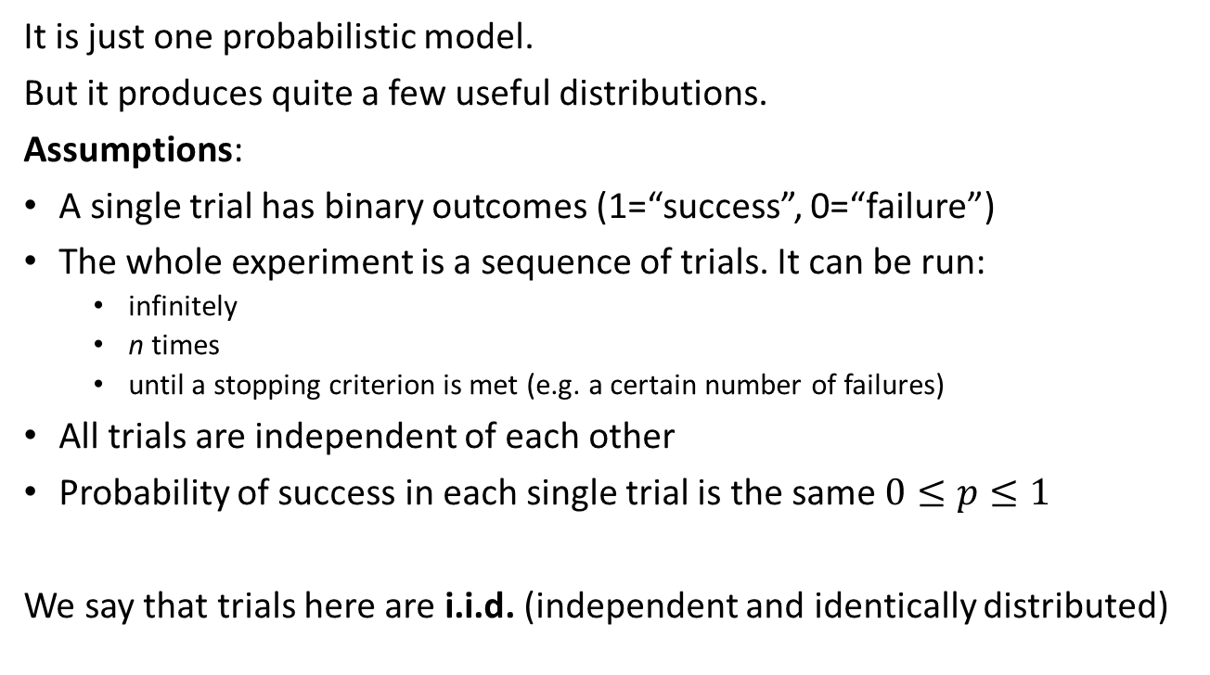
Bernoulli process

Slide 33
RVs based on Bernoulli process
Variable | Distribution | PMF
Number of successes in the first n trials | Binomial
Number of failures before the first success | Geometric
Number of failures before the r-th success | Negative binomial
 | Poisson
Notes:
Geometric:
with 3 coin tosses--

Slide 34
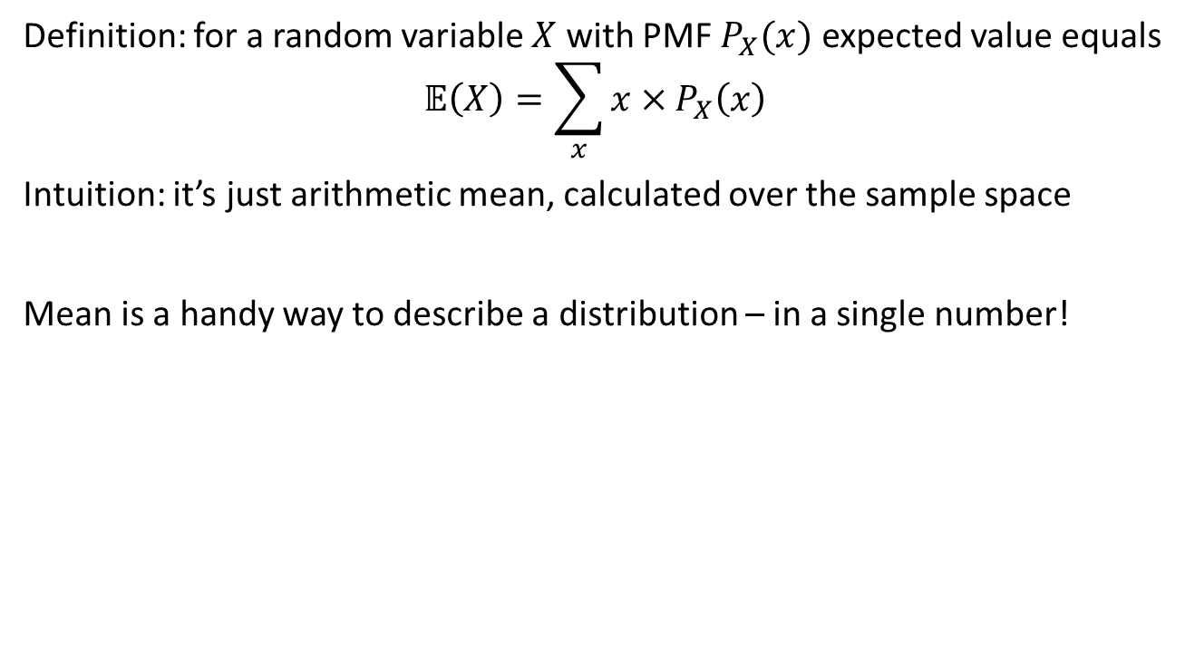
Expectation a.k.a. mean

Slide 35
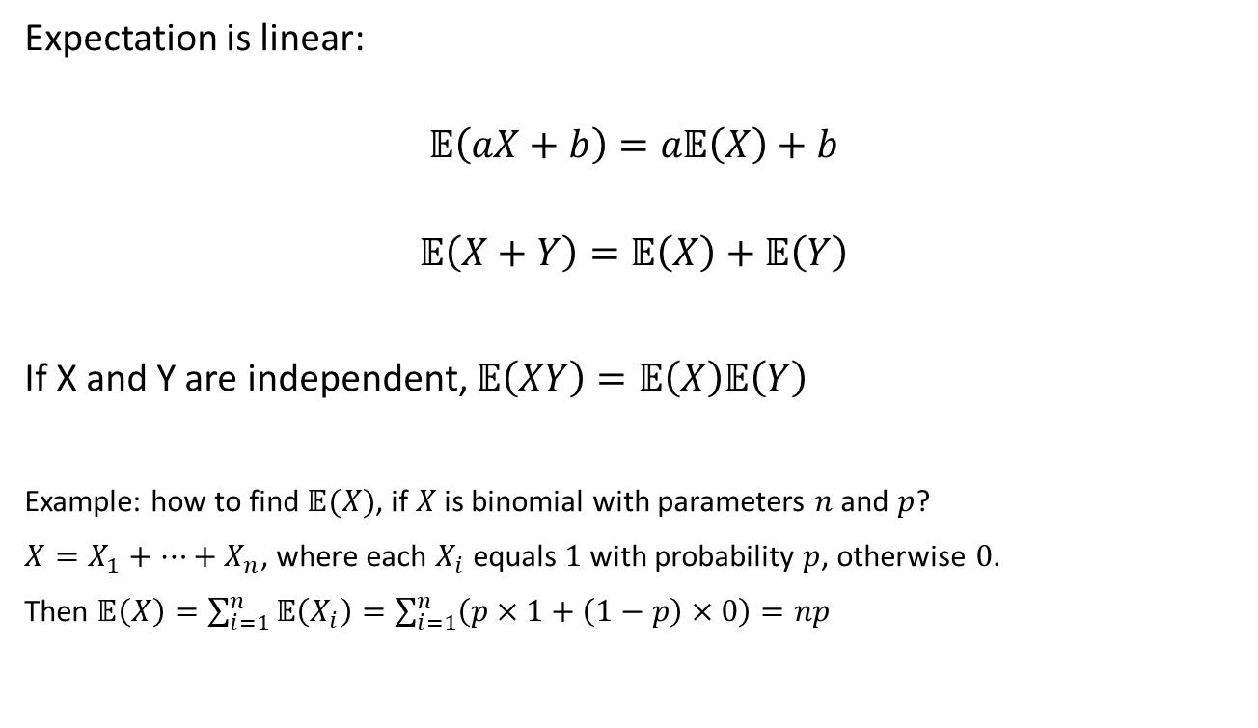
Properties of expectation

Slide 36
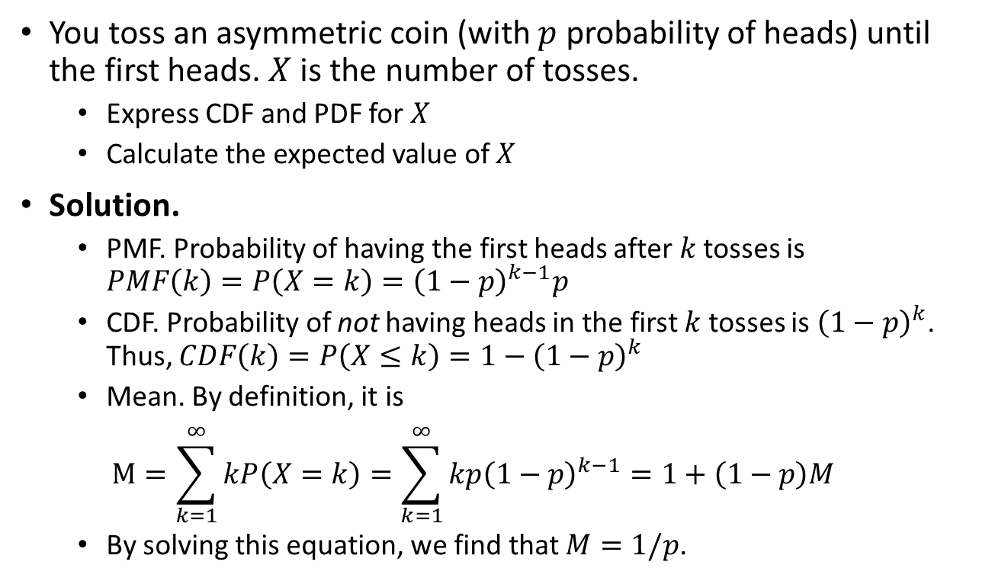
Example: Geometric trials
Notes:
Infinite Geometric Series: a1/ (1-r) , where a1 = First Term, and r = ratio.

Slide 37
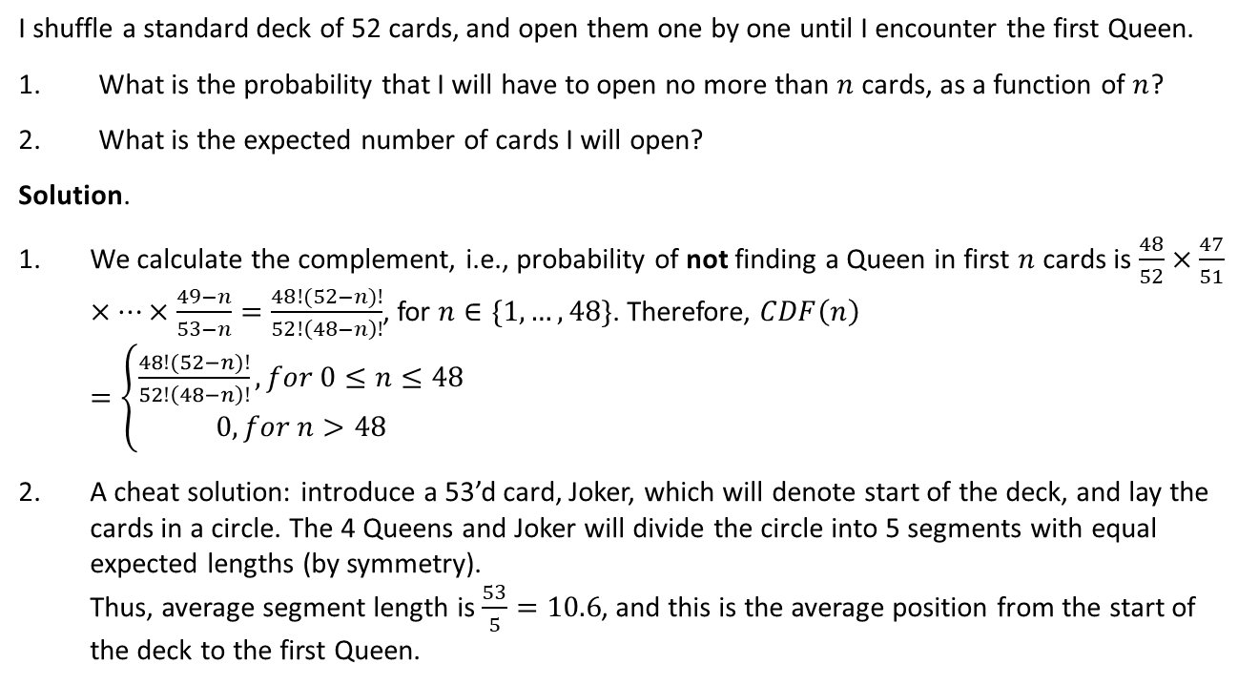
Example: Queens

Slide 38
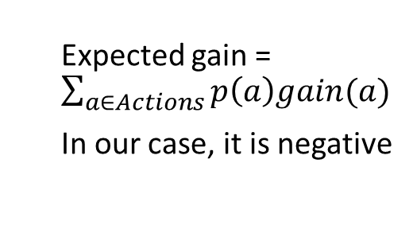
Example: stories recommender
A bank can show stories in the mobile app.
For any story, profit from showing it depends on the user reaction.
For a particular story, there are probabilities of various reactions, predicted by an ML model. Should we show it?
Action | Reward | Predicted probability
Dislike | -10 | 10%
Skip | -0.1 | 20%
View | +0.1 | 30%
Like | +0.5 | 40%

Slide 39
Gambling
Which lottery is better?
Don’t gamble at all
Pay $1, win $200 with 1% probability
Pay $10, win $300 with 3% probability
Pay $2, win $100 with 5% probability
Pay $3, win $50 with 10% probability
Pay $4, win $50% with 10% or $10 with 10% probability
Expected gains are $0, $1, -$1, $3, $2 and $2

Slide 40
Why expectation is not enough?
Other things matter:
Funds are limited
Value of money can be non-linear
The more times you are going to play, the less these factors are important
The law of large numbers: as the number of games grows, the nearly-average outcome gets more and more likely (we’ll prove it)
Thus, if in every game you maximize expected gain, then most probably your total gain in the long run will be maximal

Slide 41
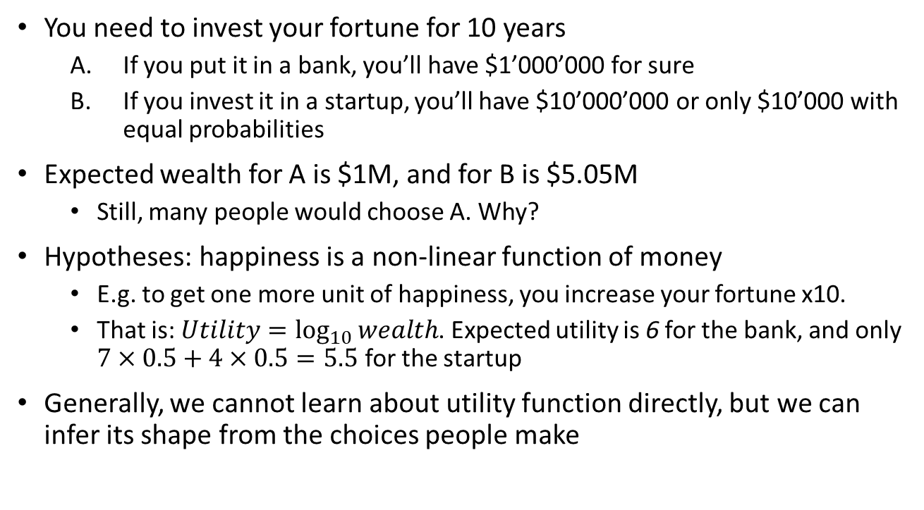
Expected utility

Slide 42
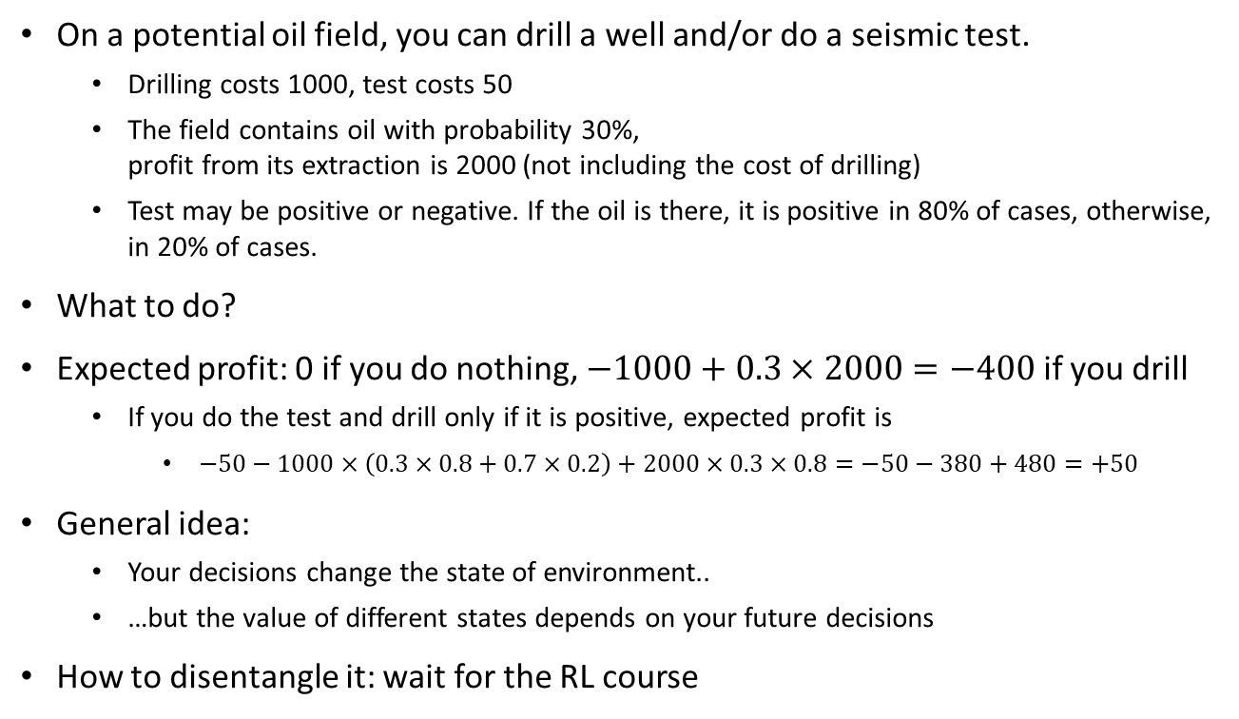
Sequential decisions

Slide 43
Graphical models

Slide 44
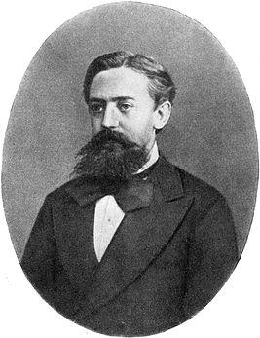
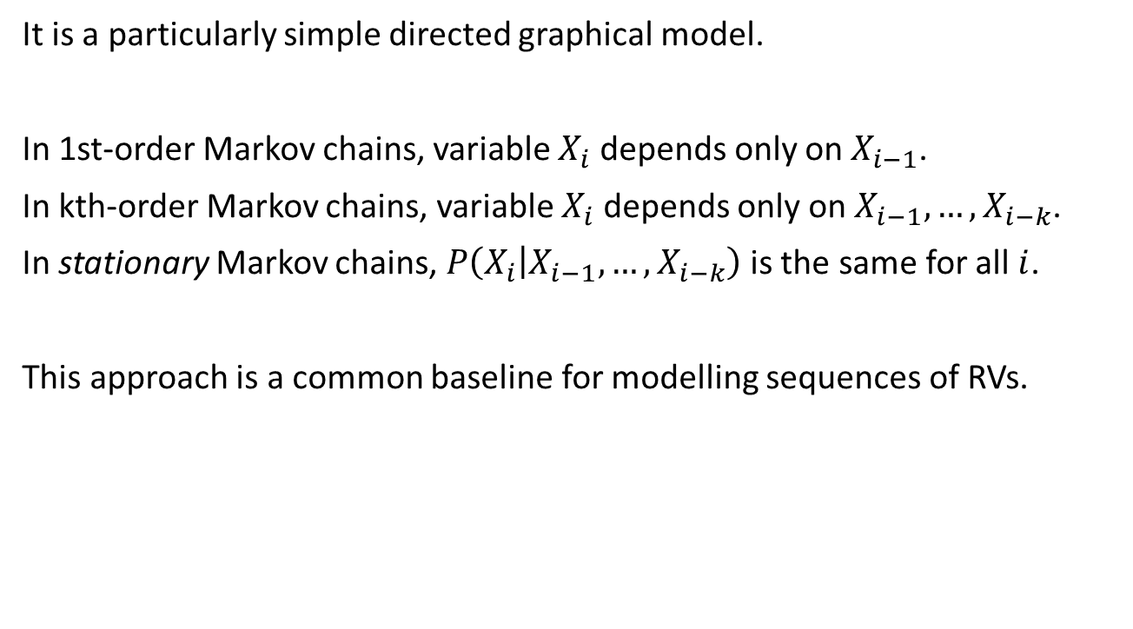





Markov chain

Slide 45

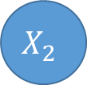
Diving deeper into Markov chains
 | I | A | D | X | C
I | 0.5 | 0.4 | 0.0 | 0.0 | 0.1
A | 0.2 | 0.7 | 0.1 | 0.0 | 0.0
D | 0.1 | 0.6 | 0.2 | 0.1 | 0.0
X | 0.0 | 0.0 | 0.0 | 1.0 | 0.0
C | 0.0 | 0.0 | 0.0 | 0.0 | 1.0
Stationary Markov chains can be represented with a table of transition probabilities.

Slide 46
And deeper
0.4
0.2
I
A
0.5
0.7
0.1
0.6
 | I | A | D | X | C
I | 0.5 | 0.4 | 0.0 | 0.0 | 0.1
A | 0.2 | 0.7 | 0.1 | 0.0 | 0.0
D | 0.1 | 0.6 | 0.2 | 0.1 | 0.0
X | 0.0 | 0.0 | 0.0 | 1.0 | 0.0
C | 0.0 | 0.0 | 0.0 | 0.0 | 1.0
0.1
0.2
0.1
C
D
X
1.0
0.2
1.0
Stationary Markov chains can be represented with a table of transition probabilities.
Or with a transition graph.

Slide 47
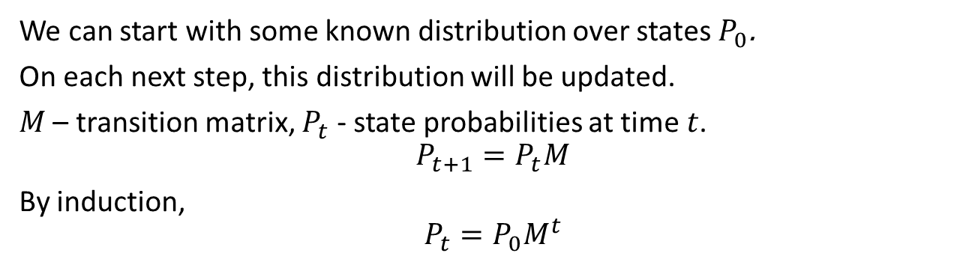
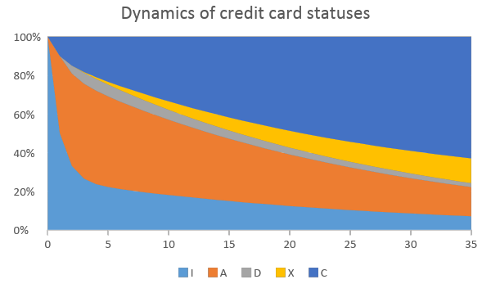
And deeper

Slide 48
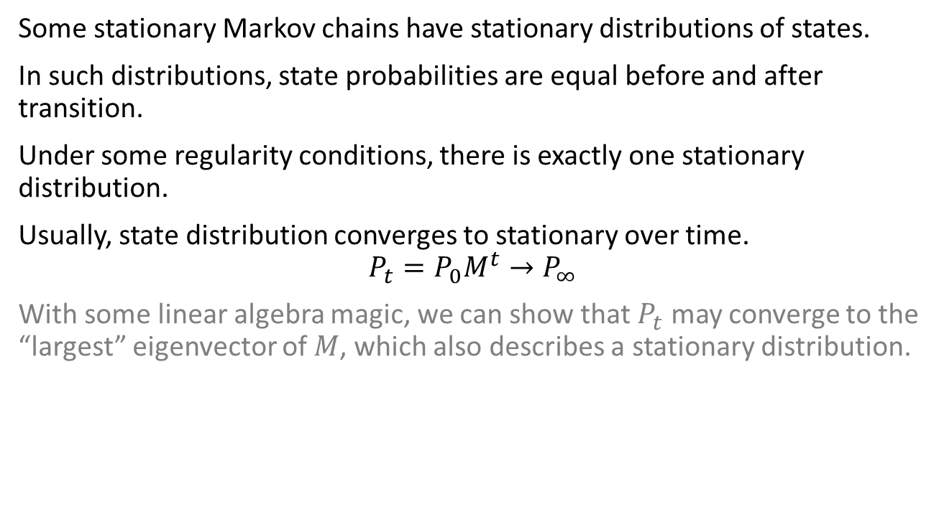
And even deeper

Slide 49
Example: Weather
The weather in London can be summarized as:
if it rains one day there's a 70% chance it will rain the following day;
if it's sunny one day there's a 40% chance it will be sunny the following day.
What fraction of days on average will be rainy?
Using this answer as the prior probability that it rained yesterday, what is the probability that it was raining yesterday given that it's sunny today?

Slide 50
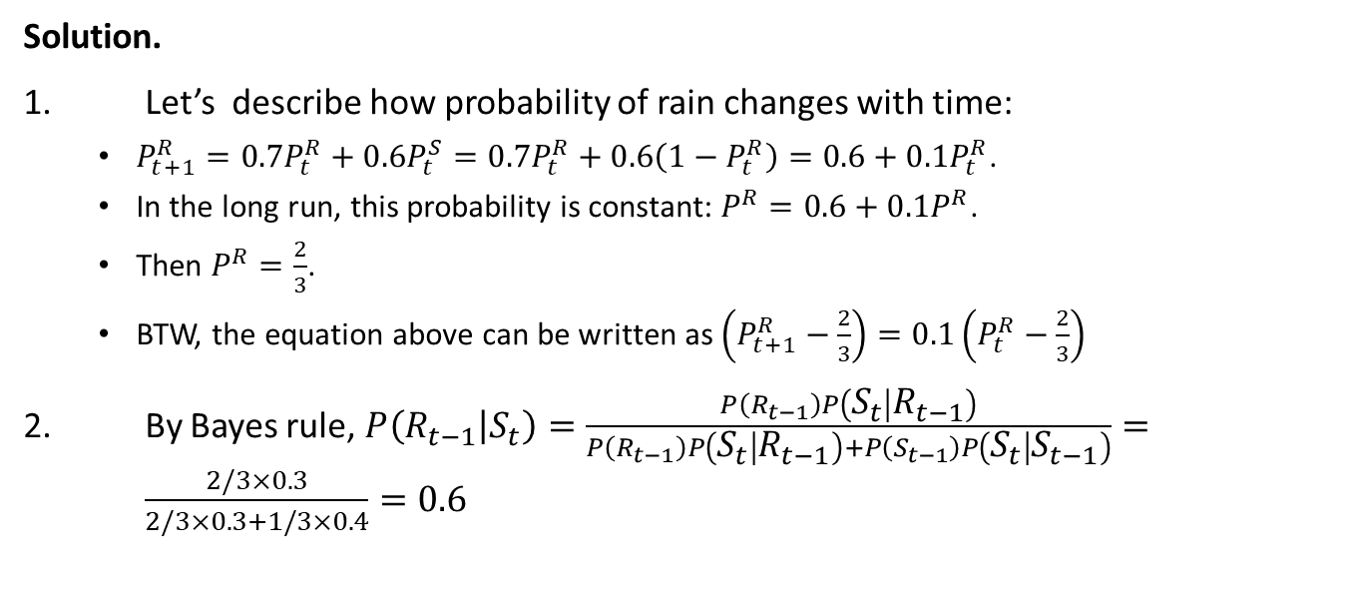
Example: Weather

Slide 51
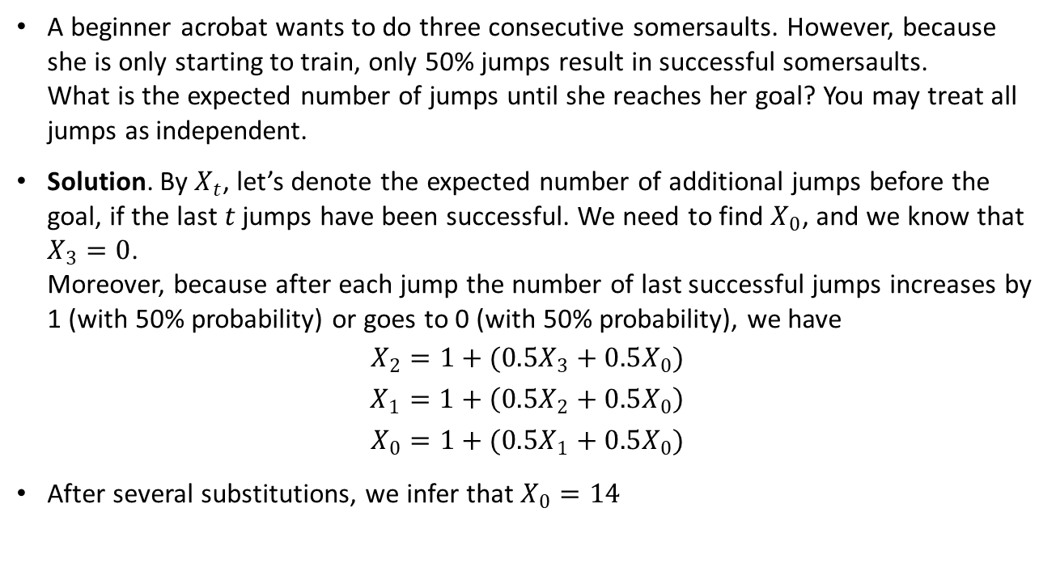
Example: Jumping

Slide 52
Example: Jumping
A beginner acrobat wants to do three consecutive somersaults. However, because she is only starting to train, only 50% jumps result in successful somersaults. What is the expected number of jumps until she reaches her goal? You may treat all jumps as independent.

Slide 53
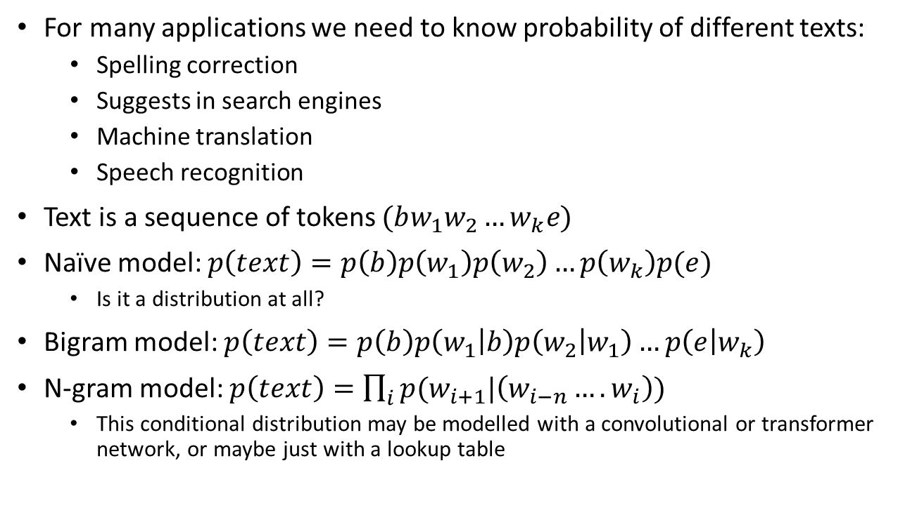
Language models

Slide 54
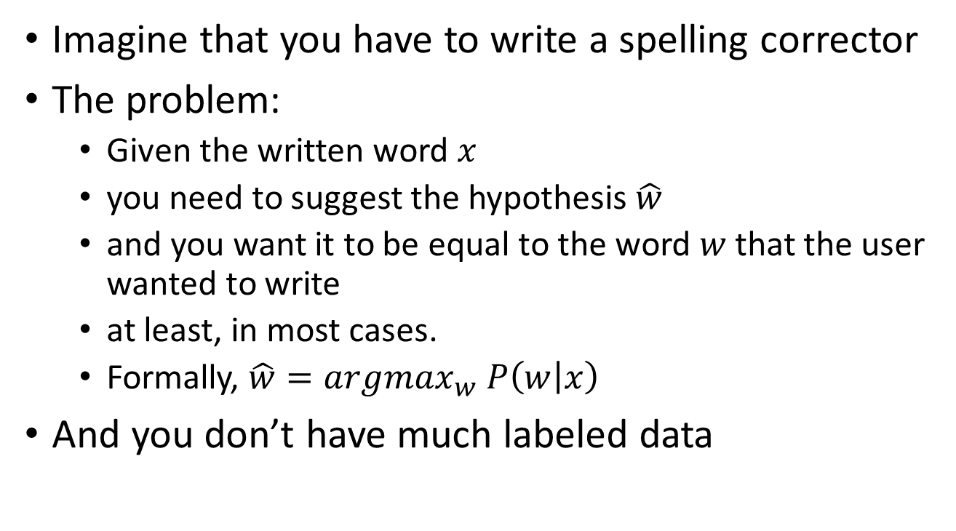
Spelling correction problem

Slide 55
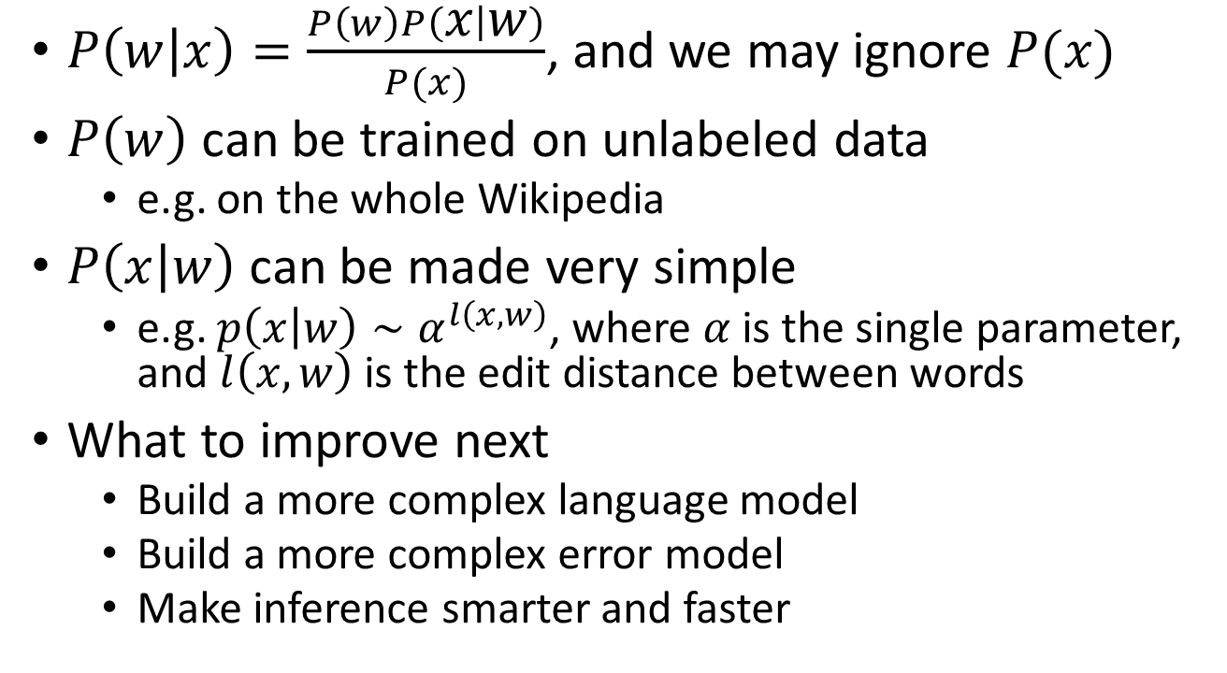
Noisy channel model

Slide 56
Continuous probability

Slide 57
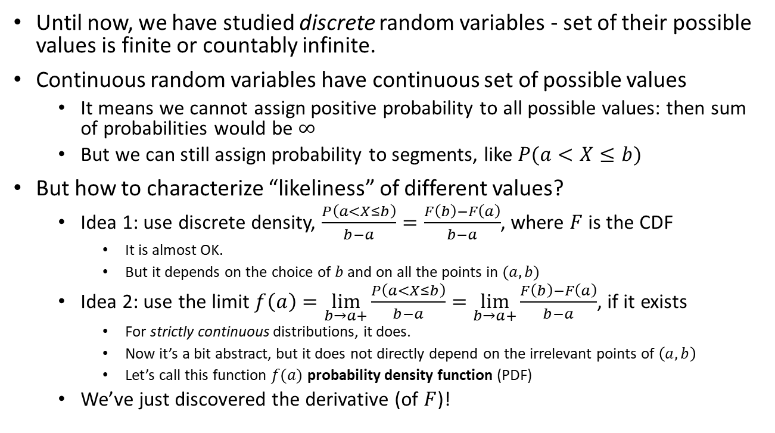
Continuous density

Slide 58
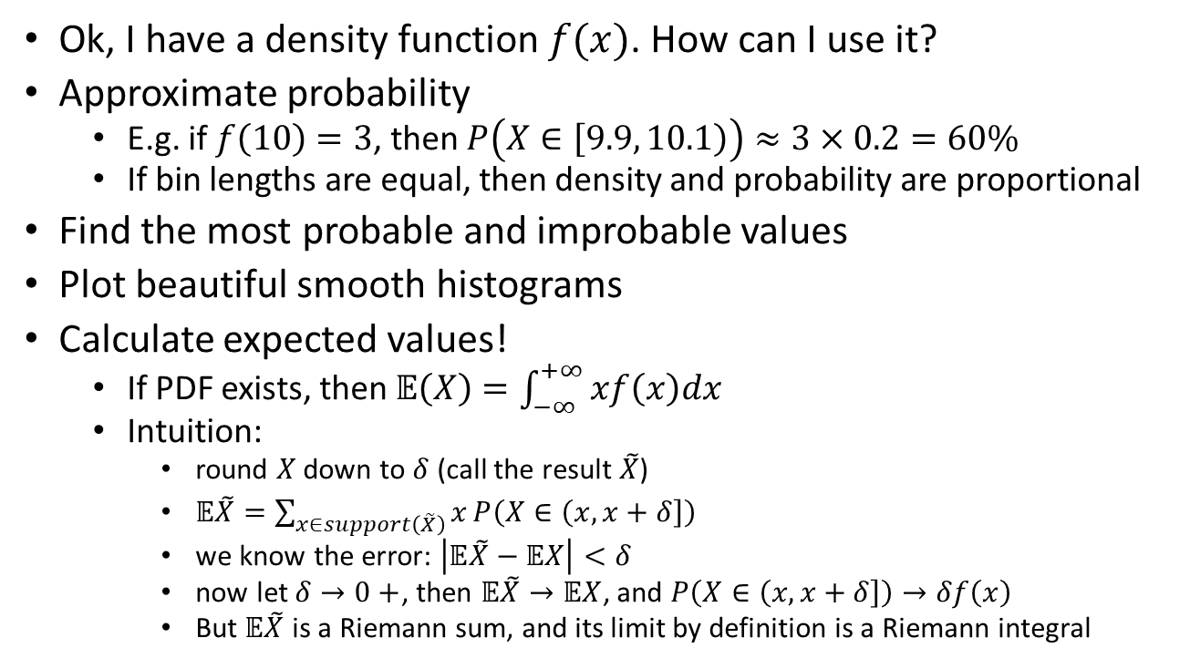
How to apply density

Slide 59
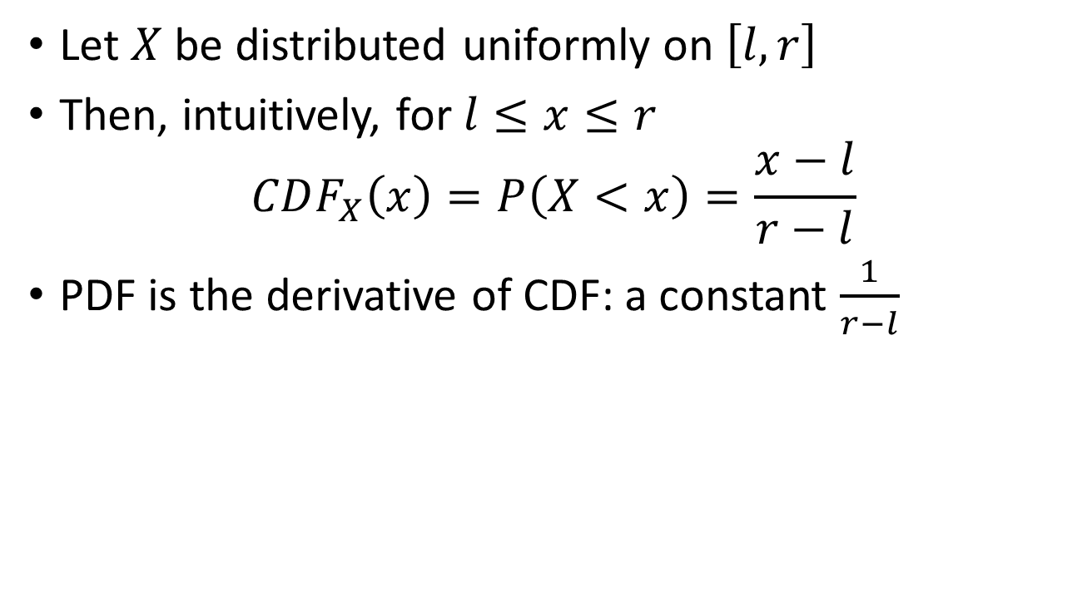
Example: continuous uniform

Slide 60
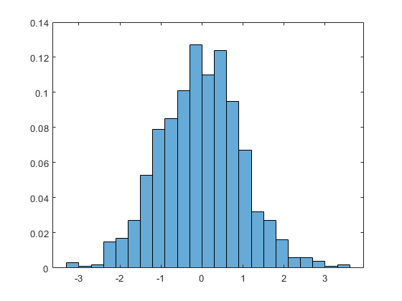
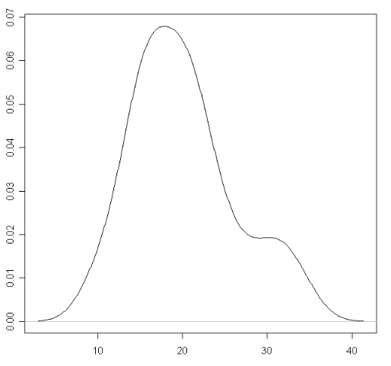
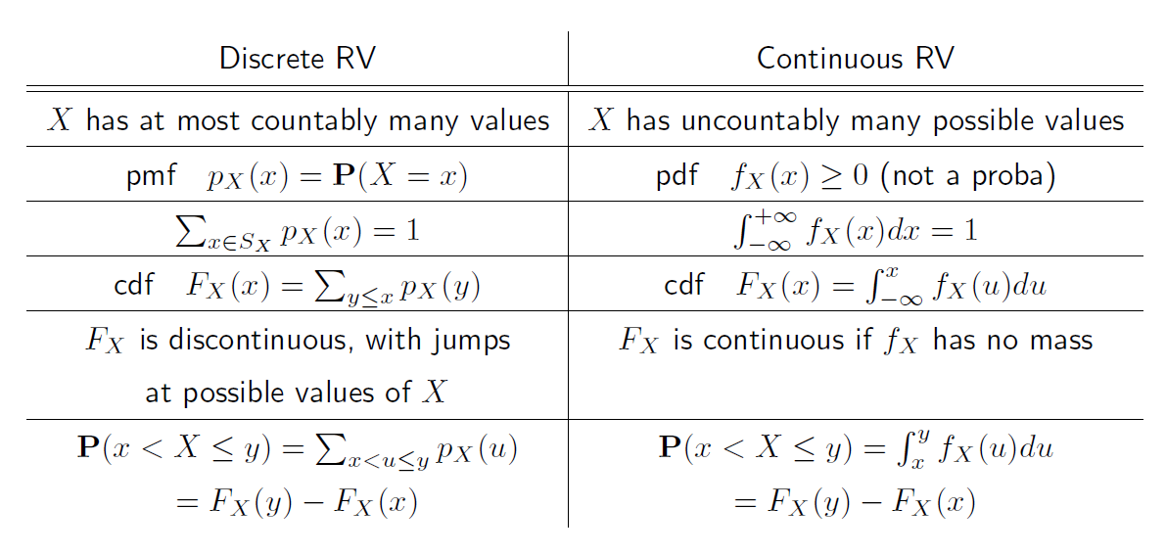
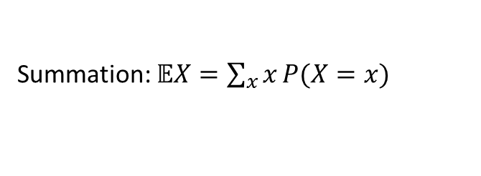
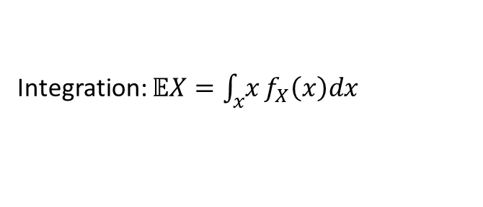
Discrete vs continuous
Finite or countable number of outcomes
Uncountable number of outcomes
PMF (tabular form or formula)
PDF (only formula)

Slide 61
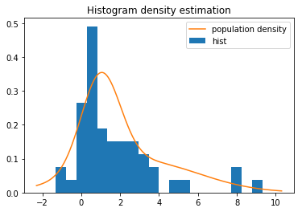
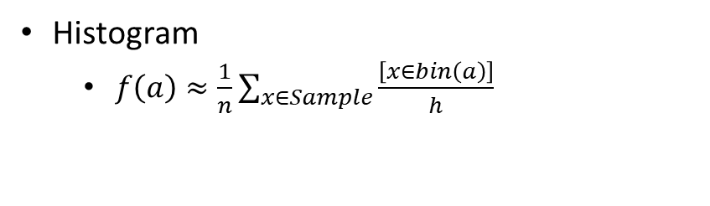
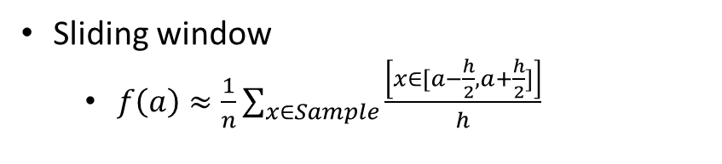
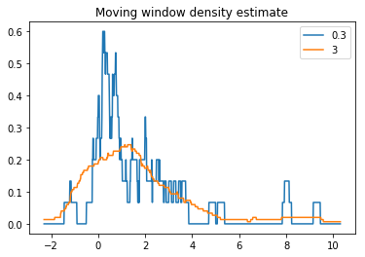
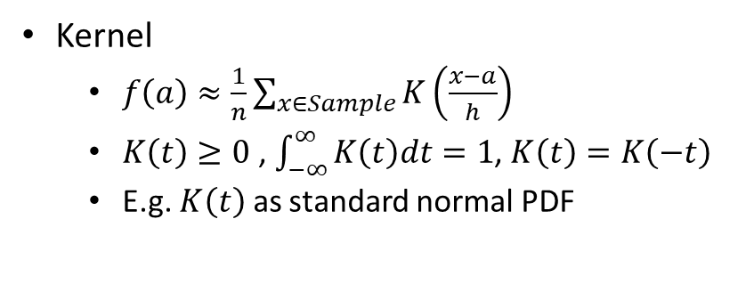
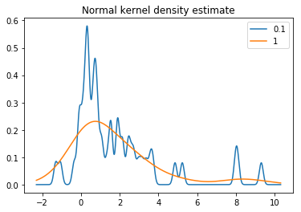
Estimation of density
Or just fit a parametric distribution

Slide 62
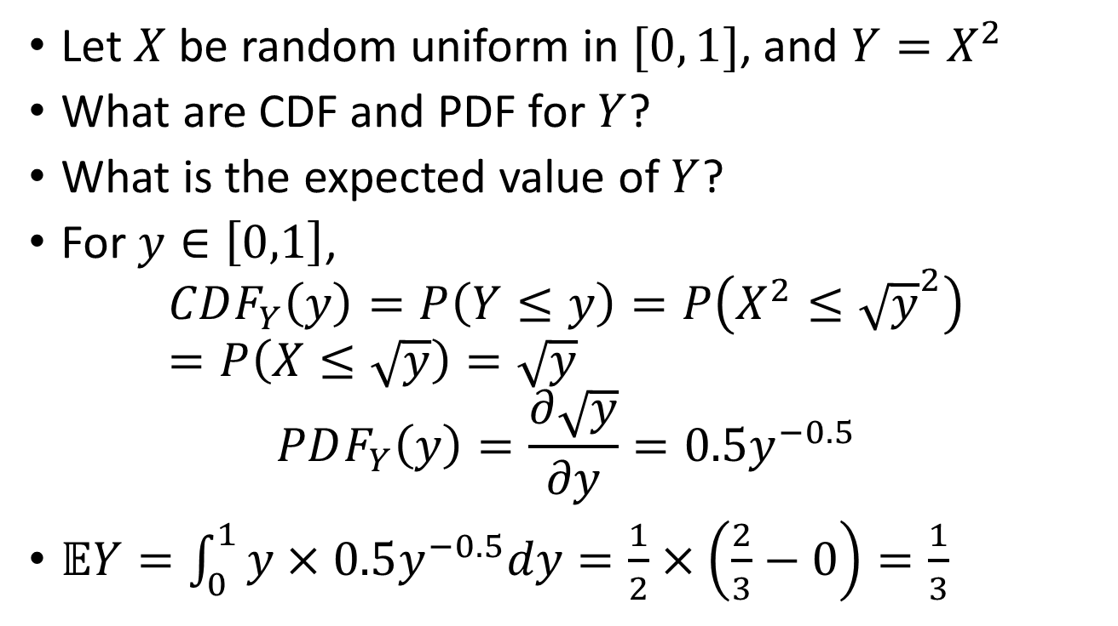
Example: transforming CDFs

Slide 63
Properties of random variables and data

Slide 64

Properties of expectation

Slide 65



Slide 66

Moments

Slide 67

Properties of variance

Slide 68

Example: Pareto moments

Slide 69

Quantiles

Slide 70
Final remarks

Slide 71
What we learned
Basic rules of manipulating probabilities
How to describe random variables
How predictive models can be built on top of random events and variables

Slide 72
The homework
Programming assignment
Spam classifier – a guided task in Jupyter notebook.
Paper-and-pencil problems
9 problems (more like brainteasers)

Slide 73
References
Introduction to Probability by M. Grinstead and J. Snell. Explain most topics on Probability in a gentle way.
Probability by A.N. Shiryaev. An old and very comprehensive book that covers most of the theory of our course.
Probability theory: the language of science by E.T. Jaynes. A fundamental explanation of the Bayesian approach to probability theory.
Bayesian Reasoning and Machine Learning by D. Barber. Focused mostly on graphical models, but covers lots of different topics in Probability and ML
Off-topic:
Thinking, fast and slow by D. Kahneman. It is a book on psychology, but it shows many interesting examples of how people perceive probability.
Speech and Language Processing by D. Jurafsky. NLP is a discipline on its own, but chapters 4 and 5.6 describe n-gram (Markov) language models and the Noisy channel for spelling well.

Slide 74
Graphical models

Slide 75

Probability in practice
x
y
z
v
t

Slide 76

Probability in practice
x
y
z
v
t

Slide 77

Probability in practice
x
y
z
v
t

Slide 78

Probability in practice
x
y
z
v
t

Slide 79

Directed graphical model
What we obtain is called a directed graphical model.
Such models have a controlled structure. It makes them flexible. Different parts can be detached and combined. It makes them even more useful.
There exist undirected graphical models as well. But they are more complex and less common.
x
y
z
v
t

